Slide 1

Clever Elephants Always Eat Ice Cream
Headline Analysis

Slide 2
Analysing Headines
Have you ever seen an elephant eating ice cream? Probably not! But this memorable image will help us remember the important ingredients of a strong analysis paragraph. Using the mnemonic Clever Elephants Always Eat Ice Cream, you’ll learn how to develop ideas, explain evidence, and create thoughtful responses to texts.
News headlines don’t only report the facts of a story. They attract attention, create impressions, and influence what people think before they even begin reading the main article. This lesson will show you how to unpack headlines and analyse them in original and thoughtful ways. You’ll learn how to focus on certain words, pick out dramatic language, and think about how readers might react. Finally, you’ll learn how to put all of this together into well-structured analysis paragraphs of your own.
Text Types
News reports
Feature articles
Magazine articles
Interviews
Scientific articles
Tabloids / Infotainment
Opinion columns
Travel writing

Slide 3
Clever Elephants Mnemonic
Clever | Claim | What is the text suggesting? What is the message?
Elephants | Evidence | Which part of the text supports your claim?
Always | Analysis | What connotations, tone, techniques, or devices can you find?
Eat | Explain | How do these choices influence the message?
Ice | Impact on Reader | How might readers react? What thoughts/feelings are created?
Cream | Connections | How does this link to the ‘big picture’? What issues are behind the writer’s choices? How does this fit into context?

Slide 4
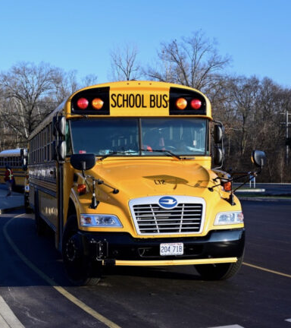
Yellow Buses are Going Green for Kids’ Health and Environment
Imagine riding on a school bus with an engine that doesn’t roar like an old lion or stink like a diesel spill. Quieter, cleaner transportation is on the way for some kids as school districts roll out electric buses.
Nearly all of the 480,000 traditional yellow school buses in the US run on diesel fuel. They emit more greenhouse gasses than other vehicles. The buses only get six miles per gallon of diesel. The air quality inside and around them is poor.
Not so with electric vehicles. The electric buses are cheaper to maintain, don’t pollute like the current buses, and are very quiet. However, the buses cost a lot. They cost at least twice as much as diesels. Schools also need the ability to charge them. That's stopped many school systems from buying them.
That’s starting to change. The Biden administration’s $1.2 trillion infrastructure package includes $5 billion for school buses. School districts are facing pressure from parents and activists to address children’s health concerns as well as the environment. So, they are coming up with funding on their own to buy more electric buses.
One school board in Maryland voted in 2021 to replace 25 diesel buses with electric ones. It's committed to swapping out its entire fleet through a lease program by 2035. California’s legislature has already paid for 1,167 electric buses. 1,000 more will be bought. In Florida, 12-year-old Holly Thorpe lobbied Miami-Dade Public Schools to apply for a state grant to purchase 50 electric buses. The school board got the grant.

Slide 5
Clever Elephants Analysis Framework
Claim | The headline suggests that changing school buses is a good decision that will have positive benefits for children and the environment
Evidence | “Going Green for Kid’s Health”
Analyze | “Green” is a common symbolic colour for eco-friendly; “for kids’ health” focuses on child protection
Explain | Both phrases are used to focus on positive benefits of the decision to change school buses
Impact | Readers who are parents would be drawn to the idea of protecting children
Context | Wider context of switch to electric vehicles; headline does not mention cost or infrastructure.

Slide 6
Sample Clever Elephants Headline Analysis
The headline suggests that changing school buses from diesel to electric will have positive effects on both children’s health and the environment. This can be best seen in the phrase “Going Green for Kid’s Health.” Green is a colour that is often used to symbolize ‘eco-friendly’; it has positive connotations with being environmentally conscious and responsible. As school buses are traditionally yellow, the headline puns on the idea of ‘going green’ to imply that the switch to electric will be a positive upgrade. The headline also focuses on ‘kids’ health’ which may appeal to readers who care about children’s wellbeing. The language encourages readers to see the new buses as an effective solution, framing the change as a positive decision that helps reduce pollution and therefore protect children’s lives. Parents may feel particularly supportive, as would anybody who cares about the environment. Even people who are attached to traditional buses would find it hard to oppose these changes. By mentioning two positive benefits, the headline also avoids calling attention to wider issues around the switch to electric buses, such as cost or electric charging infrastructure; instead, the headline focuses on the advantages of the change.
What
How
Why

Slide 7
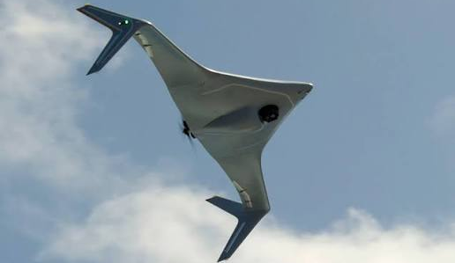
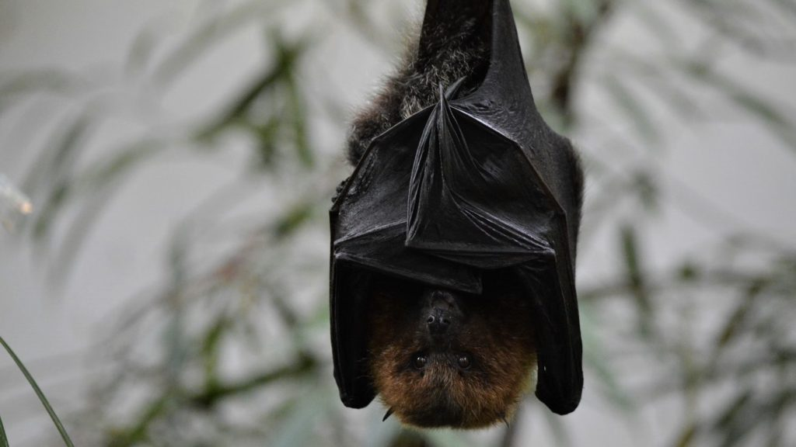
Bat-Drones to the Rescue!
When disasters strike, every moment can mean the difference between rescue and tragedy. Finding people trapped by floodwaters or beneath the rubble of an earthquake can be difficult even in broad daylight. In the dark of night, it's twice as tricky. That’s where robot engineers aim to help.
Engineer Nitin Sanket works at the Worcester Polytechnic Institute in Massachusetts. “We all know that when there’s an earthquake or a tsunami the first thing that goes down is power lines. A lot of times, it’s at night, and you’re not going to wait until the next morning to go and rescue survivors,” Sanket told The Associated Press (AP). “So we started looking at nature. Is there a creature in the world which can actually do this?”
The answer to Sanket’s question: bats. Sanket’s team is working on tiny drones. They are equipped with technology inspired by the flying mammals’ echolocation skills. The robots are designed to fly through darkness, storms, and fog. They can even fly underground. Rather than a single drone piloted by a human, the bat-drones work in swarms, Sanket says. They send out pulses of sound. Then they read the waves as they bounce off of debris and other obstacles, not unlike a bat on the hunt for bugs. Sanket's team hopes to use artificial intelligence (AI) to translate various sounds and shapes into data for rescuers. That can pinpoint where a trapped person might be.
“Bats are amazing,” Sanket told the AP. “We are nowhere close to what nature has achieved. But the goal is that one day in the future, we will be there and these will be useful for deployment in the wild.”

Slide 8
Clever Elephants Analysis Framework
Claim | The headline presents the invention of a new drone that can be used in rescue operations.
Evidence | “Bat-drones to the rescue!”
Analyze | ‘To the rescue’ associated with superheroes or dramatic situations. ‘Bat-drones’ combines nature with technology to create a new word.
Explain | The use of language makes bat-drones sound like an exciting development, combining a bat’s skills with drone technology to make it even more agile and effective.
Impact | Readers may be interested in or excited about an innovation in search and rescue.
Context | In future, bat-inspired drones could play an important role during natural disasters or emergencies, reaching areas that are normally impassible and saving more lives.

Slide 9
Sample Clever Elephants Headline Analysis
The headline presents bat-inspired drones as an important new development in search and rescue situations. The headline focuses on drama, saying: “Bat-Drones to the Rescue!” The phrase ‘to the rescue’ is often associated with superheroes saving the day or people being rescued from dramatic situations like emergencies or natural disasters. For this reason, the writer uses an exclamation mark to add even more excitement or urgency to the headline. The term ‘bat-drones’ combines nature and technology into a new word, making the development sound innovative and fresh. This choice of language makes the science of flying drones more dramatic and action-oriented and the idea of using this technology to help people in dangerous situations is potentially exciting for readers, who might be intrigued by the mix of science, nature, and action. Overall, readers will understand the drone may be capable of flying in an especially agile way, capable of reaching people in previously impassable areas during times of emergency and potentially saving even more lives.
What
How
Why

Slide 10

Analysis Writing Practice: Headlines
On the following slides you’ll see examples of texts with prominent and catchy headlines;
Identify words and phrases you think grab attention or lead the reader’s reaction and devices such as alliteration, puns, hypophora (questions), and the like;
Create a ‘clever elephants’ planning framework for your chosen example(s);
Use your framework(s) as the basis for practicing Clever Elephants analysis writing;
After you finish you could: colour-code your paragraph(s); swap with a friend to offer/receive feedback; submit your writing for checking.

Slide 11
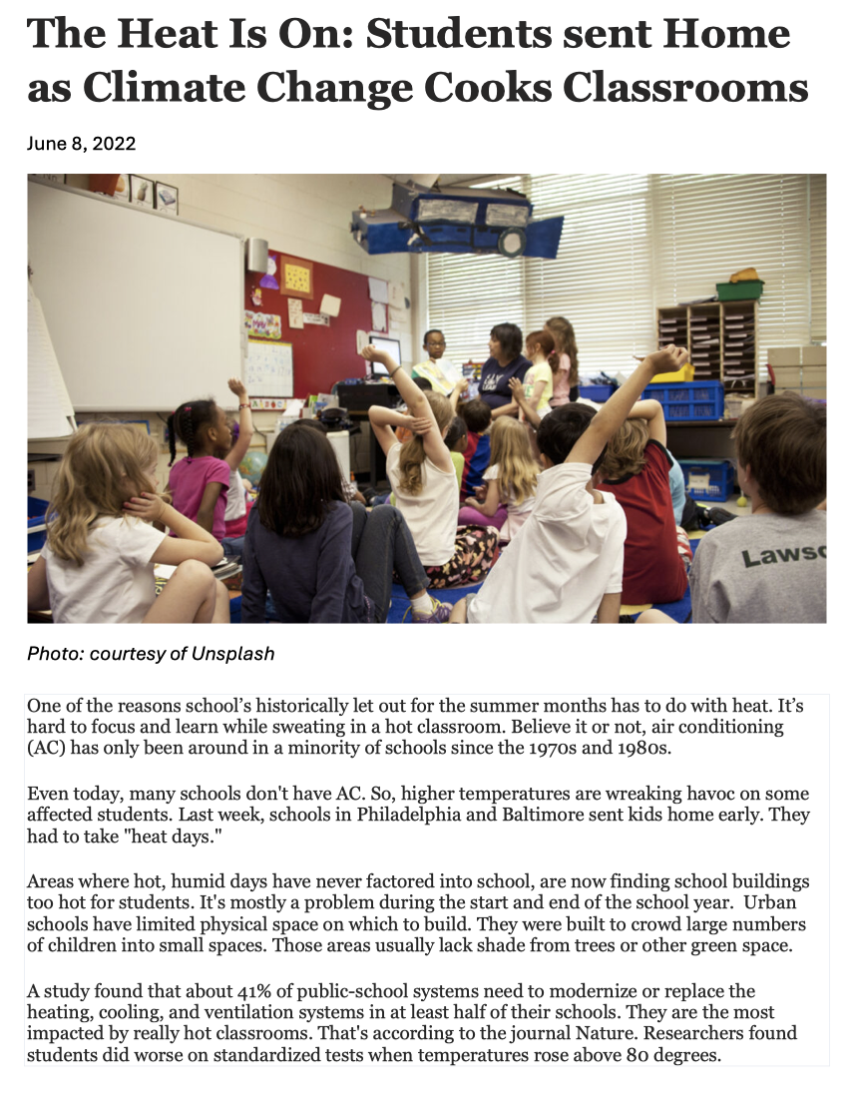

Slide 12
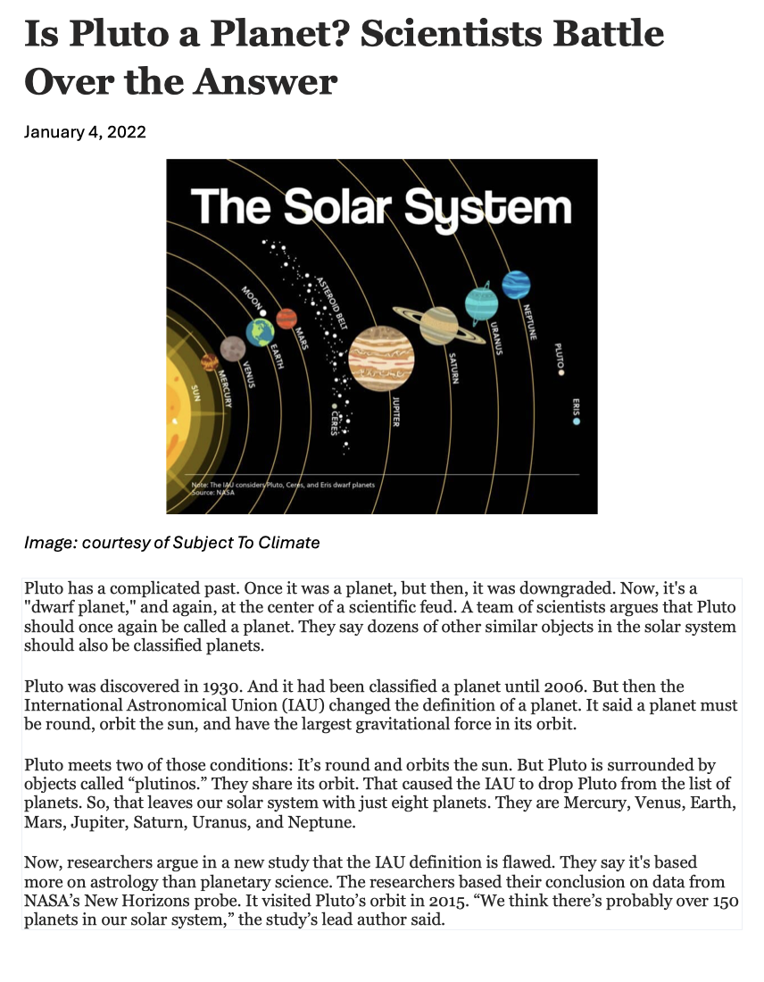

Slide 13
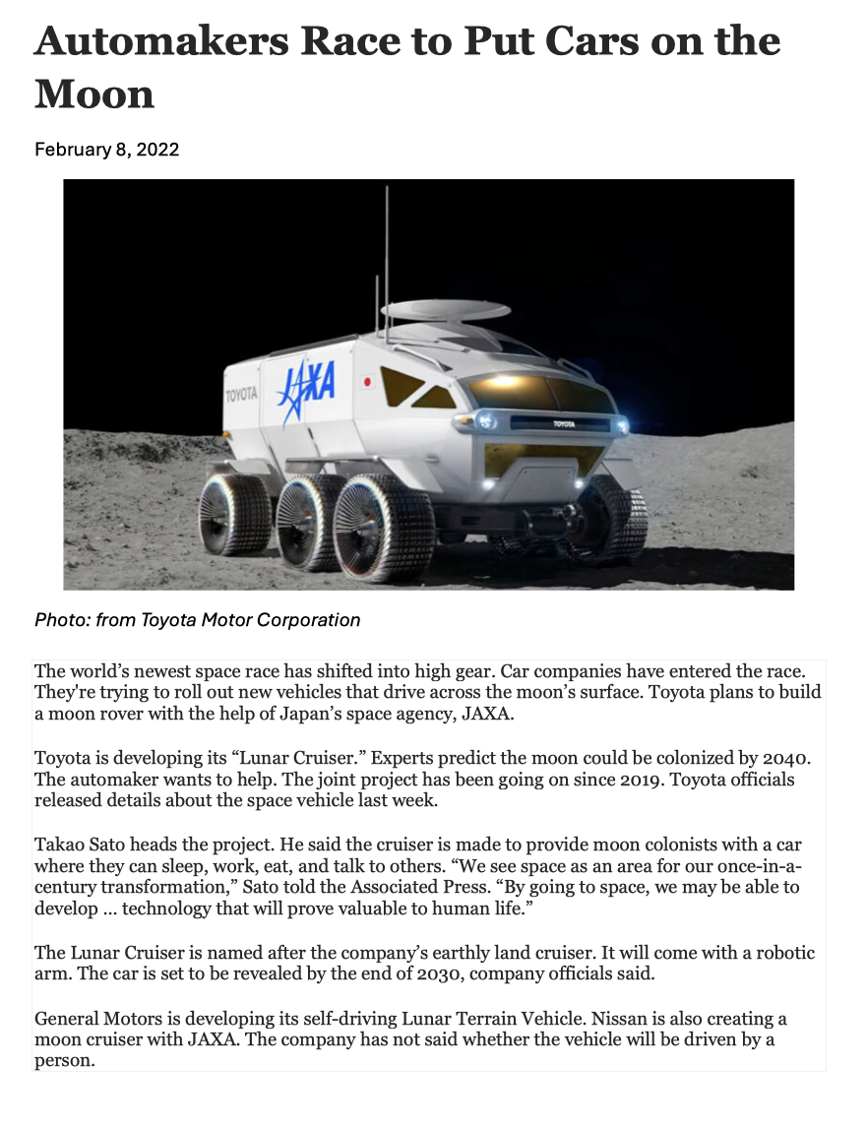

Slide 14
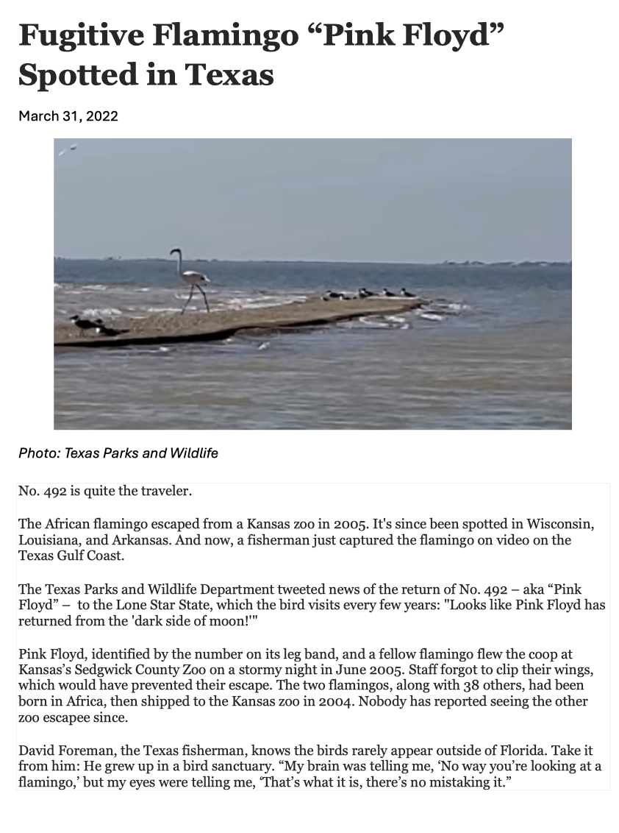

Slide 15
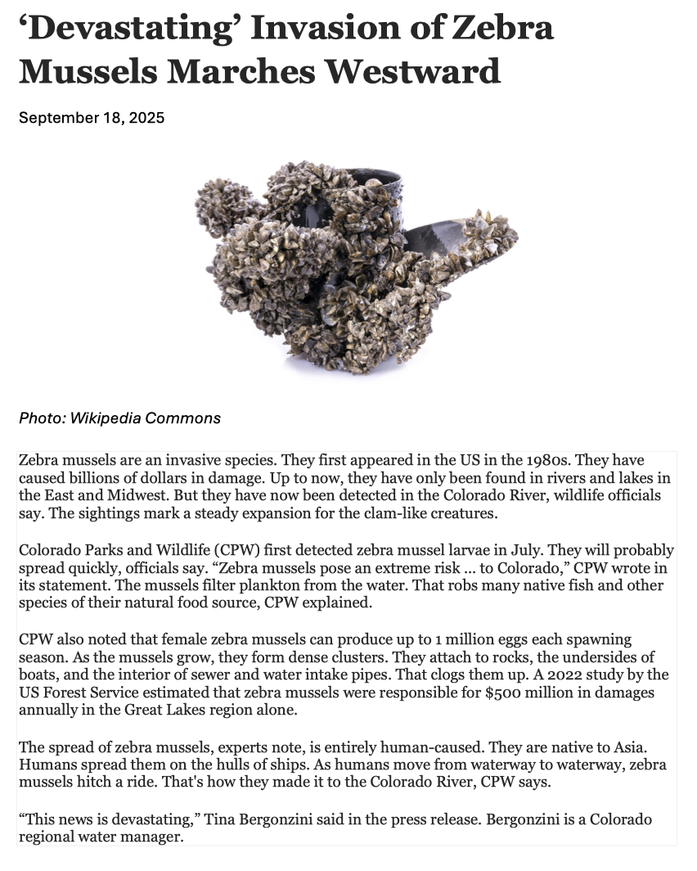

Slide 16
