Slide 1
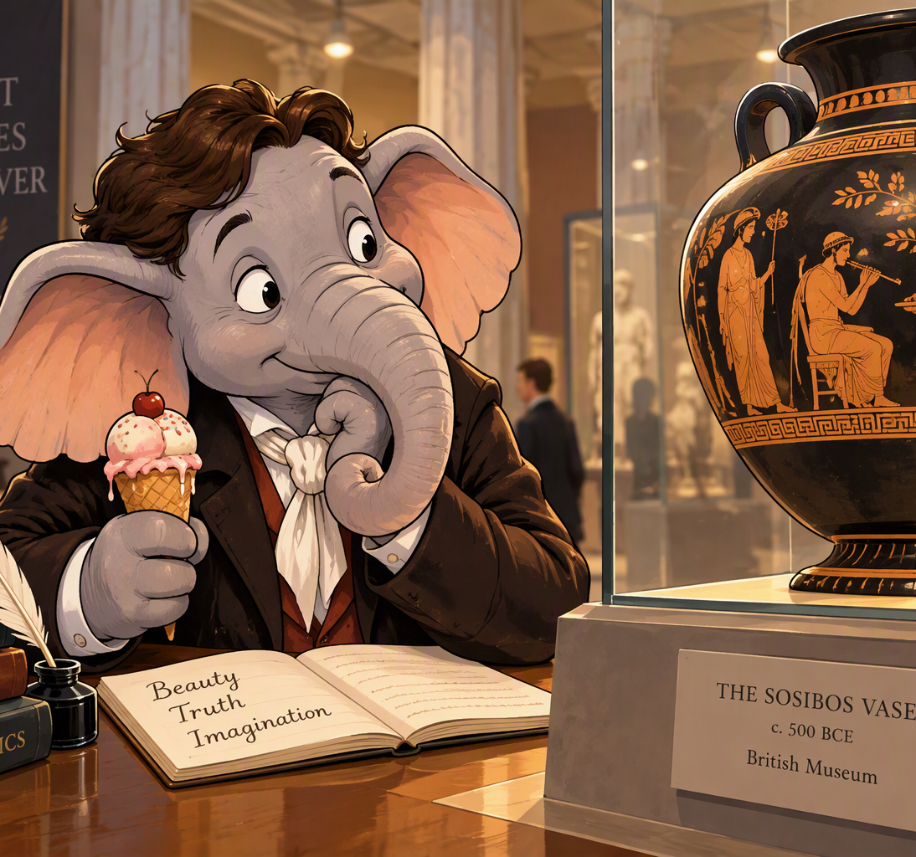
Clever Elephants Always Eat Ice Cream
Ode on a Grecian Urn
Analysis Writing

Slide 2
Introduction
Have you ever seen an elephant eating ice cream? Maybe not! But this memorable image will help us remember the important ingredients of a strong analysis paragraph. Using the mnemonic Clever Elephants Always Eat Ice Cream, you’ll learn how to develop ideas, explain evidence, and create thoughtful responses to texts.
Over the next few slides, you'll explore John Keats's Ode on a Grecian Urn and consider how the poem presents art as a force that can resist the passage of time. Through close analysis of poetic writing such as imagery, symbolism, apostrophe, or even paradox, you'll investigate how Keats portrays the urn as something that preserves beauty, youth, and human experience long after individuals have disappeared. By the end of this sequence, you'll be able to develop a clear analytical argument about the poem's central tension: whether the timeless perfection offered by art is ultimately more desirable than the changing, imperfect reality of human life.

Slide 3
Clever Elephants Mnemonic
Clever = | Claim | What will be the focus and argument of your paragraph?
Elephants = | Evidence | Which part of the extract supports your claim?
Always = | Analysis | What words, phrases, techniques, or writer’s choices can you find?
Eat = | Explain | How do these writer’s choices develop your argument?
Ice = | Impact on Reader | How might readers react? What thoughts/feelings are created?
Cream = | Connections | How does this contribute to your interpretation of the passage or work as a whole?

Slide 4
- How does Keats present the power of art to convey beauty in this poem?
Thou still unravish'd bride of quietness,
Thou foster-child of silence and slow time,
Sylvan historian, who canst thus express
A flowery tale more sweetly than our rhyme:
What leaf-fring'd legend haunts about thy shape
Of deities or mortals, or of both,
In Tempe or the dales of Arcady?
What men or gods are these? What maidens loth?
What mad pursuit? What struggle to escape?
What pipes and timbrels? What wild ecstasy?
Heard melodies are sweet, but those unheard
Are sweeter; therefore, ye soft pipes, play on;
Not to the sensual ear, but, more endear'd,
Pipe to the spirit ditties of no tone:
Fair youth, beneath the trees, thou canst not leave
Thy song, nor ever can those trees be bare;
Bold Lover, never, never canst thou kiss,
Though winning near the goal yet, do not grieve;
She cannot fade, though thou hast not thy bliss,
For ever wilt thou love, and she be fair!

Slide 5
Ah, happy, happy boughs! that cannot shed
Your leaves, nor ever bid the Spring adieu;
And, happy melodist, unwearied,
For ever piping songs for ever new;
More happy love! more happy, happy love!
For ever warm and still to be enjoy'd,
For ever panting, and for ever young;
All breathing human passion far above,
That leaves a heart high-sorrowful and cloy'd,
A burning forehead, and a parching tongue.
Who are these coming to the sacrifice?
To what green altar, O mysterious priest,
Lead'st thou that heifer lowing at the skies,
And all her silken flanks with garlands drest?
What little town by river or sea shore,
Or mountain-built with peaceful citadel,
Is emptied of this folk, this pious morn?
And, little town, thy streets for evermore
Will silent be; and not a soul to tell
Why thou art desolate, can e'er return.
O Attic shape! Fair attitude! with brede
Of marble men and maidens overwrought,
With forest branches and the trodden weed;
Thou, silent form, dost tease us out of thought
As doth eternity: Cold Pastoral!
When old age shall this generation waste,
Thou shalt remain, in midst of other woe
Than ours, a friend to man, to whom thou say'st,
"Beauty is truth, truth beauty,—that is all
Ye know on earth, and all ye need to know."
John Keats (1819)

Slide 6
Clever Elephants Analysis Framework
Claim | Keats uses the images on the urn to show that art conveys an imperfect replication of beauty.
Evidence | “Bold Lover, never canst thou kiss…” “She cannot fade, though thou hast not thy bliss"
Analyze | “Cannot fade” implies art preserves an image of beauty forever “hast not thy bliss” reveals that this beauty is imperfect, lacks feeling
Explain | Art can preserve beauty, but the depicted beauty lacks depth. ‘Bliss’ implies heightened emotion; art replicates some emotions but it cannot convey full range of human desires.
Impact | Readers might feel the art on the vase is a bit ‘flat’, lacking the heightened emotion that characterizes true beauty.
Connections | The vase conveys beauty, but imperfectly so. Beauty is protected from the effects of time, but is also stripped of depth of feeling or emotion.

Slide 7
Clever Elephants Analysis Sample
Keats uses the images on the urn to show that art conveys an imperfect replication of beauty. Describing the lovers on the urn, Keats writes, “Bold Lover, never canst thou kiss” and “She cannot fade, though thou hast not thy bliss.” The phrase “cannot fade” suggests that art can preserve beauty forever, protecting it from the effects of time and change. However, the statement “hast not thy bliss” reveals a limitation of this preservation because the lover can never experience the fulfilment of his desires. The word “bliss” implies a heightened emotional experience, yet the lover remains permanently unable to achieve it. This suggests that while art can preserve beauty, the beauty it depicts lacks emotional depth. As a result, readers may feel that the beauty captured on the urn is somewhat flat or incomplete, lacking the depth of feeling that characterises real human experience. Therefore, Keats presents art as a powerful way of conveying beauty, but not a perfect one. Although the urn protects beauty from the effects of time, it also strips that beauty of the emotions and desires that make it fully meaningful.
What
How
Why

Slide 8
Clever Elephants Analysis Framework
Claim | Keats uses the images on the urn to show that art conveys an imperfect replication of beauty.
Evidence | “Bold Lover, never canst thou kiss… She cannot fade, though thou hast not thy bliss” “Happy boughs! That cannot shed your leaves, nor bid the spring adieu”
Analyze | “Cannot fade” = beauty preserved forever ”Cannot shed your leaves” = trees frozen in a forever spring “hast not thy bliss” = fulfilment denied
Explain | Art can preserve beauty but lacks aspects of real life or deep emotion. Lovers cannot fulfil desire, trees cannot grow or change with the seasons.
Impact | Readers may admire the urn’s beauty and power to outlast time, but recognize what has been sacrificed in doing so.
Connections | Similar pattern across poem: images show ‘lessened’ beauty. Art can convey beauty, but cannot reproduce change, growth, or depth of experience.

Slide 9
Clever Elephants Layered Analysis
Keats uses the images on the urn to show that art conveys an imperfect replication of beauty. Describing the figures on the urn, Keats writes, “Bold Lover, never canst thou kiss… She cannot fade, though thou hast not thy bliss” and later depicts the “Happy boughs! That cannot shed your leaves, nor bid the spring adieu.” The phrase “cannot fade” suggests that art preserves beauty forever, protecting it from the effects of time and decay. However, “hast not thy bliss” reveals the limitation of art’s power, as the lover can never fulfil his desires. Similarly, the description of boughs that “cannot shed” their leaves presents the trees as frozen in a permanent state of spring. This suggests that while art can preserve beauty, it cannot fully reproduce the richness and variety of lived experience. The word “bliss” implies intense emotional fulfilment, yet the lover remains unable to achieve it, while the trees are denied the seasonal changes that form part of their natural identity. As a result, readers may admire the urn's beauty and its power to outlast time, while also recognising what has been sacrificed in the process. The repeated images encourage readers to question whether such immortality is worth the loss of emotional depth and expressive range. Throughout the poem, Keats presents images of ‘lessened’ beauty: music that cannot be heard, trees that cannot grow, and lovers who can never consummate desire. Through these images, Keats suggests that art can preserve beauty permanently, but is ultimately incapable of reproducing the change, fulfilment, and growth that give beauty its fullest meaning.
What
How
Why

Slide 10

Analysis Writing Practice: Grecian Urn
Choose another moment, image, or example from Ode on a Grecian Urn that you can use to explore John Keats’ presentation of beauty and the power of art;
For instance: you could look at the happy musicians and the music they play, the abandoned town, the mysterious priest and the sacrificial procession, an example of apostrophe or questioning, the poem’s famous closing lines, or any other aspect of the poem you find interesting and relevant.
Create a Clever Elephants planning frame(s) for at least one paragraph and write your answer.
If this is the first time you’ve used the Clever Elephants mnemonic, to make doubly sure you’ve included all the different analysis elements, colour-code your writing and submit to get some feedback on your analysis skills.

