Slide 1

Clever Elephants Always Eat Ice Cream
Analysing Mise-En-Scene

Slide 2
Analysing Mise-en-Scene
‘Clever Elephants Always Eat Ice Cream’ is a framework for building strong analysis paragraphs. It will help you move beyond simple observations by making clear claims, selecting relevant evidence, and developing thoughtful explanations. By following each stage of the framework, you'll learn how to communicate your ideas in a clear, organised and convincing way.
Analysing mise-en-scène means to focus on the details around the main subject of an image. Settings, scenery, objects, lighting, colour, space, and background details all contribute to the meaning of a text. This lesson will show you how to identify these features and analyse their effects in original and thoughtful ways. You'll learn how background environments can create atmosphere, influence viewer perceptions, and contribute to the message of a text. Finally, you'll learn how to bring these observations together in well-structured analysis paragraphs of your own.
Text Types
Advertisements
PSAs
Charity campaigns
Recruitment drives
Film posters
Magazine covers
Travel writing
Promotional leaflets

Slide 3
Clever Elephants Mnemonic
Clever | Claim | What is the text suggesting? What is the message?
Elephants | Evidence | Which part of the text supports your claim?
Always | Analysis | What connotations, tone, techniques, or devices can you find?
Eat | Explain | How do these choices influence the message?
Ice | Impact on Reader | How might readers react? What thoughts/feelings are created?
Cream | Connections | How does this link to the ‘big picture’? What issues are behind the writer’s choices? How does this fit into context?

Slide 4


Slide 5
Clever Elephants Analysis Framework
Claim | The mise en scene presents missing a train as a frustrating and disappointing experience.
Evidence | The image is set on a railway platform. Train tracks stretch into the distance, and a train can be seen at the far end of the line.
Analyze | Empty platform emphasizes man’s isolation; others boarded the train leaving him behind. Tracks form leading lines to the faraway train, emphasizing man’s detachment from his ‘goal’.
Explain | The mise en scene highlights the consequences of arriving too late. The man’s frustration is mirrored in the empty tracks, platform, and empty sky.
Impact | Readers can imagine the frustration of missing a train and recognize how bad timekeeping can disrupt plans. The mise en scene conveys feelings of loneliness and isolation.
Connections | The mise en scene supports the slogan by suggesting the ‘good’ day has been ruined by a bad watch. The elements combine to emphasize disappointment and frustration.

Slide 6
Sample Clever Elephants Mise en scene Analysis
The mise en scene presents missing a train as a frustrating and disappointing experience. The advertisement is set on a railway platform, with train tracks extending into the distance and a train barely visible at the far end of the line. The tracks create strong leading lines that end up at the train, emphasizing the man’s detachment from his goal. The empty platform and empty sky suggest his isolation and loneliness; presumably, all other passengers have successfully boarded the train leaving him behind. In this way the desolation of the mise en scene mirrors the man’s frustration. The ordinary setting makes this situation feel relatable – anybody could be this unfortunate man. Readers can easily imagine the inconvenience and frustration of missing a train because of bad time-keeping and appreciate the importance of having a good watch. This is supported by the ad’s slogan which reinforces how a ‘good day’ can be ruined by a ‘bad watch’. The elements combine to reinforce the importance of timekeeping to avoid frustration and disappointment.
What
How
Why

Slide 7


Slide 8
Clever Elephants Analysis Framework
Claim | The ad uses a beach setting to associate Corona with relaxation, freedom, and escape.
Evidence | Wide empty beach, white sand, blue water, a clear sky.
Analyze | Bright, natural lighting and a bright blue-white colour palette. Negative space: open horizon creates sense of space, absence of people makes beach feel peaceful and secluded.
Explain | Mise en scene associates the product with rest and relaxation. The ad creates a sense of escapism and freedom from responsibility.
Impact | The reader may imagine what it’s like to be in this setting and associate the product with personal freedom and escapism.
Connections | Mise en scene connects with the message to ‘find your beach’ suggesting everyone can discover their own place of escape. The ad provides an idealized version of what that might look like.

Slide 9
Sample Clever Elephants Mise en scene Analysis
The advertisement uses a beach setting to associate Corona with relaxation, freedom, and escape. The image depicts a wide stretch of empty beach: white sand, clear sky, blue sea. The bright natural lighting and dominant blue-white colour scheme create a calm and inviting atmosphere. At the same time, the uninterrupted expanse of sand and open horizon suggest freedom from restriction and create a sense of possibility. Furthermore, the scene is deserted, empty of people, and detached from the pressures of everyday life, work and school, creating a sense of escapism and freedom from responsibility. The reader may imagine what it’s like to be in this setting, removed from everyday work or school contexts, and feel the pull of escaping to a paradise where they can relax and unwind. The scenery connects with the slogan ‘find your beach’ suggesting that everybody can discover their own place of freedom and relaxation. Through mise en scene, the ad represents an idealised version of what such a private and secluded place might look like. By backdropping the product, the ad presents Corona as a means of accessing this more carefree lifestyle.
What
How
Why

Slide 10

Analysis Writing Practice: Mise en Scene
On the following slides you’ll see plenty more examples of texts with mise en scene;
Find the elements of mise en scene you can analyse: setting, lighting, colour, objects, scenery, negative space, or other details;
Create a ‘clever elephants’ planning framework for your chosen text(s);
Use your framework(s) as the basis for practicing Clever Elephants analysis writing;
After you finish you could: colour-code your paragraph(s); swap with a friend to offer/receive feedback; submit your writing for checking.

Slide 11
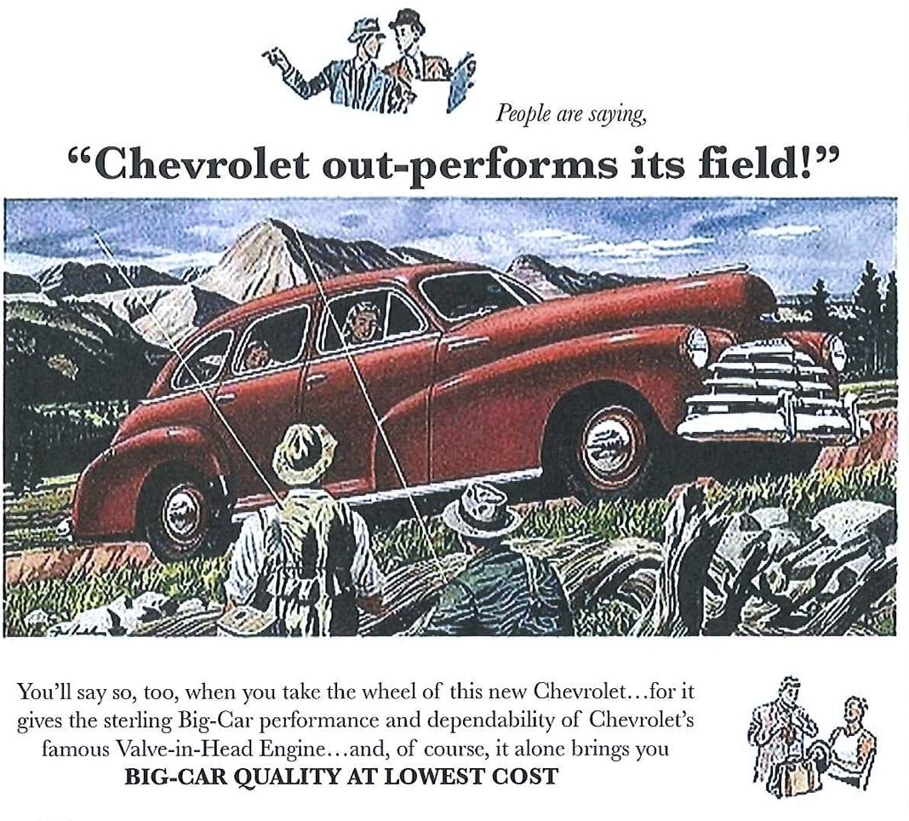

Slide 12


Slide 13


Slide 14


Slide 15
