Slide 1
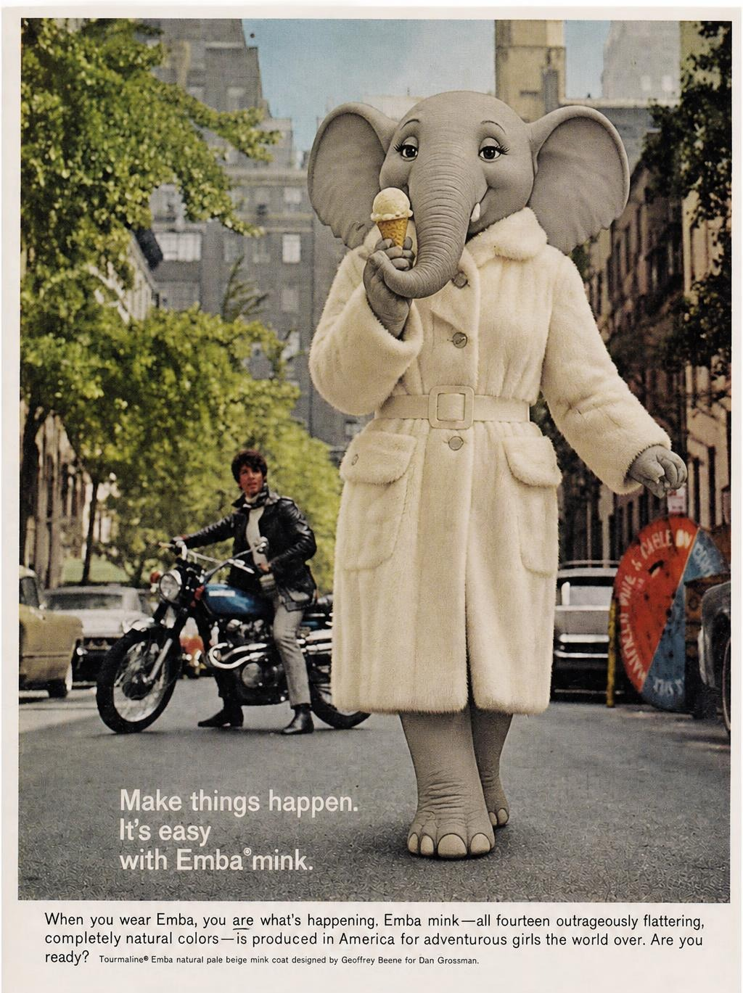
Clever Elephants Always Eat Ice Cream
Analysing Human Figures

Slide 2
Analysing Human Figures
‘Clever Elephants Always Eat Ice Cream’ is a framework for building strong analysis paragraphs. It will help you move beyond simple observations by making clear claims, selecting relevant evidence, and developing thoughtful explanations. By following each stage of the framework, you'll learn how to communicate your ideas in a clear, organised and convincing way.
Human figures often occupy a prominent position in visual texts and may be the single most important feature in drawing readers’ attention and creating meaning. Facial expressions, body language, gestures, clothing, and gaze all contribute to the impressions audiences form as they view the image. The examples and explainers on these slides will show you how to analyse these features in a range of advertisements, campaigns, posters and other multimodal texts. You'll see how depictions of people can communicate ideas, reinforce messages and guide the way a text is interpreted. Finally, you'll learn how to bring these observations together in well-structured analysis paragraphs of your own.
Text Types
Advertisements
PSAs
Charity campaigns
Recruitment drives
Film posters
Magazine covers
Blogs
Comics and Cartoons
Infographics

Slide 3
Clever Elephants Mnemonic
Clever | Claim | What is the text suggesting? What is the message?
Elephants | Evidence | Which part of the text supports your claim?
Always | Analysis | What connotations, tone, techniques, or devices can you find?
Eat | Explain | How do these choices influence the message?
Ice | Impact on Reader | How might readers react? What thoughts/feelings are created?
Cream | Connections | How does this link to the ‘big picture’? What issues are behind the writer’s choices? How does this fit into context?

Slide 4
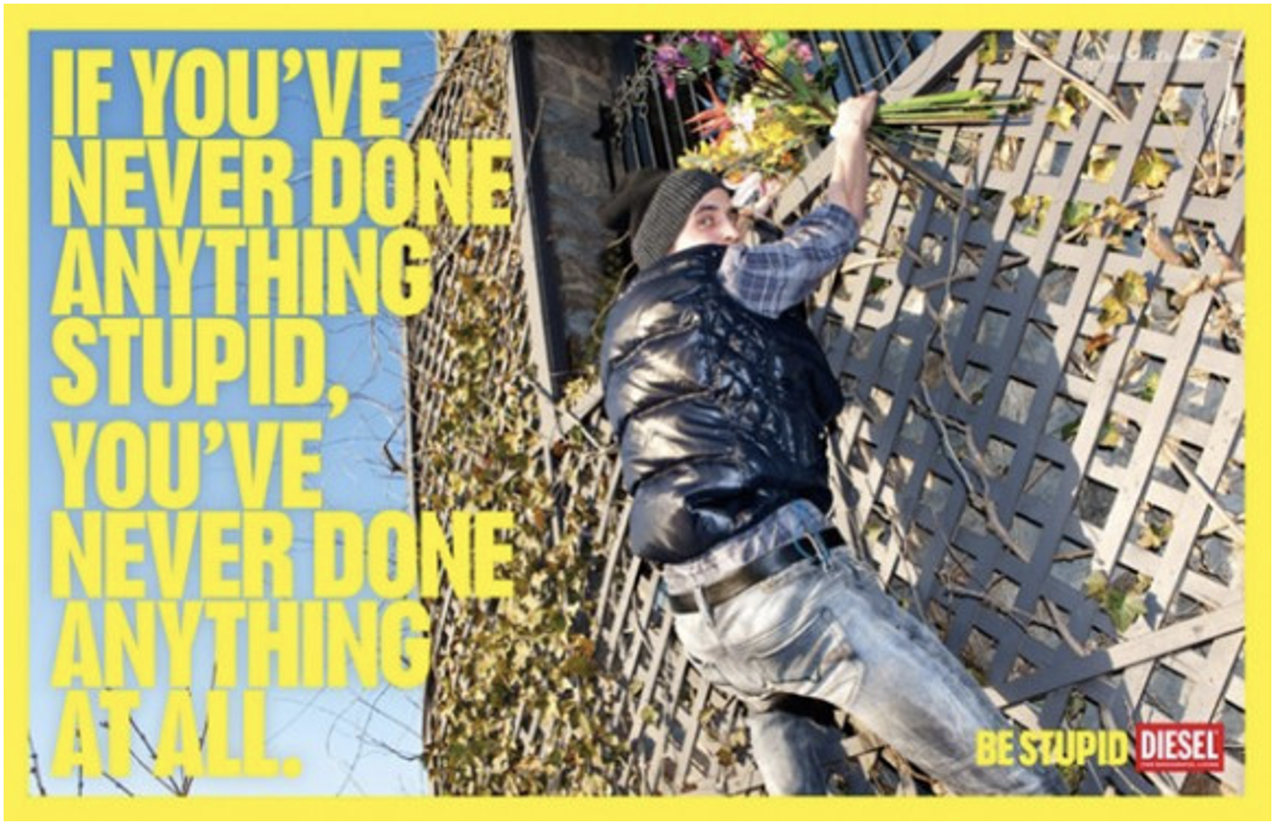

Slide 5
Clever Elephants Analysis Framework
Claim | The figure is presented as bold, spontaneous, willing to take risks.
Evidence | The figure is climbing a fence to a balcony. His body is angled upwards while his gaze turns to look at the camera.
Analyze | Climbing posture shows adventure and willingness to take risks. Arm reached upwards to show determination. Gaze makes eye-contact with the viewer.
Explain | Posture and gaze present unconventional behaviour as exciting and adventurous. The figure’s gaze appears confident, playful, or self aware, inviting the viewer like a collaborator.
Impact | Viewers might admire the figure’s confidence and bravery. The image encourages viewers to see risk-taking as something to be embraced.
Connections | In context with the slogan, the main figure redefines ‘stupid’ not as a lack of intelligence but as a willingness to take risks and be adventurous.

Slide 6
Sample Clever Elephants Mise en scene Analysis
The main figure is presented as bold, spontaneous, and willing to take risks. He is shown climbing a fence to a balcony. His body is angled upwards while his head turns so he looks straight at the viewer. The climbing posture creates a strong sense of adventure and reveals a willingness to take risks. He’s positioned halfway up a fence in a precarious situation, yet his upward stretching arm implies his determination to climb higher and reach his goal, despite any risks of falling. His direct gaze makes eye-contact with the viewer, establishing a relationship. The gaze seems knowing and self-aware, as if he’s issuing a challenge or inviting the viewer into the scene like a collaborator. Posture and gaze combine to suggest this unconventional action is exciting and empowering rather than dangerous or foolish. Readers may admire the figure’s courage and adventurous spirit, and associate his risk-taking with confidence or independence. This interpretation is reinforced by the advert’s slogan which redefines ‘stupid’ not as a lack of intelligence, but as a quality that encourages spontaneity, bravery, and adventure. The figure represents the ability to embrace risk and pursue a goal that others might not be able to attain.
What
How
Why

Slide 7
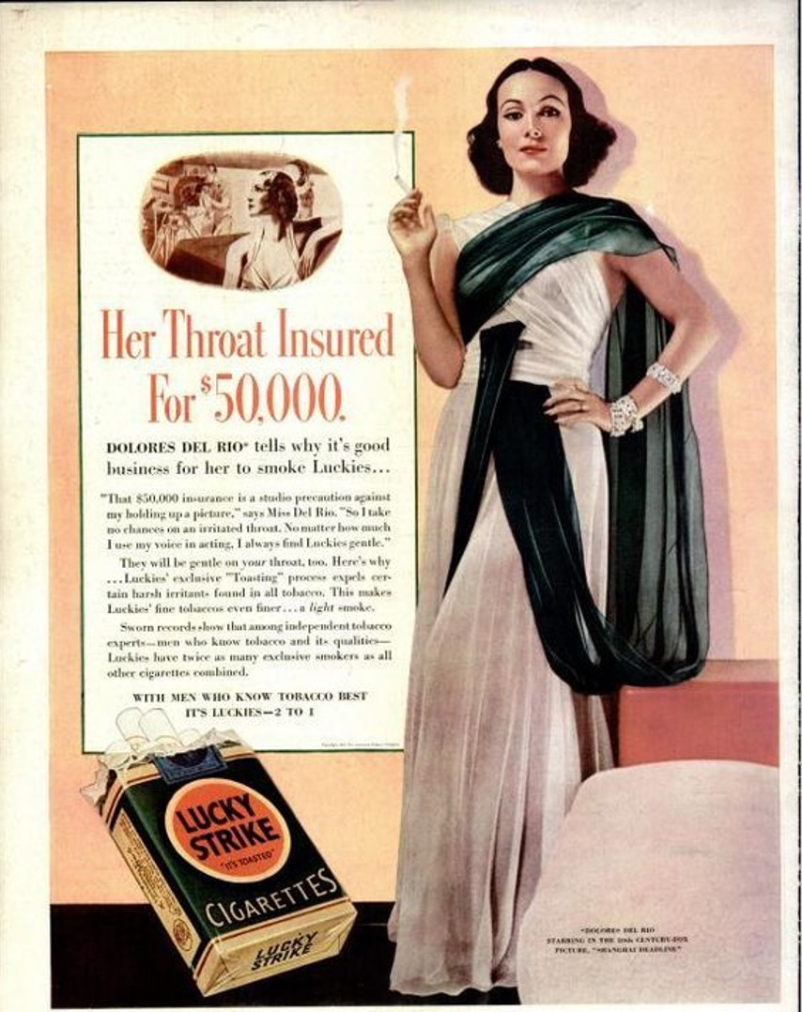

Slide 8
Clever Elephants Analysis Framework
Claim | The figure is presented as sophisticated, elegant, and authoritative.
Evidence | The figure stands upright with one hand resting on her hip while the other is raised. Gaze is direct. Wears an elegant formal dress with jewelry.
Analyze | Upright posture creates poise and self-assurance. Hand on hip suggests elegance, hand raised draws attention to smoking. Direct gaze projects confidence and authority.
Explain | The figure is someone to admire, someone trustworthy. Her gaze is commanding and clothes reinforce elegance, glamour, and high status.
Impact | Readers may be more willing to accept the claims made in the advert because the figure is sophisticated and respectable. High status and glamour may be aspirational for readers.
Connections | In the context of cigarette advertising, the figure supports the idea that cigarettes are glamourous and sophisticated. Harmful effects are minimized in favour of a ‘soft’ image.

Slide 9
Sample Clever Elephants Human Figure Analysis
The figure is presented as sophisticated, elegant, and authoritative. She stands upright with one hand resting on her hip and the other raised, maintaining a direct gaze towards the viewer. Her posture creates a strong impression of poise and elegance. Her hand-on-hip pose suggests self-assurance, and a kind of elegant self-control, while her raised hand is both elegant and draws attention to the action of smoking. Her direct gaze stares at the viewer in a way that projects authority, creating the impression that she endorses the product with certainty and assurance. These impressions are reinforced by her elegant clothing: a formal dress with expensive looking jewelry, which accentuate her glamour and high-status. As a result, the figure appears both confident and authoritative, elegant and commanding. Readers may be inclined to accept her views about smoking as credible because they are made by someone so sophisticated and authoritative. She may also appear as a status symbol to which the viewers may look up to and mimic. In the context of the cigarette advertising, the figure reinforces the suggesting that smoking is a glamourous and sophisticated activity. Harmful effects are minimized in favour of promoting a lifestyle that viewers may aspire to.
What
How
Why

Slide 10

Analysis Writing Practice: Human Figures
On the following slides you’ll see plenty more examples of texts with prominent human figures;
Make observations about aspects of presentation such as: facial expression, body language, posture, gesture, clothing, and gaze;
Create a ‘clever elephants’ planning framework for your chosen text(s);
Use your framework(s) as the basis for practicing Clever Elephants analysis writing;
After you finish you could: colour-code your paragraph(s); swap with a friend to offer/receive feedback; submit your writing for checking.

Slide 11
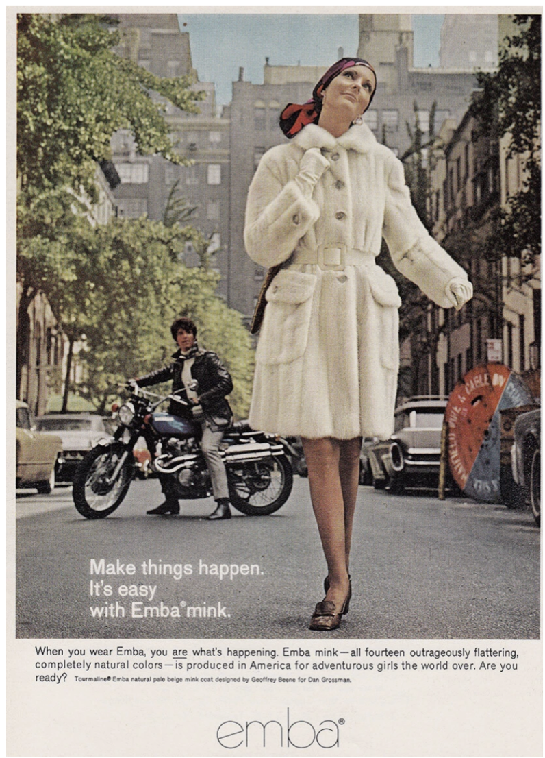

Slide 12


Slide 13
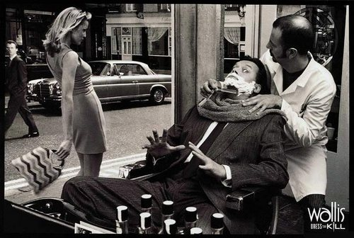

Slide 14
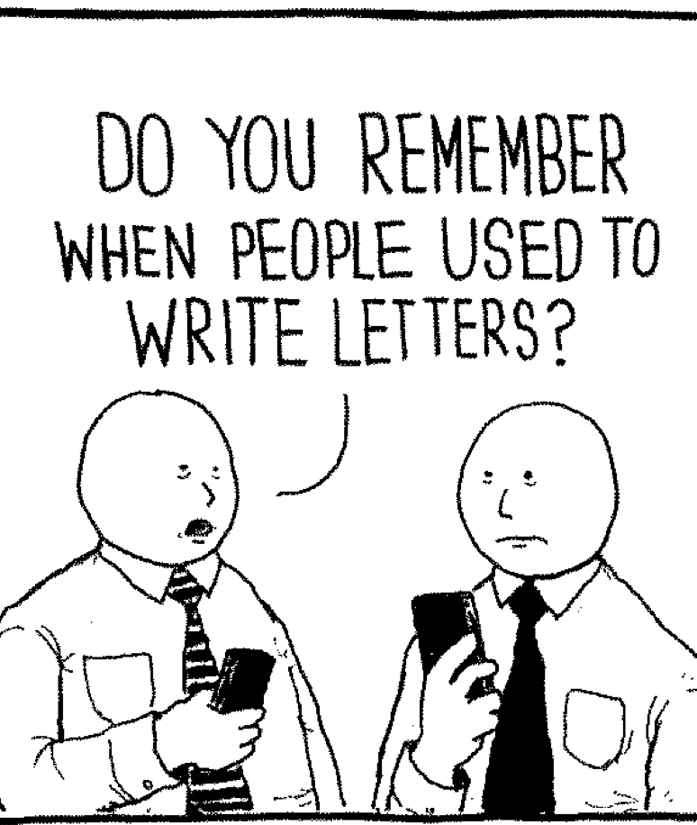

Slide 15


Slide 16


Slide 17
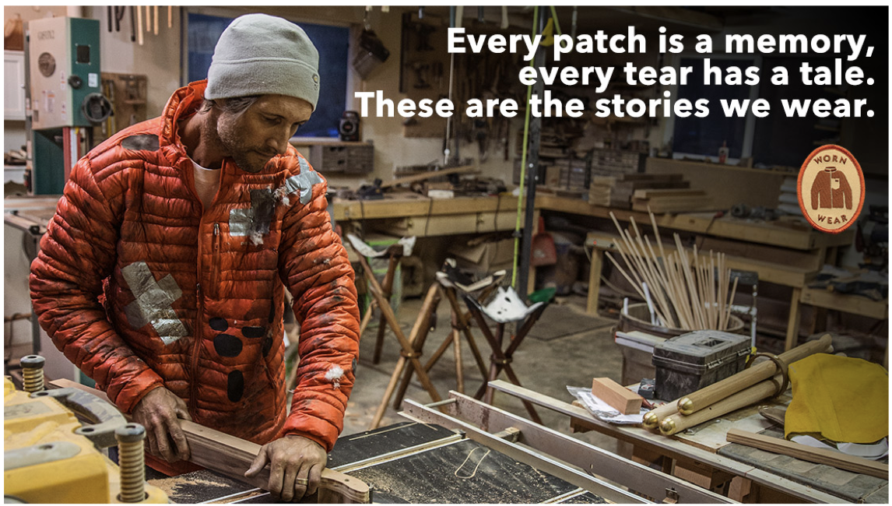

Slide 18
