Slide 1
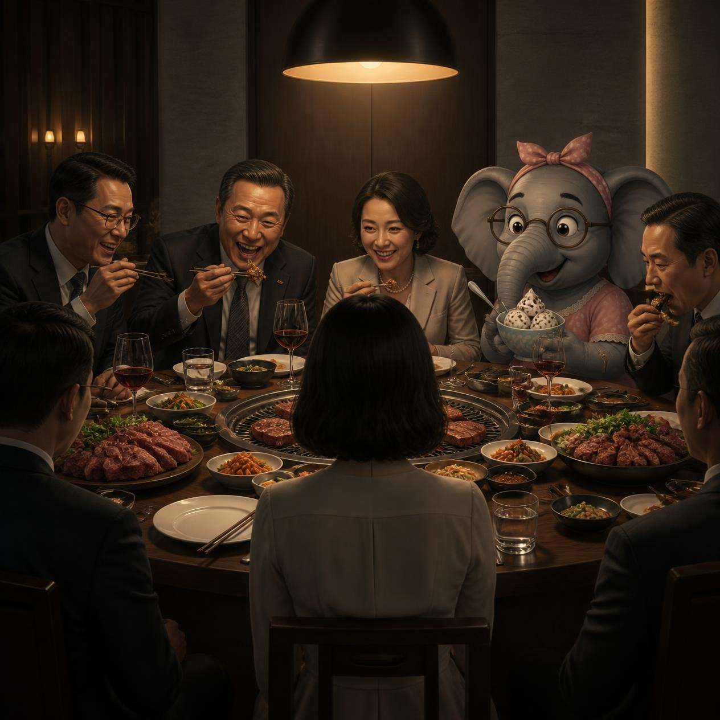
Clever Elephants Always Eat Ice Cream
The Vegetarian by Han Kang Analysis Writing

Slide 2
Introduction
Have you ever seen an elephant eating ice cream? Maybe not! But this memorable image will help us remember the important ingredients of a strong analysis paragraph. Using the mnemonic Clever Elephants Always Eat Ice Cream, you’ll learn how to develop ideas, explain evidence, and create thoughtful responses to texts.
Over the next few slides, you’ll consider evidence from part one of Han Kang's The Vegetarian and explore how Kang presents Yeong-hye's vegetarianism as more than a personal lifestyle choice. Through close analysis of language, characterisation, and symbolism, you'll investigate how her decision challenges the expectations of her family or the wider society around her. By the end of this sequence, you'll be able to develop a clear analytical argument that Yeong-hye's vegetarianism represents a refusal to conform to the roles and behaviours others expect her to accept.

Slide 3
Clever Elephants Mnemonic
Clever = | Claim | What will be the focus and argument of your paragraph?
Elephants = | Evidence | Which part of the extract supports your claim?
Always = | Analysis | What words, phrases, techniques, or writer’s choices can you find?
Eat = | Explain | How do these writer’s choices develop your argument?
Ice = | Impact on Reader | How might readers react? What thoughts/feelings are created?
Cream = | Circle Back | How does this contribute to your interpretation of the passage as a whole?

Slide 4
- How does Han Kang suggest Yeong-hye’s decision to turn vegetarian represents a refusal to conform to the expectations of family or wider society?
‘Did you have any problems finding the place?’ my boss’s wife asked me.
‘No, no, I’ve been past here once or twice before. In fact, I’d been thinking of coming here myself.’
‘Ah, I see… yes, the garden has turned out quite well, hasn’t it? You ought to try coming in the daytime; you can see the flower beds through that window over there.’
But by the time the food began to be served, the strain of maintaining a casual façade, which I had just about managed so far, was bringing me close to breaking point.
The first thing placed in front of us was an exquisite dish of mung-bean jelly, dressed with thin slivers of green-pea jelly, mushrooms and beef. Up until then my wife had merely sat and observed the scene in silence, but just as the waiter was on the point of ladling some onto her plate, she finally opened her mouth.
‘I won’t eat it.’
She’d spoken very quietly , but the other guests all instantly stopped what they were doing, directing glances of surprise and wonder at her emaciated body.
‘I don’t eat meat,’ she said, slightly louder this time.
‘My word, so you’re one of those “vegetarians”, are you?’ my boss asked. ‘Well, I knew that some people in other countries are strict vegetarians, of course. And even here, you know, it does seem that attitudes are beginning to change a little. Now and then there’ll be someone claiming that eating meat is bad… after all, I suppose giving up meat in order to live a long life isn’t all that unreasonable, is it?’

Slide 5
‘But surely it isn’t possible to live without eating meat?’ his wife asked with a smile. The waiter whisked nine plates away, leaving my wife’s still-gleaming plate on the table. The conversation naturally continued on the topic of vegetarianism.
‘Do you remember those mummified human remains they discovered recently? Five hundred thousand years old, apparently, and even back then humans were hunting for meat – they could tell from the skeletons. Meat-eating is a fundamental human instinct, which means vegetarianism goes against human nature, right? It just isn’t natural.’
‘People mainly used to turn vegetarian because they subscribed to a certain ideology… I’ve been to various doctors myself, to have some tests done and see if there was anything in particular I ought to be avoiding, but everywhere I went I was told something different... in any case, the idea of a special diet always made me feel uncomfortable. It seems to me that one shouldn’t be too narrow minded when it comes to food.’
‘People who arbitrarily cut out this food or that food, even though they’re not actually allergic to anything – that’s what I would call narrow-minded,’ the executive director’s wife chimed in; she had been sneaking sideways glances at my wife’s breasts for some time now. ‘A balanced diet goes hand in hand with a balanced mind, don’t you think?’ And now she loosed her arrow directly at my wife. ‘Was there some special reason for your becoming vegetarian? Health reasons, for example… or religious, perhaps?’
‘No.’ Her cool reply proved that she was completely oblivious to how delicate the situation had become. All of a sudden, a shiver ran through me – because I had a gut feeling that I knew what she was about to say next.
‘I had a dream.’
From The Vegetarian by Han Kang (2007)

Slide 6
Clever Elephants Analysis Framework
Claim | Yeong-hye’s behaviour at the restaurant represents a refusal to conform to social pressure.
Evidence | “I won’t eat it.”
Analyze | Brevity of line shows strong personal conviction. No argument, a strong declaration.
Explain | Interruption to casual conversation; strong challenge to other guests. Symbolic act of ‘going against the flow’ and refusal to conform to rule of majority.
Impact | Readers may admire Yeong-hye’s courage and feel anxious for her being the focus of hostile attention.
Circle back | Kang uses Yeong-hye’s refusal to eat meat as a symbolic act of refusing to follow social rules and expectations against one’s own personal convictions.

Slide 7
Clever Elephants Analysis Sample
Han Kang presents Yeong-hye’s vegetarianism as a refusal to conform to the expectations of those around her. This is evident when she plainly states: “I won’t eat it.” The brevity of this declaration conveys certainty and determination, as she neither apologises for nor explains her decision. Her refusal immediately interrupts the casual conversation around her and draws attention from the other guests. In a social setting where people are expected to behave politely and follow accepted customs, Yeong-hye’s rejection of the meal becomes symbolic of rejecting wider social expectations. Readers may admire Yeong-hye’s principled stance, as it takes courage to stand against the rule of the majority, while feeling anxious that she is now the focus of attention. Therefore, through her simple statement and refusal to follow the rules others place upon her, Kang presents Yeong-hye’s vegetarianism as a symbolic act of refusing to allow social convention to contravene one’s own personal convictions.
What
How
Why

Slide 8
Clever Elephants Analysis Framework (Layered)
Claim | Yeong-hye’s behaviour at the restaurant represents a refusal to conform to social pressure.
Evidence | “I won’t eat it” “I don’t eat meat” “Vegetarianism goes against human nature… It just isn’ t natural.”
Analyze | Brevity and repetition of Yeong-hye’s statements; no argument, strong declaration. Contrast with other’s reactions, implication of abnormality.
Explain | Conflicting voices suggests Yeong-hye’s decision is a violation of social norms. Guests’ language suggests they feel threatened by her decision and meet her decision with hostility.
Impact | Readers may admire Yeong-hye for her stance and sympathise when she becomes the center of unwanted attention. Anxiety over the conflict between a majority and a ‘lone voice’.
Circle back | Yeong-hye’s personal choice to become vegetarian is interpreted as a challenge to social convention.

Slide 9
Clever Elephants Layered Analysis
Han Kang represents Yeong-hye’s vegetarianism as a refusal to allow social pressure to dictate her actions. This is first evident when Yeong-hye firmly declares: “I won’t eat it.” The short, blunt sentence conveys certainty and determination, suggesting that she feels no obligation to argue with others or justify her decision. Later in the scene she reiterates: “I don’t eat meat,” revealing the strength of her commitment to stick to her own choices. Her simple words cut across the casual flow of conversation and the other guests direct their attention towards her. This reaction highlights how unusual her choice appears to be within this social setting. The pressure to conform becomes even clearer when guests insist “vegetarianism goes against human nature” and “It just isn’t natural.” The repetition of ideas about what is “natural” suggests that conformity is the norm. Any deviation is met with hostility and suspicion. Kang contrasts Yeong-hye’s quiet self-assurance with the increasingly judgemental comments of those around her, and uses conflicting voices to comment on how society attempts to control behaviours that challenge accepted norms. Readers may sympathise with Yeong-hye and question whether the real problem is her vegetarianism or the group’s inability to tolerate difference. They may feel anxious over the conflict between a forceful majority and a ‘lone voice’ who becomes the target of hostility. Overall, through Yeong-hye’s refusal and the hostile reactions it provokes, Kang presents vegetarianism as a symbol of resistance to the social expectations that dictate a person’s behaviour and override their personal convictions.
What
How
Why

Slide 10

Analysis Writing Practice: Han Kang
Choose another example from Part One of The Vegetarian that you can use to create the argument that Yeong-hye’s decision to turn vegetarian represents a refusal to conform to wider social expectations.
For instance: use a different example from the restaurant scene; look at her actions as she throws out the meat in the house; examine how Mr Cheong frames her decision; explore how she responds to her husband’s questions and accusations; analyse how she remains defiant in front of her family.
Create a Clever Elephants planning frame(s) for at least one paragraph and write your answer.
If this is the first time you’ve used the Clever Elephants mnemonic, to make doubly sure you’ve included all the different analysis elements, colour-code your writing and submit to get some feedback on your analysis skills.

Slide 11
Useful Sentence Patterns for Clever Elephants Analysis
Claim | Through… Kang conveys… The writer uses… to… | Kang presents… by…
Evidence | For example: “…” This can be seen when… | Mr Cheong thinks: “…” This is evidenced by: “…”
Analysis | The word X connotes… The detail of… reveals… | The writer uses… to imply… Through the writer’s choice of…
Explanation | Such use of language conveys the idea… The metaphor creates an impression that… | The phrase calls attention to… Kang is suggesting…
Impact on Reader | Readers are encouraged to think… This might make readers question… | Readers might become aware of… Readers may feel…
Circle Back | Therefore, by combining… Kang implies… Through this… Kang reveals… | Overall, Kang suggests…

