Slide 1
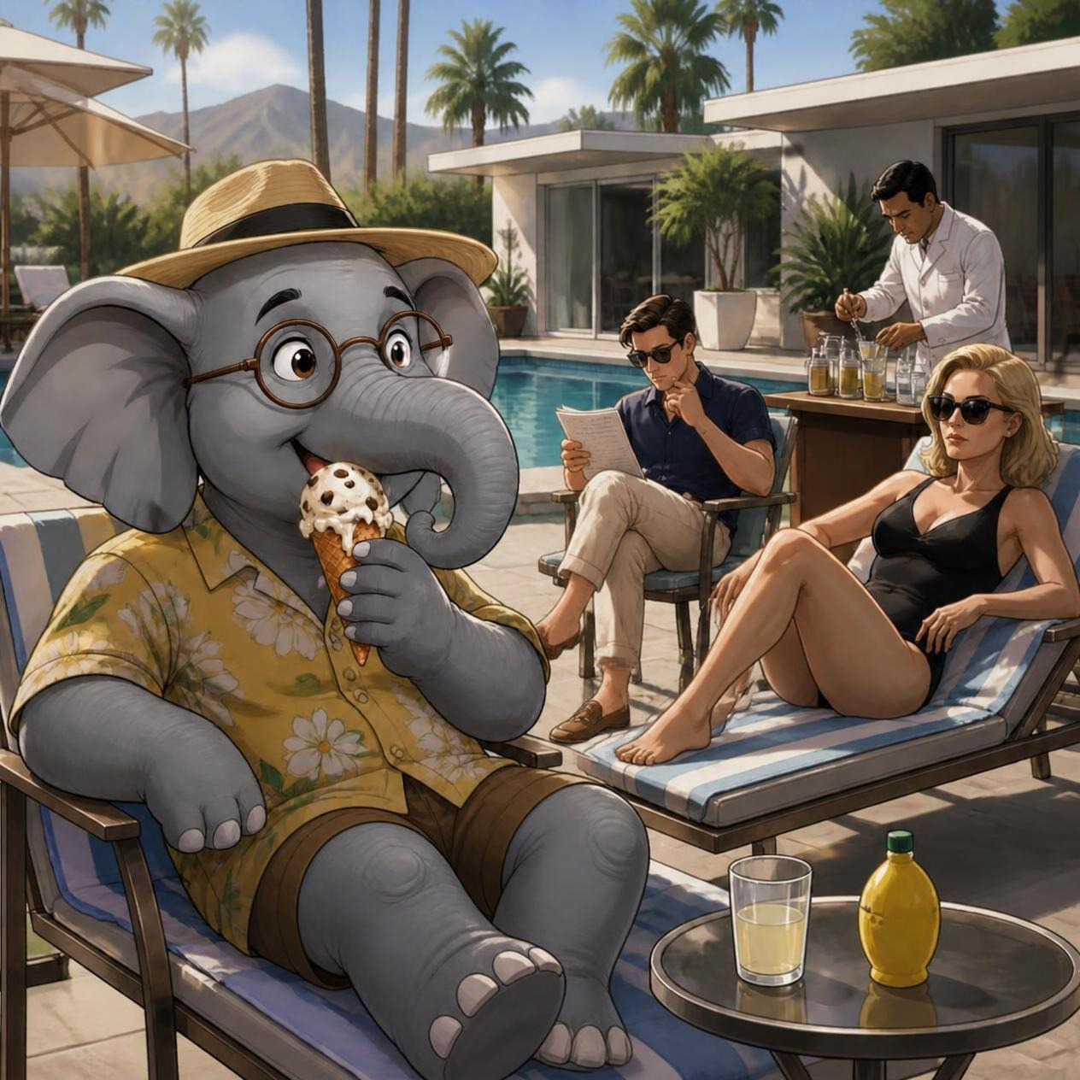
Clever Elephants Always Eat Ice Cream
Play It As It Lays by Joan Didion Analysis Writing

Slide 2

Introduction
Have you ever seen an elephant eating ice cream? Maybe not! But this memorable image will help us remember the important ingredients of a strong analysis paragraph. Using the mnemonic Clever Elephants Always Eat Ice Cream, you’ll learn how to develop ideas, explain evidence, and create thoughtful responses to texts.
Over the next few slides, you’ll read an extract from Joan Didion’s Play It As It Lays and examine how Didion uses imagery, symbolism, and Maria’s perspective to reveal the emptiness beneath a glamorous lifestyle. Through selecting evidence, analysing key details, and considering the effect of Didion’s choices on the reader, you'll uncover how appearances, youth, and beauty become carefully maintained performances that mask the superficiality and emptiness of the scene, and the Hollywood culture of the novel. By the end of this sequence, you'll be able to craft analytical paragraphs that move beyond summary and explore how Didion exposes the unsettling realities hidden beneath a polished social façade.

Slide 3
Clever Elephants Mnemonic
Clever = | Claim | What will be the focus and argument of your paragraph?
Elephants = | Evidence | Which part of the extract supports your claim?
Always = | Analysis | What words, phrases, techniques, or writer’s choices can you find?
Eat = | Explain | How do these writer’s choices develop your argument?
Ice = | Impact on Reader | How might readers react? What thoughts/feelings are created?
Cream = | Circle Back | How does this contribute to your interpretation of the passage as a whole?

Slide 4
Maria is hanging out with Carter, Helene, and BZ by the pool in her and Carter’s Beverly Hills home. BZ has invited a masseur who is mixing drinks. Maria feels unsettled. Read this extract and answer the guiding question:
- How does Didion present the emptiness beneath a world obsessed with appearances?
Usually Maria could avoid hearing Helene’s friends but BZ’s friends were more difficult, and this one was particularly difficult. Part of it was his voice and part of it was Maria had met him before, she was certain she had. He did not seem to recognise her but she was sure that she had met him before some three years before, at someone’s house in Santa Barbara. He had come in after a polo game with some people who spoke only to the host and to one another, never to Carter and Maria – there had been an actor who’s last several pictures had failed, the actor’s mother, and a nervous steel heiress with whom the others seemed to have spent a week in Palm Beach – and then he had been not a masseur but the actor’s secretary. Even lying in the noon sun on this blazing dry October day Maria felt a physical chill when she thought about that afternoon in Santa Barbara. The way he looked was the problem. The way he looked was exactly the same. He looked untouched and she did not.
“BZ, you’ve planned this to torment me,” he was saying now. He stood on the deck, holding a plastic lemon at elaborate arm’s-length. “You couldn’t possibly buy artificial lemon juice, someone left it there, it’s a bad joke.”
”All BZ’s friends are purists,” Helene murmured without opening her eyes.
“You’re a nasty,” BZ said and laughed. He twisted a silver medallion on his chest so that it flashed in the sun. BZ was perpetually tanned, oiled, gleaming, not the negotiable health-club tan of people like Freddy Chaikin but tanned as evidence of a life spent in-season. “Isn’t Helene a nasty Carter?”
“Carter’s not listening,” the masseur said. “Don’t be draggy, Helene, run down the beach and ask Audrey Wise for a couple of lemons.”

Slide 5
Carter threw down the script he was reading and stood up. “I’ll get the goddamn lemons,” he said. Maria lay perfectly still until she knew that he was beyond the dunes and then she sat up, everything swimming in her vision. Beneath the faded American flag hanging over the sun deck they were arranged in tableau: BZ and the masseur, their bodies gleaming, unlined, as if they had an arrangement with mortality. Helene stood on the edge of the deck, looking down the beach. Helene was not so immune to time, there was a certain texture to Helene’s thighs, a certain lack of resilience where fabric cut into Helene’s flesh. It occurred to Maria that whatever arrangements were made, they worked less well for women. That nervous steel heiress with whom Maria had met the masseur, something bad had happened to her. She had been shot in the face by her fourteen-year-old son. It had been in the newspapers a few years ago. After the boy killed his mother he shot himself, and was later described by his father as a victim of divorce and drugs. Maria imagined that she had sunstroke. She closed her eyes and concentrated on a prayer she had learned as a child.
”That’s one less for lunch,” Helene said pleasantly.
“I seem to have come in after the main titles,” the masseur said petulantly. ”Is he going to get the lemons or isn’t he?”
BZ laughed. “Actually, Nelson” he said then, “that lemon is not artificial. That lemon is reconstituted."
From Play It As It Lays by Joan Didion (1970)

Slide 6
Clever Elephants Analysis Framework
Claim | Descriptions of BZ’s body reveals obsession with maintaining an image of youth, beauty and perfection.
Evidence | “BZ was perpetually oiled, tanned, gleaming.”
Analyze | “Gleaming” is something polished or manufactured; triple adjectives suggest meticulous cultivation.
Explain | Emphasis on the body rather than personality implies physical appearance is highly valued.
Impact | Descriptions make readers question how authentic these characters really are.
Circle back | Didion uses obsession with youth and appearance to expose emptiness underneath the glamourous lifestyle.

Slide 7
Clever Elephants Analysis Sample
Throughout chapter 10, Didion presents characters as obsessively concerned with maintaining an image of youth, beauty, and perfection, revealing the superficial values of their social world. This is evidenced in the description of BZ’s body as “perpetually oiled, tanned, gleaming.” The adjective ‘gleaming’ suggests something polished, artificial or manufactured rather than something natural, while the triple structure of adjectives mimics the action of BZ carefully maintaining his body’s appearance. Maria’s observations focus on physical qualities rather than personality, suggesting that outward image is valued more highly than the quality of one’s character in this social circle. By presenting BZ as a body to be admired rather than an individual, Didion suggests that appearances have become a defining measure of worth. The effort invested in maintaining youth and attractiveness reflects a culture that prises surface-level perfection above all else. As readers, we may start to question how authentic such characters really are. Their flawless appearance seems staged and artificial. Through this obsession with beauty, Didion reveals that beneath the glamour of Maria’s elite social group lies emptiness and vacuity.
What
How
Why

Slide 8
Clever Elephants Analysis Framework (Layered)
Claim | Descriptions of BZ’s body reveals obsession with maintaining an image of youth, beauty and perfection.
Evidence | “BZ was perpetually oiled, tanned, gleaming.” “Arrangement with mortality” “They were arranged in tableau”
Analyze | “Gleaming” is something polished or manufactured; triple adjectives suggest meticulous cultivation. ”Arrangement” is a metaphor suggesting an unnatural bargain.
Explain | Emphasis on the body rather than personality implies physical appearance is highly valued. The whole scene is described as a “tableau” meaning a staged picture; they perform an image of perfection.
Impact | Descriptions are repeatedly contrived and even unsettling, making readers question how authentic these characters really are.
Circle back | Didion uses obsession with youth and appearance to expose emptiness underneath the glamourous lifestyle.

Slide 9
Clever Elephants Layered Analysis
Throughout chapter 10, Didion presents characters as obsessively concerned with maintaining an image of youth, beauty, and perfection, revealing the superficial values of their social world. This is evidenced in the description of BZ’s body as “perpetually oiled, tanned, gleaming” and later when Maria imagines they had “an arrangement with mortality.” The adjective ‘gleaming’ suggests something polished, artificial or manufactured rather than something natural, while the triple structure of adjectives mimics the action of BZ carefully maintaining his body’s appearance. This impression of artificial preservation is enhanced through the metaphor of having an ‘arrangement with mortality,’ as if they have made an unnatural bargain to stay forever young. Moreover, the description of the group as “arranged in tableau” evokes a staged image, as if the characters are putting on a performance, creating a carefully presented image of glamour rather than enjoying a spontaneous interaction between them. The characters seem less like individuals, but more like objects frozen in youth and beauty. All the images are of physical perfection rather than personal qualities, suggesting the outward image is the only thing they value. People are presented as bodies for admiration above all else, making the culture of the group feel contrived and inauthentic. As readers, we may start to question how authentic such characters really are and even start to feel unsettled by their apparent flawlessness, which seems staged and artificial. Through this obsession with beauty, Didion exposes the emptiness that lies beneath the surface of Hollywood’s superficially glamorous lifestyle.
What
How
Why

Slide 10
Analysis Writing Practice: Didion
Choose another idea from the extract (or from Chapter 10) of Play It As It Lays that answers the question: How does Didion present the emptiness beneath a world obsessed with appearance?
For instance: the artificiality symbolized by the lemon juice; the contrast between surface glamour and Maria’s interior thoughts; the contrast between Maria and masseur; a growing awareness of the hollowness of Maria’s social circle.
Create a Clever Elephants planning frame(s) for at least one paragraph and write your answer.
If this is the first time you’ve used the Clever Elephants mnemonic, to make doubly sure you’ve included all the different analysis elements, colour-code your first couple of paragraphs before you submit them for checking.

Slide 11
Useful Sentence Patterns for Clever Elephants Analysis
Claim | Through… Didion conveys… The writer uses… to… | Didion presents… by…
Evidence | For example: “…” This can be seen in the words: “…” | The narrator thinks: “…” This is evidenced by: “…”
Analysis | The word X connotes… The detail of… reveals… | The writer uses… to imply… Through the writer’s choice of…
Explanation | Such use of language conveys the idea… The metaphor creates an impression that… | The phrase calls attention to… Didion is suggesting…
Impact on Reader | Readers are encouraged to think… This might make readers question… | Readers might become aware of… Readers may feel…
Circle Back | Therefore, by combining… Didion implies… Through this… Didion exposes… | Overall, Didion suggests…

