Slide 1

Clever Elephants Always Eat
Ice Cream
Analysing Composition

Slide 2
Analysing Composition
‘Clever Elephants Always Eat Ice Cream’ is a framework for building strong analysis paragraphs. It will help you move beyond simple observations by making clear claims, selecting relevant evidence, and developing thoughtful explanations. By following each stage of the framework, you'll learn how to communicate your ideas in a clear, organised and convincing way.
Composition refers to the arrangement of visual elements within an image. Designers, photographers and advertisers carefully decide where to place people, objects, and text in order to guide the viewer's attention and highlight certain meanings. This sequence will show you how to analyse compositional techniques such as positioning, proximity, negative space, leading lines, size/scale, rule of thirds, and juxtaposition. You'll learn how these choices influence what viewers notice, establish relationships between elements, and communicate ideas. Finally, you'll learn how to bring these observations together in well-structured analysis paragraphs of your own.
Text Types
Advertisements
PSAs
Charity campaigns
Recruitment drives
Film posters
Magazine covers
Blogs
Comics and Cartoons
Infographics
Leaflets and flyers
Travel and tourism guides
Posters
Webpages

Slide 3
Clever Elephants Mnemonic
Clever | Claim | What is the text suggesting? What is the message?
Elephants | Evidence | Which part of the text supports your claim?
Always | Analysis | What connotations, tone, techniques, or devices can you find?
Eat | Explain | How do these choices influence the message?
Ice | Impact on Reader | How might readers react? What thoughts/feelings are created?
Cream | Connections | How does this link to the ‘big picture’? What issues are behind the writer’s choices? How does this fit into context?

Slide 4


Slide 5
Clever Elephants Analysis Framework
Claim | The composition presents Bond as the central figure in a scene of action and danger.
Evidence | Bond is positioned in the center of the image, larger than surrounding figures. Space filled with explosions, vehicles, weapons, and secondary characters.
Analyze | Central placement establishes Bond as the focal point of the image. Large size creates a visual hierarchy. Crowded composition. Gun as a vector line pointing to Bond.
Explain | Bond is the figure around which action revolves. Composition suggests Bond is at the center of a world of action, danger, and excitement.
Impact | Readers may perceive Bond as a powerful and dominant figure. They may notice he stays calm and collected despite the danger and threats pointing to him.
Connections | Composition reinforces Bond’s role as an action hero. He is the center of attention, is surrounded by action and danger, yet remains impassive and calm. An idealized version of masculinity.

Slide 6
Sample Clever Elephants Composition Analysis
The composition presents Bond as the principal figure in a scene of action and danger. Bond occupies the center of the poster and is considerably larger than the surrounding figures. Explosions, weapons, vehicles, and secondary characters fill the space around him. His central position and large scale create a visual hierarchy with Bond as the focal point that dominates every other character. Furthermore, the densely packed composition creates a sense that he is constantly threatened by danger and involved in action. The most striking compositional feature is the gun in the foreground which points at Bond. Not only is this the most obvious of many vector lines that converge on Bond but the gun is aligned with the viewer’s perspective, drawing them into the scene. As a result, Bond is the center of attention and the focus of every threat and conflict. Readers may view him as a powerful and dominant figure, who drives the action of the narrative. Additionally, they may be impressed that he stays so calm amidst the chaos. Overall, the composition reinforces Bond’s role as an action hero, surrounded by danger and threats, dominating attention and staying cool, calm, and collected – an idealized version of masculinity.
What
How
Why

Slide 7


Slide 8
Clever Elephants Analysis Framework
Claim | The composition supports the ideas that physical activity is an essential part of child development and makes this advice easy to follow.
Evidence | The large 180 minutes per day icon positioned next to activity boxes that include suggestions such as ‘walk’, ‘jump’, ‘climb’ and ‘bike’.
Analyze | Large scale of orange circle establishes an activity target as most important. Surrounding boxes link examples to the target. Sequential arrangement creates a progression.
Explain | Composition suggests physical activity is a developmental process. Activities mirror increasing mobility and independence, emphasizing growth over time.
Impact | Parents and carers will find information simple to digest and view physical activity as something that should be adopted into everyday life for young children.
Connections | Composition supports the message ‘every movement counts’. Activities placed next to a target help parents make healthy outcomes seem achievable.

Slide 9
Sample Clever Elephants Composition Analysis
The composition supports the idea that physical activity is an essential part of children’s development. The large orange circle containing a ”180 minutes a day” target is placed next to stacks of activity boxes with examples such as ‘walk’, ‘run’, ‘climb’, and ‘bike’. The large scale of the circle establishes the 180-minute target as the most important piece of information in the infographic. Activities are positioned in close proximity to this circle, visually linking practical ways of achieving the target to the recommendation itself. The boxes are arranged in stacks that progress sequentially from one to five. Furthermore, activities increase in complexity, mobility, and independence (from ‘tummy time’ in the first stack to activities like biking and climbing in the last). This progression suggests physical development is a continuous process and emphasizes growth over time. Parents and carers will find the information is presented in a way that is simple and easy to digest, and it should also motivate them to incorporate physical activity into children’s everyday lives, varying the activities as children get older. Compositional choices support the message that ‘every movement counts’, making healthy outcomes seem achievable by placing a clear target next to a wide variety of examples that most people should be able to provide.
What
How
Why

Slide 10

Analysis Writing Practice: Composition
On the following slides you’ll see plenty more examples of texts with thoughtfully designed compositional features;
Notice aspects of composition such as: rule of thirds, size and scale, negative space, crowded space, vectors/leading lines, positioning, proximity, or juxtaposition;
Create a ‘clever elephants’ planning framework for your chosen text(s);
Use your framework(s) as the basis for practicing Clever Elephants analysis writing;
After you finish you could: colour-code your paragraph(s); swap with a friend to offer/receive feedback; submit your writing for checking.

Slide 11
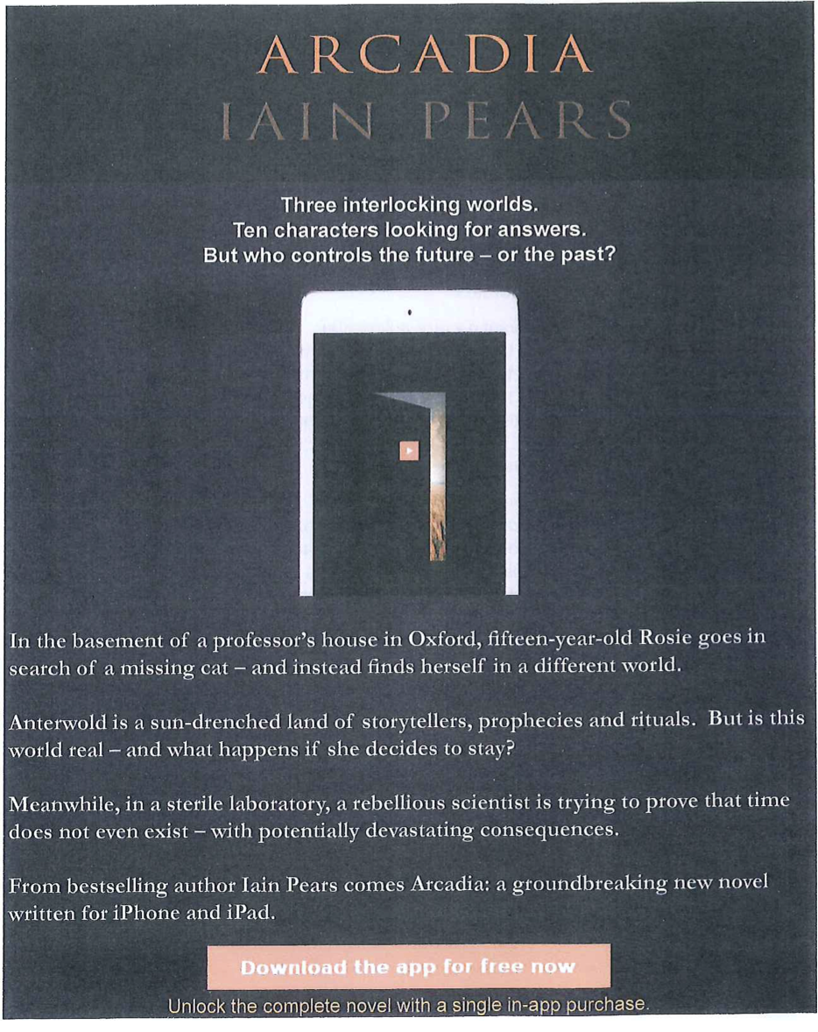

Slide 12


Slide 13


Slide 14


Slide 15


Slide 16
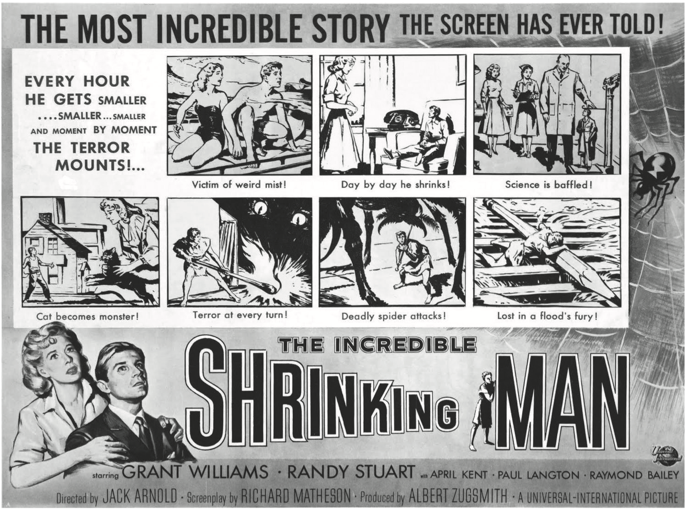

Slide 17
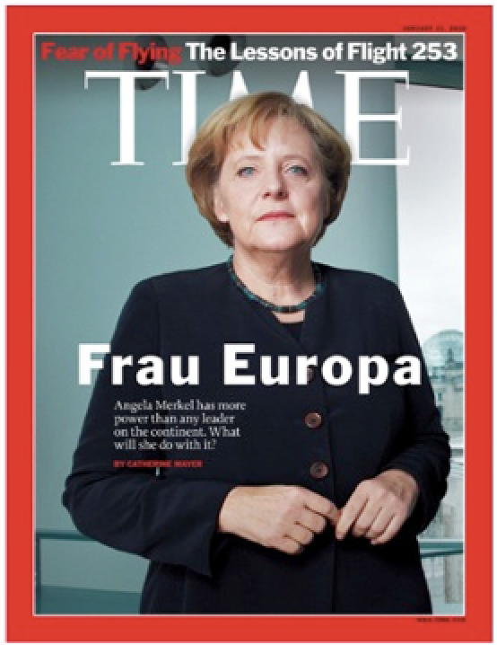

Slide 18
