Slide 1
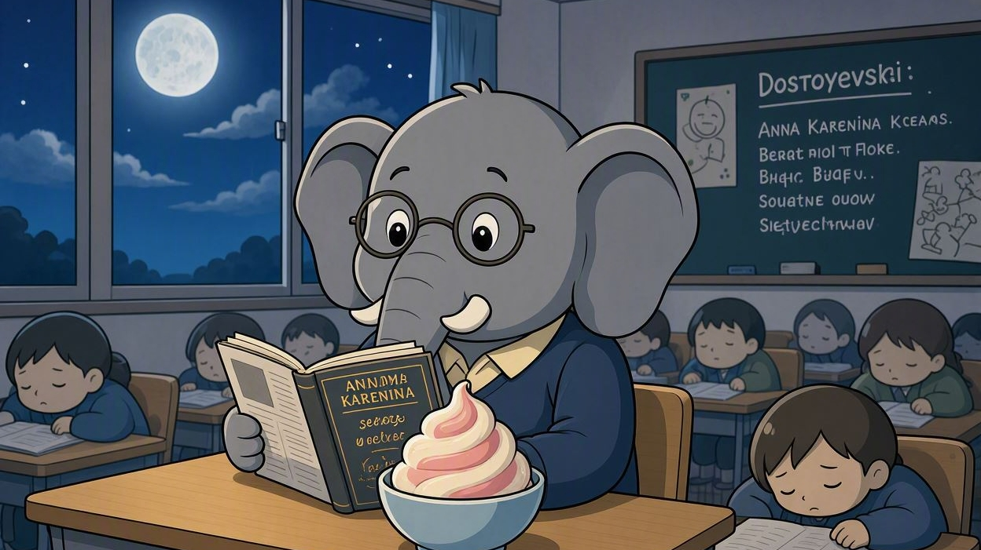
Clever Elephants Always Eat Ice Cream
Sleep by Haruki Murakami
Passage Analysis

Slide 2

Introduction
Have you ever seen an elephant eating ice cream? Probably not! But this memorable image will help us remember the important ingredients of a strong analysis paragraph. Using the mnemonic Clever Elephants Always Eat Ice Cream, you’ll learn how to develop ideas, explain evidence, and create thoughtful responses to texts.
Over the next few slides, you’ll look at a passage from Haruki Murakami’s short story Sleep (from The Elephant Vanishes collection) and explore how Murakami uses language, metaphor, and stylistic choices to develop the story’s ideas. Through selecting evidence, analysing key details, and exploring the impact of the text on readers, by the end of this sequence you’ll know how to craft thoughtful analytical paragraphs that don’t just summarise the story, but unlock the secrets of Murakami’s alluring-yet-mysterious world.

Slide 3
Clever Elephants Mnemonic
Clever = | Claim | What will be the focus and argument of your paragraph?
Elephants = | Evidence | Which part of the extract supports your claim?
Always = | Analysis | What words, phrases, techniques, or writer’s choices can you find? Why did Murakami choose these specific words?
Eat = | Explain | How do this writer’s choices develop your argument?
Ice = | Impact on Reader | How might readers react? What thoughts/feelings are created?
Cream = | Circle Back | How does this contribute to your interpretation of the passage as a whole? Circle back to your thesis.

Slide 4
In Sleep by Haruki Murakami, the narrator has experienced seventeen days and nights without sleep. In this extract she wonders about the effects of her sleeplessness on her life.
- How does the writer develop the narrator’s thoughts and feelings about her experiences across this extract?
Now my inability to sleep ceased to frighten me. What was there to be afraid of? Think of the advantages! Now the hours from ten at night to six in the morning belonged to me alone. Until now, a third of every day had been used up by sleep. But no more. No more. Now it was mine, just mine, nobody else’s, all mine. I could use this time in any way I liked. No one would get in my way. No one would make demands on me. Yes, that was it. I had expanded my life. I had increased it by a third.
You are probably going to tell me that this is biologically abnormal. And you may be right. And maybe someday in the future I’ll have to pay back the debt I’m building up by continuing to do this biologically abnormal thing. Maybe life will try to collect on the expanded part – this ‘advance’ it is paying me now. This is a groundless hypothesis, but there is no ground for negating it, and it feels right to me somehow. Which means that, in the end, the balance sheet of borrowed time will even out.
Honestly, though, I didn’t give a damn, even if I had to die young. The best thing to do with a hypothesis is to let it run any course it pleases. Now, at least, I was expanding my life, and it was wonderful. My hands weren’t empty anymore. Here I was – alive, and I could feel it. It was real. I wasn’t being consumed any longer. Or at least there was a part of me in existence that was not being consumed, and that was what gave me this intensely real feeling of being alive. A life without that feeling might go on forever, but it would have no meaning at all. I saw that with absolute clarity now.

Slide 5
After checking to see that my husband was asleep, I would go sit on the living-room sofa, drink brandy by myself, and open my book. I read Anna Karenina three times. Each time, I made new discoveries. This enormous novel was full of revelations and riddles. Like a Chinese box, the world of the novel contained smaller worlds, and inside those were yet smaller worlds. Together these worlds made up a single universe, and the universe waited there in the book to be discovered by the reader. The old me had been able to understand only the tiniest fragment of it, but the gaze of this new me could penetrate to the core with perfect understanding. I know exactly what the great Tolstoy wanted to say, what he wanted the reader to get from his book; I could see how his message had organically crystallized as a novel, and what in that novel had surpassed the author himself.
No matter how hard I concentrated, I never tired. After reading Anna Karenina as many times as I could, I read Dostoyevski. I could read book after book with utter concentration and never tire. I could understand the most difficult passages without effort. And I responded with deep emotion.
I felt that I had always been meant to be like this. By abandoning sleep, I had expanded myself. The power to concentrate was the most important thing. Living without this power would be like opening one’s eyes without seeing anything.
From The Elephant Vanishes by Haruki Murakami (1993)

Slide 6
Example 1: Murakami’s use of repetition
Clever Elephants Analysis Framework
Claim | Repetition and short sentences conveys the narrator’s excitement
Evidence | “But no more. No more. Now it was mine, just mine, nobody else’s, all mine.”
Analyze | “Mine” is a possessive word; repetition builds the feeling of strong possessiveness.
Explain | Repetition combines with short sentences to create energy and determination.
Impact | Readers can sense excitement, but also her jealousy, especially through culmination of the phrase: “all mine”.
Circle back | The narrator is excited about her sleepless powers but also fears that they might be lost or taken away.

Slide 7
Clever Elephants Analysis Sample 1
Through repetition and patterns of short sentences, Murakami conveys the narrator’s excitement over her sleepless situation. This is especially apparent in the first paragraph of the extract when she says: “But no more. No more. Now it was mine, just mine, nobody else’s, all mine.” The word ‘mine’ implies feelings of possessiveness; repetition strengthens this feeling, culminating in the strongly possessive phrase: “all mine.” She speaks in short, sharp sentences, making strong declarations that are both energetic and determined to keep hold of her new possession. As well as relishing her power, the reader may sense that she’s guarding it jealously. Therefore, repetition combines with short sharp phrases to connote the idea that, while excited about her sleepless power and determined to use it for herself, nevertheless the narrator also fears that it may be lost or taken away.
What
How
Why

Slide 8
Example 2: a layered paragraph
Clever Elephants Analysis Framework
Claim | Repetition and short sentences conveys the narrator’s excitement
Evidence | “But no more. No more. Now it was mine, just mine, nobody else’s, all mine.”
Analyze | “Mine” is a possessive word; repetition builds the feeling of strong possessiveness.
Explain | Repetition combines with short sentences to create energy and determination.
Impact | Readers can sense excitement, but also her jealousy, especially through culmination of the phrase: “all mine”.
Connective | Furthermore, ”my hands weren’t empty anymore” implies her power is new. She mentions a husband who might be a limit on her freedom (traditional housewife expectations?) Is she afraid of losing her power?

Slide 9
Clever Elephants Analysis Sample 2
Through repetition and patterns of short sentences, Murakami conveys the narrator’s excitement over her sleepless situation. This is especially apparent in the first paragraph of the extract when she says: “But no more. No more. Now it was mine, just mine, nobody else’s, all mine.” The word ‘mine’ implies feelings of possessiveness; repetition strengthens this feeling, culminating in the strongly possessive phrase: “all mine.” She speaks in short, sharp sentences, making strong declarations that are both energetic and suggest she’s determined to keep hold of her new possession. Furthermore, the phrase “nobody else’s” combines with clues elsewhere in the passage to suggest that having power and control may be a new experience for her. A reference to her husband hints at a limiting force, as does the third paragraph metaphor “my hands weren’t empty anymore.” The image of empty hands is one of powerlessness; by implication, the opposite image of holding something suggests she now has the ability to take control. In this way, the reader feels the narrator’s positive energy also has a tone of protective jealousy, revealing excitement about her sleepless powers – but also the fear that they will be taken away.
What
How
Why
Connect
What
How
Why

Slide 10
Analysis Writing Practice: Murakami
Use another extract to write your own Clever Elephants analytical response;
You can highlight and makes notes on the extract to get started;
Try to work up a three-stage answer to the question using selected details from the passages to support you claims;
Create Clever Elephants planning frames for each paragraph;
If this is the first time you’ve used the Clever Elephants mnemonic, to make doubly sure you’ve included all the different analysis elements, colour-code your first couple of paragraphs before you submit them for checking.

Slide 11
Useful Sentence Patterns for Clever Elephants Sleep Analysis
Claim | Through… Murakami conveys. The writer uses… to… | Murakami presents a feeling of… by…
Evidence | For example: “…” This can be seen in the words: “…” | The narrator thinks: “…”
Analysis | The word X connotes… The detail of… reveals… | The writer uses… to imply… Through the writer’s choice of…
Explanation | Such use of language conveys the idea… The metaphor creates an impression that… | The phrase calls attention to… Murakami is suggesting…
Impact on Reader | Readers are encouraged to think… This might make readers feel… | Readers might become aware of… Readers may be interested in…
Circle Back | Therefore, by combining… Murakami reveals… | Overall, the narrator feels both… and… While feeling… however, the narrator also…

