Slide 1
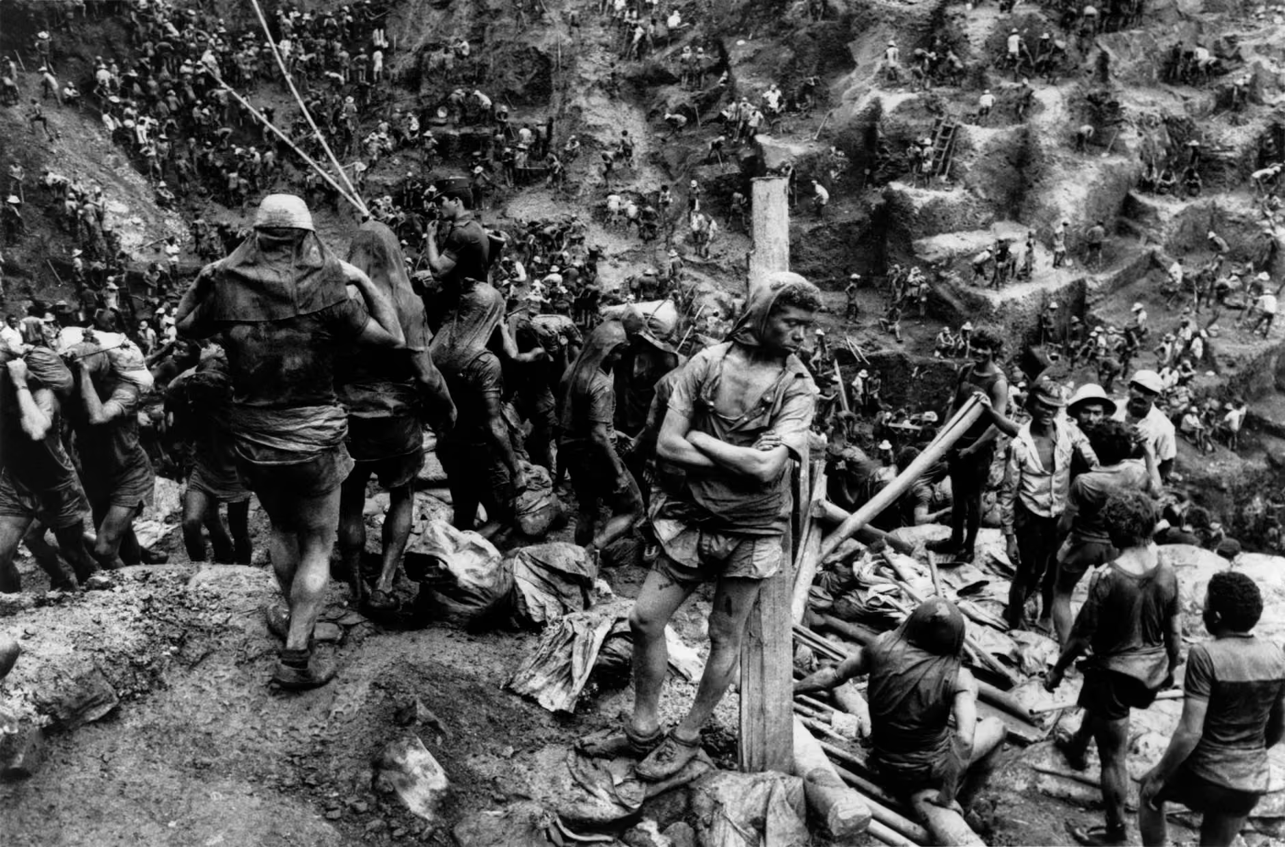
Photojournalism
Research and Presentation Task

Slide 2
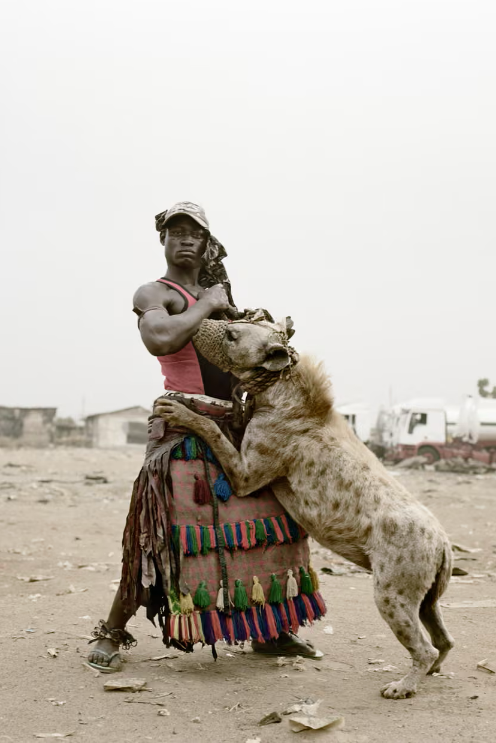
Introduction
Pieter Hugo’s The Hyena and Other Men series tells an incredible story of itinerant street performers in Lagos through photography.
Photojournalism is the practice of using photography to tell stories and spread awareness. It combines visual skill, ethical responsibility, and deep engagement with the world, documenting moments of crisis, change, injustice, resilience, and everyday life. Photojournalists work in many contexts, from war zones and protest movements to family homes, workplaces, and remote environments, but wherever or whoever they might be, the the best photojournalists share a committed to using images to inform, bear witness, and provoke understanding.
This collection is organised into three overlapping categories to introduce you to the wide and wonderful field of photojournalism. Firstly, Seminal / Canonical Photojournalists introduces figures who helped shape the foundations of the profession and whose images established many of its visual and technical conventions. Contemporary Photojournalists highlights practitioners working today, showing how photojournalism continues to evolve in response to new challenges and media developments. Diverse / Global Photojournalists broadens the picture further, foregrounding voices and perspectives that may have been marginalised in traditional histories of the field.

Slide 3
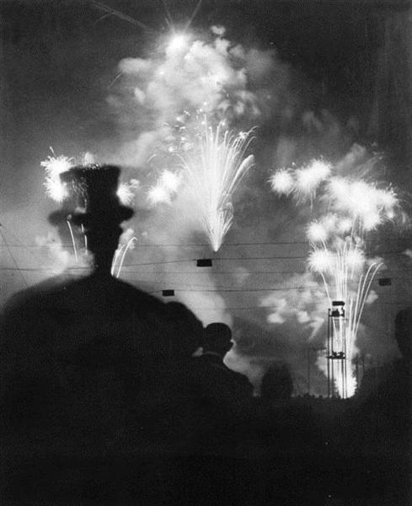
Seminal / Canonical Photojournalists
The photojournalists in this section helped define the visual language and establish the foundations of modern photojournalism. Through the early–mid twentieth century, the field became institutionalised through newspapers, magazines, and government documentation projects. Many of the photographers represented here are American because the emerging media of the United States played a fundamental role in shaping the profession. Publications such as Life, Look, and National Geographic provided funding, wide circulation, and access for photographers working during periods of war, economic crisis, and social change. Despite the American bias, you can still find photographers working further afield should you wish, in arenas such as the Vietnam War, Irish Troubles, or the backstreets and dimly lit alleyways of Paris.
Despite the fact that many canonical photojournalists are American, you can still find pioneering images from further afield such as Brassai’s seminal Paris By Night (Paris de nuit)

Slide 4
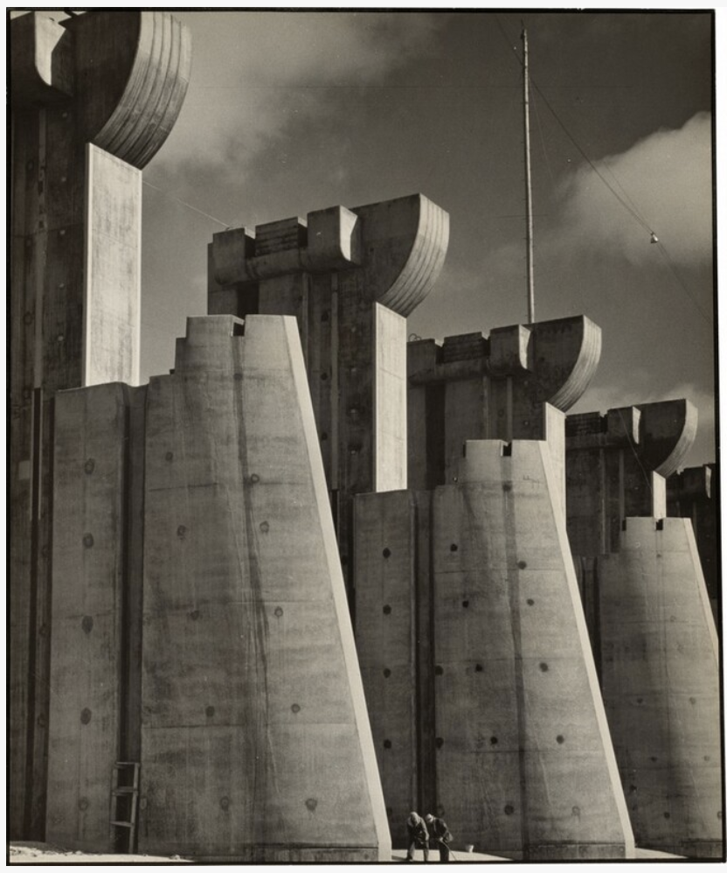
Margaret-Bourke White (USA)
Industrial Modernism
War reportage
Political access
Example: Fort Peck Dam, Montana (1936)
Notes:
https://www.nga.gov/artworks/165921-fort-peck-dam-montana

Slide 5
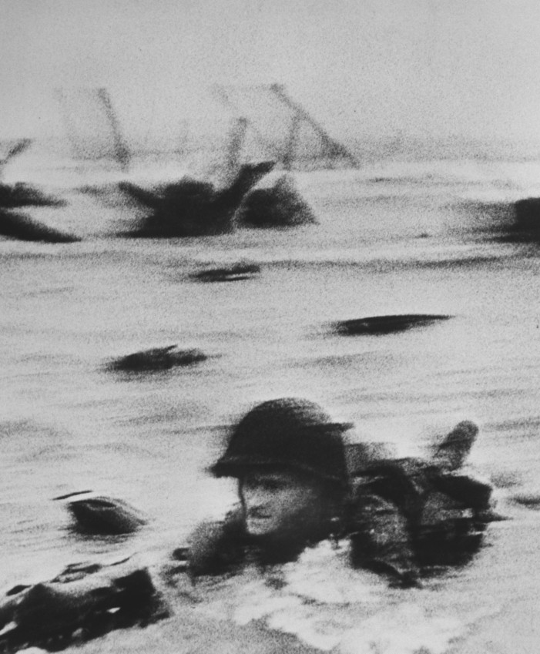
Robert Capa (Hungary/USA)
Combat photography
Proximity
Risk
Example: D-Day Landing, Normandy (1944)
Notes:
https://www.magnumphotos.com/newsroom/conflict/robert-capa-d-day-omaha-beach/

Slide 6
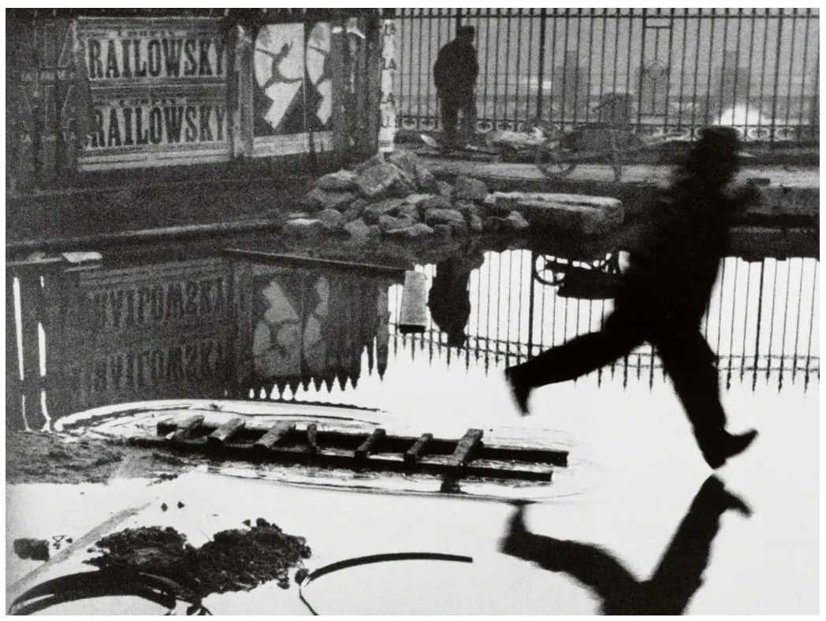
Henri Cartier-Bresson (France)
Decisive timing
Geometry
Real life, candid imagery
Example: Behind the Gare Saint-Lazare, Paris (1932)
Notes:
https://www.artsy.net/artist-series/henri-cartier-bresson-behind-the-gare-saint-lazare

Slide 7
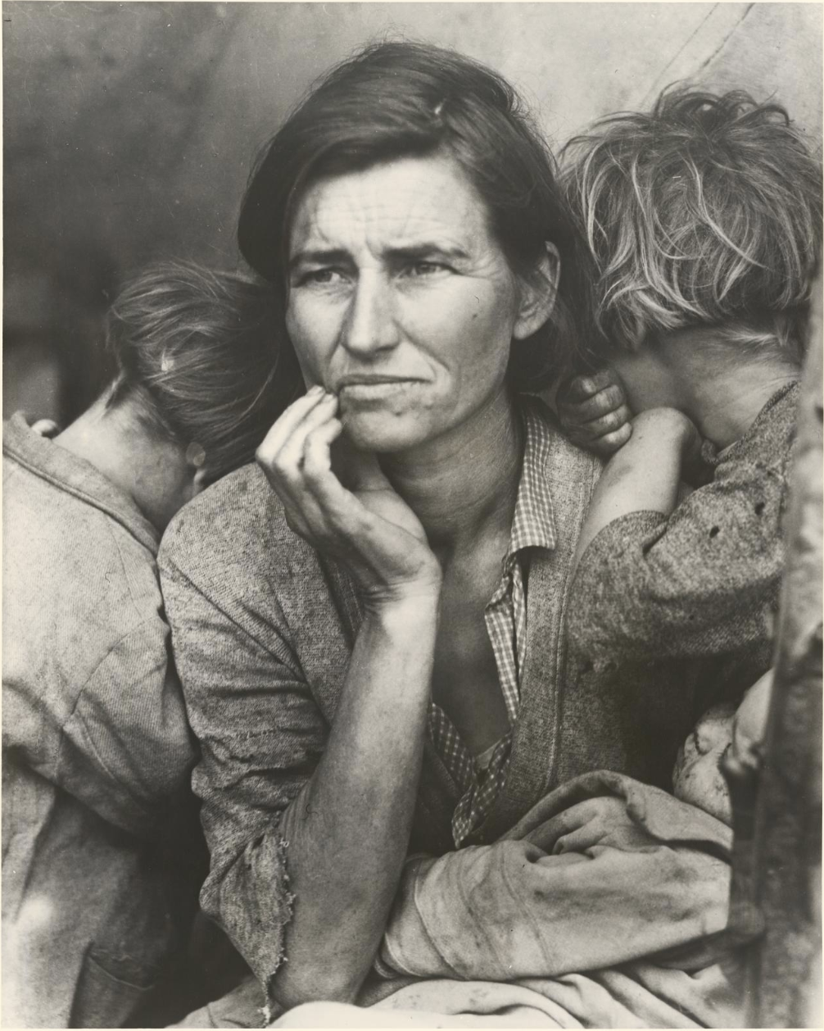
Dorothea Lange (USA)
Empathy
Environmental portraiture
Great Depression
Example: Migrant Mother, California (1936)
Notes:
https://www.ngv.vic.gov.au/explore/collection/work/8153/

Slide 8
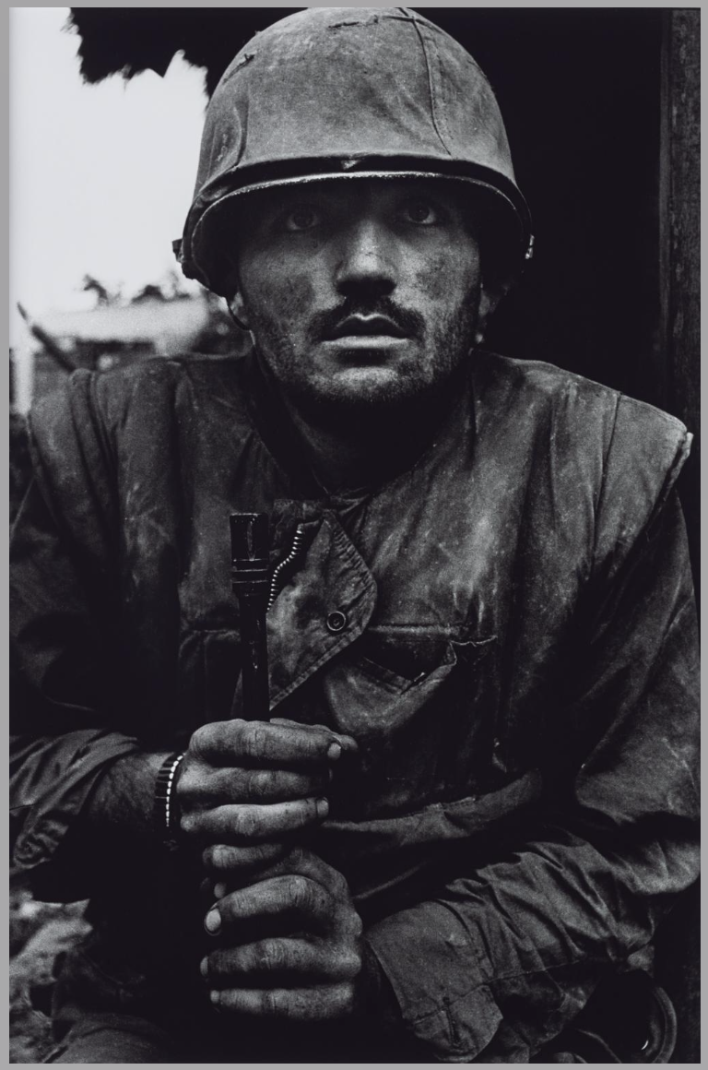
Don McCullin
(UK)
War
Poverty
Moral investigations
Example: Shell-shocked Marine, Hue (1968)
Notes:
https://www.tate.org.uk/art/artworks/mccullin-shell-shocked-us-marine-the-battle-of-hue-ar01201

Slide 9
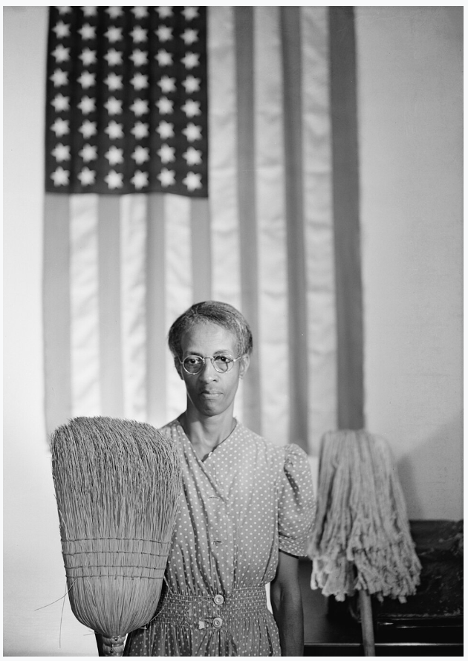
Gordon Parks
(USA)
Race
Inequality
Lyricism in everyday life
Example: American Gothic, Washington DC (1942)
Notes:
https://en.wikipedia.org/wiki/American_Gothic_(photograph)

Slide 10
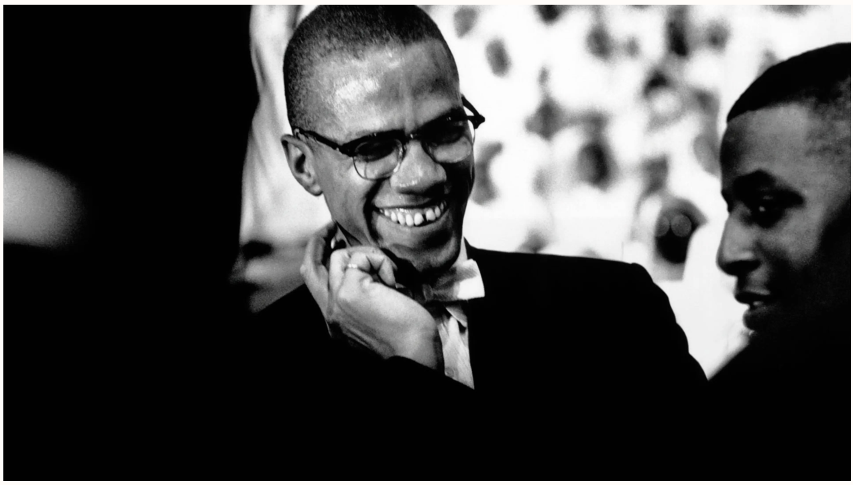
Eve Arnold
(USA)
Politics
Celebrity portraiture
Everyday, unguarded moments
Example: Malcolm X, Chicago (1961)
Notes:
https://time.com/3502682/malcolm-x-and-the-nation-of-islam-eve-arnolds-quietly-powerful-portraits/

Slide 11
Sebastaio Selgado
(Brazil)
Global development
Environmental impact
Indigenous experience
Example: Serra Pelada Mine, Brazil (1986)
Notes:
https://www.theguardian.com/global-development/gallery/2024/feb/08/i-photographed-the-world-the-art-of-sebastiao-salgado-in-pictures

Slide 12
Seminal or Canonical – You Also Might Like:
Walker Evans (USA) – documented American life; eg. Alabama Tenant Farmer Wife
Brassai (Hungary/France) – night photography, urban life; eg. Paris de Nuit
Roman Vishniac (Russia/USA) – prewar Jewish life in Eastern Europe; eg. Children in a Chedar
Arthur ‘Weegee’ Fellig (USA) – crime scene photographer; eg. Their First Murder
Lewis Hine (USA) – child labour and industrial reform; eg. Breaker Boys in a Coal Mine
Erich Salomon (Germany) – candid political photography; eg. League of Nations meetings

Slide 13
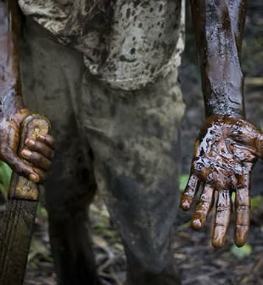
Contemporary Photojournalists
This section highlights photojournalists who are actively working today, responding to current global issues such as conflict, migration, climate change, human rights, and environmental crisis. They are building on the foundations laid by earlier practitioners and adapting to operate in a rapidly changing media landscape of digital publication, social media, and widespread consumption of photography. Many of these photojournalists focus on long-term projects, returning to the same places or communities to tell longer and deeper stories about their subjects. Others collaborate with NGOS and advocacy groups to raise awareness of global issues from the mundane to the consequential.
Environmental and human concerns overlap in Ed Kashi’s series Curse of the Black Gold, documenting 50 years of oil extraction in Niger.

Slide 14
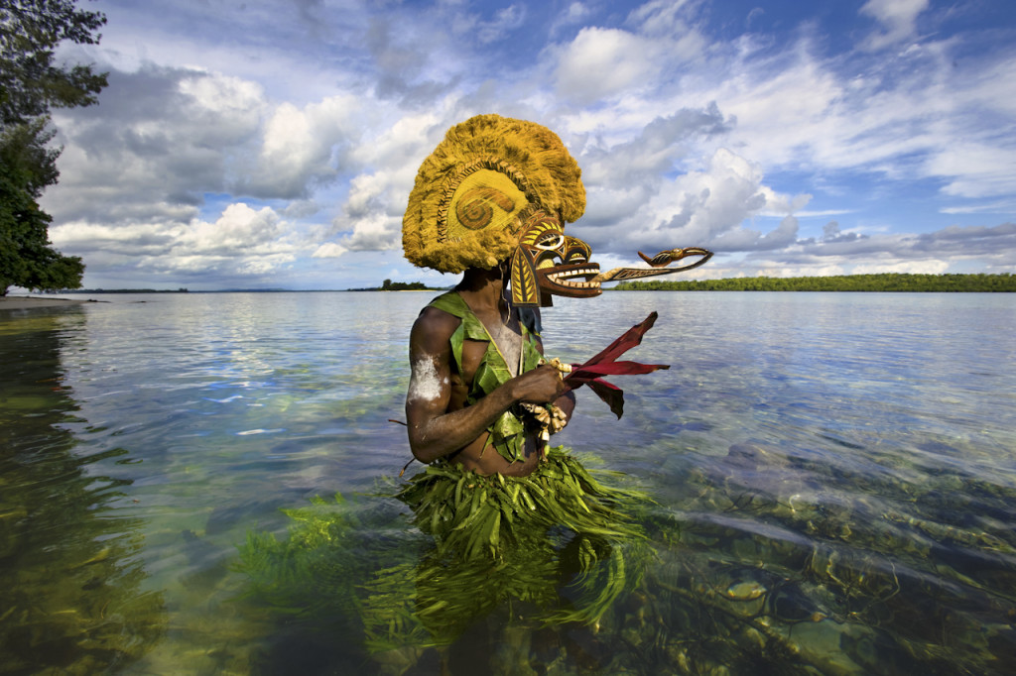
Alison Wright
(USA)
Environment
Cultural preservation
Human lives
Example: Malagan Ceremonial Mask, Papua New Guinea (2010)
Notes:
https://alisonwright.com/collections/human-tribe-global-portraits/

Slide 15
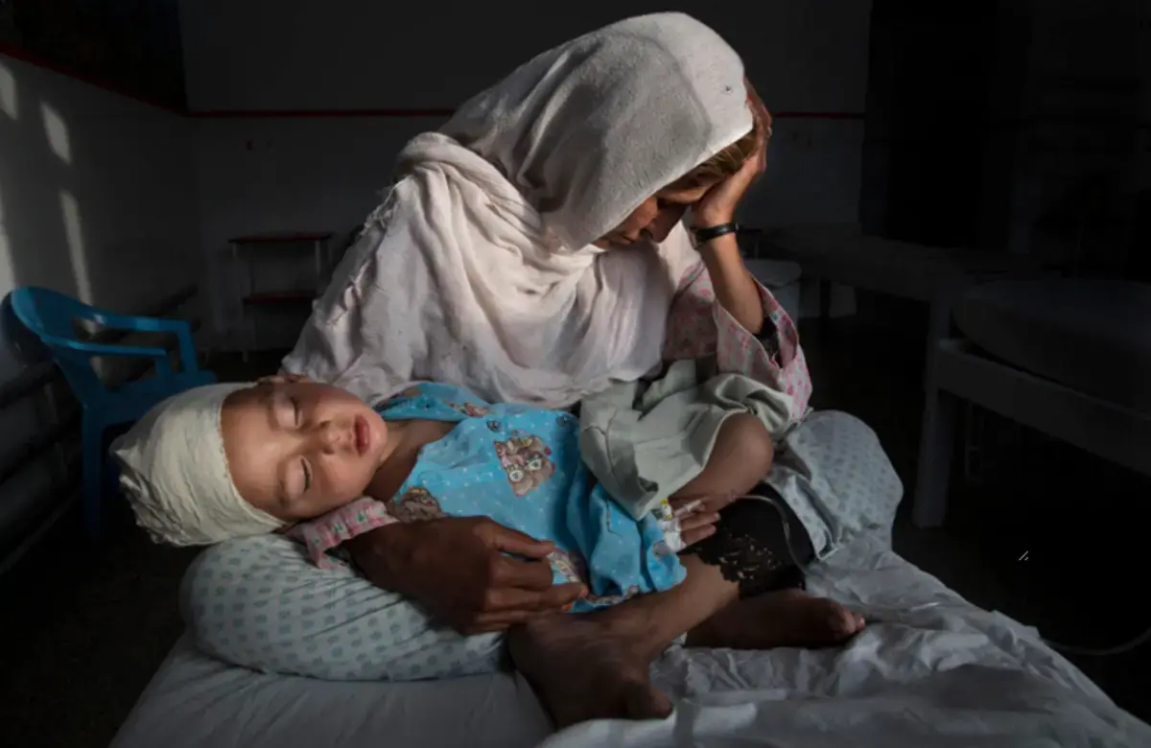
Paula Bronstein
(USA)
Conflict
Gender
Human rights
Example: Afghan Women
Under Taliban Rule, Kabul (2016)
Notes:
https://pulitzercenter.org/stories/paula-bronstein-afghanistans-war-wounded

Slide 16
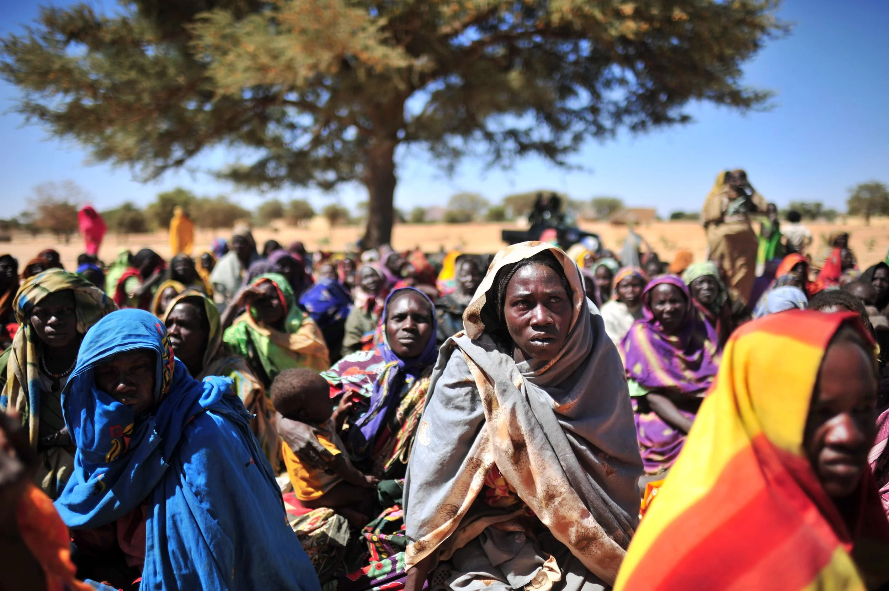
Lynsey Addario
(USA)
War
Displacement
Women in conflict zones
Example: Darfur Refugee Camp, Sudan (2008)
Notes:
https://www.lynseyaddario.com/darfur

Slide 17
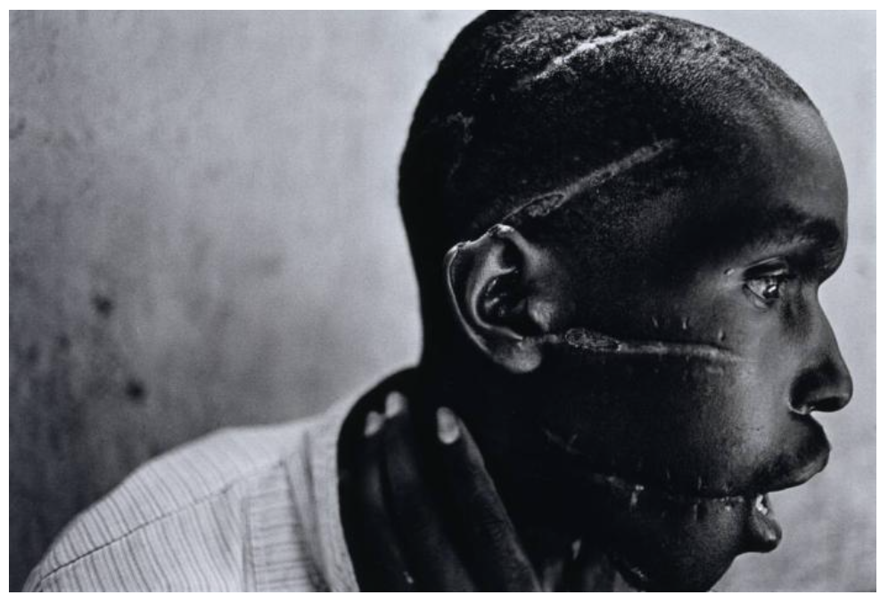
James Nachtwey
(USA)
Conflict
Global health
Witness to history
Example: Survivor of Hutu Death Camps, Rwanda (1994)
Notes:
https://emuseum.mfah.org/objects/53377/survivor-of-hutu-death-camp-rwanda

Slide 18
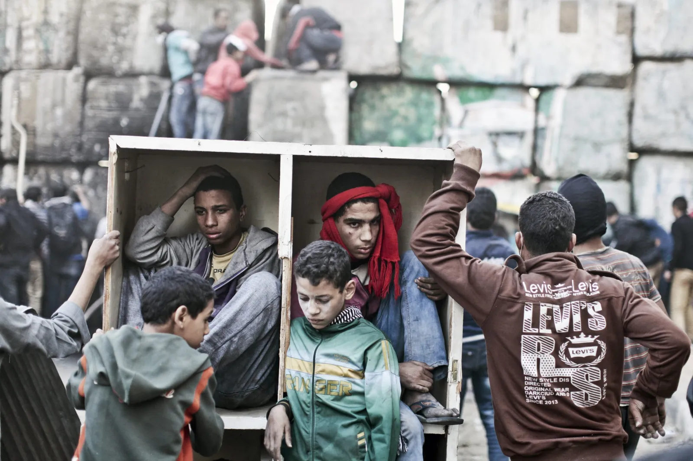
Moises Saman
(Venezuela)
Political upheaval
Protest
Conflict
Example: Tahrir Protesters, Cairo (2013)
Notes:
https://www.newsweek.com/discordia-moises-saman-arab-spring-interview-431012

Slide 19
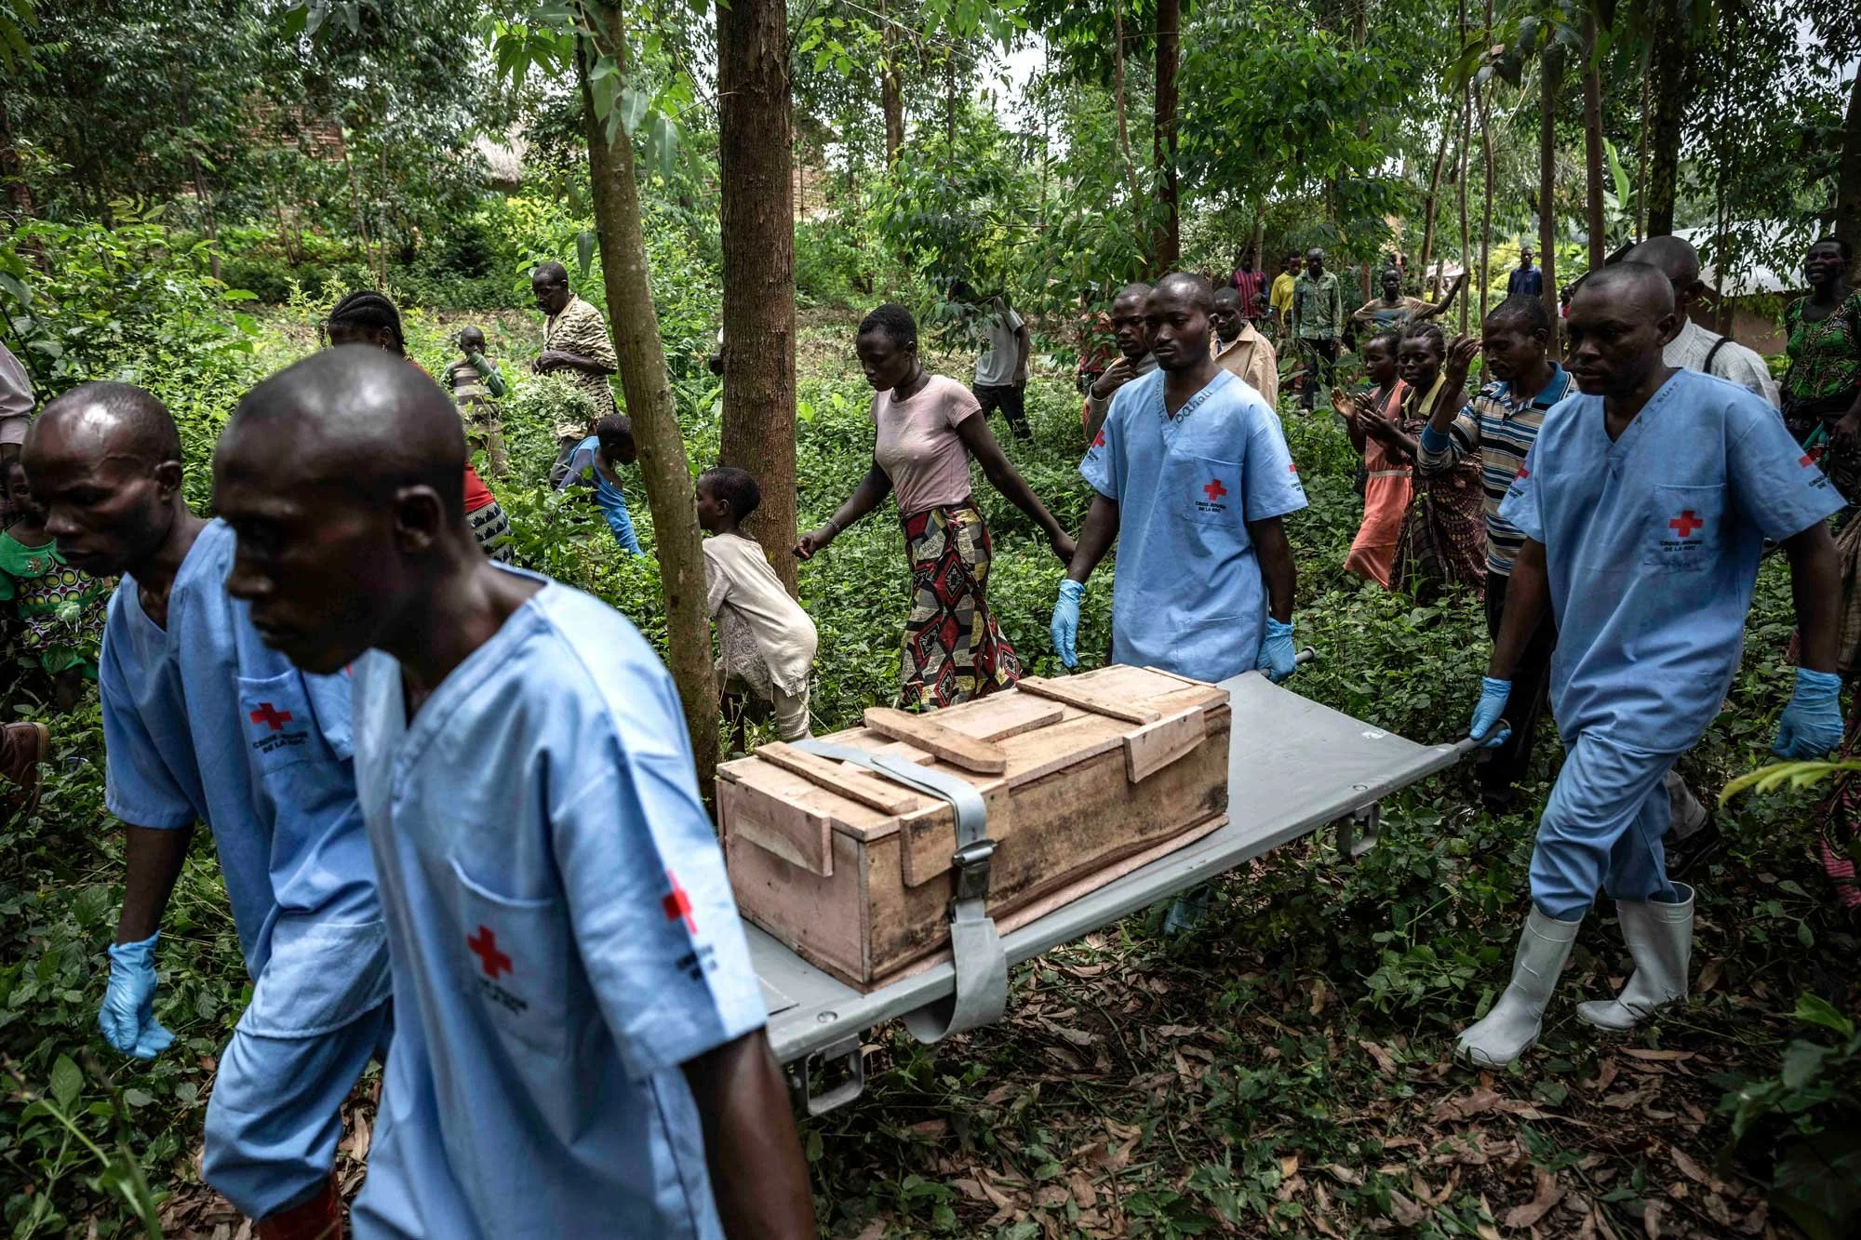
Finbarr O’Reilly
(Ireland)
Conflict
Global health
Resilience
Example: Red Cross Burial, Democratic Republic of Congo (2020)
Notes:
https://www.hot-mirror.com/edition-17/finbarr-oreilly

Slide 20
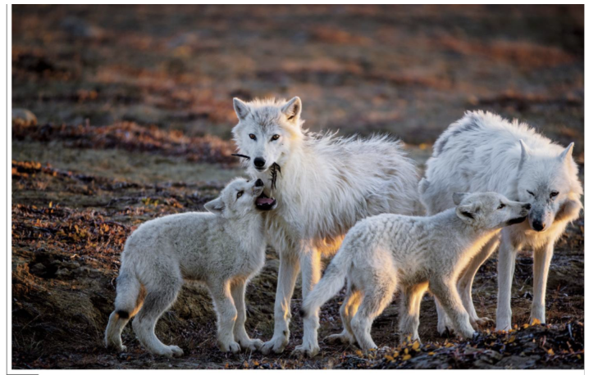
Ronan Donovan
(USA)
Wildlife
Conservation
Impact of climate change
Example: Arctic Wolves, Canada (2019)
Notes:
https://ronandonovan.squarespace.com/arctic-wolves-1

Slide 21
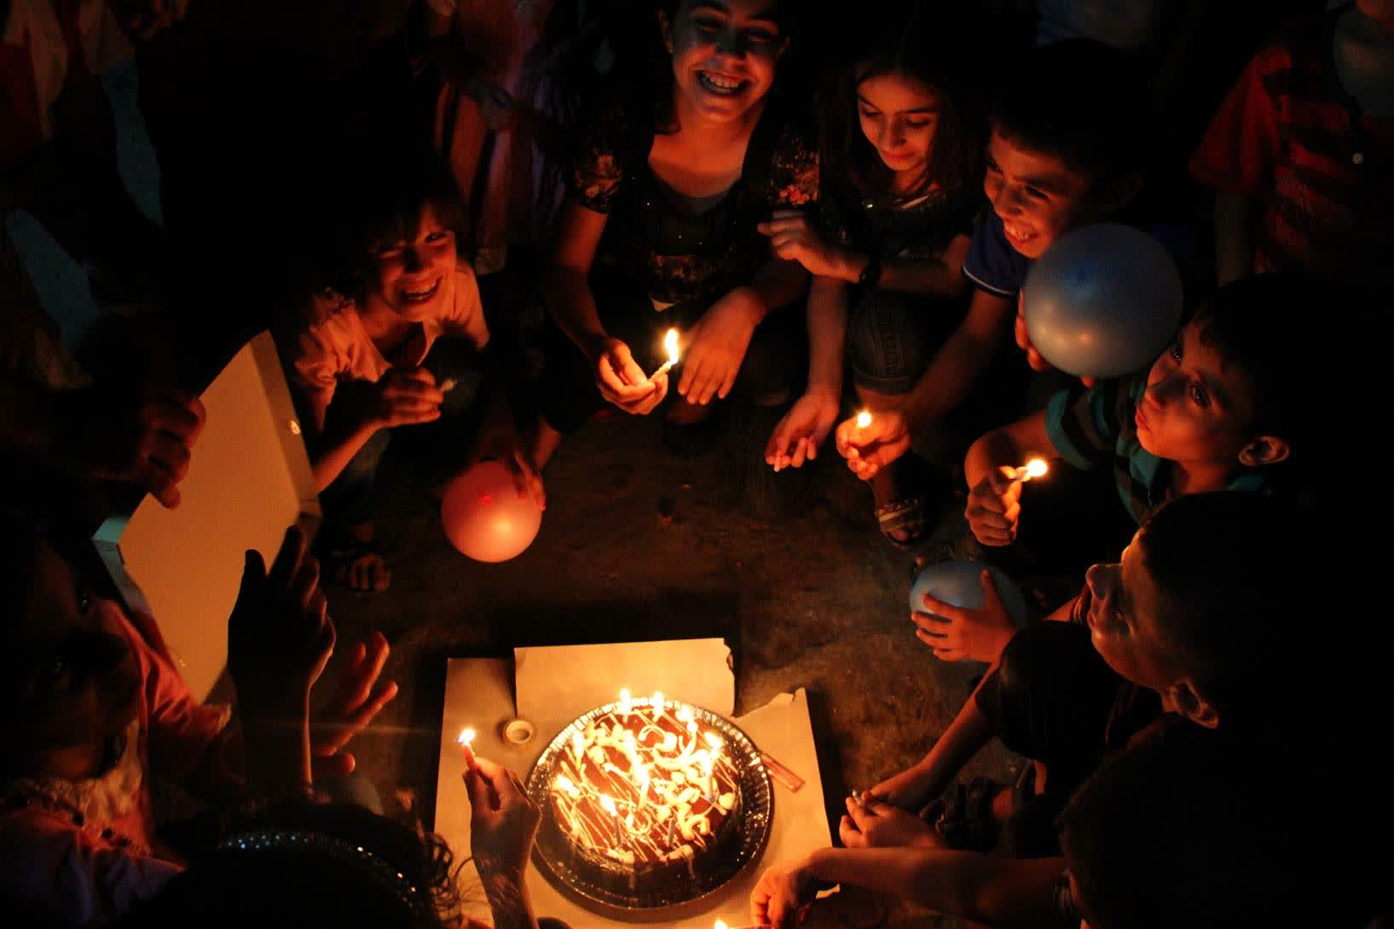
Samar Abu Elouf
(Palestine)
Civilian life in wartime
Family
Intimate moments
Example: Birthday at the Al-Shati refugee camp, Gaza (2012)
Notes:
https://ronandonovan.squarespace.com/arctic-wolves-1

Slide 22
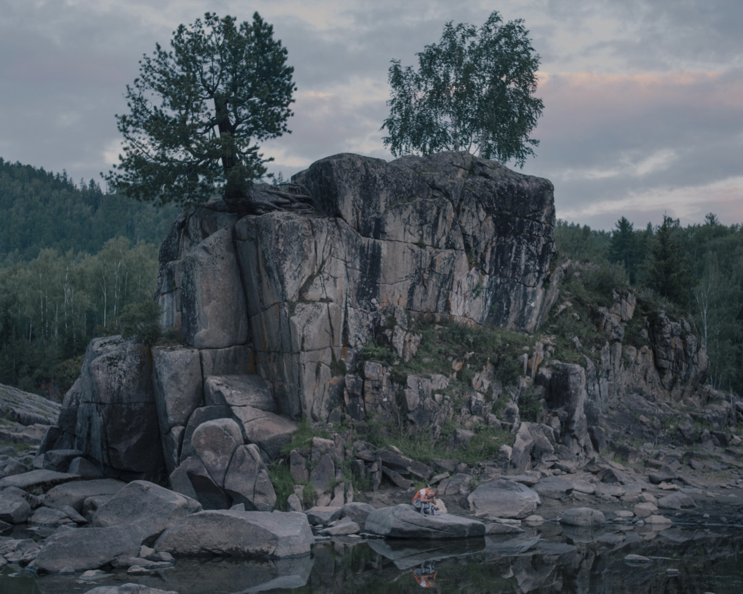
Nana Heitmann
(Germany)
Social and geographical isolation
Identity
Environmental portraiture
Example: Vaselia in the Old Believer village, Siberia (2018)
Notes:
https://www.magnumphotos.com/arts-culture/society-arts-culture/hiding-from-baba-yaga-russia-folklore-nanna-heitmann/

Slide 23
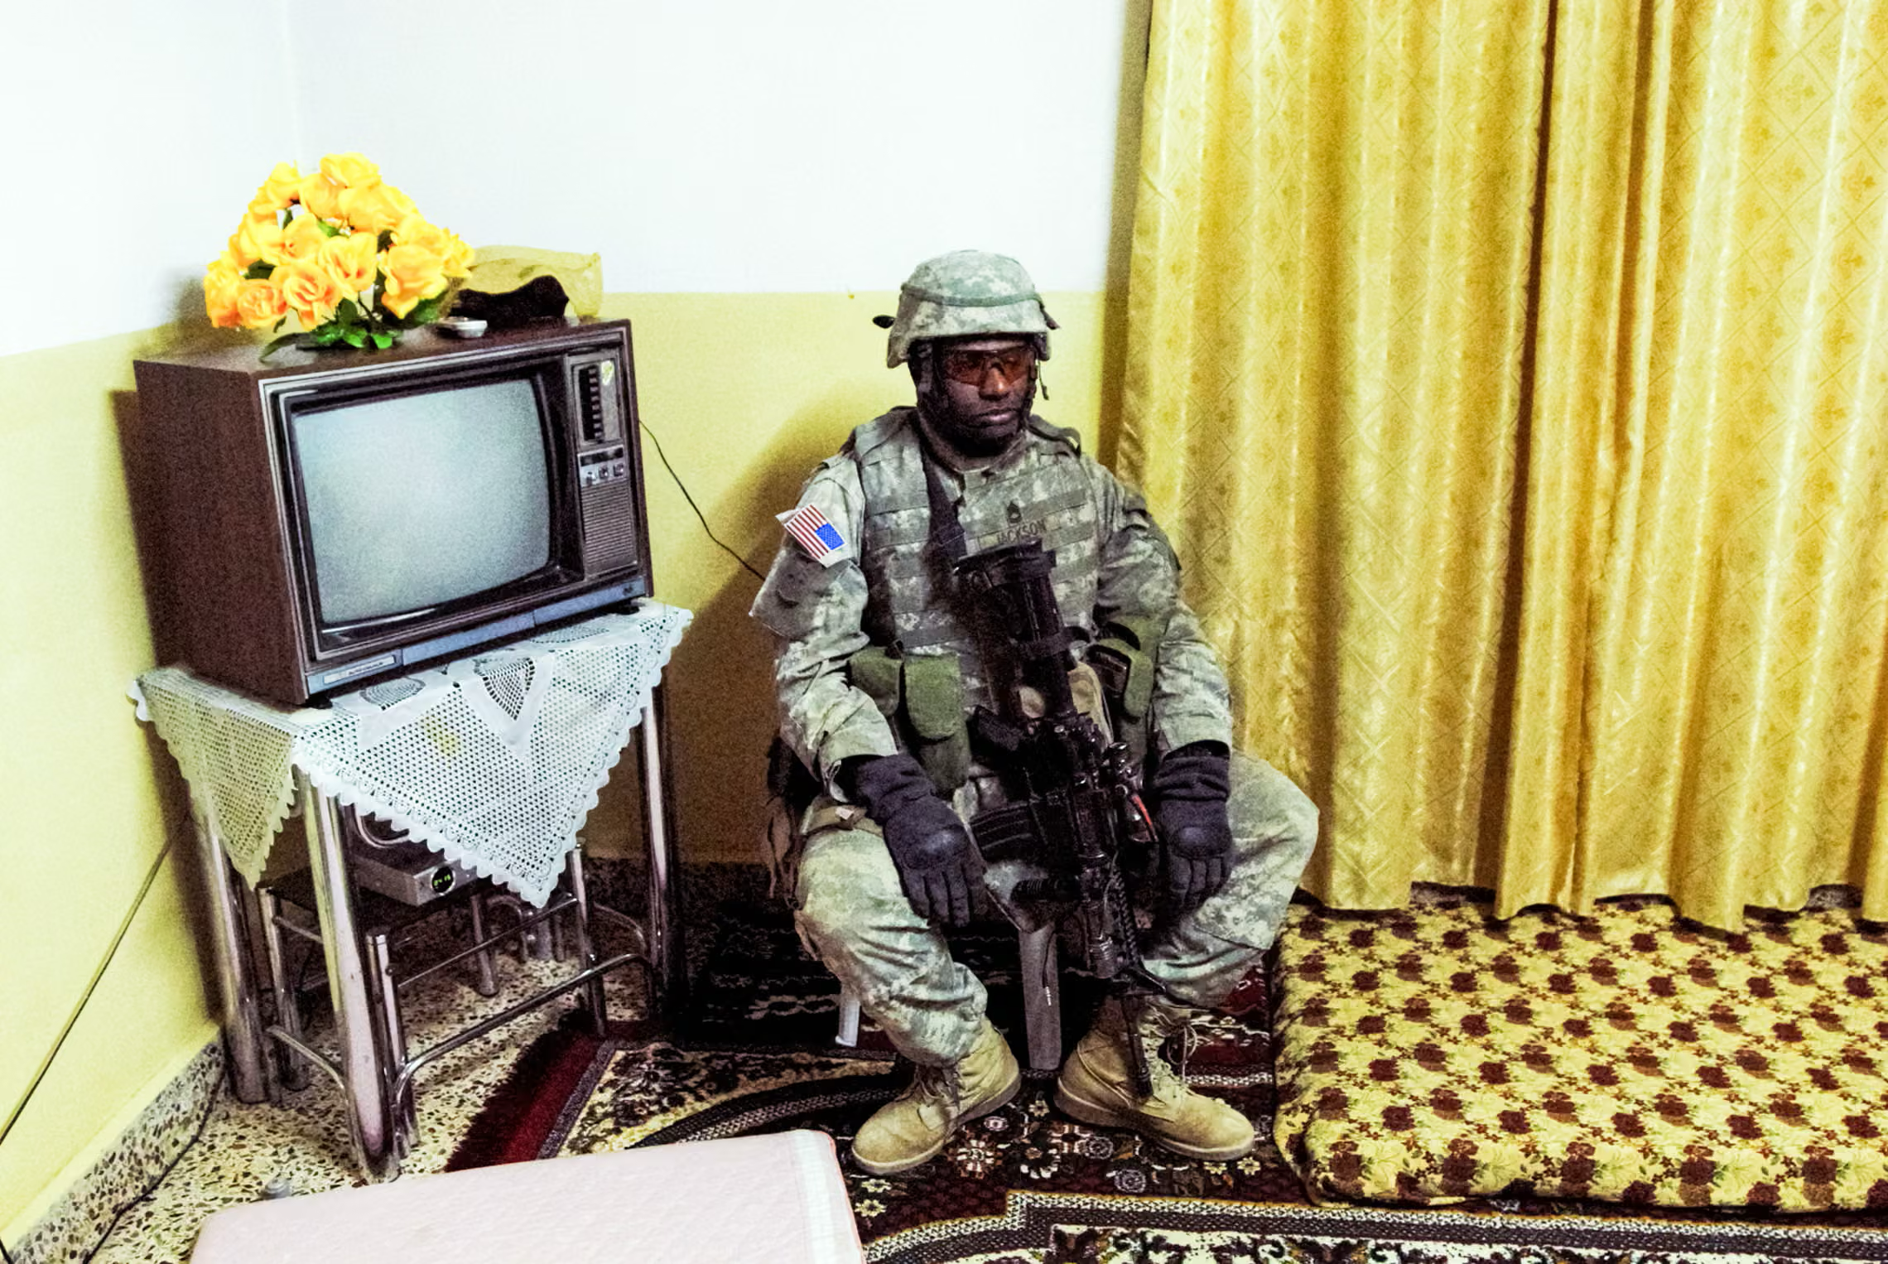
Peter van Agtmael
(USA)
War experience
Veterans and returning soldiers
National identity
Example: Night Raid, Iraq (2008)
Notes:
https://www.theguardian.com/artanddesign/2026/mar/25/absurdity-of-war-peter-van-agtmaels-best-photograph-us-soldiers-iraq

Slide 24
Contemporary – You Also Might Like:
Muhammed Muheisen (Jordan) – documented refugee crises; eg. Syrian Refugee Children
Ed Kashi (USA) – global health and the environment; eg. Curse of the Black Gold
Tamara Merino (Chile) – cultural traditions and rituals; eg. Underland
Pieter Hugo (South Africa) – images of post-colonial Africa; eg. The Hyena and Other Men
Ashley Gilbertson (USA) – aftermath and consequences of war; eg. Bedrooms of the Fallen

Slide 25
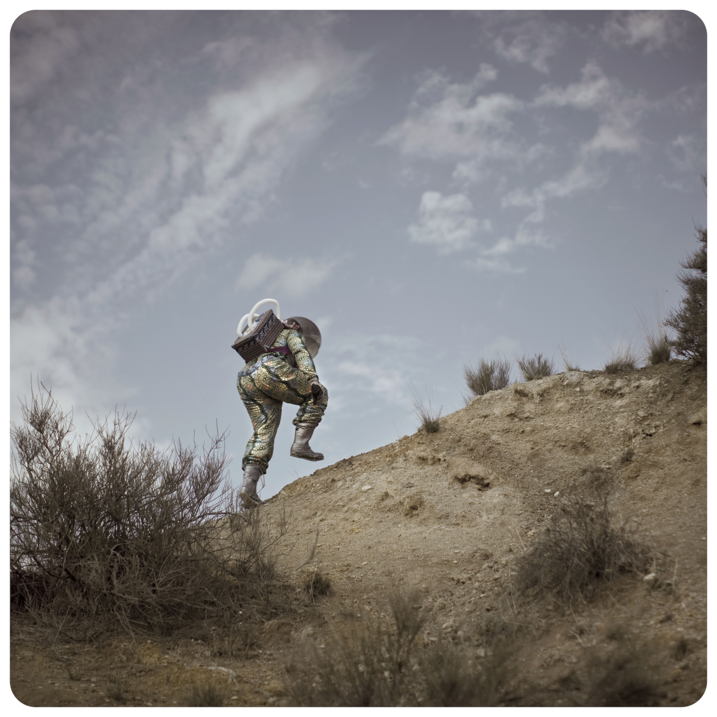
Diverse, Global, or Under-represented Photojournalists
The photographers in this section broaden the understanding of who tells stories and from what perspective. Coming from a wide range of cultural and geographical backgrounds, these photojournalists often work alongside the communities they photograph. Their images challenge our assumptions about who can tell stories, and what stories can be told at all. Others challenge notions of neutrality or intimacy, getting uncomfortably close to their subjects, occasionally raising ethical questions. While some use tried and tested photography methods, others blend photojournalism with more experimental techniques, blurring the boundary between photography and art, and between objective and subjective reality.
Cristina de Mittel’s series The Afronauts uses photography to imagine an alternate reality, forcing us to ask questions about our real world.

Slide 26
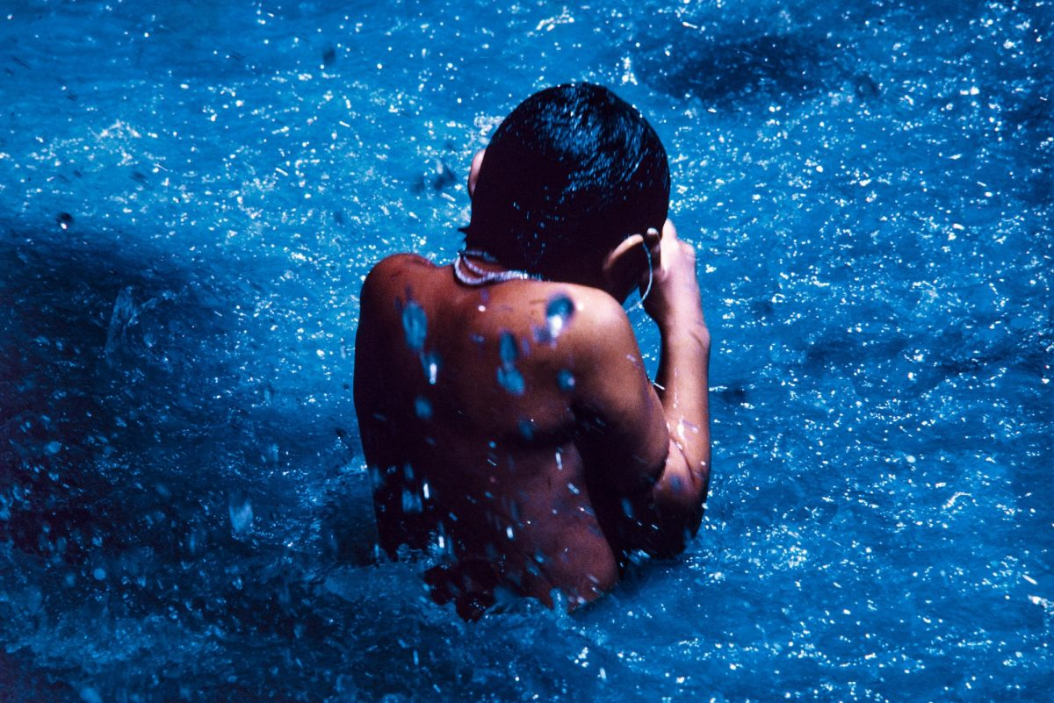
Claudia Andujar
(Brazil)
Indigenous rights
Total immersion
Advocacy
Example: The Yanomani Struggle, Brazil (1970s)
Notes:
https://doorofperception.com/2021/02/claudia-andujar-the-yanomami-struggle/

Slide 27
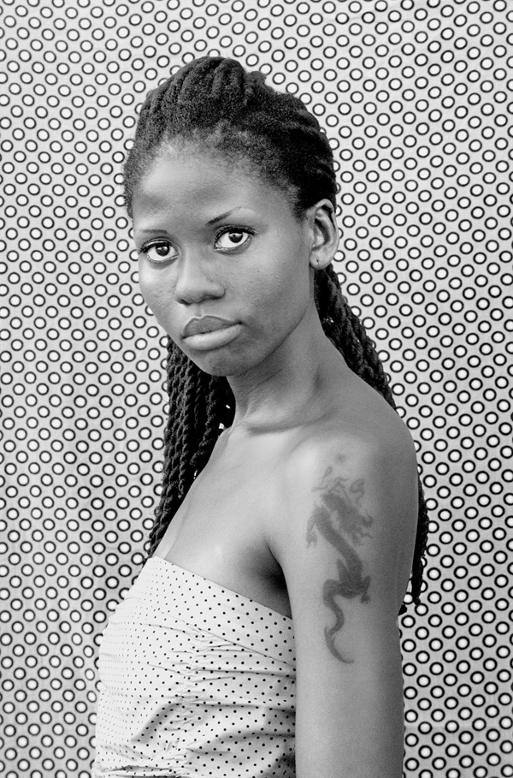
Zanele Muhoni
(South Africa)
Social activism
LGBTQ+
Portraiture
Example: Lesidi Modise, Mafikeng (2010)
Notes:
https://aperture.org/editorial/magazine-zanele-muholis-faces-phases/

Slide 28
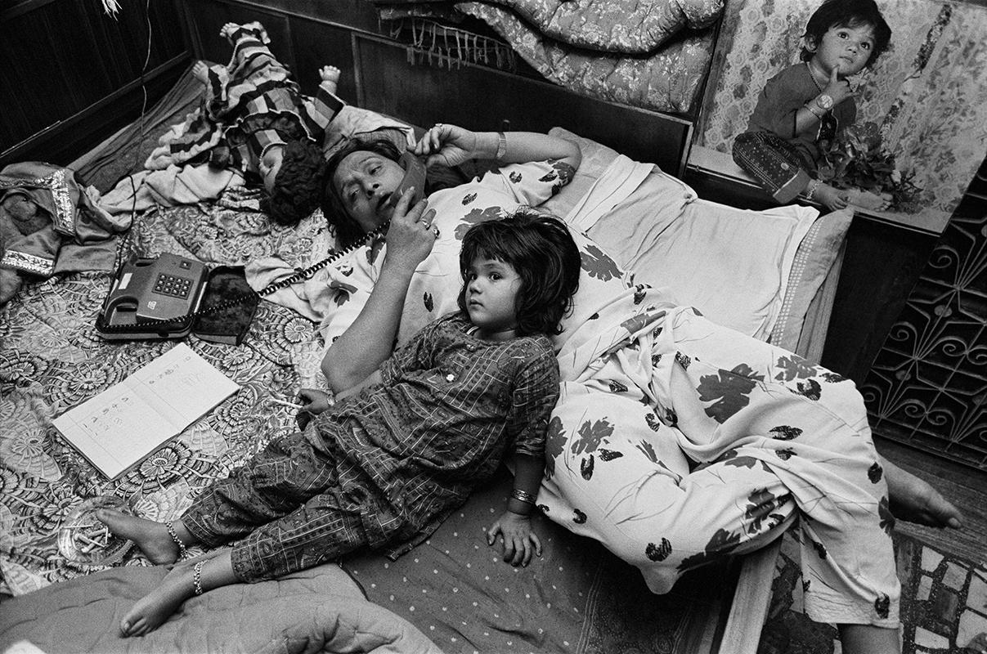
Daniyita Singh
(India)
Identity
Hijira (third-gender) communities
Everyday moments
Example: Myself Mona Ahmed (1992)
Notes:
https://www.frieze.com/article/myself-mona-ahmed-revisiting-dayanita-singhs-landmark-photobook

Slide 29
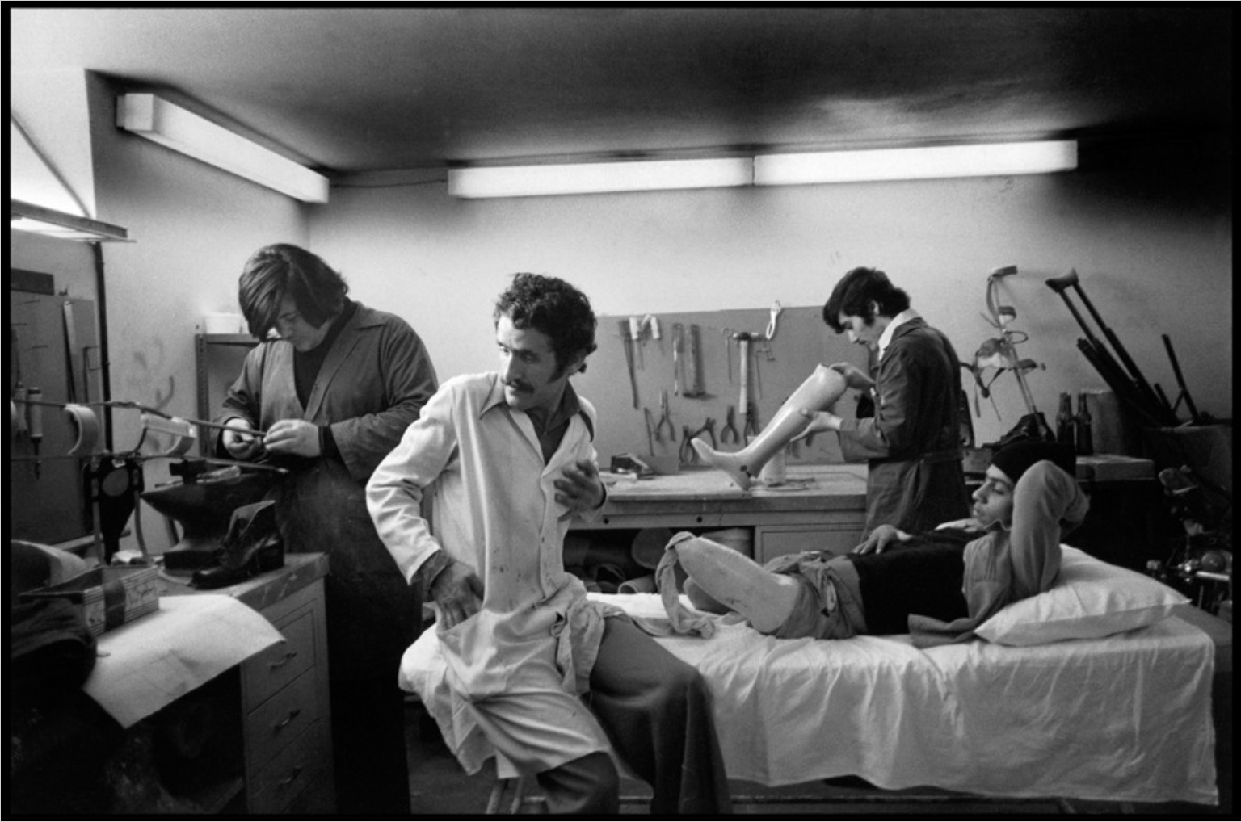
Abbas Attar
(Iran/France)
Societies in conflict
Religion
Tradition vs modernity
Example: Artificial Leg, Beirut (1977)
Notes:
https://www.blind-magazine.com/stories/abbas-the-eye-of-men-and-gods/

Slide 30
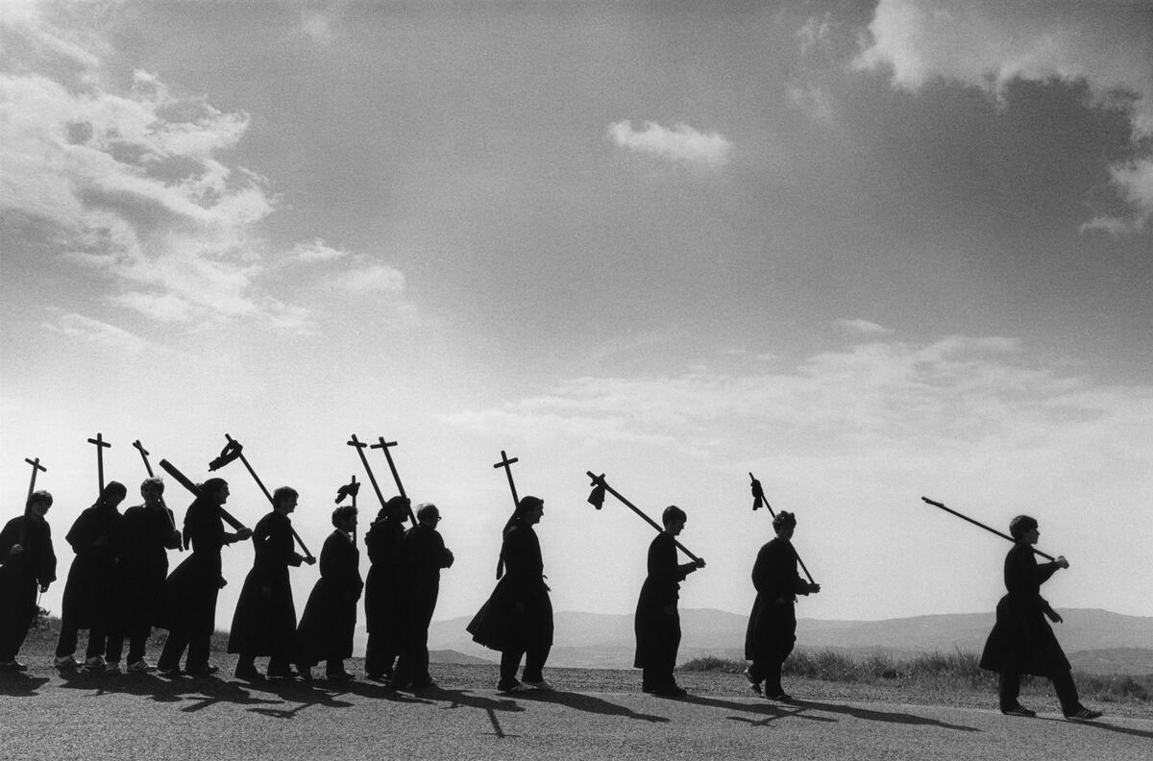
Cristina Garcia
Rodero (Spain)
Tradition
Ritual
Collective identity
Example: Espana Occulta, Spain (1980)
Notes:
https://www.magnumphotos.com/arts-culture/a-closer-look-at-espana-oculta/

Slide 31
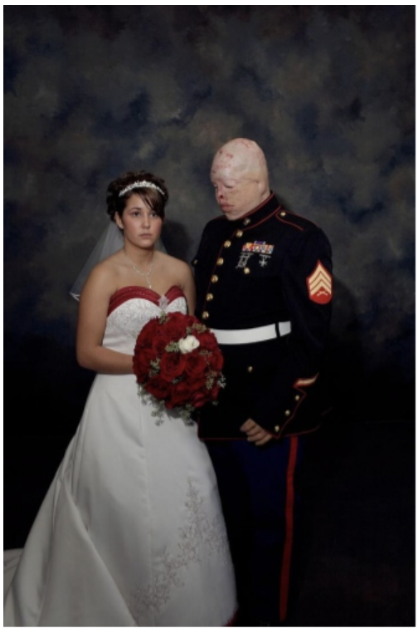
Nina Berman
(USA)
Militarism
Trauma
American identity
Example: Marine Wedding, Illinois (2006)
Notes:
https://www.ninaberman.com/marine-wedding

Slide 32
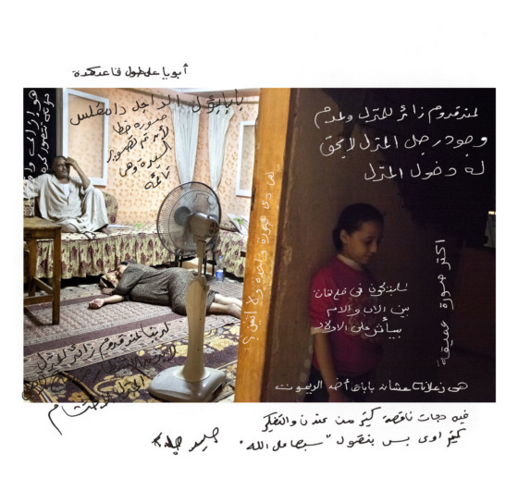
Bieke Depoorter
(Belgium)
Subjectivity of photography
Intimacy and access
Astronomy
Example: Egypt, Cairo (2012)
Notes:
https://www.magnumphotos.com/arts-culture/as-it-may-be-bieke-depoorter/

Slide 33
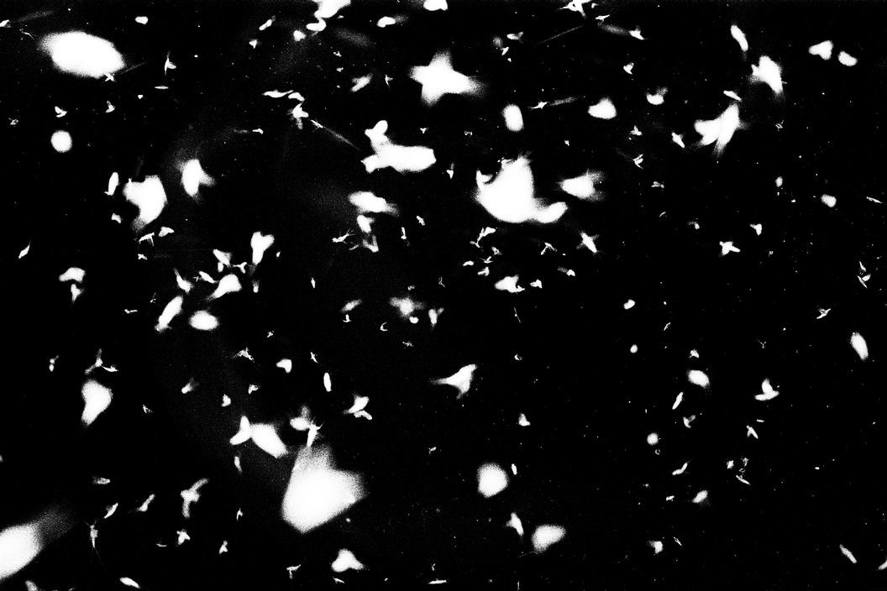
Sohrab Hura
(India)
Experimental
Fragmented imagery
Surreality
Example: Moths, Cambodia (2011)
Notes:
https://www.magnumphotos.com/arts-culture/art/sohrab-hura-life-is-elsewhere/

Slide 34
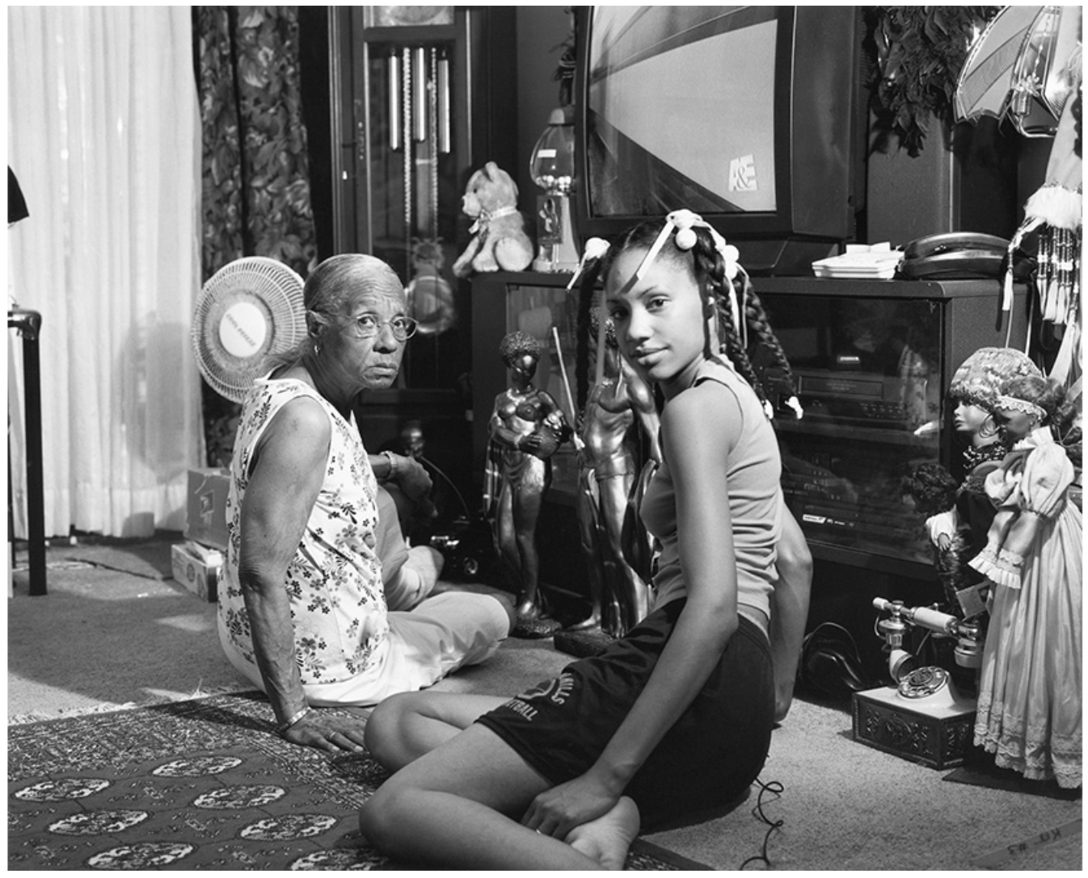
LaToya Ruby Frazier
(USA)
Race
Family
Community advocacy
Example: The Notion of Family (2014)
Notes:
https://latoyarubyfrazier.com/news/latoya-ruby-frazier-raises-her-lens-against-environmental-racism-and-healthcare-inequity-in-america/

Slide 35
Diverse, Global, Under-represented – You Also Might Like:
Samuel Aranda (Spain) – images from the Arab world; eg. Mother and Son, Yemen
Shahidal Alam (Bangladesh) – social justice and activism; eg. Workers and Protests in Bangladesh
Chien-Chi Chiang (Chinese Taiwan/USA) – mental health and migration; eg. China’s Laogai
Federico Rios (Columbia) – documentation of human migration; eg. El Camino
Tasneen Alsultan (Saudi Arabia) – youth identity in Saudi Arabia; eg. Saudi Tales of Love
Cristina de Middel (Spain) – questioning truth and reality through photography; eg The Afronauts

Slide 36
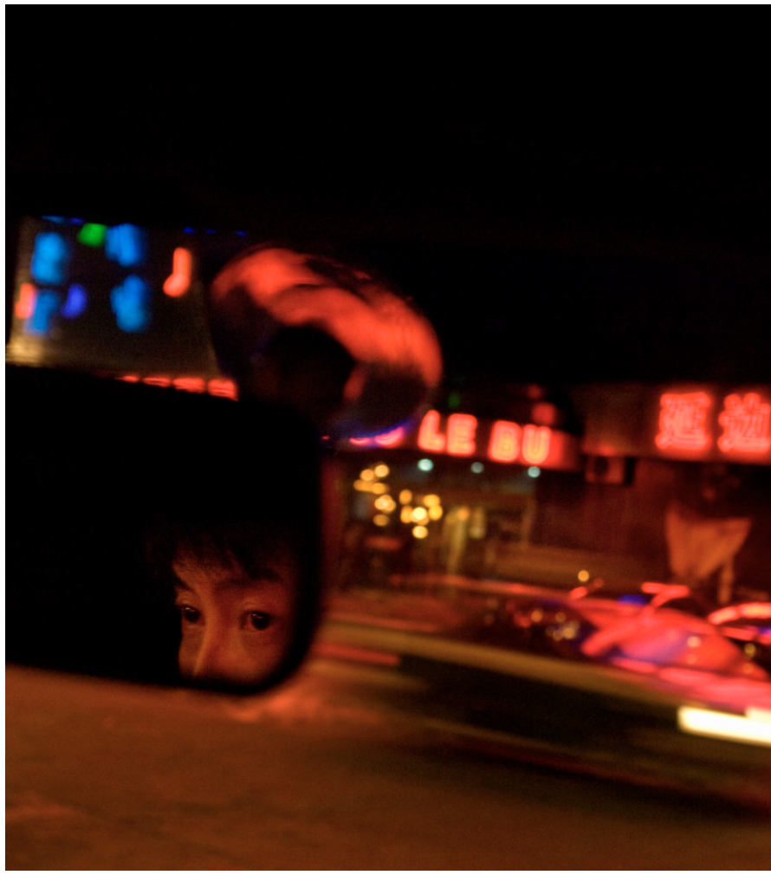
Activity: Research and Presentation
Research a photojournalist and see what discoveries you can find. For example, here’s an image from Chien-Chi Chiang’s photo-essay Escape from North Korea. There are 12 images in this collection, making it a perfect Body of Work to add to your collection and to speak about in your Individual Oral, should you choose.
Choose a photojournalist to research further. Where are they from? Where are they working? What issues are they determined to uncover through photojournalism? Find their wider bodies of work and discover the themes and stories they are telling.
Create a collage of images that you think define their work, and select an image that showcases their personal style or photographic techniques. Use these resources to support a 5-minute presentation back to the class.
If you want to make your presentation more formal, or practice your Individual Oral presentation skills, use a mini-IO rubric to help you structure your talk.
Notes:
https://www.magnumphotos.com/newsroom/politics/chien-chi-chang-escape-from-north-korea/

