Slide 1
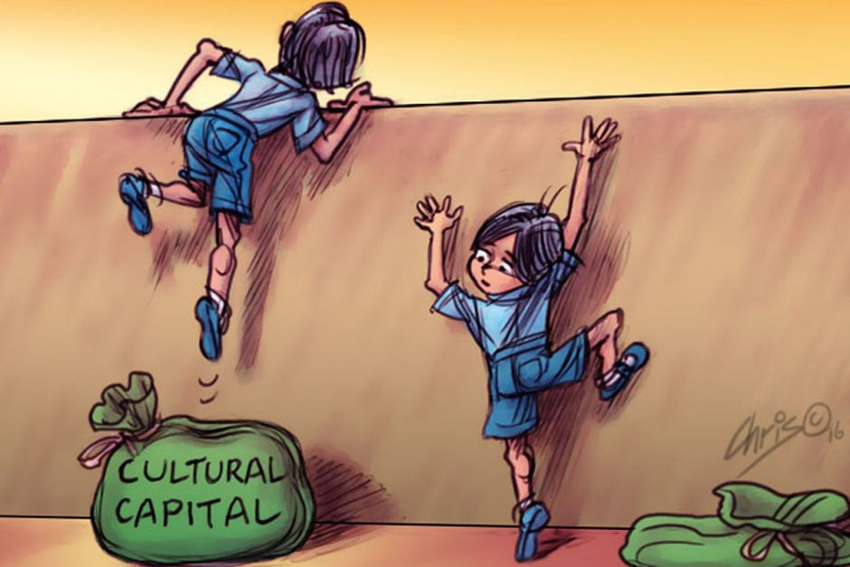
Language and Cultural Capital
How Accent and Register Influence Social Judgment

Slide 2

Introduction
Language is a social asset. The way we choose to speak and our accents can signal education, class, and privilege. Certain accents and vocabulary carry prestige, while others may be unfairly stigmatized, shaping how people are perceived in schools, workplaces, and wider society. These linguistic markers act as cultural capital, influencing opportunities and reinforcing social hierarchies.
Sociolinguists have shown how language variation reflects social class, while Pierre Bourdieu (pictured) introduced the concept of cultural capital to explain how linguistic practices can grant or restrict access to power.

Slide 3
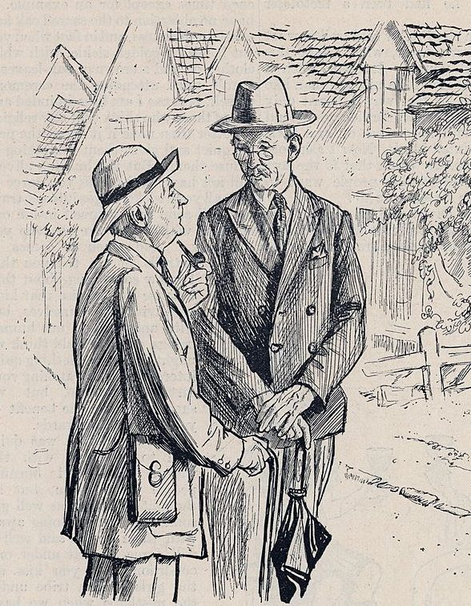

Prestige Accents
In the UK, Received Pronunciation (RP) is historically linked with the upper class and elite education (e.g. Oxford/Cambridge). By contrast, accents like Cockney or Scouse are frequently stereotyped as working-class. Research involving over 800 participants rating 38 British accents over 50 years confirms that RP consistently ranks highest in prestige and perceived pleasantness, while regional accents such as Birmingham, Afro-Caribbean, Indian, and Liverpool (Scouse) are rated lowest.
https://www.cambridge.org/elt/blog/2022/05/25/received-pronunciation-old-new/
Notes:
Click the audio file to hear this slide read aloud in an RP accent

Slide 4
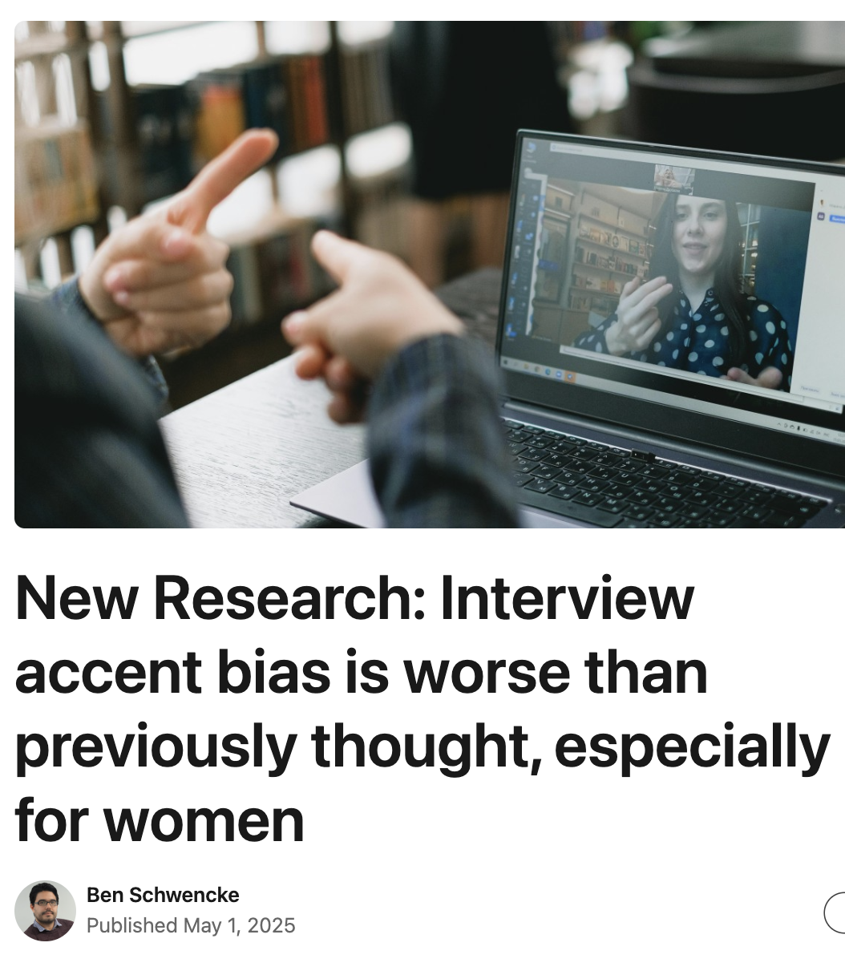
Accent Bias
In mock job interviews conducted in the UK, speakers with non-standard accents were judged less suitable for certain roles; this persists even when evaluators hear formal content. A meta-analysis across 7,596 participants found that individuals with non-standard accents were rated significantly lower in employability.
https://www.linkedin.com/pulse/new-research-interview-accent-bias-worse-than-thought-ben-schwencke-1baze
Notes:
Click the audio files to hear this slide read in a British Indian accent and a Geordie accent

Slide 5
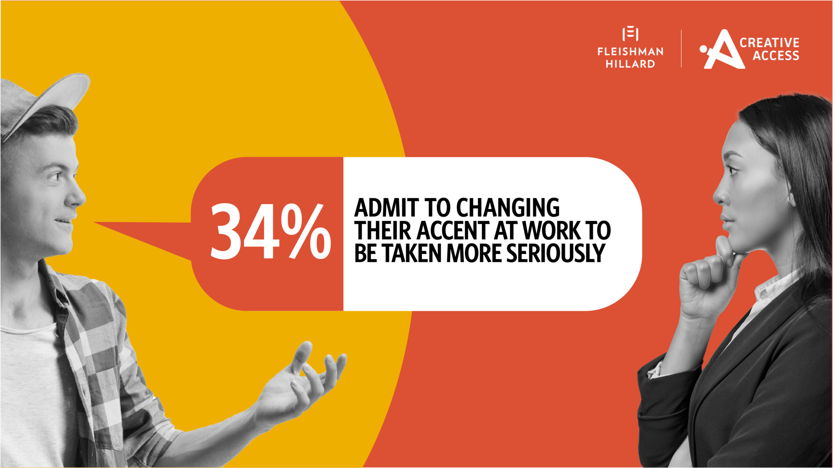
Accent Discrimination
Accent discrimination is a significant barrier to social mobility, with studies in Britain showing that around 30% of university students and applicants and 25% of professionals have been mocked or singled out because of their accent. This bias is closely tied to socioeconomic background, as regional or working-class accents (like Scouse or Brummie) are often stereotyped as less educated or competent. Such perceptions can influence hiring decisions, academic success, and career progression, leading individuals to feel pressure to modify their speech or avoid certain professions.
https://fleishmanhillard.co.uk/2023/02/accent-bias-language-discrimination-creative-industries/
Notes:
Click the audio file to hear this information read aloud in a Glaswegian accent

Slide 6

Accent Pigeonholing
Certain accents are perceived as better suited for specific roles based on stereotypes of trustworthiness, friendliness, or authority. For example, in the UK, Received Pronunciation (RP) is often associated with education and credibility, making it common in professions like law, broadcasting, or politics. Conversely, accents considered warm and approachable, such as some West Country or Irish accents, are often favoured in customer service or hospitality roles because they are perceived as friendly and reassuring. These preferences are not based on linguistic ability but on social attitudes, which can influence hiring decisions and reinforce inequality.
In a 2002 survey, Yorkshire was found to be the most ‘trustworthy’ accent, perhaps explaining it’s outsized presence in customer service (https://www.countryliving.com/uk/news/a34435560/most-trustworthy-accent-uk/)

Slide 7
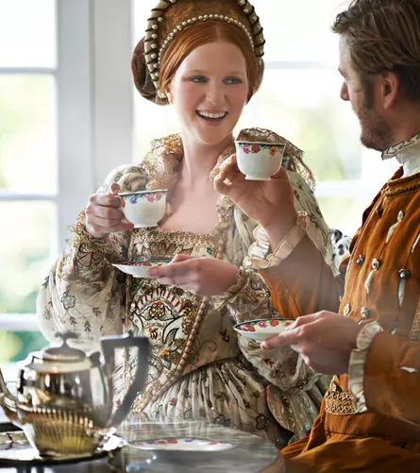
Prestige Vocabulary
Certain words and expressions carry social value because they are associated with education, refinement, or high-status groups. These words often originate from Latin or French roots, which historically entered English through law, government, and academia. For example, “commence” instead of “start”, or “terminate” instead of “end”. In professional settings, phrases like “endeavour to optimize” sound more prestigious than “try to make better”, even though the meaning is similar. Using such vocabulary often signals sophistication and authority.
https://www.thoughtco.com/linguistic-prestige-1691533

Slide 8

Register and Hedging
The level of formality in language often signals social relationships and power dynamics. Politeness strategies (such as indirectness or ‘hedging’) can indicate respect, deference, or authority. In formal contexts, speakers tend to use a high register with elaborate structures and polite forms. For example, in a business meeting, someone might say: “Would you mind if I shared a few observations regarding the proposal?”, ‘hedging’ the request and conveying professionalism. By contrast, in an informal setting among friends, the same idea might be expressed as: “Can I say something about the plan?” This is more direct, uses simpler vocabulary, and lacks hedging.

Slide 9
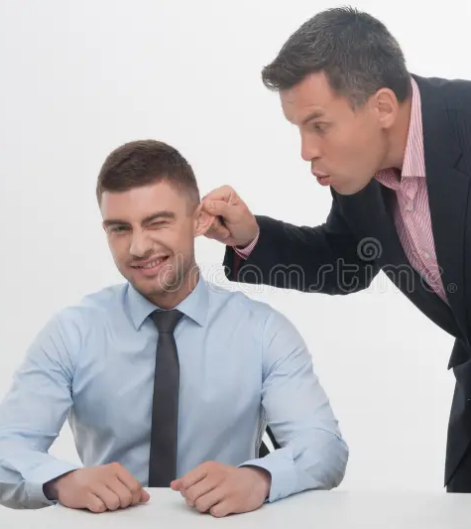
Politeness
Politeness varies with status. A junior employee addressing a manager might say: “I was wondering whether it might be possible to adjust the deadline a little,” with indirect phrases signalling deference. Meanwhile, the manager might respond more directly: “We’ll move the deadline to Friday,” reflecting his or her authority and confidence.

Slide 10

Media Amplification
Media perpetuates accent bias by consistently linking certain accents to specific traits and social classes. Films and television often cast Received Pronunciation (RP) for characters who are intelligent and authoritative while regional accents like Cockney or Scouse are portrayed as working-class, humorous, or criminal. News broadcasting historically favoured RP or ‘neutral’ accents as the standard of professionalism, implying that other accents lack credibility. Advertising reinforces this hierarchy by using RP for luxury brands to signal prestige and regional accents for customer service to convey friendliness. These patterns normalize the idea that some accents are inherently superior or more trustworthy, shaping public attitudes and influencing real-world hiring practices.
A surprising number of actors with a distinctive ‘Yorkshire lilt’ win prestige parts in media and entertainment (https://inews.co.uk/culture/television/yorkshire-took-over-entertainment-world-81910?srsltid=AfmBOorPKfrjCEUft-AyVvrNyuZbUOS3U5Dj2-GjDbqpeqhVsebqWUjj

Slide 11
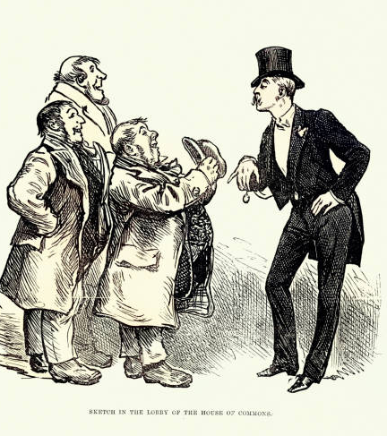
Conclusion
Accent interacts with vocabulary and register to shape social perception. Accent sets an immediate impression of region and class, while vocabulary reinforces or challenges that image. For instance, Received Pronunciation (RP) paired with prestige words like “commence” signals education and authority, whereas a regional accent using the same vocabulary may sound incongruous. Formal phrasing (“Would you be so kind…”) amplifies status, while informal language is more approachable. Add politeness into the mix to convey deference or confidence. For instance, a Glaswegian accent saying “I was wondering if you could help me out” sounds polite but may still be perceived as less formal than an RP accent asking the same thing. Together, the sound of a voice and the speaker’s use of words influence judgments of people’s competence, intelligence, and status.

Slide 12
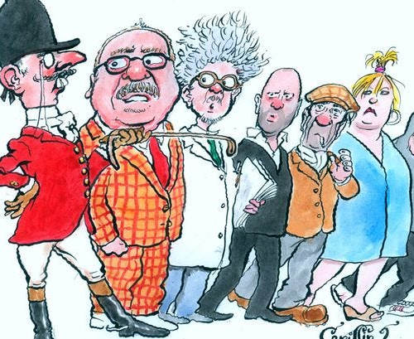
Activity: Accents and Associations
Over the next few slides, you’ll hear clips with different accents and language styles. For each clip, jot down one or two words or phrases you instinctively associate with the voice. For example, do you think: educated, trustworthy, friendly, funny, intimidating, professional, and so on? Afterward, compare your responses: which accents were linked to authority? Which sounded approachable? How did accent and language use influence your impressions?
https://aaronguthrie.medium.com/the-representation-of-class-in-contemporary-british-film-and-tv-afc5882dd7d3

Slide 13
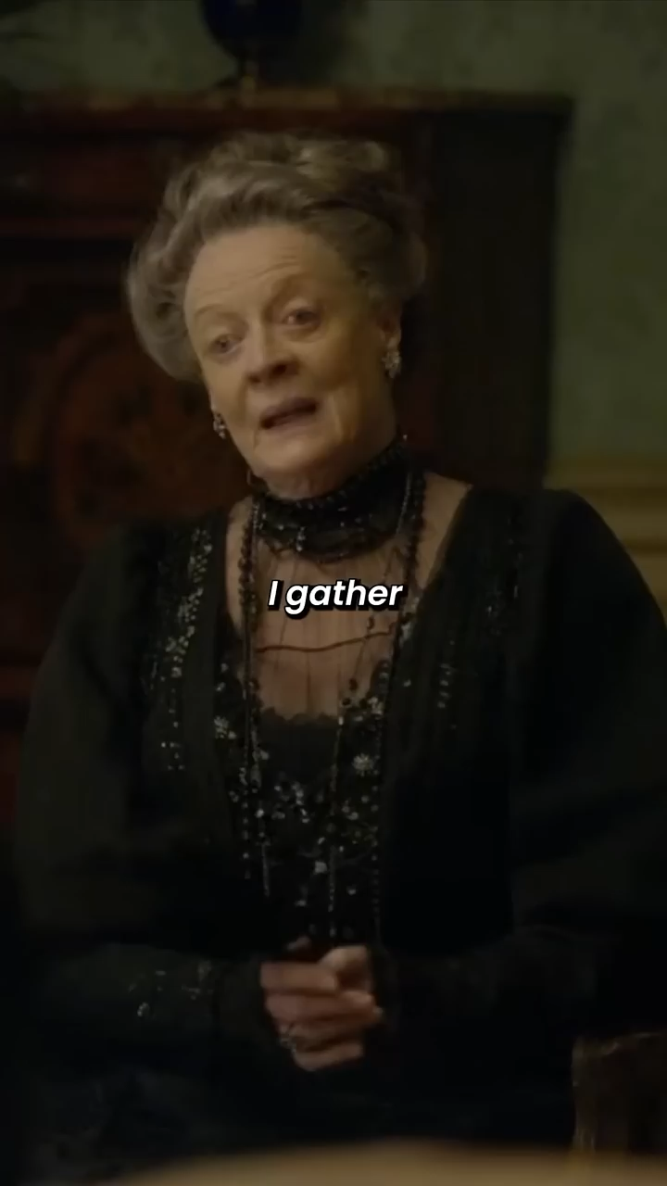
Received Pronunciation (RP)

Slide 14

Liverpool (Scouse)

Slide 15

Newcastle (Geordie)

Slide 16
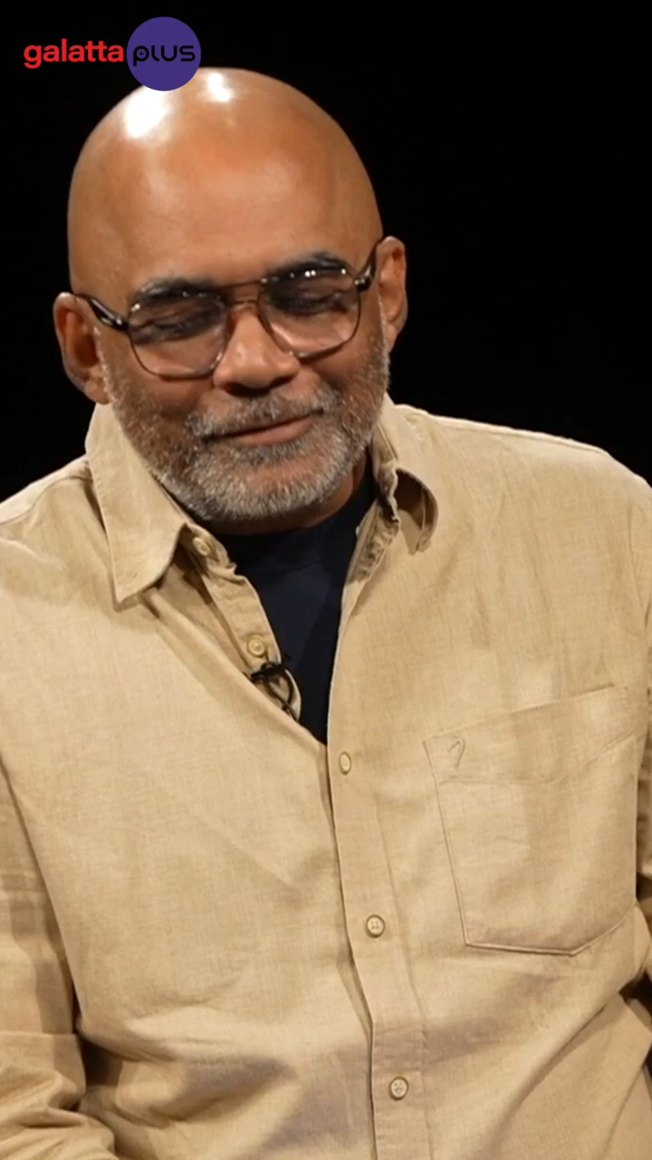
Indian English

Slide 17
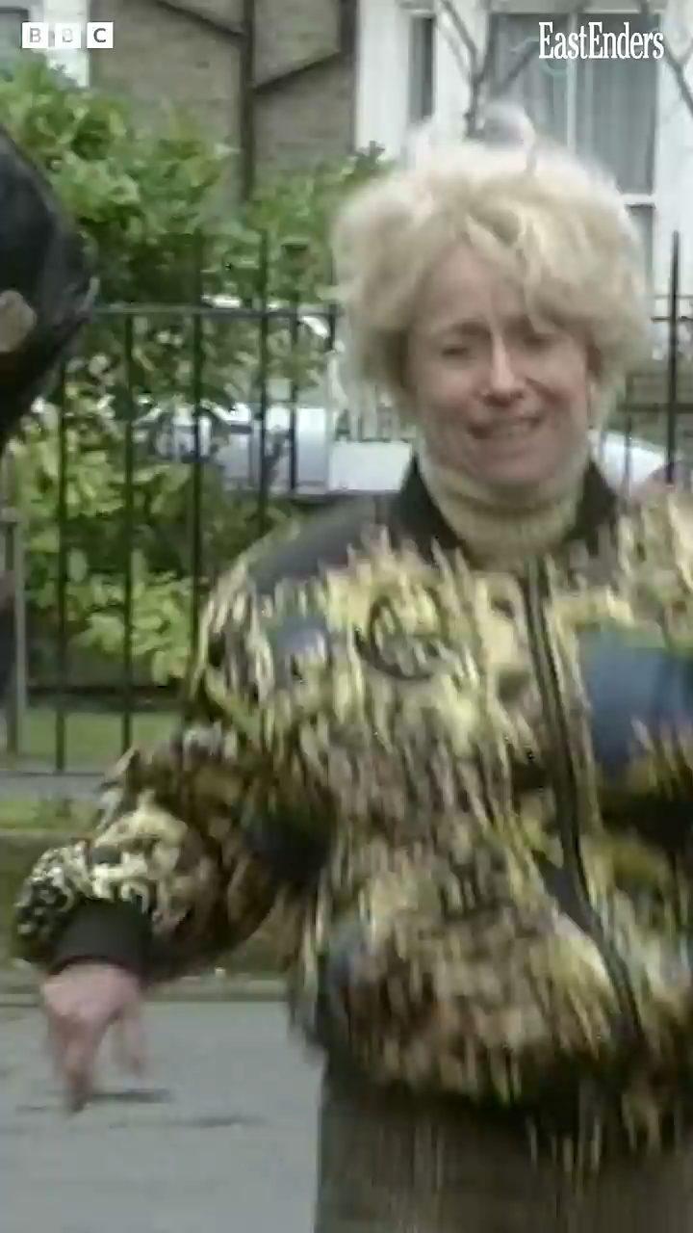
Cockney (South London)

Slide 18

BBC English (Modern
Standard English)

Slide 19
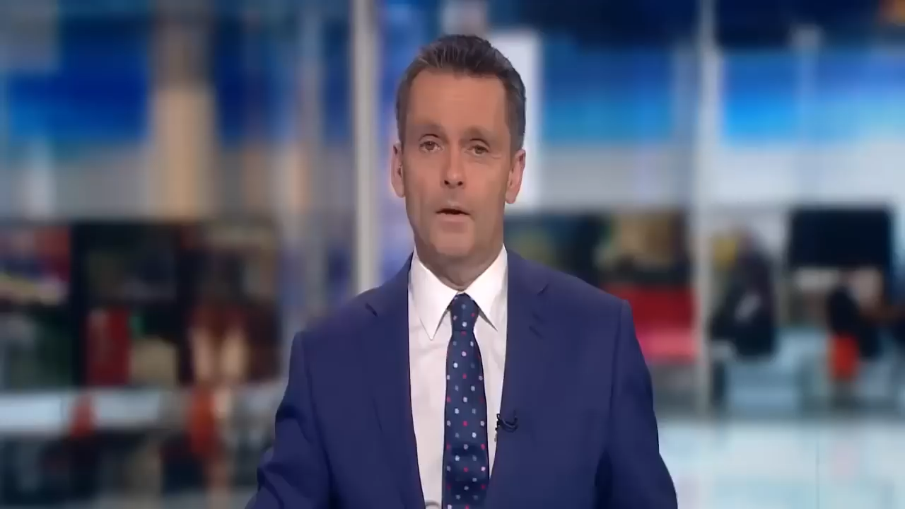
Irish

Slide 20

Reflection
Why do accent and register associations exist? Are they simply personal preferences, or do they reflect broader social patterns? Was it possible to listen to different accents and not make judgments, even in this simple activity? Consider your responses to any of these reflection questions:
Which accents did you associate with positive traits (e.g. educated, friendly) and why? Were there any accents you linked to negative traits? Where do you think those ideas come from?
How do films, TV, and advertising shape your impressions of certain accents? Can you think of a character, celebrity or show where accent influences portrayal and/or perception?
What can be done to reduce accent bias, discrimination, or pigeonholing?

