Slide 1
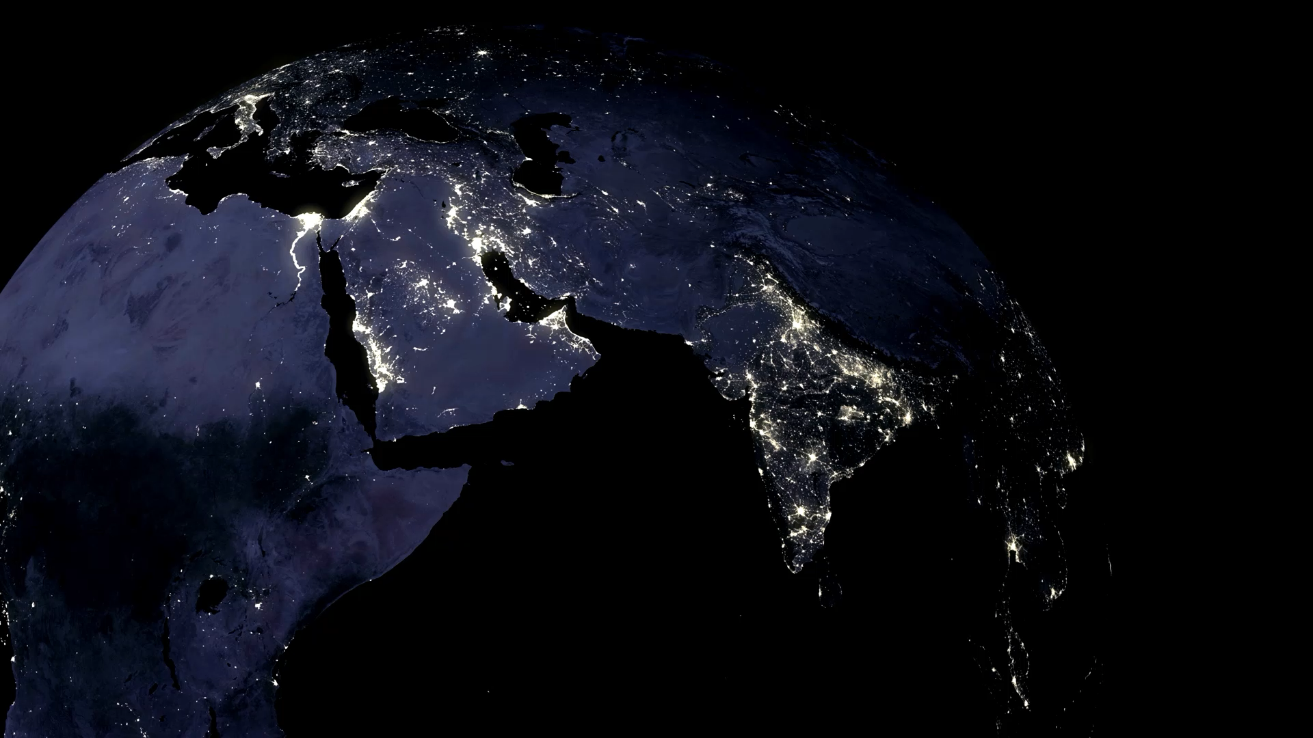
The Spread of English
Class Quiz

Slide 2

Introduction
Sort into small teams (2 – 4 people works best) and let’s go on a quick journey around the world of English and other languages. How widely has English spread? How many people speak English, or learn it at school? Which places in the world are the most linguistically diverse? And how long does it take a language to die? Test your knowledge and assumptions of English and global communication by participating in this friendly quiz – and take in a few fun facts along the way.

Slide 3
How many countries in the world list English as an official language?
20 | 58
84 | 144

Slide 4
Did You Know?
This number only refers to sovereign states (independent countries) where English has an official status – meaning it is legally recognized in courts, governments, education, or administration. If non-sovereign territories such as Hong Kong, Guam, or Bermuda are included the number rises to 86.

Slide 5
In which of these countries is English NOT listed as an official language?
Canada | India
Nigeria | United States

Slide 6
Did You Know?
Some very famous English-speaking countries – the US, United Kingdom, Australia, and New Zealand – do not actually list English as an official language in the law or constitution. This doesn’t stop English being the de facto working language of the country.

Slide 7
Which continent has the most countries with English as an official language?
North America | Europe
Oceania | Africa

Slide 8
Did You Know?
Of Africa’s 54 countries, 27 (or half) use English in an official capacity. Countries like Nigeria, Ghana, and Kenya use English as a primary language, while Cameroon, Rwanda, and South Africa list English as a co-official language. Countries like Rwanda and Eritrea use English even though they were never British colonies. More countries (29) list French as an official language in some capacity, either as the sole official language or a co-language.

Slide 9
How many people worldwide speak English as a native language?
100 million | 400 million
1.3 billion | 4.6 billion

Slide 10
Did You Know?
A ‘native speaker’ is defined as somebody who learned English from birth, not later (such as at school). Although native English speakers mostly come from the core Anglophone countries of United Kingdom, United States, Canada, Australia, and New Zealand, you can be born elsewhere and still be a native speaker of English.

Slide 11
How many people worldwide speak English as a second or learned language?
500 million | 1.1 billion
2.9 billion | 7.2 billion

Slide 12
Did You Know?
The total number of English speakers in the world is counted by adding native speakers (L1) to non-native speakers of English (L2). While census information is not completely accurate, it is commonly accepted that between 1.5 billion and 1.53 billion people – or 20% of the world’s population – speak English.

Slide 13
England has the third most native speakers: which two languages have more?
Spanish | French
Mandarin Chinese | Arabic

Slide 14
Did You Know?
Mandarin Chinese has the world’s highest number of native speakers (between 920 million – 1 billion) and Spanish has the second highest number of native speakers (between 480 – 500 million). Hindi is fourth (with around 350 million) and Portuguese rounds out the top 5 with up to 250 million native speakers. If non-native speakers are included, English jumps to the top and Arabic replaces Portuguese as the fifth most widely spoken language.

Slide 15
About how many living languages are there currently in the world?
1000 | 2500
4500 | 7000

Slide 16
Did You Know?
The number of languages existing in the world is 7,159 languages (according to Ethnologue, the research center for language intelligence). However, as English, and other global languages like Spanish, the total number of languages in the world is reducing.

Slide 17
Of these languages, how many are spoken by 50% of the world’s population?
20 | 50
150 | 300

Slide 18
Did You Know?
The world’s top 20 spoken languages (including French, Urdu, Bengali, Nigerian Pigeon, Japanese, Vietnamese, Hausa, and Turkish – see the full list here) account for nearly 4 billion people, half of the world’s population. And the top 200 languages include 88% of all the world’s speakers.

Slide 19
Of the more than 7000 living languages, approximately how many are spoken in Africa and Asia combined?
1500 | 2500
3500 | 4500

Slide 20
Did You Know?
Both Africa and Asia are the world’s language powerhouses, accounting for over 60% of the world’s languages together. Asia has 32% and Africa 30%, making Asia the most linguistically diverse continent on the planet.

Slide 21
Which country has the greatest number of spoken languages within its borders?
Brazil | China
Papua New Guinea | South Africa

Slide 22
Did You Know?
With 839 distinct languages spoken within its borders, Papua New Guinea is the most linguistically diverse country in the world. Some of the larger languages are Enga, Melpa, and Kuman. Other Papuan languages spoken in small communities are Huli, Duna, Eipo and Yimas. Of course, English is also a language spoken in PNG as well as Tok Pisin, an English-based creole that is used as a lingua franca.

Slide 23
A language is classed as ‘extinct’ when there are no more native speakers. At what current rate are languages becoming extinct?
1 language per 1 – 2 months | 1 language per 6 - 9 months
1 language per year | 1 language per 3 years

Slide 24
Did You Know?
A language is classed as ‘extinct’ when its last native speaker dies AND it is no longer used in any form of communication. A language is called ‘dead’ when it is no longer spoken as a native language, but is still learned and used in some form (either written or spoken) by a language community (such as on a university course). Therefore, while there are no longer any native speakers of Latin, it is classed as a ‘dead’ language, not an extinct one. Occasionally, dead languages can be revived (as in the case of Hebrew).

Slide 25

Reflection
This quiz has given you some of the facts behind the spread of English, but what does all of this mean? What are the implications of these statistics? Choose one or more of the reflection questions here, take a few minutes to note your thoughts, and share your ideas:
Is the global spread of English a positive or negative phenomenon? Who benefits – and who might be disadvantaged?
How does the growth of English affect smaller languages?
What will the world look (sound?) like in 100 years’ time if current trends in the spread of English continue? Would this be a good or bad thing?

