Slide 1
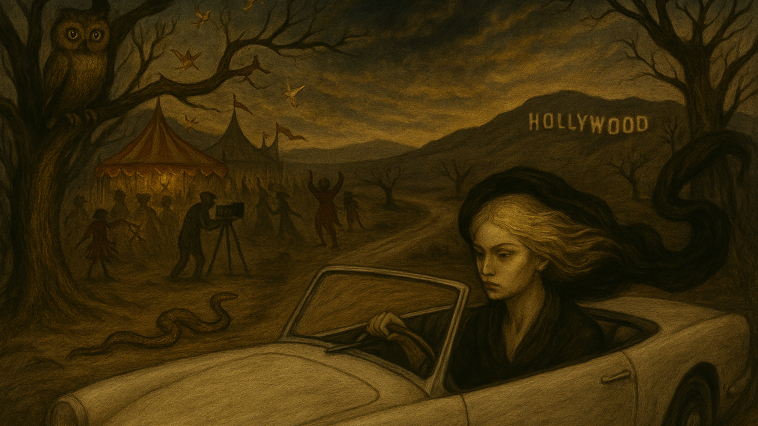
Compare and Contrast (Paper 2)
Sample Answer using The Farmer’s Bride and Play It As It Lays

Slide 2
Sample Introduction
Animals and images drawn from the world of animals are a rich source of inspiration for writers. Discuss how animals are used to develop central ideas in at least two works you have studied.
Charlotte Mew and Joan Didion are both writers who use images of animals and nature to advance themes in their literary works. In Play It As It Lays and The Farmer’s Bride, both writers use pathetic fallacy to reflect their character’s emotional states in the natural world. Furthermore, both writers use animal symbolism to convey the indifference of the natural world to human dreams and suffering. However, the writers differ in the way they use natural imagery. On one hand, Mew uses natural imagery to create a natural world that is vivid, harmonious and lively, a world that her speaker yearns to belong to. On the other hand, Didion paints a picture of a world in which nature has been replaced and replicated, a cold and artificial place that leaves characters spiritually unfulfilled.
Introduce the writers and works you will use to answer the question.
Set out your compare-and-contrast thesis: in what ways are the works similar and different in terms of the question?

Slide 3

What your examiners say
Creating introductions that provided a clear thesis statement or sense of the forthcoming argument proved challenging for some students. Too often introductions became convoluted with contextual information or lost the sense of the demands of the chosen question as it moved along into the body of the response.
Students should practice crafting introductions that present the works, and deliver a clear thesis or argument that allows them to set up their response well for better subsequent development of ideas.
Extract from May 2024 Subject Report

Slide 4
Sample Main Body Paragraph 1: comparing both works
Both writers use natural imagery that reflects the emotional landscape of characters and speakers in their works. For example, in Charlotte Mew’s poem The Farmer’s Bride, an older man has chosen a young girl to be his wife. Afraid of him, the girl retreats into a silent, protective state, avoiding her husband as much as possible. His loneliness is conveyed not only through his complaints about this situation, but also through descriptions of the surrounding landscape and changing seasons. As winter falls across the land, he describes details such as “brown oaks”, “blue smoke” and “short days” that get shorter and darker. His melancholy and desolate words and images paint a picture of a sad, lonely world that mirrors his own emotional state. The farmer fixates on red berries which fatten up even as the land grows cold and bare. To him, berries symbolize fertility and new life, something he desires but that his wife cannot or will not provide. To convey his frustration, he projects descriptions of winter onto his wife, describing her emotionless face as “the shut of a winter’s day” conveying the finality of the ‘cold’ way she emotionally and physically separates herself from him. His projection of winter onto his wife suggests his view of her as something to conquer – a winter landscape he can’t navigate – rather than as a person he can talk to or try to help. Similarly, Joan Didion uses images of the American landscape to mirror Maria’s emotional state in Play It As It Lays. Maria’s situation resembles the Farmer’s Bride, in that she’s trying to distance herself from her husband’s cruelty. Her way of coping is to spend her days driving in the desert – an arid, empty environment. The desert’s harsh geography embodies Maria’s difficulties navigating her own life, such as her relationship with Carter and the death of her mother, something she has never really gotten over. On a symbolic level, the desert’s emptiness represents the empty superficiality of Hollywood life, full of gossip and shallow relationships, with which Maria has become tired. Her driving “nowhere” is also a kind of pathetic fallacy: her attempts to take back control of her life lead nowhere but the emptiness of the desert where she can find no answers. Therefore, both Joan Didion and Charlotte Mew use images of different natural landscapes, winter and the desert, which convey similar ideas about the loneliness and frustrations of characters in their works.
It’s a good idea to write about how both works are similar in the opening paragraph.
Words like ‘both’, ‘similarly’, ‘resembles’, and so on, should be used to compare the two works. Using connectives throughout your writing sends a clear signal to your reader that you’re on task.
Draw ideas about both works together at the end of each paragraph, using the words of the question.

Slide 5
Sample Main Body Paragraph 2: comparing both works
Furthermore, while pathetic fallacy suggests the natural world may have sympathy with human concerns, both Didion and Mew use animals as symbols to suggest how nature is indifferent to human suffering. For example, in Play It As It Lays, Didion uses the symbol of the rattlesnake to show Maria’s belief that the universe is essentially cold and indifferent. Growing up, Maria’s parents were incredibly optimistic about life in Silver Wells, an out-of-the-way town in the desert. Her father spent his life chasing dreams, having plans to start a cattle ranch, run a ski resort, or open a motel. However, none of these came to fruition because a planned highway nearby Silver Wells was never built. As an adult, Maria rejects her father’s optimistic attitude; her philosophical system is that ‘bad things happen’. Didion uses rattlesnakes, a recurring symbol of the universe’s indifference to human dreams, to represent Maria’s philosophy. Connecting with the novel’s title, Play It As It Lays, snakes suggest the world’s indifference to Maria’s plight while the metaphor of a card game implies that Maria must cope with the world as it is ‘dealt’ rather than as she would like it to be. Likewise, Charlotte Mew uses animal symbolism to convey the death of her dream to escape a society that she finds repressive. In the poem Fame, Mew imagines herself speaking in public, uncomfortable in the spotlight and conscious that she’s putting on an unconvincing act. In truth, she abhors the noise and vicious gossip of polite society. She imagines nature as a place of escape, free from the judgment of others, surrounded only by “wise trees that do not care”. But these dreams are always marred by dead animals. In Fame, she sees a “frail, dead, new-born lamb”, a symbol of how her dreams are stillborn, dead-on-arrival. And in The Fete she imagines following a long dark road outside of the stifling town, as free as the wind to go where she likes. But this dream is marred by the discovery of a dead dog on the road. Like Maria’s rattlesnakes, Mew’s symbolically dead animals convey the recognition that some dreams are impossible to achieve. Therefore, whether rattlesnakes or dead animals, both writers use animal symbolism to undermine the effect of pathetic fallacy and suggest that, in the end, nature is neither benign nor a caring refuge; it exists apart from and is indifferent to human concerns.
Don’t be afraid to compare works that are more similar in more than one way.
Choose examples carefully, trying to match one or two well-chosen examples to each argument. Avoid listing lots of examples or summarizing the stories.
At the end of this paragraph the comparison is restated, with evaluation of the meaning/effect of writers’ choices.

Slide 6
Sample Main Body Paragraph 3: contrasting works
However, the shared use of animal imagery and symbolism belies an essential contrast between the two works: on one hand Didion’s characters live in a superficial, artificial world, a pale replica of the real thing; on the other hand Mew’s speakers yearn for a connection with the natural world that promises a kinder, more harmonious way of existing. For example, in The Changeling, Mew’s speaker is sensitive to noise and is easily overwhelmed in the “nursery riot” of her parent’s house. She withdraws, choosing silence as a response to stress, a response misunderstood by her parents, who punish her. However, the child is attuned to the sounds of nature outside her window. In an extended passage, Mew describes “shy grasses making love” and the “patter” of small animals, both intimate, small sounds that one must be incredibly perceptive to hear. She describes the “swishing” of bat wings and even the “humming” of flowers, sounds and motions combining to create the effect of a warm, welcoming world that Mew desires to be a part of. By contrast, Maria is surrounded by an artificial and cold world that simply worsens her feelings of disconnection. Natural things are replaced by artificial ones: the water in her swimming pool, for example, is carefully regulated so it is always exactly 80 degrees. When mixing drinks, the characters use “reconstituted” lemons rather than the real fruit, and even plants in Maria’s agent’s office are described as “glossy”, as if they have taken on the artificiality of Hollywood life. Everything around Maria has the picture-perfect quality of magazine images but lacks the warm and welcoming texture of the natural world as described by Mew. Didion writes in a completely different style to Mew; instead of long, flowing images, she writes in a fragmented and episodic style, as if Maria’s life is a film patched together in the editing room. Their imagery opposes one another, so Mew’s images drawn from the world of animals are warm, fizzing with life, and participatory, whereas Maria’s world is flat and pale, reflecting her characters’ shallow and selfish concerns.
As Paper 2 is closed book, you do not need to include exact quotations in your essay. This approach of paraphrasing while embedding short phrases and key words from Mew’s poems is effective.
The vocabulary of contrast is different to comparison. Use connectives such as ‘by contrast’, ‘on the other hand’, ‘whereas’, and so on to write about differences.
The end of this paragraph presents an effective contrast between the two writers’ imagery which is evaluative and insightful.

Slide 7
Sample Conclusion
In conclusion, Play It As It Lays and The Farmer’s Bride are both works which develop ideas through natural imagery and animal symbolism. The loneliness of characters, their failures and frustrations, are reflected in the pathetic fallacies of the natural world around them. Both writers use animal symbolism to imply the indifference of a callous world, whether snakes that strike from nowhere or stillborn animals that show how dreams can’t survive in a cruel reality. However, whereas Mew never fails to show the allure of a return to nature, Didion shows a world in which nature has been replaced by a pale facsimile that fails to deliver the spiritual nourishment people crave.
Use the words of the question again in the essay’s conclusion.
The similarity of theme and difference in methods is evaluated at the end.
The final line attempts to leave the reader with a ‘sense of ending’.

Slide 8

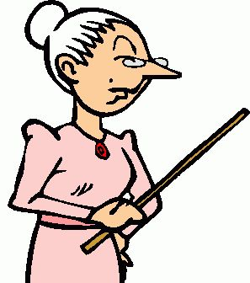
What your examiners say
The most effective conclusions draw the essay to a
satisfying sense of an argument having been proven; they do not simply summarise the points just made, nor do they introduce new analysis.
The most successful student responses directly addressed the chosen prompt, offering original insights and a clear enthusiasm for sharing interpretation of the works in relation to their argument developed around the chosen question. Examiners were impressed by fresh perspectives and in-depth knowledge and understanding demonstrated by some students.
Extract from May 2024 Subject Report

Slide 9

Points to Remember
Your task is to write a compare-and-contrast essay, so begin each paragraph with an idea about how the works are similar or different.
Present a limited number of examples per work per paragraph to support what you say about how the works are similar or different. One or two examples is enough. Do not fall into the trap of writing a list of features or retelling the story of the works! Strictly control the length of your paragraphs.
End each paragraph by returning to the compare/contrast point, restating how the works are similar or different, ideally providing insight into the similar or different ideas created by writers.

