Slide 1
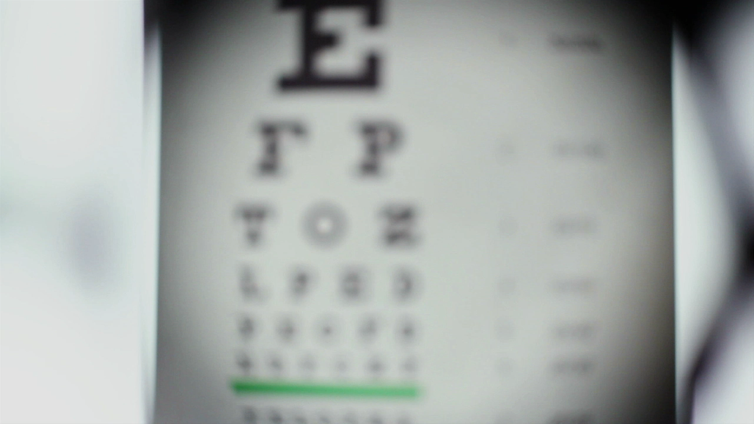
Subtle Types of Bias
Case studies in How News media frames information

Slide 2
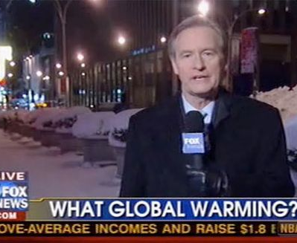
Introduction
Everyone knows that when right-wing news channels shout about freedom of speech or left-wing reporters target authoritarian laws, there’s bias at work. However, in today’s news, bias isn’t always so loud and obvious. Instead, it hides in details like the words chosen in the headline, pictures shown in the story, and what information is left in or cut out. These subtle forms of bias are more dangerous as they influence what we think without us being aware of it. Over the next few slides you’ll see case studies that illustrate subtle forms of bias such as loaded language, selection bias, personalization, and more. Once you’ve looked at the evidence, decide for yourself which you believe are the most dangerous forms of bias in the news.

Slide 3
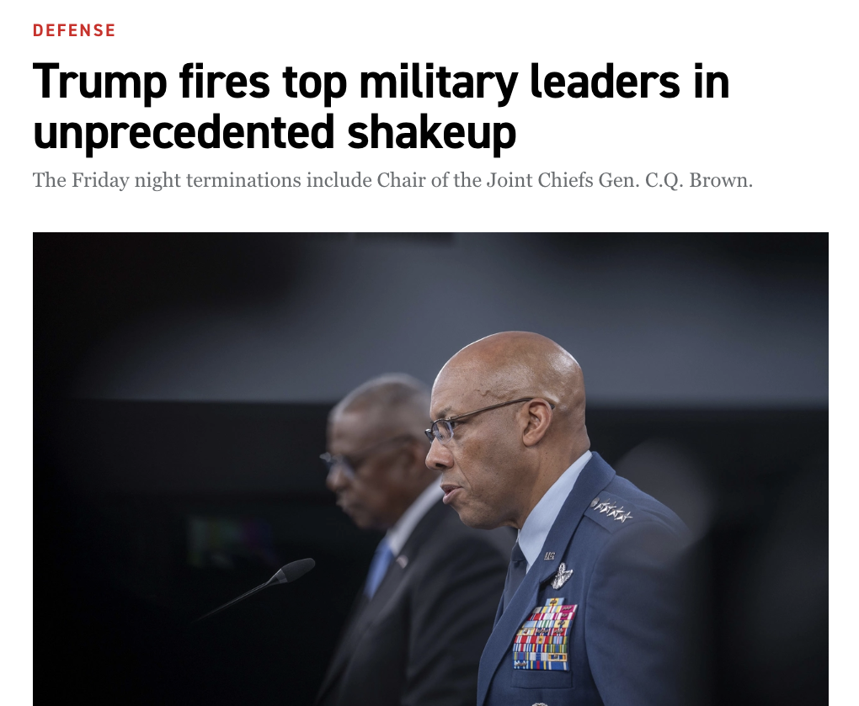
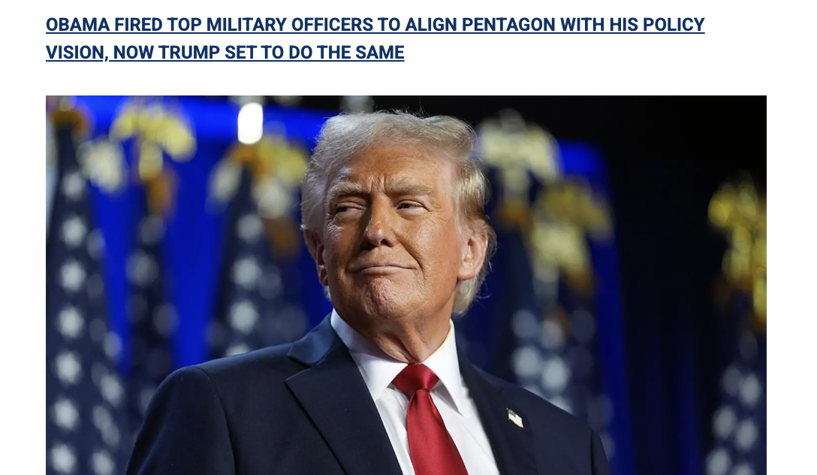
Selection/ Placement Bias: The Firing of General Charles “CQ” Brown Jr.
When this story broke in 2024, many mainstream outlets such as Politico (top) and CBS News treated it as a major event. Their coverage highlighted the nation’s top black military officer, explored the implications for U.S. defence policy, and raised concerns about politicization within the armed forces.
By contrast, Fox News (bottom) gave the story minimal attention. When it was mentioned, coverage focused narrowly on defending the decision as part of a broader effort to purge ‘woke’ military leaders. The reporting lacked depth, offered little historical context, and framed the event as routine by aligning it with Obama-era policies, rather than as an extraordinary, racially motivated step. This selection bias meant that audiences relying on Fox News were less likely to view the firing as a major national security issue or racial issue.
https://www.foxnews.com/politics/trump-goes-unprecedented-pentagon-firing-spree-report

Slide 4
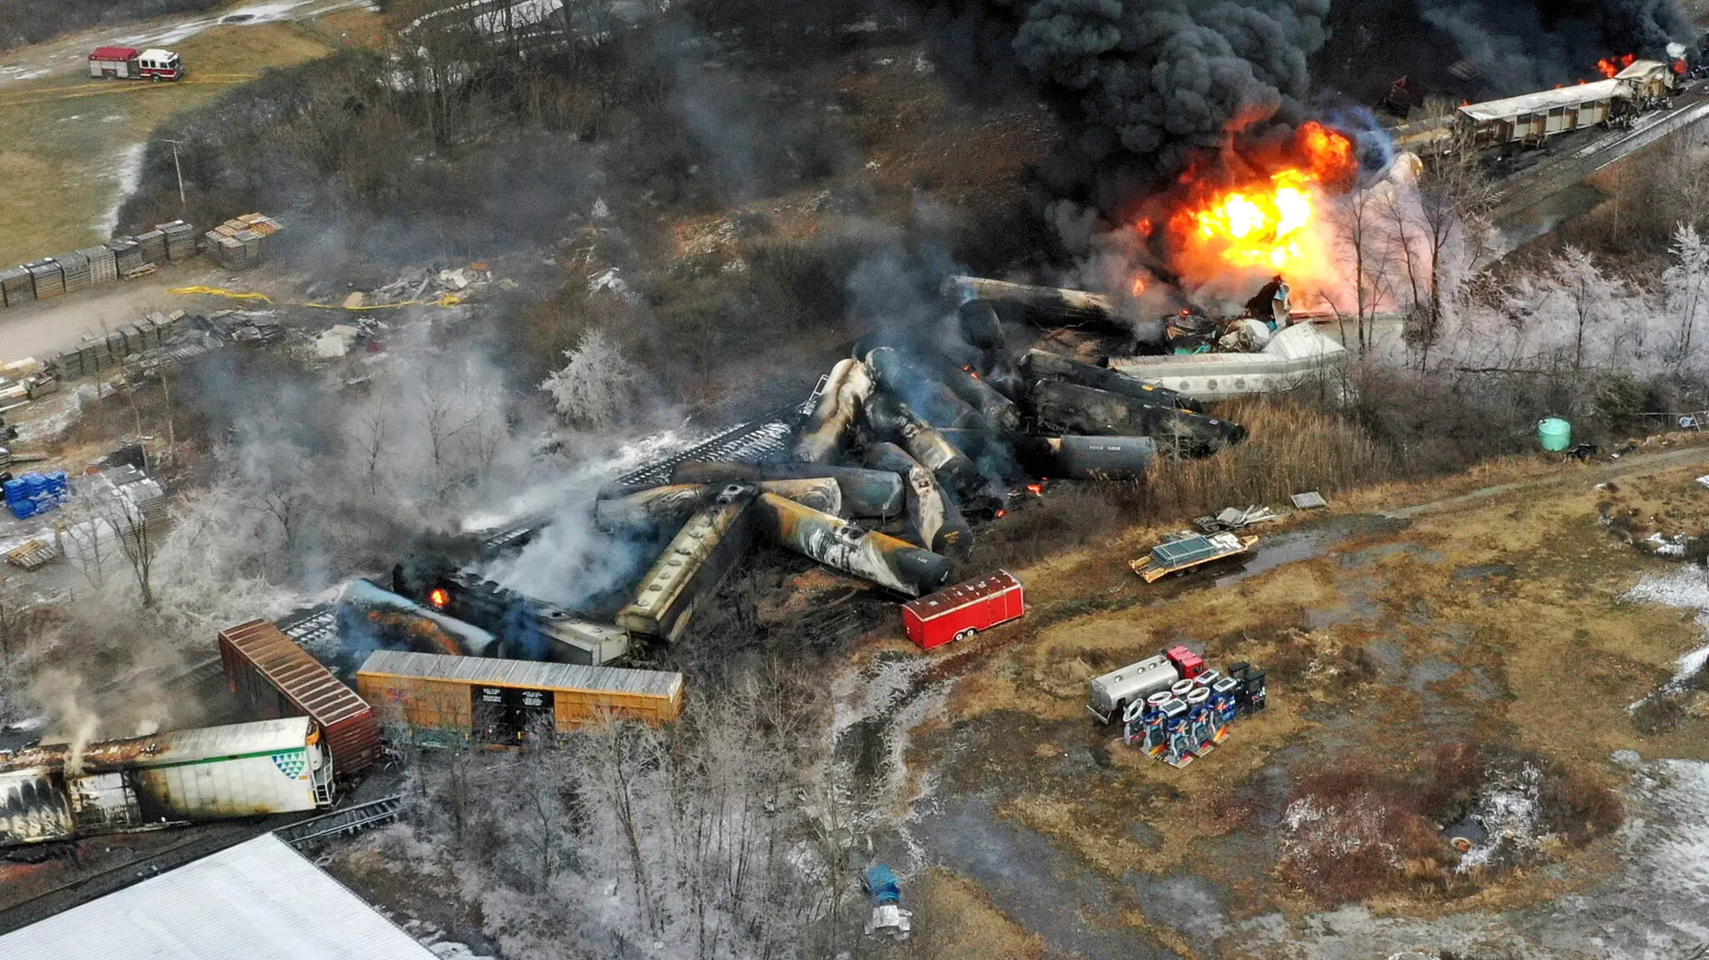
Slanted Sources: Coverage of the 2023 Ohio Train Derailment
When a train carrying hazardous chemicals derailed in Ohio, the story became a major national issue. However, some outlets framed the event very differently through their choice of sources. For example, Norfolk Southern’s own statements and government officials were heavily quoted in several mainstream reports, reassuring the public that, despite clouds of smoke in the air from a deliberate ‘controlled burn’ of the chemicals, the situation was ‘under control’ and that cleanup efforts were ‘effective.’ These articles lacked voices from independent environmental experts or local residents who were experiencing health issues and property damage. Through slanted sources, readers were led to believe the crisis was minor; later investigations revealed significant environmental and health damage.
Notes:
https://san.com/cc/report-alleges-biden-admin-hid-toxic-plume-release-after-ohio-train-derailment/

Slide 5
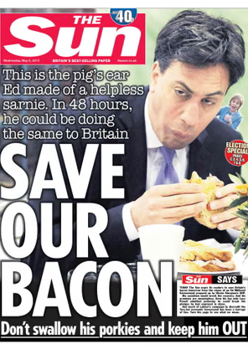
Visual Bias: Ed Miliband and the Bacon Sandwich
In 2014, during the UK general election campaign, The Sun published a photograph of Labour leader Ed Miliband awkwardly eating a bacon sandwich. The image went viral, becoming a meme and dominating public conversation about Miliband’s character. Instead of focusing on his policies or leadership qualities, the photo presented him as clumsy and out of touch.
This was a deliberate choice of an unflattering image; alternative photos where Miliband looked composed were ignored in favour of a single awkward moment. The photo also carried cultural undertones. Miliband is Jewish, and bacon is traditionally avoided in Jewish dietary laws. While Miliband is not strictly observant, as is his right, the image raised questions about his loyalty, ‘otherness,’ and public image that undermined his campaign at a crucial time.

Slide 6
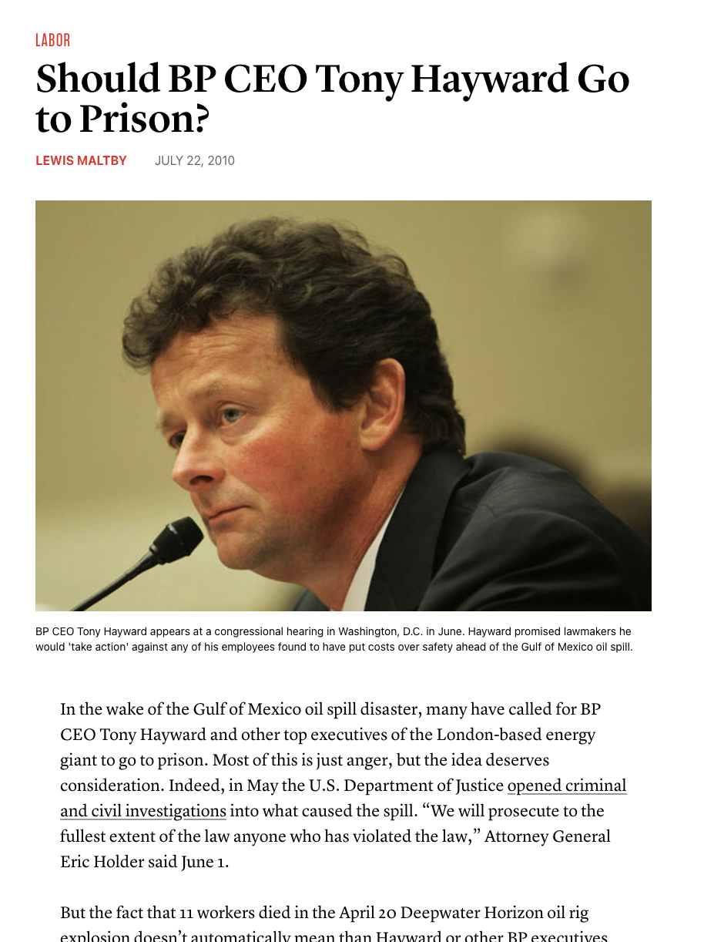
Personalization: Resignation of Tony Hayward
After the 2010 Deepwater Horizon oil spill – the largest oceanic oil spill in history – media coverage quickly shifted from systemic failures in safety regulation and corporate oversight to the personal actions of BP’s CEO, Tony Hayward. Headlines focused on Hayward’s comments, such as “I’d like my life back,” and portrayed him as the face of the disaster. His resignation became the climax of the story.
However, while Hayward was at fault in many ways, the disaster was the result of complex technical and regulatory failures involving multiple companies and government agencies. Instead of exploring these, coverage zeroed in on Hayward as the ‘fall guy,’ reporting the crisis as a matter of individual incompetence or insensitivity. This simplified a multifaceted problem into a personal drama, which is easier for audiences to engage with but obscures deeper causes and solutions.
https://inthesetimes.com/article/should-bp-ceo-tony-hayward-go-to-prison

Slide 7
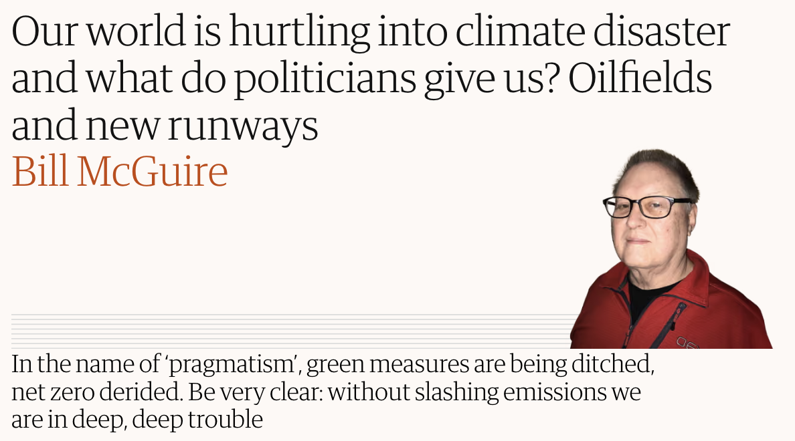
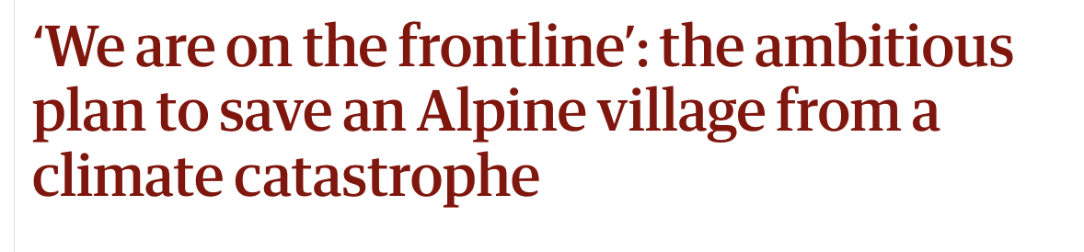
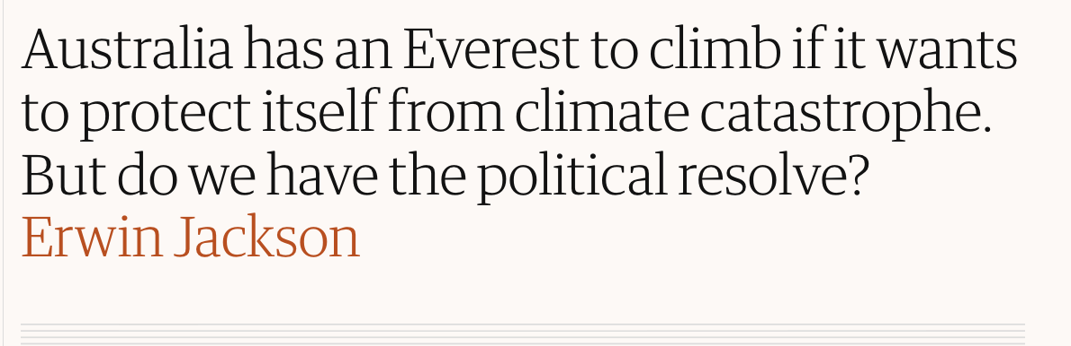
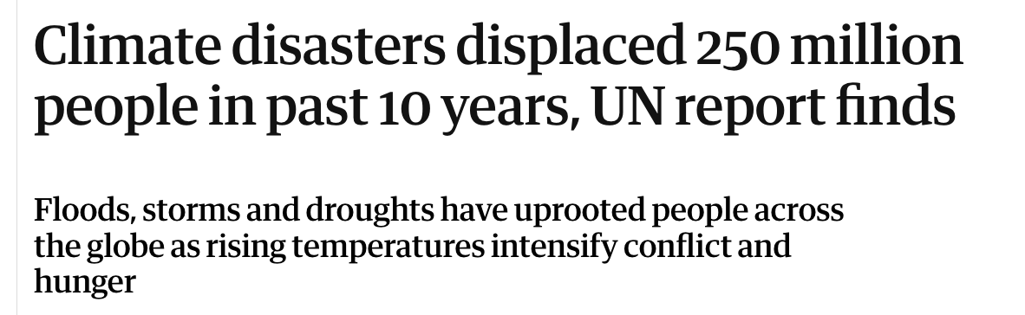
Loaded Language: The Guardian’s ‘Climate Catastrophe’ Reporting
A study analysing approximately 4,000 climate-related articles (link below) published by The Guardian between 2021 and 2024 found that nearly half of its climate journalism employed loaded language. Terms like "collapse," "disaster," "apocalypse," and "catastrophe" intensify the sense of crisis in the reports. By contrast, such language appeared in only around 6% of general news articles. While The Guardian is a reliable, factual news outlet, nevertheless these words frame facts in emotional ways.
https://journals.sagepub.com/doi/pdf/10.1177/14648849251383363

Slide 8
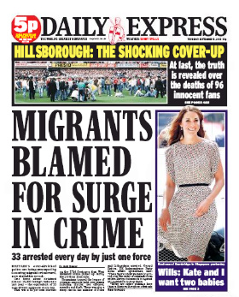
Flawed Logic: Migration Reporting in the Tabloid Press
Several UK tabloids, including The Daily Mail and The Sun, have published headlines such as:
“Migrant Crime Wave Hits Britain” or “Foreign Criminals Flood Our Streets.” These stories often rely on flawed logic as they cite isolated incidents involving individuals and then generalise that immigration causes rising crime. Correlation is presented as causation: crime rates often go up and down, but the articles imply migration is the cause without direct evidence.

Slide 9
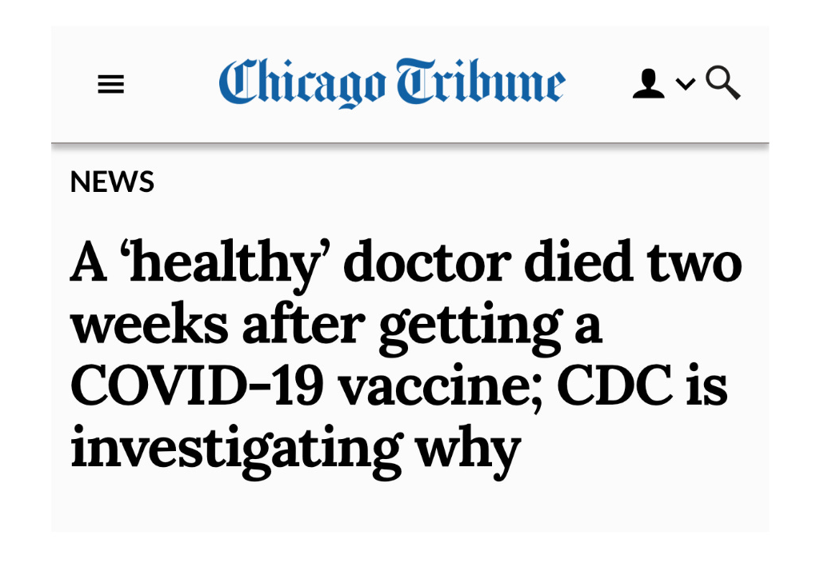
Fragmentation / Lack of Context: ‘Healthy’ Doctor Dies After Vaccination
Research found that misleading (but not factually false) headlines in mainstream media significantly lowered COVID-19 vaccination rates. For example, a Chicago Tribune article titled “A ‘healthy’ doctor died two weeks after getting a COVID-19 vaccine; CDC is investigating why” was widely shared causing people to interpret it as proof vaccines were dangerous. Although later in the article it was presented that an investigation into the actual cause of death was still underway, the headline alone (without this context) fuelled fear and discouraged vaccination efforts.
https://english.elpais.com/technology/2024-05-30/misleading-headlines-in-mainstream-media-are-more-dangerous-than-outright-fake-news.html

Slide 10
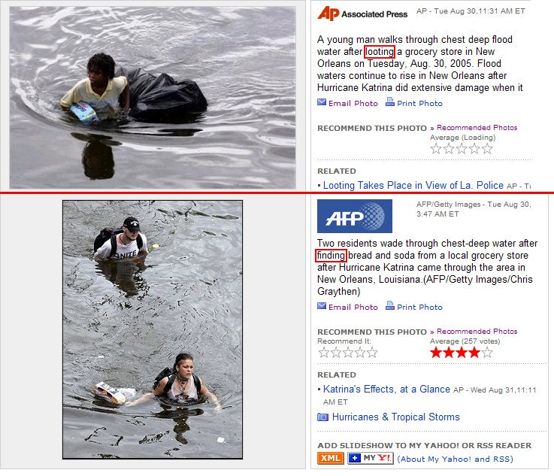
Labelling Bias: ‘Looting’ vs ‘Finding’ Food
During the aftermath of Hurricane Katrina in 2015, three individuals – one Black, two White – were photographed wading through floodwaters carrying grocery bags. These nearly identical situations were described very differently in media coverage. The Black man was labelled as “looting” a grocery store whereas the white couple was described as “finding” bread and soda. The labelling discrepancy, despite similar circumstances, portrayed one as a criminal and the other as a victim, reinforcing racial stereotypes.
From Katrina: Come Hell or High Water at Netflix

Slide 11

Reflection: diamond nine
Which are the most dangerous forms of bias? Which have the most damaging effects? In pairs or threes, discuss this question and come to a consensus by arranging nine subtle forms of bias into a diamond shape. Share your conclusions and prepare to justify your choices.

Slide 12
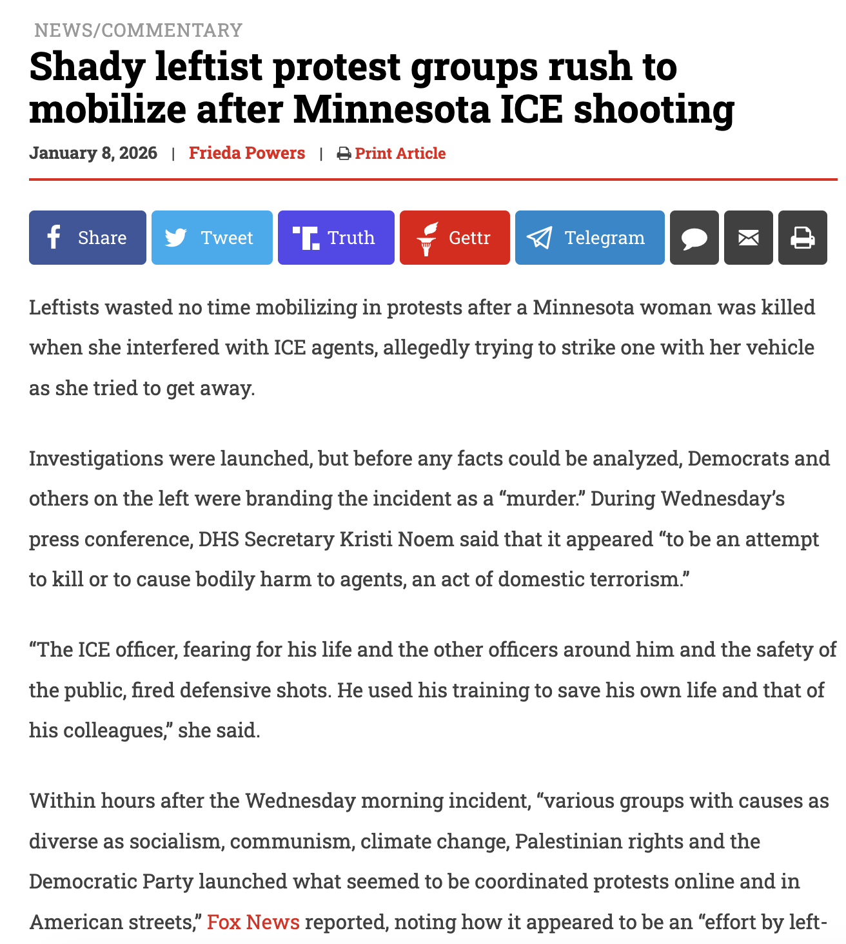
Activity
Which subtle biases did you decide were the most dangerous? Using your diamond nine, research recent news stories to find the biases you’ve discussed. Share your findings and articulate how different biases are noticeable in the story(s) you’ve uncovered.
This story by American Wire News was published in January 2026 after the shooting of Renee Good by an ICE agent. Noticeable biases are labelling, slanted sources, fragmentation, and loaded language. What can you find in a recent news story? https://americanwirenews.com/shady-leftist-protest-groups-rush-to-mobilize-after-minnesota-ice-shooting/

