Slide 1
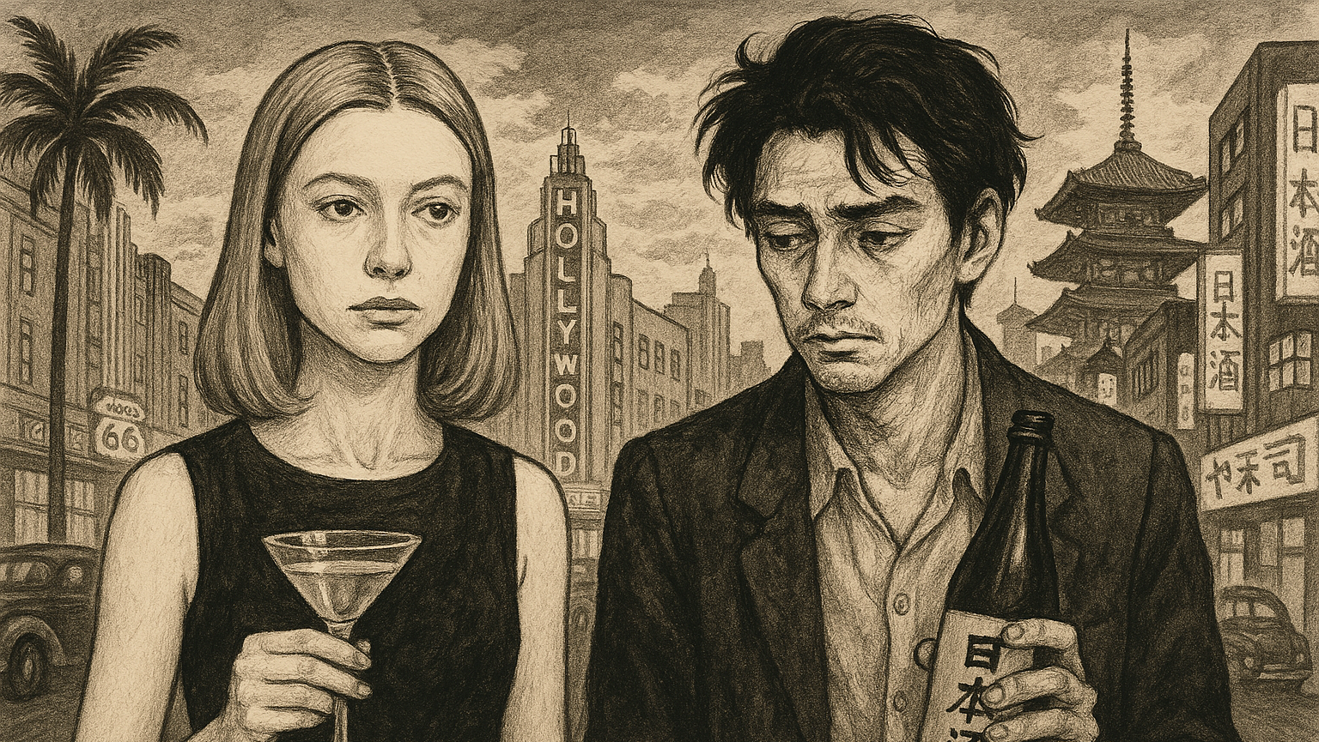
Compare and Contrast (Paper 2)
Sample Answer using Play It As It Lays by Joan Didion and No Longer Human by Osamu Dazai

Slide 2
Sample Introduction
Whether implicitly or explicitly, literary works communicate cultural values to the reader. How have cultural values been conveyed in two works you have studied, and to what effect?
Literary works are never written in a vacuum, writers are affected by and motivated by the time and place in which they live. Both Joan Didion in Play It As It Lays and Osamu Dazai in No Longer Human communicate cultural values of Hollywood’s ‘golden age’ and post-World War Two Japan respectively. Both writers use the viewpoint of a character who is a cultural insider to critique each culture and use the symbolism of drink and drugs to convey the shallow superficiality of both cultures. However, the works differ in style. On one hand, Didion uses a fragmented narrative style to represent Maria’s dislocation from Hollywood’s vacuous culture; on the other hand, Dazai uses an intimate, confessional style to invite readers to see the world through Yozo’s eyes, and be appalled by what they find.
Clarify the terms of the question as you understand them at the start of your answer.
Introduce the two works you will use to answer the question.
Set out your compare-and-contrast thesis: in what ways are the works similar and different in terms of the question?

Slide 3

What your examiners say
Creating introductions that provided a clear thesis statement or sense of the forthcoming argument proved challenging for some students. Too often introductions became convoluted with contextual information or lost the sense of the demands of the chosen question as it moved along into the body of the response.
Students should practice crafting introductions that present the works, and deliver a clear thesis or argument that allows them to set up their response well for better subsequent development of ideas.
Extract from May 2024 Subject Report

Slide 4
Sample Main Body Paragraph 1: compare both works
Both Osamu Dazai and Joan Didion craft characters who are positioned as cultural insiders in order to communicate cultural values. Didion’s narrator is Maria Wyeth, a former film star who is deeply embedded in Hollywood culture; her husband is a director and all her friends are actors, producers, and models. By writing from Maria’s perspective, Didion reveals how Hollywood culture is superficially glamourous, but culturally empty, even meaningless. For example, many of the dialogues Maria participates in are gossips about other people inside the Hollywood machine. In one scene, characters revel over the news that a former starlet has been hospitalized for a mental health issue. Ironically, Maria’s internal dialogue often reveals her own mental health issues, and the reader knows she is destined to be committed to a psychiatric hospital herself. The contrast between Maria’s inner thoughts and the meaningless gossip that surrounds her therefore reveals the shallow superficiality of Hollywood culture. Similarly, Dazai’s narrator is a member of Tokyo’s elite society. Yozo’s father is a wealthy government minister and Yozo was educated at an elite private school; his family is embedded in the political and social life of Japan. Just like Maria, though, his inner thoughts reveal the superficiality of Japanese cultural life. Through Yozo’s eyes, the reader is taken on a tour of Tokyo’s seedier side: he often visits bars, interacts with prostitutes and drug dealers, and immerses himself in drink and womanizing. His friend Horiki, who he met at art school, also indulges in these behaviours, suggesting that Japanese wastrel culture is widespread and that many young people are disaffected with mainstream Japanese culture and society. Written after World War Two, Dazai uses his characters to critique mainstream conservative Japanese culture – by rejecting it, Yozo and Horiki are refusiing to participate in the traditional culture that led Japan into the disaster of the second world war. Likewise, Didion uses Hollywood as a microcosm of American society; Hollywood superficiality is a representation of a wider cultural malaise in 1960s America. The assassinations of Martin Luther King and President Kennedy and the Vietnam War were signs that the golden age of US optimism was ending. Therefore, both works feature characters who are cultural insiders, allowing readers to see the shallow cultural values that surround them.
It’s a good idea to make your first section about both works.
Words like ‘similarly’ show you’re focused on the task of comparison. Using connectives throughout sends a clear signal to your reader that you’re on task.
Go back to the question at the end of the paragraph, drawing together your points about both works. This sentence adds nuance by suggesting the works are ‘similar-but-different’.

Slide 5
Sample Main Body Paragraph 2: compare both works
While this is a ‘composition/interpretation’ question, it’s time to include discussion of a common methodology: in this case, symbolism.
Furthermore, both writers use drink and drugs as symbols of each culture’s shallow superficiality. In Didion’s case, she surrounds Maria with an intoxicating mix of pills and drugs that Maria resorts to using at all times. For example, when she visits the doctor he comments that ‘It’s nothing… I’ll give you some Edrisal.’ When she gets home, Maria drinks gin and takes Darvon, another medication too. Later she mixes Dexedrine and Sedonal! The sheer variety of pills and names of medication is overwhelming for the reader and gives us a sense of the dependency on drugs and alcohol Maria is experiencing. Equally, Dazai uses the symbolism of alcohol and drugs to comment on the vacuous emptiness of Japanese culture. Yozo becomes more and more dependent on alcohol, even stealing money from one of his girlfriends to pay for his nights out. Just like Maria, Yozo’s rejection of acceptable social norms through alcohol symbolizes a rejection of mainstream cultural values, in this case conveying Dazai’s position that Japan’s conservative thinkers led the country into the disaster of World War Two. Ultimately, both writers trap their characters on the slippery slope of drug and alcohol use, suggesting that neither writer feels that there is anything of value in their cultures that they can use as an alternative.
Connectives like ‘equally’ , ‘just like’ and ‘in this case' signpost comparisons. Your reader will be looking for these throughout your essay.
This end of the paragraph restates the comparison point about cultural values. So far, the answer is completely on task.

Slide 6
Sample Main Body Paragraph 3: contrasting works
While both works feature inside viewpoints that convey the authors’ critiques of their cultures, the works differ greatly in style, one using a fragmented third person narrative compared to the other which employs first person narration in an almost stream of consciousness style. On one hand, Joan Didion employs an episodic narrative structure throughout Play It As It Lays. Unlike Dazai, Didion’s style is evocative of Hollywood’s glory days, the short, episodic chapters feel like cut scenes from a reel of film edited back together. Sometimes, Didion uses elision to omit important incidents that occur between one chapter and the next. In this way, the gaps between chapters become a representation of the culture that Didion is criticizing: empty, repetitive, and banal. Furthermore, Didion populates her empty Hollywood world with characters that represent emptiness. Helene is a perfect example of this as she represents Hollywood’s vacuous fixation on youth. For example, when Helene looks intently in the mirror and traces the lines of her own face, commenting that ‘You really can tell’, she is referring to going three days without her anti-aging medication. The mirror is symbolic of Helene’s selfishness, something that is key to her character. Didion’s episodic narrative style is a perfect way to illustrate the disconnect between Helene and Maria. While they should be able to bond over shared fears and concerns (Maria too worries about how ageing and how the menopause will make her uncastable in the film roles she desires) more often Maria is thinking about one thing (such as her daughter in hospital) while Helene is obsessing over something superficial, like her hairdresser going out of town for three days. In this way, style combined with superficial character relationships strongly conveys the shallow superficiality of the culture around them.
This transition sentence smoothly moves the essay from the ‘compare’ stage to the ‘contrast’ stage.
In the ’contrast’ section of the essay, the approach changes. This paragraph focuses on one work only, waiting to draw comparisons until the final paragraph.
As Paper 2 is closed book, you do not need to include exact quotations in your essay. This approach of paraphrasing while embedding only key words or short quotations is effective.

Slide 7
Sample Main Body Paragraph 4: contrasting works
On the other hand, Dazai writes in the style of a Japanese I-novel, a semi-autobiographical genre that shares similarities with Western confessional literature. Yozo’s thoughts pour out in an unfiltered way, in the style of a stream of consciousness. There are only three chapters in the whole novel; however, unlike Didion, Dazai doesn’t leave out anything meaningful. All of Yozo’s significant life incidents, such as his discovery of a new style of painting, his marriage to two different women, and his suicide attempts are visible in the narrative. The reader can feel the banality of Yozo’s life through the flowing style of narration: the language mirrors the way Yozo ‘drifts’ purposelessly. Like Didion, Dazai reveals how Yozo finds it hard to connect with other characters: unlike Didion, Dazai reveals how this is a result of Yozo’s profound selfishness. Maria’s character can be redeemed as she cares so much about her daughter, Kate. Yozo’s character is continually offered help and support by women he encounters who are ‘tricked’ by his outward displays of charm and affection. In one relationship, he becomes a surrogate father to a young girl: Shigeko. However, on overhearing a private conversation, Yozo becomes overwhelmed when the mother tells the daughter he drinks because he is ‘too good.’ Without a second thought, Yozo abandons the two women, without even a word of explanation or goodbye. Compared to Maria, his actions are never redeemable. Therefore, the flowing, confessional style of writing works in the opposite way to Didion’s fractured narrative. The style is intimate and should draw the reader closer to Yozo: but because Yozo’s actions are so repetitively irredeemable, the reader paradoxically finds themselves ever more apart from Yozo. This arguably suits Dazai’s intention, as by stranding his character so thoroughly, he conveys how lonely and isolating it can be for someone who rejects the overwhelmingly conformist traditional cultures of Japan in the years leading up to the second world war.
The pattern ‘On one hand... On the other hand…’ is a good way of contrasting two works. The final paragraph continually links the two works using ‘like’ or ‘unlike’.
‘Balance’ between the two works is assessed in Criteria C. The structure of this essay ensures the treatment of both works is ‘balanced’. Equal attention is paid to each work.
At the end of this section, the contrast between the two works is restated and the ‘to what effect’ part of the question addressed.

Slide 8
Sample Conclusion
In conclusion, both Joan Didion and Osamu Dazai communicate cultural values in similar ways by putting characters in conflict with society to comment on the superficiality of cultural values. Both characters retreat into drink and drug-filled lives to fill the void that comes with having no purpose in life. The main difference is the tone and texture of the narratives which reflect the individual character’s particular neuroses; Maria dissociates from her circumstances, something reflected through the fractured, fragmented style of Didion’s novel. By contrast, Yozo is unable to dissociate form the fear he feels, something that drives him to ever deeper acts of depravity. The emptiness of Japanese culture reflects itself in his increasingly empty behaviour, until nothing is left but a hollow shell of a man.
Use the words of the question again in the essay’s conclusion.
Briefly evaluate the similarities and differences in the essay.
The final line attempts to leave the reader with a ‘sense of ending’.

Slide 9
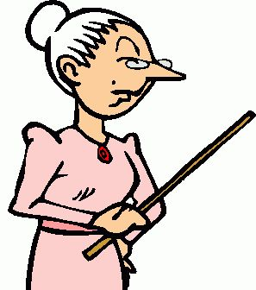
What your examiners say
The most effective conclusions draw the essay to a
satisfying sense of an argument having been proven; they do not simply summarise the points just made, nor do they introduce new analysis.
The most successful student responses directly addressed the chosen prompt, offering original insights and a clear enthusiasm for sharing interpretation of the works in relation to their argument developed around the chosen question. Examiners were impressed by fresh perspectives and in-depth knowledge and understanding demonstrated by some students.
Extract from May 2024 Subject Report

Slide 10

Points to Remember
Your task is to write a compare-and-contrast essay, so begin each paragraph with an idea about how the works are similar or different.
Present a limited number of examples per work per paragraph to support what you say about how the works are similar or different. One or two examples is enough. Do not fall into the trap of writing a list of features or retelling the story of the works! Strictly control the length of your paragraphs.
End each paragraph by returning to the compare/contrast point, restating how the works are similar or different, ideally providing insight into the similar or different ideas created by writers.

