Slide 1
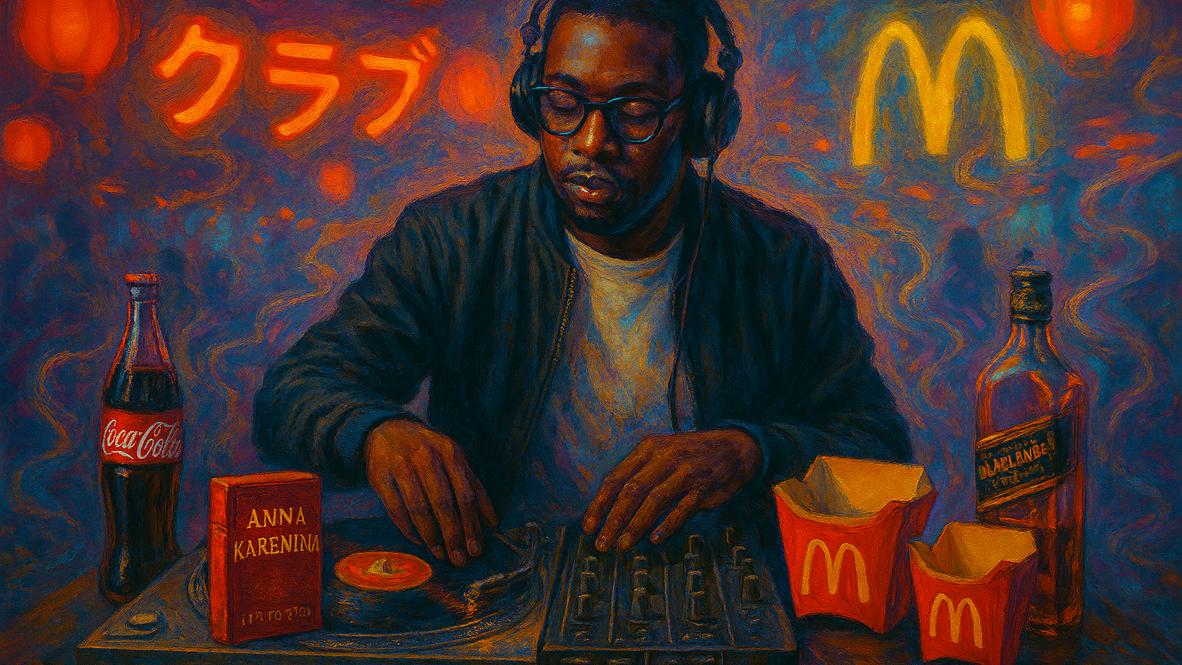
Compare and Contrast (Paper 2)
Sample Answer using Kumukanda and The Elephant Vanishes

Slide 2
Sample Introduction
Consider the use to which music and/or musical elements have been made in two works of literature you have studied.
Kayo Chingonyi and Haruki Murakami are writers who weave music and musical elements into the fabric of Kumukanda and The Elephant Vanishes stories. Both writers show how music can be a refuge from the world and a defense against life’s difficult challenges. Both writers also use the same technique of weaving musical allusions into their works. However, the reasons for this are different: through allusion to Black musicians, Kayo shows how music helped him find his place in a like-minded community and overcome the legacy of racism in Britain. By contrast, Murakami uses allusion to Western musicians to suggest the fraying of traditional Japanese culture that leaves people alienated in a rapidly changing world.
Introduce the writers and works you will use to answer the question.
Set out your compare-and-contrast thesis: in what ways are the works similar and different in terms of the question?

Slide 3

What your examiners say
Creating introductions that provided a clear thesis statement or sense of the forthcoming argument proved challenging for some students. Too often introductions became convoluted with contextual information or lost the sense of the demands of the chosen question as it moved along into the body of the response.
Students should practice crafting introductions that present the works, and deliver a clear thesis or argument that allows them to set up their response well for better subsequent development of ideas.
Extract from May 2024 Subject Report

Slide 4
Sample Main Body Paragraph 1: compare both works
Both writers depict music as a shield that armours people against the difficulties and threats they face in their lives. In the opening story of Murakami’s collection (The Wind-up Bird and Tuesday’s Women), the narrator is depicted in his kitchen cooking spaghetti while listening to The Thieving Magpie, a classical music symphony, on the radio. The narrator recognizes the voice of Claudia Abbado, an opera singer, suggesting that he is a music aficionado. In fact, listening to music is part of his routine, something he relies on to stay grounded. For example, when his routine is interrupted by repeated telephone calls, he becomes upset and anxious to return to his kitchen sanctuary. In this way, music is depicted as a comfort blanket for the narrator, who finds the outside world intrusive, so retreats to the familiar (cooking, ironing, listening to music) when he is put under pressure. His knowledge of music also lets the reader see that, despite his stiff and fussy exterior, he does have interests and can be enthusiastic; this allows readers to stay sympathetic with a character who might otherwise be frustrating to read about, potentially softening our response to his strangeness. Similarly, Kayo Chingonyi depicts music as a refuge in his Kumukanda poems. As an immigrant from Zambia, he lived in a “white-flight-satellite” town where he was the only black boy at school and struggled to make friends. In Self Portrait As a Garage Emcee Kayo used music to fight loneliness, describing how the radio kept him company after school in the same way that Murakami’s narrator finds solace in music. The way he describes his discovery of a radio station he likes (“I hear those click-and-clack hi-hats and stop on Majik FM”) uses onomatopoeia and alliteration to bring music to life on the page, conveying its vivid power to stave off loneliness to the reader. In the same poem he describes music as a metaphorical suit of armour that protects him against bullies: “Since I could spit lyrics…” the stones they threw bounced off him, as if he was impervious to harm. This image puts his mental fortitude down to the confidence he gained by learning rap lyrics and performing them for others. Therefore, both Kayo and Murakami show how music can be a refuge for people: whether knocked off-balance emotionally or threatened by racist bullies, music gives people in both works the mental and emotional strength to endure difficult challenges.
This sentence clearly explains how the works can be interpreted in a similar way in light of the question.
Words like ‘both’, ‘similarly’ and ‘same’ should be used to compare the two works. Using connectives throughout your writing sends a clear signal to your reader that you’re on task.
The end of this paragraph effectively draws together the comparisons between the two works, using the words of the question.

Slide 5
Sample Main Body Paragraph 2: contrasting works
While both writers weave musical allusions into their work, they do so for very different reasons. On one hand, Kayo Chingonyi alludes to musicians and DJs as a way of showing his path to identity and belonging. In The Colour of James Brown’s Scream, Kayo depicts an underground nightclub in which people are united by music. The DJ, who Kayo likens to famous New York DJ Larry Levan, orchestrates a scene in which people mix freely without inhibitions. The allusion to Larry Levan shows Kayo’s respect and appreciation for a regular club DJ who has the power to move audiences through his musical skill, using it to bring people together. Moreover, Kayo embeds allusions to historical Black performers such as Bojangles, an early 20th century dancer and singer, and Sammy Davis Junior, a pioneering Black jazz musician. These allusions not only pay tribute to Black musicians who paved the way for Kayo to be successful, but suggest music can be an antidote to racism. For instance, in Some Bright Elegance, Kayo shows a crowd not “lynching but laughing” as they delight in Bojangles’ performance. The deliberate juxtaposition of ‘lynching’ with ‘laughing’ shows not just the binding power of music but it’s role in helping transform a racist society into a more inclusive one, albeit imperfectly. On top of this, Kayo weaves musical elements into his own poetry: for example, communal scenes of music and dancing are ornamented with auditory patterns that express joy, such as the line: “I see your hand in the abandon of a couple… sliding quick and slick as a skin fade.” Here, internal rhyme combines with light, quick gutturals to give Kayo’s poetry its own musical energy, so that readers can hear and feel for themselves the bonding power of music. Therefore, through frequent musical allusions combined with musical embellishments, Kayo depicts music as a pathway to belonging, a way of overcoming history’s injustices, and ultimately helping him find his own identity as a musician and poet.
This sentence transitions from comparison to contrast. A ‘similar-but-different’ argument is introduced.
As Paper 2 is closed book, you do not need to include exact quotations in your essay. This paragraph mixes details with keywords, with one longer quotation, all of which are effective in supporting the argument.
The end of this paragraph makes the argument about one work clear, so that a contrast can be drawn in the next paragraph.

Slide 6
Sample Main Body Paragraph 3: contrasting works
By contrast, Murakami weaves musical allusions into The Elephant Vanishes for a different reason: to show how cultural estrangement leads to alienation for the characters in his stories. For example, in Barn Burning, Murakami writes a scene in which the narrator entertains a guest with music from his collection: he chooses the curious combination of Miles Davis and Strauss. However, this scene marks the beginning of the narrator’s destabilization. While they smoke marijuana, the guest tells the narrator about burning barns, marking the beginning of his descent into obsession. He goes on to alter his daily routines, poring over maps, and trying to track down barns that are in danger of disappearing. The uncomfortable and ill-fitting soundtrack of Miles Davis and Strauss’ waltzes accentuates the strange, dislocating feeling as the narrator descends into madness. Furthermore, Murakami alludes to musicians in other stories, such as Bruce Springsteen, AC/DC, Haydn and Mozart – but none of the music is Japanese. This choice fits into a wider pattern of language use adopted by Murakami: he embeds references to popular culture, music, novels, brands and advertising, most of which is American or globalized Western culture, not Japanese. For example, characters eat McDonalds, drink Coca Cola or Johnny Walker whiskey. In one story, a character immerses herself in Anna Karenina, losing herself in a fantasy history to escape her own life. One narrator thinks about the invasion of Poland and the Roman Empire – but none of this culture or history is Japanese. The allusions come thick and fast, obscuring people’s lives in a blizzard of imported consumerism, while any authentic, traditional Japanese culture has disappeared. Unlike Kayo, whose life is enriched by music, imported culture effects people in Murakami’s world negatively. Words such as “melancholy” and “pragmatic” are used to create a drab atmosphere and most characters are trapped in an existential malaise. Therefore, Murakami’s use of musical allusion combines with other cultural allusions to evoke the dislocation characters feel in modern consumerist Japan – the very opposite of how Kayo uses music as a pathway to belonging in his poetry.
While there are no memorized quotations in this paragraph, nevertheless the details are precise and accurate, supporting the argument clearly and effectively.
Words and connectives like ‘by contrast’, ‘different’, ‘unlike’ and ‘opposite’ ensure that contrasts are drawn. Callbacks to the previous paragraph are an effective way of showing the reader you are on-task.

Slide 7
Sample Conclusion
In conclusion, both writers depict music as a shield against difficulty, whether the existential difficulty of facing the modern world or the more viscous challenge of being a target for racist bullies when one is already lonely and friendless. However, for Murakami, this is where the positive associations of music end. While his characters seek solace in music, it is ultimately just another symptom of the modern, globalised, consumer culture that has thrown Japan off-track. By contrast, Kayo Chingonyi shows how music helped modern Britain overcome racism by bringing disparate people together. More, music is the key to unlocking his own creative potential. From learning to “spit lyrics” in the playground to a deep “purist” appreciation for pirate recordings, Kayo uses music as not only a shield against harm, but as a pathway to belonging and the gateway to his self-actualisation.
Use the words of the question again in the essay’s conclusion.
The essay’s central arguments are revisited at the end
The final line attempts to leave the reader with a ‘sense of ending’.

Slide 8

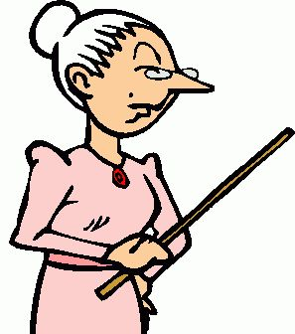
What your examiners say
The most effective conclusions draw the essay to a
satisfying sense of an argument having been proven; they do not simply summarise the points just made, nor do they introduce new analysis.
The most successful student responses directly addressed the chosen prompt, offering original insights and a clear enthusiasm for sharing interpretation of the works in relation to their argument developed around the chosen question. Examiners were impressed by fresh perspectives and in-depth knowledge and understanding demonstrated by some students.
Extract from May 2024 Subject Report

Slide 9

Points to Remember
Your task is to write a compare-and-contrast essay, so begin each paragraph with an idea about how the works are similar or different.
Present a limited number of examples per work per paragraph to support what you say about how the works are similar or different. One or two examples is enough. Do not fall into the trap of writing a list of features or retelling the story of the works! Strictly control the length of your paragraphs.
End each paragraph by returning to the compare/contrast point, restating how the works are similar or different, ideally providing insight into the similar or different ideas created by writers.

