Slide 1
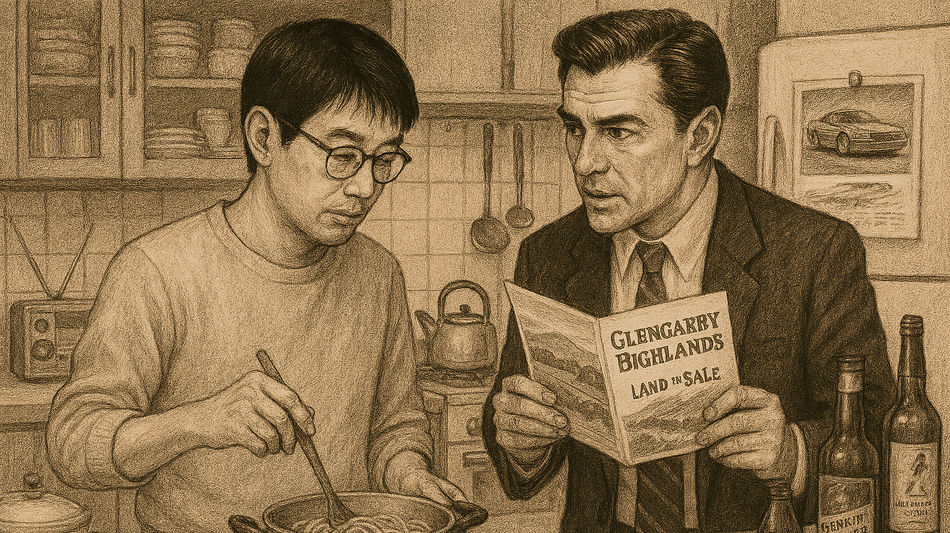
Compare and Contrast (Paper 2)
Sample Answer using The Elephant Vanishes and Glengarry Glen Ross

Slide 2
Sample Introduction
Writers can present their ideas in unusual or thought-provoking ways. How, and to what effect, has this been shown in two works you have studied?
David Mamet and Haruki Murakami are writers who use literary works to provoke thoughts about the world in which we live, and particularly the global capitalist, corporate systems that drive the world’s culture. In Murakami’s The Elephant Vanishes stories, characters struggle to find meaning in a world of convenience while in Mamet’s play Glengarry Glen Ross characters are pitted against each other in a dog-eat-dog sales contest, revealing the worst aspects of capitalist society. While Murakami is a novelist and Mamet a playwright, nevertheless there are similarities in the thought-provoking ways they present ideas. For example, both writers use physical spaces to show that proximity to others doesn’t always equate to intimacy. Furthermore, both writers use corporate jargon to show how the modern world is stripped of meaning, richness and culture. Of course, there are many differences between Mamet’s play and Murakami’s prose, particularly in the writers’ use of symbolism. On one hand, Mamet uses off stage characters to symbolize how the men’s world is controlled by unseen forces; on the other hand, Murakami uses ambiguous symbols to provoke thoughts about the meaning of our lives in a world stripped of human intimacy and connection.
Clarify the terms of the question as you understand them at the start of your answer.
Introduce the two works you will use to answer the question.
Set out your compare-and-contrast thesis: in what ways are the works similar and different in terms of the question?

Slide 3

What your examiners say
Creating introductions that provided a clear thesis statement or sense of the forthcoming argument proved challenging for some students. Too often introductions became convoluted with contextual information or lost the sense of the demands of the chosen question as it moved along into the body of the response.
Students should practice crafting introductions that present the works, and deliver a clear thesis or argument that allows them to set up their response well for better subsequent development of ideas.
Extract from May 2024 Subject Report

Slide 4
Sample Main Body Paragraph 1: compare both works
Both writers use physical space to show how proximity between characters does not always equate to intimacy. For example, in Murakami’s The Elephant Vanishes collection, in the first story the narrator and his wife live in a suburban Tokyo house. The house is small and intimate, yet there is a noticeable distance between the narrator and his wife. He positions himself in the kitchen and immerses himself in simple household activities such as cooking spaghetti and ironing shirts, all the while finding ways to avoid going outside. He doesn’t share his wife’s priorities; for example, he refuses to accept a job writing ‘make-do poetry’ for a magazine she found for him and delays going to search for their missing cat, which is her constant request. At the end of the story, he isolates himself in the kitchen while his wife is in another room crying; he finds it difficult to reach out and focuses on his own thoughts instead. Their separation in the same space signals the distance that has grown between them; even though they live together, there is a gap of understanding and communication that cannot be resolved. Similarly, Mamet uses the physical space of the stage to place his characters in close proximity, yet provokes the thought in his audience that the men are trapped in their own separate worlds. The office is an intimate, closed environment in which the men work together, rub shoulders, and talk constantly. Yet each man has his own priorities that he doesn’t share with others: Moss is secretly planning to rob the office; Roma is intent on his own success, demanding to know whether the sale he closed has been filed with the bank; Levene lives in the past, reminiscing about his former sales glories. Similarly, in Act One when the men relocate to a Chinese restaurant, Mamet splits them into three pairs, each cloistered in their own separate booths. Each pair performs a duologue that is entirely separate from the other pairs. Therefore, both Mamet and Murakami use physical space as a thought-provoking way to show that, in the modern world, people who could be intimate are instead isolated, forced by the pressures of work or marriage into their own little ‘cubicles’ of thought.
It’s a good idea to make your first section about both works.
Words like ‘similarly’ show you’re focused on the task of comparison. Using connectives throughout your writing sends a clear signal to your reader that you’re on task.
Go back to the question at the end of the paragraph, drawing together your points about both works.

Slide 5
Sample Main Body Paragraph 2: compare both works
Furthermore, both writers use corporate and commercial jargon as a thought-provoking way of suggesting that the modern world is driven by capitalist imperatives, and showing how, even as we enrich ourselves financially, we lose something in the process. For example, in the title story of The Elephant Vanishes collection, the narrator talks about his work in the PR section of an electrical appliance manufacturer. While he is in Japan and speaks Japanese, he pointedly uses the English word ‘kitch-en’ as part of his marketing for new appliances. He stresses that what people like about his company’s ‘kitch-en’ is the ‘unity of design, unity of function’. In these phrases, repetition of words and sentence patterns suggest the way the modern world is not harmonizing but homogenizing, losing distinct and unique aspects as everything becomes the same. The English word ‘kitch-en’ implies how Japan is losing its distinctive character and, through globalisation, becoming more like the global west. To reinforce this thought, Murakami laces his stories with a modern vocabulary of brands and advertising: Coca Cola, KFC, Johnny Walker, Sony, McDonalds and many more pepper the pages of the stories, implying how Japan’s traditional identity is being overtaken by corporations whose primary aim is profit. The narrator even admits that his ‘pragmatic’ worldview makes him financially successful, although he feels that he’s not happy or content with this life. Likewise, Mamet’s characters speak in the clammy jargon of a real estate sales office. They use words like ‘leads’, ‘sits’, and ‘closing’ to describe interactions with their clients, who they see only as resources to be exploited. The word ‘lead’ is dehumanizing, reflecting how capitalism corrupts human connections into something transactional. This is further reflected through transactional dialogue, such as when Roma tells Williamson: “what’s mine is mine, what’s his is half mine.” Like Murakami, through jargon-laden language, Mamet shows his audience that the men think and feel in the mode of sales; their jobs define them more than any other aspect of their personalities. Therefore, both writers use corporate language and jargon as a thought-provoking way of implying that, in the modern world, people are losing their own unique identities, and are reduced to representatives of a corporate, consumer culture that just wants them to work, sell, and replicate the same brands and products in the pursuit of profit above all else.
Focus your comparison paragraphs on a shared aspect of both works: in this case, use of language
Connectives like ’equally’, ‘likewise’ and ‘just like’ signpost comparisons. Your reader will be looking for these throughout your essay.
The end of the paragraph restates the comparison point about use of language and the effect created in both works. So far, the answer is completely on task.

Slide 6
Sample Main Body Paragraph 3: contrasting works
While both writers use symbolism to provoke further thought into the ways characters are subsumed by capitalist forces, the way they do so is different. As a playwright, Mamet uses off-stage characters to symbolize the unseen power dynamics of the men’s lives. While on stage, the men do everything they can to assert control over one another – beg, borrow, steal, lie – all to further their own interests. Yet the most powerful and influential characters are off-stage and never seen. For example, despite their misogynistic worldviews (the salesmen associate women with housework, commenting only on their cooking and housekeeping), Lingk’s wife foils Roma’s scheme by insisting her husband cancel the sales contract. Despite all his persuasive guile, Roma is unable to influence this decision as Lingk’s wife remains safely off-stage, away from his malign control. Furthermore, the men’s fates are decided by the office bosses, Mitch and Murray, who have set up a Darwinian sales contest in which whoever is at the bottom of the sales board at the end of the month will be fired. Brutally, they reserve the most promising leads for salesmen who ‘close’, ensuring that the competition favours those who are most likely to bring them the profits they crave. Mamet uses the off-stage characters of Mitch and Murray as a thought-provoking way to show how, in a capitalist system, individual power is an illusion: people are always at the mercy of unseen forces that set the agenda and control the distribution of resources. In the real world, as in the play, this results in huge inequality between those who have access to resources and those without. Therefore, throughout the play, Mamet’s use of off-stage characters symbolizes the world’s true powers: the men can’t see them, so turn on each other, ensuring the system of winners and losers is perpetuated.
This transition sentence moves the essay from the ‘compare’ stage to the ‘contrast’ stage.
In the ’contrast’ section of the essay, the approach changes. This paragraph focuses on one work only, waiting to draw contrasts until the final paragraph.
As Paper 2 is closed book, you do not need to include exact quotations in your essay. This approach of paraphrasing while embedding only key words is effective.
The response answers both parts of the question: ‘how’ and ‘to what effect’.

Slide 7
Sample Main Body Paragraph 4: contrasting works
While Murakami’s symbolism of the unseen is similar in some ways to Mamet’s off-stage characters, the motif of vanishing provokes slightly different thoughts in Murakami’s readers. Throughout his stories, objects, animals, and even people mysteriously disappear without trace, sometimes destabilizing the narrators but, more often, causing no ripples in the lives of those who lose them. For example, in Little Green Monster, a lonely woman is approached by an ugly creature who offers her love and companionship. Blinded by his monstrous appearance, the woman rejects his offer and, more, tortures him until he vanishes. At the end of the story, it’s implied that she continues her monotonous and lonely life. The monster seems to have made no impression, vanished as mysteriously as he appeared, suggesting that the modern world erodes our natural capacity for empathy with others. By contrast, the disappearance of the elephant in the collection’s title story completely destabilizes the narrator. While others around him soon lose interest in the unexplained event, he obsesses over how the elephant disappeared from his enclosure, going so far as to collect newspaper clippings and keeping a scrapbook of references to the mystery. His obsession causes a disconnect with those around him; when talking about the elephant, his listener becomes confused, saying she “can’t understand him” anymore. So too does the narrator of Barn Burning become destabilized, completely changing his life’s routine and hunting for barns that he believes are at risk of disappearing. Like in other Murakami stories, barns are unusual symbols of traditional, historical cultures and traditions that are vanishing in our modern, homogenized world. The way characters are destabilized by this implies the mental and spiritual harm caused when ties to their past are erased and replaced by corporate blandness. Therefore, despite his unusual motif of vanishing differing from Mamet’s use of off-stage characters, both methods are ways of provoking thought about how things we can’t directly perceive nevertheless have a profound effect on our wellbeing and the emotional balance of our lives.
Contrasts can also be linked. You shouldn’t be worried about evaluating works that are ‘similar-but-different’.
‘Balance’ between the two works is assessed in Criteria C. The structure of this essay ensures the treatment of both works is ‘balanced’. Equal attention is paid to each work.
At the end of this section, the contrast between the two works is restated and the way the works are ‘different-but-similar’ is evaluated.

Slide 8
Sample Conclusion
In conclusion, while Mamet and Murakami write in vastly different literary genres (prose and drama) – and come from very different places in the world (Japan and the US) – nevertheless their works both provoke thoughts about our modern, capitalist, consumer societies and the effect such cultures have on individuals. Both play and stories show how people are losing connections with each other, inhabiting ‘cubicles’ of thought that isolate us in our own worlds. Both works lament the passing of an authentic, traditional world, and both feature hidden, looming forces that secretly determine the direction of our lives.
Use the words of the question again in the essay’s conclusion.
The evaluation of the works is that they are more similar than different in terms of the ideas identified.
The final line attempts to leave the reader with a ‘sense of ending’.

Slide 9

What your examiners say
The most effective conclusions draw the essay to a
satisfying sense of an argument having been proven; they do not simply summarise the points just made, nor do they introduce new analysis.
The most successful student responses directly addressed the chosen prompt, offering original insights and a clear enthusiasm for sharing interpretation of the works in relation to their argument developed around the chosen question. Examiners were impressed by fresh perspectives and in-depth knowledge and understanding demonstrated by some students.
Extract from May 2024 Subject Report

Slide 10

Points to Remember
Your task is to write a compare-and-contrast essay, so begin each paragraph with an idea about how the works are similar or different.
Present a limited number of examples per work per paragraph to support what you say about how the works are similar or different. One or two examples is enough. Do not fall into the trap of writing a list of features or retelling the story of the works! Strictly control the length of your paragraphs.
End each paragraph by returning to the compare/contrast point, restating how the works are similar or different, ideally providing insight into the similar or different ideas created by writers.

