Slide 1
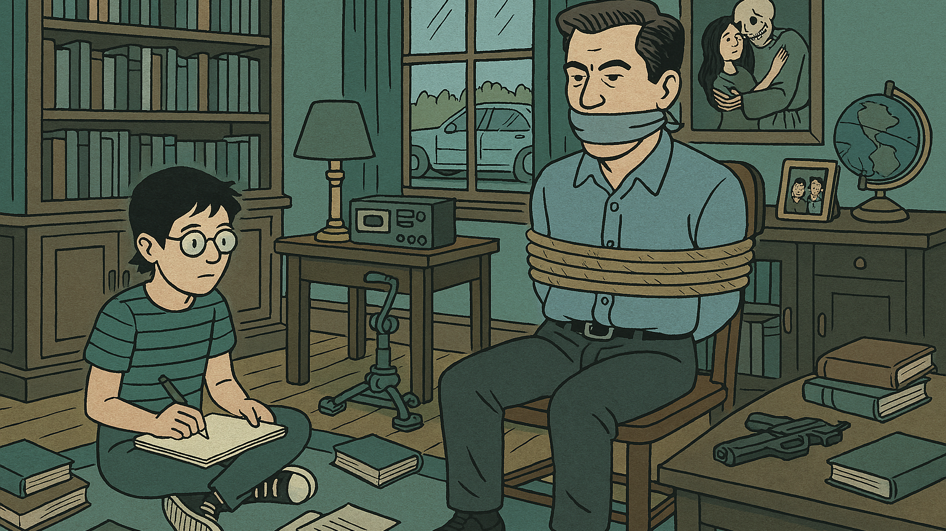
Compare and Contrast (Paper 2)
Sample Answer using Death and the Maiden and Fun Home

Slide 2
Sample Introduction
The struggle against injustice is a theme that speaks to people. Compare and contrast the ways in which the authors of literary works depict unjust worlds.
Ariel Dorfman and Alison Bechdel are writers who both tackle the theme of injustice through literature. Both Dorfman’s Death and the Maiden and Bechdel’s Fun Home depict unjust worlds: Dorfman’s play is set in a country transitioning from dictatorship to democracy and Bechdel’s graphic novel depicts Alison’s childhood in 1980s America, a heteronormative society that expects people to express mainstream sexual identities, something Alison’s father forced upon her when she was young. However, the methods the writers use to depict these unjust worlds are different: as a graphic novelist Alison uses illustration, body language and framing to depict the unjust world of her childhood whereas, being a playwright, Dorfman uses stagecraft such as lighting and sound to depict the lingering injustice of the recent dictatorship on Paulina Salas, who struggles in the aftermath of her imprisonment and torture by the previous dictator’s thugs.
Introduce the writers and works you will use to answer the question.
Clarify the terms of the question as you understand them at the start of your answer.
Set out your compare-and-contrast thesis: in what ways are the works similar and different in terms of the question?

Slide 3

What your examiners say
Creating introductions that provided a clear thesis statement or sense of the forthcoming argument proved challenging for some students. Too often introductions became convoluted with contextual information or lost the sense of the demands of the chosen question as it moved along into the body of the response.
Students should practice crafting introductions that present the works, and deliver a clear thesis or argument that allows them to set up their response well for better subsequent development of ideas.
Extract from May 2024 Subject Report

Slide 4
Sample Main Body Paragraph 1: compare both works
Both writers depict unjust worlds through the eyes of characters who experienced injustice directly: in Death and the Maiden, Paulina Salas was forcibly imprisoned, tortured, and raped under a dictatorship that used violent tactics to repress political opposition; while not as explicit as Paulina’s experiences, in a way, Alison was ‘tortured’ as a child by her father who, due to his own struggles with sexuality, forced a heteronormative identity onto his daughter. Furthermore, both writers show how historical injustice continues to impact people long after the events took place. In Paulina’s case, her imprisonment happened seventeen years ago, yet the events continue to haunt her. She tells Roberto, a doctor she suspects of being complicit in the crimes against her, that she “still hears his voice everyday”. More, she can still feel the texture of his skin and smell the garlic on the breath of her kidnappers. Through Paulina’s words, Dorfman explores how injustice collapses time, trapping victims in a past world from which they cannot escape: Paulina’s experiences have invaded her sense perceptions until she cannot help but experience the present through the prism of the past. In this way, Dorfman explores how injustice works its way into a person’s body where it remains lodged. This explains Paulina’s extreme actions in the play: kidnapping, tying up, and interrogating Roberto is her way of trying to exorcise the ghosts of the past and expel injustice from her body. Similarly, Alison Bechdel shows how historical injustice lingers, in this case using herself as the example. Alison is the narrator of her own story, telling readers of the overbearing and forceful presence of her father who forced her to ‘perform’ a heteronormative childhood. He would dress her in overtly feminine clothes and style her hair in pigtails with ribbons, despite Alison’s preference for boy’s clothes and short hair. In the early chapters of her novel, she depicts her father as a ‘looming’ presence, often using low angles to draw him from a child’s point of view, or drawing him as a dark silhouette against a light background. When dressing Alison in a barrette, he places his hand on her head, and Alison uses close-up framing to create a strong impression of her father’s control. These choices depict him as a malevolent, controlling, and sinister figure who perpetrated injustice on Alison as a child. In a way, Fun Home is Alison’s way of implying the way this trauma has lingered: like Paulina, she needs to expel this trauma from herself, so uses the process of drawing and writing to process what happened to her. While this is not as extreme as Paulina’s reactions, nevertheless, creating a graphic novel requires considerable time and work, immersing oneself in unpleasant memories and collapsing the time between the past and present. Therefore, both works depict characters who were victims of past injustice struggling to overcome this in their own ways.
This sentence clearly explains how the works can be interpreted in a similar way in light of the question.
Words like ‘both’, ‘similarly’ and ‘like’ should be used to compare the two works. Using connectives throughout your writing sends a clear signal to your reader that you’re on task.
The end of this paragraph effectively draws comparisons between the two works, using the words of the question.

Slide 5
Sample Main Body Paragraph 2: contrasting works
However, as playwright and graphic novelist, Bechdel and Dorfman use contrasting methods to depict the unjust worlds in which their characters reside. On one hand, Dorfman opens Death and the Maiden with an extended stage direction describing Paulina’s secluded beach house where she is staying with her husband Gerardo. Stage directions indicate how the sound of passing cars disturb the serenity of the house. Additionally, as cars pass, headlights shine through the windows, strafing the scene like searchlights. As the play opens, Paulina hides behind the curtains, visibly nervous and agitated. Dorfman uses the stagecraft of light and sound to imply an unjust world where characters still live in fear of reprisals by agents of the former dictator. Having only recently transitioned to democracy, Dorfman combines light and sound to create a tense, fragile atmosphere on stage, not only reflecting Paulina’s fragile state of mind, but suggesting that the country is not as safe and secure as the audience might think. On the other hand, as a graphic novelist, Alison uses techniques of illustration to depict the injustices of her childhood home. She thinks back to the Gothic revival mansion in which her family lived when she was young, depicting the house as something of a labyrinth, twisting corridors, ornate passages, secretive rooms, such as her father’s library, at the center of the maze. Through allusions to Greek mythology, she conveys her upbringing as ‘monstrous’, even going so far as to compare her father to the minotaur lurking in the depths of the labyrinth. The library and her father’s desk is a forbidden place for young Alison, so she draws these spaces using slanted and low angles, conveying the forbidding atmosphere of her father’s space. When drawing herself or her siblings, Alison depicts the children as very small, suggesting how powerless they all were under her father’s control. When her father is around, Alison is often confined inside rooms or in the car, such as in the scene at a petrol station, where Alison is separated from a more inclusive world (she sees a butch woman with short hair filling up her car) by being kept inside the car. Therefore, while both works suggest the physical and emotional effects of past injustice on Paulina and Alison, the methods of presentation vary enormously because of the different literary genres of drama and graphic memoir.
This sentence transitions from comparison of the works’ themes to contrasting the works’ methods, just like the question asked.
Connectives like ‘on one hand’, ‘on the other hand’, and ‘by contrast’ signpost contrasts. Your reader will be looking for these throughout your essay.
The end of each paragraph restates compare-and-contrast points, drawing the works together. It’s good to evaluate where the works are ‘similar-but-different’ at the same time.

Slide 6
Sample Main Body Paragraph 3: contrasting works
Finally, while Dorfman depicts a world in which injustice is impossible to overcome, Bechdel shows how individuals can come to terms with and rise above historical injustice. At the end of the play, Dorfman once again uses dramatic devices, such as off-stage action and lighting, to craft an ambiguous ending that denies the possibility of injustice being fully redressed. Once she extracts a confession from Roberto, it is strongly implied that Paulina murders her once-torturer. Sending Gerardo on an errand, she takes Roberto outside with a gun. However, as the killing happens off-stage the audience cannot be certain that Paulina goes through with the murder. She had previously promised to release Roberto, and the audience has to accept that this is still a possibility. In the play’s final scene, set months later in a theater, Paulina sees Roberto in the audience. However, Dorfman’s stage direction indicates that Roberto is bathed in a “phantasmagoric light”. As the connotations of this word are ghostly, the implication seems to be that Roberto is dead and, like Banquo’s ghost returned to haunt Macbeth, now symbolizes Paulina’s guilt at taking on the methods of the dictatorship to overcome her personal traumas. Yet, in another twist, Paulina’s husband speaks to Roberto, so we still cannot be certain of whether he is dead or alive. This ambiguity is fully intentional: through the combination of off-stage action, lighting, and dialogue Dorfman conveys to the audience Paulina’s failure to overcome historical injustice through violent means.
Both point-by-point structure (writing about both works in one paragraph) and block structure (writing about one work then writing about the next) are valid ways to compare-and-contrast. This paragraph focuses on only one work; the next will draw contrasts.
As Paper 2 is closed book, you do not need to include exact quotations in your essay. This approach of paraphrasing while embedding only key words is effective.

Slide 7
Sample Main Body Paragraph 4: contrasting works
By contrast, Bechdel uses illustrative methods to suggest that, although the process may be difficult, it is possible to struggle successfully against and rise above historical injustice. Bechdel depicts scenes of comparative tenderness between herself and her father. On the first page of her story, she draws young Alison playing with her father as he balances her airplane style on his upraised legs. Her arms are wide and her facial expression happy, depicting an alternative to the forbidding and sinister images of her father that we are later presented. The size of this panel, splashed across the whole page, suggests that this is a powerful and important moment. Despite what the reader later learns about their relationship, this image lingers in the memory implying that Bechdel wants to temper criticism of her father in her work. Furthermore, unlike Dorfman who depicted only antagonism between Paulina and Roberto, Bechdel depicts an important moment of rapprochement between her and her father. Towards the end, she draws an extended scene of them sitting side-by-side as he confesses the truth of what he’s done. Bechdel uses repetition and graphic matching to draw the same panel over and over, with only subtle changes in facial expression as her father speaks. His voluntary admission of the truth, even partial, is one of the only times in the story that her father exposes himself and shows vulnerability. It allows the reader to see that truth is a vital starting point for reconciliation. While confession is a point of comparison between both works, the difference here is that Alison’s father’s confession was voluntary while Roberto’s was forced. Because of this difference, the audience cannot trust that what we are hearing really is the truth or is just Roberto saving himself by saying what Paulina wants to hear. Therefore, the works use contrasting approaches to explore the struggle against injustice, yet point towards the same understanding of truth being a necessary first step in coming to terms with and moving on from injustice when living in unjust worlds.
Because the last paragraph was focused on one work, this paragraph will draw contrast using the second work.
‘Balance’ between the two works is assessed in Criteria C. The structure of this essay ensures the treatment of both works is ‘balanced’. Equal attention is paid to each work.
At the end of this section, the contrast between the two works is restated and the way the works are ‘different-but-similar’ is evaluated.

Slide 8
Sample Conclusion
In conclusion, the struggle against injustice takes many forms in literary works, from the need to recover after wrongful imprisonment and torture, to the desire to escape the malign influence of an overbearing father. Furthermore, different writers like Dorfman and Bechdel use different literary genres (drama and graphic memoir) to explore this theme. Yet the roots of coming to terms with the injustices of the world are similar in each story: both writers encourage facing injustice honestly, beginning with simply speaking out, writing, or drawing the truth, as the first step in the road to reconciliation and recovery.
Use the words of the question again in the essay’s conclusion.
The similarity of theme and difference in methods is evaluated at the end.
The final line attempts to leave the reader with a ‘sense of ending’.

Slide 9


What your examiners say
The most effective conclusions draw the essay to a
satisfying sense of an argument having been proven; they do not simply summarise the points just made, nor do they introduce new analysis.
The most successful student responses directly addressed the chosen prompt, offering original insights and a clear enthusiasm for sharing interpretation of the works in relation to their argument developed around the chosen question. Examiners were impressed by fresh perspectives and in-depth knowledge and understanding demonstrated by some students.
Extract from May 2024 Subject Report

Slide 10

Points to Remember
Your task is to write a compare-and-contrast essay, so begin each paragraph with an idea about how the works are similar or different.
Present a limited number of examples per work per paragraph to support what you say about how the works are similar or different. One or two examples is enough. Do not fall into the trap of writing a list of features or retelling the story of the works! Strictly control the length of your paragraphs.
End each paragraph by returning to the compare/contrast point, restating how the works are similar or different, ideally providing insight into the similar or different ideas created by writers.

