Slide 1
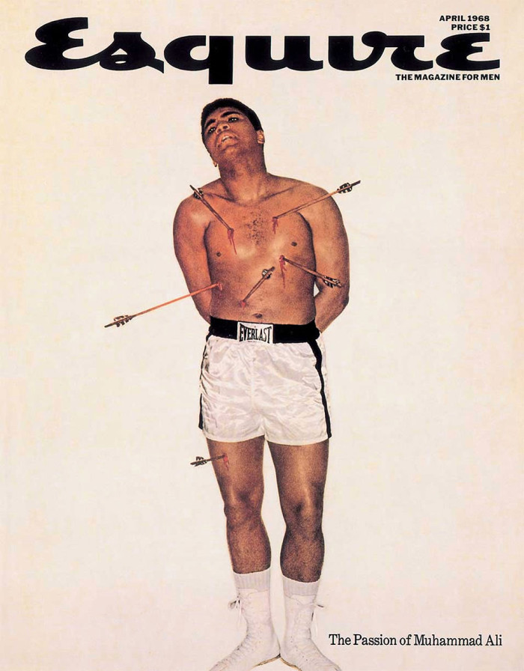
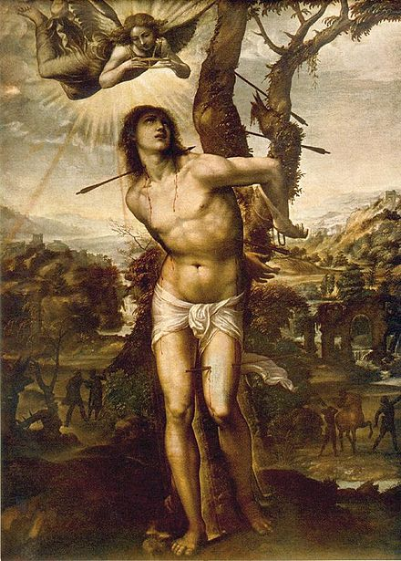
Intertextuality
Relationships between texts

Slide 2
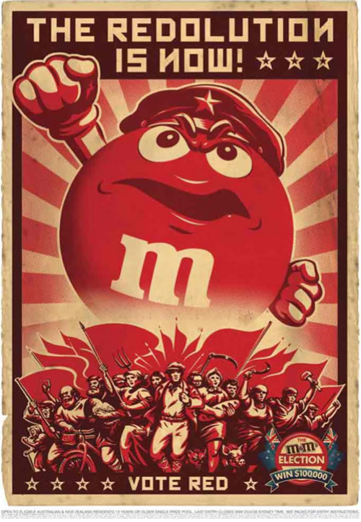
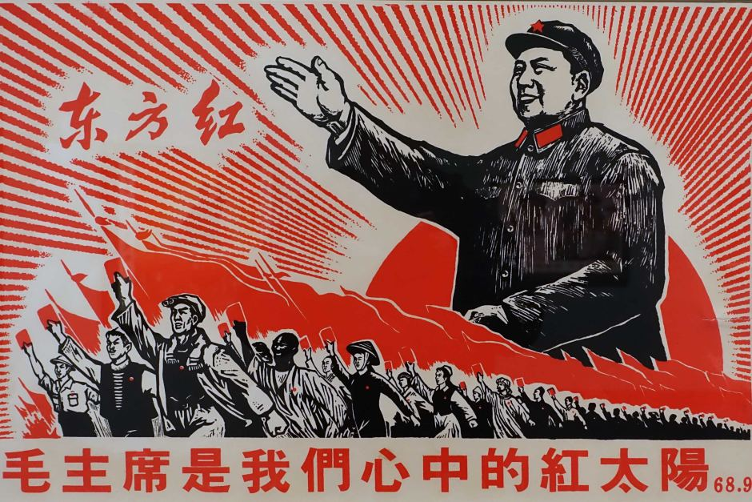
Introduction
Texts can borrow structures and styles from other texts or text types. Writers often imitate other writers, in order to convey their own meaning. This process of imitation purposefully forms relationships between one text and another. This relationship is known as intertextuality.

Slide 3
Connecting texts
Look at the pairs of imitating texts. What is the relationship of one text to the other?
(Scroll down to find answers and explainers.)
  Imitation: texts can borrow structures and styles from other texts or text types, in order to convey their own meaning.
  Homage / Pastiche: one author can pay tribute to another author by imitating the author’s style (possibly giving credit to him or her for inspiration).
  Mash-up: writers can take elements from different source texts and mix them, or 'mash' them up, to make a new, original text.
  Repurposing: texts can be taken out of their original context and used in another context, serving another purpose.
  Allusion: suggest a similarity to an original text, often a famous or recognisable text, in order to suggest a common purpose, association, or comparison.
  Parody / Satire: exaggerate form and language, making fun of the original text, its purpose and style.
  Spoof: very similar to, but slightly different from, parody. Rather than making fun of a particular text or person, spoof makes fun a particular genre of texts or medium, such as a particular genre of films.
  Plagiarism: one author copies the work of another author without giving credit to him or her.

Slide 4
allusion
Mash up
parody
‘The Passion of Muhammed Ali’ by Carl Fischer for Esquire Magazine, 1968
‘The Martyrdom of Saint Sebastian’ by Il Sodoma, 1525

Slide 5
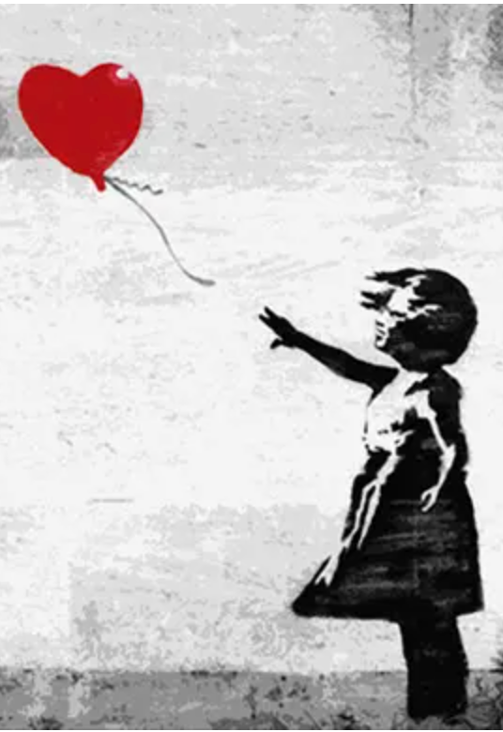
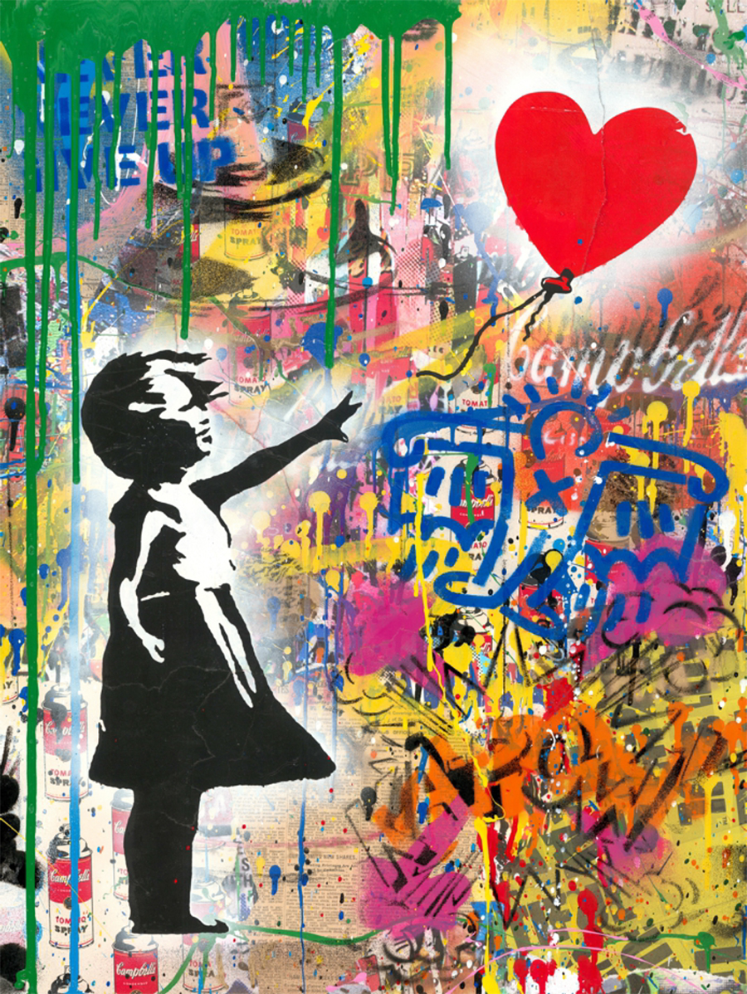
plagiarism
allusion
repurposing
‘Girl with a balloon’ by Banksy, 2002
‘Balloon Girl’ by Mr Brainwash, 2019

Slide 6
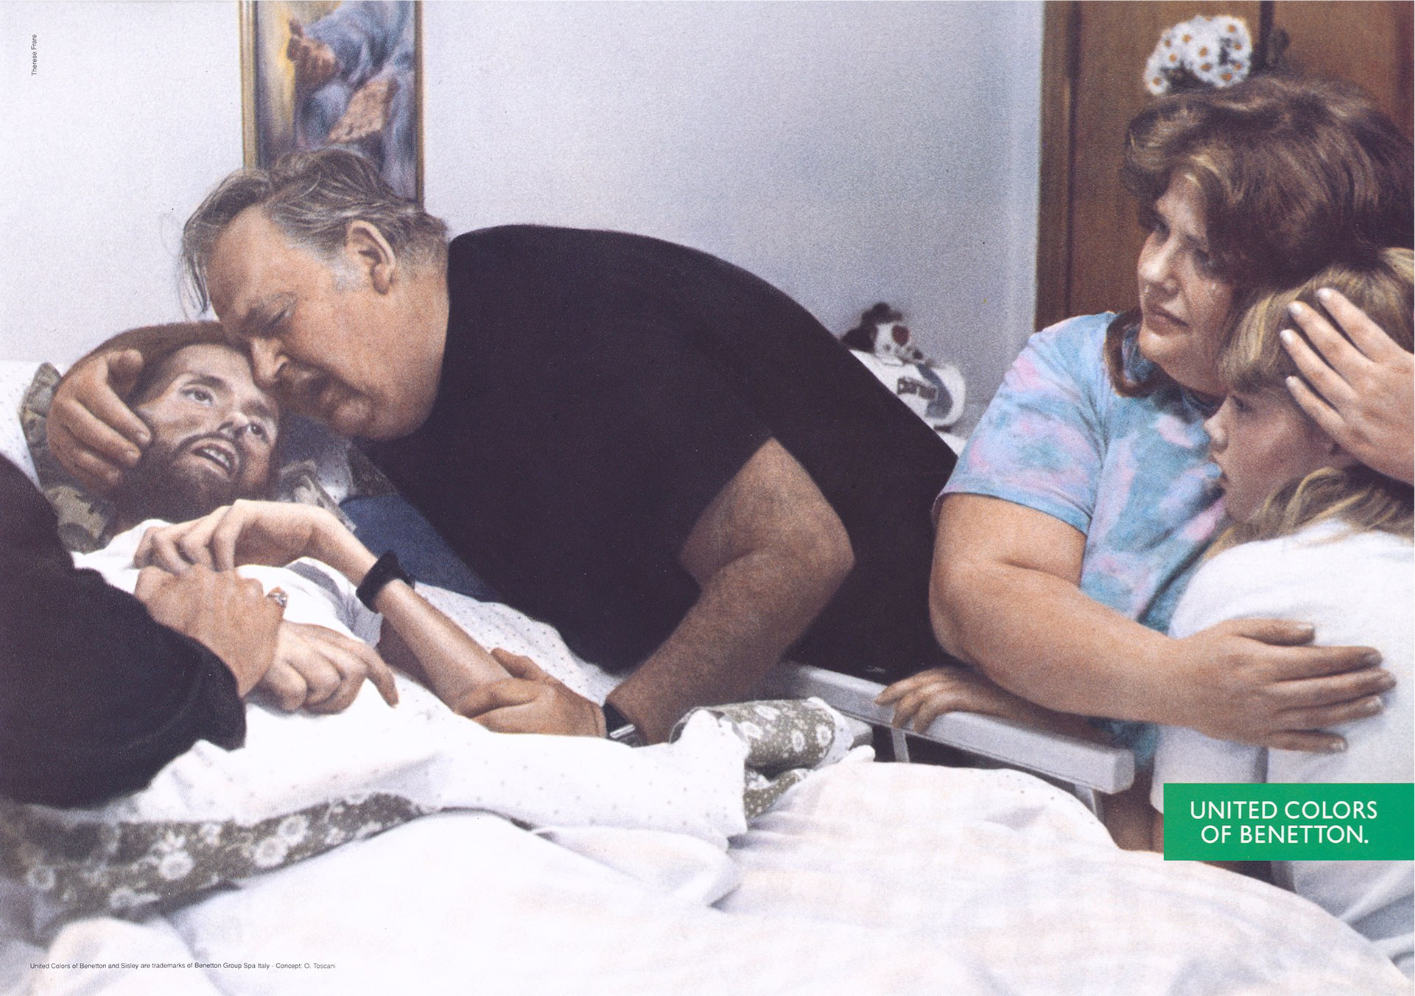
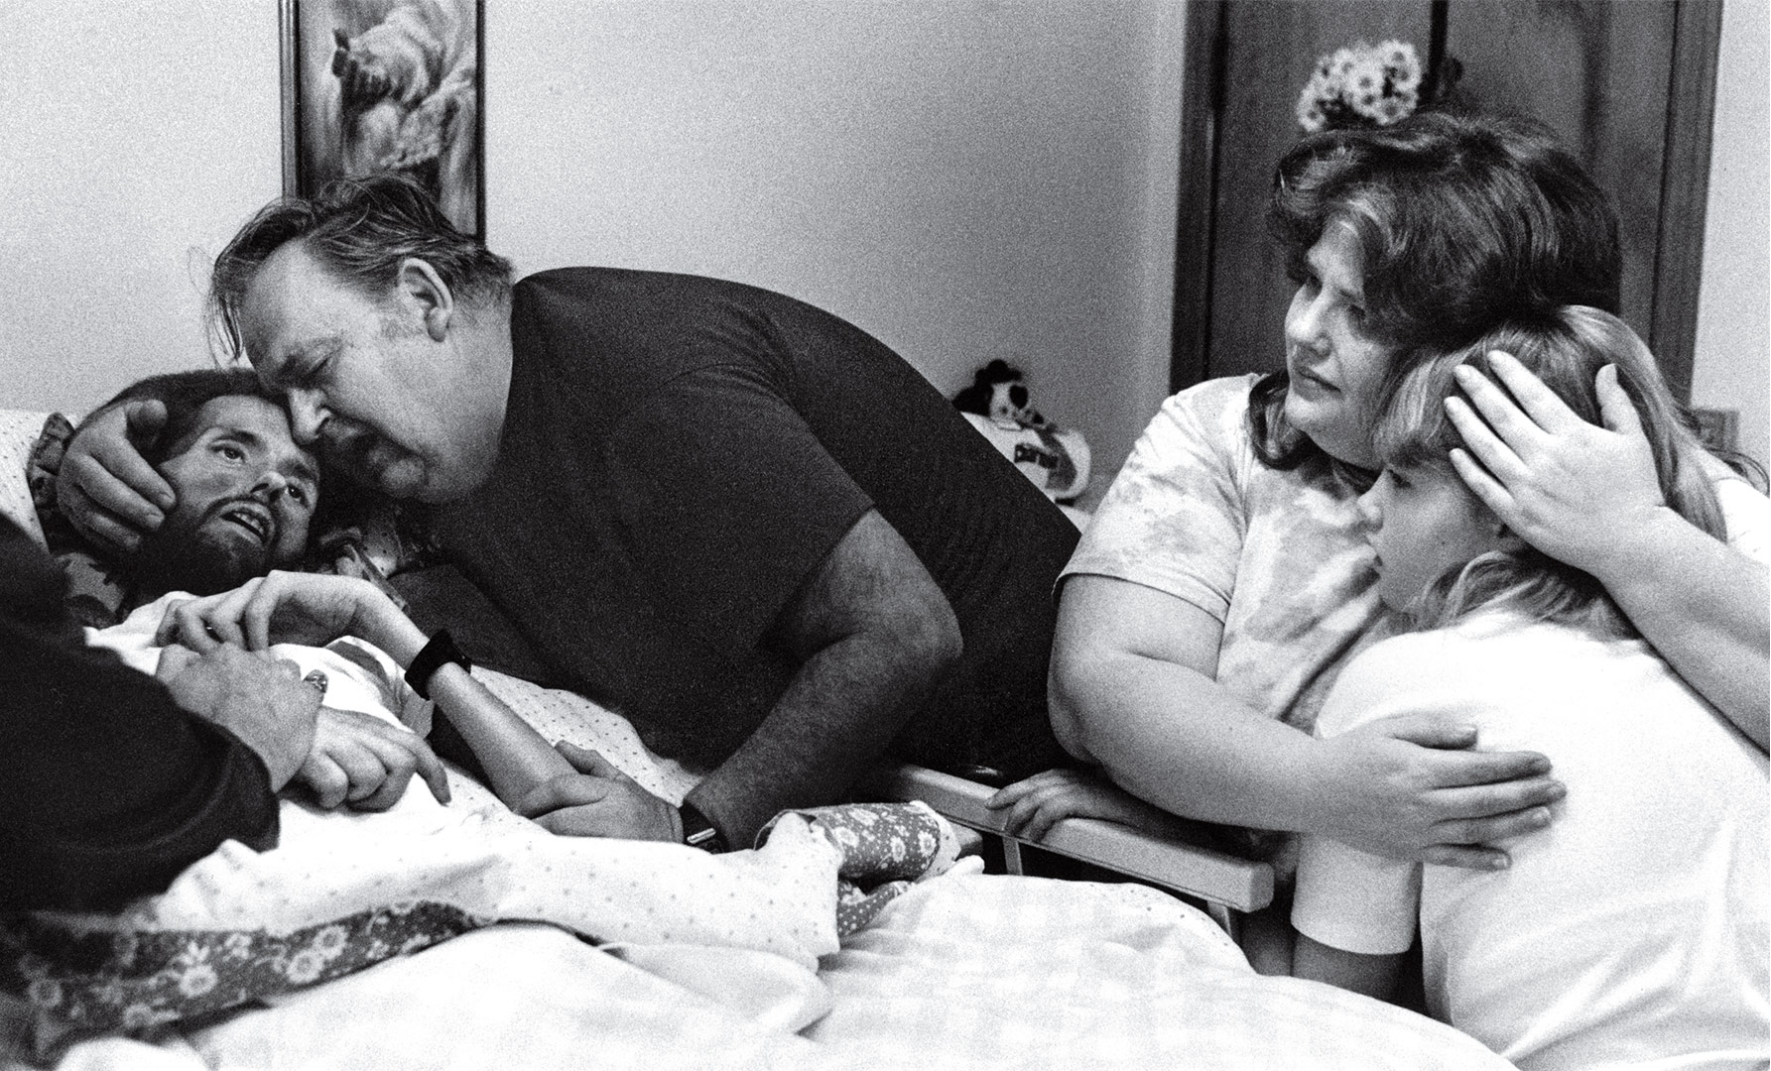
repurposing
spoof
imitation
‘La Pieta’ advert by Oliviero Toscani for Benetton, 1992
‘David Kirby’s final moments’, by Therese Frare, 1990

Slide 7
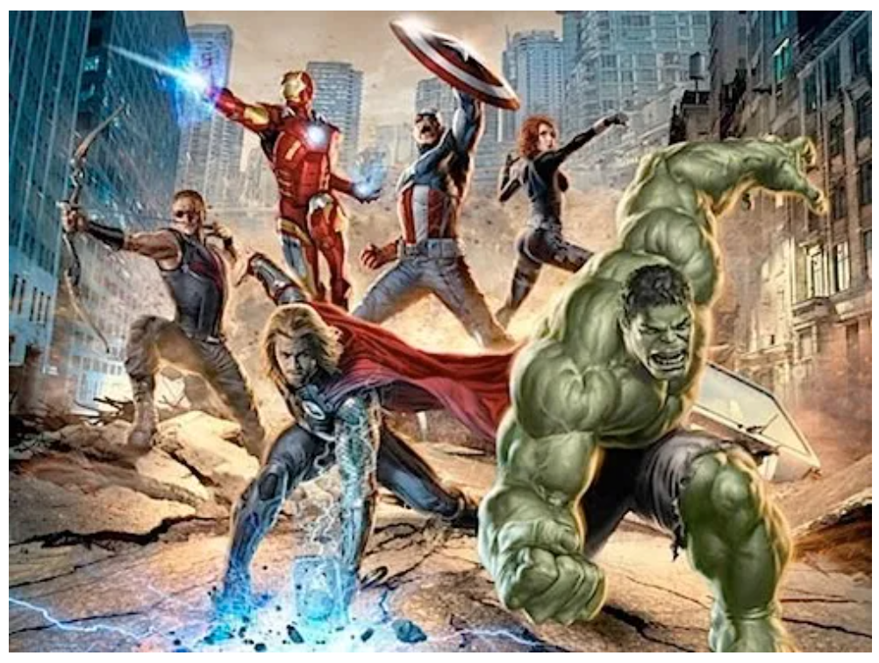
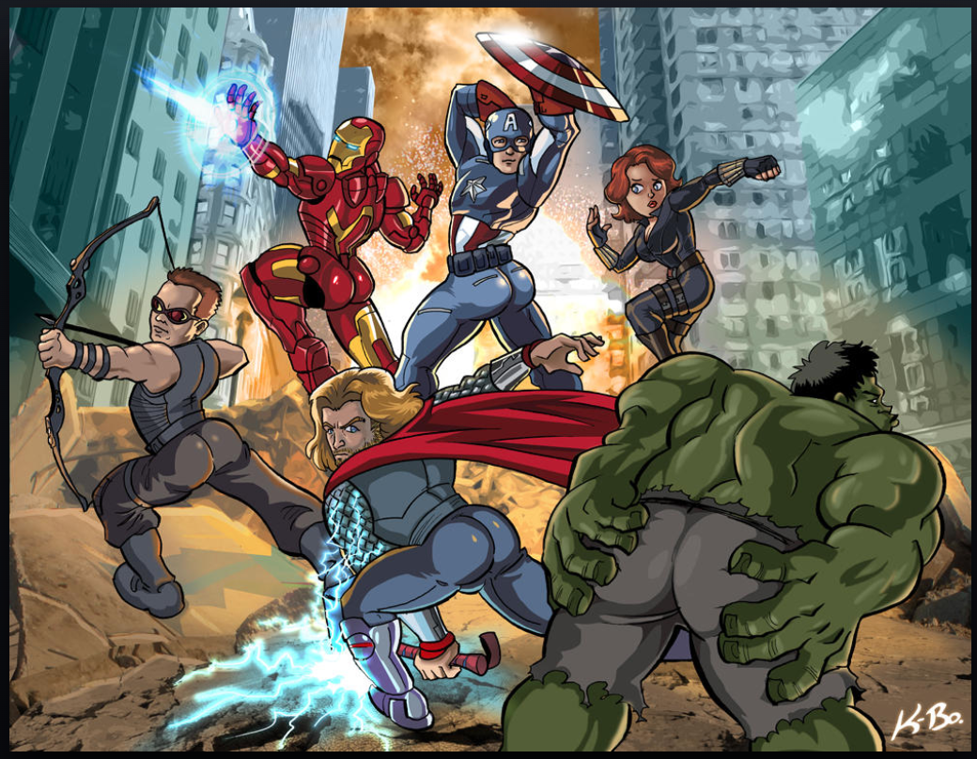
Parody
Mash up
Plagiarism
‘Avengers Assemble’ promotional poster, 2011
‘Avengers Booty Ass-emble’ by Kevin Bolk , 2011

Slide 8
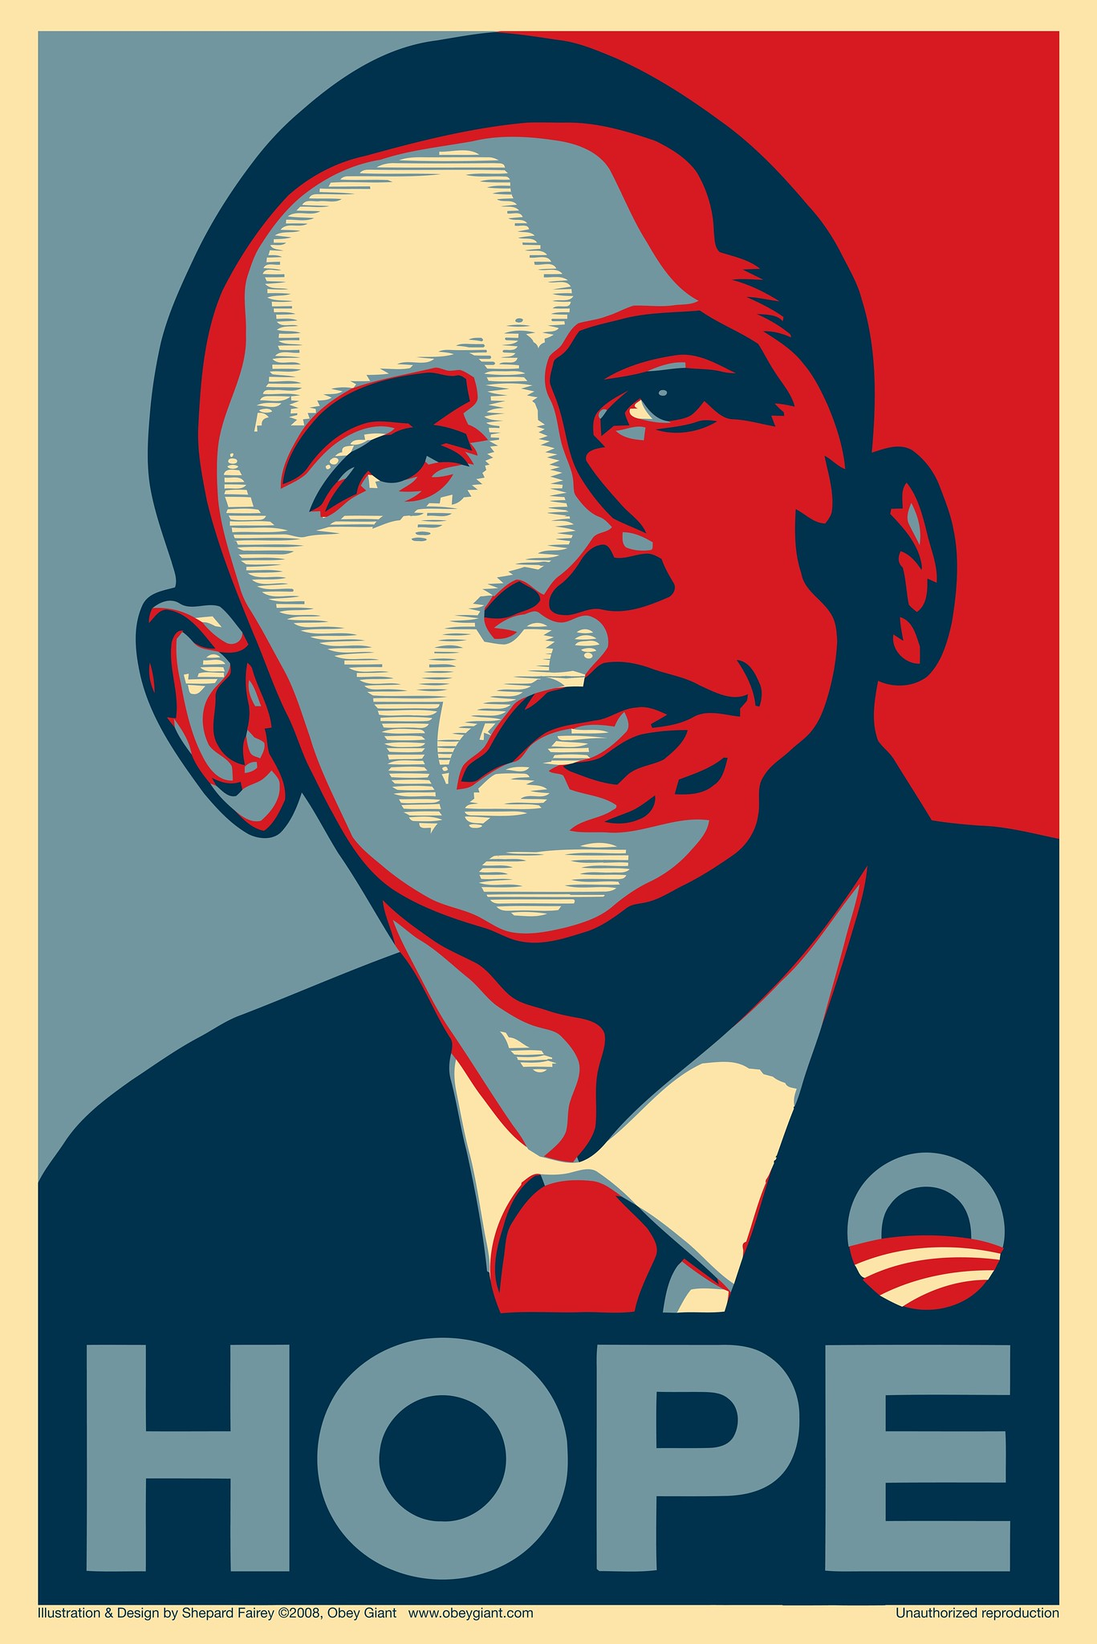
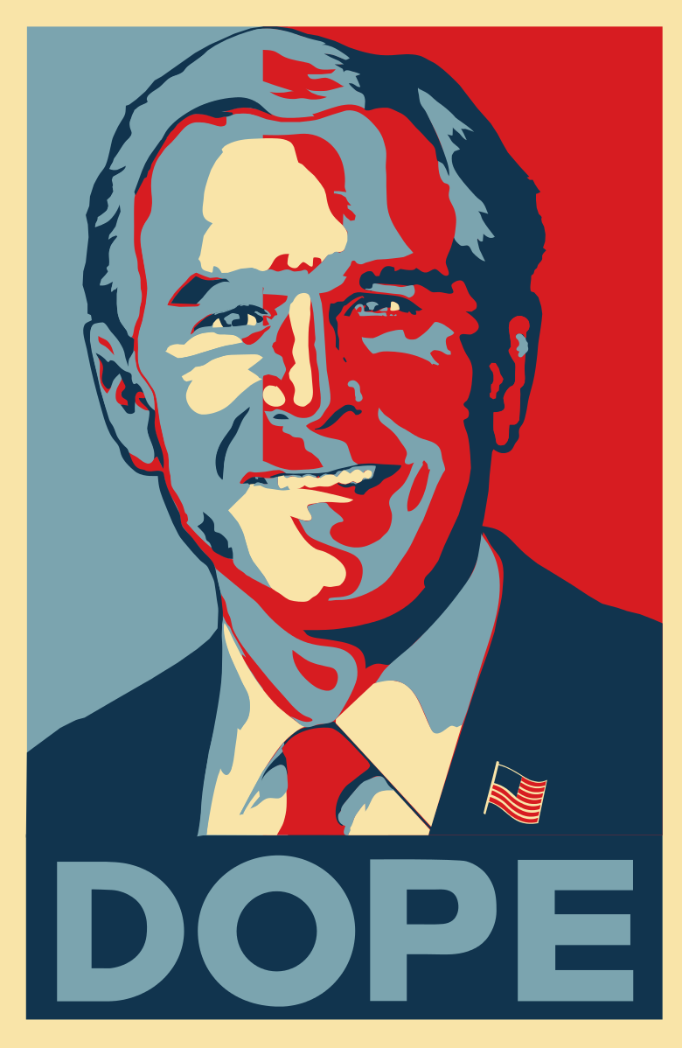
Imitation
homage
Parody
‘Hope’ by Shepard Fairey, 2008
‘Dope’ by Jeff Rankin, 2009

Slide 9
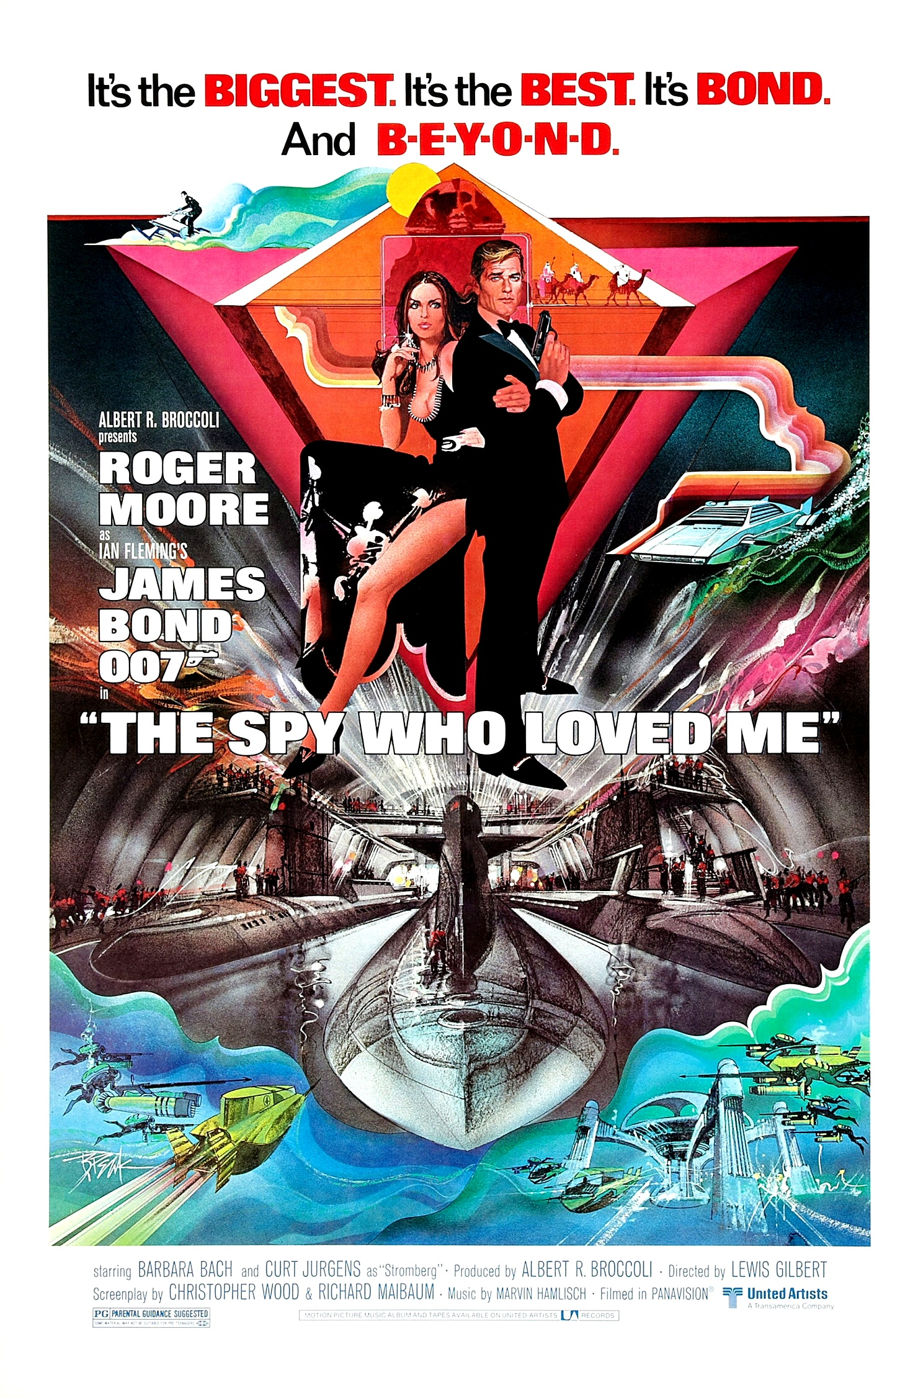
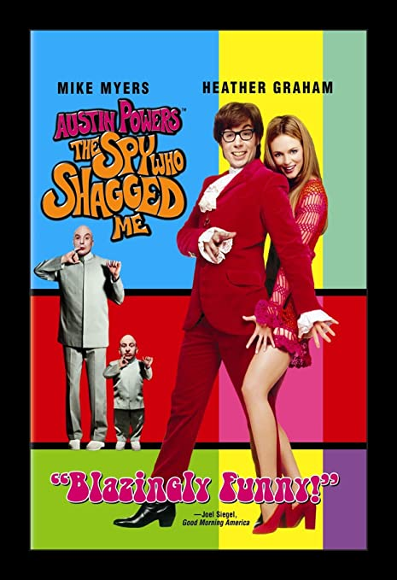
spoof
imitation
Mash up
‘The Spy Who Shagged Me’, 1999
‘The Spy Who Loved Me’, 1977

Slide 10
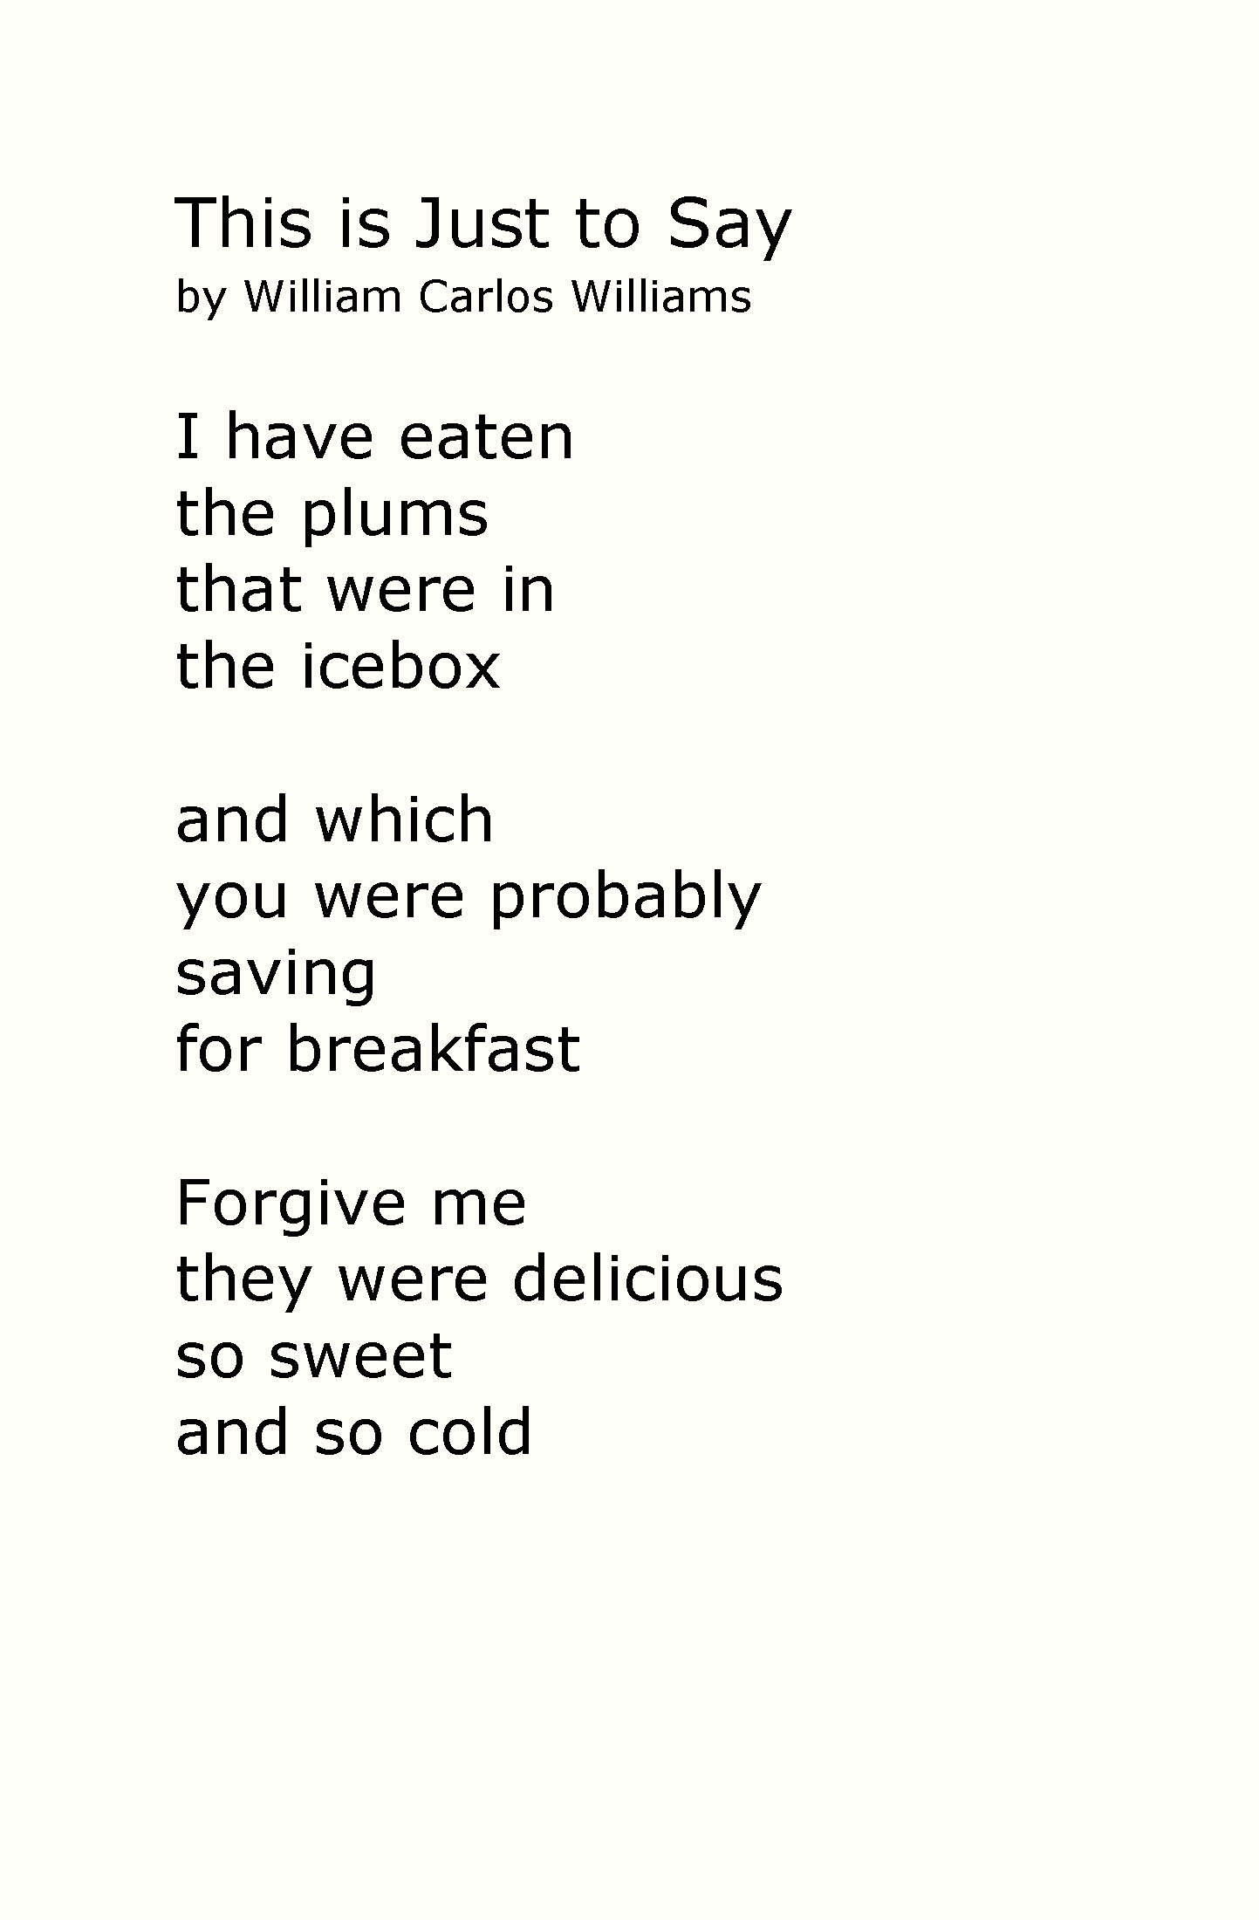
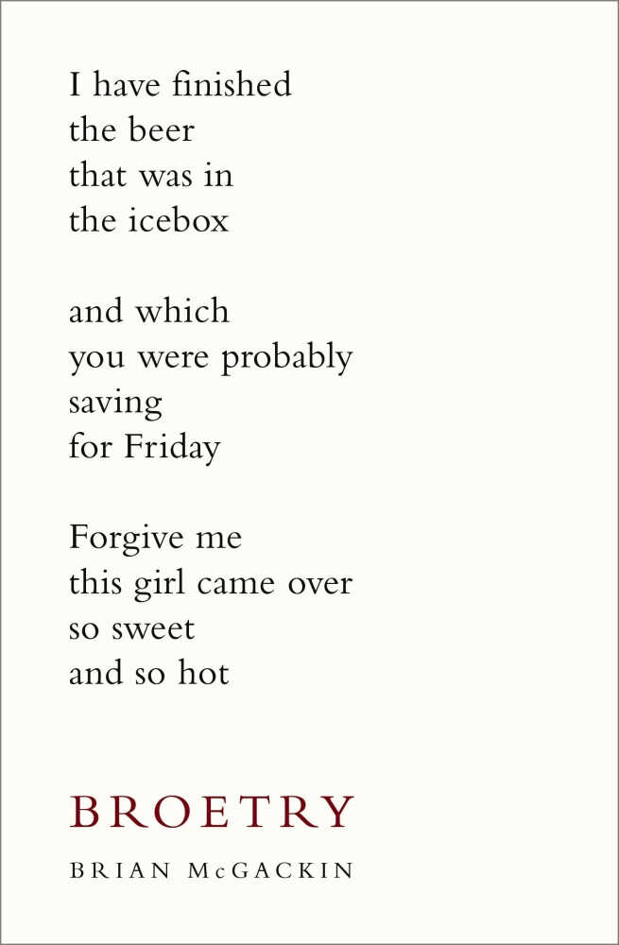
homage
spoof
allusion
‘This is just to Say’ by William Carlos Williams, 1938
‘Broetry’ by Brian McGackin, 2011

Slide 11
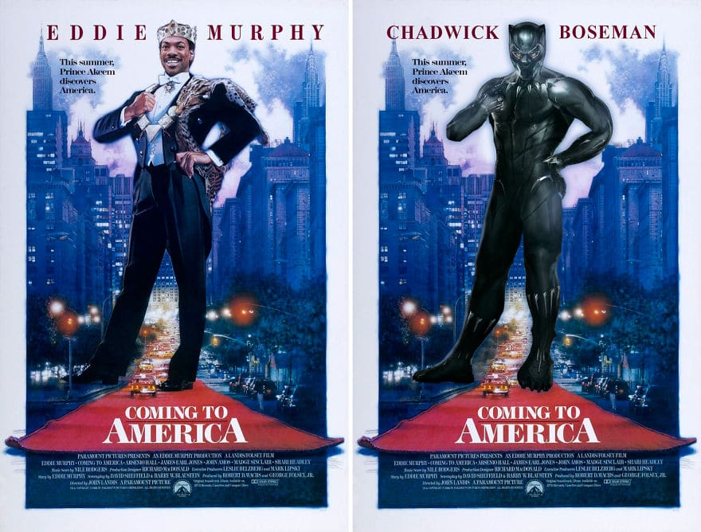
Mash up
parody
allusion
‘Coming to America’, 1988
‘Coming to America’, 2018

Slide 12
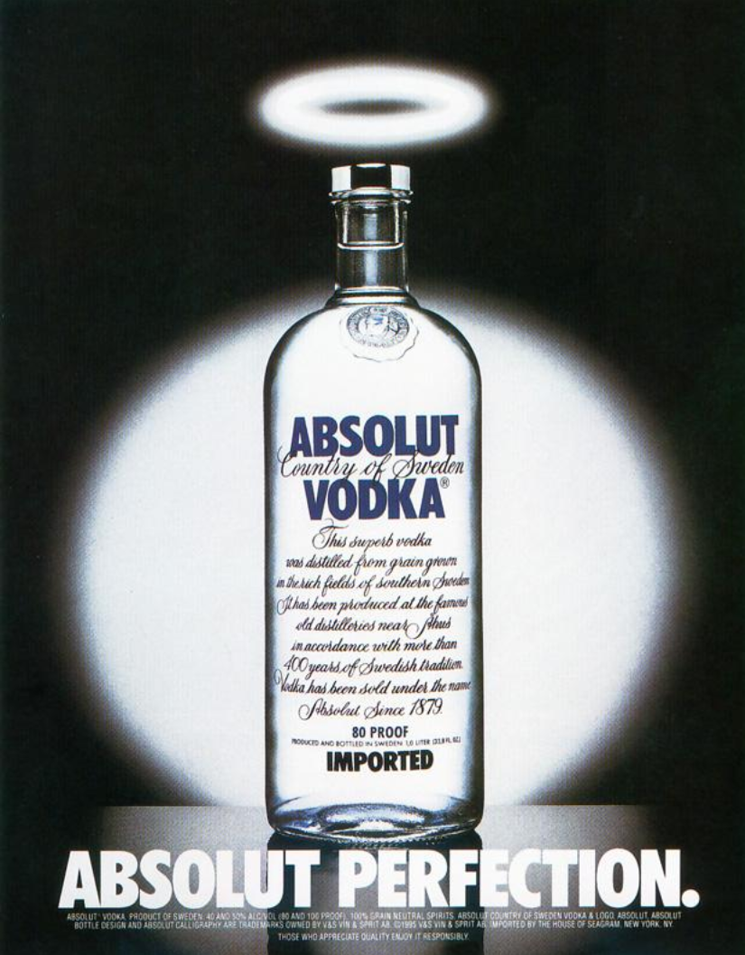
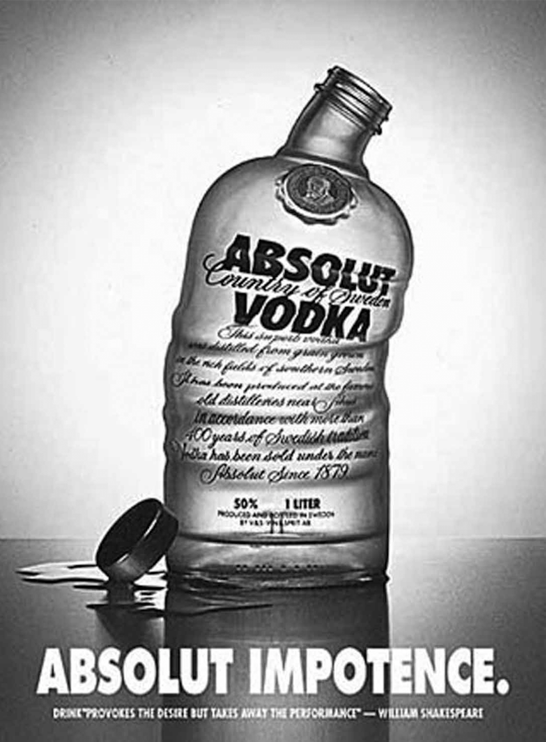
Parody
repurposing
Allusion
‘Absolut Perfection’ advert, 1981
‘Absolut Impotence’ by Adbusters, 1992

Slide 13
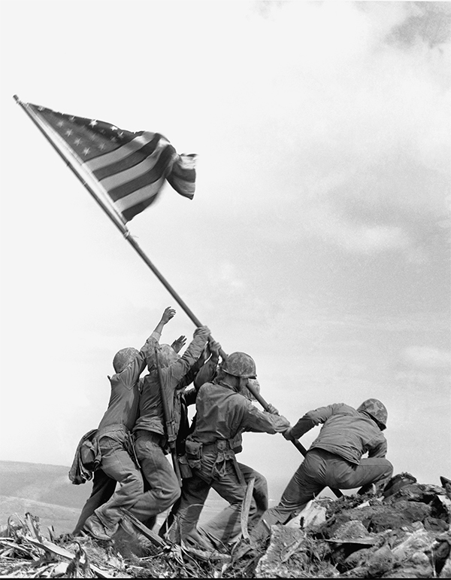
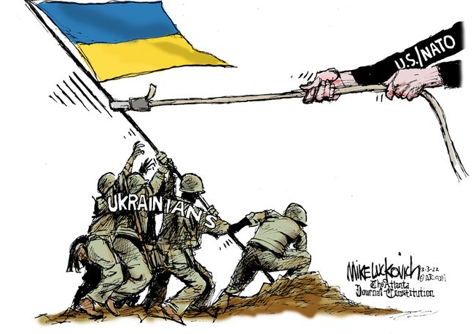
Allusion
Pastiche
repurposing
‘Raising the Flag on Iwo Jima’ photographed by Louis Lowery, 1945
‘Outside Help’, by Mike Luckovich, 2022

Slide 14
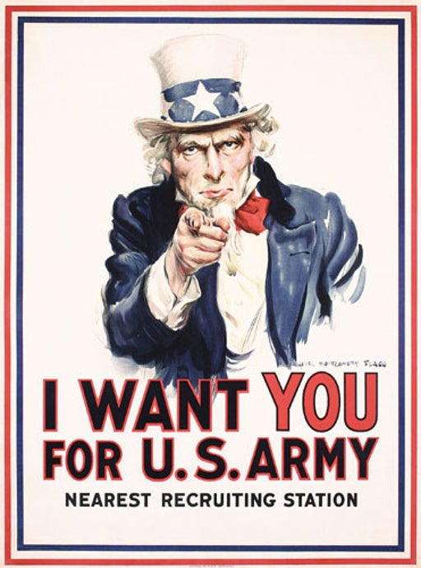
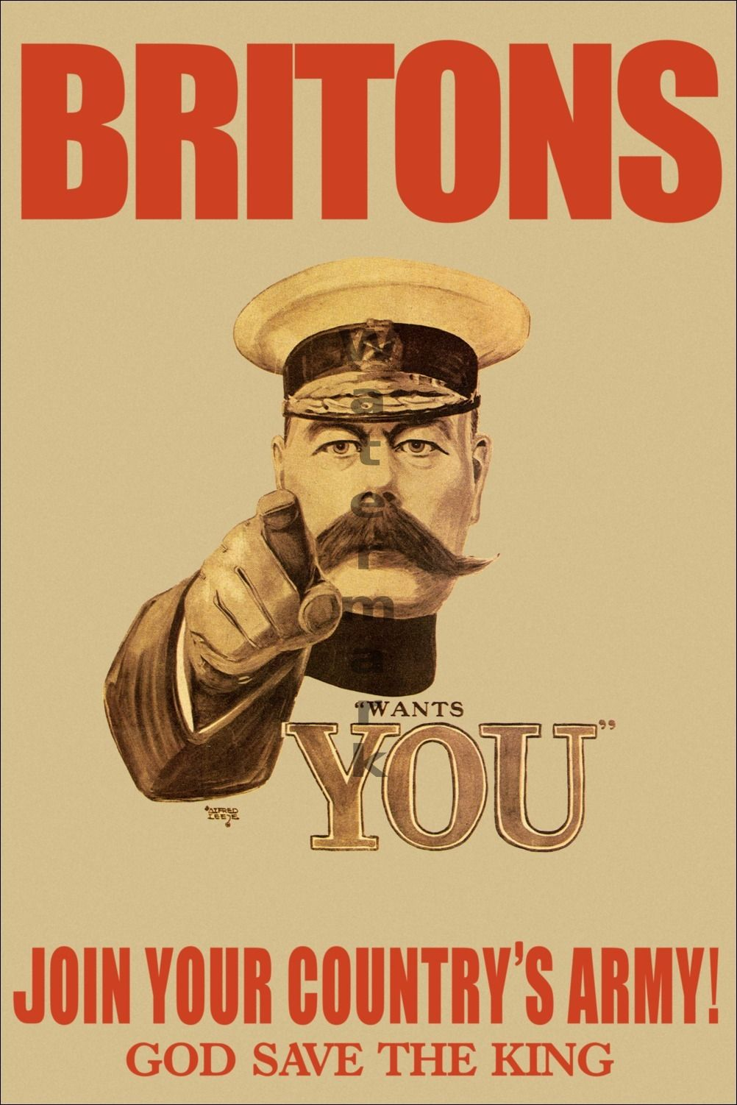
imitation
plagiarism
homage
‘I Want You for U.S. Army’ from painting by James Montgomery Flagg, 1941
‘Lord Kitchener wants you’ by Alfred Leete, 1914

Slide 15
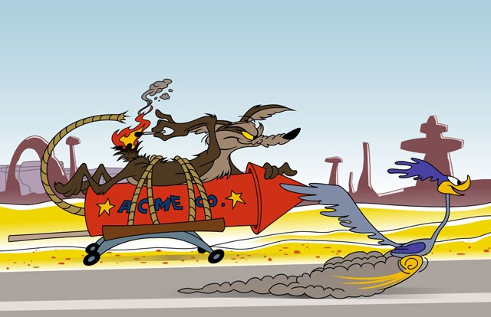
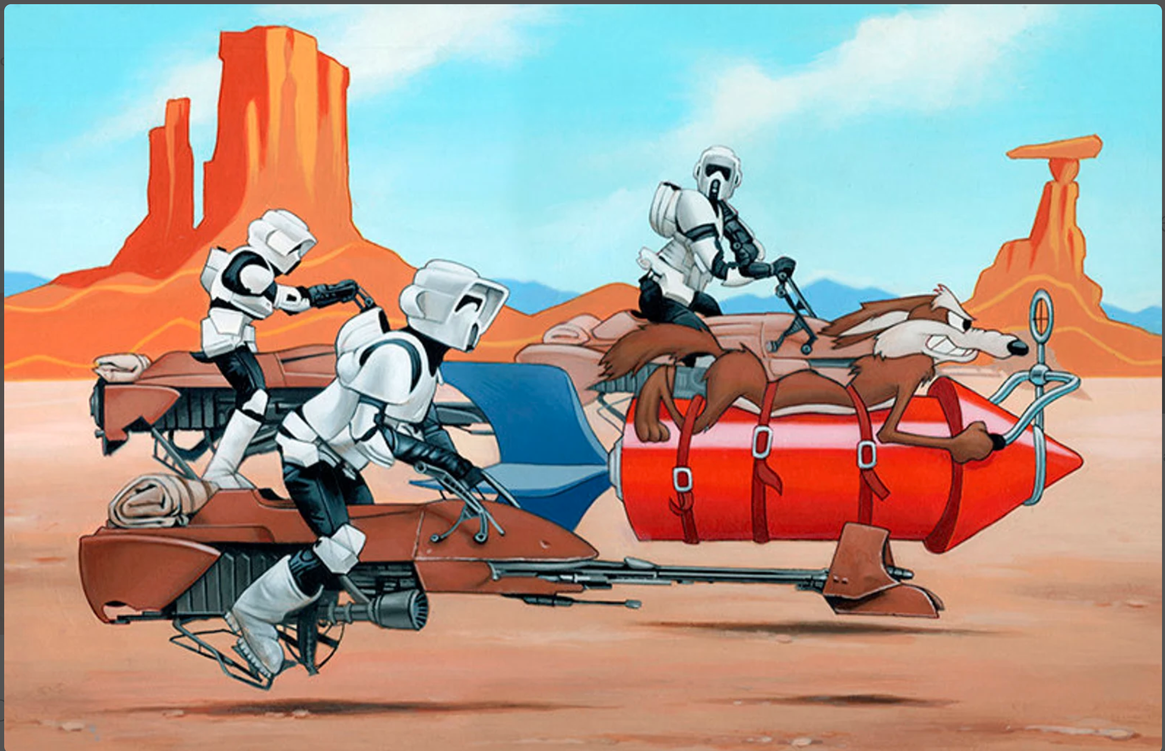
imitation
Mash up
satire
‘Road Runner’ cartoon by Warner Bros, 1966
‘Caution Tunnel Ahead’ by Dave Nestler, 2016

Slide 16
plagiarism
spoof
imitation
‘The East is Red’ propaganda poster, 1969
‘The Revolution is Now’ advert, 2008

Slide 17
Allusion
Muhammed Ali’s body is posed in the same position as Saint Sebastien and he is similarly pierced by arrows.
Readers who recognize the allusion will transfer the ideas of suffering and martyrdom onto the figure of Muhammed Ali. Perhaps the writer is also suggesting that Ali is more than mortal through allusion with a divine saint as well.

Slide 18
Plagiarism
As straightforward an example of plagiarism as one is likely to see, although Mr Brainwash would likely argue he is ‘referencing’ or ‘repurposing’. The image of Banksy’s ‘Girl with a Balloon’ is directly copied and, while many readers will recognize this as Banksy’s girl with a balloon, it is not altered or placed in a new context. Banksy made it as a piece of street art; Mr Brainwash uses it as a piece of art resembling street art.
Sharp-eyed readers will notice Andy Warhol’s soup cans and other motifs from popular culture in Mr Brainwash’s work, so this is a mash up as well.

Slide 19
Repurposing
Oliviero Toscani takes Therese Frare’s famous photograph from one context and places it in another with a minimum of alteration (he colourises the image and adds the United Colors of Benetton logo in the bottom right corner).
While one might argue the image is still being used to raise awareness, it’s primary purpose has now become entangled with the marketing of a clothing brand, a clear example of repurposing.

Slide 20
Parody
In order to draw attention to the double standards in the way women’s bodies are distorted and artificially posed in movie marketing and men’s bodies are not, Kevin Bolk made this ad-busting image as a direct parody of the official marketing poster for Avengers Assemble.
It is not a spoof because the genre of superhero action films is not being made fun of, rather the target is the visual language of the original text. It is an effective example of culture-jamming too.

Slide 21
Imitation
Jeff Rankin directly imitates Shepard Fairey’s style and structure in order to comment on the ‘credentials’ of another president.
Arguably this is also an example of allusion, as readers who recognize Fairey’s style will make a comparison with his work. It’s not a satire or parody because, while his text mocks George W Bush, it is not mocking the original text in any way.
The imitation does, however, flirt with plagiarism although Rankin would probably argue it’s an homage.

Slide 22
imitation
This is a tough one as the Austin Powers film is a famous spoof of James Bond spy movies.
However, the poster created to market the film does not exaggerate or distort the conventions or genre of film posters, rather it employs them in a straightforward way to create an effective marketing campaign. So, technically, this is an imitation rather than a spoof. In fact, you could argue it’s an homage to the funky and psychedelic posters of the 1970s too.

Slide 23
Homage
McGackin borrows the form, structure and style of William’s poetry to create his own work in a respectful way that compliments Williams’ famous poem.
You might suggest this piece is an allusion too. As Broetry has its own themes and concerns, I’d argue it’s more than a simple imitation.

Slide 24
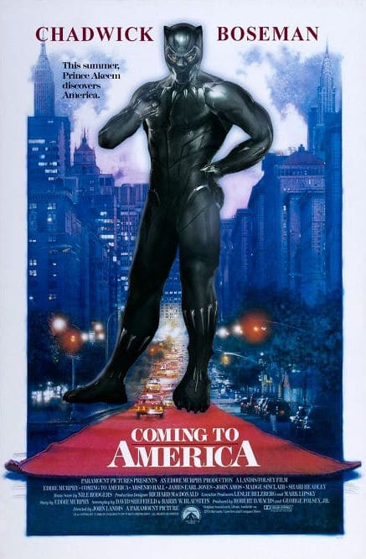
Mash up
The writer takes two famous posters for films about powerful black characters and mashes them together to create a clever pun about the phenomenon of Black Panther and the impact it had on American audiences.
The piece is not an allusion as it’s not really a poster for Black Panther. The writer simply swaps out Eddie Murphy for Chadwick Boseman but leaves the original film title in place.

Slide 25
Parody
Adbusters are a famous culture jamming organization. This advert responds directly to the successful Absolut Vodka advertising range that has won many awards.
The central premise of this anti-ad campaign is to borrow the structure, style and symbolism of the original advert and call attention to the ill effects caused by consuming alcohol by parodying (make fun of) their message.

Slide 26
allusion
Luckovich’s cartoon features the soldiers of Ukraine hoisting their flag in resistance. The composition of the picture imitates the famous picture taken of American soldiers fighting in the Pacific during World War Two. Through allusion, readers will transport values such as courage, bravery and resistance onto the Ukrainian soldiers.
The image also satirizes US declarations of support for Ukraine during this conflict. In the original text the US soldiers were front and center. In the imitation, America / Nato does not want to be seen overtly helping Ukraine, so are drawn out of the picture. However, it’s not a satire or parody per se, as the original text is not mocked.

Slide 27
imitation
Flagg imitates the style and structure of famous World War One recruitment posters in this World War Two era painting.
You might argue this is an allusion, as both texts share a common purpose. And perhaps this imitation also homages or pastiches the original text, which was simple and effective in design.

Slide 28
Mash up
By borrowing elements of style and content from two different sources and combining them in an original piece, Nestler has created a mash up. And it’s a pretty good one too.
This is not plagiarism, as Nestler has used his own distinctive style of art and posed the characters in a fresh way. Compare to Mr Brainwash, who simply replicated Banksy’s original ‘Balloon Girl.’

Slide 29
imitation
The writers of this text imitate the structure and style of Communist propaganda posters to sell their chocolatey products.
Is this a parody or even homage of the original poster designs? I don’t think so. Beyond borrowing stylistic elements, I’m not sure the new text has anything to say about the original posters. You may feel that the genre of Mao or Soviet era propaganda is being spoofed, which is fair enough, although it probably wasn’t the writers’ primary intention.

Slide 30
Discussion points / reflection
  Did you agree on the relationships between each pair of texts?
  Did you find any particular relationships harder to define than others? Why?
  Is it possible for one reader’s ‘imitation’ to be another person’s ‘parody’? How might two different readers respond differently to the same texts?
  How can texts offer different perspectives on a topic, issue or theme?
  How does a text's meaning change when explored alongside another text?
  How can comparing and interpreting texts be transformative for the reader?

