Slide 1
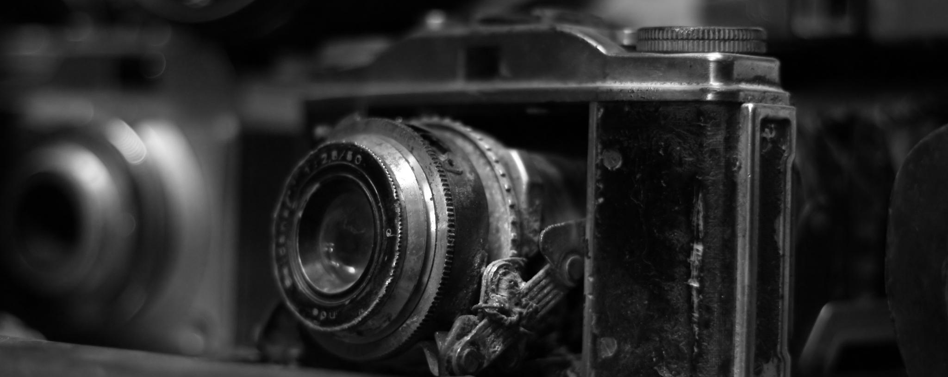
Iconic Photojournalism Images
Powerful visuals that documented history – and sometimes changed it
Notes:
---

Slide 2
Introduction
Photojournalism has the power to define how we remember history. Some events become globally recognized not because of written accounts, but because a single photograph freezes a moment for generations. Iconic photojournalism does more than document, it makes history instantly recognizable and emotionally unforgettable.
Over the next slides you’ll see iconic images from the history of photojournalism. What makes these photographs so powerful is their ability to communicate emotion at a glance. Fear, hope, injustice, resilience; feelings that reach us before any caption or headline can. A single shot can stir empathy, outrage, or solidarity, and – with the right photo – ignite global conversations that inspire movements and shift public opinion. From civil-rights to political upheavals, these images both recorded history… and helped change its direction.

Slide 3
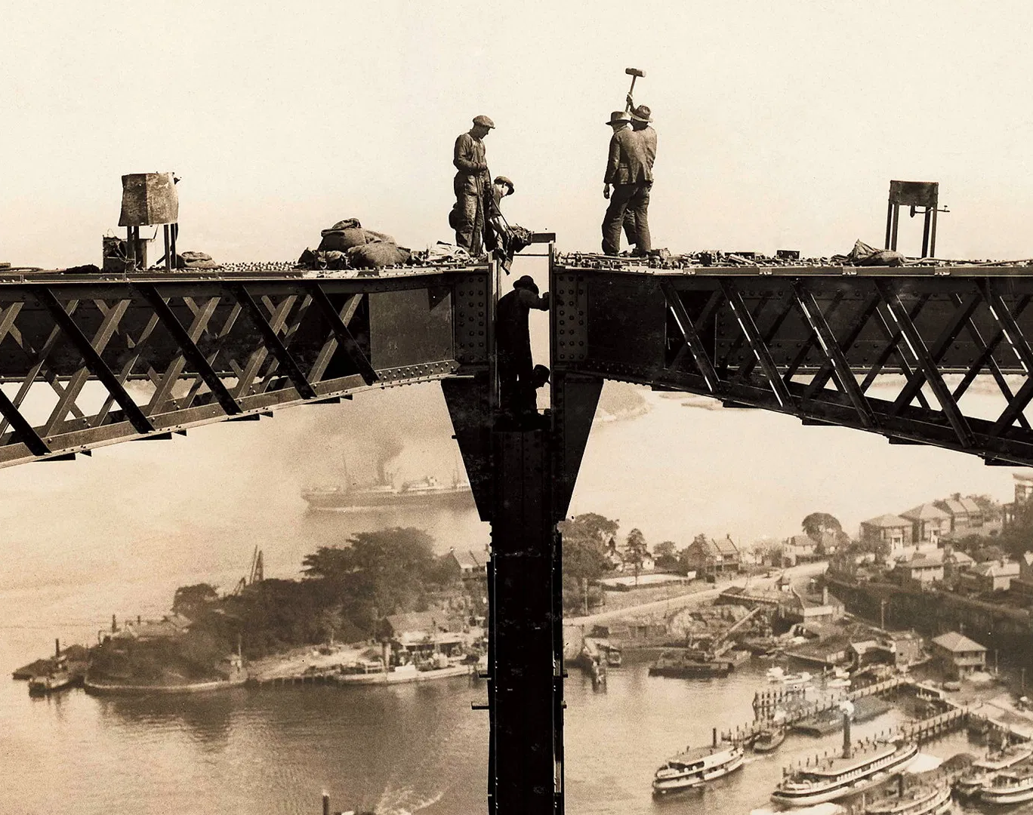
Joining Sydney Harbour Bridge (1930)
Unknown, Australia
This image shows the construction of the Sydney Harbour Bridge and was likely taken by an official public works photographer such as Robert Bowden, who was known for balancing precariously on steel girders to get his shots. Here, workers are poised at the arch junction point during one of the most dangerous engineering phases. Despite the dizzying height, the men aren’t wearing any safety harnesses!
Can You Spot… there are six workmen in this picture, can you find them all?
https://mhnsw.au/stories/general/bridging-sydney/

Slide 4
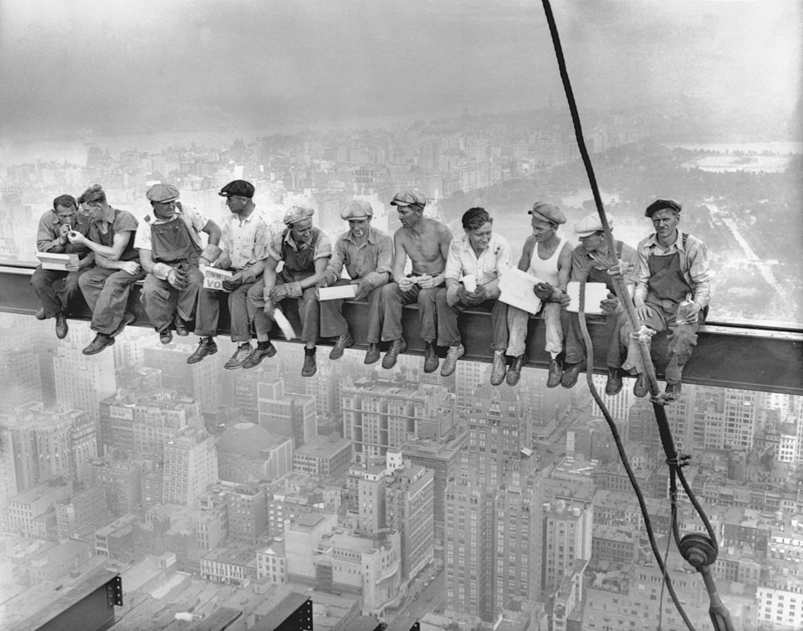
Lunch Atop A Skyscraper (1932)
Unknown, US
A black-and-white photograph of eleven ironworkers sitting on a steel beam of the RCA Building, 850 feet (260 meters) above the ground during the construction of Rockefeller Center in Manhattan, New York City. It was a staged photograph arranged as a publicity stunt, part of a campaign promoting the skyscraper.
Can You Spot… one of the men holding a bottle of whiskey, even at that height!
https://en.wikipedia.org/wiki/Lunch_atop_a_Skyscraper

Slide 5
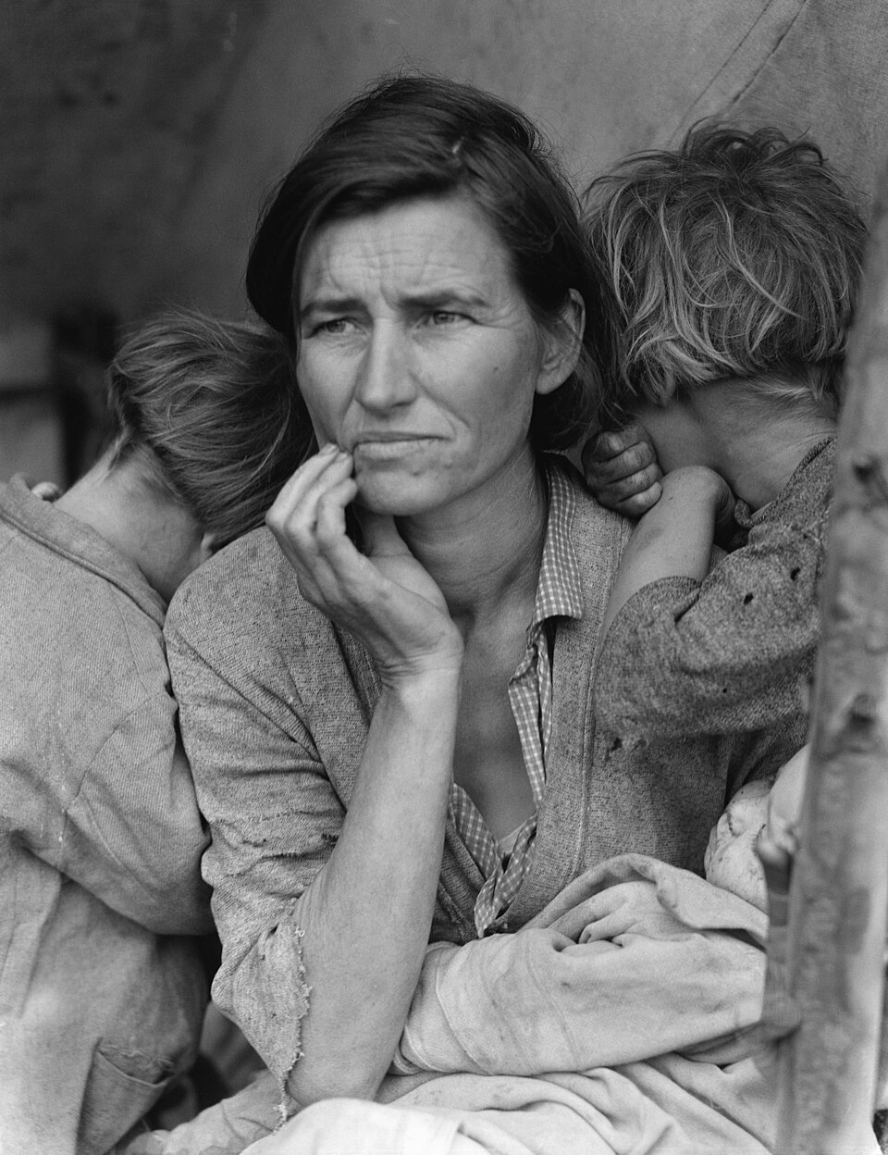
Migrant Mother (1936)
Dorothea Lange, US
To raise support for his New Deal, Roosevelt had journalists visit the Californian dustbowl to capture the plight of migrant workers. Lange was driving home from a long assignment when she passed a pea pickers’ camp. She later said she had a ”gut feeling” she needed to be there. This decision resulted in one of the most iconic photographs in American history. The subject is Florence Owens Thompson. The pea crop that year had failed and Florence’s family of seven children were penniless and starving.
Out of frame… after this picture was published, the American government sent 20,000 pounds of food aid to the camp, showing that photojournalism can inspire humanitarian responses.
https://en.wikipedia.org/wiki/Migrant_Mother

Slide 6
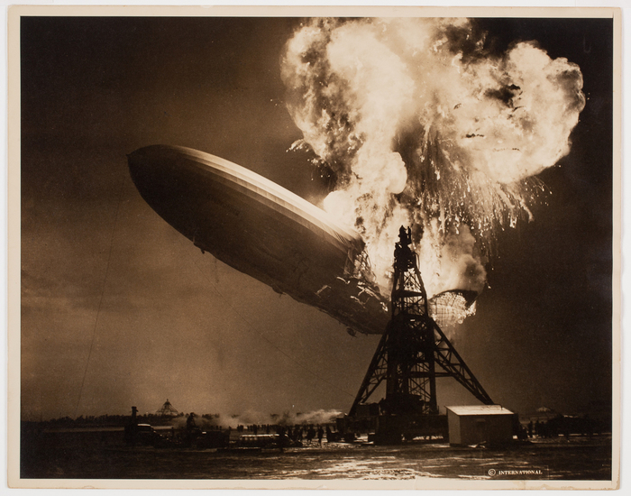
Crash of the Hindenberg (1937)
Sam Shere, US
A photograph of the explosion of the Hindenburg dirigible balloon as it returned from a transatlantic crossing. Shere said of the photo: "I had two shots in my big Speed Graphic [his camera] but I didn't even have time to get it up to my eye. I literally 'shot' from the hip--it was over so fast there was nothing else to do."
Can You Spot… tiny figures of people to the left of the pylon running towards the disaster?
https://en.wikipedia.org/wiki/Hindenburg_disaster

Slide 7
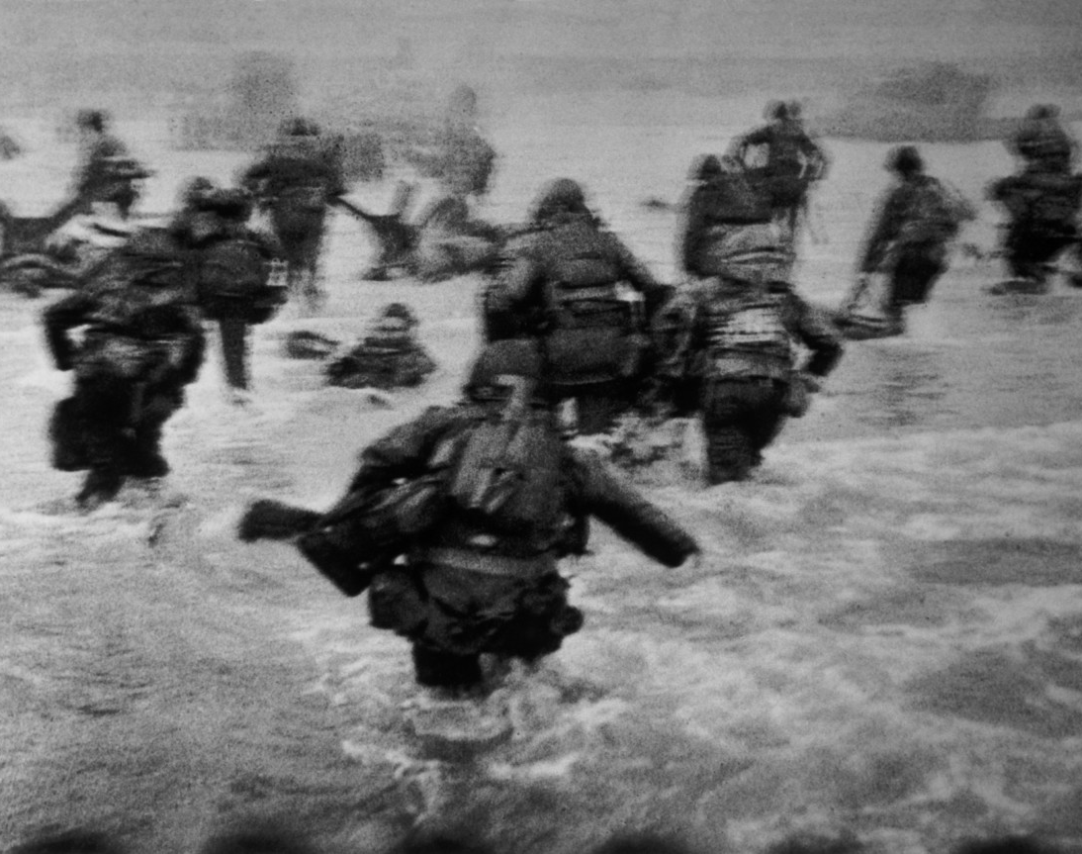
D-Day Landings (1944)
Robert Capa, France
The only journalist to land on Omaha Beach alongside US soldiers as they began the invasion of Normandy, Robert Capa’s photos are an invaluable historic record. Of the hundreds of images he captured that day, only eleven survive. The others were ruined in development by a technician who turned the heat up too high and melted the exposed film!
Look closely… this picture, like many Capa took, is slightly out of focus because he was right there, in the midst of the action. Nevertheless, Capa’s images tell a story of heroism that has become mythlike.
https://www.magnumphotos.com/newsroom/conflict/robert-capa-d-day-omaha-beach/

Slide 8
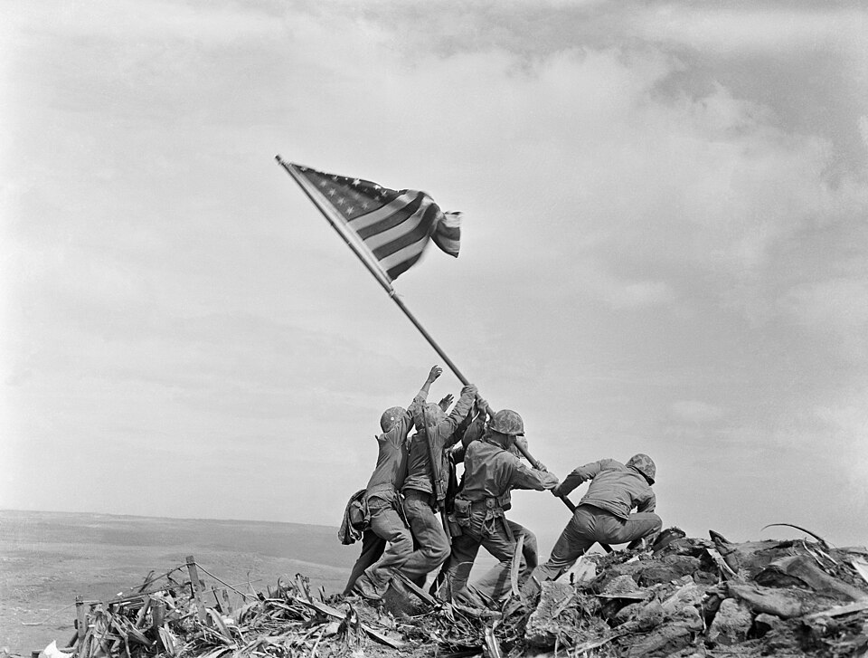
Raising the Flag on Iwo Jima (1945)
Joe Rosenthal, Iwo Jima
An iconic photograph of six United States Marines raising the U.S. flag atop Mount Suribachi during the Battle of Iwo Jima in the final stages of the Pacific War. The photograph was published in Sunday newspapers two days later and reprinted in thousands of publications. It won the 1945 Pulitzer Prize for Photography and has come to be regarded in the United States as one of the most recognizable images of World War II.
Look closely… none of the men’s faces are visible, the angle and timing keep them anonymous, making this image a universal symbol of bravery.
https://en.wikipedia.org/wiki/Raising_the_Flag_on_Iwo_Jima

Slide 9
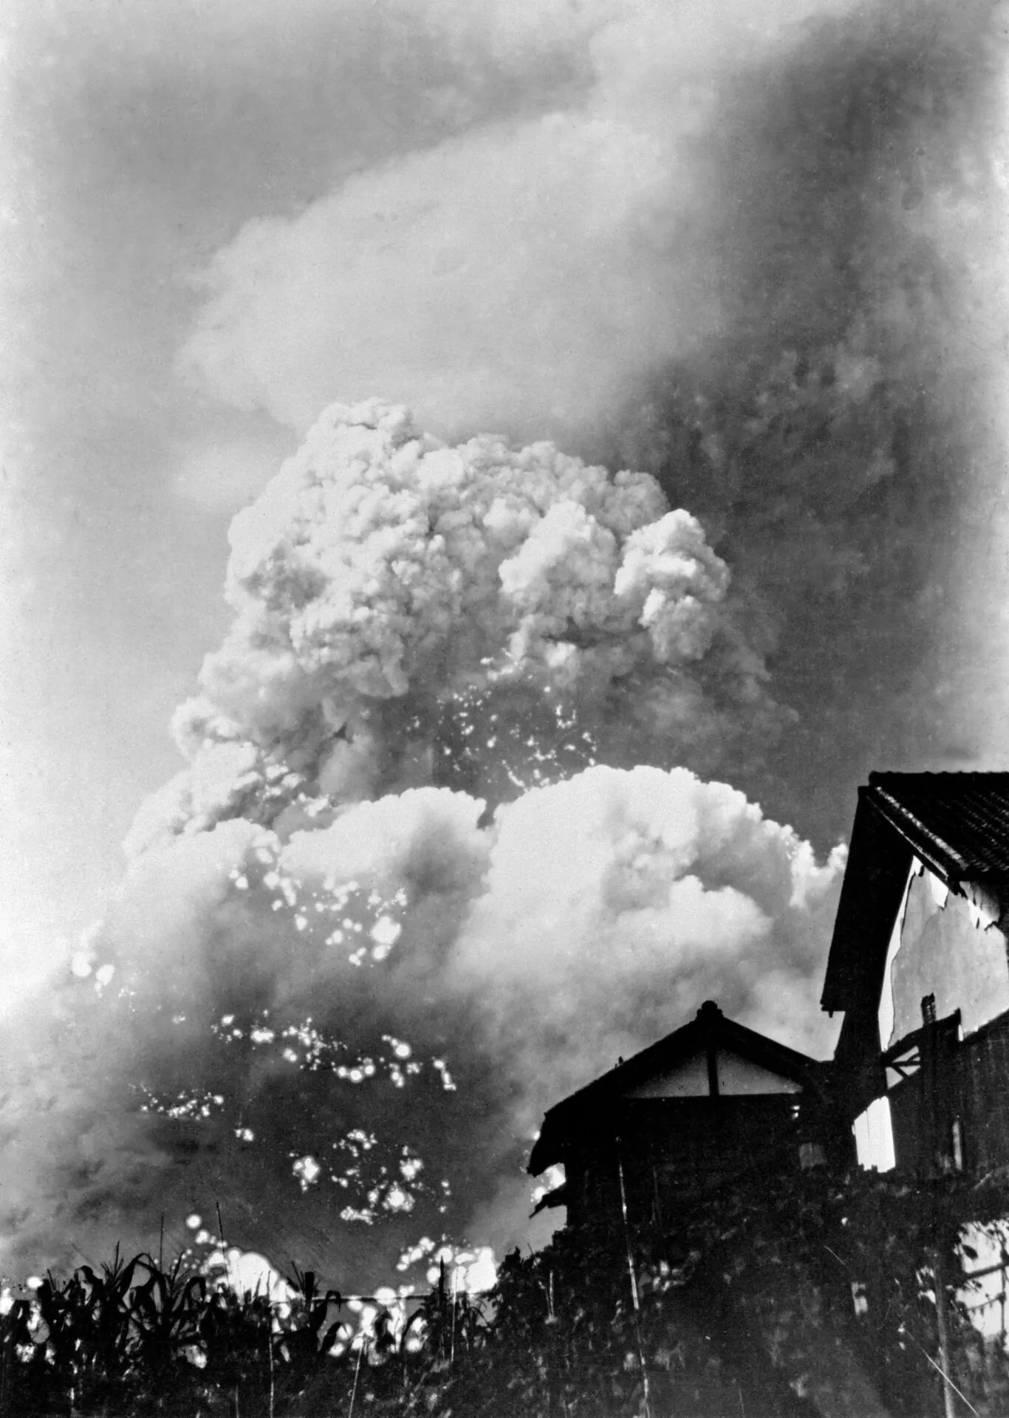
Mushroom Cloud (1945)
Yoshito Matsugishe, Japan
An image like this has never been recorded before or since. Taken by an army photojournalist, it is the first of the only five surviving images to have documented the impact and immediate aftermath of a nuclear bomb detonation from within the city of Hiroshima. Matsushige’s home was only 1.7 miles from the impact site – just outside the radius of total destruction.
Out of frame… ground-level images of the conditions following the bombing of Hiroshima were suppressed by the US military until 1952, when Matsugishe’s photographs were published in Life magazine.
https://thebulletin.org/2025/08/atomic-testament-yoshito-matsushige-and-the-first-photos-of-hiroshimas-nuclear-toll/

Slide 10
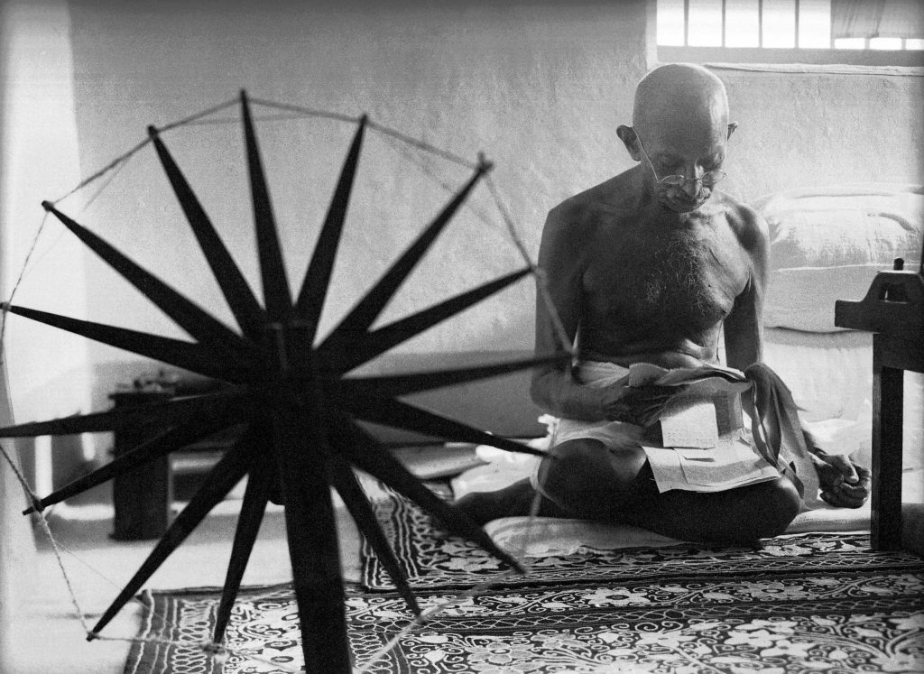
Gandhi and his Spinning Wheel (1946)
Margaret Bourke-White, India
Few public figures of the 20th century are as recognizable as Gandhi and no single picture has become more closely associated with his life than Margaret Bourke-White’s 1946 portrait of the civil-disobedience pioneer beside his cherished spinning wheel. Gandhi believed this tool was the key to India’s economic independence from Britain. When she commented that photography was also a kind of craft, she received the reply: “the greater of the two is spinning.”
Look closely… Gandhi is reading newspaper clippings, a detail noted by the photographer in her diary.
https://www.life.com/people/gandhi-and-his-spinning-wheel-the-story-behind-an-iconic-photo/

Slide 11
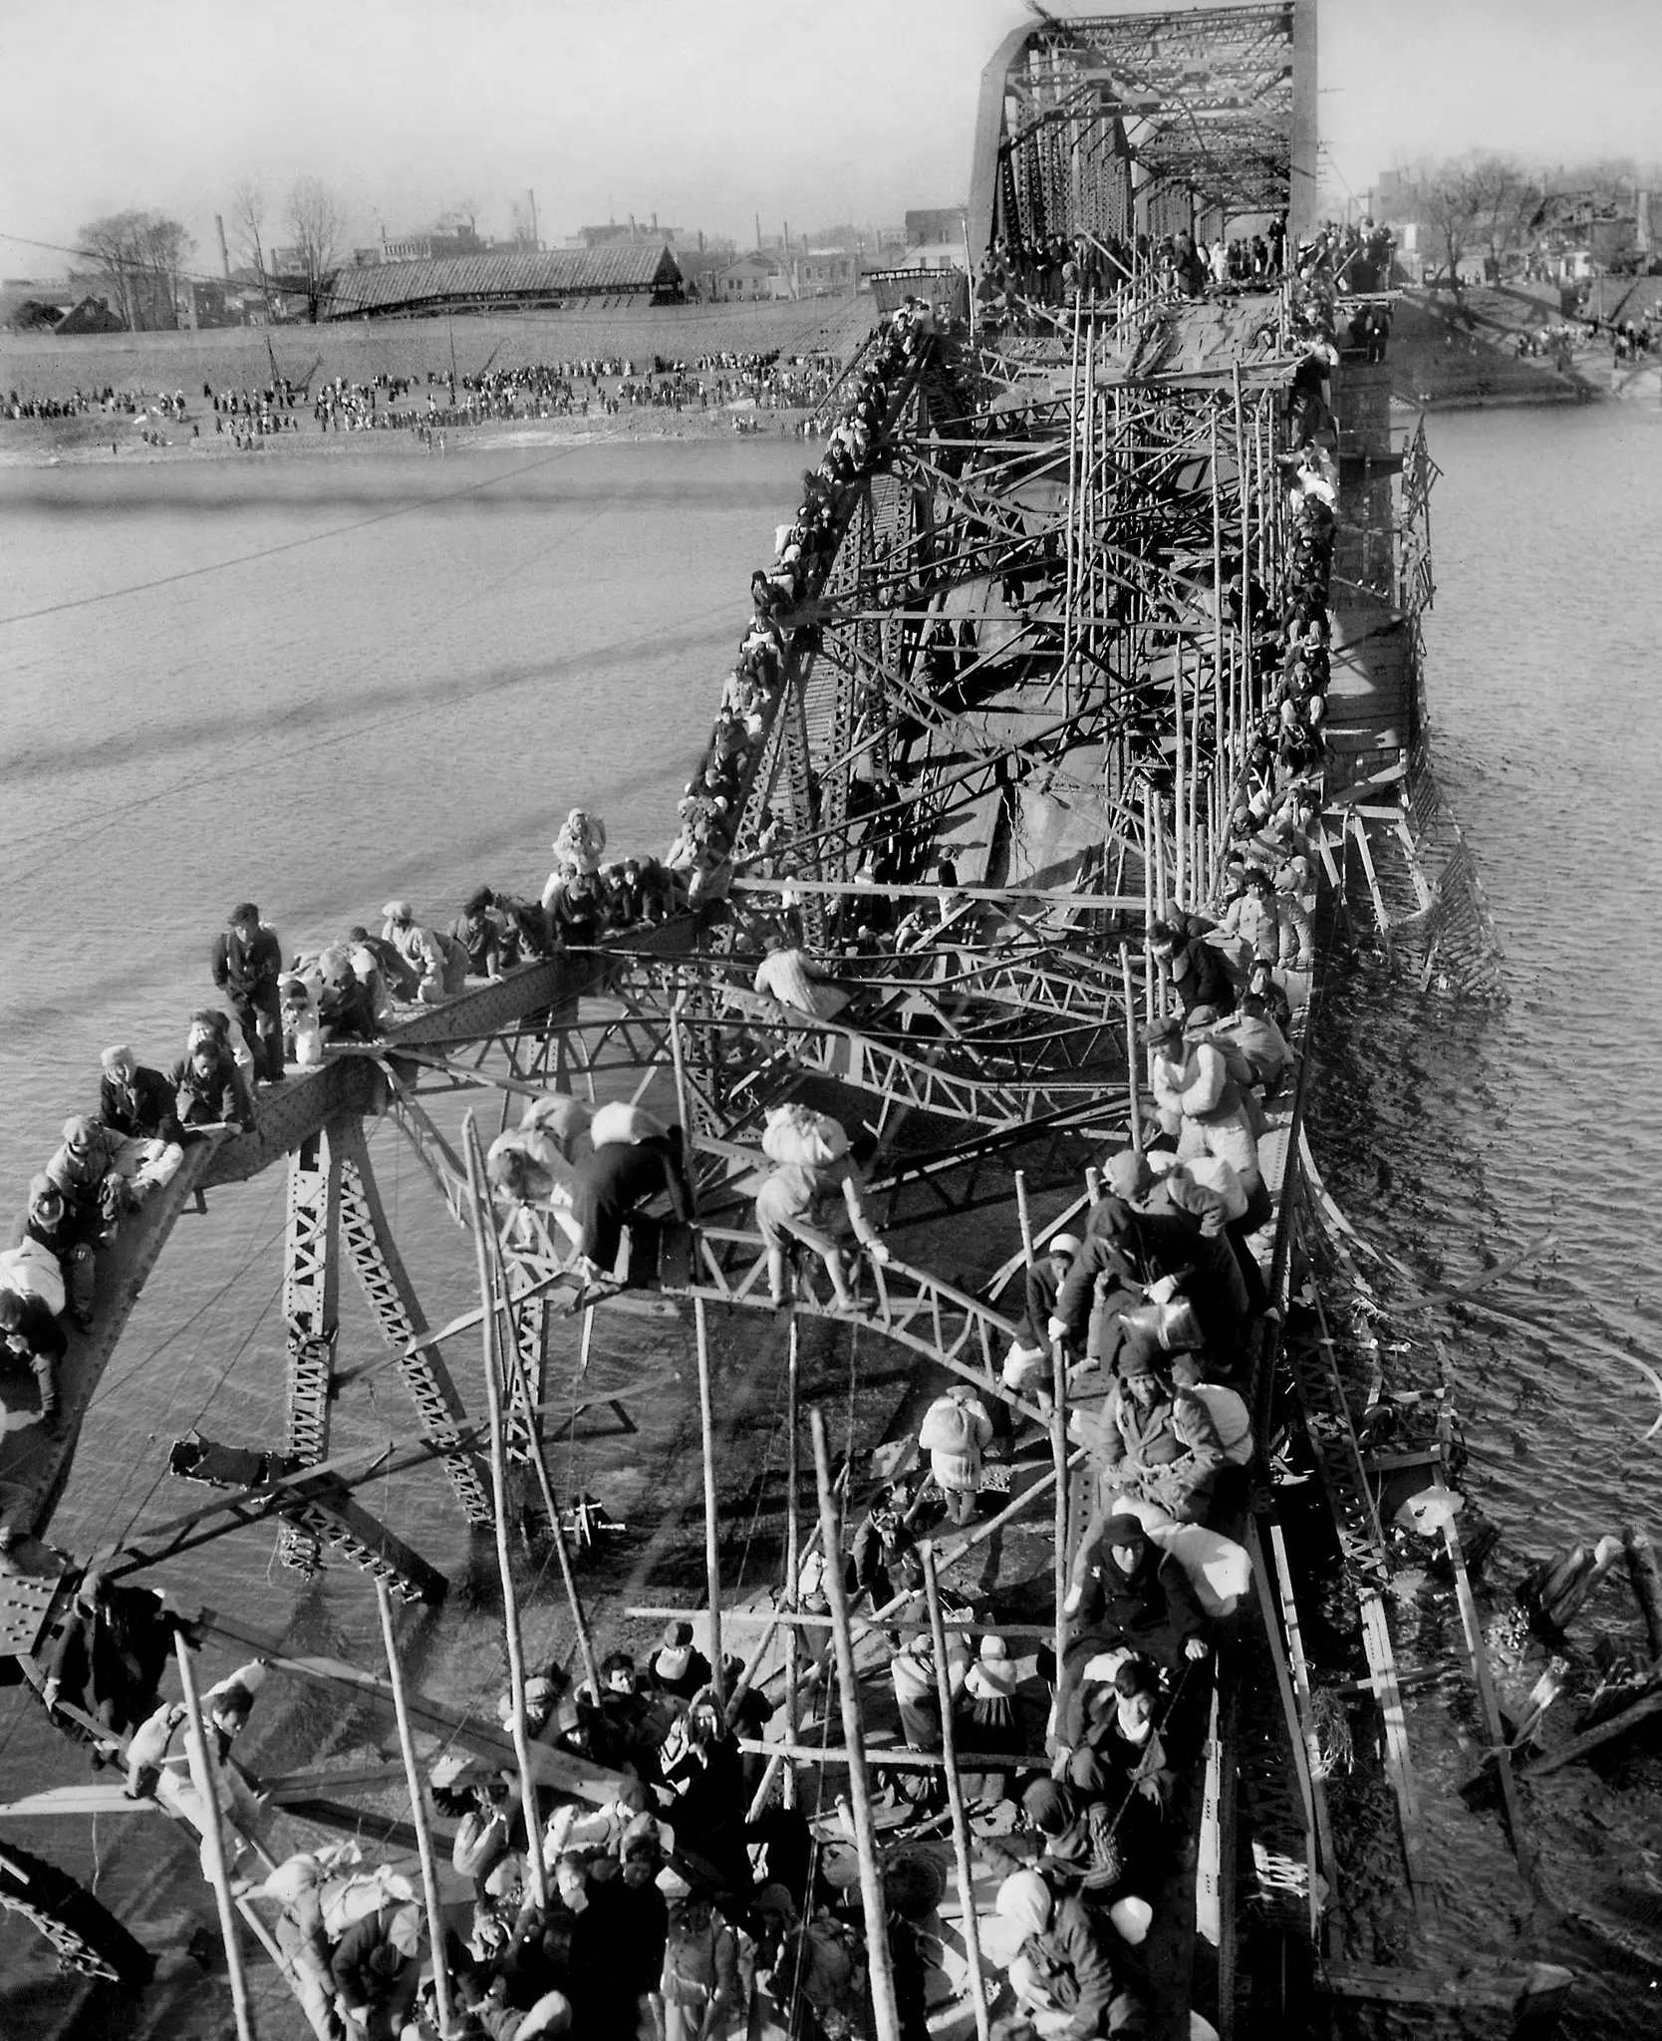
Taedong River Bridge (1950)
Max Desfor, North Korea
Covering the Korean War for the news service when the North invaded the South in June 1950, Desfor was with United States troops as they retreated from the North. He was in a Jeep near Pyongyang when he spotted a bridge along the Taedong River that had been bombed. Thousands of refugees were lined up on the north bank waiting their turn to cross the river. “We came across this incredible sight,” Mr. Desfor said in 1997 for an A.P. oral history. “All of these people who are literally crawling through these broken-down girders of the bridge. They were in and out of it, on top, underneath, and just barely escaping the freezing water.”
Look closely… people carry bundles of possessions tied to their backs; at least one of these bundles is a baby whose head is visible.
https://www.nytimes.com/2018/02/21/obituaries/max-desfor-104-war-photographer-at-midcentury-is-dead.html

Slide 12
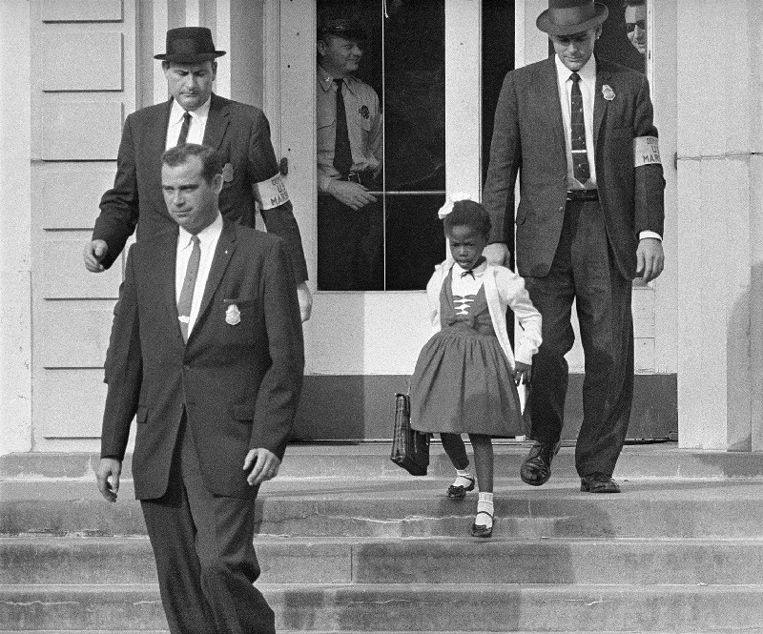
Ruby Bridges Goes to School (1960)
Unknown, US
Federal marshals escort six-year-old Ruby Bridges to her first day of school as the first Black student to attend previously all-white William Frantz Elementary School in New Orleans. A riotous white mob organized by the local White Citizens' Council gathered to protest her arrival, screaming hateful slurs, threats, and insults.
Look closely… can you see the armbands worn by Ruby’s escorts? They delineate the federal marshals from local policemen who did not enforce the law.
https://rarehistoricalphotos.com/ruby-bridges-1960/

Slide 13
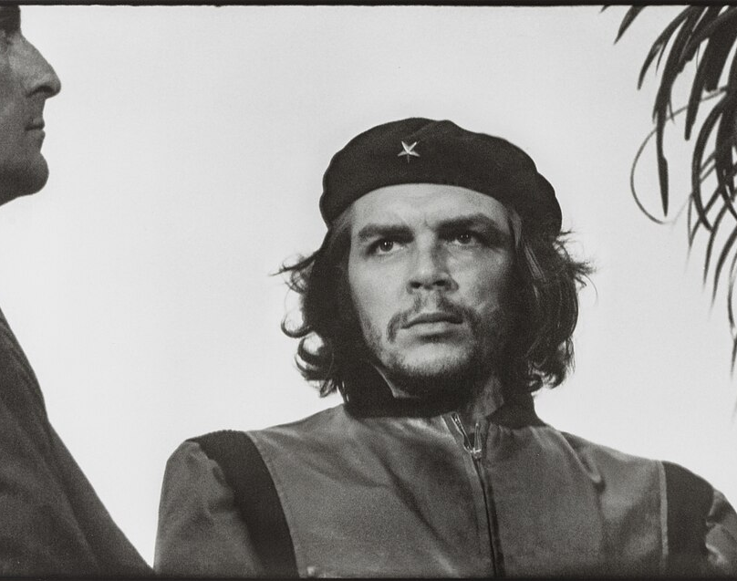
Guerrillero Heroico (1960)
Alberto Korda, Bolivia
This photograph of Argentine revolutionary Che Guevara was captured at a memorial service for victims of an explosion in Havana. Korda has said that at the moment he shot the picture, he was drawn to Guevara's facial expression, which showed "absolute implacability”. Guevara was 31 years old at the time the photograph was taken.
Did you know… when reproducing this image, the palm tree on the right and man on the left were cropped, giving rise to the mythic cultural image of Guevara standing alone that is so popular today.
https://en.wikipedia.org/wiki/Guerrillero_Heroico#:~:text=Guerrillero%20Heroico%20(Latin%20American%20Spanish,of%20the%20La%20Coubre%20explosion.

Slide 14
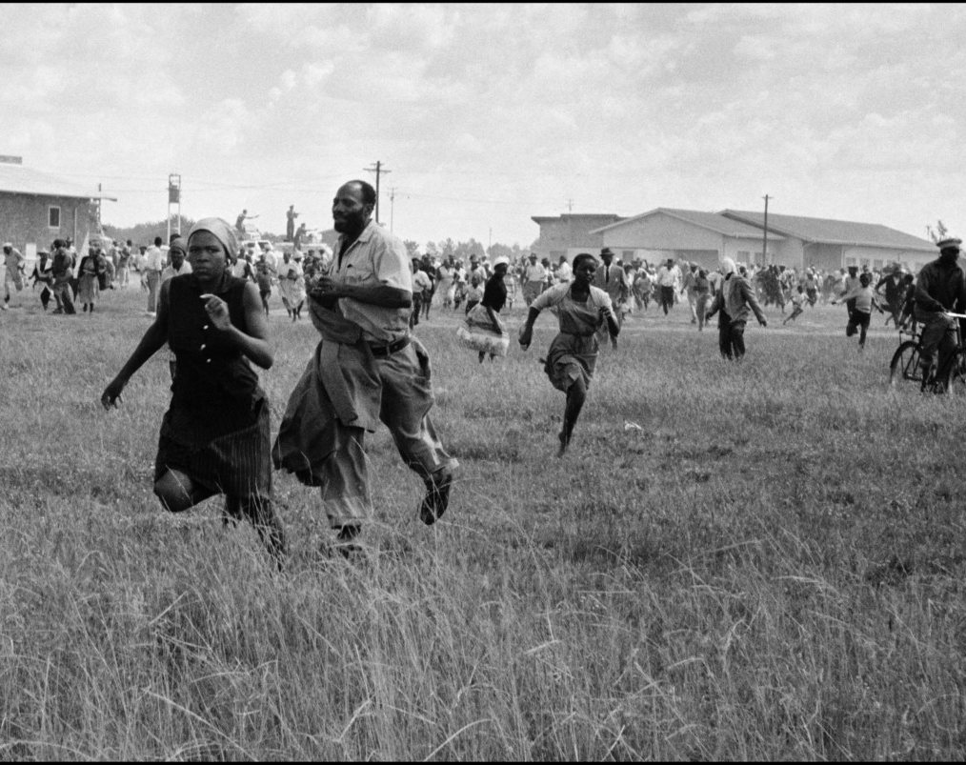
The Sharpeville Massacre (1960)
Ian Berry, South Africa
When South African police opened fire on peaceful protesters, killing 69 people and wounding nearly 200, Ian Berry was the only journalist at the scene. His photos are more than just important documents of apartheid-era brutality: the images were used in court to expose the lie that protesters had attacked police and helped turn global opinion against South Africa’s apartheid regime.
Can you spot… in the background police standing on their armoured cars pointing their weapons at fleeing civilians?
https://www.magnumphotos.com/newsroom/politics/ian-berry-sharpeville-massacre/

Slide 15
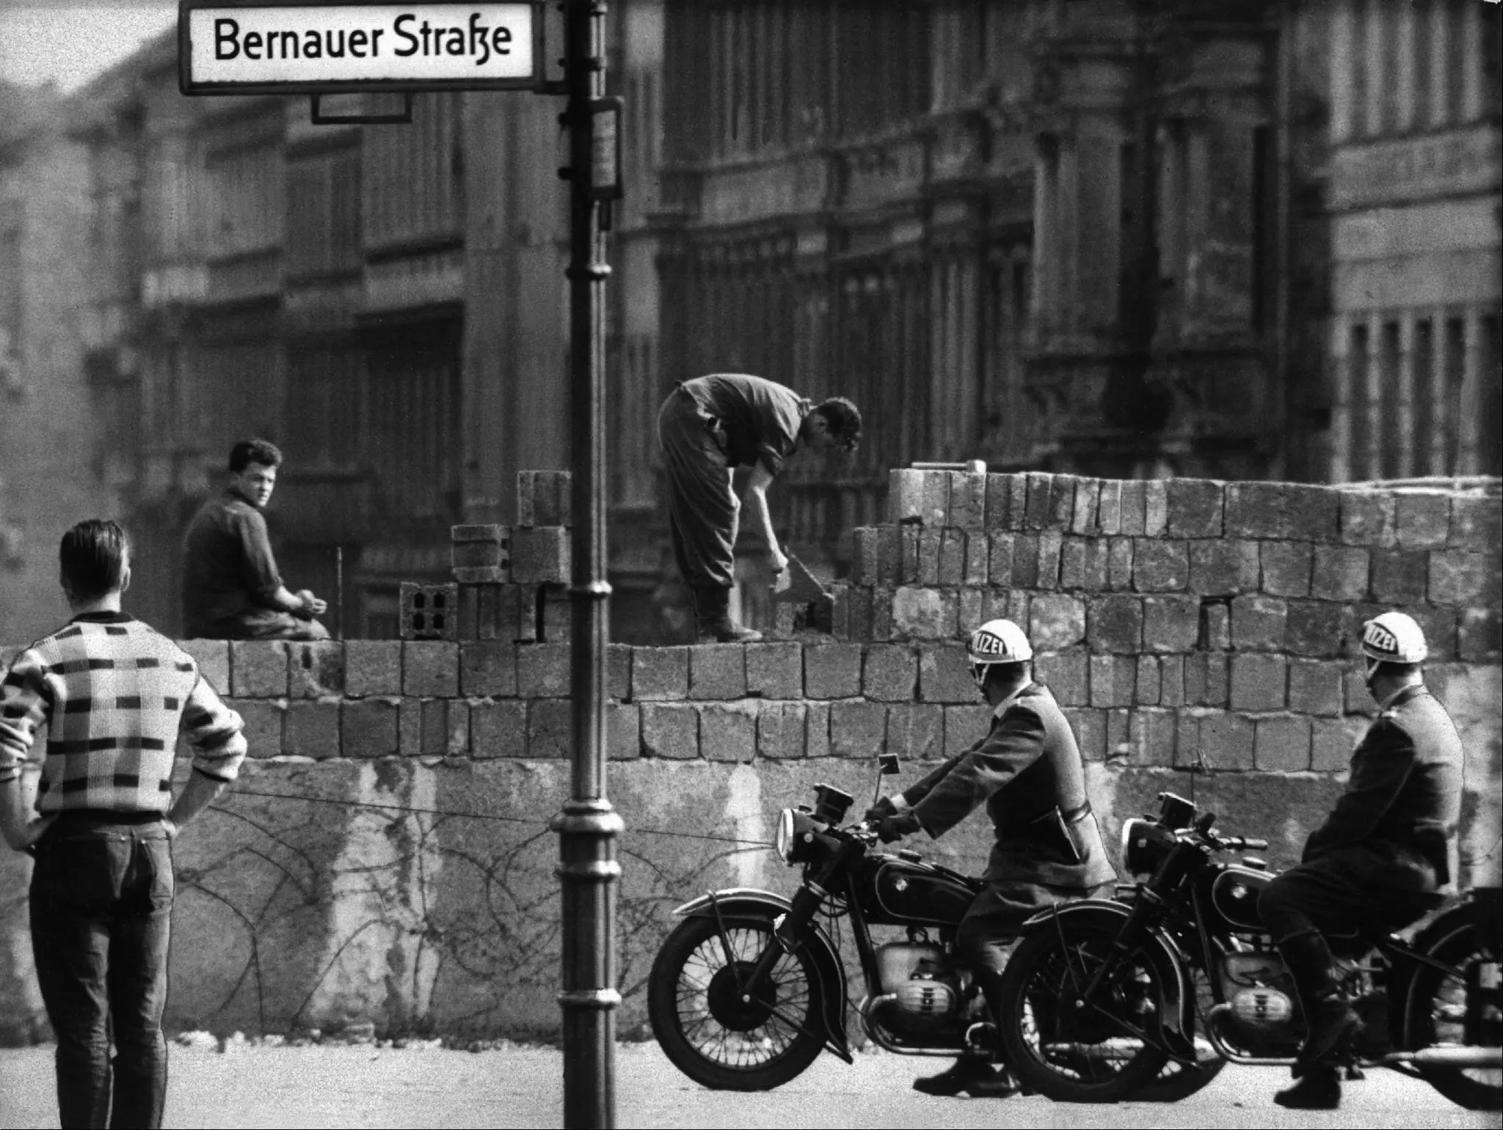
Berlin Wall Construction (1961)
Unknown, Germany
Early morning press images from August 13th show East German police and workers quickly throwing up what would become one of the world’s most infamous walls. Stunned citizens look on as the wall rips a city in two. It would stand for the next 26 years, manned by armed guards with orders to shoot to kill anyone attempting to cross.
Can you spot… the barbed wire that the wall replaced in the foreground?
https://www.nytimes.com/2019/11/09/world/berlin-wall-photos-30-year-anniversary.html

Slide 16
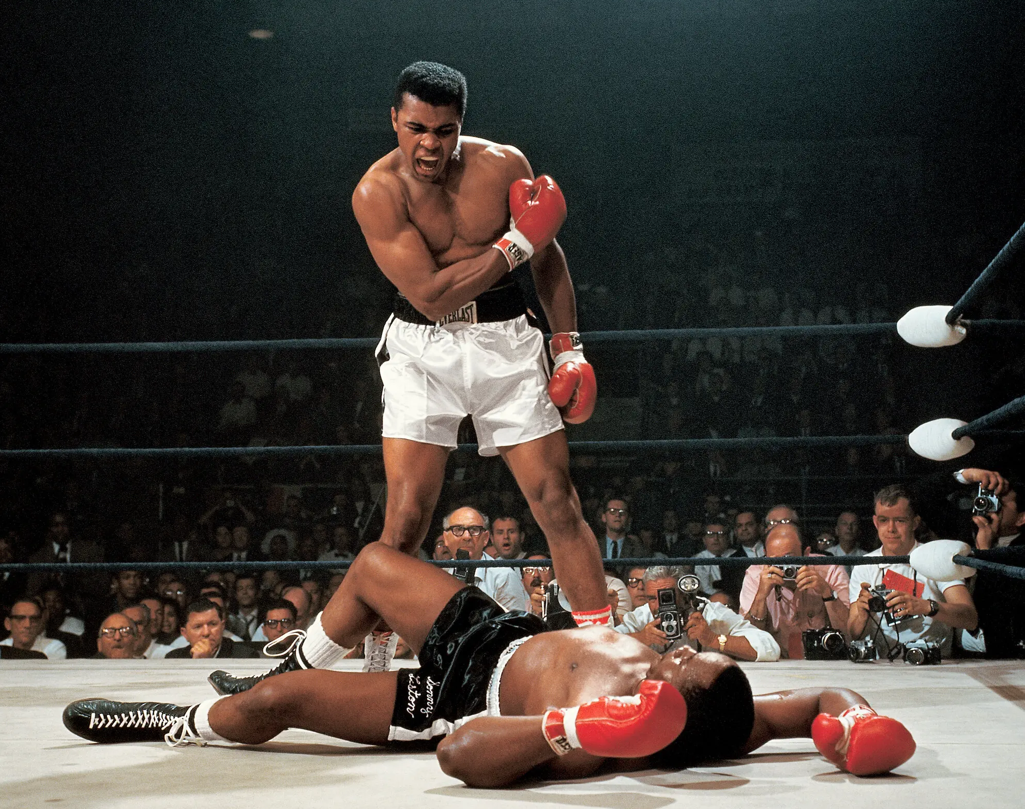
Mohammed Ali Standing Over Sonny Liston (1965)
Neil Leifer, US
When Muhammad Ali caught Sonny Liston 1 minute and 44 seconds into their title bout, Liston hit the mat. Ali hovered over him, shouting, “Get up and fight, sucker!” Amid the pop and sparkle of flashbulbs, a 22-year-old freelance photographer working for Sports Illustrated, tripped the shutter of his camera. His image of Ali did not make the cover of the magazine. It wasn’t even used for the story’s opening spread, running instead on the final page, then languishing in a photo editor’s file. And yet 60 years later, Leifer’s picture is considered by many to be the greatest sports photo of all time.
Look closely… Leifer’s camera position is above the cameras of the other journalists you can see. How do you think he got this shot?
https://www.nytimes.com/2025/05/25/arts/design/muhammad-ali-neil-leifer-photograph.html
Notes:
Leifer was kneeling on the edge of the canvas, making an angle the other photographers couldn’t get from the floor

Slide 17
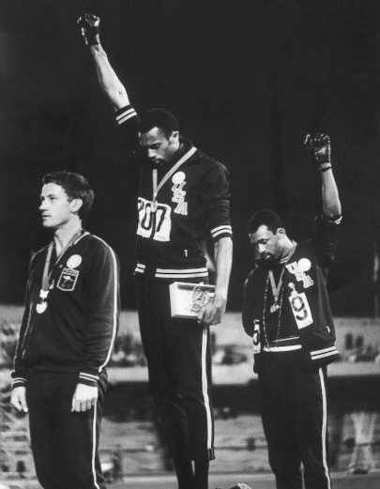
Black Power Salute (1968)
John Dominis, Mexico
After a suggestion to boycott the Mexico City Olympics to protest civil rights in the US didn’t happen, nevertheless black athletes Tommie Smith and John Carlos wanted to send a message. After finishing first and third in the 200-meter sprint, they mounted the podium shoeless, wearing buttons supporting sociologist Harry Edwards’ Olympic Project for Human Rights. As the national anthem played, they held up their gloved fists.
Can you spot… Australian Peter Norman (in second place) isn’t making the salute, but he is wearing the OPHR button in support of his competitors.
https://abcnews.go.com/blogs/headlines/2014/01/john-dominis-iconic-black-power-salute-photographer-dies

Slide 18
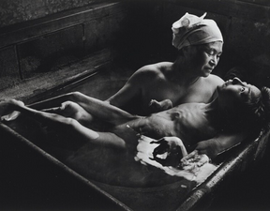
Tomoko and Mother in the Bath (1971)
W. Eugene Smith, Japan
In the 1950s and ’6os, people living in the coastal fishing village of Minamata complained of itaiitabyo, a disease marked by tremors, bad sight and deafness. Later the cause emerged: a chemical company was dumping mercury in the water. Tomoko Uemura, seen here in 1971 being bathed by her mother, was poisoned in the womb and born blind, mute and with mangled limbs. This image gave a face to the effects of industrial mercury poisoning and led to the company’s allocating funds for the victims.
Look closely… photographer and subject collaborated intentionally on the posing of this image which recalls La Pieta, the traditional imagery of Mary cradling the body of Jesus.
https://en.wikipedia.org/wiki/Tomoko_and_Mother_in_the_Bath#:~:text=Tomoko%20and%20Mother%20in%20the%20Bath%20is%20a%20photograph%20taken,in%20a%20traditional%20Japanese%20bathroom.

Slide 19
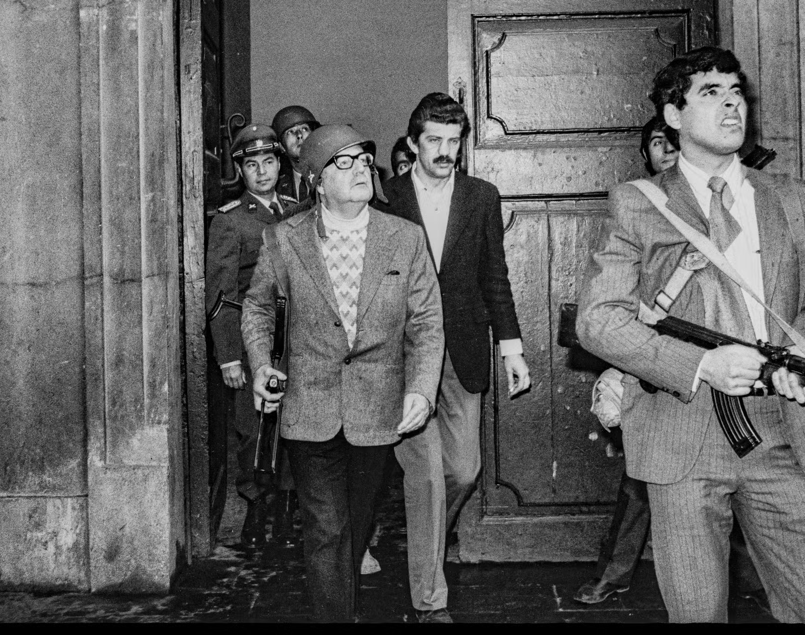
The ‘last photo’ of Salvador Allende (1973)
Leopoldo Victor Vargas, Chile
For decades, the creator of this iconic image was unknown. Not until 2010, when Allende’s sons revealed a cache of six more photos, did the photographer’s name come to light. This image shows the democratically elected president of Chile leaving the presidential palace flanked by his bodyguards as a military coup begins. Allende looks up as bomber planes fly overhead. Later that night, Allende would die by his own hand and 16 years of military dictatorship would begin.
Can you spot… Allende is holding an AK-47 machine gun, a gift from Cuba’s Fidel Castro on which he’d inscribed: “To my good friend Salvador from Fidel”.
https://www.lemonde.fr/en/history/article/2023/09/11/the-story-of-the-last-photo-of-salvador-allende-the-chilean-president-who-killed-himself-in-the-1973-coup_6132828_157.html

Slide 20
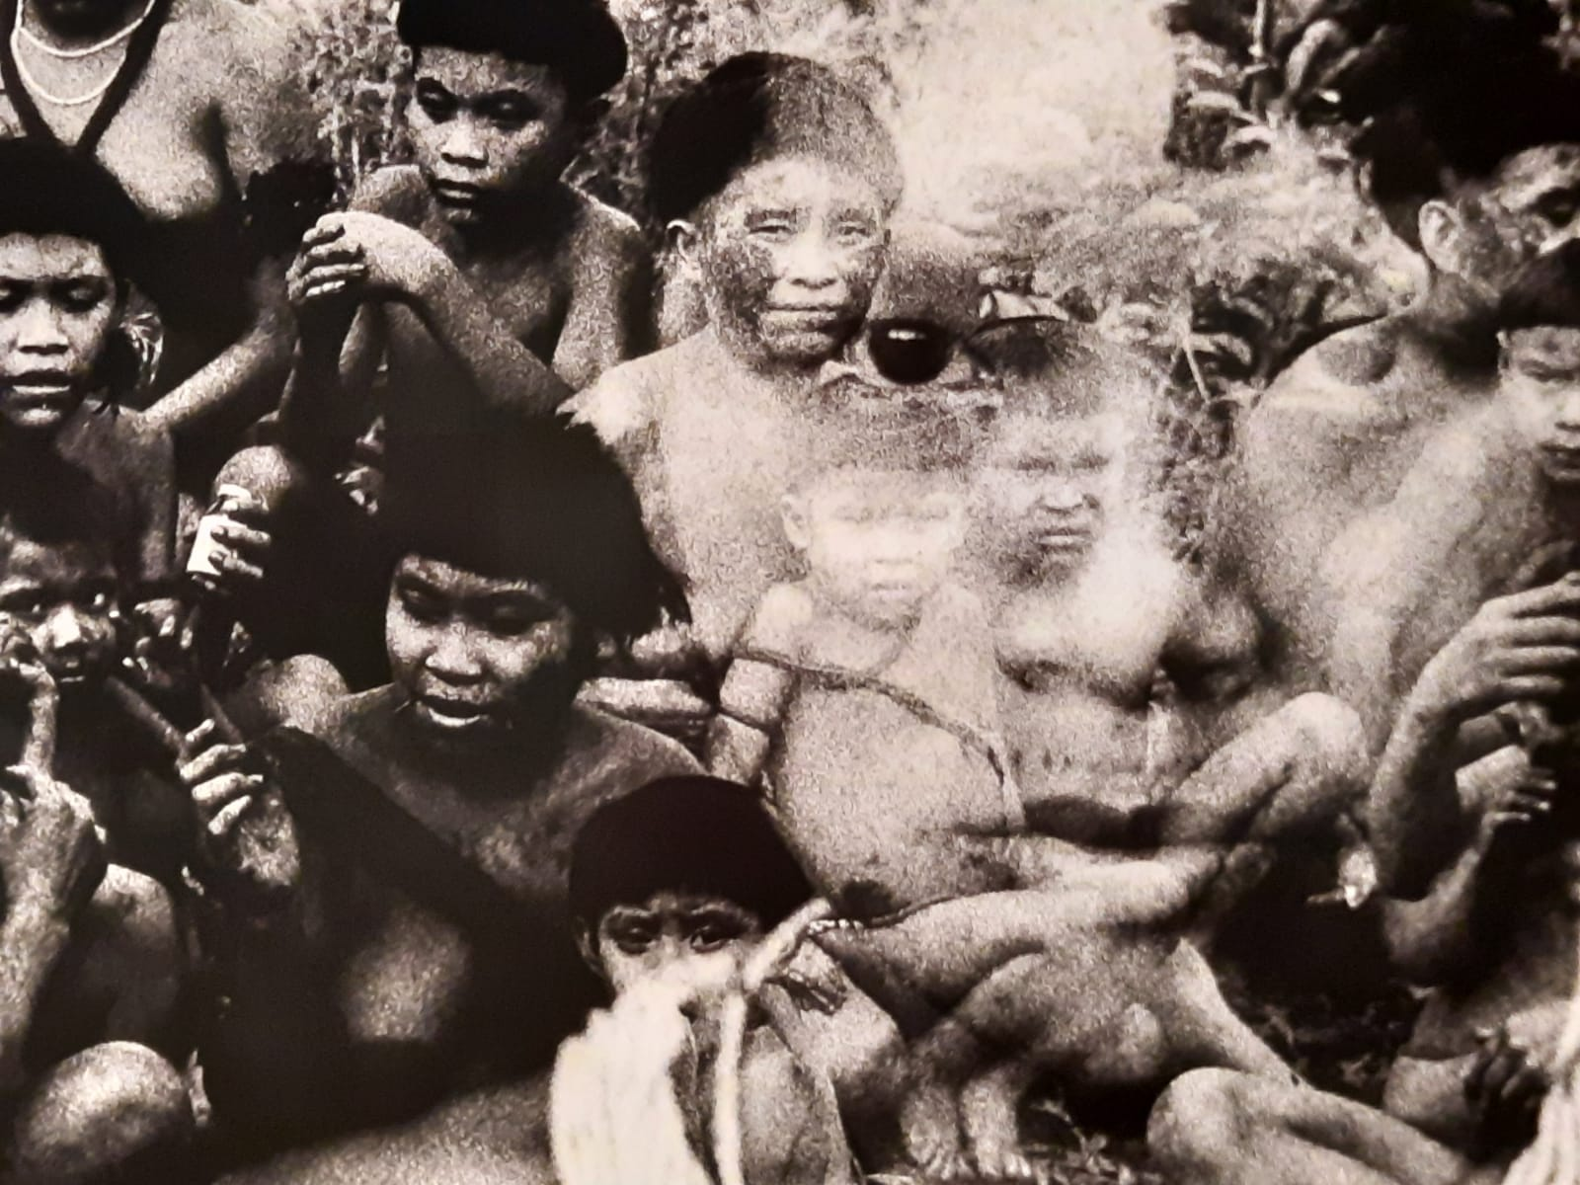
The Yanomani (1974)
Claudia Andujar, Brazil
In the 1970s, Andujar revealed the indigenous Amazon tribe Yanomami to the world, and used her images to advocate for their protection. Entire communities were being decimated by the construction of new roads and incursions of illegal mining into their lands. Sent to the region on a photojournalism assignment on the Amazon Forest, Andujar was charmed by the group and dove into the Yanomami culture, absorbing it into her photographic work.
Can you spot… Andujar sometimes uses a double exposure method to produce her images, meaning visual distortion was common. Can you see a face superimposed over/under this image?
https://awarewomenartists.com/en/magazine/claudia-andujar-photographier-comme-on-lutte/

Slide 21
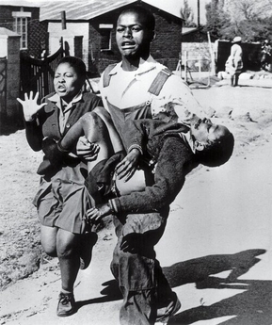
Soweto Uprising (1976)
Sam Nzima, South Africa
The Soweto uprising was a series of demonstrations led by black school children in South Africa during apartheid. They were met with fierce police brutality: 176 pupils had been killed in Soweto inside a month. This photo shows Hector Pieterson carried by Mbuyisa Makhubo after being shot by the South African Police. His sister, Antoinette Sithole, runs beside them.
Out of frame… the subjects are running towards the photographer’s car, which they used to get to hospital where Hector was pronounced dead.
https://en.wikipedia.org/wiki/Soweto_uprising

Slide 22
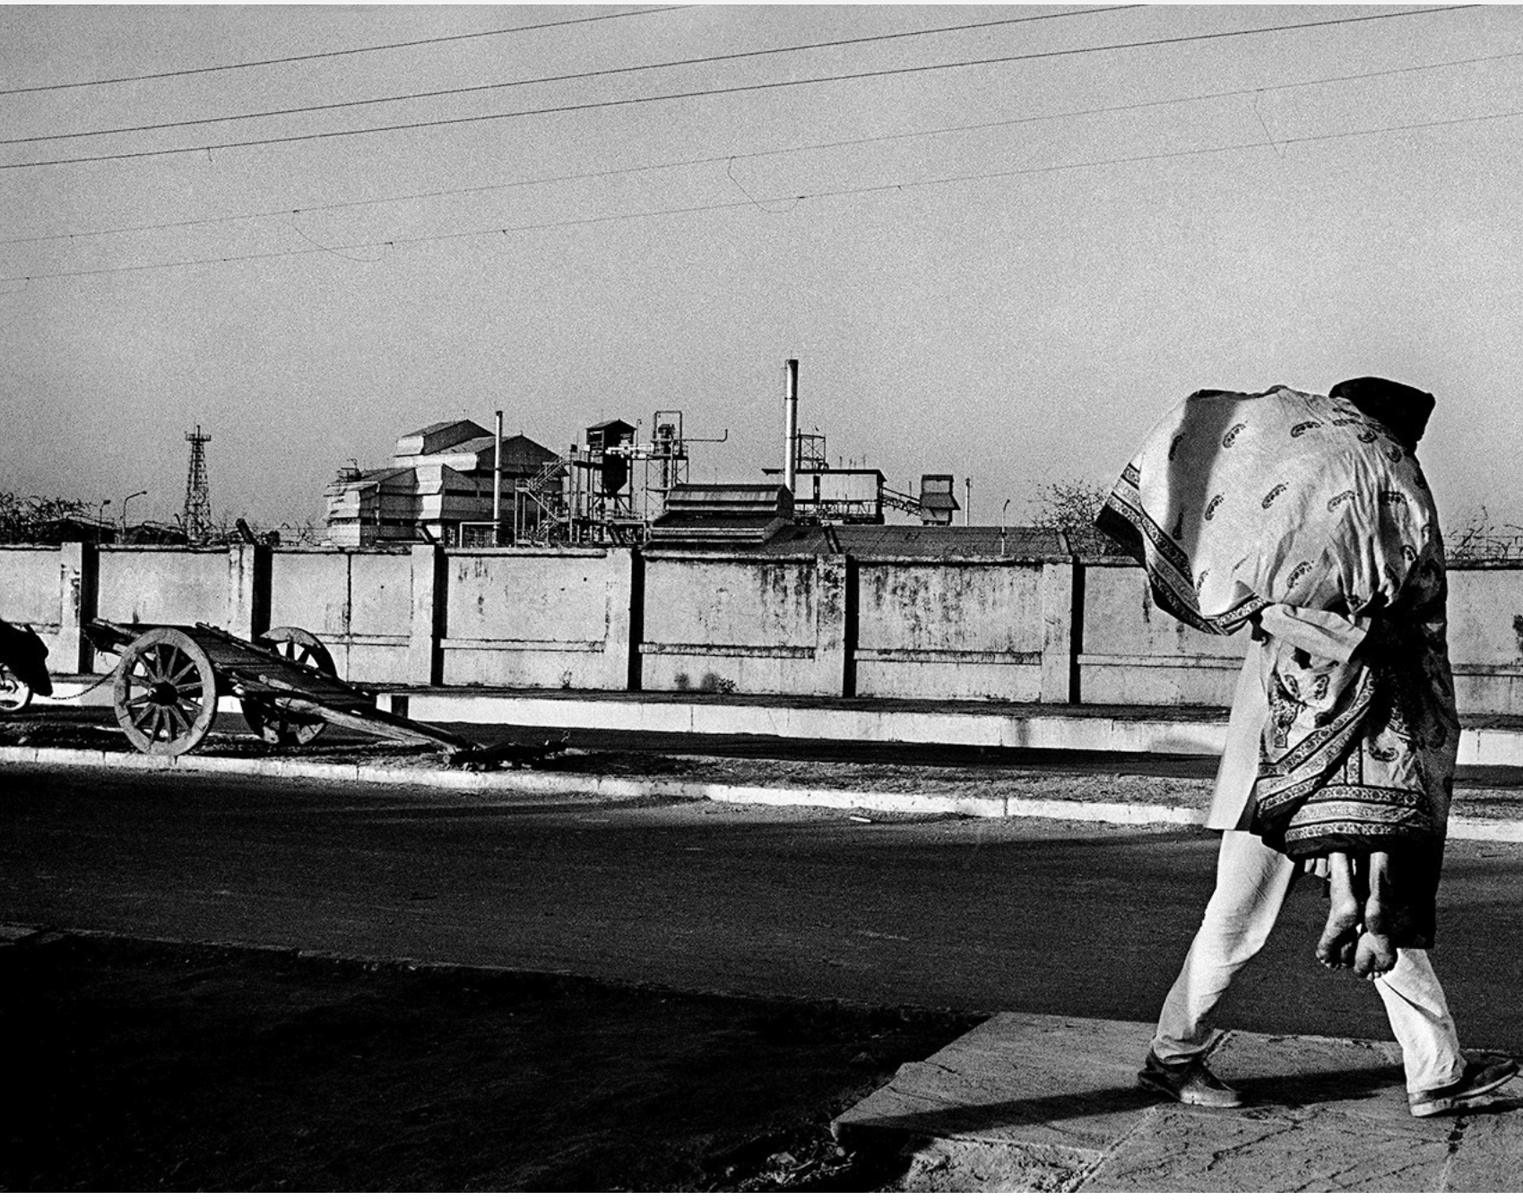
Man Carrying His Wife (1984)
Raghu Rai, India
Arriving in the town of Bhopal, where Union Carbide, an American pesticide factory, had blown up the night before, Raghu Rai shot for three days as leaked gas killed 8000 people, a toll that rose to 20,000 in the following weeks and months. His photography became symbolic of one of the world’s worst industrial accidents.
Out of frame… the photographer returned to Bhopal several times over the next two decades, photographing the aftermath of the disaster.
https://raghuraifoundation.org/bhopal/

Slide 23
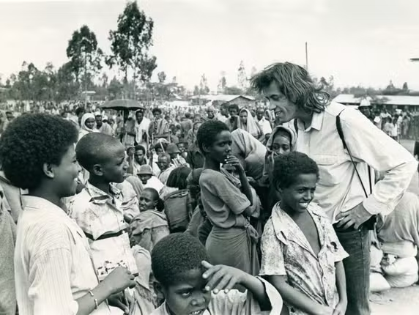
Bob Geldof with Famine Victims (1985)
Mohamed Amin, Ethiopia
Mohamed Amin, working alongside BBC journalist Michael Buerk, documented the Ethiopian famine in late 1984 and their still images were broadcast worldwide, triggering unprecedented global shock. The famine was caused not only by drought: Ethiopia’s ruling regime used starvation as a weapon during civil conflict. This image features Bob Geldof after Live Aid, visiting Ethiopia to see the crisis firsthand and understand how donations were being used. Amin’s images were so impactful that they shifted international consciousness and mobilised never-before-seen charity efforts, even forcing governments to change aid policies.
Out of frame… in 1991 Amin lost his let arm in an explosion in Addis Ababa. Within months he had returned to work, using a bionic arm and specially fitted equipment to hold his camera.
https://www.dxbnewsnetwork.com/mohamed-amins-lens-that-stirred-conscience-and-saved-millions-of-lives-globally

Slide 24
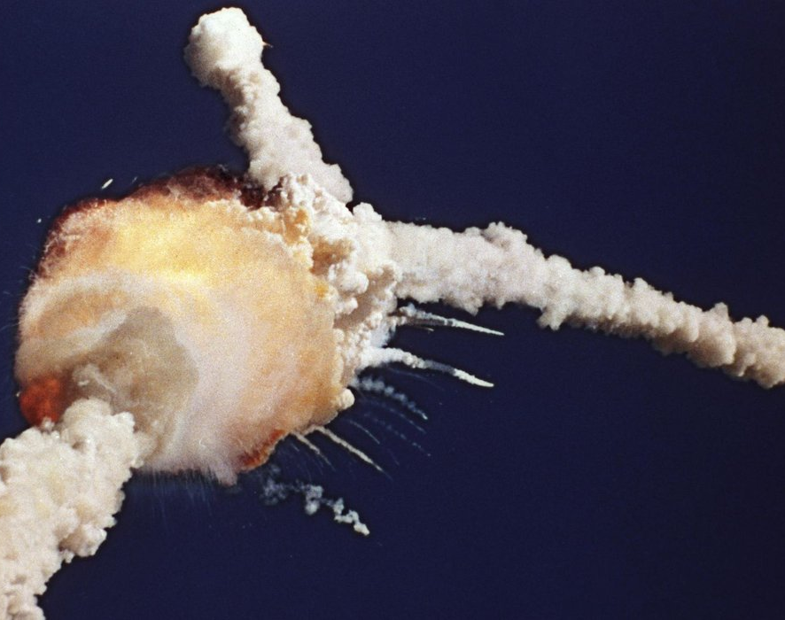
Challenger Disaster (1986)
Bruce Weaver, US
The Challenger space shuttle and her seven-member crew were lost when a ruptured rocket booster caused an explosion soon after launch. Because shuttle launches had become almost routine after 24 successful missions, those watching the shuttle launch in person and on television found the sight of the explosion especially shocking and difficult to believe until NASA confirmed the accident.
Did you know… the two plumes forming the image’s distinctive Y shape were caused by booster rockets breaking off and spiralling in opposite directions.
https://rarehistoricalphotos.com/challenger-disaster-pictures/

Slide 25
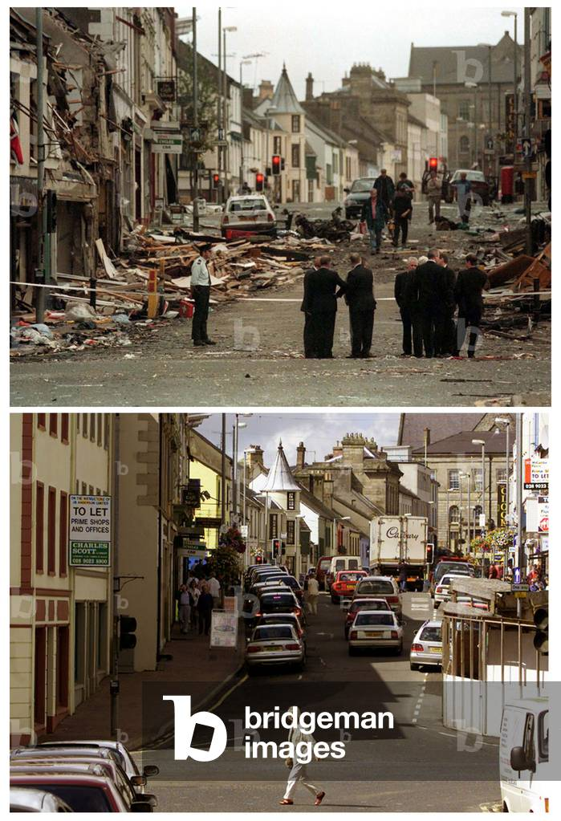
Aftermath of Omagh Bombings (1988)
Paul McErlane, Ireland
This photograph captures the immediate aftermath of the Omagh bombing, the deadliest single attack of the Northern Ireland Troubles. It visually documents the devastation in Market Street, after a Real IRA car bomb exploded, killing 29 people and injuring hundreds. Occurring just months after the Good Friday Agreement, the photo reminds us that violence and hatred linger even after progress is made in politics.
Out of frame… three years later, McErlane returned to the scene and took the exact same photo from the exact same angle. Eerily, shopfronts had been repaired and peace restored, almost as if nothing had ever happened.
https://www.rte.ie/news/2023/0813/1399371-omagh-bombing-25-years-on/

Slide 26
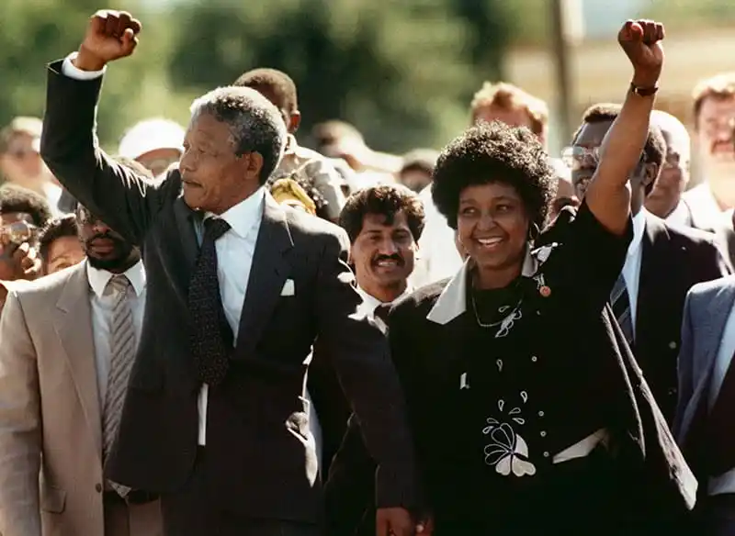
Release of Nelson Mandela (1990)
Greg English, South Africa
Photographers, journalists, TV crews and crowds waited outside Victor Verster prison in Western Cape. Finally, the gates opened and Mandela appeared with his wife Winnie. He had not been photographed for more than 25 years and this grey-haired, smartly dressed and dignified figure looked very different from the young revolutionary fighter the world had previously seen.
Did you know… Nelson is accompanied by his wife Winnie Madizikela-Mandela, known as ‘Mother of the Nation’. Over the years, she became more politically controversial.
https://amateurphotographer.com/iconic-images/nelson-mandela-released-iconic-photograph/

Slide 27
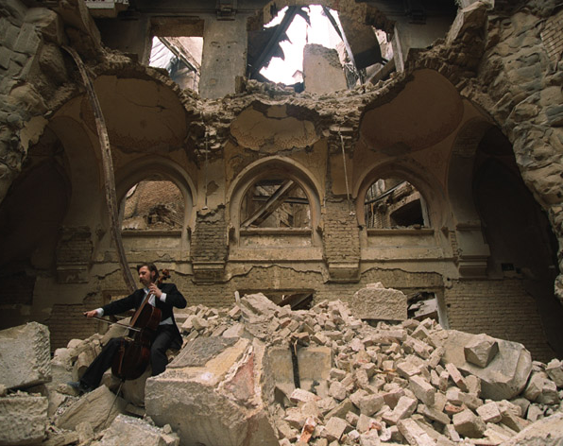
The Cellist of Sarajevo (1992)
Mikhail Evstafiev, Bosnia
This photo was taken in the bombed ruins of the National Library after it was shelled during the siege of Sarajevo, which lasted for 1,425 days. The bombing destroyed millions of books and historical archives, an immeasurable cultural loss. As an act of mourning and defiance, cellist Vedran Smailovic played in 22 different sites around the city after bomb attacks, earning international fame.
Can you spot… Vedran is wearing full concert attire, tuxedo and tails, for his performance despite the risk of sniper and mortar fire.
https://en.wikipedia.org/wiki/Vedran_Smailovi%C4%87

Slide 28
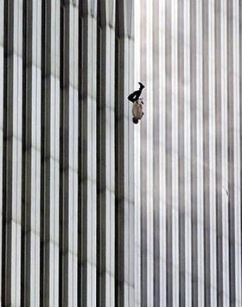
The Falling Man (2001)
Richard Drew, US
An unidentified man falling from the World Trade Center during the September 11 attacks in New York City. A Time magazine retrospective published in 2016 stated: "Falling Man's identity is still unknown, but he is believed to have been an employee at a restaurant atop the North Tower. The true power of Falling Man, however, is less about who its subject was and more about what he became: a makeshift Unknown Soldier in an often unknown and uncertain war, suspended forever in history."
Out of frame… the posture of the man has been described as a diver entering the water.
https://en.wikipedia.org/wiki/The_Falling_Man

Slide 29
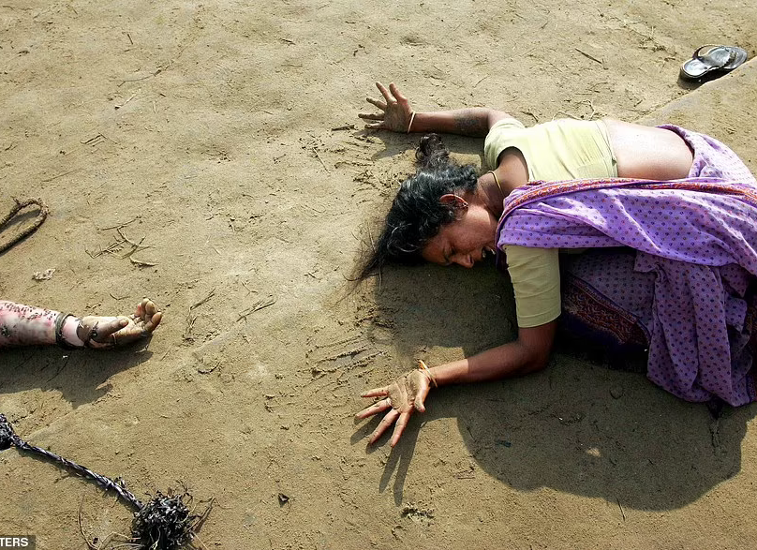
Tsunami Aftermath (2004)
Arko Datta, India
On Boxing day 2004 a devastating tsunami struck the coastlines of Indonesia, Thailand, Sri Lanka and India, causing 200,000 deaths. Two days later, this photo was taken in Tamil Nadu, where fishing villages had been wiped out by the disaster, as the floodwaters began to recede. Showing only one grieving woman, the photo became a symbol of the catastrophe, winning the World Press Photo Award the following year.
Out of frame… according to World Press Photo jury chairperson Diego Goldberg, the photo “contrasts the roar of nature with the silence of grief.”
https://www.worldpressphoto.org/collection/photocontest/2005

Slide 30
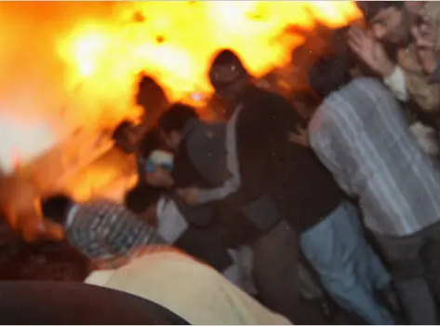
Benazir Bhutto Assassination (2007)
John Moore, Pakistan
Former Pakistan Prime Minister Benazir Bhutto was assassinated moments after addressing supporters at a political rally. As she waved from the sunroof of her vehicle, an attacker opened fire and then detonated a suicide bomb. At least 15 people were killed in the blast in addition to Bhutto herself. Moore was covering the political rally and captured moments before and immediately after the attack. About twenty meters away from the scene, he heard the gunshots and raised his camera… just as the bomb went off.
Out of frame… Moore’s photographs form before and after the bombing recreate the narrative of what happened that day.
https://www.worldpressphoto.org/collection/photo-contest/2008/john-moore-sns/4

Slide 31
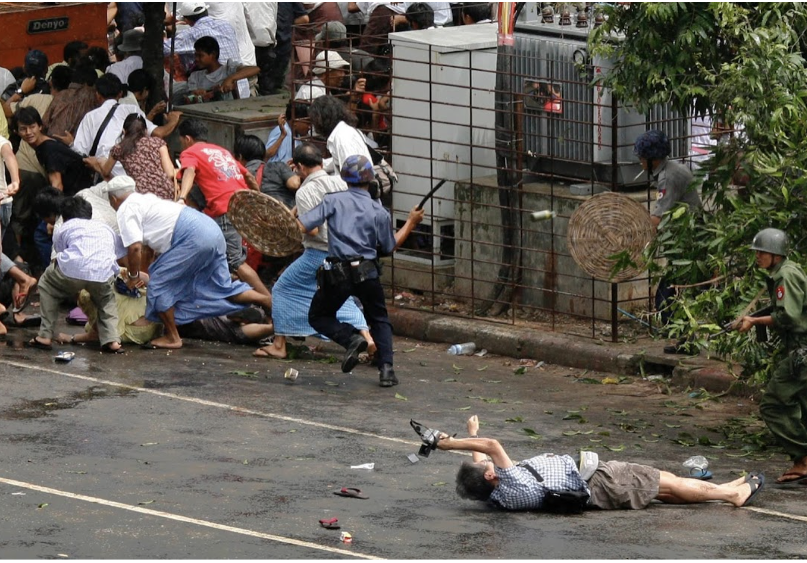
The Saffron Revolution (2007)
Adrees Latif, Myanmar
Rising prices in Myanmar fueled unrest. After weeks of protests led by the country’s Buddhist monks, security forces began raiding monasteries. The population erupted, tens of thousands taking to the streets of Yangon. Armed military opened fire and charged the protesters. As a man falls to the ground, Reuters photographer Adrees Latfi took this image, distilling the chaos of the scenes that day.
Look closely… the fallen man is holding a camera. He is Japanese APF photojournalist Kenji Nagai. He has just been shot but is still trying to take pictures. Later, he would die of his injuries.
https://widerimage.reuters.com/story/30-years-of-reuters-pictures-part-two

Slide 32
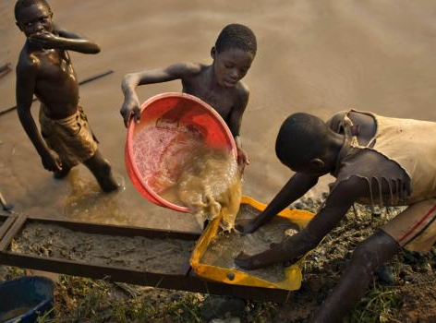
Child Miners in the DRC (2009)
Finbarr O’Reilly, Congo
This photograph shows boys panning for gold near Iga Barriere, a settlement with mines carved directly into river beds. His work directly exposes the human cost of resource extraction: the miners are children, working near-naked with no safety equipment. O’Reilly’s images appeared in the Carmignac Award project and internationally in the monograph ‘Congo: A Sublime Struggle’ which documents the DRC’s social and environmental challenges.
Out of frame… according to World Press Photo jury chairperson Diego Goldberg, the photo “contrasts the roar of nature with the silence of grief.”
https://www.globalsistersreport.org/column/justice-matters/equality/parable-today-introducing-maisha-new-life-outside-mines-33451

Slide 33
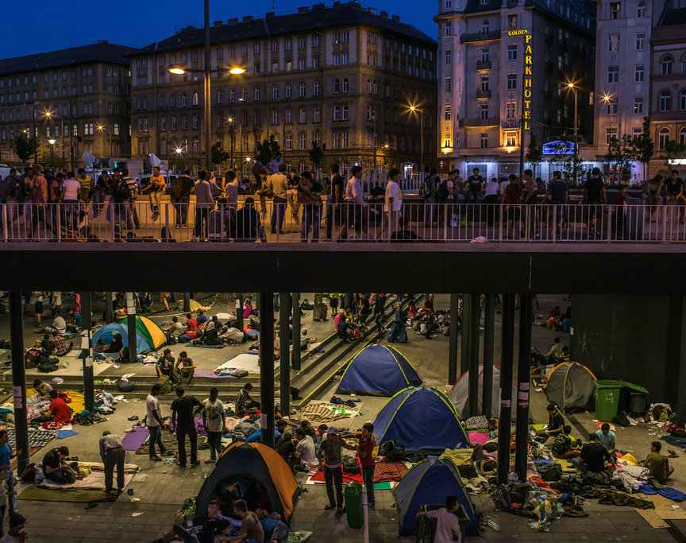
Keleti Station (2015)
Bach Mate, Hungary
The image represents the mass displacement of Syrians, Afghans, Iraqis, and others who became stranded in Hungary while trying to reach Western Europe. It was widely circulated in international media and symbolizes the desperation and the political tensions of the 2015 migrant crisis. Thousands were stranded when international routes were closed or restricted and Keleti Station became a de-facto refugee camp in the center of an EU capital.
Look closely… the composition of the image tells its own story: the grand imperial architecture of Europe above, while uprooted people cluster in tents and makeshift spaces below.
https://www.nytimes.com/interactive/projects/cp/reporters-notebook/migrants/budapest-s-keleti-train-station-has-become-a-de-facto-refugee-camp

Slide 34
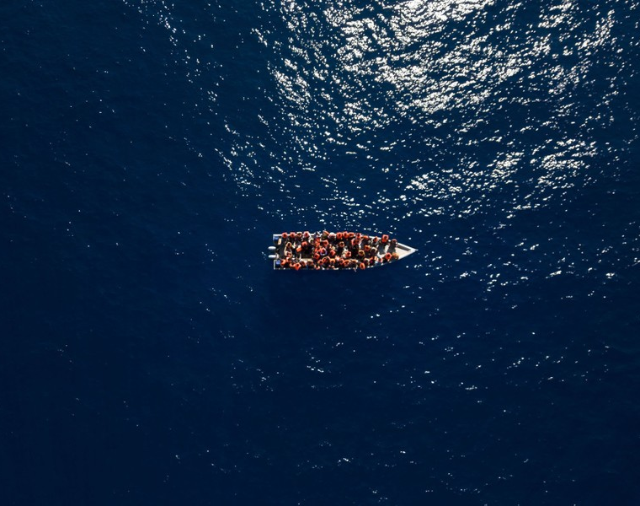
Migrant Boat (2023)
Joan Mateu Parra
This famous image shows migrants from Eritrea, Syria, and Libya on a small wooden boat crossing the Mediterranean, one of the world’s most dangerous sea crossings. Although the water looks calm in this photo, the route claimed 1,700 lives in the first half of 2023 alone. Widely circulated, this image has been frequently re-used when stories of migrant boat shipwrecks, rescues, and fatalities broke in subsequent months and years.
Can you spot… despite the boat’s flimsy construction and the danger of sinking, one man has removed his lifejacket.
https://www.theatlantic.com/photo/2023/12/2023-photos-look-middle-months/676245/

Slide 35
Reflection
After looking at the images in this collection, take a moment to reflect on the purpose and ethics of photojournalism. Think not only about what you saw, but what you felt when you saw the images. Briefly note your ideas about the following questions:
What makes these photographs more than ordinary? What makes them ‘iconic’ or ‘unforgettable’? How does a photojournalist capture such images?
How do the photographs help us understand the truth – or how do they obscure certain truths – about politics, power, people, and world events?
Some of these photos depict suffering, violence, and trauma. Where is the line between documenting history and exploitation? What ethical issues arise from some of these photographs?

