Slide 1

Gans’ Inherent News Values

Slide 2
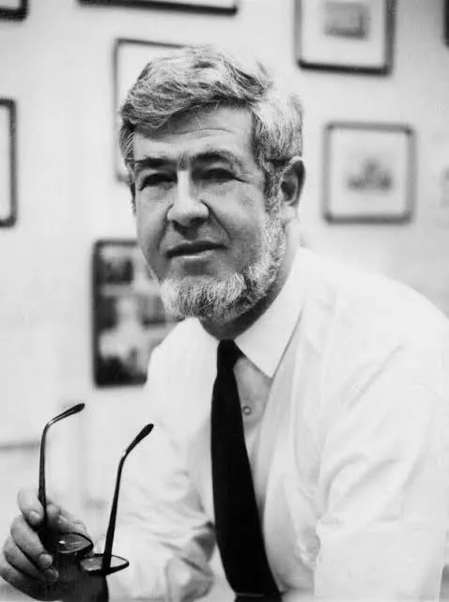
Introduction
Herbert J. Gans (1927 – 2025), a leading German-born American sociologist, reshaped the understanding of journalism with his seminal book Deciding What’s News (1979). In this work, Gans argued that news is not a neutral reflection of reality but a ‘product’ shaped by underlying values. He identified eight ‘inherent news values’ that influence what stories are selected and how they are framed. These values guide reporting in subtle ways, revealing the biases and assumptions embedded in modern media.

Slide 3

Ethnocentrism
The tendency of news media to judge other countries and cultures according to their own national values and norms. Journalists often assume their own society’s political system, economic structure, and cultural practices are superior, and they frame stories about other nations accordingly.
When U.S. media reports on elections in another country, the coverage often emphasizes whether that nation is ‘moving toward democracy’ or ‘falling short of democratic ideals.’ This assumes that democracy, as practiced in the United States, is the benchmark for good governance. Similarly, in conflict reporting, the focus is on how events abroad affect ‘our’ security, rather than exploring the local perspective.
https://www.localsyr.com/news/ny-daily-news-to-ted-cruz-drop-dead-ted/

Slide 4
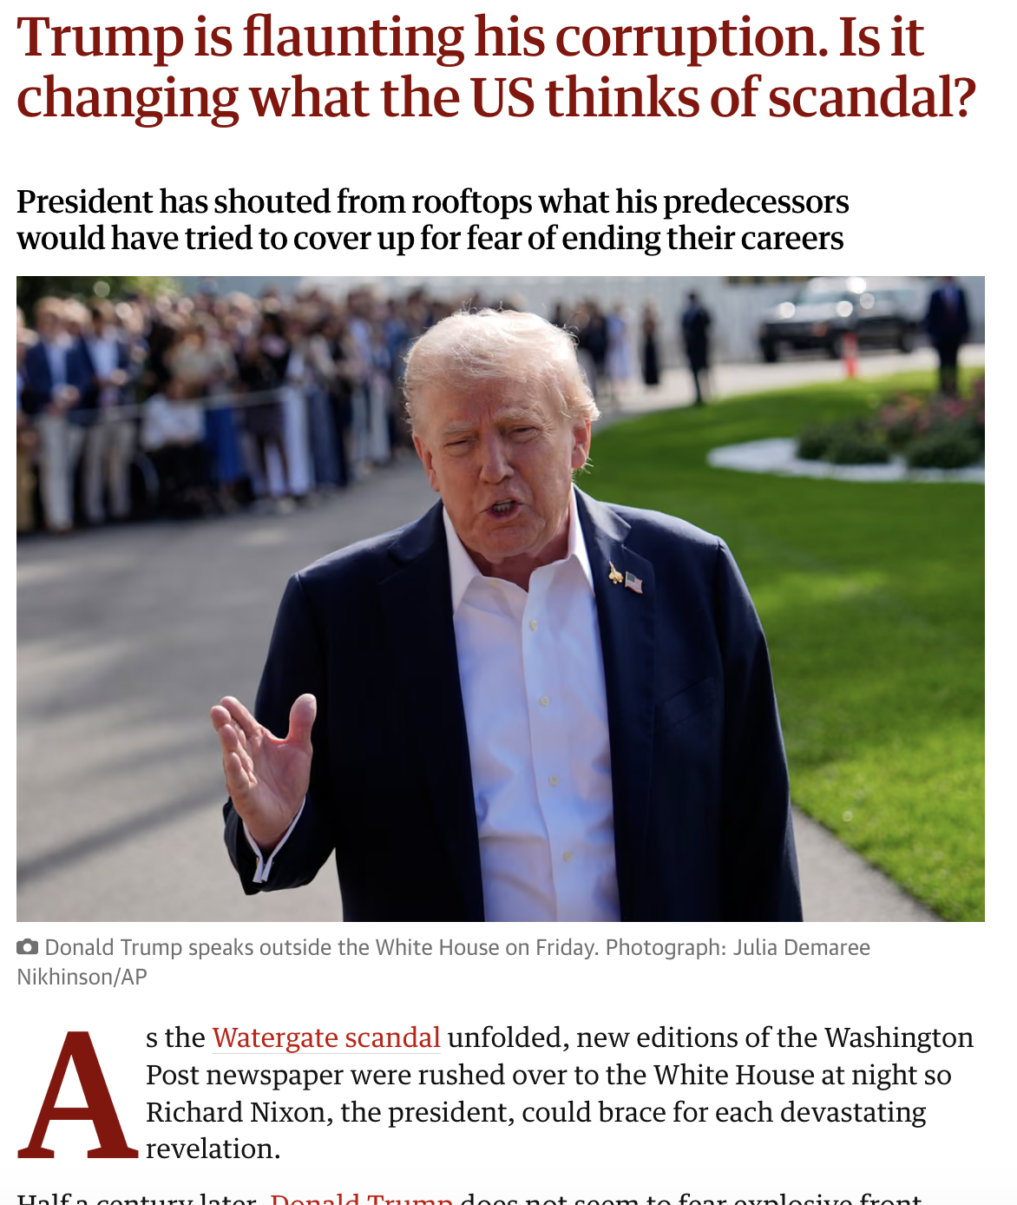
Altruistic Democracy
The belief that democracy is the ideal form of government and that it should operate in the public interest. This value assumes that elected officials ought to serve the people selflessly and be accountable, criticising politicians who fall short of this ideal. Journalists frame stories around whether democratic principles are being upheld or violated.
For example, news coverage frequently praises efforts to expand voting rights or increase government transparency because these actions align with democratic ideals. Conversely, reports on corruption scandals, voter suppression, or authoritarian tendencies are framed as threats to democracy and public welfare. Democracy is the standard against which all governments should be judged and serving the common good is a measure of political integrity and legitimacy.
https://www.theguardian.com/business/2025/dec/05/trump-billionaires-dell-investment-accounts

Slide 5

Responsible Capitalism
The assumption that businesses should pursue profits in a fair and ethical way, without exploiting workers, consumers, or society. This value reflects the belief that, if it operates responsibly, capitalism is generally positive and productive. So journalists praise companies that innovate or create jobs while criticizing those that engage in harmful practices such as fraud, price gouging, or environmental damage.
For instance, news reports celebrate entrepreneurial success stories, portraying business leaders as visionaries who contribute to economic growth. At the same time, coverage of scandals, tax evasion or unsafe working conditions emphasize a failure to uphold responsible capitalism. Capitalism serves the public good (rather than purely private interests) so businesses should balance profit-making with ethical conduct.
https://timesofindia.indiatimes.com/world/us/h-1b-visa-success-stories-elon-musk-sundar-pichai-and-other-h-1b-visa-holders-who-shape-the-future-of-the-us-tech-industry/articleshow/124037259.cms

Slide 6
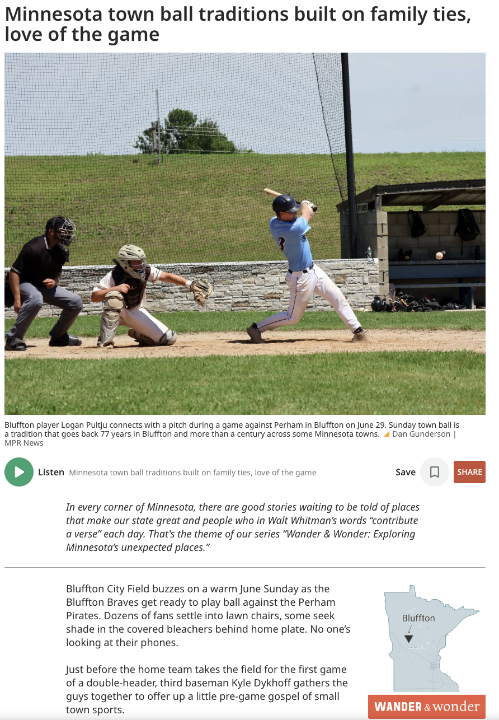
Small Town Pastoralism
The idealisation of rural life and small communities as wholesome, safe, and morally superior, while often portraying urban areas as chaotic, corrupt, or dangerous. This value reflects a nostalgic belief that traditional, close-knit communities embody honesty and strong social bonds, in contrast to the morally ambiguous ‘big cities’.
This value can be seen in stories that celebrate small-town resilience, neighbourly cooperation, and ‘heartwarming’ local events. For example, a news feature about a rural town coming together to rebuild after a natural disaster often emphasizes themes of solidarity and virtue. Conversely, crime or political scandals in large cities are frequently framed as evidence of urban decay or moral decline. Rural living is romanticized as peaceful and authentic, while urban life is associated with stress and danger.
https://www.mprnews.org/story/2025/07/28/town-ball-built-on-family-ties-and-love-of-the-game

Slide 7

(Rugged) Individualism
This value emphasizes personal responsibility, autonomy, and individual’s achievement, manifesting in stories that highlight personal triumphs or struggles. Events are portrayed as individual effort rather than collective dynamics. The idea is that personal initiative is the key to progress and that individuals should be held accountable for their circumstances.
For example, coverage of a successful entrepreneur typically focuses on their personal vision, hard work, and determination, even if other factors contributed to their success. Similarly, when reporting on social problems such as poverty or unemployment, the narrative suggests what individuals can do to overcome these challenges, rather than examining systemic causes, suggesting how solutions should be found by specific people rather than by reforming systems.
https://www.bbc.com/sport/africa/67695351

Slide 8
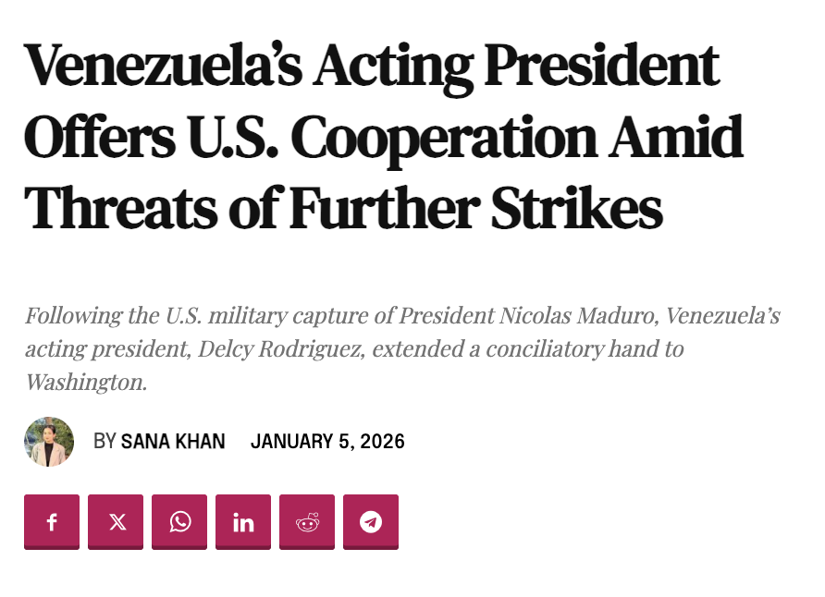
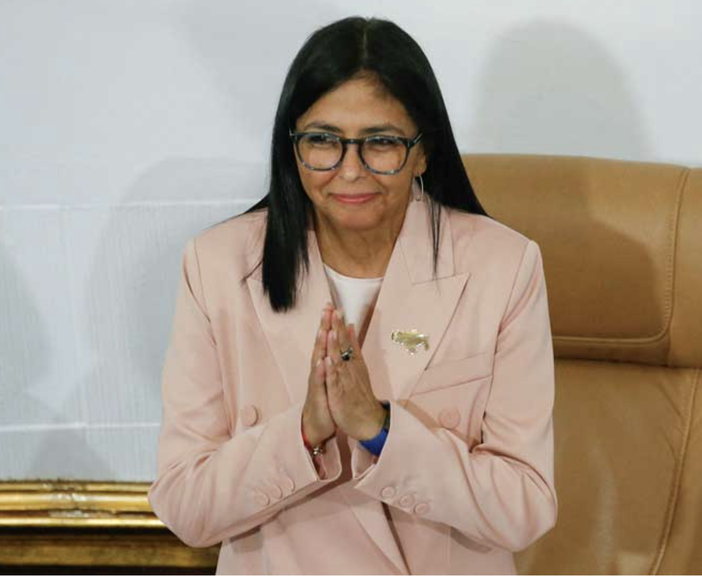
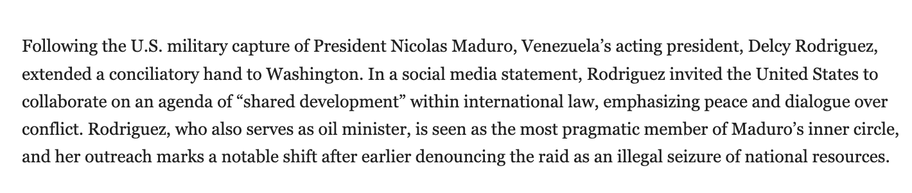
Moderatism
News favours moderation over extremes in politics, behaviour, and opinion. The belief is that balanced, centrist positions are desirable, while radical or extreme views are problematic – or even dangerous. Compromise and small changes are seen as the most reasonable path forward.
For example, when covering political campaigns, journalists frequently highlight candidates who appeal to the ‘middle ground’ and describe them as pragmatic or sensible. Conversely, those with strongly progressive (left wing) or conservative (right wing) platforms are often ‘radical’ or ‘fringe.’ Similarly, in reporting on protest movements, the media tends to emphasize peaceful, orderly demonstrations while portraying disruptive actions as excessive or harmful.
https://moderndiplomacy.eu/2026/01/05/venezuelas-acting-president-offers-u-s-cooperation-amid-threats-of-further-strikes/

Slide 9
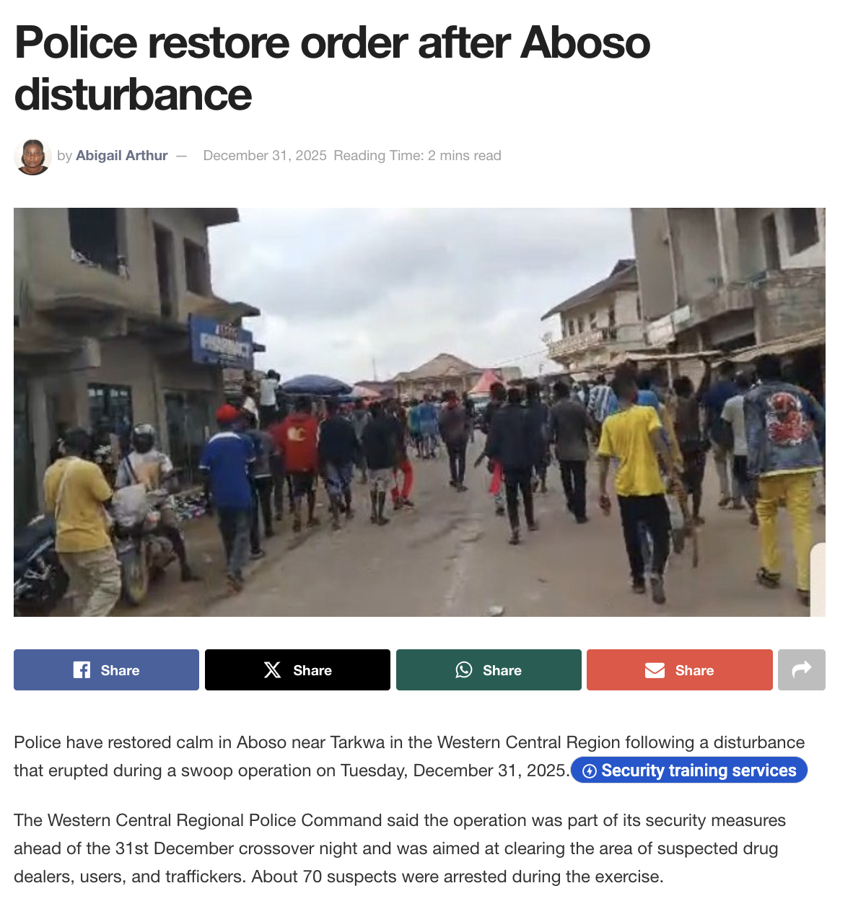
Social Order
The media prefers stability and continuity in society. News coverage assumes that maintaining order is essential and frames disruptions such as crime, protests, natural disasters, and so on, as problems that need to be resolved quickly. This value reassures audiences that normalcy will return and that institutions are working to restore balance.
The media frequently emphasizes traffic delays, clashes with police, or threats to public safety. Similarly, coverage of natural disasters highlights efforts by authorities and communities to rebuild and restore normal life, reinforcing the idea that order must be reestablished. Even in political reporting, sudden changes or radical reforms are often portrayed as destabilizing, while gradual, adjustments are preferable.
https://citinewsroom.com/2025/12/police-restore-order-after-aboso-disturbance/#google_vignette

Slide 10
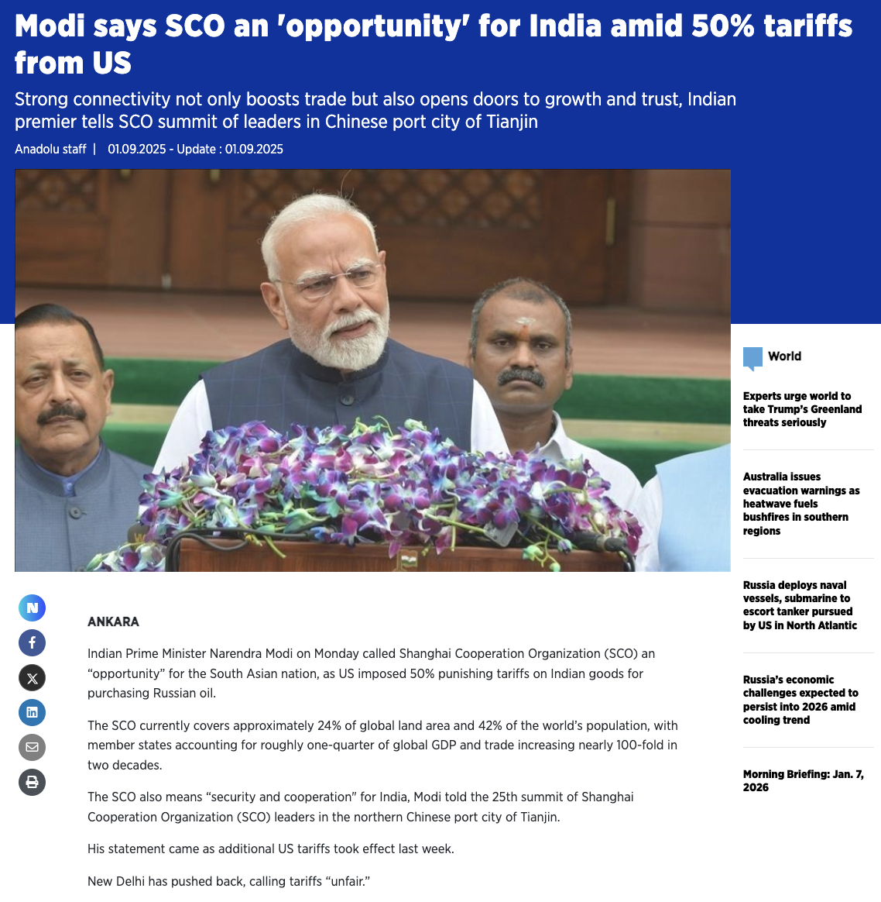
Leadership
The tendency of news media is to focus on the actions, decisions, and personalities of leaders when reporting events. This value assumes that leaders like presidents, business executives, or community heads like mayors are central to shaping outcomes and solving problems. As a result, news stories often highlight what leaders say or do to the exclusion of other possibilities.
For example, during a political crisis, media covers the president’s response, speeches, and decisions, even though many other factors may influence the situation. Similarly, in business reporting, stories often spotlight CEOs as visionaries or decision-makers, attributing a company’s success or failure largely to their leadership. This focus reinforces the idea that strong leadership is the key to progress and stability.
https://www.aa.com.tr/en/asia-pacific/modi-says-sco-an-opportunity-for-india-amid-50-tariffs-from-us/3674820

Slide 11
Conclusion
Herbert Gans’ inherent news values remind us that bias and subjectivity are built into the way news is produced. Journalism is not purely objective; it contains cultural assumptions and leans towards audience expectations. Ethnocentrism privileges one nation’s perspective, while altruistic democracy and responsible capitalism promote democratic ideals and business practices. Small-town pastoralism and individualism show preferences for simplicity and personal achievement, and moderatism, social order, and leadership emphasize stability and authority. Taken together, the values show how complex issues can often be simplified into familiar narratives. News is not a neutral reflection of reality – subtle forces mould the news into stories that help direct the flow of public opinion towards a surprisingly narrow range of options.
Herbert J. Gans died April 21st 2025 at the age of 97 (https://www.nytimes.com/2025/04/21/books/herbert-j-gans-dead.html)

Slide 12

Headline Activity
Over the next few slides you’ll see different headlines. Read each carefully to identify which of Herbert Gans’ inherent news values are reflected in the headline. Some headlines may include more than one value.
Write down the value(s) you think apply and be ready to explain your reasoning.
For example:
“Western Leaders Urge Stability Abroad Amid Rising Global Unrest”
Ethnocentrism / Leadership / Social Order: positions Western leaders as guardians of global order.

Slide 13
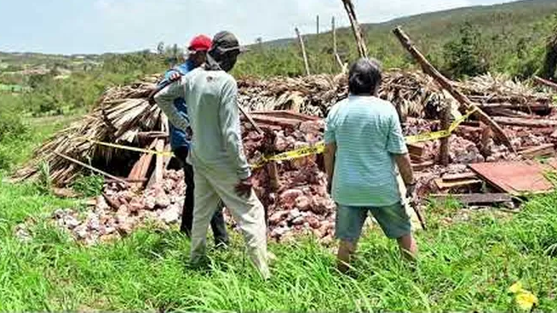
“Farmers Band Together to Rebuild After Storm, Restoring Normalcy”
Notes:
Small-Town Pastoralism / Social Order: romanticizes rural solidarity and the return to stability.

Slide 14
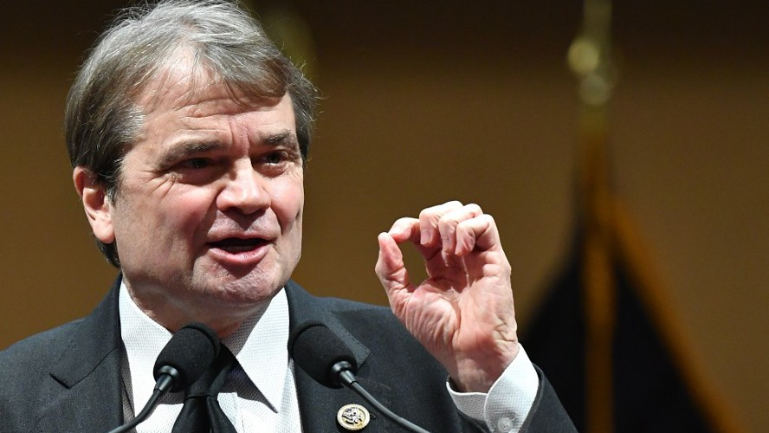
“President Vows Transparency to Restore Public Trust in Government”
Notes:
Altruistic Democracy / Leadership: highlights democratic accountability through strong leadership.

Slide 15

“Self-Made Entrepreneur Champions Ethical Business Model”
Notes:
Responsible Capitalism / Individualism: celebrates personal success being tied to socially responsible business practices.

Slide 16

“Nation X Embraces Free Elections in Step Toward Democratic Ideals”
Notes:
Ethnocentrism / Altruistic Democracy: frames another country’s reforms as progress toward Western-style democracy.

Slide 17
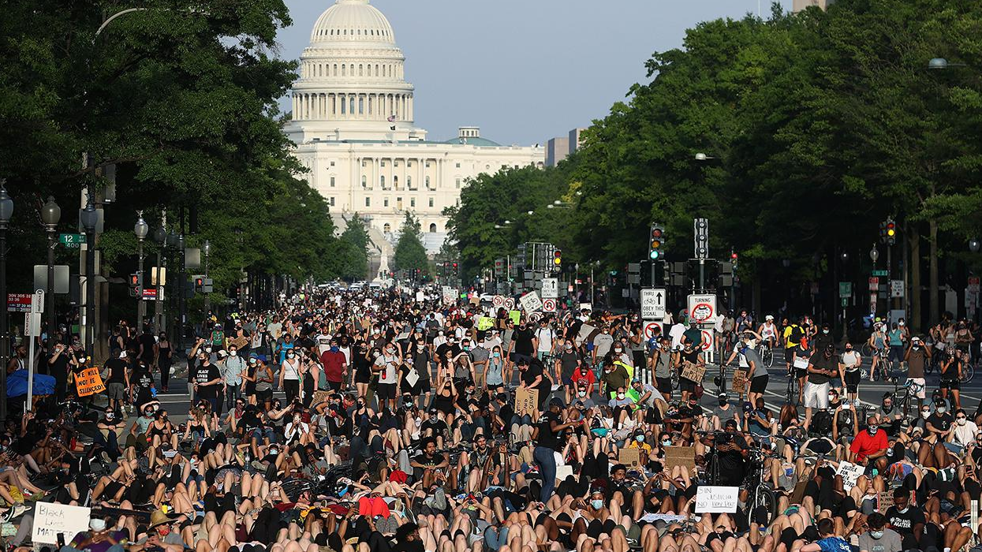
“Lawmakers Seek Compromise to Calm Political Tensions”
Notes:
Moderatism / Social Order: frames moderation as the solution to restore harmony.

Slide 18
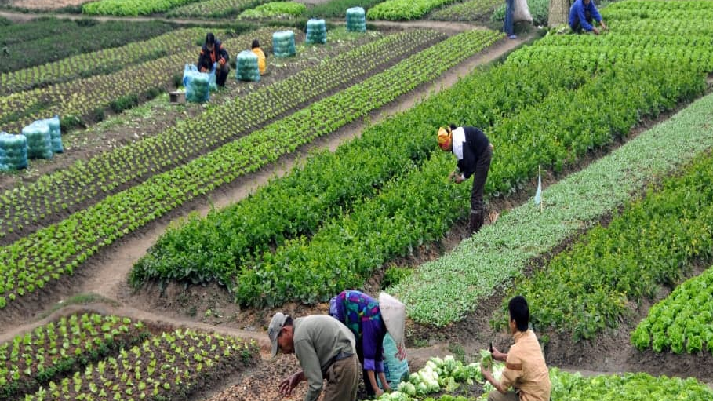
“Developing Country Urged to Adopt European Fair Trade Practices for Global Growth”
Notes:
Ethnocentrism / Responsible Capitalism: suggests Western economic standards as the benchmark for ethical growth.

Slide 19

“Visionary CEO Drives Company’s Turnaround Through Bold Decisions”
Notes:
Individualism / Leadership: focuses on one leader’s decisive role in corporate success.

Slide 20
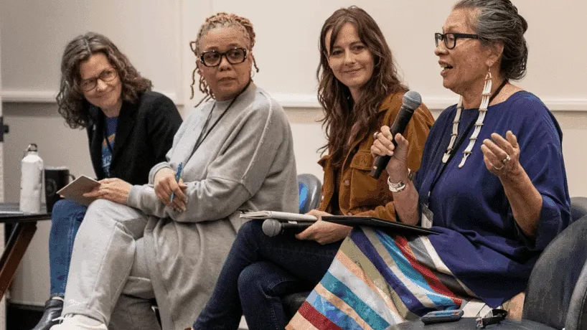
“Women’s Groups Push Balanced Policies to Preserve Tradition and Progress in Rural Areas”
Notes:
Small-Town Pastoralism / Moderatism / Leadership: emphasizes rural values while advocating moderate reforms driven by local leaders

Slide 21
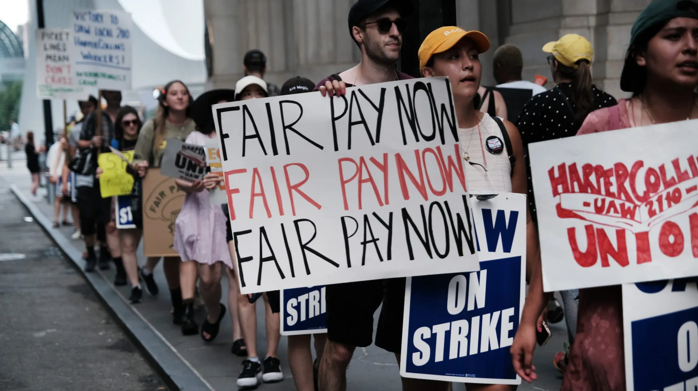
“Corporations Commit to Fair Wages to Prevent Labor Strikes”
Notes:
Responsible Capitalism / Social Order: links ethical business practices to maintaining societal stability.

Slide 22
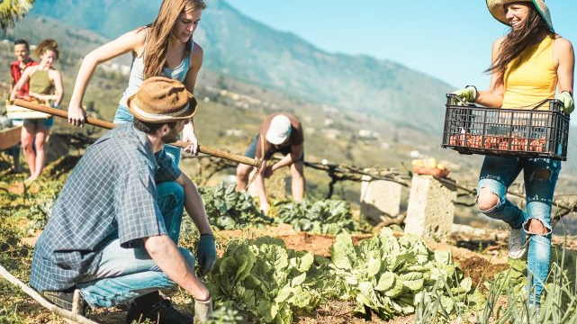
“Local Innovator’s Efforts Revitalize Rural Economy”
Notes:
Individualism / Small-Town Pastoralism: celebrates personal initiative improving a traditional community.

Slide 23
Reflection
Think about what Gans’ inherent news values reveal about the stories you see in the news. Reflect on your own reactions and consider how these values might affect your understanding of media and bias:
  Which news value do you think influences headlines the most today, and why?
  How might these values affect your own perception of what is ‘important’ news?
  What steps can journalists (and/or readers) take to reduce bias created by these values?

