Slide 1
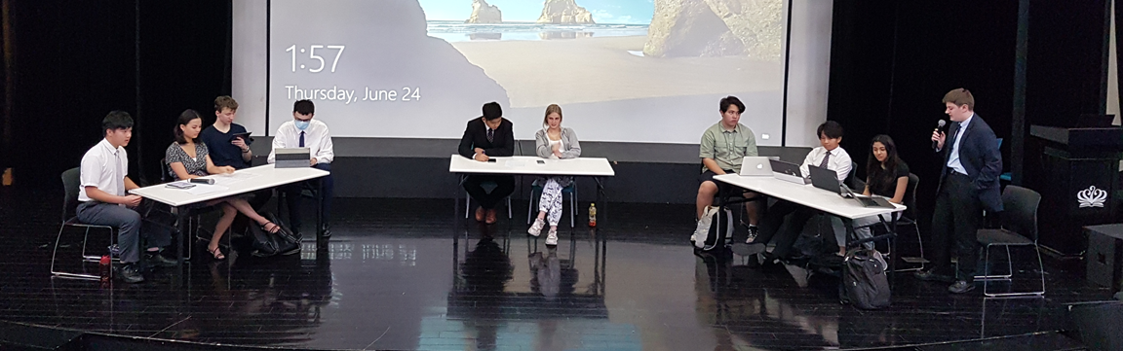
This house believes that technology is ruining the English language.
Go head-to-head and display your debating skills.

Slide 2
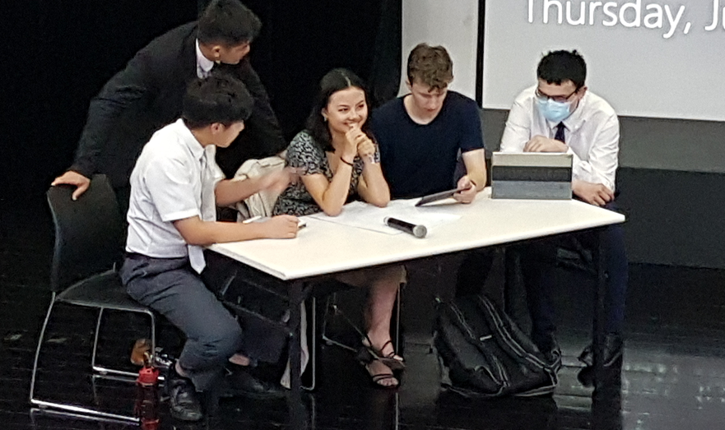
The Rules
Each debate has 2 teams (a Proposition team and an Opposition team)
Each team will contain 4 speakers. The aim of each team is to work together to provide a good case for or against the ‘motion’ set for the debate.
3. Each speaker in the debate gives a 5 min speech, in a zig-zag order:
1st Prop – 1st Opp; 2nd Prop – 2nd Opp; 3rd Prop – 3rd Opp.
After the main debate has finished, there will be a floor debate where members of the audience (if there is an audience) can ask questions to either side in the debate. These questions should be responded to not by the speakers but in the 3-minute summary speeches which take place after the floor debate, given by the fourth member of the group. The Opposition summary goes first, followed by the Proposition summary.

Slide 3
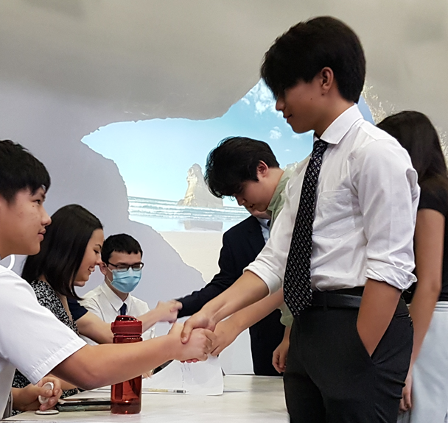
The Rules
4. Points of information (POIs), short interruptions, may be made after the first minute and before the last minute of a speaker’s speeches to speakers on the other side of the debate.
The POI is made by standing up and stating ‘Point of information’; then the speaker speaking may decide whether or not to accept the POI.
POIs should be as short as possible and last no longer than 15 seconds.
You must accept at least 2 POIs that are offered, but may also reject a POI. The chairperson may overrule any POI is he or she feels it is not apposite to the debate, poorly phrased, obstructive or irrelevant. Timekeepers must not allow POIs inside the first or last minute of the presentation.

Slide 4
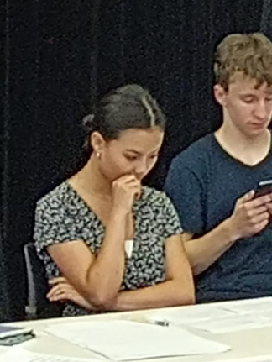
The Rules
5. A debate can be supervised by a chairperson who introduces the motion and the speakers before they speak, keeps order if necessary, and chooses the members of the audience who ask questions during the debate.
The timekeeper signals to the speakers how much time they have left by banging a gavel or clapping: a single bang after 1 minute, a single bang after 4 minutes and a double bang after 5 minutes which indicates that the speaker should finish speaking.
The judges decide which team has won the debate on the basis on which team presented the more convincing arguments, taking into account Content, Style and Strategy.

Slide 5

Advice
6. All the speakers on the proposition and the opposition should present arguments and examples of their own and respond to the arguments made by the other team.
The aim of each team is to work together in order to win the debate by presenting the most convincing arguments on their side and by responding effectively to the arguments presented by the other side.
For this reason, teams should attempt to split up their arguments between the speakers, with each speaker making different arguments and responding to the arguments made by the previous speaker on the other side of the debate.

Slide 6
Each person will have a responsibility when preparing for the debate. Research each role and decide on the role you would prefer. These are the following roles:
Review of the roles of all:
1. 1st speaker
2. 2nd speaker
3. 3rd speaker
4. Chairperson
5. Floor debate members
6. 2x Time keeper
Everybody is a researcher.
4. Summary speaker

