Slide 1
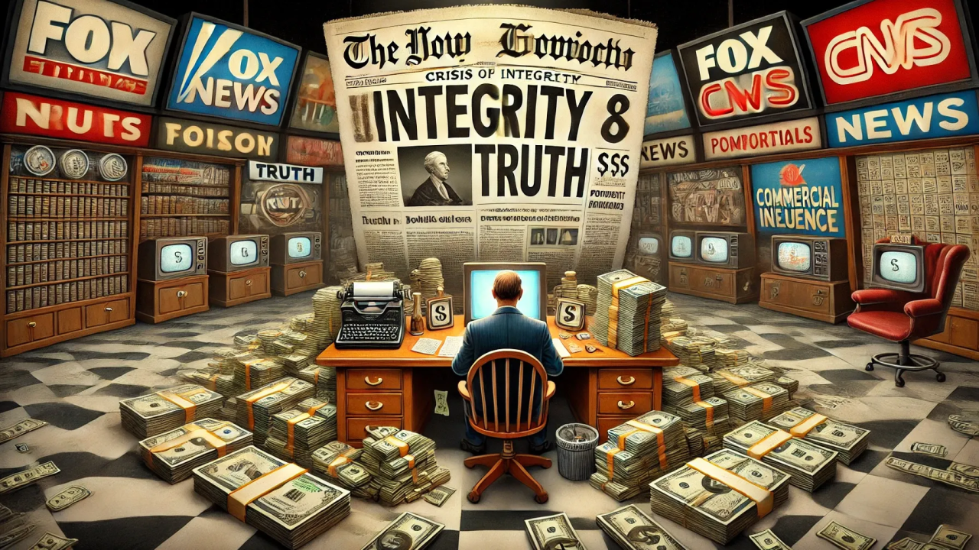
Challenges to Journalistic Integrity
Case Studies in Misreporting and Inaccuracy in the News

Slide 2
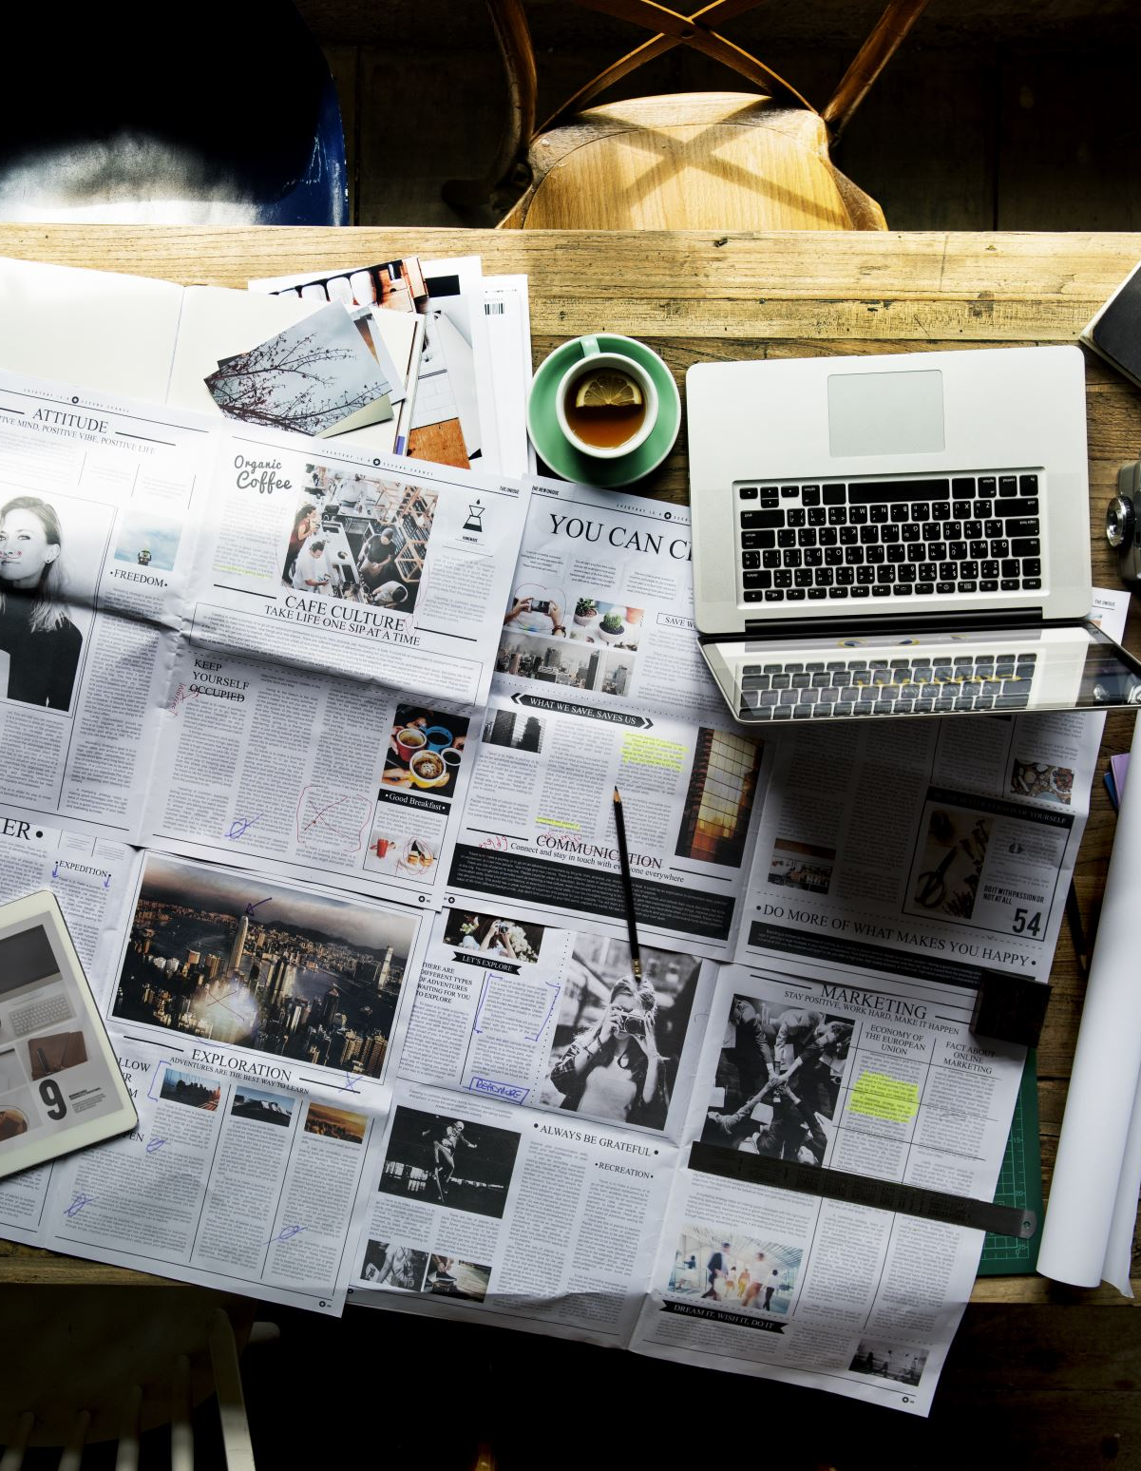
Introduction
Journalism is often described as a pursuit of truth and the journalist’s integrity is a cornerstone of many societies. Yet, in reality, the commitment to telling the truth is always tested by external pressures. Commercial interests can shape what stories are told and the race to publish first can lead to errors and incomplete reporting. Protecting sources, navigating uncertain risks, and cutting corners for the sake of a deadline or one’s future career prospects, add further complexity. Beyond these practical challenges, social norms influence what is considered ‘acceptable’ to report, while powerful people exert pressure from above. In this situation, journalists must balance idealism with reality, making ethical decisions that affect public trust. This presentation will outline some of the challenges to integrity faced by journalists, illustrating each one with a real-life case study. By the end, you’ll ask: can journalism ever be completely truthful, or is it always a compromise?

Slide 3
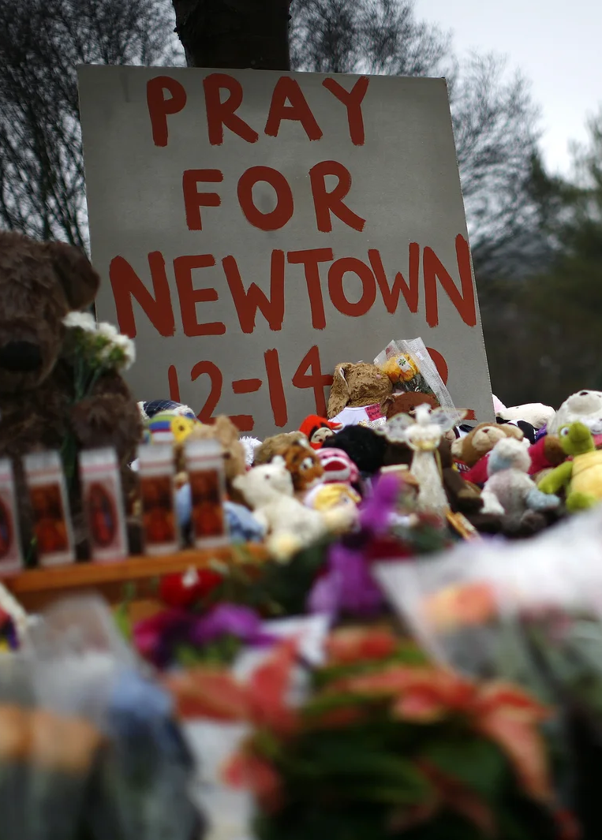
Race to Publish
Pressure to break news first, before competitor news outlets, can lead to inaccurate or incomplete reporting.
Case Study: In December 2012, following the shooting of schoolchildren and teachers at Sandy Hook school in Newtown, Connecticut, Fox News reported that ‘cops’ had identified 24-year-old Ryan Lanza as the perpetrator. Other news outlets (such as The New York Times, CNN, and Associated Press) took this up and reported that ‘authorities’ had identified the shooter. The trouble is – they were wrong. Subsequent investigations uncovered many other factual errors in early coverage, and identified the rush to ‘scoop’ as a primary factor in spreading misinformation.
https://www.npr.org/2012/12/18/167466320/coverage-rapid-and-often-wrong-in-tragedys-early-hours

Slide 4
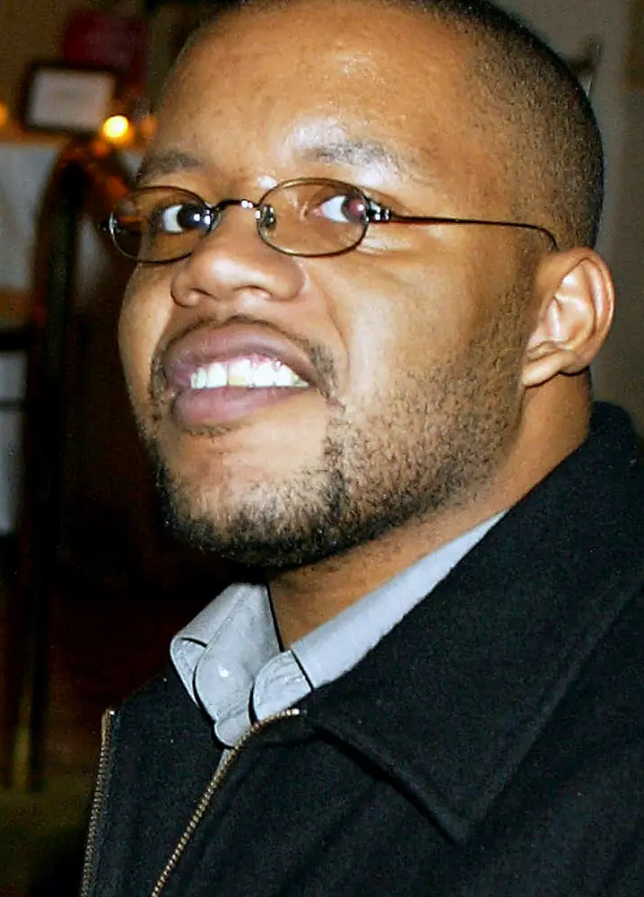
Sensationalism Drives Revenue
Negative and shocking news sells more papers and gets more clicks, so increased revenue (plus the chance for more advertising revenue) can affect the publication of certain stories.
Jayson Blair was hired by The New York Times as a staff writer who covered sensational stories such as the Washington DC sniper attacks and the Iraq war. In 2003, he was found to have fabricated materials in his reports, using made-up quotations and locations – but early warning signs were ignored as his sensational stories gave the paper an edge over similar coverage. Two senior editors were forced to resign in the eventual fallout.
https://www.factualamerica.com/byline-blunders/jayson-blair-the-new-york-times-plagiarism-nightmare-shakes-journalisms-core

Slide 5
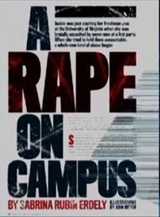
Dubitable Sources
Reliance on single sources combined with the pressure to publish sensational exclusives can lead to unverified stories that turn out to be wrong.
In 2014, Rolling Stone published a shocking story about a gang rape on campus at the University of Virginia, based mostly on the testimony of a single source: ‘Jackie’. Key details were not verified or corroborated, and the allegations turned out to be a hoax. The unverified story caused huge reputational damage to the university and personal harm to those who were falsely implicated, as well as undermining the trauma of survivors of real sexual assault cases.
https://abcnews.go.com/2020/deepdive/how-retracted-rolling-stone-article-rape-on-campus-came-print-42701166

Slide 6
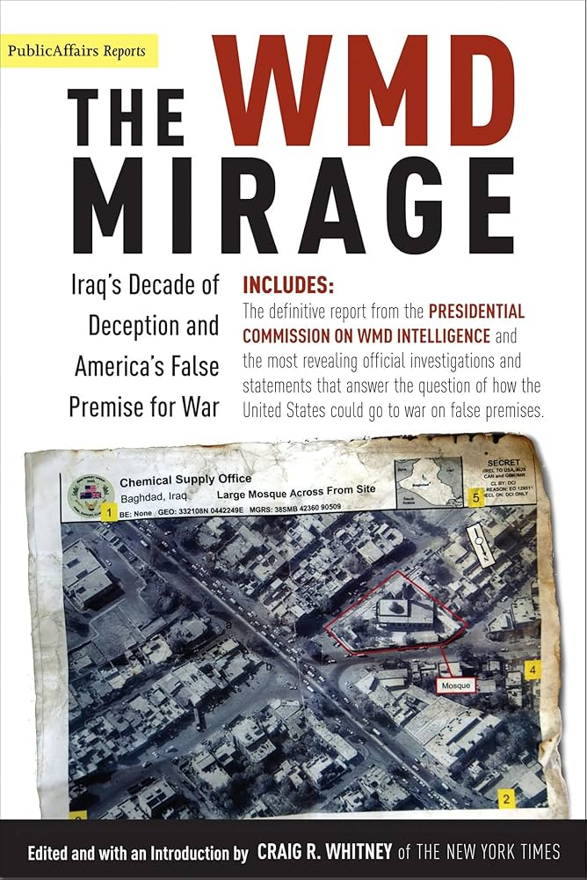
Powerful Pressure
Governments can influence news by restricting access to information, imposing censorship, or threatening legal repercussions, compromising the ideals of truth and transparency in journalism.
In the lead-up to the Iraq war (2002 – 2003), major news outlets such as CNN relied on US government sources claiming Iraq had weapons of mass destruction ready to use in an international attack. These claims were later shown to be false – but had already helped shift public support for the invasion.
https://www.peoplesworld.org/article/iraq-weapons-of-mass-destruction-remembering-the-lies-of-wars-past/

Slide 7
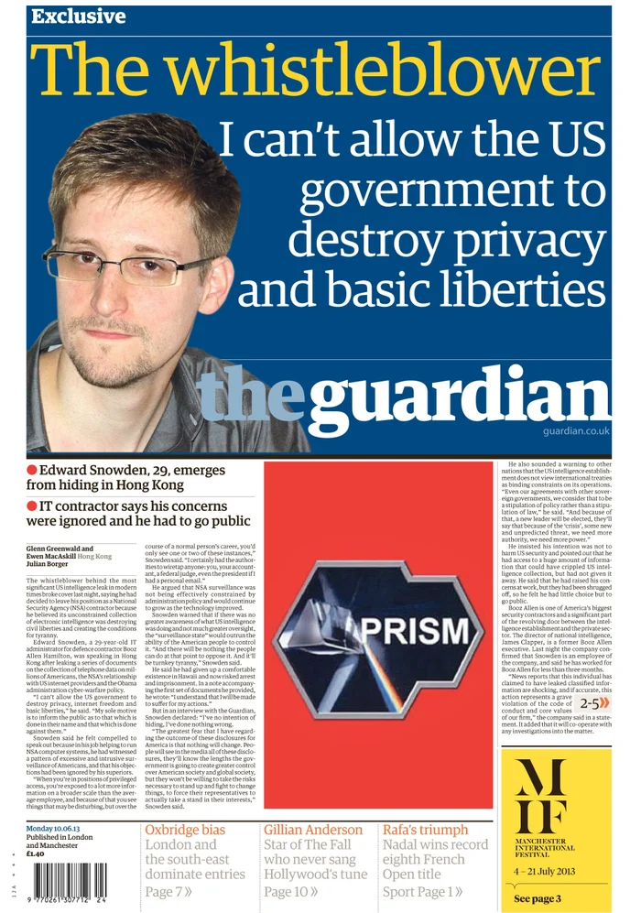
National Security
In some cases, legitimate security concerns can force journalists to exercise restraint when divulging facts or mean editors delay publishing important true stories.
In May 2013, several major newsrooms including The Washington Post, La Monde, and The Guardian received classified hacked military documents from Edward Snowden. Editors negotiated with governments to balance public interest with national security, and stories were only partially published with redactions.
https://www.theguardian.com/us-news/2023/jun/07/edward-snowden-10-years-surveillance-revelations

Slide 8
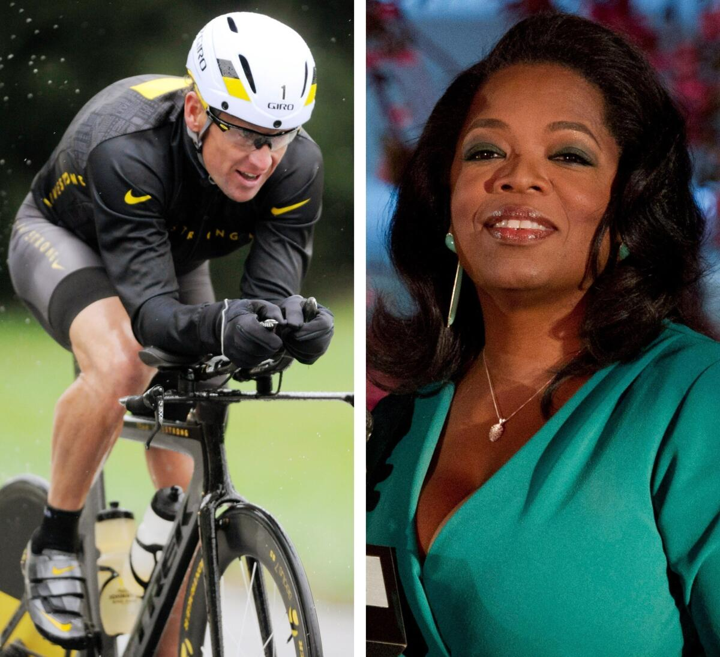
Access Journalism
Some reporters prioritize maintaining good relationships with sources such as politicians, celebrities, or corporate leaders, so they ‘soften’ their reporting, avoid tough questions, or even omit certain facts, damaging their commitment to the truth.
When former world champion cyclist Lance Armstrong chose to open-up about his career-long doping to Oprah Winfrey in 2013, it was initially billed as a coup for her show. But after the interview, Winfrey was criticized for not pressing him harder on the systemic ways he was able to abuse the system and cheat for so long. Pushing him too hard may have damaged her brand and jeopardized her show.
https://www.independent.ie/sport/other-sports/cycling-glimpses-and-admissions-but-always-armstrongs-hollow-core/28961127.html

Slide 9
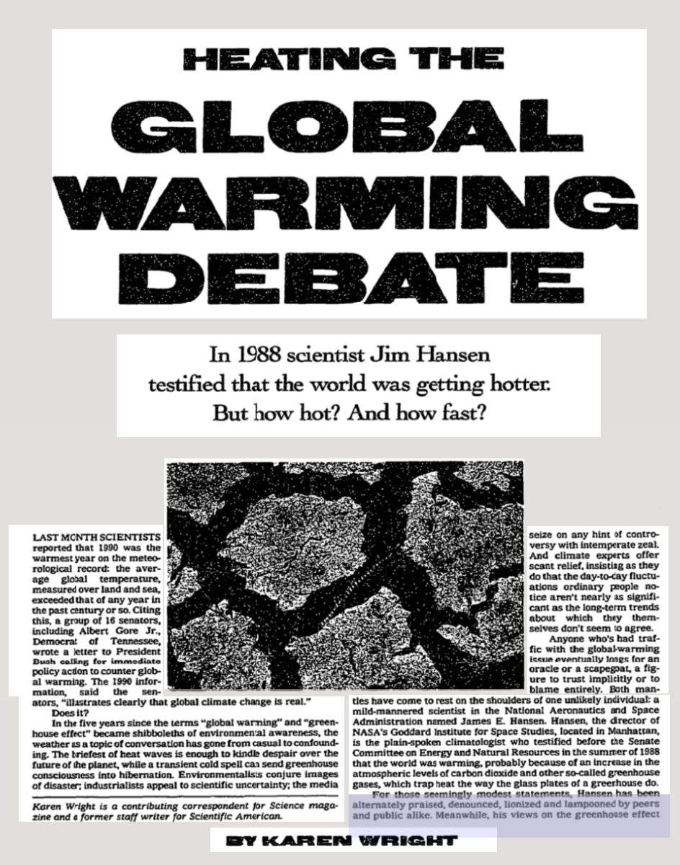
The Overton Window
The range of ideas that are acceptable or permissible to report is decided by news owners and readers. Editorial decisions keep stories within this ‘window’.
Throughout the 1980s and 1990s, stories about climate change were framed as a ‘debate’ even though scientific evidence overwhelmingly showed a ‘consensus’. Acknowledging the urgency of the issue was outside the window of acceptability. As a result of watering down the truth, climate action has been delayed and diluted.
https://timesmachine.nytimes.com/timesmachine/1991/02/03/351091.html?pageNumber=313

Slide 10
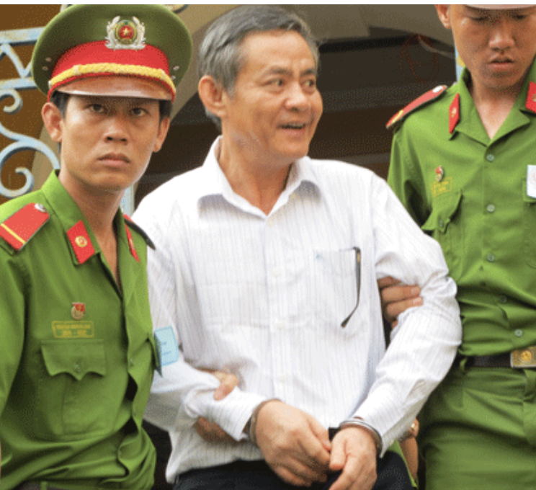
Legal and Safety Concerns
Journalists may be put in personal danger by reporting from e.g. conflict zones or in places where laws can be turned against those who seek truth.
In 2012, Vietnamese journalist Nguyễn Văn Khương posed as an offender and paid police bribes to expose corruption. He was sentenced to four years in prison even though his story was verified true (authorities charged him with bribery, not for falsifying facts).
https://rsf.org/en/newspaper-reporter-arrested-undercover-investigation-police-corruption

Slide 11
Conclusion
Knowing these challenges helps us to see that journalism is rarely a straightforward pursuit of truth. Every story is shaped by competing pressures like commercial interests, deadlines, legal risks, political influence, and social norms. These things don’t make the journalist’s quest for truth meaningless; but it is complex. The real question is how journalists can uphold integrity when perfection is impossible. Ethical choices become the guiding principles in a world where truth is negotiated rather than absolute.

Slide 12
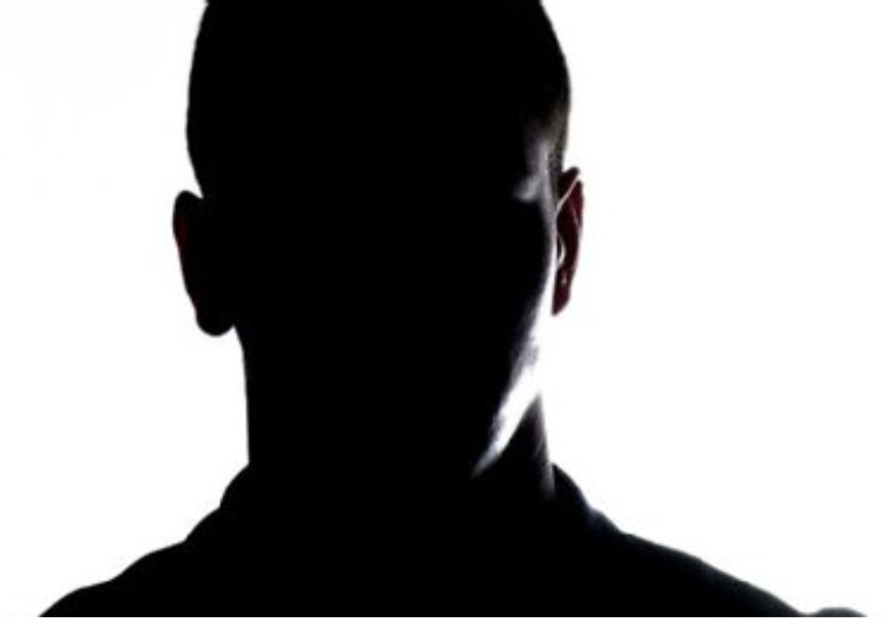
Scenario 1: The Unverified Source
You are the editor of a major news outlet. A reporter brings you a story about a high-profile corruption scandal involving a government minister. The story relies heavily on one anonymous source who claims to have insider knowledge. The source insists on confidentiality and refuses to provide documents or additional evidence, citing fear for their safety. The reporter argues that publishing now will give your outlet a major scoop and boost readership. However, verification could take days, and another outlet might break the story first.
Should you publish the story immediately, knowing the source is unverified but the allegations are serious and newsworthy? Or wait for verification?
Publish? Click Here
Wait? Click Here

Slide 13
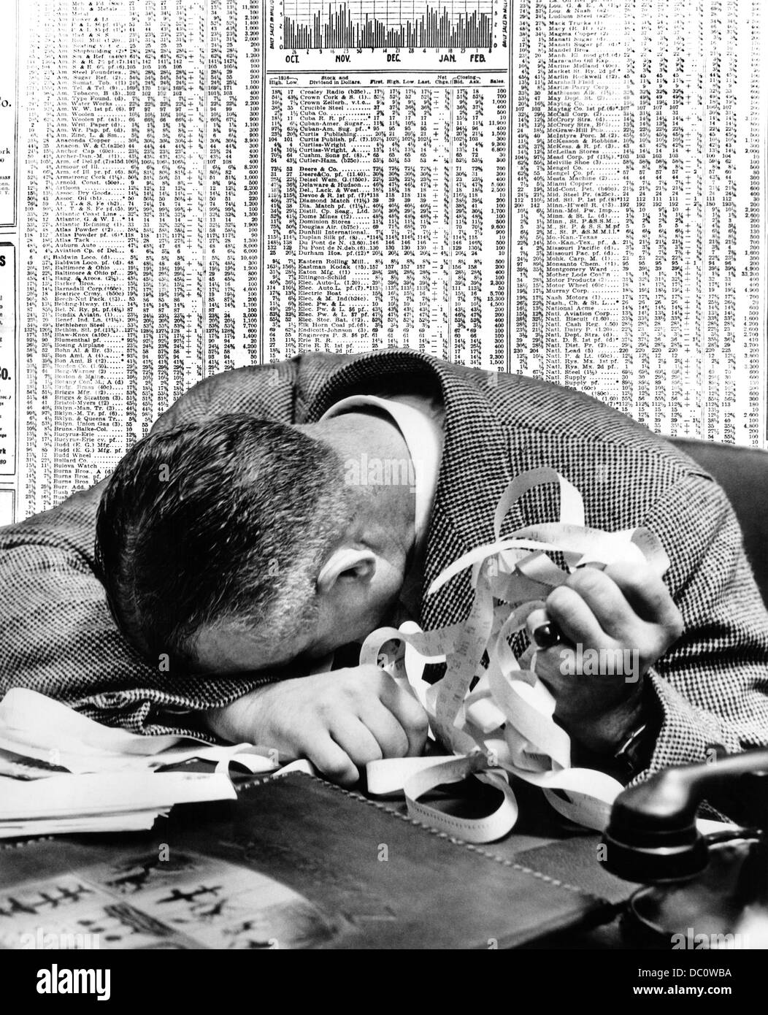
You chose to publish without verification:
You decide to publish the story, emphasizing the importance of government corruption to the public interest. The piece goes viral… but within hours the minister denies the allegations, and other outlets report conflicting information. Your credibility is questioned, and the source disappears, leaving you unable to defend the accuracy of your report.
In light of this outcome:
Was publishing justified given the potential public benefit?
How should the outlet handle the fallout now?
Does speed ever outweigh verification in journalism?

Slide 14
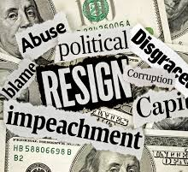
You chose to wait for verification:
You hold the story and assign a team to verify the source’s claims. Two days later, another outlet publishes similar allegations without verification, gaining massive attention. When your verified story finally runs, it confirms the scandal, but your outlet missed the initial scoop and lost readers and revenue. In light of this outcome:
Was waiting the right decision, even at the cost of losing the scoop?
How do you balance commercial risk with journalistic integrity?
Should verification always take priority over being first?

Slide 15
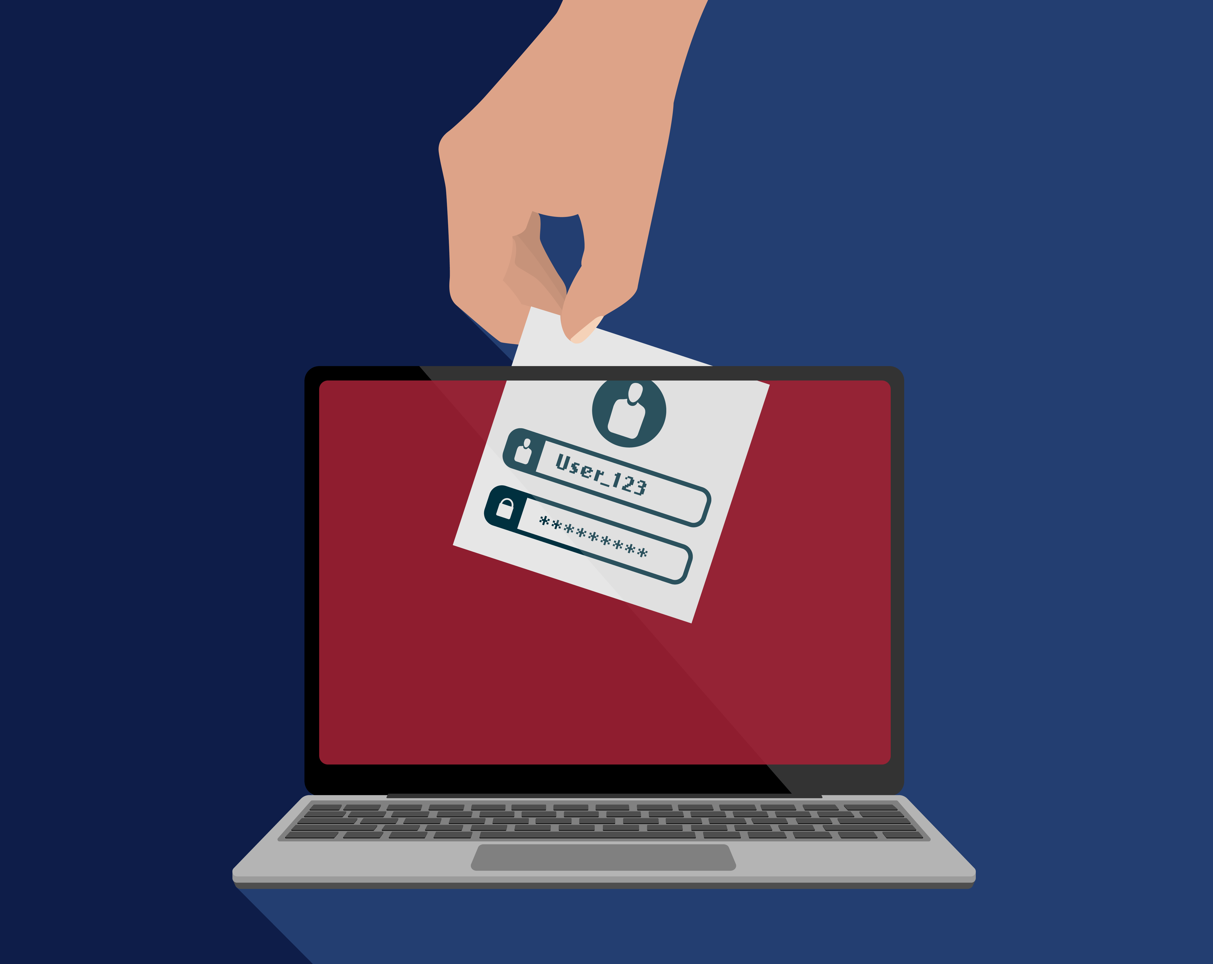
Scenario 2: The Leaked Memo
A reporter at your news outlet receives a leaked memo suggesting that a major pharmaceutical company covered up safety concerns about a new drug. The memo comes from an anonymous source claiming to work inside the company. The source refuses to provide further evidence or allow their identity to be verified, citing fear of losing their job. The reporter argues that publishing now could save lives if the drug is dangerous. However, the company denies the allegations and threatens legal action if the story runs without proof.
Should you publish the story immediately, knowing the allegations are in the immediate public interest? Or wait for more proof?
Publish immediately?
Wait for proof?

Slide 16
You chose to publish immediately:
You decide to publish the story, framing it as an urgent public health warning. The piece sparks outrage and panic, but later investigations reveal the memo was incomplete and misleading. Your outlet faces lawsuits and a major credibility crisis.
In light of this outcome:
Was the decision ethically justified given the potential risk to public health?
How should the outlet handle the fallout?
Does the public’s right to know outweigh the need for verification?

Slide 17
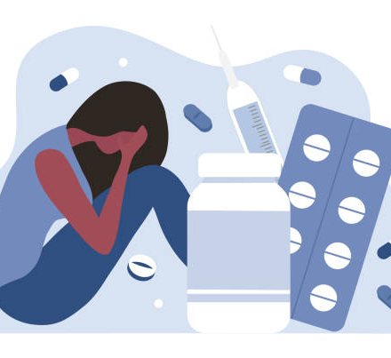
You chose to wait for more proof:
You hold the story and assign a team to verify the memo. After two weeks, you confirm the allegations and publish a detailed exposé. However, during that time, thousands of people began using the drug, and some suffered severe side effects. Critics accuse your outlet of failing to act quickly.
In light of this outcome:
Was waiting the right decision, even at the cost of harm?
Should journalists act on incomplete information when lives may be at stake?
How do you balance urgency with accuracy in reporting?

Slide 18
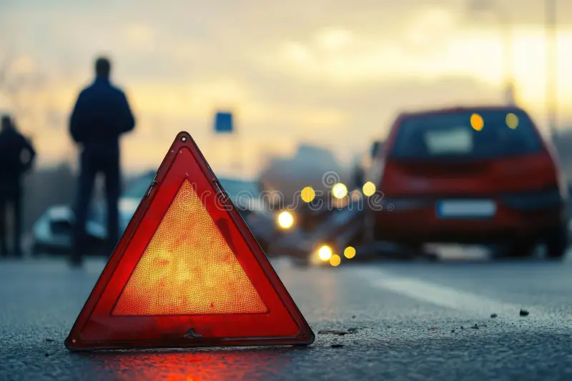
Scenario 3: The Graphic Image
Your newsroom receives verified photos of a devastating accident involving a well-known public figure. The images are authentic and shocking as they show the severity of the crash and the victim’s injuries. Publishing them would make the story more compelling and drive massive engagement. However, the victim’s family has requested privacy, and critics argue that showing such images is exploitative and harmful. The reporter insists that the public has a right to see the truth.
Should you publish the photographs alongside the story or hold back and run the story with softer images?
Publish the photos?
Go with softer images?

Slide 19
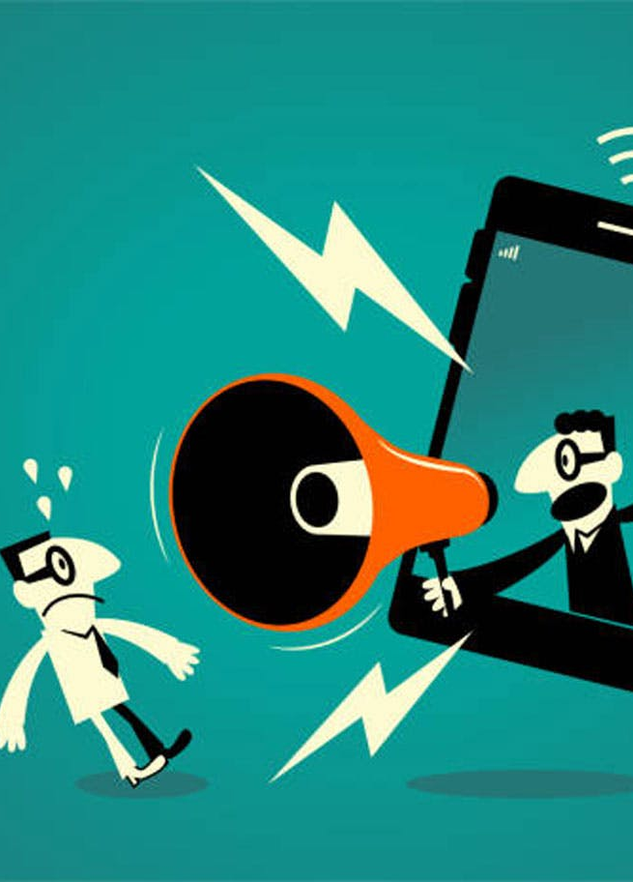
You chose to publish the photos:
You decide to publish the photos alongside the story. The article goes viral, but the family accuses your outlet of insensitivity. Public debate erupts about ethics of your decision and the line between truth and dignity, and your outlet suffers some reputational damage.
In light of this outcome:
Was publishing justified in the name of transparency?
Does the public’s right to know outweigh the victim’s right to privacy?
Should graphic truth ever be withheld for compassion?

Slide 20
You chose to hold the photos:
You describe the accident in detail but omit the photos. The story receives moderate attention, and some readers accuse your outlet of sanitizing the accident. Others praise your sensitivity.
In light of this outcome:
Did withholding the images compromise the truth?
Should journalists prioritize empathy over full disclosure?
Where should the line be drawn between informing and sensationalizing?

Slide 21
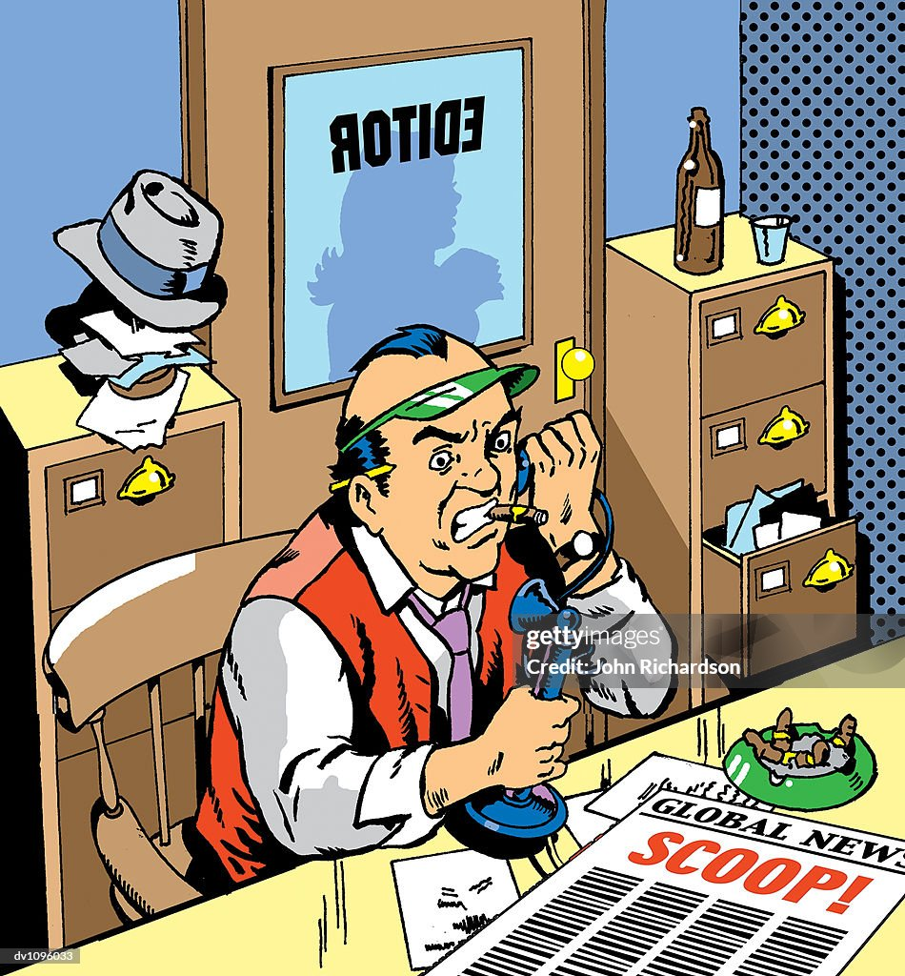
Scenario 4: The Government Request
Your newsroom uncovers verified documents showing that a government agency misused public funds for private projects. The story is solid, and the evidence is clear. Just before publication, a senior government official calls you directly. They acknowledge the documents are real but insist that publishing now would “endanger national stability” and “undermine public trust.” They hint that your outlet could lose access to future briefings and even face legal consequences if you proceed. The reporter argues that withholding the story compromises the public’s right to know.
Should you publish the full version of the story or hold back from publication hoping to negotiate a deal?
Publish the full story?
Hold the story?

Slide 22

You chose to publish the full story:
The public reacts strongly, demanding accountability from their political leaders. However, the government retaliates by restricting your outlet’s access to official information and launching an investigation into your newsroom. Your reputation for independence grows, but operational challenges mount.
In light of this outcome:
Was publishing the right choice despite the risks?
Should journalists prioritize transparency over potential harm to national stability?
How do you weigh public interest against institutional pressure?

Slide 23
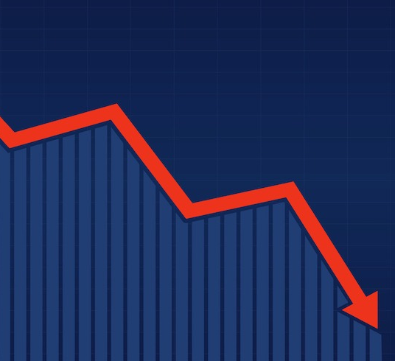
You chose to hold the story:
You decide to hold the story, hoping to negotiate with the government for a safer release. Weeks later, another outlet publishes a similar exposé, and your newsroom faces criticism for ‘protecting the powerful.’ Trust in your outlet declines, even though you avoided immediate retaliation.
In light of this outcome:
Was delaying justified to protect your newsroom and staff?
Does withholding verified information ever serve the public interest?
How should journalists respond to threats from powerful institutions?

Slide 24

Reflection
Journalism is rarely black and white. Each decision – whether to publish, delay, or omit – carries consequences for truth, trust, and public interest. Integrity isn’t just about knowing the facts; it’s about navigating competing values under pressure. After navigating these scenarios, take a step back and think: What principles should guide journalists when the ‘right’ choice isn’t obvious? How can news editors balance speed, accuracy, privacy, and accountability in a world where every decision has consequences?

