Slide 1

Between Objectivity and Subjectivity
How to Recognize When Your Response is Being Subtly Guided

Slide 2
Introduction
Photojournalism may seem like a way of showing the world exactly as it is. Yet every photograph is shaped, even subtly, by the person behind the camera. While photojournalists may aim for – or purport to claim – objectivity, subjectivity has a way of slipping into almost any image through choices of angle, distance, framing, and timing. Over the next few slides, you’ll see how certain techniques help preserve a neutral, observational viewpoint, while others introduce emotion, bias, or interpretation. By recognising the tension between objectivity and subjectivity, we can recognise when an image is documenting a moment… or when it might be guiding us toward a particular way of seeing.

Slide 3
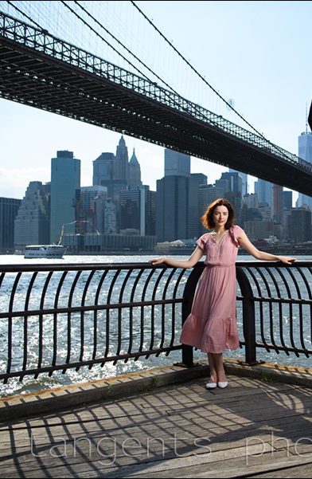
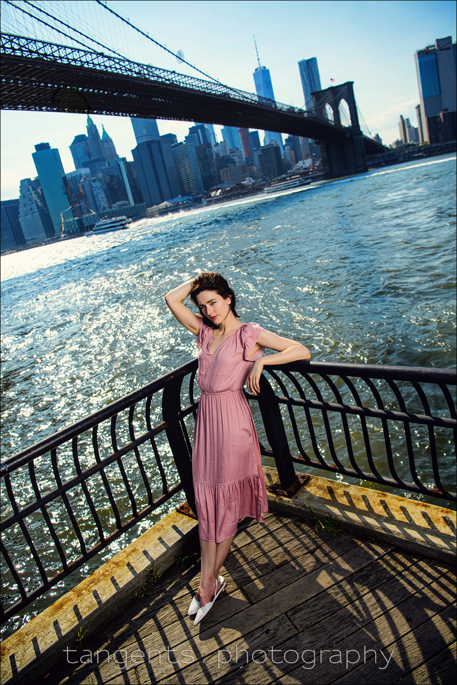
Straight Horizon vs Tilted Angle
A level horizon keeps an image feeling balanced, neutral, and objective because it’s how we naturally look at the world. A tilted angle introduces subjectivity by creating unease, drama, or emotion.
Notes:
https://neilvn.com/tangents/photography-composition-tilted-horizons-in-photographs/

Slide 4
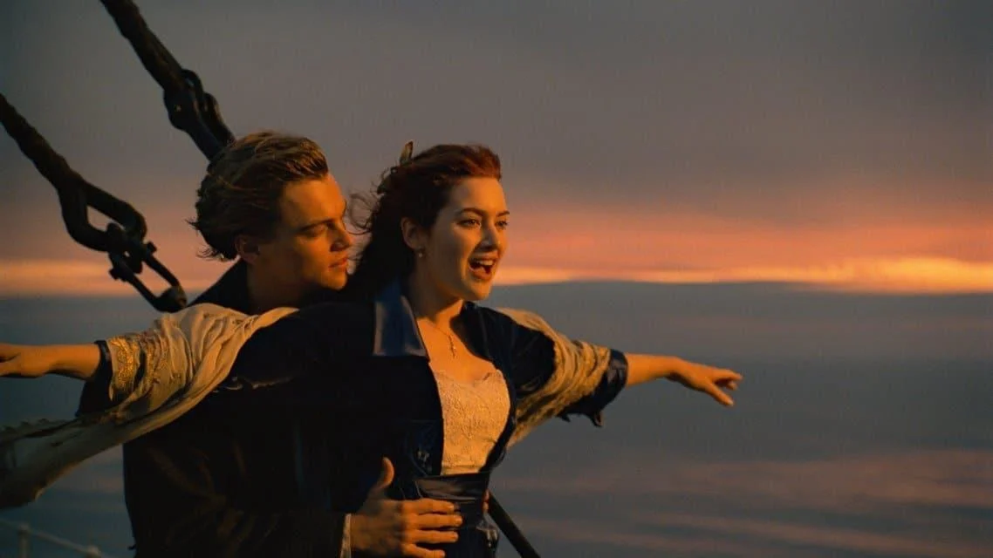
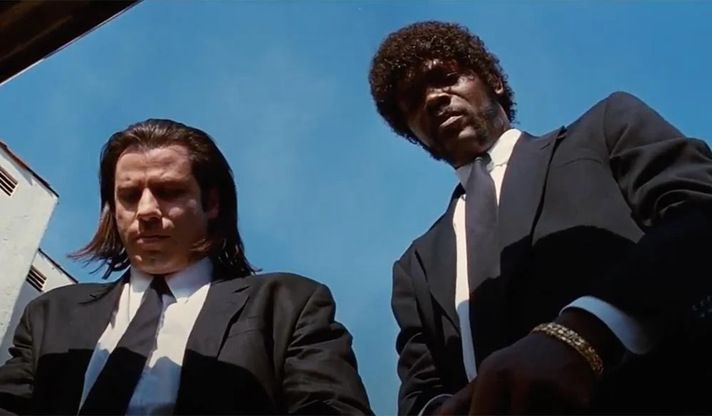
Eye-level vs high or low angle
Eye‑level shots are the most neutral and objective. Low or high angles, however, introduce subjectivity: looking up can make a subject seem dominant or heroic, while looking down can make them appear vulnerable or diminished.
Notes:
https://www.soundstripe.com/blogs/understanding-shot-angles-and-levels

Slide 5
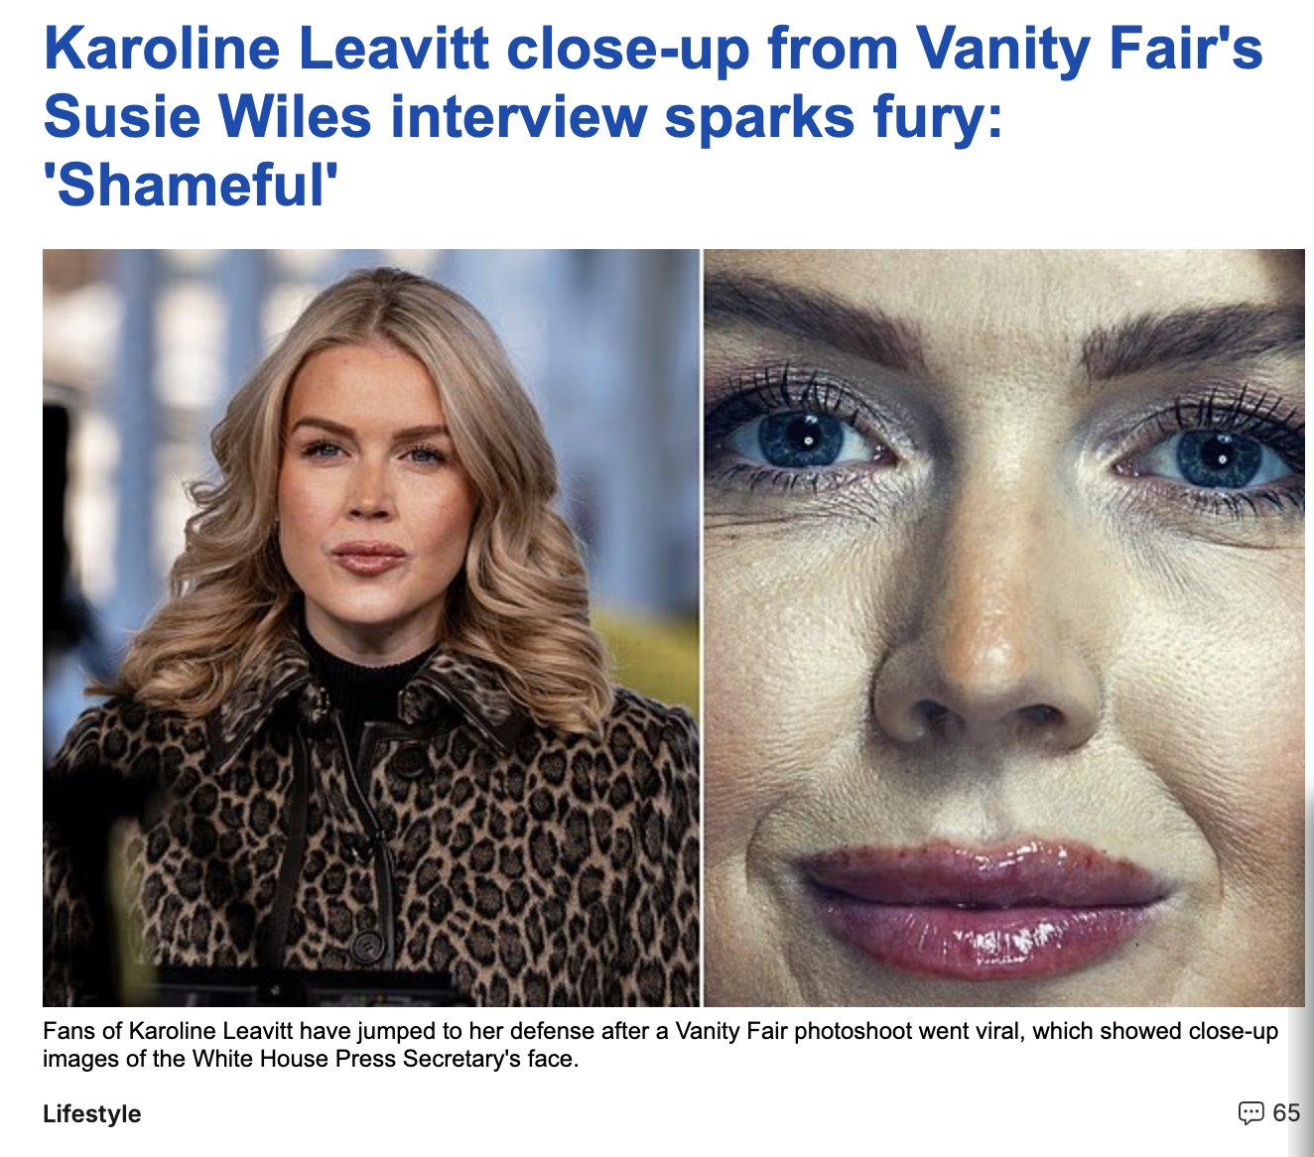
Medium Distance vs Close-up
Medium distance feels more objective because it shows subjects within their context, allowing viewers to interpret the scene for themselves. Close‑ups push the viewer closer, heightening intimacy or tension and making the photographer’s perspective more subjective.

Slide 6
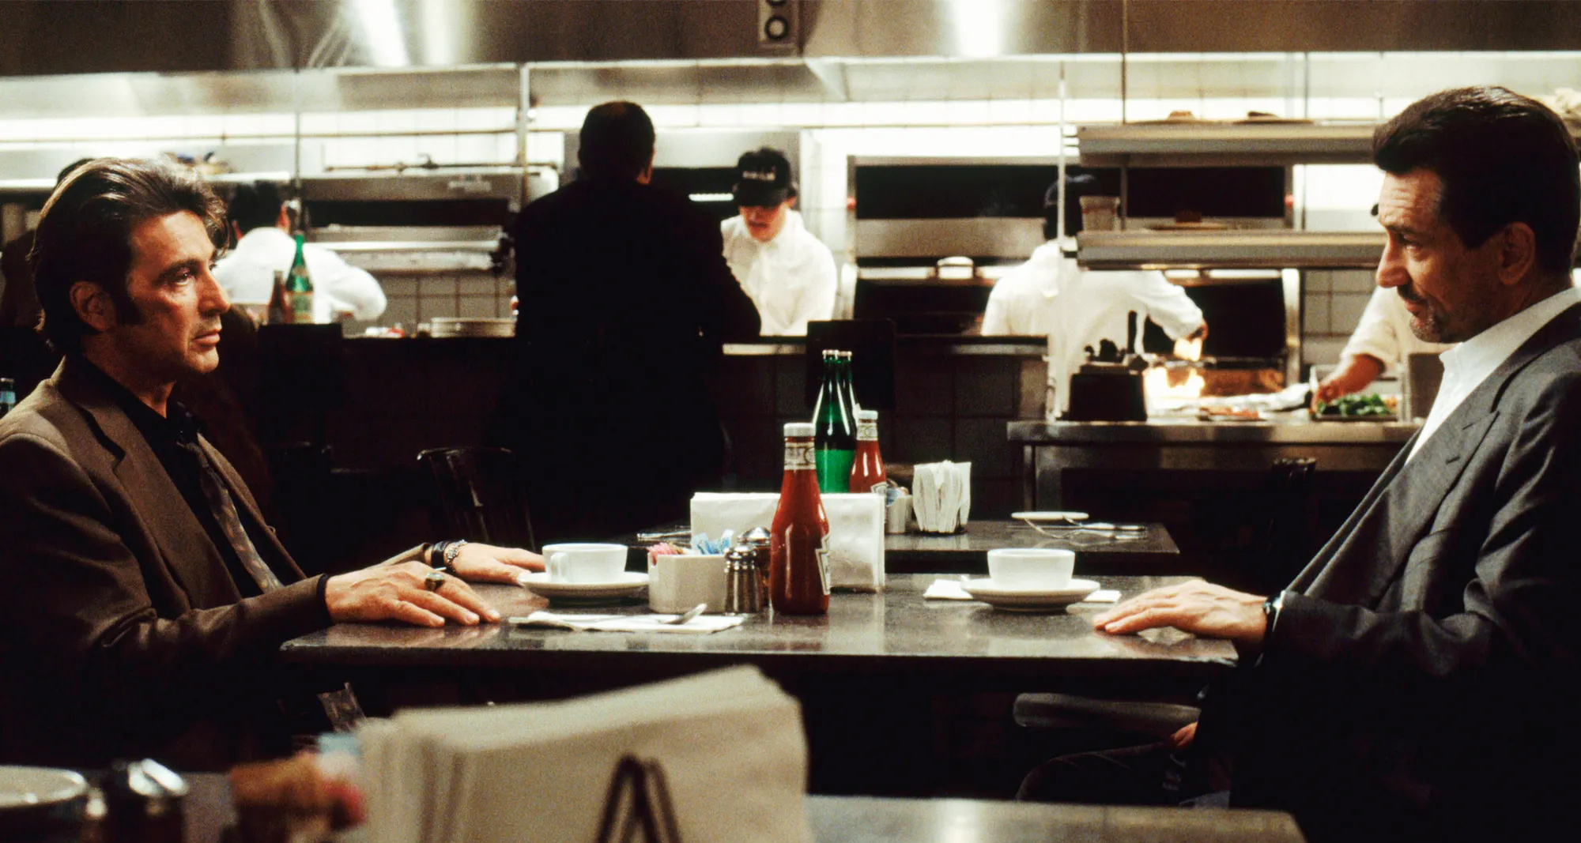
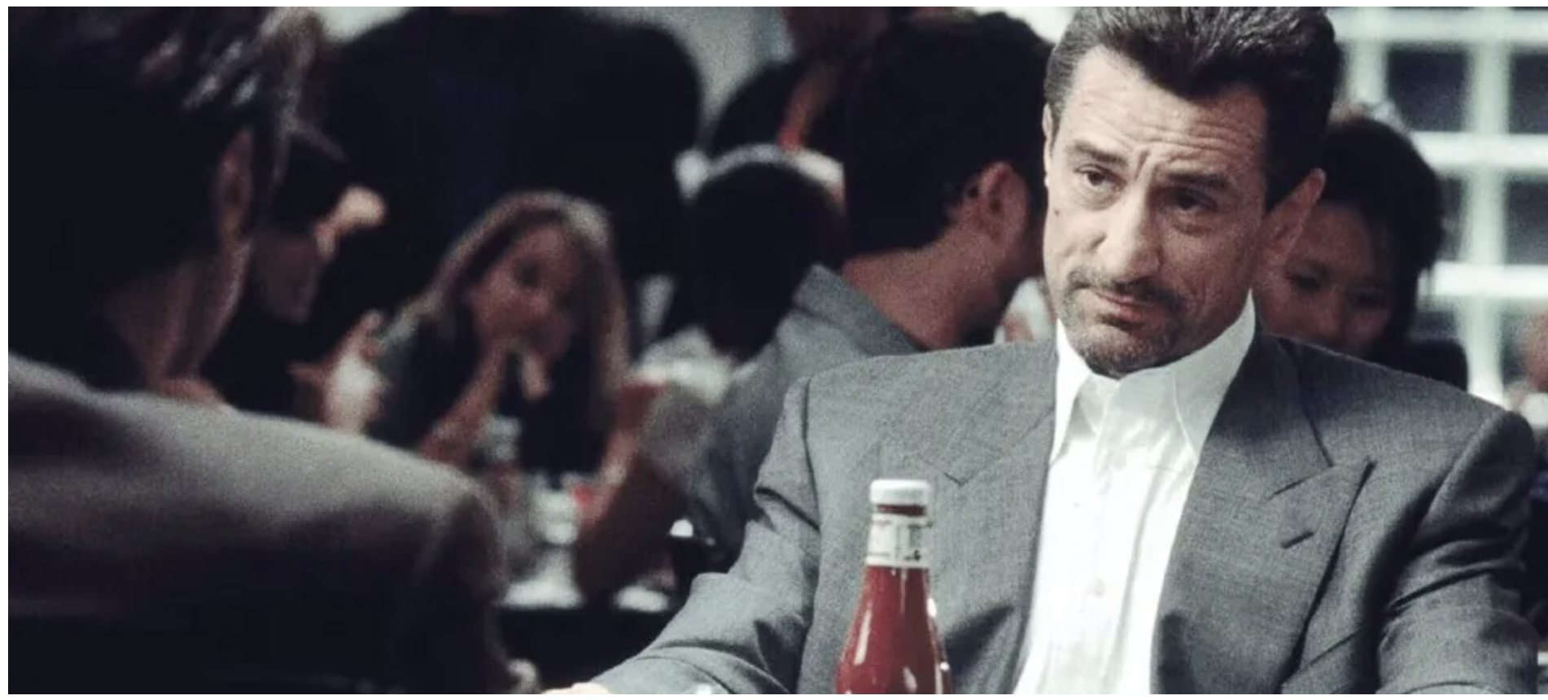
Neutral Position vs Over the Shoulder Shot
A neutral position, such as the two-shot above left, keeps the viewer at an objective distance. A position such as an over‑the‑shoulder view (left below) introduces subjectivity by placing the viewer inside the scene from somebody’s perspective, subtly guiding your interpretation.
Notes:
https://www.vanityfair.com/hollywood/2022/06/heat-al-pacino-robert-de-niro-scene?srsltid=AfmBOoq1v-319_KTm235OJVkb14HxzvmXrE-GqlLEiYmyocpMje5kJZU

Slide 7
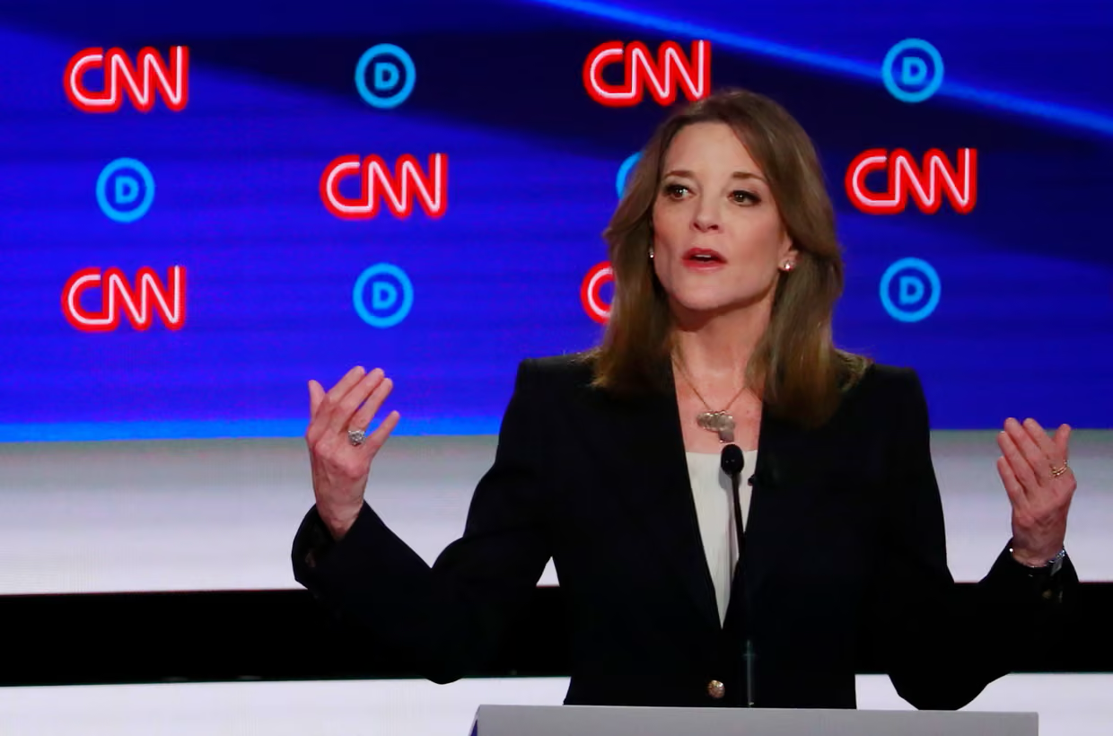
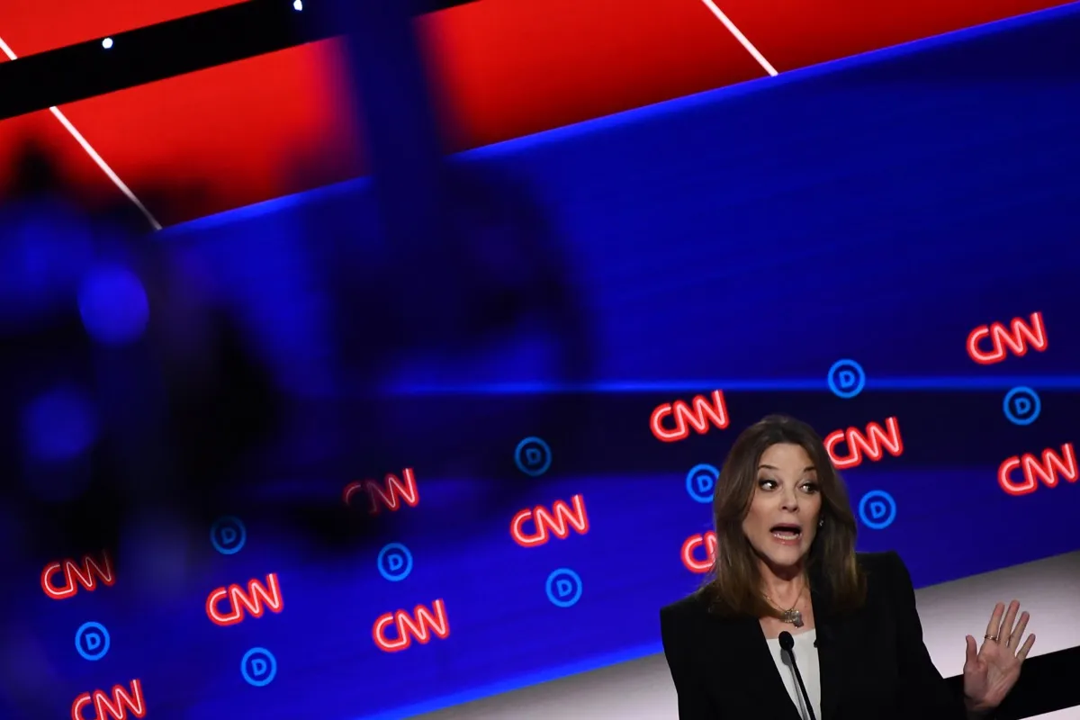
Clear View vs Shooting Through Objects
A clear, unobstructed view supports objectivity because it lets the viewer see the scene directly, without symbolic framing. Shooting through objects (like windows, fences, crowds, etc) adds subjectivity by suggesting perspective or adding drama.
Notes:
https://www.artsy.net/article/artsy-editorial-photojournalists-entirely-objective

Slide 8
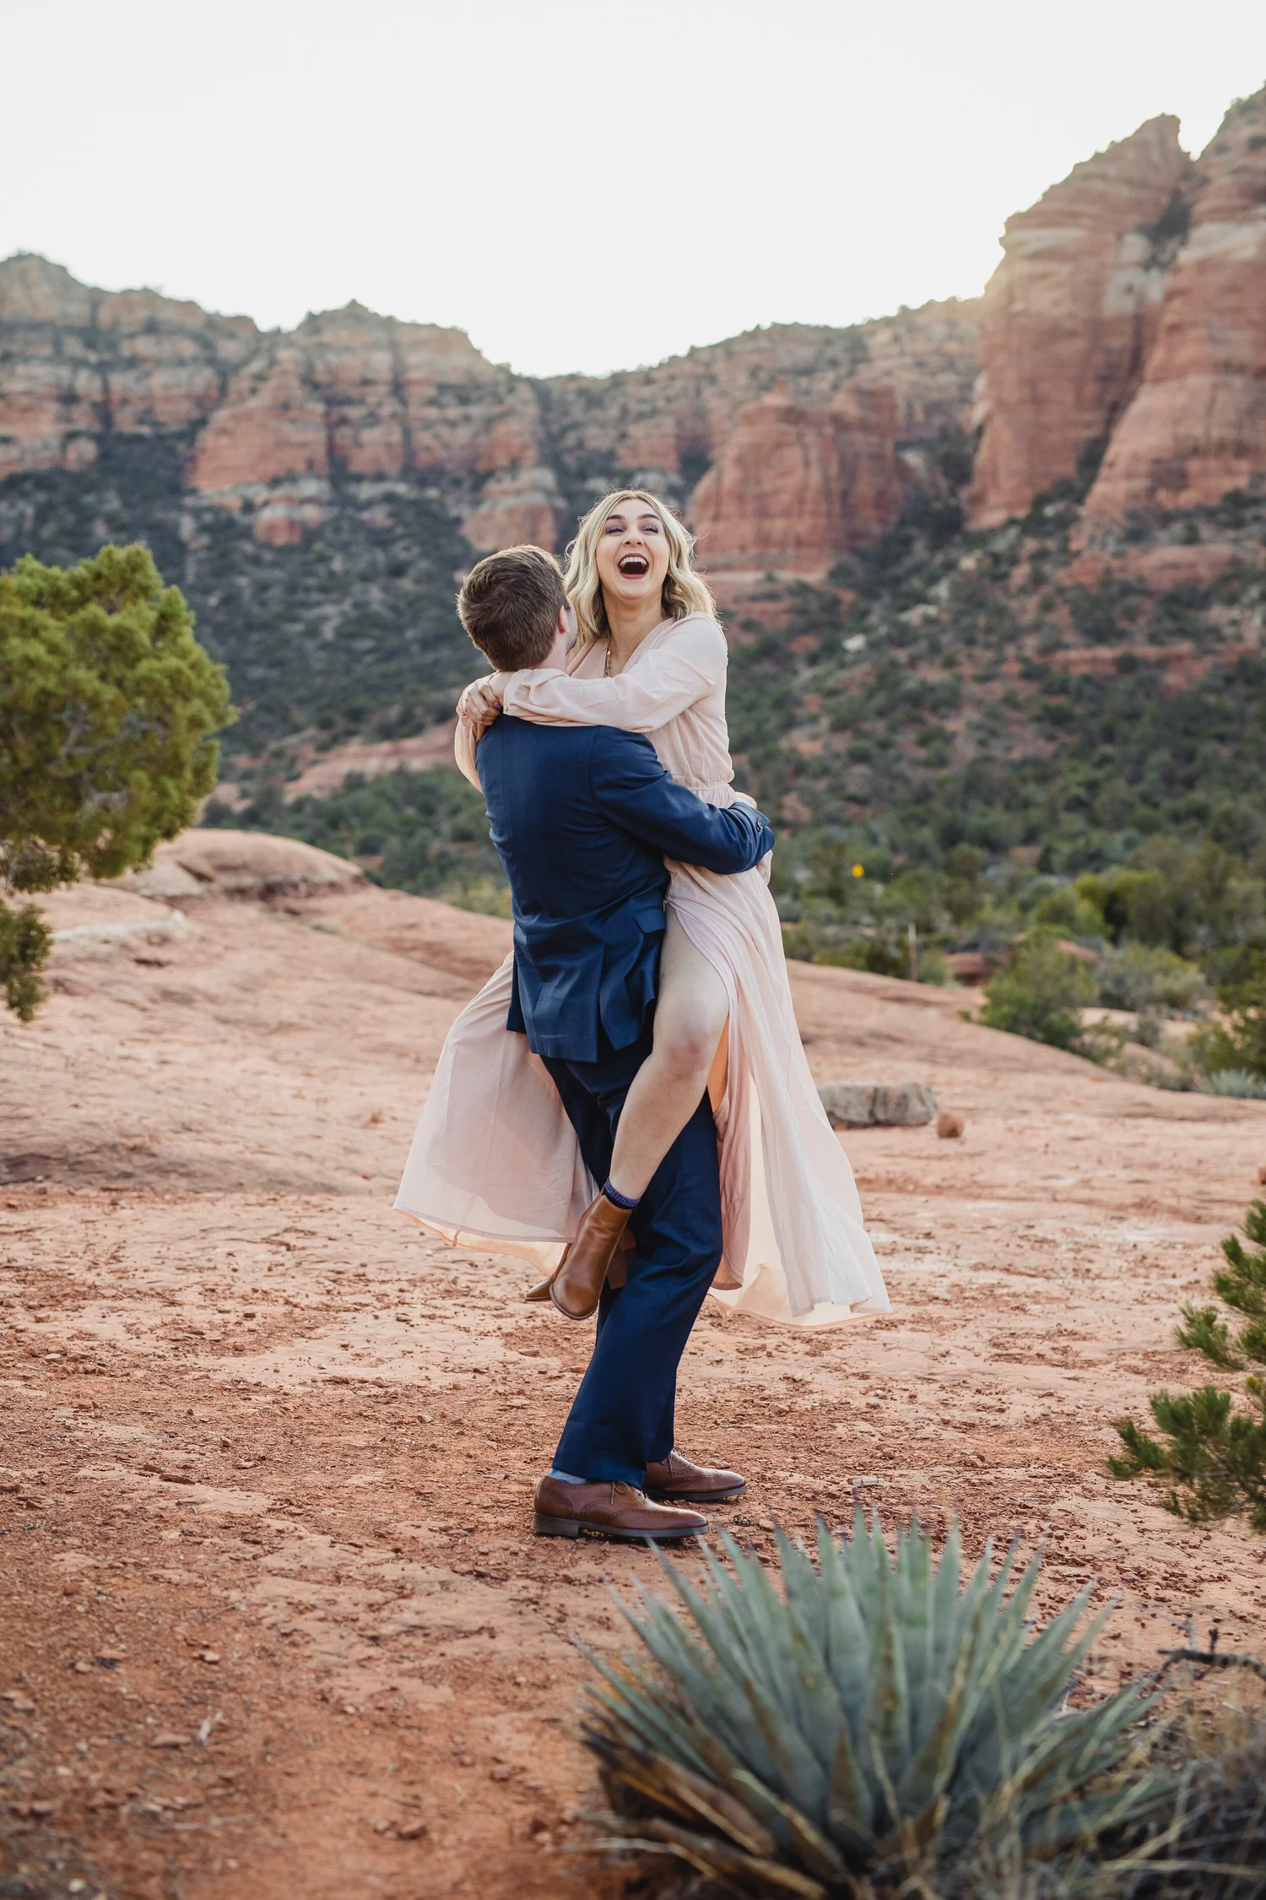
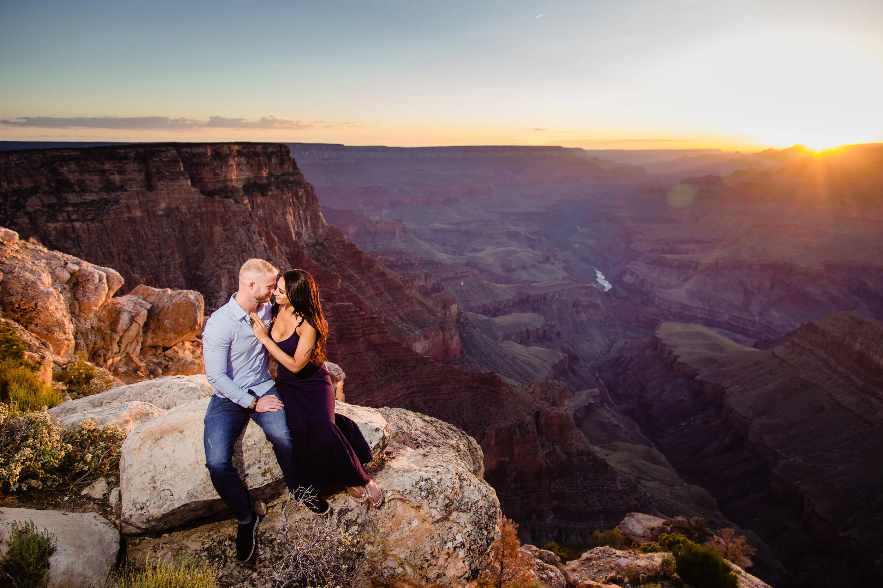
Natural vs Filtered/Stylized Lighting
Natural lighting is more objective because it shows a scene as it truly appeared. Filtered or stylized lighting introduces subjectivity by creating a mood or atmosphere, telling the viewer how to feel.
Notes:
https://www.ryanwilliamsphotography.com/blog/2020/11/24/natural-light-vs-flash-photography-which-is-better

Slide 9
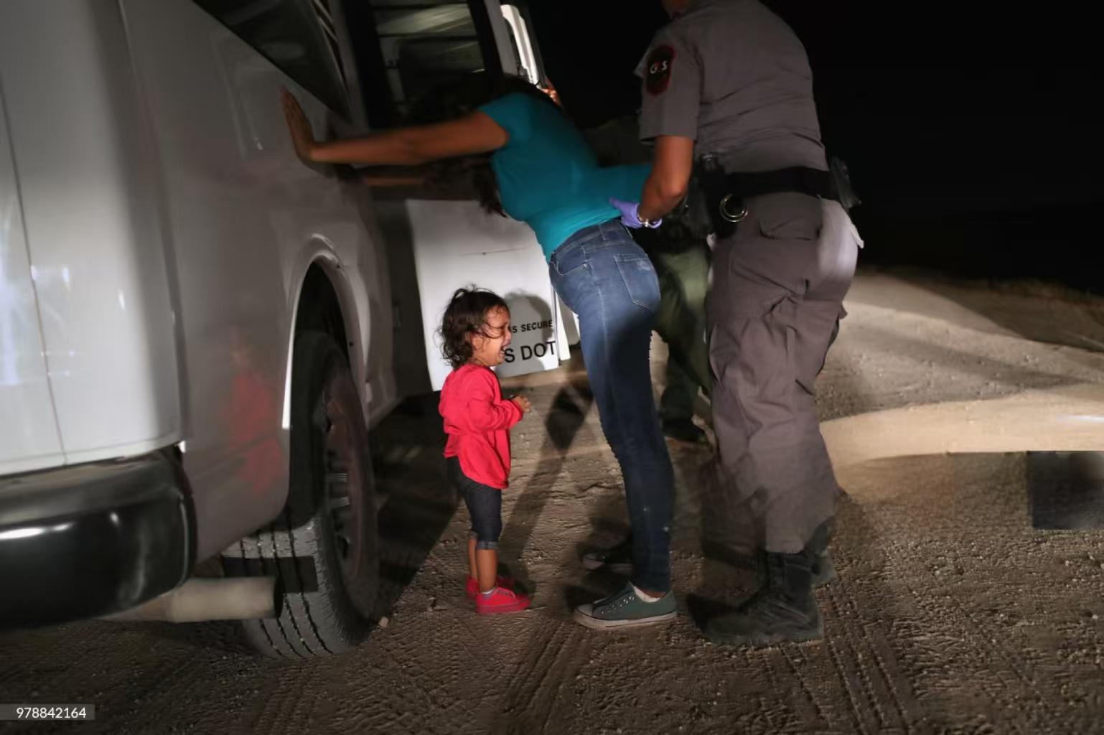

Uncropped vs Cropped Framing
An uncropped image preserves objectivity by keeping all contextual details in view, allowing the viewer to see and interpret the scene for themselves. Cropping introduces subjectivity because it removes information, directing attention and leading interpretation according to the photographer’s intention.
Notes:
https://www.artsy.net/article/artsy-editorial-photojournalists-entirely-objective

Slide 10
Activity: Evaluating Images
The following slides will present some examples of contemporary photojournalism. Look at the images one by one and ask whether the photographer has maintained objectivity or leaned towards making a subjective image. Discuss how the photographer’s choices (such as angle, framing, distance, or lighting) influence the image. Remember – photography exists on a spectrum of objectivity-subjectivity. No photograph is 100% objective, so look for small decisions in the photographer’s position or even timing. Then explain your conclusion: does the image feel like a neutral document of reality or is it leading your interpretation or emotional response?

Slide 11
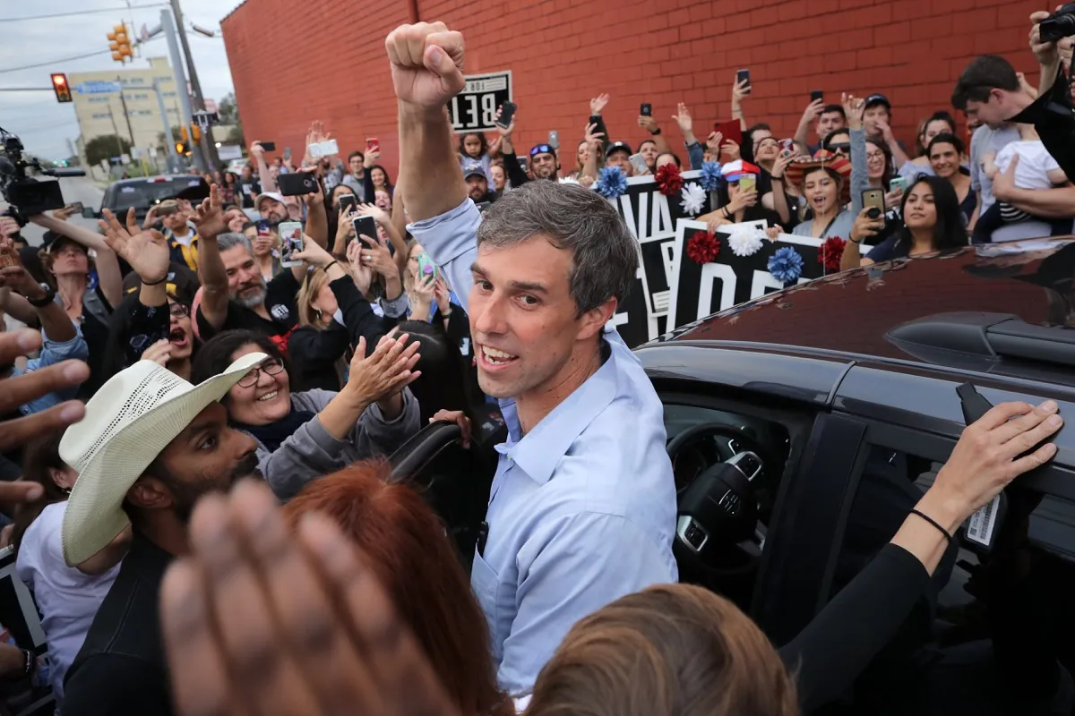
U.S. Senate candidate Rep. Beto O'Rourke pumps his fist for a cheering crowd before departing a campaign rally at the Alamo City Music Hall in San Antonio, Texas on November 4, 2018. Photo by Chip Somodevilla/Getty Image.
Notes:
https://www.artsy.net/article/artsy-editorial-photojournalists-entirely-objective

Slide 12
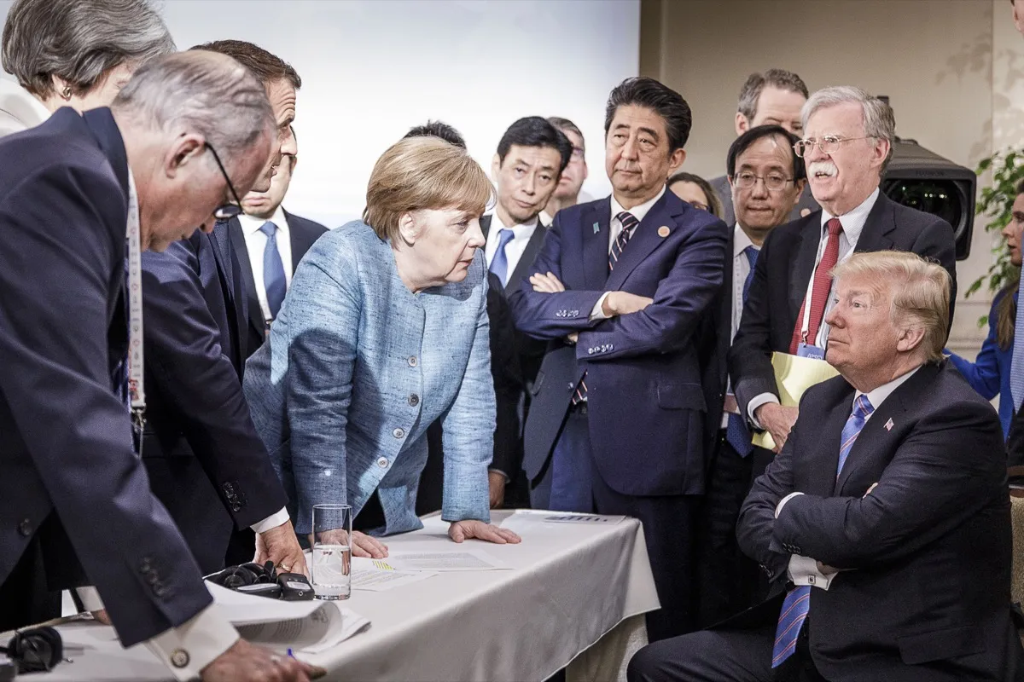
German Chancellor Angela Merkel deliberates with US president Donald Trump on the second day of the G7 summit on June 9, 2018 in Charlevoix, Canada. Photo by Jesco Denzel /Bundesregierung.
Notes:
https://www.artsy.net/article/artsy-editorial-photojournalists-entirely-objective

Slide 13
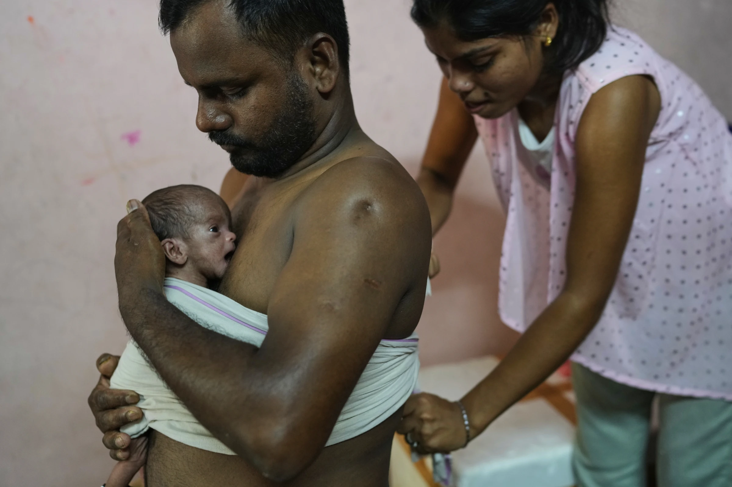
Antima Kumari helps her brother-in-law Sikandar Chaudhary hold his son close with the Kangaroo Mother Care (KMC), a skin-to-skin contact to promote bonding and well-being, at home in Gurugram, Aug. 8, 2025. (AP Photo/Manish Swarup)
Notes:
https://apnews.com/photo-essay/india-delhi-newborn-caregiving-companion-program-791d6d31829916700a6accabc17089f9

Slide 14
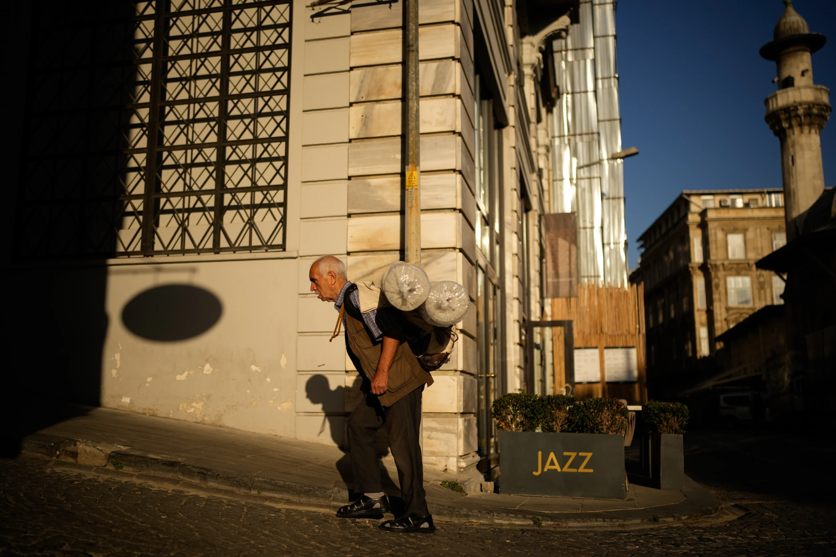
A porter carries a load on his back in Istanbul, Turkey, Wednesday, Sept. 24, 2025. (AP Photo/Emrah Gurel)
Notes:
https://apnews.com/photo-essay/turkey-istanbul-porters-photo-essay-37447b6100aa7fa7b6246ff06ad669e3

Slide 15
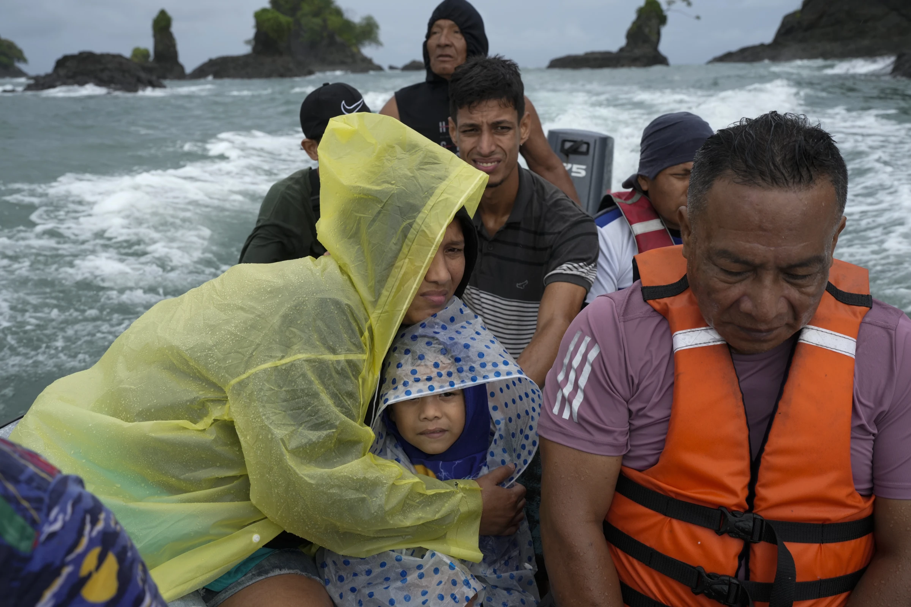
Venezuelan Mariela Gomez holds her son Mathias as they boat to shore after arriving on a larger cargo vessel in Jaque, on Panama’s Pacific coast, Thursday, Sept. 18, 2025, during their journey south after giving up on reaching the United States. (AP Photo/Matias Delacroix)
Notes:
https://apnews.com/photo-gallery/photos-migration-venezuelans-panama-darien-gap-6d48ad73f49b62c499cc19458c97fbac

Slide 16
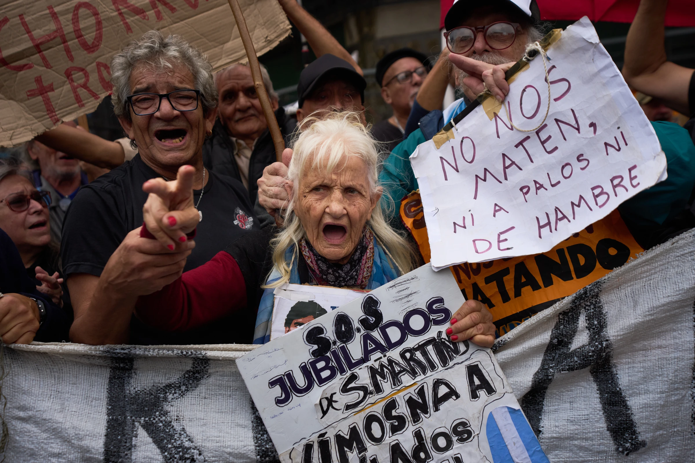
Retiree Olga Beatriz Gonzales, 79, chants anti-government slogans during a weekly protest for better pensions outside Congress in Buenos Aires, Argentina, Friday, April 4, 2025. (AP Photo/Rodrigo Abd)
Notes:
https://apnews.com/photo-essay/photo-essay-argentina-retiree-protest-milei-austerity-inflation-income-4222412f6aea61ba178230bbb294ab87

Slide 17
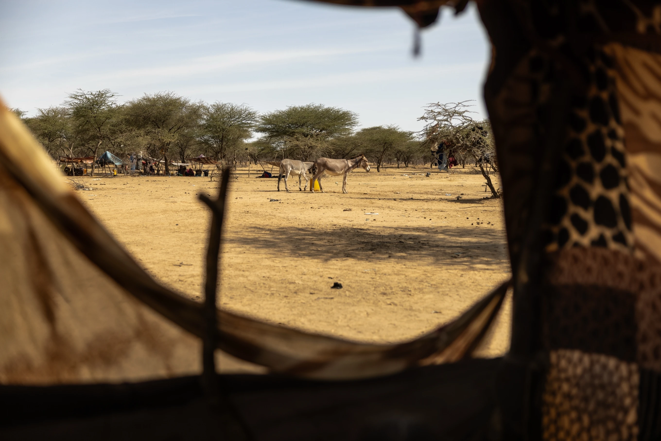
Donkeys walk past a tent occupied by two women who were attacked and assaulted by Africa Corps in Mali in Douankara, Hodh El Chargui Region, Mauritania, Nov. 6, 2025. (AP Photo/Caitlin Kelly)
Notes:
https://apnews.com/photo-essay/mali-russia-africa-corps-refugees-photo-essay-116d1ee015a57b142040ef61bdf58003

Slide 18
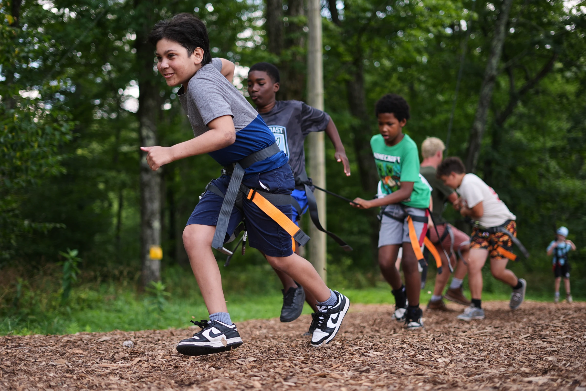
Dylan Aristy Mota, 12, left, of New York City, who has lupus, runs with fellow campers to hoist another boy into the air during an activity at the Frost Valley YMCA sleepaway camp in Claryville, N.Y., Wednesday, July 30, 2025. (AP Photo/Matt Rourke)

Slide 19
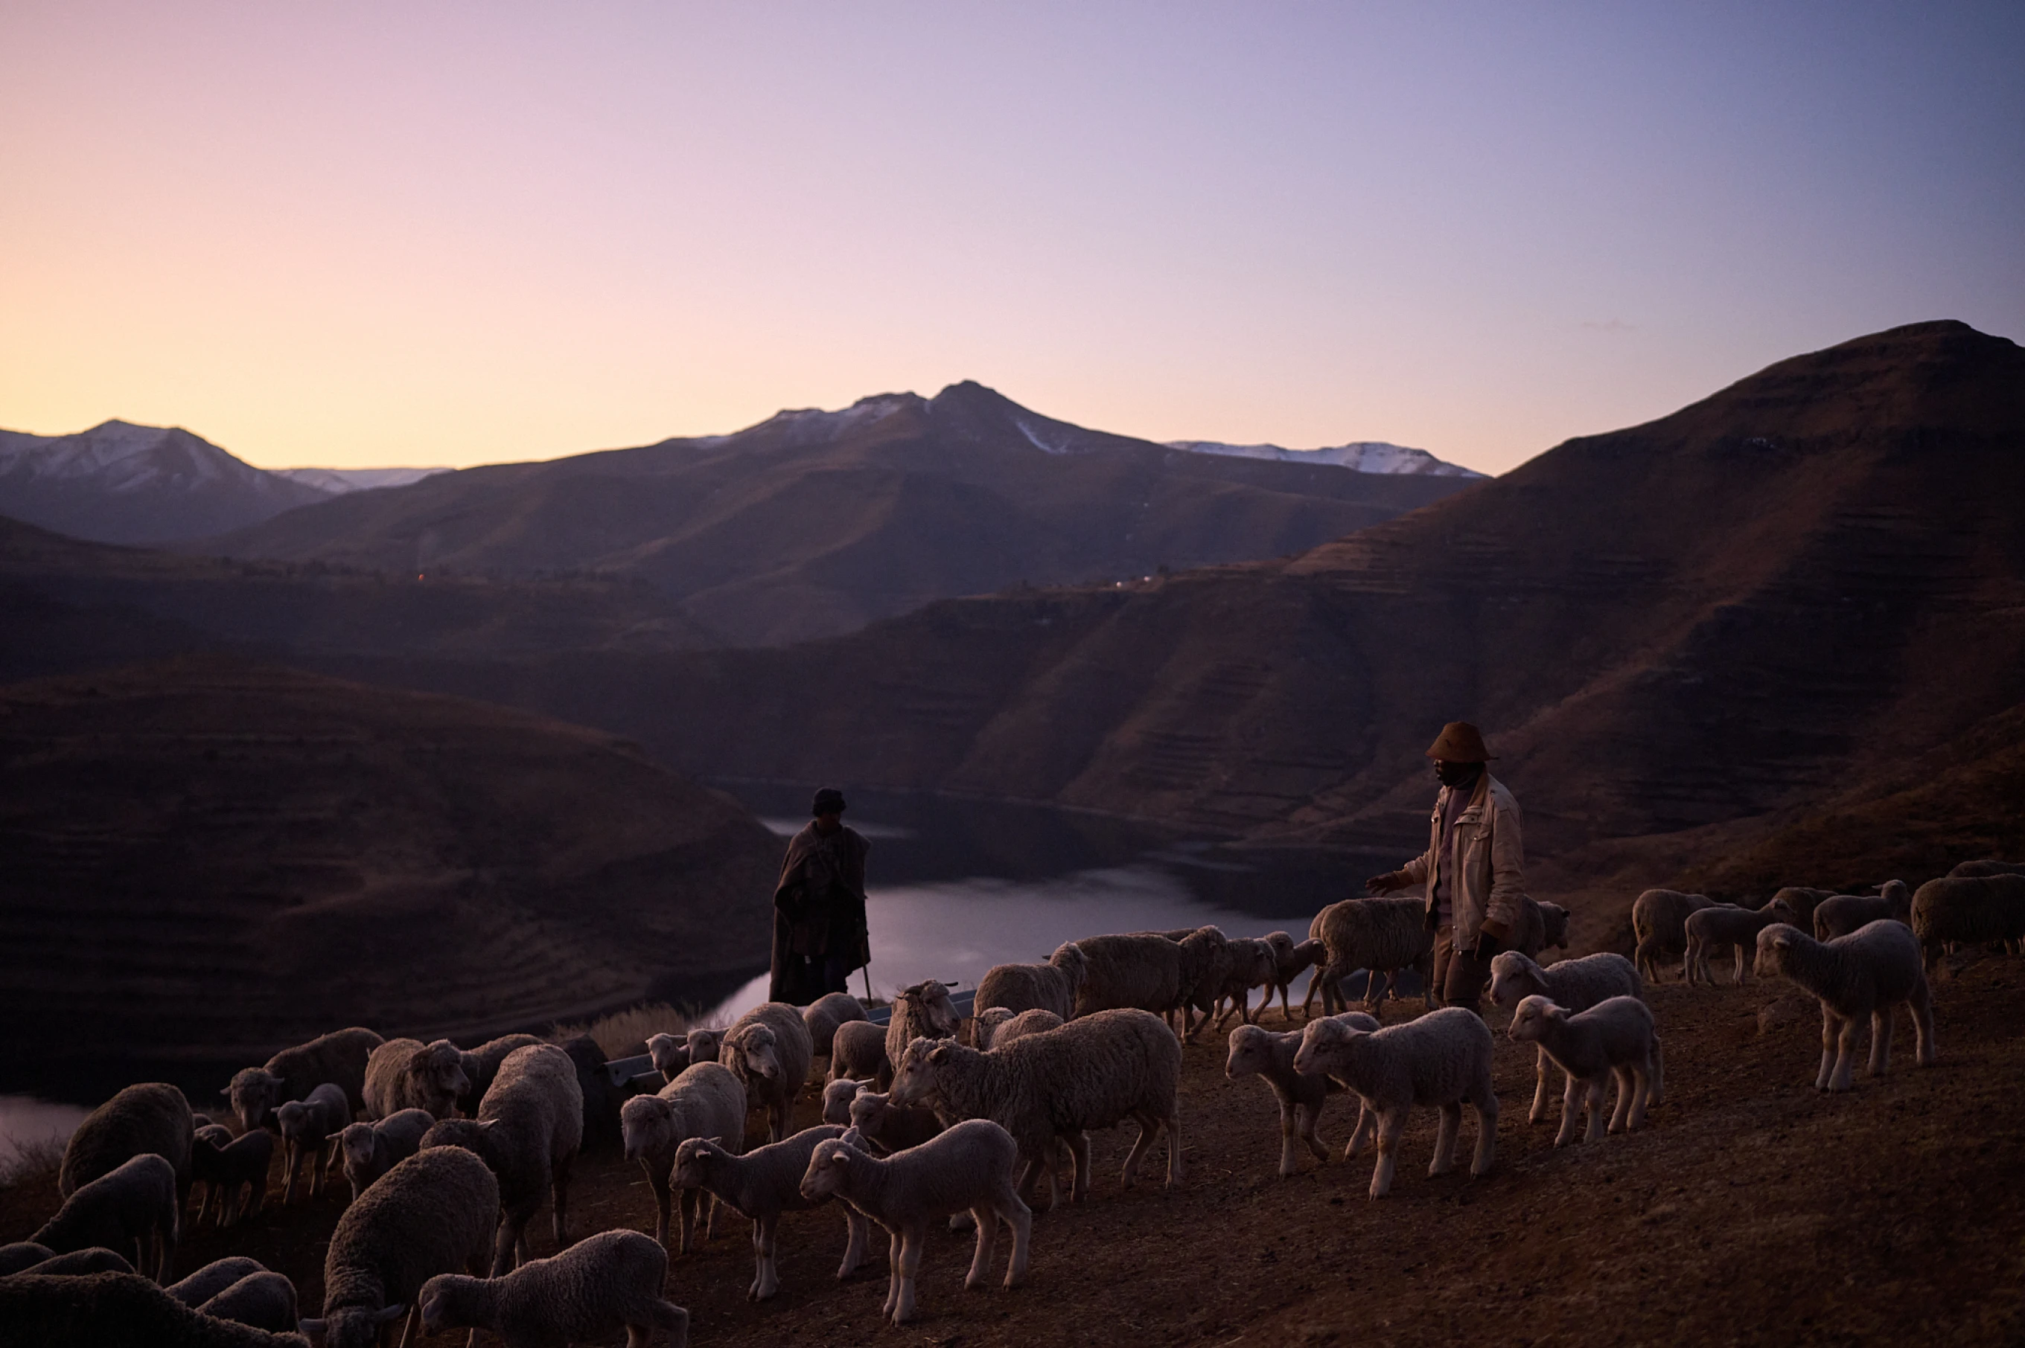
Shepherds return home at the end of the day with their flock in the mountains of Ha Lejone, Lesotho, July 14, 2025. (AP Photo/Bram Janssen, File)

Slide 20
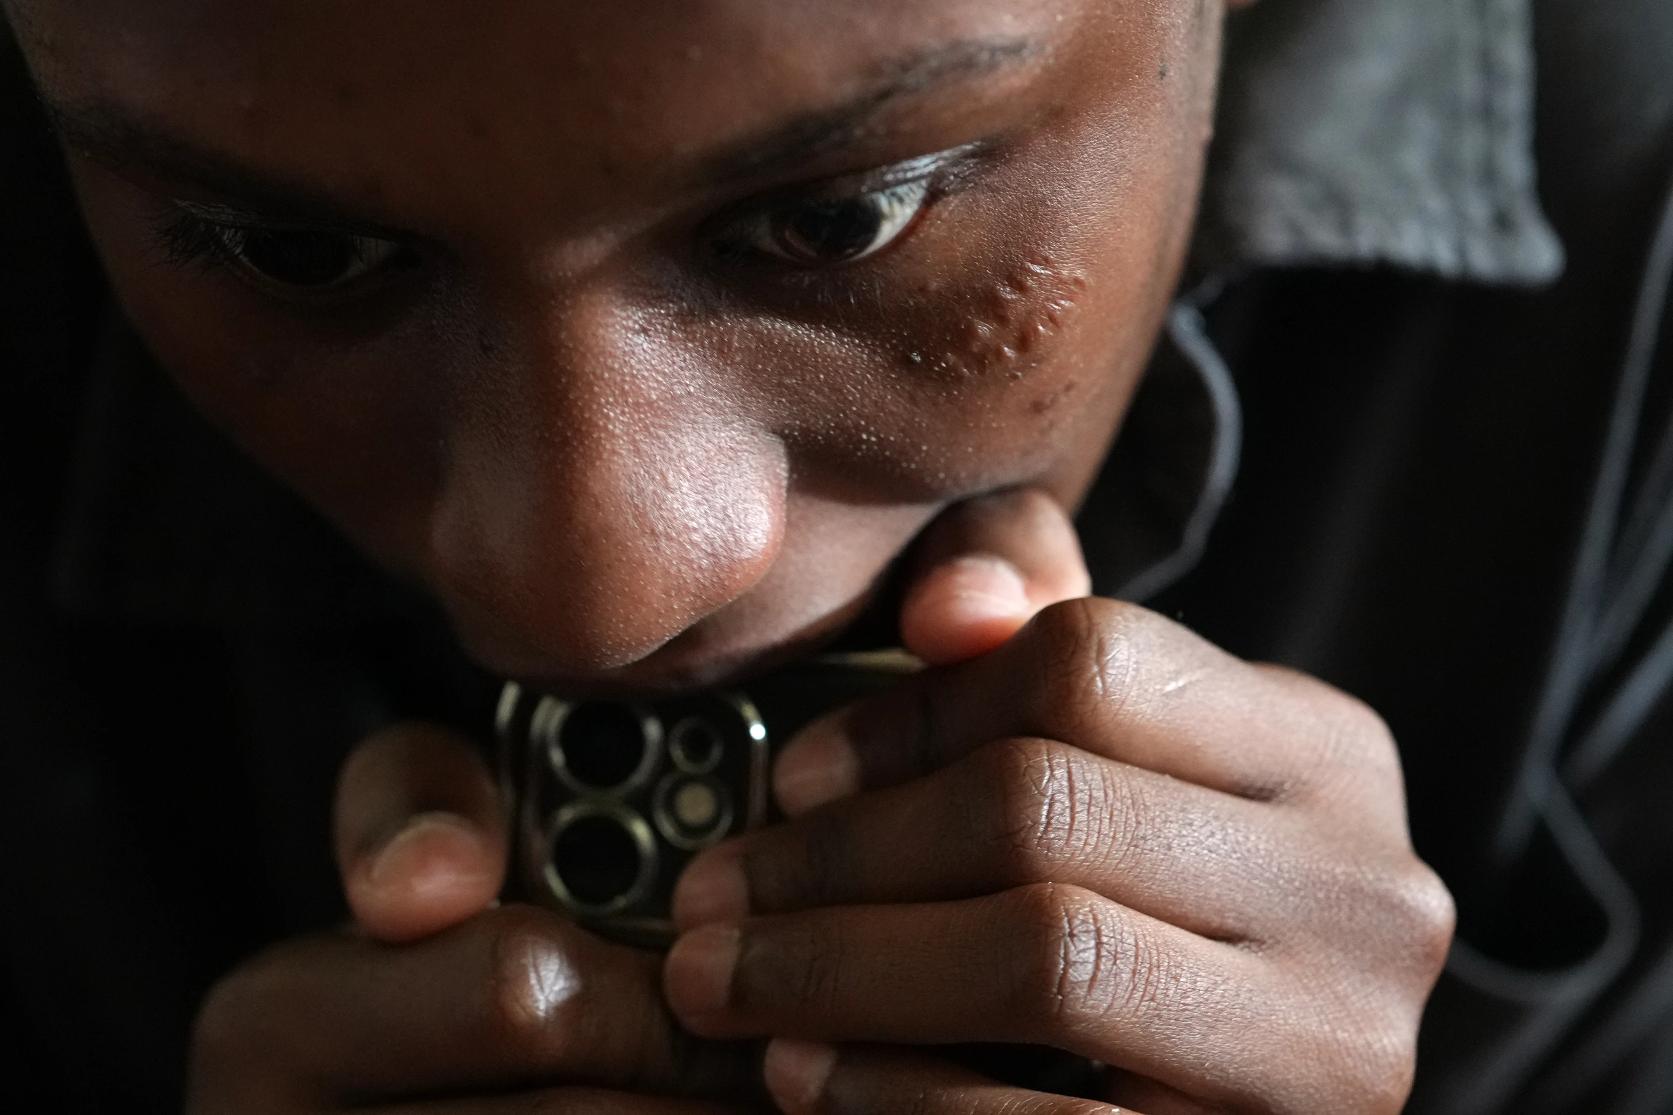
Detamisse Janvier, 20, reacts as she talks about the circumstances that led her to flee Haiti and seek asylum in the U.S., in Orlando, Fla., Friday, Aug. 22, 2025. (AP Photo/Rebecca Blackwell)

Slide 21

Reflection
Choose an image from the selection you have just discussed. Write a reflective analysis of your chosen photo in which you explain how the photojournalist has maintained objectivity, used subjective photography, or presented a picture that lies somewhere in between. Refer to the techniques and methods you have learned in this section.

