Slide 1
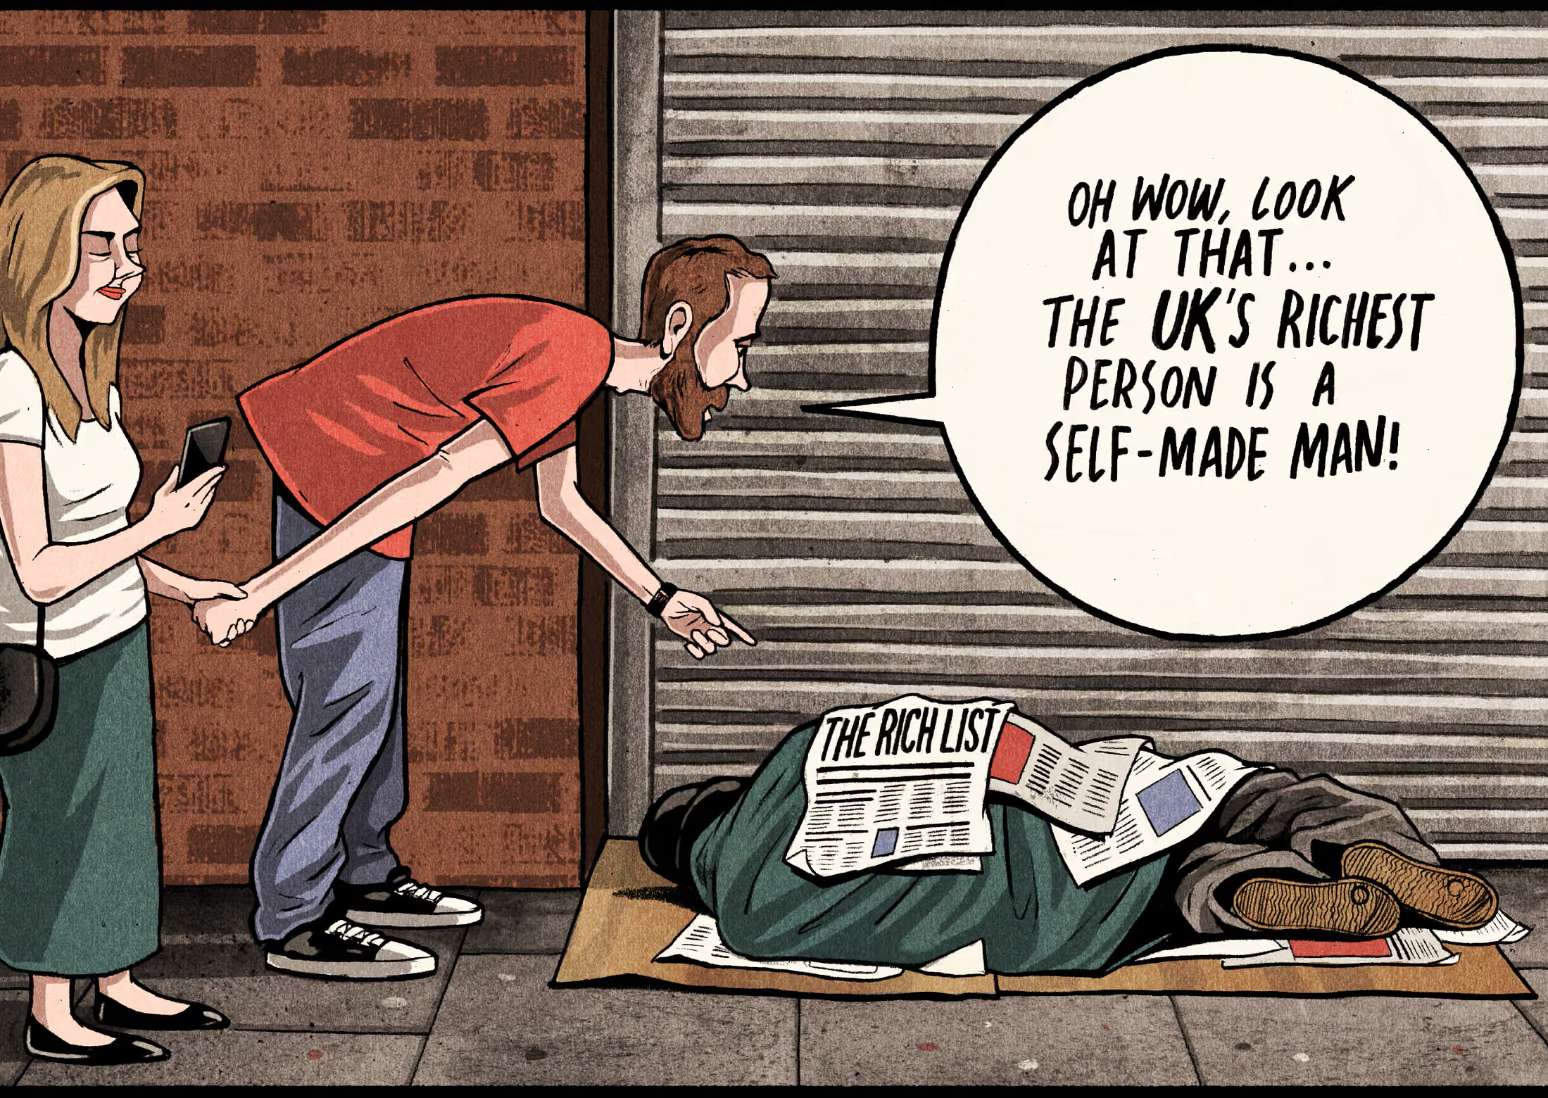
The Myth of Self-Made Men
Why We Uphold the Rich Yet Demonize the Poor
Cartoon by Ben Jennings https://www.theguardian.com/commentisfree/picture/2018/may/13/ben-jennings-on-the-latest-uk-rich-list-cartoon

Slide 2
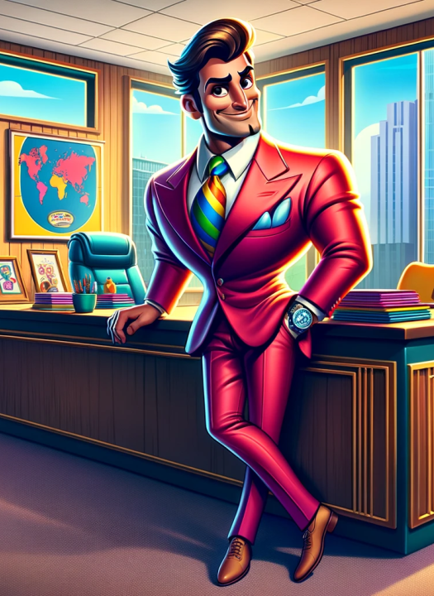
Introduction
The myth of the self-made man is a cultural narrative that portrays success as the result of individual effort, talent, and determination, while downplaying or ignoring external factors such as privilege, social networks, and systemic support. Emerging in 19th-century American ideals and popularized through figures like Benjamin Franklin and Horatio Alger’s ‘rags-to-riches’ stories, it became central to the concept of the American Dream. This myth suggests that anyone can rise from poverty to wealth through hard work alone, reinforcing values of independence and meritocracy. In reality, structural inequality, inherited advantages, and societal conditions often play decisive roles in achievement. Today, the myth persists through media, celebrity worship, and social media, where curated success stories perpetuate the illusion of pure self-reliance. While inspiring, this can obscure systemic barriers and foster unrealistic expectations about social mobility – leading to unfair judgments about who ‘deserves’ what they get in life.

Slide 3
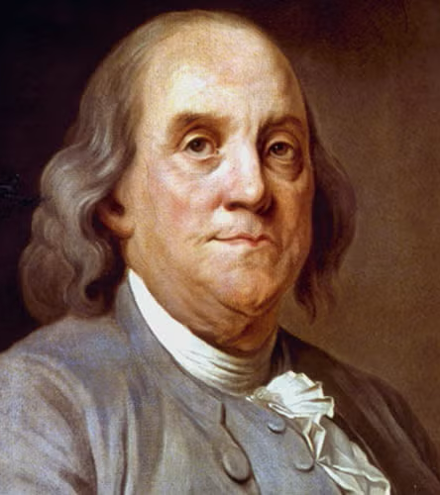
Benjamin Franklin
Benjamin Franklin is often seen as the archetype of the ‘self-made man.’ Born in 1706 to a poor family in Boston, he had little formal education and began as a printer’s apprentice. Through relentless self-improvement (reading, writing, and learning practical skills) he became a successful printer, and later a scientist, inventor, and politician. His discovery of electricity illustrated that one could rise from poor beginnings to become great purely through one’s own hard work and ingenuity, with only disciplined habits and moral virtue as a blueprint for success. While an inspiring example – and Benjamin Franklin truly was a great man – this portrayal overlooks the social networks and opportunities that aided his rise, making Franklin the first symbol of the myth that success is purely self-made.
https://www.biography.com/political-figures/benjamin-franklin

Slide 4

19th Century Rags to Riches Tales
Horatio Alger was a 19th-century American author whose popular novels played a major role in cementing the myth of the self-made man. His stories, often called ‘rags-to-riches’ tales, followed young, impoverished protagonists who rise to success through hard work, honesty, and perseverance. These narratives typically feature a poor boy who, through moral virtue and determination, earns the trust of a wealthy benefactor or seizes an opportunity that transforms his life. Alger’s formulaic plots reinforced the idea that character and effort alone guarantee upward mobility, aligning perfectly with the emerging American Dream.
Ragged Dick (1868) is one of Alger’s most famous rags to riches stories. The novel tells of Dick Hunter, a poor bootblacker in New York who rises from poverty to respectability.

Slide 5
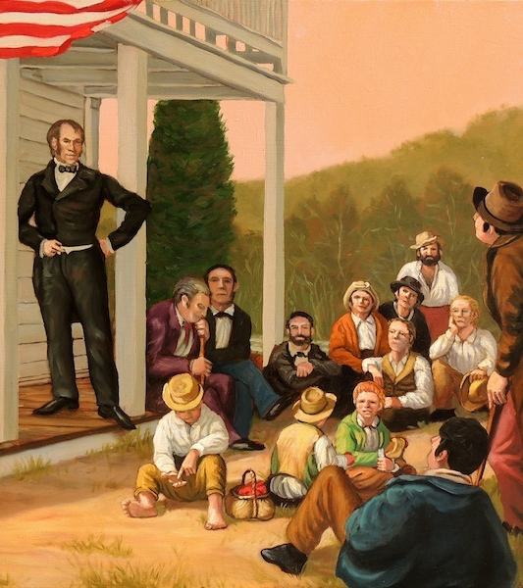
Henry Clay Senate Speech (1832)
Henry Clay, a prominent U.S. senator, played a key role in popularizing the phrase ‘self-made men.’ In an 1832 Senate speech, Clay praised “enterprising and self-made men” who had achieved wealth and status through “patient and diligent labor.” His use of the term framed success as a product of individual effort rather than inherited privilege, aligning with the democratic ideals of the era and the emerging American Dream. Clay helped embed the concept into public consciousness, reinforcing the idolisation of hard work and meritocracy, and making the self-made ideal not just a personal aspiration but a patriotic virtue.
Henry Clay Speaking at the Trebor Inn by Herb Roe, 2013 (https://sciotohistorical.org/items/show/39?tour=7&index=9#&gid=1&pid=1)

Slide 6
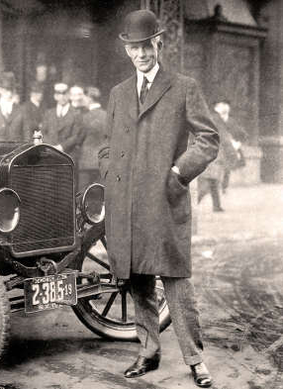
Henry Ford
Henry Ford is a classic early 20th-century example of the self-made man myth. Born in 1863 on a farm, Ford had limited formal education and began his career as a machinist’s apprentice. Through persistence and mechanical skill, he founded the Ford Motor Company and revolutionized transportation with the Model T car. Ford’s story was widely celebrated as proof that ingenuity and hard work could lead to extraordinary success, reinforcing the ideal of individual achievement However, like Franklin and Alger’s characters, Ford’s rise was not purely individual; he benefited from industrial growth, investor support, and a favourable economic climate.
Henry Ford with a model T car in New York, 1921

Slide 7
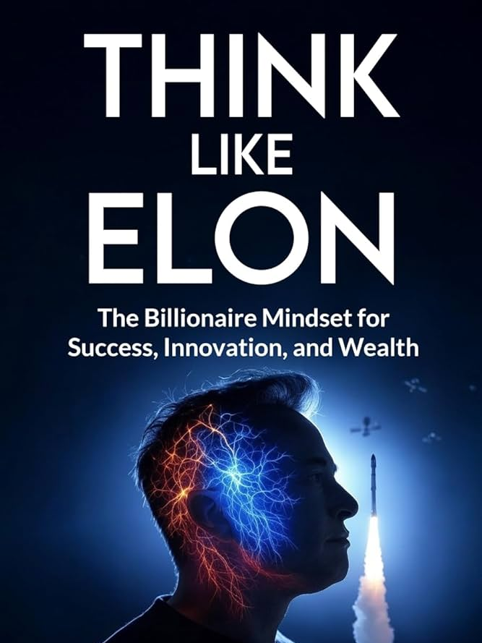
Roland Barthes’ Mythologies
20th century philosopher Roland Barthes mythological theory explains why the story of the self-made man is so pervasive. Roland Barthes tell us that media transforms cultural ideas into ‘natural truths’ through repetition. Applied to the self-made man idea, this means success myths such as ‘hard work equals wealth’ are presented as obvious, universal pathways while other factors (social, economic, political) are masked. Modern media amplifies the self-made myth through stories that glorify business or financial triumphs. These narratives often appear in viral posts, motivational videos, and profiles that frame success as the result of determination, grit and hustle alone.
Books like this won’t tell you about Elon’s access to family wealth, his private education, and the privileged networks that provided his capital and support.

Slide 8
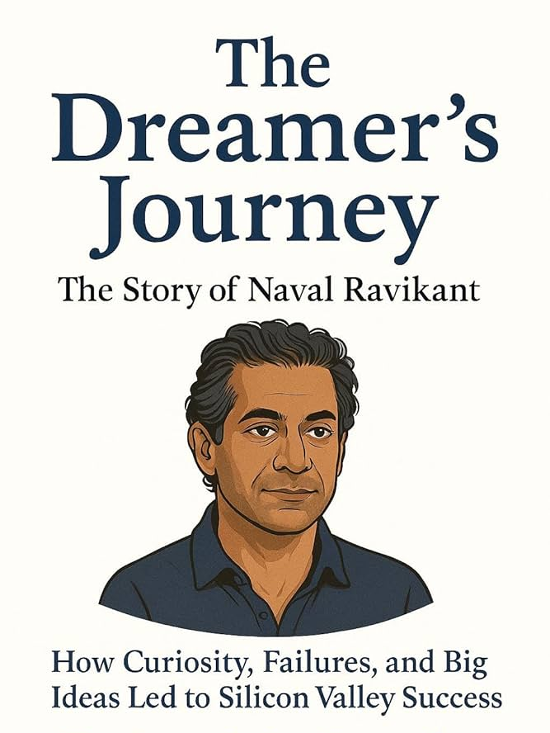
21st Century Tech Bros are the new Ragged Dick
In the 21st century, the self-made myth thrives in new forms, largely driven by digital media and entrepreneurial culture. Modern success stories often feature tech founders, influencers, and startup entrepreneurs portrayed as lone visionaries who built empires from scratch. Platforms like Instagram, YouTube, and LinkedIn amplify these narratives through curated content of luxury lifestyles, motivational quotes, and ‘hustle culture’. These stories almost never make mention of inherited privileges like family handouts, or access to elite social networks that can link entrepreneurs with capital – or worse, exploitation of friends, workers, the taxpayer, and the environment.

Slide 9
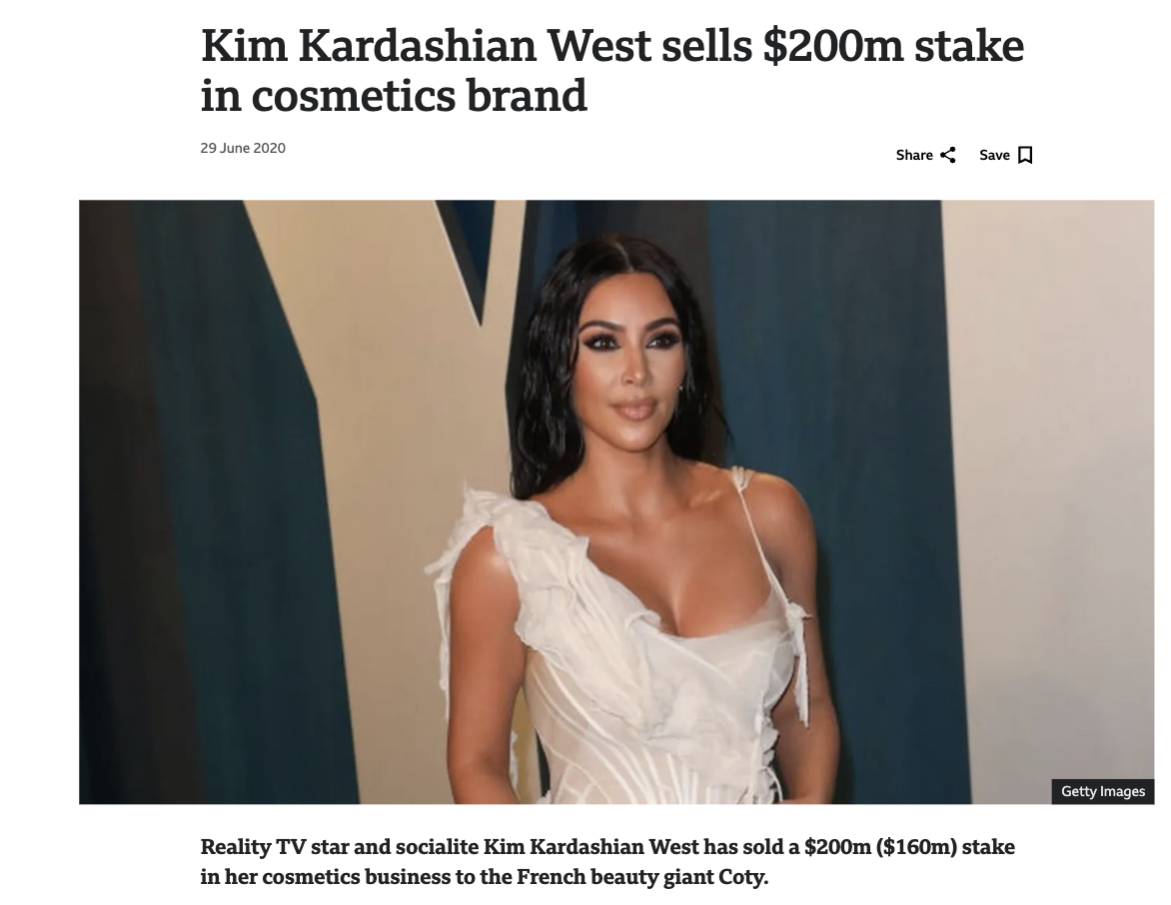
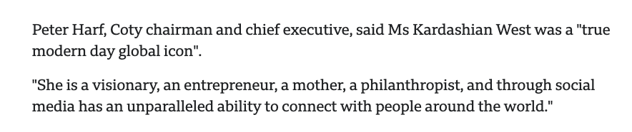
Activity: Deconstruct the ‘Self Made’ Myth
Choose a famously wealthy or successful individual (for example Elon Musk, Zhang Yiming, Kim Kardashian, or similar) and discover how they are portrayed in media. Look for two or three articles that use language and imagery to idolize them and/or reinforce the idea of being ‘self-made.’ Examples include words like visionary, genius, or trailblazer, and stories that frame their journey as ‘rags to riches.’ You might like to look out for visual cues too. Photos featuring luxury cars, private jets, or minimalist tech offices often signal success and status. Try to identify patterns and answer the questions:
What adjectives and metaphors are used?
How do images contribute to the myth?
What details are emphasized… and what’s left out (e.g., privilege, networks, luck)?
https://www.bbc.com/news/business-53221513

Slide 10
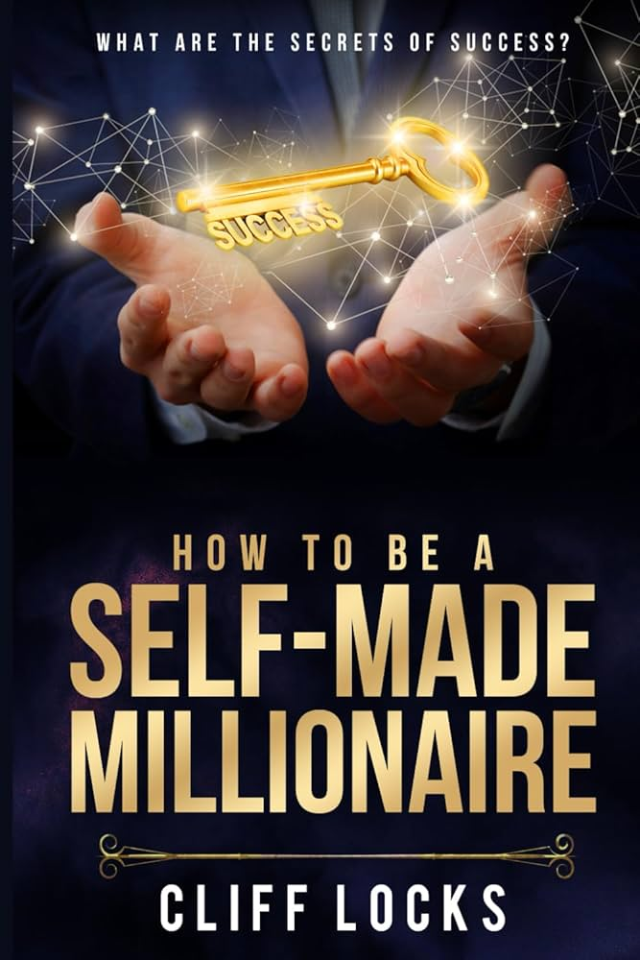
Reflection
After exploring the myth of the self-made man, consider its impact today. Media doesn’t just tell stories; it shapes what we believe about success, wealth, and poverty. When headlines call someone a “visionary” or show images of luxury, what message does that send? Does it make success seem accessible to everyone? Does it hide structural advantages or systemic barriers?
Reflection Question:
How does media representation influence our perception of success, wealth, and poverty?

