Slide 1
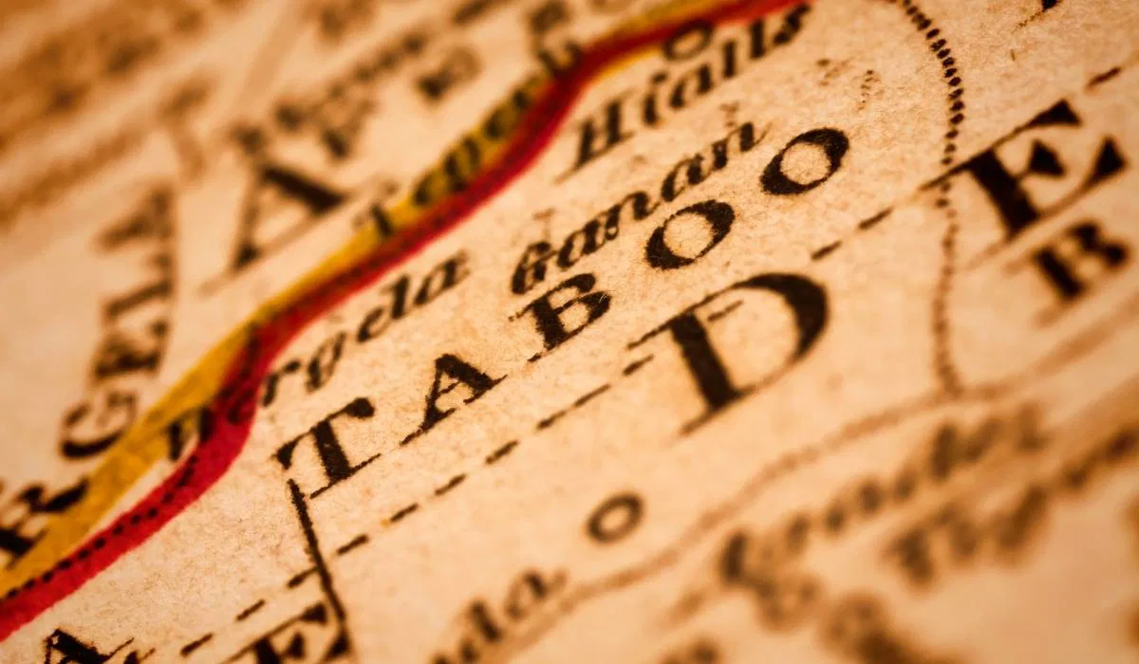
Taboo
Origins of the Forbidden

Slide 2
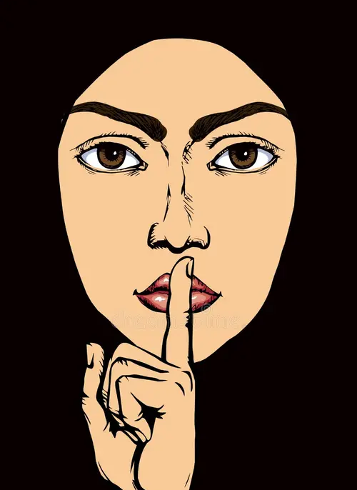
Introduction
Taboo is more than a list of ‘forbidden’ topics; it is a phenomenon that shapes behaviour, language, and identity in society. The word itself comes from Polynesian origins, meaning “sacred” or “prohibited,” and anthropologists have long debated why societies create taboos. Are they rooted in fear of supernatural forces? Do they arise from psychological repression? Or do they serve to maintain order?
This presentation explores the foundations of taboo: its origins, its role in regulating social life, and the categories that recur across cultures: death, sickness, sex, bodily fluids, and more. You’ll find out why certain topics become ‘unspeakable,’ how taboos reflect human anxieties and values, and ask why they persist or fade over time.

Slide 3
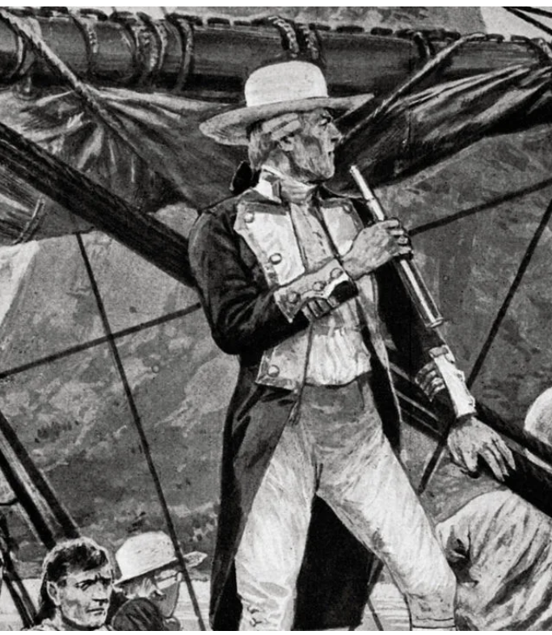
Etymology
The word ‘taboo’ entered English in 1777 through Captain James Cook’s account of his Pacific voyages. It derives from Polynesian languages, like Tongan tapu and Tahitian tabu, meaning ‘sacred’ or ‘forbidden.’ These terms were rooted in spirituality – actions or objects considered inviolable because of their connection to supernatural forces. In Polynesian culture, taboos governed everything from food and hierarchy to ritual purity. The concept was so striking that Cook adopted the term into English to describe these prohibitions.
https://www.economist.com/culture/2024/04/08/an-enthralling-account-of-captain-cooks-final-fatal-voyage

Slide 4
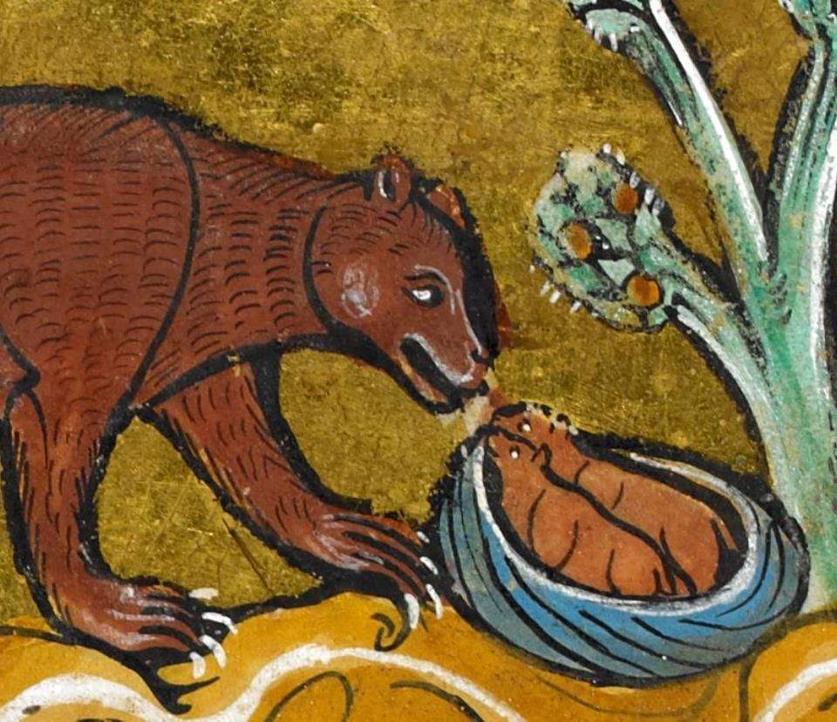
The First Linguistic Taboo?
While this story may be apocryphal (unproven), the idea of linguistic taboo (a forbidden word) also appears in Indo-European traditions. The modern word ‘bear’ in Germanic languages is thought to be a euphemistic replacement for the original Proto-Indo-European word h₂ŕ̥tḱos. Early hunters avoided speaking the true name of the animal out of fear that naming it would summon it, an example of taboo-driven language change. Instead, they used descriptive substitutes like “the brown one” or “honey-eater,” which eventually became the standard word.
topicsofnote.wordpress.com/2021/03/02/the-words-we-cannot-say-on-the-origin-of-the-word-for-bear/

Slide 5
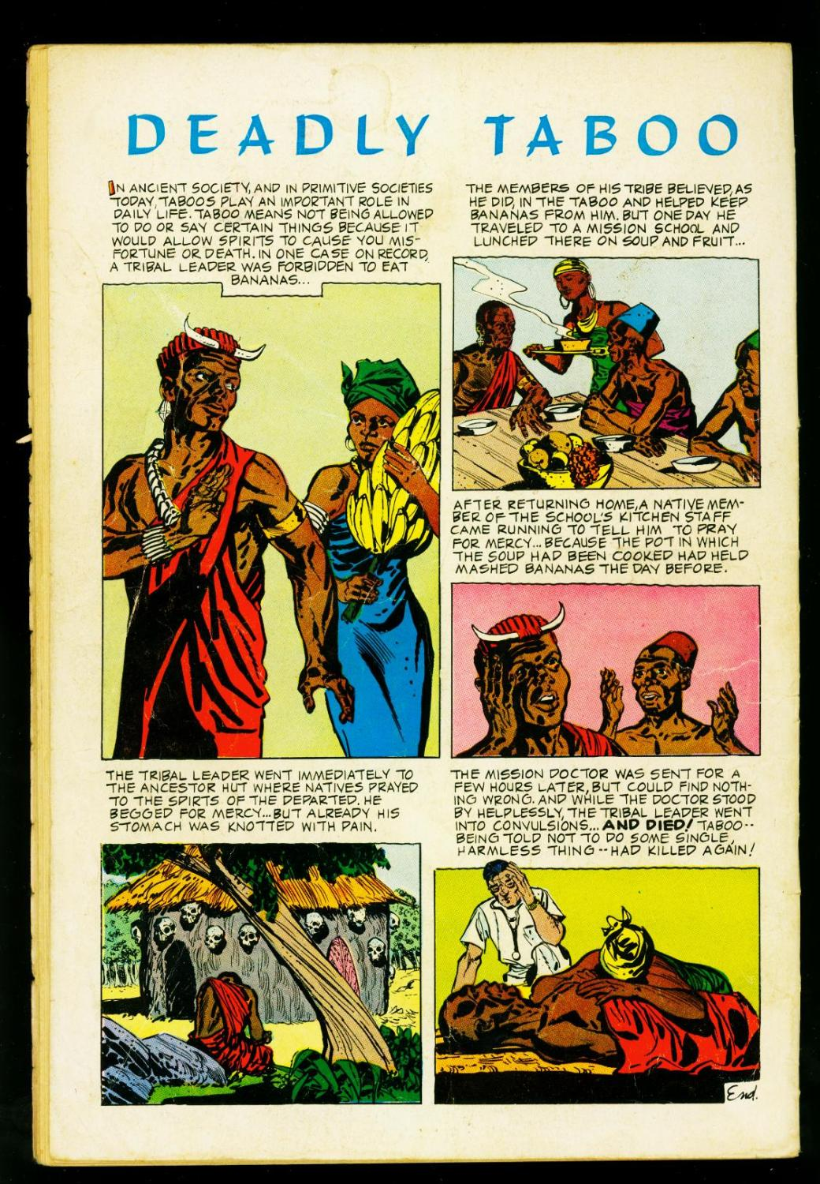
Why Did Early Societies Create Taboos?
Taboos are not arbitrary or accidental. They emerge from real cultural, psychological, and practical needs. In early societies, taboos served as protective mechanisms, regulating behaviour in ways that preserved social order and physical survival.
www.abebooks.com/comics/Brain-Boy-1962--Comics--Dinosaur-cover-/22383810873/bd

Slide 6
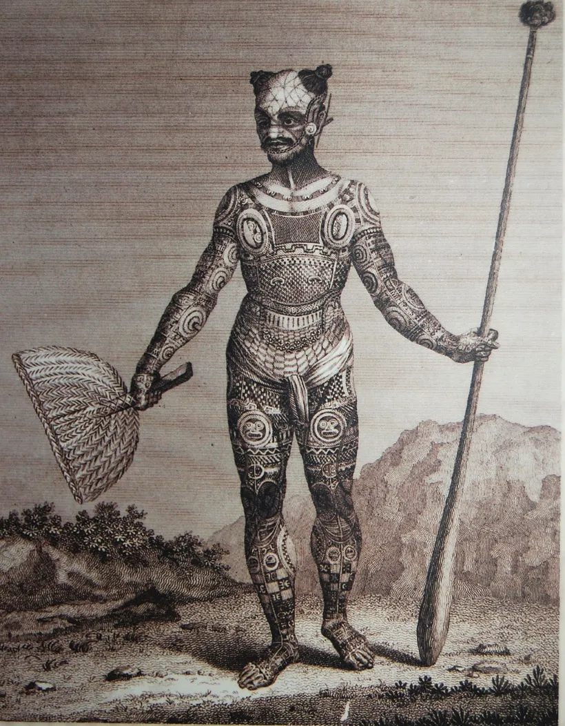
Religion and Spiritualism
In Polynesian societies, the concept of tapu marked certain people, places, and objects as sacred and untouchable. A chief might be considered so holy that touching his belongings – or even his shadow – was forbidden, because it was believed to disrupt cosmic balance and invite disaster. These prohibitions reinforced hierarchy and maintained spiritual harmony, but they also had practical effects: limiting contact with powerful individuals reduced the spread of disease and preserved resources reserved for leadership.
https://the-past.com/feature/taboo/

Slide 7
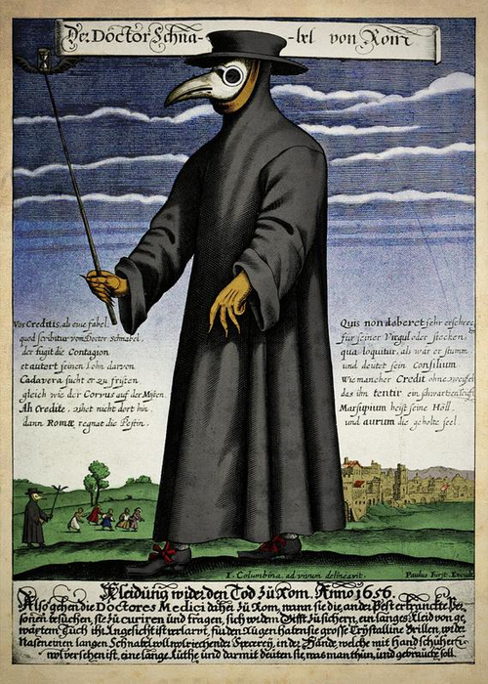
Health and Hygiene
Before scientific understanding of disease, taboos often functioned as early public health measures. Restrictions on contact with corpses, bodily fluids, or certain foods helped prevent contamination and the spread of disease, even if the reasoning was not fully understood.
https://en.wikipedia.org/wiki/Second_plague_pandemic

Slide 8
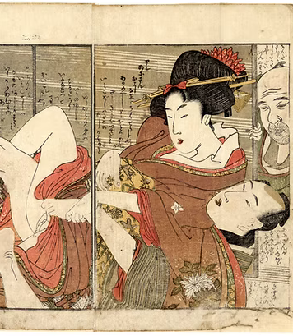
Social Order and Hierarchies
Taboos maintained social structure by defining boundaries; who could marry whom, what foods were permissible, and what behaviours were acceptable and unacceptable. Incest taboos, for instance, prevented genetic risks and reinforced family systems. In this taboo-themed wood block print from 1803 Japan, a brother and sister are caught in the act of their incestuous relationship by their father who stumbles upon them while opening the shoji (sliding door).
https://www.shungaisart.com/product-page/very-rare-1803-utamaro-taboo-shunga-incest

Slide 9
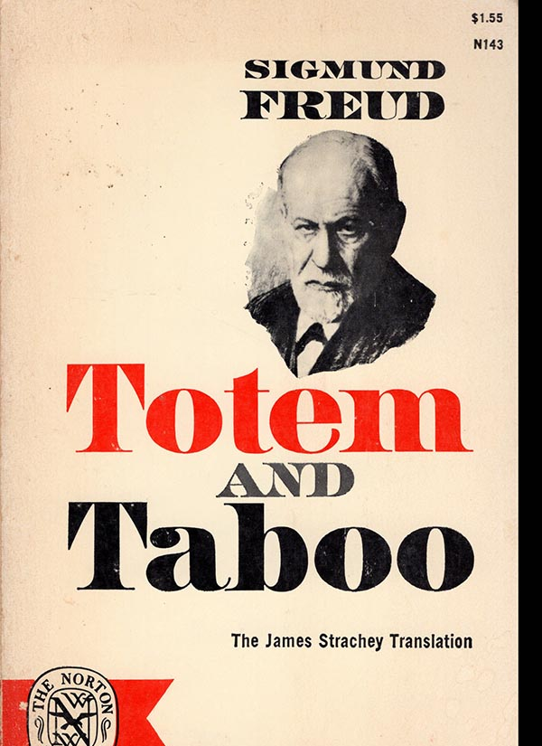
Psychological Taboos
According to psychologist Sigmund Freud (in his seminal 1913 book Totem and Taboo) taboos are not simply cultural or social, they emanate from deep with the human psyche. He believed that individuals harbour drives for sexuality and violence, which, if left unchecked, could destabilize social life. Taboos act as a psychological safety measure: they suppress impulses and redirect them into behaviours that maintain order. For example, murder and death taboos restrain aggressive instincts.

Slide 10
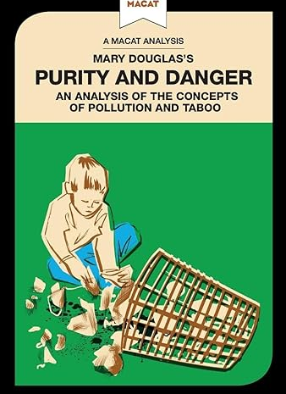
Symbolic Taboos
In 1966, cultural anthropologist Mary Douglas published her book Purity and Danger, which examined concepts of taboo in terms of cleanliness and pollution. She believed bodily fluids gained their taboo power because they blur the boundaries between what should be and what might be – between inside and outside, pure and unclean. “Dirt is matter out of place,” she famously wrote.

Slide 11
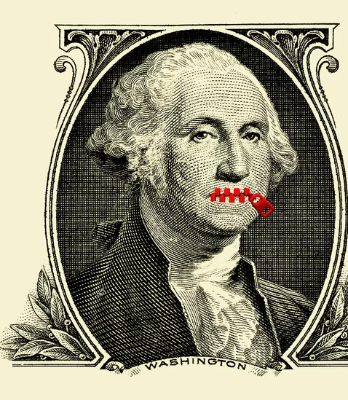
Taboos Over Time
Taboos began as protective mechanisms in early societies, guarding health, maintaining social order, and reinforcing religious and spiritual beliefs. While some have faded, others endure, reshaped by culture and context. Death, sex, and bodily fluids remain sensitive topics, but they are not alone. Illness, food restrictions, religion, money, and even politics can still provoke discomfort or silence.
https://www.theatlantic.com/family/archive/2020/03/americans-dont-talk-about-money-taboo/607273/

Slide 12
Today’s Taboos
Death and Mortality
Sex and Sexuality
Bodily Fluids and Functions
Illness and Disability
Food and Eating Practices
Religion and the Sacred
Money and Wealth
Clothing and Appearance
Here are some Taboo Categories. Work together to mind-map taboos that exist in cultures and societies today. For example, in the category of Sex and Sexuality, incest is a persistent taboo; in many societies nowadays it’s joined by sensitivity or even prohibition of non-normative sexual identity. Can you think of other sensitive areas in this category and others from the list opposite?

Slide 13
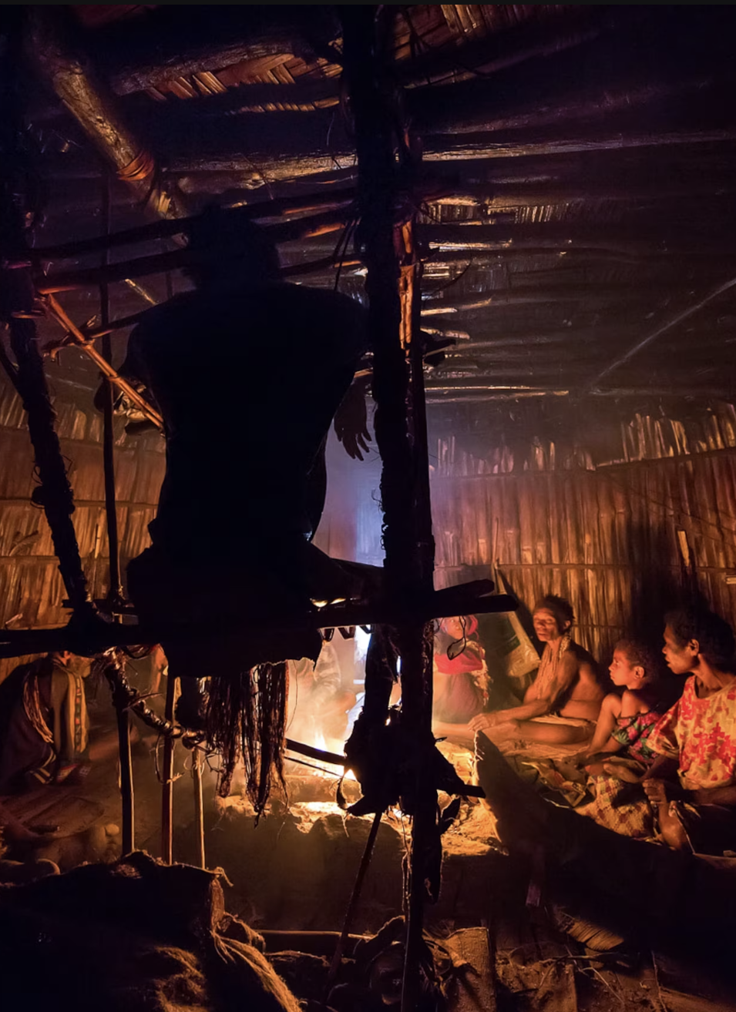
Reflection Questions
Share your mind-maps around before reflecting on the following questions:
Which taboos persist most strongly? Are there ‘lesser’ and ‘greater’ taboos?
Did you encounter culturally specific taboos? Which ones?
Why do some taboos weaken over time while others remain powerful?
In Papua New Guinea, the remote Agra tribe practice mummification, and are comfortable sharing their homes with bodies of the deceased. Read more at https://www.nationalgeographic.com/photography/article/mummy-photography-ulla-lohmann

