Slide 1

Paper 2: Compare and Contrast
Question Mapping

Slide 2

Paper 2 Brief
Paper 2 is a 1-hour 45-minute examination in which you are asked to write an essay about literary works you have studied on the IB course. The paper is the same for all students, whether you study Lit, Lang and Lit, study at HL or at SL. However, there is a difference in weighting: Paper 2 accounts for 35% of your final grade if you are an SL student and 25% of your final grade if you are an HL student.
You are given a choice of four questions and must answer one question only.
The essay must be a compare-and-contrast essay about two literary works.
Paper 2 is closed book, meaning you will not have your works with you when you sit this exam.

Slide 3
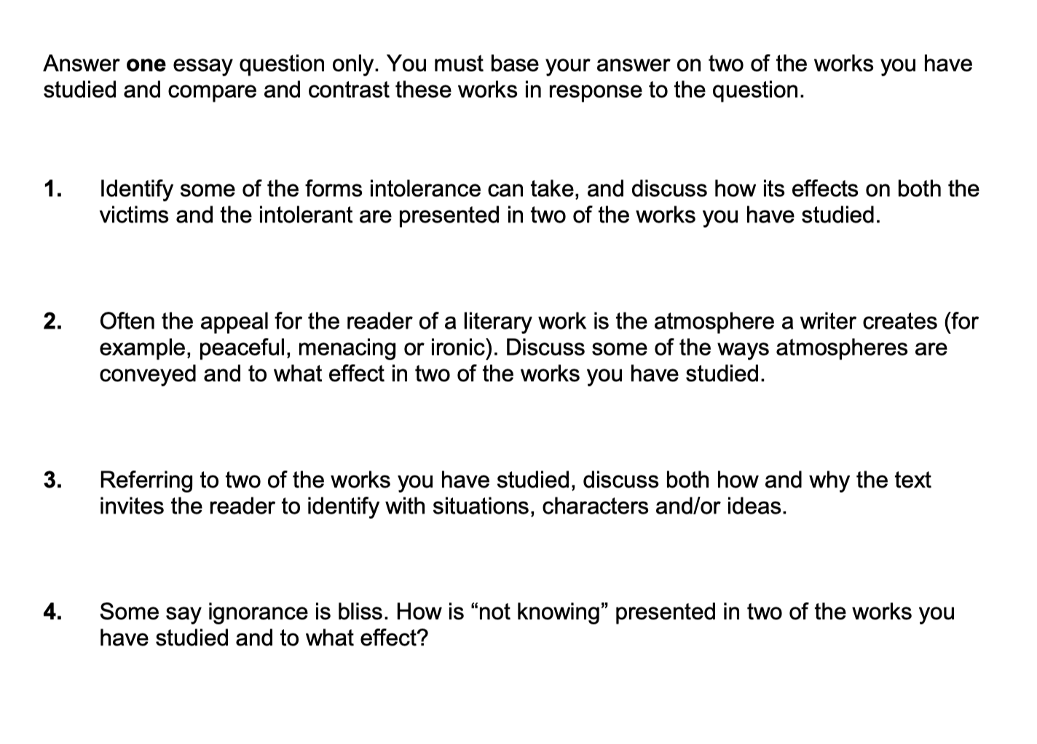
Question Types
Paper 2 questions are always broad and open. In fact, the whole paper is designed to test your ability to think flexibly and critically about the texts you’ve studied. While it’s impossible to predict the exact questions that will appear on your paper, there are certain ‘categories’ that you’ll recognize as you revise and prepare for Paper 2 using past questions. These categories are:
  ‘theme’ questions
  ‘character’ questions
  ‘methodology’ questions
  ‘composition’ questions
  ‘interpretation’ questions
This specimen exam paper was provided by the IB to show the kinds of questions you can expect to be asked in Paper 2. The questions are broad and open, designed to test both your knowledge of the literary works you have studied and your ability to think flexibly about the ways in which they are similar and different.

Slide 4
Theme Questions
Theme questions are like pot-luck questions. They tend to be either highly suitable or highly unsuitable for different students. For example, if a question asks you to compare-and-contrast the ways love is presented in two literary works, and you’ve studied
However, remember that Paper 2 is asking you to think flexibly and critically. Love can be interpreted in different ways beyond ‘romantic’ love. Love for a country, for a certain position in society, for oneself or one’s tribe, or loving a job, hobby or lifestyle would all be valid ways of approaching this theme. Love might cross over with themes like ‘obsession’ or ‘loyalty’ which you can perhaps reframe as ‘love’. While a theme can only be stretched so far, you should be prepared to take a bold approach when setting out the terms of your response.
Sample Theme Questions:
  Discuss the role that regret plays in at least two works studied. How is regret central to the works’ ideas or themes?
  Consider how the idea of freedom is explored in at least two works you have studied.
  Compare how betrayal is explored in at least two works you have studied.
  Explore the importance of trust in at least two literary works you have studied.

Slide 5
Character Questions
All literary works have characters, in one form or another. Novels and plays are most often all about individual people’s thoughts, actions, and interactions with others. Poems have speakers and personas. Non-fiction works have narrators and are also likely to feature real people who you can consider characters. Sometimes, a writer of a literary work can be a character too, especially in the case of (e.g.) confessional poetry, memoir, or autobiography.
Remember that this paper is asking you to think flexibly and critically. You might immediately think of the main characters (protagonist and antagonist) from the literary works you’ve studied. But, as part of your planning for character questions, think about how supporting characters or minor characters could help you show a deeper knowledge of your works in terms of the question.
Sample Character Questions:
  Can it be concluded that characters are better judged by their actions, not their words?
  Examine the role and function of the outsider in two works you have studied.
  Explore how women are represented as stronger than men in at least two of the works you have studied.
  Consider how and why writers create characters who do not conform to norms in at least two of the works you have studied.

Slide 6
Composition Questions
Why do writers write? What reasons motivate writers to put pen to paper and create compelling stories for others to read? How does time and place effect the content of literary works? What is a writer’s intention when crafting a particular story or describing an event? These kinds of concepts underpin ‘composition’ questions.
You’ll need to have some contextual knowledge to answer composition questions well. General statements like ‘make the reader read on’ will not be sufficient if you want to show your understanding and evaluation of literature. It’s likely that you’ve learned about the context of your literary works throughout your course of study, so make sure you have this knowledge at your fingertips.
Sample Composition Questions:
  Authors often write because they feel their stories need to be told. Compare how and why authors have written two literary works that you’ve studied on your course.
  The time and place where a literary work is set are of crucial importance to understanding the work as a whole. Discuss with reference to at least two literary works you have studied.
  How have at least two of the works you have studied pursued overt political aims and to what larger effect?
  Works of literature can often function as social commentary. Discuss with reference to at least two literary works you have studied.

Slide 7
Interpretation Questions
How do readers interpret what they read? Why do different readers interpret the same text in similar or different ways? What impact does genre, style, and form have on a reader? Can the meaning of a text change over time? These kinds of reader response issues are the bread and butter of interpretive questions.
Interpretation questions can provoke ‘love / hate’ responses, with some students gravitating towards questions of interpretation and other students just crossing them out immediately! In many ways, these are quintessential Paper 2 questions, as they are asking you to think critically and reflectively about not just what you read but how you read as well. Interpretation questions are sometimes, but not always, built around a premise or statement and are explicitly asking you to ‘consider’ your personal response and the response of other readers, to literary works.
Sample Interpretation Questions:
  Friendship marks a life more deeply than romantic love. Consider this idea with reference to two literary work’s you have studied.
  Sometimes a crisis creates a positive change. Consider this idea with reference to two literary works you’ve studied.
  A good life means different things to different people. Consider how a good life is presented in two works of literature you’ve studied.
  How valid is the assertion that literary works are a voice for the oppressed? Consider this question using two works of literature you’ve studied.

Slide 8
Methods Questions
Like theme questions, methods questions have an element of pot-luck about them. Some students like methodology questions as they feel like a ‘safety net’ in the examination; they provide the most straightforward route to analysis, which you need to get marks in Criteria B.
While ‘methods’ questions are more straightforward, that doesn’t mean there isn’t room for critical thinking and evaluation. For example, a question about ‘symbolism’ appears simple enough, but you still should think carefully about the symbols you choose to present. The choices you make will determine how deeply you can discuss the literary works.
Sample Methods Questions:
  With reference to two works you’ve studied, consider how point of view shapes our understanding of the story.
  Discuss how formal characteristics of literary genres affect meaning in two literary works you’ve studied.
  How do two writer’s you’ve studied use language to create intense or unforgettable moments?
  Discuss the creation of setting and its role in creating a physical and/or emotional landscape in two works of literature you have studied.

Slide 9
Mixed Category Questions
Often, a single question will address more than one category. The words ‘and / or’ in the question are a signal that the question mixes categories. Here’s another look at the IB provided specimen paper:
Question 1 is a ‘theme’ question about intolerance. But the question also asks you to consider how the effects of intolerance are presented, encouraging you to write about methodologies too.
Question 2 is a ‘methodology’ question asking you to write about the methods writers use to create atmosphere. However, the question also asks you to consider ‘to what effect’, drawing attention to the importance of interpretation in this question as well.
Question 3 is an example of a truly mixed category question. The question is so broad you can decide to write about almost any aspect of your literary works. The question asks ‘how’ writers invite readers to identify with their writing, encouraging you to discuss writer’s methods. The word ‘why’ reminds you to consider writer’s purposes, making this a mixed ‘methods/composition’ question. But then things open up even more: do you want to write about ideas? You can make this a theme question. Do you want to focus on ‘characters’? The question gives you this option. Or if you prefer to explore your personal interpretation of literature, you can write about ‘situations’ the author presents and how you identify with these too. The words ‘and/or’ in the question means you can choose what to write about.
Question 4 is an interpretation question asking you to consider the idea of ‘not knowing’ in your works. However, the question also asks ‘how’ this idea is presented, pushing you towards writing about methods writers use as well. The words ‘to what effect’ remind you to interpret writers’ choices, not just identify them.
Look out for the words ‘and’, ‘or’ and ‘and/or’ in the questions. These words alert you to what you must write about and what you can choose to include or exclude.

Slide 10
Activity
Create a pentagon template like the one opposite. Here are 12 sample Paper 2 questions. Place the number of each question on your pentagon to reflect the kind of question you think it is. Consider the placement of ‘mixed category’ questions:
Referring to two works you have studied, discuss how the author has created a convincing ‘world’?
Some writers shine a light while others criticize explicitly. Compare and contrast these different approaches in two works of literature you’ve studied.
Compare and contrast the way people in two works of literature are trapped or confined in some way, and the reasons for this.
With regard to two works of literature you have studied, explore the representation of poverty.
Writers can present their ideas in unusual or thought-provoking ways. How, and to what effect, has this been shown in two works you have studied?
Whether implicitly or explicitly, literary works communicate cultural values to the reader. How have cultural values been conveyed in two works you have studied, and to what effect?
Explain how the works you have studied present characters who are complex and multi-faceted.
To what extent do male and female characters accurately reflect the role of men and women in society in two literary works you have studied?
How, and for what purposes, do writers of two works portray the societies they are writing about?
Authors sometimes change the order of events in literary works while sometimes events play out in chronological sequence. Discuss how and why authors change the order of events in two literary works, and the effects created by these choices.
Writers choose words, phrases, and names of people and places to suggest further meanings to the reader. With reference to two works you have studied, discuss how such words and their associations further your understanding of the works.
Discuss how two of the works you have studied present concepts of good and bad, not as absolutes, but as a matter of individual perception.
Theme
Methodology
Interpretation
Composition
Character

Slide 11

What your examiners say
The most successful student responses directly addressed the chosen prompt, offering original insights and a clear enthusiasm for sharing interpretation of the works in relation to their argument developed around the chosen question.
Examiners observed an issue with some students who do not fully address their chosen question and instead attempt to respond with a ‘prepackaged’ answer – this led to a lack of focus on the specific demands of the question at hand and weaker critical analysis of the works in relation to the question.
Extract from May 2024 Subject Report

