Slide 1
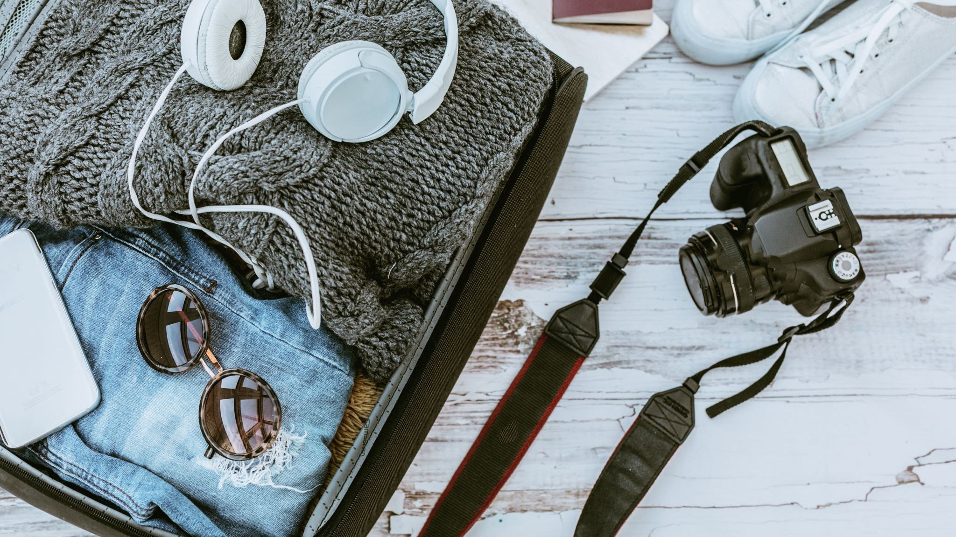
Our Urge to Explore
Purposes and Forms of Travel Documentation

Slide 2
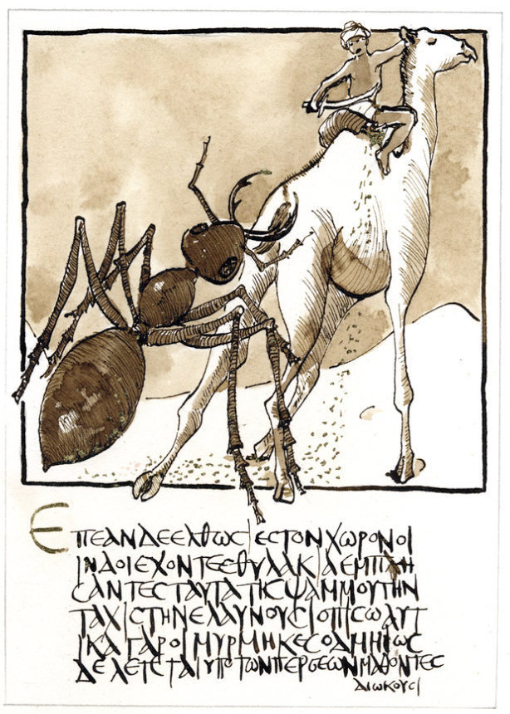
Early Travellers
Travel narratives have existed for millennia, evolving alongside human mobility and cultural exchange. In antiquity, early examples include Herodotus’s Histories and accounts of pilgrimages, which blended observation with myth and moral reflection. Herodotus wrote his Histories around 430-420 BCE, during the Classical period of Ancient Greece. It’s considered one of the earliest travel narratives because Herodotus collected stories from his extensive journeys across the Mediterranean, Egypt, and parts of Asia.
Herodotus tells how the ends of the earth are places of wealth and natural abundance but also great danger. His passage about Indian giant ants digging up golden sand shows Herodotus as a gullible (or cunning) storyteller and demonstrates how early travel narratives blended observation with myths and legends.
(https://www.flickr.com/photos/alexhollmann/9141900470)

Slide 3
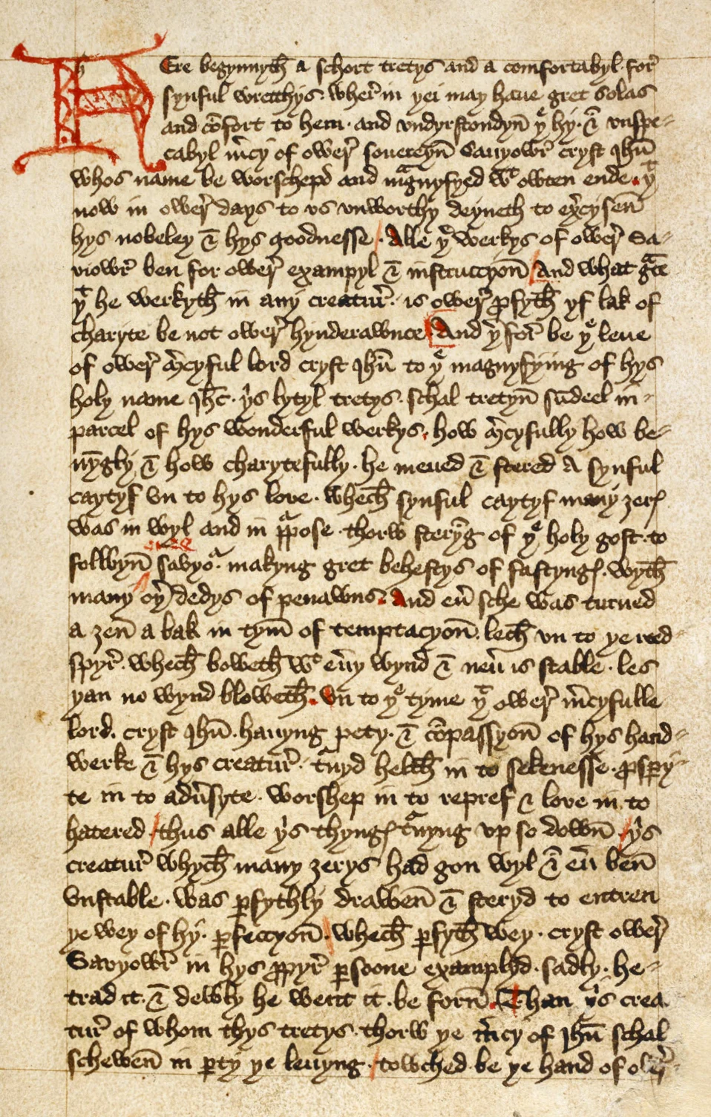
Middle Ages (6th – 16th centuries)
During the Middle Ages, travel writing was often religious in nature; pilgrims documented journeys to holy sites, such as in The Travels of Ibn Battuta or The Book of Margery Kempe, emphasizing spiritual transformation. Ibn Battuta’s account spans nearly 30 years and covers over 40 countries, blending vivid descriptions of Islamic culture with personal reflections on faith. Margery Kempe’s text, considered the first autobiography in English, records her pilgrimages to Jerusalem and Rome, portraying travel as a path to penitence. These texts reveal how medieval travel was intertwined with devotion and the quest for divine salvation.
A page from The Book of Margery Kempe, c. 1440, can be viewed at the British Library (https://www.culturefrontier.com/margery-kempe/)

Slide 4
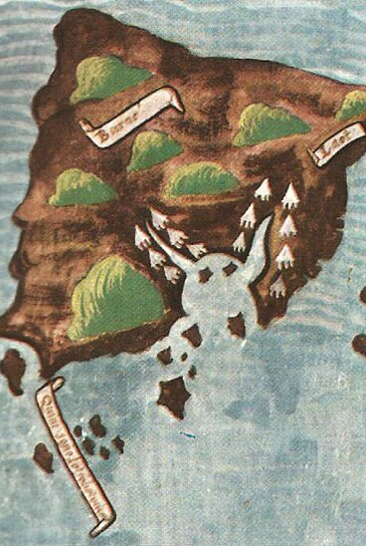
The age of exploration (15th – 17th Centuries)
During the Age of Exploration, travel narratives became instruments of empire and curiosity. European explorers documented their voyages to the Americas, Africa, and Asia, blending observation with wonder and ambition. Accounts described unfamiliar landscapes, flora and fauna alongside exaggerated tales of wealth and exotic customs, fuelling both scientific inquiry and colonial desire. Columbus’s letters to the Spanish crown portrayed the Caribbean as a paradise of abundance. Similarly, Antonio Pigafetta’s chronicle of Magellan’s circumnavigation combined meticulous descriptions of spices and navigation with monstrous creatures and mythical islands. These travel writings shaped European perceptions of the New World and justified imperial expansion.
This map of Borneo was drawn by Antonio Pigafetta in 1521 during the expedition with Ferdinand Magellan that completed the very first circumnavigation of the world. Whie Pigafetta was a meticulous observer, he also accepted any tall tale that he heard, blending fact and fiction in his recordings.

Slide 5
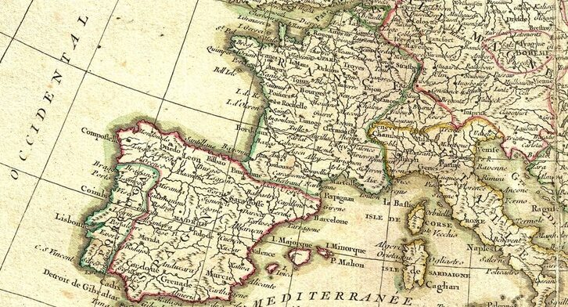
THe ‘Grand Tour’
(18th century Romantic Era)
In the Romantic era, travel writing shifted from conquest to contemplation. British writers such as William Wordsworth, Lord Byron, and Mary Wollstonecraft infused their journeys with emotion, imagination, and a reverence for nature. Travel became a means of self-discovery and aesthetic experience. Wordsworth’s accounts of walking tours in the Lake District celebrated solitude and spiritual renewal. This period also saw the rise of the Grand Tour, a cultural rite of passage for the aristocracy, where travel narratives emphasized art, architecture, and self-refinement, redefining travel as an inward journey of the self as much as an outward journey of discovery.
Popularized in the seventeenth century, the Grand Tour was typically a long, circuitous European journey undertaken by young men of good birth in order to broaden their cultural, philosophical and moral horizons. An itinerary could last years. (https://lithub.com/the-original-eurotrip-how-the-grand-tour-shaped-generations-of-19th-century-elites/)

Slide 6
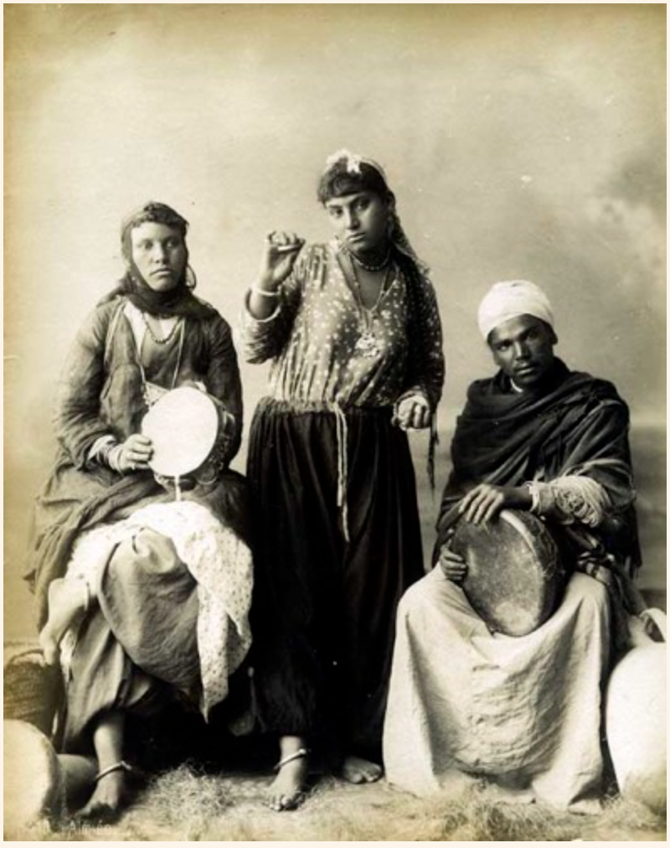
The Advent of photography (19th century)
The 19th century introduced a new dimension to travel narratives: visual documentation. Photography offered travellers a way to ‘capture’ reality, lending authenticity to their accounts. Illustrated travel books and photographic albums accompanied written descriptions, and travellers were transformed into ‘authorities’ about the world. Writers like Isabella Bird combined vivid prose with photographs to convey adventure and cultural difference, while publications such as National Geographic blended scientific inquiry with subjective spectacle. Issues of representation and exoticization arose. Photographs of colonial subjects in Africa, Asia, and the Middle East often staged people and places to fit Western stereotypes.
This cliched photo of an Egyptian dancer flanked by drummers was deliberately posed to capture a feeling of oriental exoticism (https://photorientalist.org/about/orientalist-photography/)

Slide 7
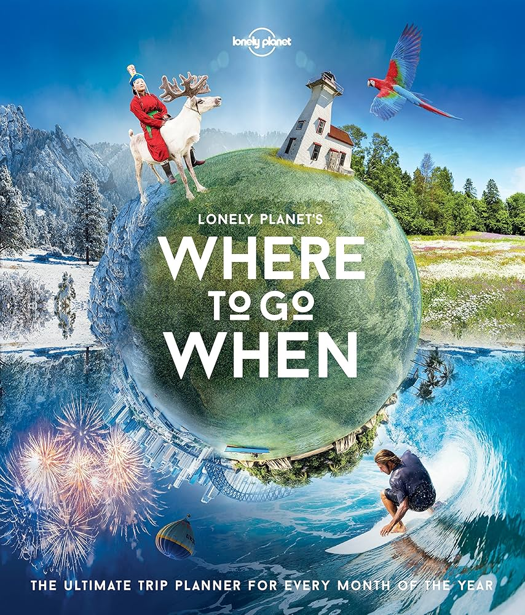
The Rise of tourism (20th century)
In the 20th century, travel narratives diversified dramatically, reflecting social and technological changes. Memoirs and autobiographical accounts emphasized personal growth and cultural encounters, while guidebooks catered to the growing middle-class tourist market, offering practical advice and recommended itineraries. Writers like Paul Theroux and Bruce Chatwin brought literary sophistication to travel writing, blending reportage with reflection. Later, the rise of mass tourism and globalization shifted the tone of many narratives toward leisure and cultural curiosity, often framing travel as a lifestyle choice rather than an arduous journey.
Founded in 1973, Lonely Planet shifted travel writing from elite or literary circles to practical, accessible guidebooks aimed at independent travellers influencing how millions of people approached travel as a lifestyle choice.

Slide 8
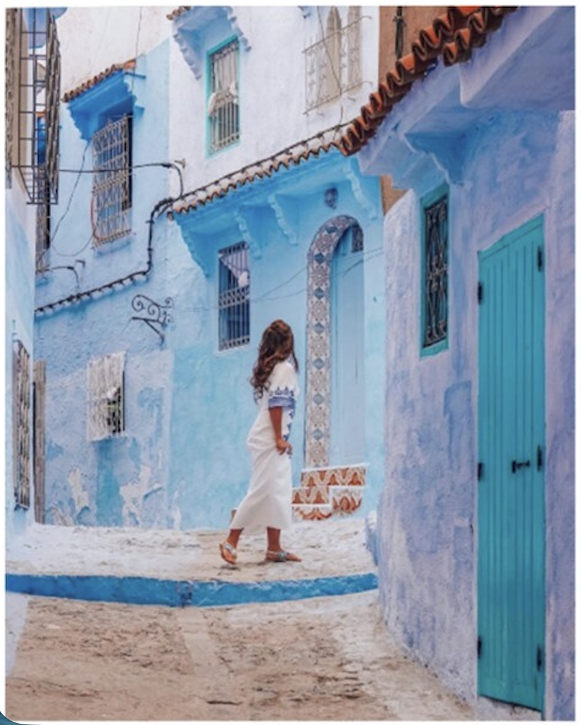
The Digital Generation (21st century)
In the late 20th and early 21st centuries, digital platforms revolutionized travel. Blogs, vlogs, and social media posts transformed travel writing into an interactive, visual, and highly commercialized form. Instagram aesthetics and influencer culture introduced new pressures of curating idealized experiences for followers rather than documenting authentic encounters. This evolution raises new questions: how does the pursuit of likes and sponsorship affect representation? Does digital travel writing perpetuate stereotypes or challenge them? And what does ‘authenticity’ mean when travel becomes performative? Today, the genre is global and more people than ever before have the chance to participate: but travel and travel writing or documentation is also deeply entangled with issues of ethics, sustainability, and cultural sensitivity.
Does this image show genuine exploration or an idealized performance to get likes? https://www.tandfonline.com/doi/full/10.1080/13683500.2022.2086451#d1e671

Slide 9
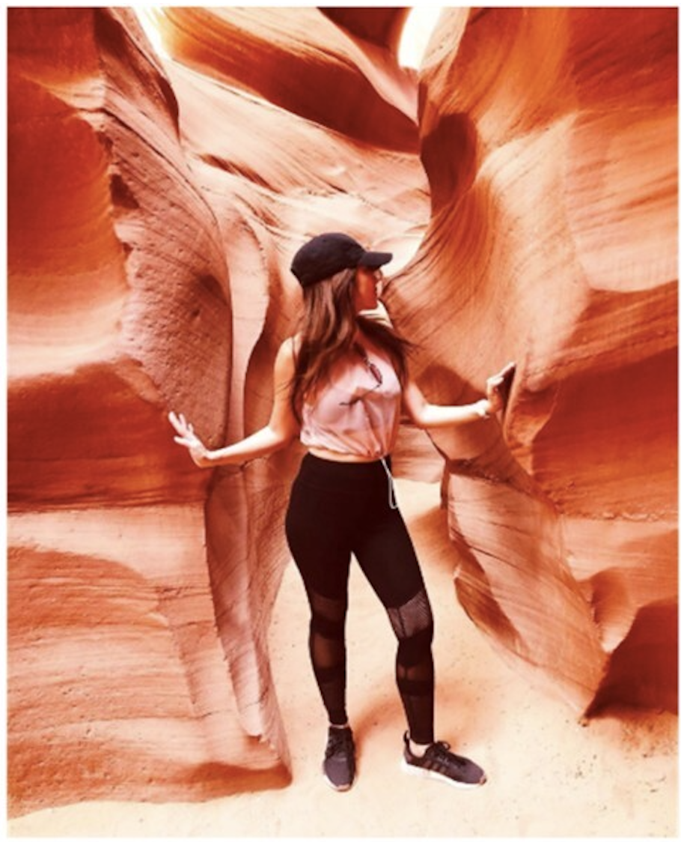
Follow Up Questions
What motivates people to travel and to document travel? Can you list half a dozen or more purposes of travel?
Are modern travelers and travel writers motivated in similar or different ways to historical travelers?
In what ways can travel be authentic or performative? How might this distinction create different impacts related to culture or sustainability?
Notes:
Purposes of travel: search for the self; return to one’s roots; curiosity about others; education and information; religious/spiritual reasons; to seek ‘awe’; escapism; search for wealth/monetization

