Slide 1
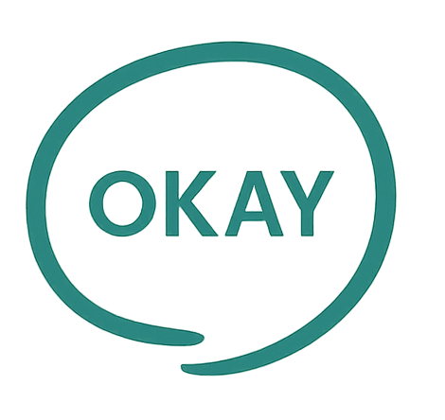
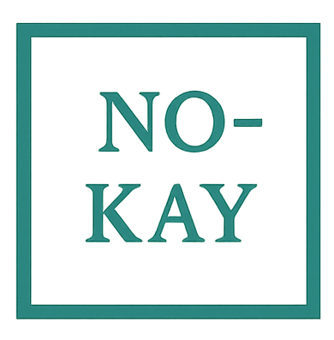
Linguistic Pet Peeves
Attitudes to Language Correctness

Slide 2
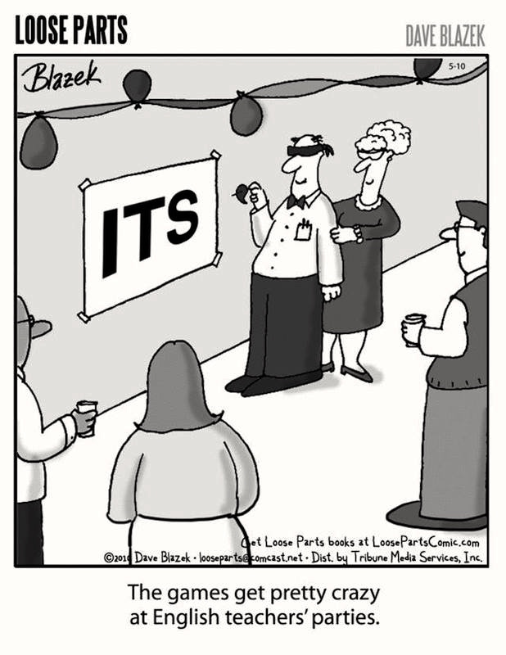
Introduction
Do you know what truly counts as ‘proper English’? In this activity, you will examine a series of common examples often debated as linguistic errors or ‘pet peeves’. For each example, let’s decide whether the usage is acceptable (‘Okay’) or unacceptable (‘No-kay’). In this way we’ll see how attitudes toward correctness in language use reveal deeper questions about language, authority, and change.

Slide 3
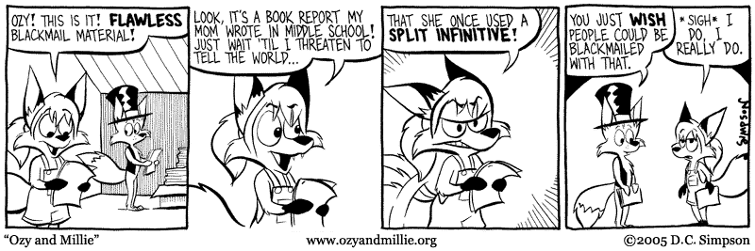
1. Split Infinitives
For example:
‘To boldly go…’ instead of ‘To go boldly…’

Slide 4
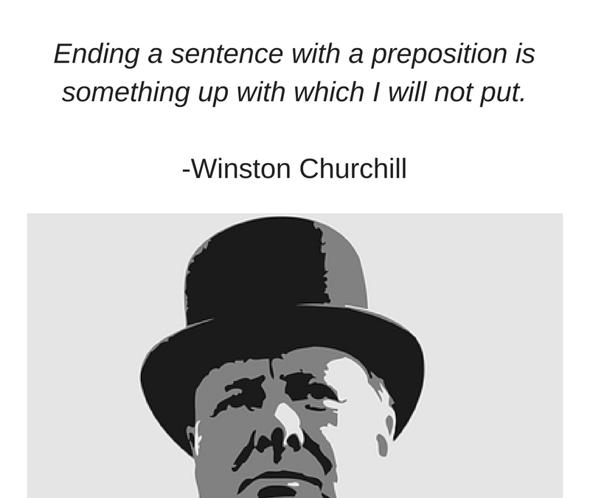
2. Ending sentences with prepositions
For example:
‘Who are you talking to?’ instead of ‘To whom are you talking?’

Slide 5
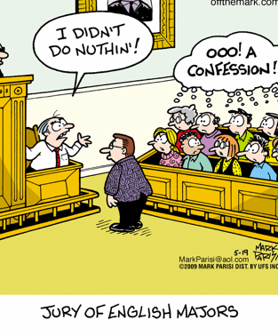
3. Double Negatives
For example:
‘I don’t know nothing.’

Slide 6
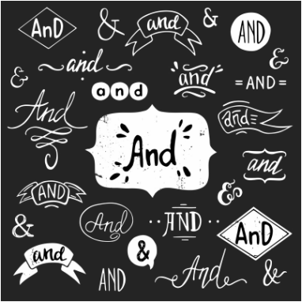
4. Starting sentences with conjunctions
For example:
‘And then it was all over.’

Slide 7
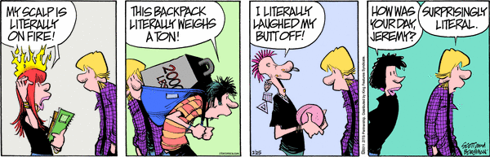
5. Using ‘literally’ figuratively
For example:
‘I literally died laughing’

Slide 8
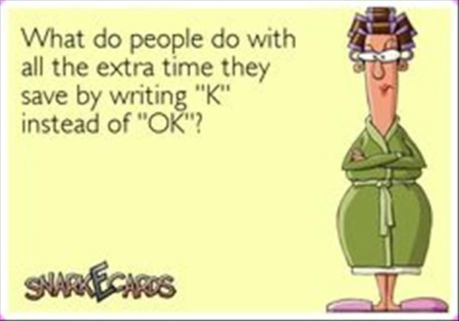
6. ‘Textese’ and Abbreviations
For example:
‘U’ (for ‘you’), ‘L8r’ for ‘later’

Slide 9
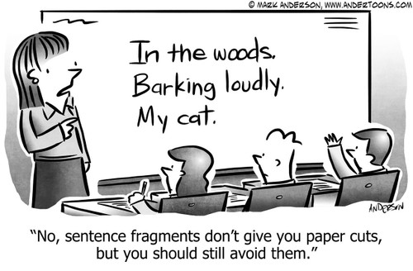
7. Sentence Fragments
For example:
‘So unfair’

Slide 10
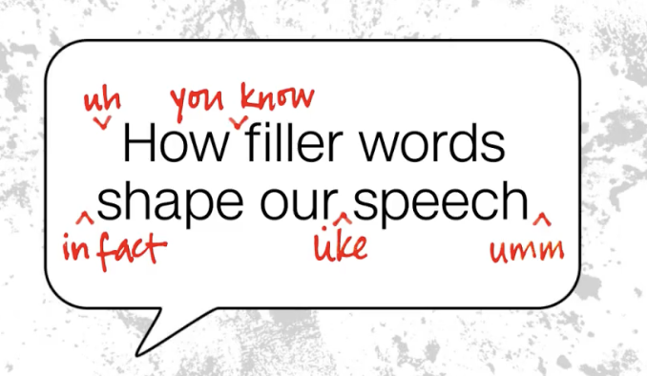
8. Using ‘like’ as a filler
For example:
‘I was, like, so tired’

Slide 11
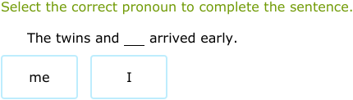
9. ‘Me’ vs ’I’ in compound subjects
For example:
‘Me and Sarah went to the cinema’

Slide 12
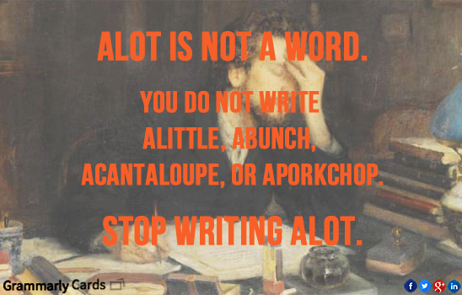
10. ‘A lot’ vs ‘a lot’ in spelling
For example:
‘There were alot of people there’

Slide 13
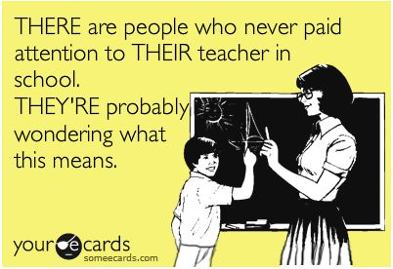
Over to You…
Do you have any pet peeves of your own that were not covered in this activity?
Chat amongst yourselves and see if you can produce more examples of ‘debateable’ usage of English.

Slide 14

Reflection
Most of our reactions, whether we said something was acceptable or not, reflect underlying attitudes about language. If you thought certain examples were wrong, you were taking a prescriptivist stance: believing that English should follow fixed rules set by tradition or authority. If you argued that these examples are fine as long as they communicate meaning, you were leaning toward descriptivism, which sees language as dynamic and shaped by real-world use.
Which examples did you decide are No-kay and why? Do your reasons relate to clarity or tradition or another reason?
How do prescriptivist rules influence the way we judge people for their language use? Do these rules protect clarity of communication, or do they reinforce ideas about education and status?
If language is constantly evolving, do you think we should hold on to rules or go with the flow of change?

