Slide 1

Masterstroke or Misstep?
You Decide

Slide 2
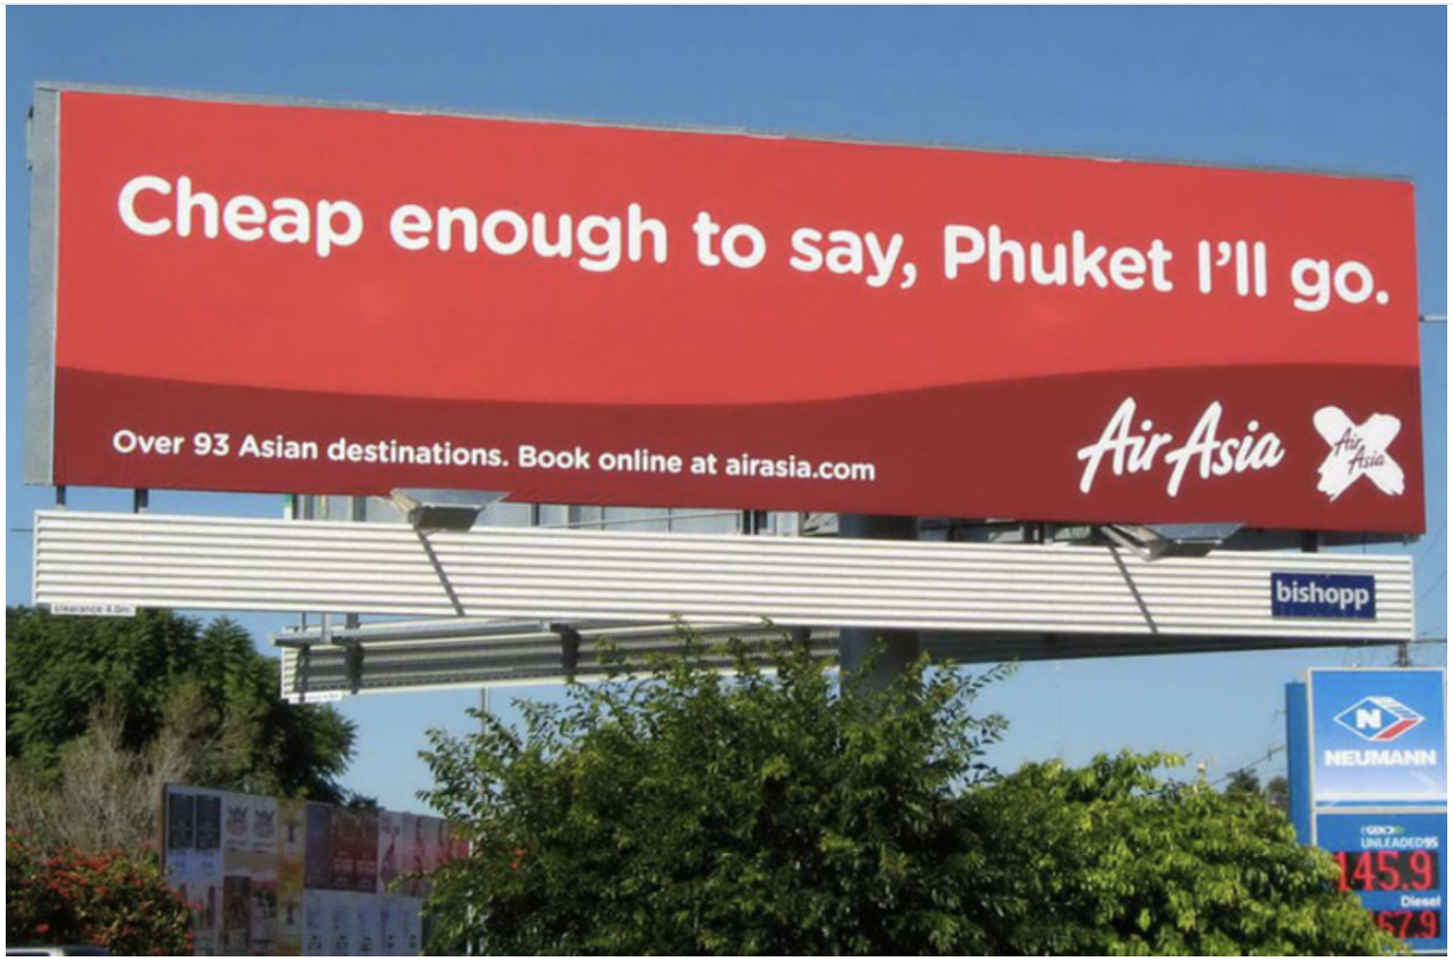
Introduction
You’re about to explore a series of striking images taken from advertising campaigns, protest movements, awareness drives, and art installations, all of which rely on shock factor and provocation to grab attention and highlight urgent issues.
As you examine each image, look closely at the details and ask yourself what issue the creator is concerned about. Try to decode the strategy behind it: what are the specific shock factor tactics (e.g. nudity, graphic imagery, hyperbole, and so on) being employed?
Once you’ve studied the image, make a judgment: Is the image effective? Does it feel like a bold, powerful move that could spark conversation and inspire action? Or does it cross the line into being gratuitous, tacky, or sensational, risking the message being lost in the outrage? In other words, decide whether the image is a ‘masterstroke’ or a ‘misstep’.

Slide 3


Notes:
https://timesofabetterindia.com/unplastic-india

Slide 4


Notes:
https://abcnews.go.com/blogs/politics/2013/04/moms-gun-control-ad-cites-dangers-of-little-red-riding-hood

Slide 5

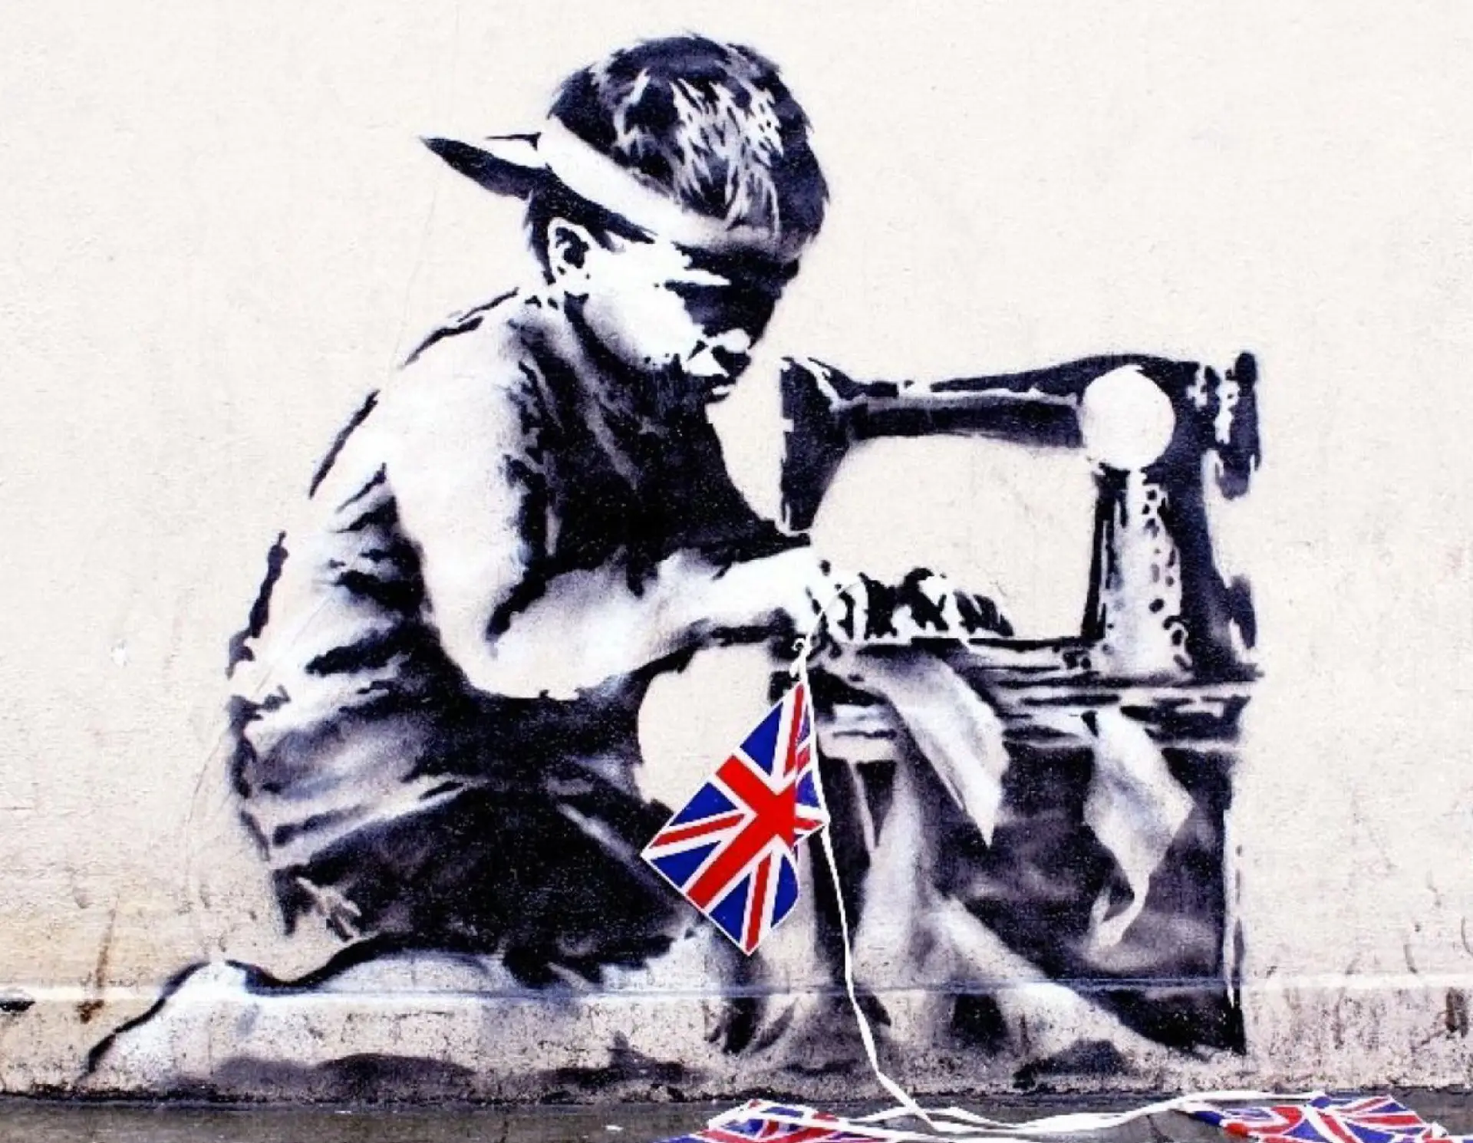
Notes:
https://hungermag.com/editorial/from-shredding-iconic-works-to-taking-on-the-catholic-church-here-are-the-5-most-controversial-banksy-moments

Slide 6


Notes:
https://www.dochipo.com/best-visual-advertising-techniques/

Slide 7


Notes:
https://www.th-ink.co.uk/2014/07/21/petas-ink-not-mink-campaign/

Slide 8


Notes:
https://rangefinderonline.com/news-features/industry-news/domestic-violence-campaigns-photoshopped-images-of-high-profile-women-spark-outrage/

Slide 9


Notes:
https://www.youtube.com/watch?v=UnB8WRDq48g

Slide 10

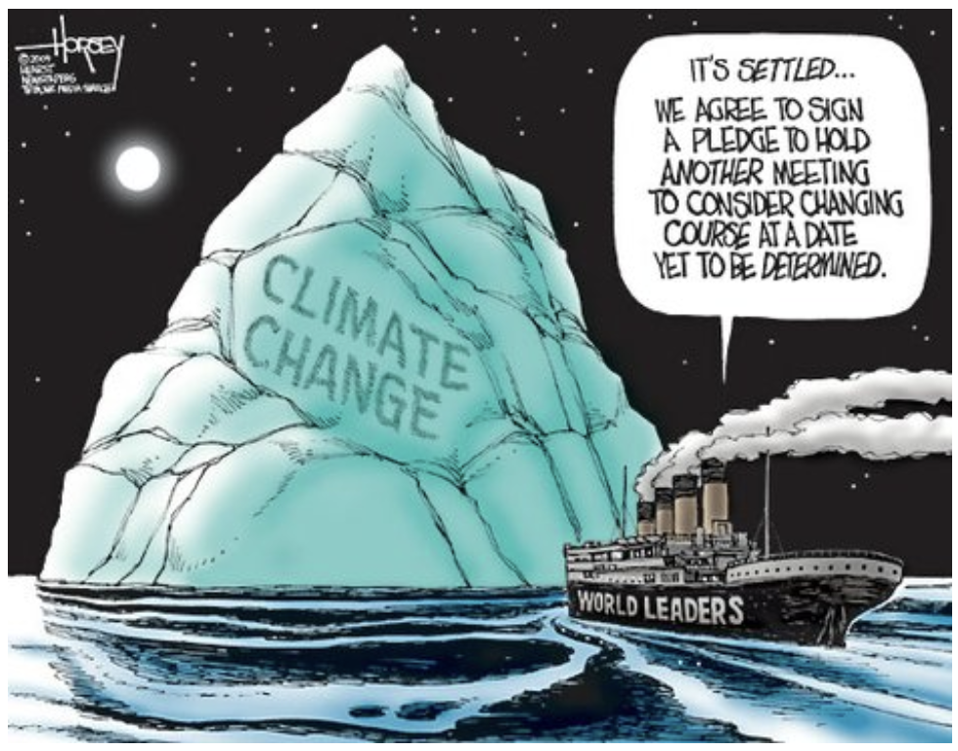
Notes:
http://theclimatepsychologist.com/best-metaphors-for-the-climate-crisis/

Slide 11


Notes:
https://www.youtube.com/watch?v=YzVYyDehMUY

Slide 12


Notes:
https://www.themarshallproject.org/2025/10/22/trump-ice-portland-no-kings-protest

Slide 13

Follow-up Activity
Now it’s your turn to explore how shock tactics are used to achieve an aim. Your task is to find a real-world campaign that relies on provocation. This could be an advertising campaign, a protest action, an awareness drive, or even an art installation. Once you’ve chosen your example, look closely at what the campaign is trying to accomplish and how it uses shock to do so. Identify the specific techniques at play and think about why the creators might have chosen this approach. Finally, evaluate its impact: did the campaign succeed in raising awareness, sparking conversation, or driving action, or did the shock overshadow the message? Prepare to present your findings and explain whether you believe this was a smart strategy or a step too far.

