Slide 1
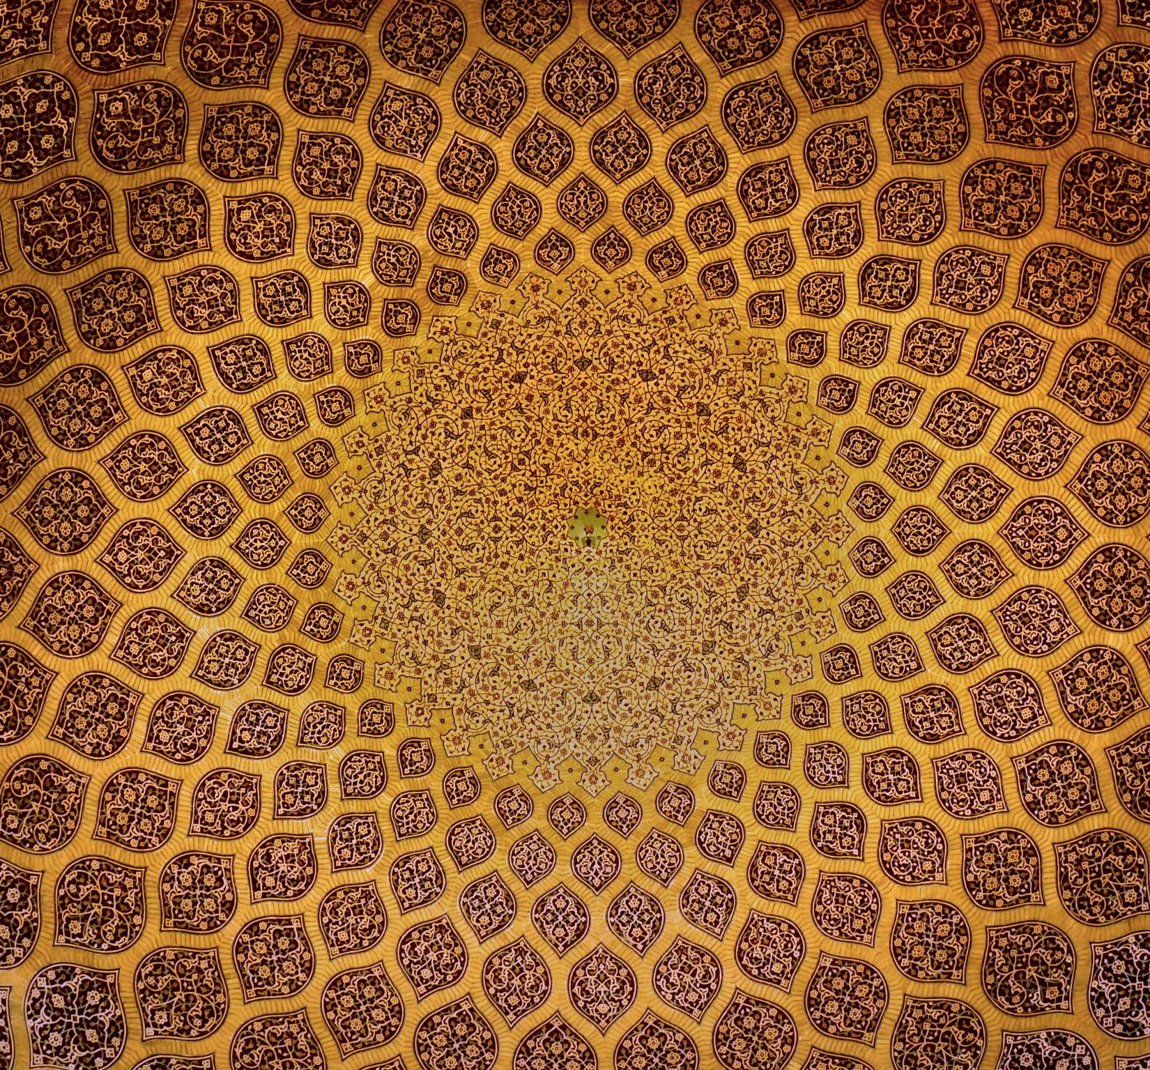
Exoticizing the East
Trends in Western Orientalism

Slide 2
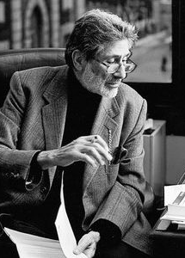
Introduction
Palestinian-American scholar Edward Said defines Orientalism as a way in which Western cultures have historically represented the East not as it truly is, but through a lens of stereotypes and power. According to Said, Orientalism is a system that portrays Eastern societies as exotic, backward, and inferior to the West (which is depicted as modern, rational, and progressive). These representations were deeply tied to colonial ambitions, serving to justify domination by framing the East as needing Western control or enlightenment. Said argues that this discourse persists in literature, art, and even modern media, shaping how cultures perceive one another today.
Said is best known for his influential 1978 work, *Orientalism*, which critiqued Western representations of Eastern cultures and laid the foundation for postcolonial studies (https://www.ebsco.com/research-starters/biography/edward-w-said)

Slide 3
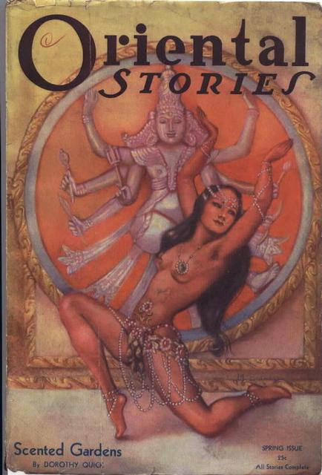
Exoticism
The most important signifier of Orientalism is the exoticism of language and images describing foreign cultures (especially Asian, North African, and Middle Eastern cultures) portraying them as essentially different to Western cultures. This otherness may be romanticized or fetishized through sensual – or sexual – imagery and sensory overload: bright colours, rich textures, and dramatic landscapes. There should be a focus on the strange or unusual food, architecture, clothing, customs and rituals, and suchlike. Exoticism can run in different directions: places can be made to look like an idealized, idyllic paradise; or demonized into threatening lands of danger and peril. Often this polarization is gendered: women seem alluring, sensual, and inviting. Men, on the other hand, are often depicted as primitive, or even barbaric. Above all, whether through language or imagery, a sense of distance is achieved through the portrayal of a ‘them’ who are different to ‘us’.
Cover of Oriental Stories pulp anthology magazine from 1932 (https://commons.wikimedia.org/wiki/File:Oriental_Stories_Spring_1932.jpg?uselang=en#Licensing

Slide 4
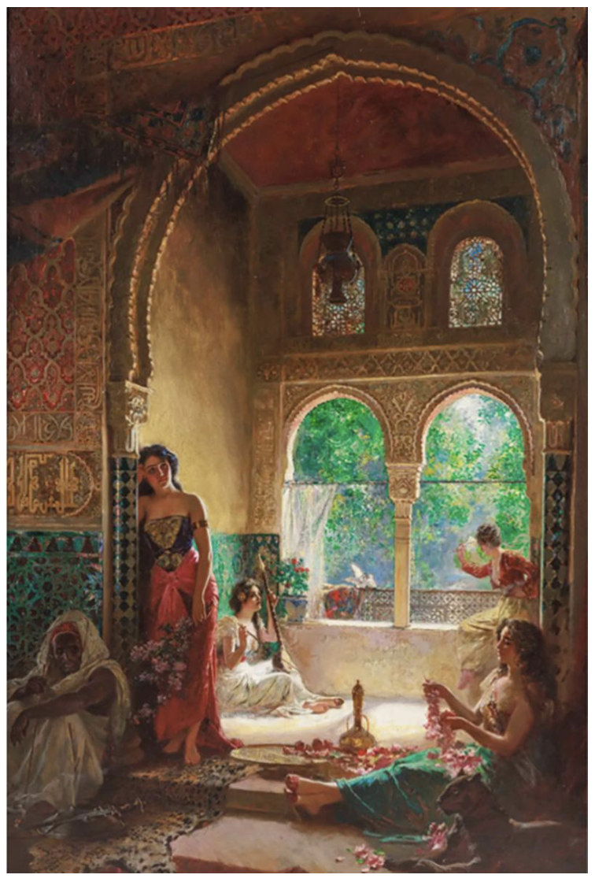
Spotting Exoticism in Orientalist Art
Over the next few slides, you’ll see famous 19th-century Orientalist paintings, all lavish depictions of Eastern settings created by Western artists. These works romanticize foreign cultures, portraying them as mysterious, sensual, and dramatically different from the familiar. Can you identify the exoticized features in each painting? Look for opulent interiors, exaggerated costumes, staged harem scenes, or idealized landscapes. Additionally, notice how colour, composition, and subject matter construct the exotic ‘Other’ and reflect Western fantasies rather than authentic realities.
Rudolf Ernst – Four Women in the Harem (late 19th century) depicts women in a staged harem scene with intricate tile work and bright, vivid lighting and colours. https://www.incollect.com/listings/decorative-arts/wall-art/rudolf-ernst-19th-century-italian-orientalist-masterpiece-painting-four-women-in-the-harem-646340

Slide 5
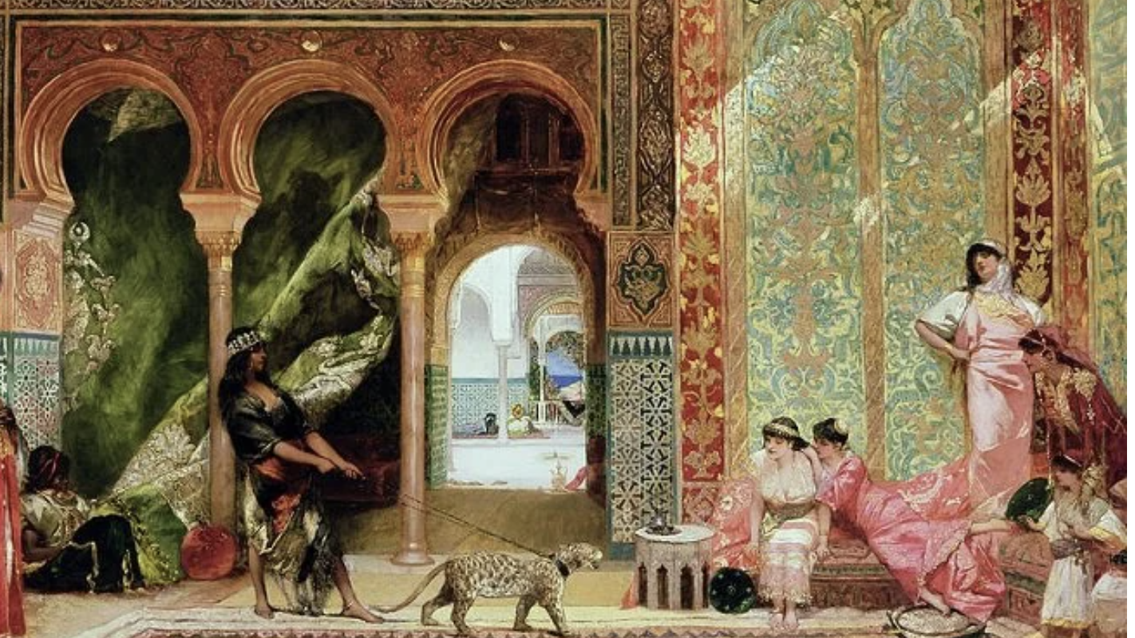
Jean-Joseph Benjamin-Constant – A Royal Palace in Morocco (c.1880)

Slide 6
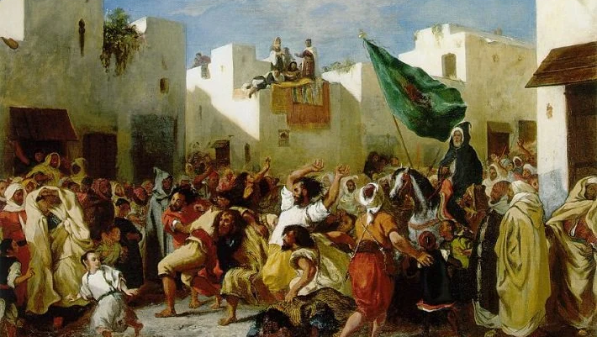
Eugene Delacroix – Les Fanatiques du Tangers (1838)

Slide 7
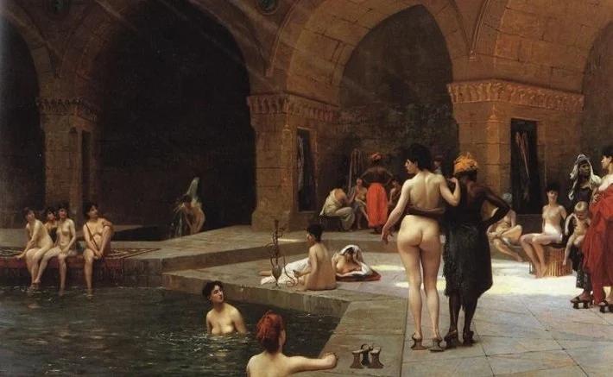
Jean-Leon Gerome – La Grand Piscen de Brousse Fanatiques du Tangers (1885)

Slide 8
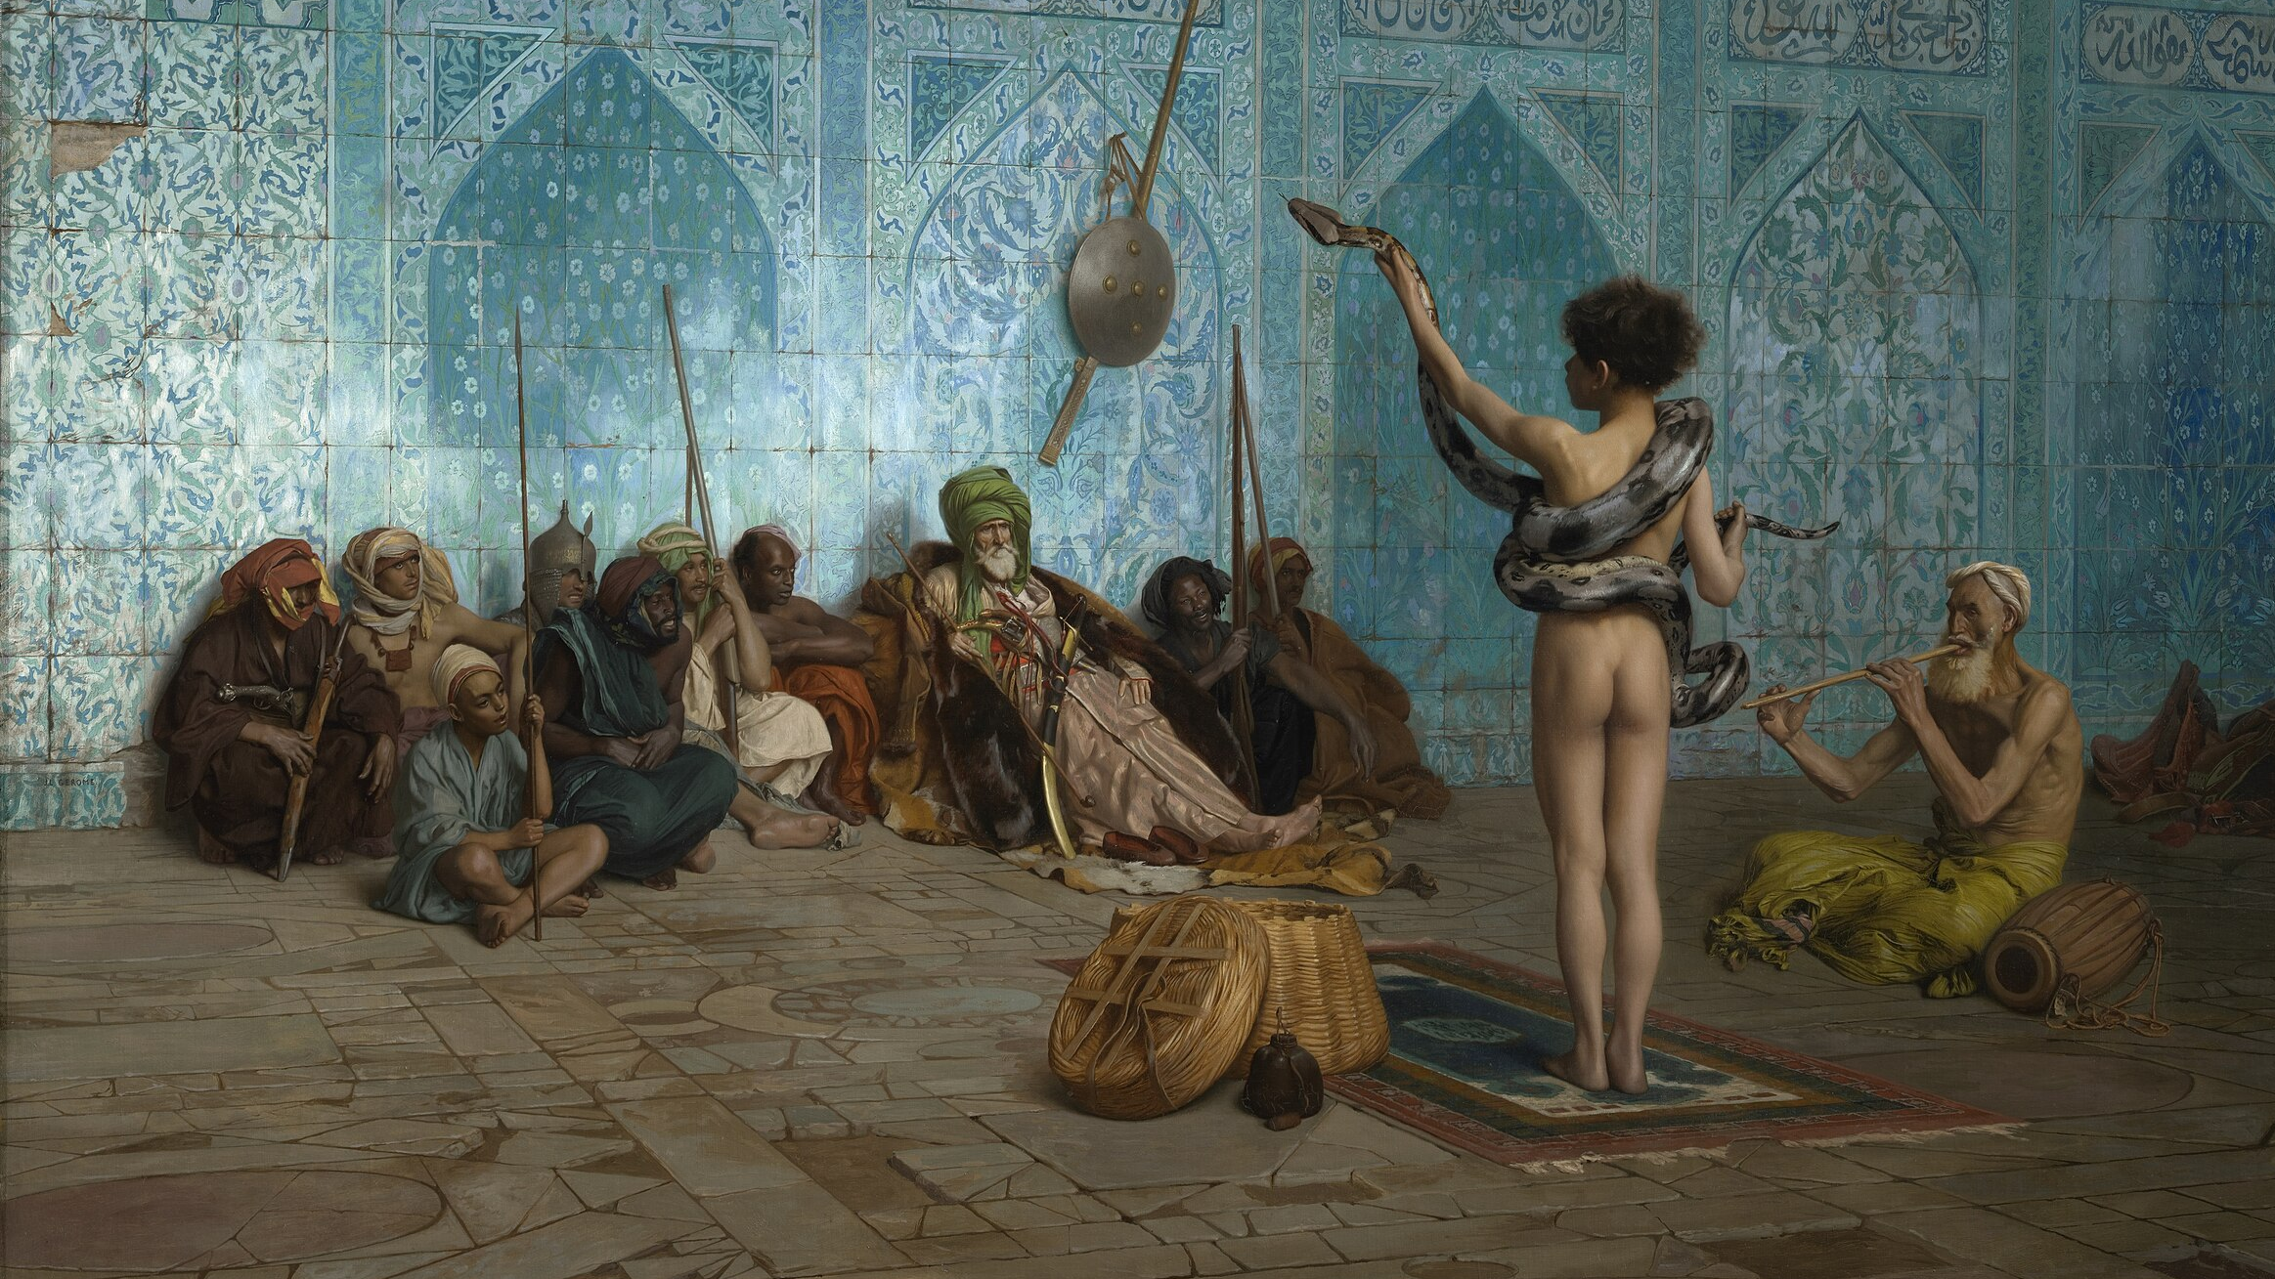
Jean-Leon Gerome – The Snake Charmer (1879)

Slide 9
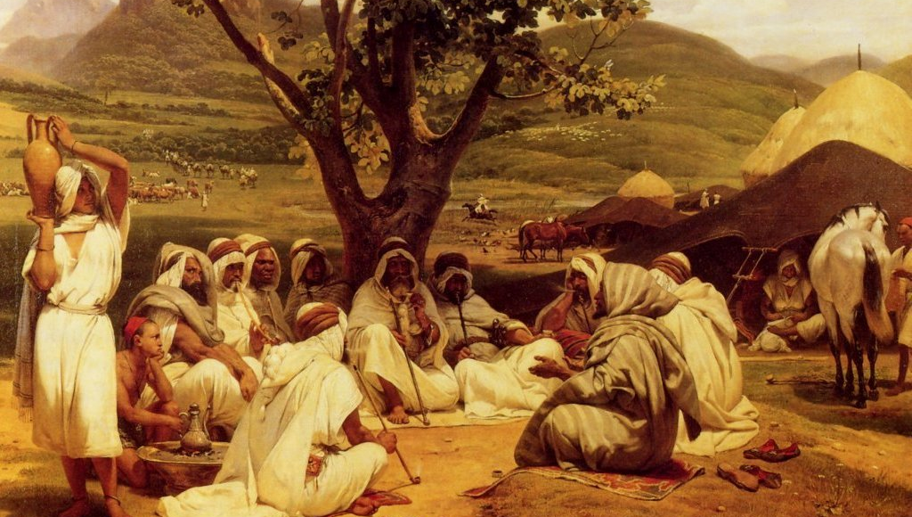
Horace Vernet – The Arab Tale Teller (1833)

Slide 10
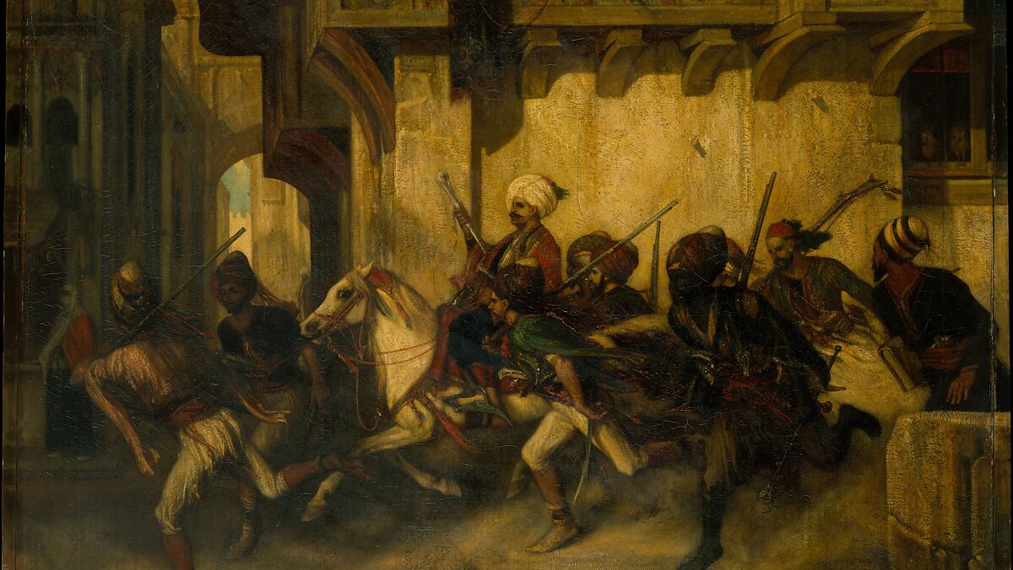
Alexandre-Gabriel Decamps – The Turkish Patrol (1831)

Slide 11
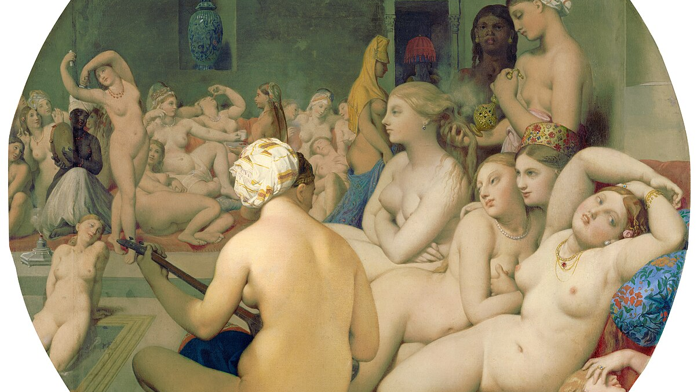
Jean Auguste Dominique Ingres - The Turkish Bath (1862)

Slide 12
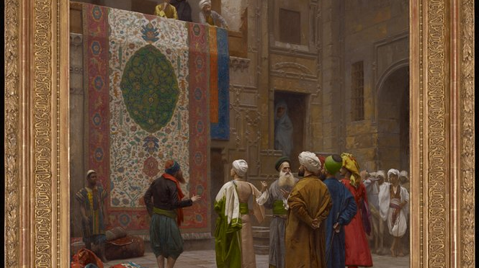
Jean-Leon Gerome - The Carpet Merchant (1887)

Slide 13
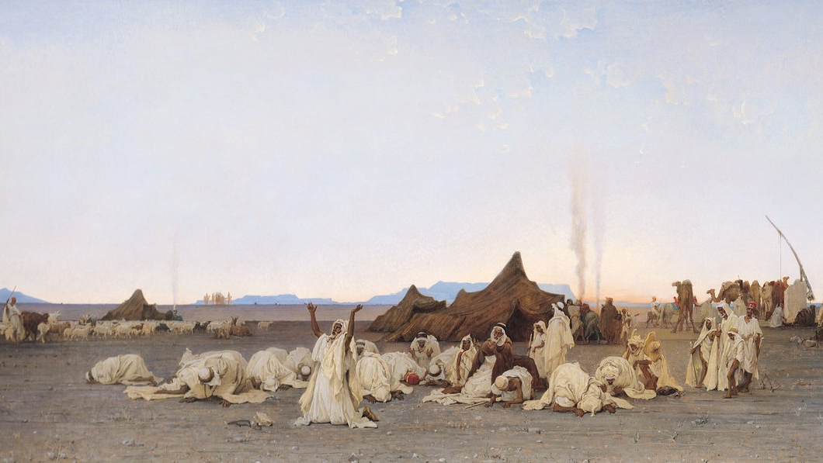
Gustave Guillaumet – Evening Prayer in the Sahara (1863)

Slide 14
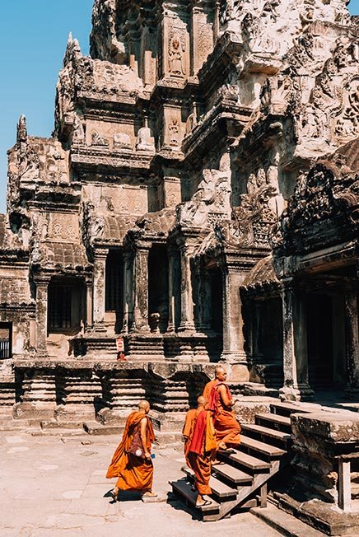
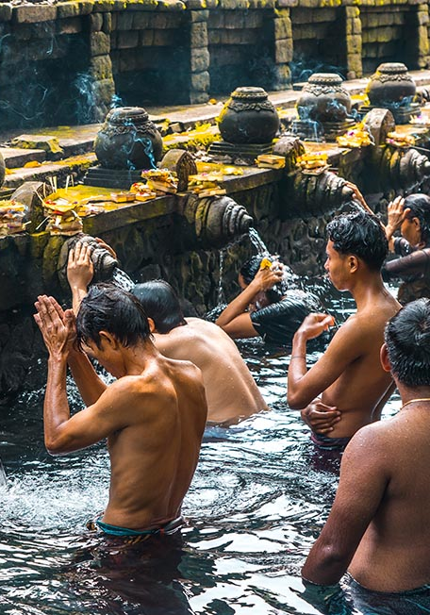
From 19th Century Canvases to 21st Century Instagram Feeds
In the 19th century, European artists painted lavish interiors, bustling bazaars, and imagined harems – images that were less reality and more fantasies of otherness. These works idealized distant cultures and turned them into spectacles for Western consumption. They presented the East as timeless, sensual, and exotic, reinforcing stereotypes while ignoring everyday life. Fast forward to the 21st century, and the medium has changed, but the impulse remains strikingly similar. Today’s Instagram travel aesthetic often performs the same work: curating idealized snapshots of faraway places, stripped of complexity and framed as paradises for consumption. Both practices transform real cultures into visual commodities, inviting viewers not to understand, but to admire and desire. In this way, the romanticized Orient of oil paintings finds its echo in the filtered landscapes of social media.

Slide 15
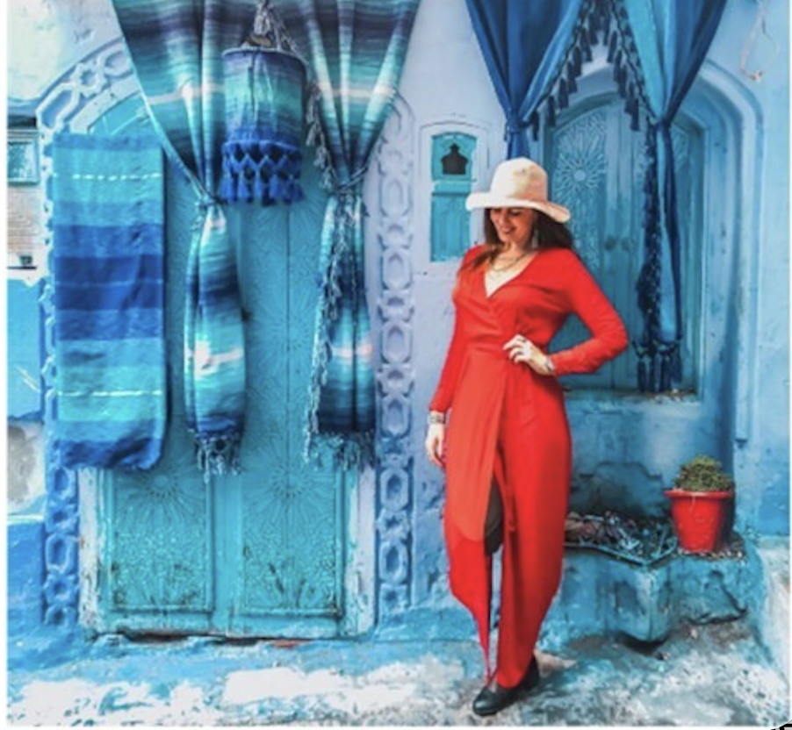
Follow-up Activity
Now that you’ve explored Orientalist art, examine how similar ideas appear in today’s digital culture. Curate a gallery of travel photographs that you believe exoticize faraway places, using Instagram posts or images from popular travel blogs. To guide your choices, consider these parallels between Orientalist exoticism and modern Instagram aesthetics:
  Ideation and Fantasy – romanticized settings presenting an imagined paradise rather than reality
  Selective Representation – highlighting photogenic scenes while ignoring inconvenient life
  Otherness – marketing cultural difference as fascinating, alluring, exotic
  Commodification – turning places into products

