Slide 1

Propaganda: the tricks of the trade

Slide 2
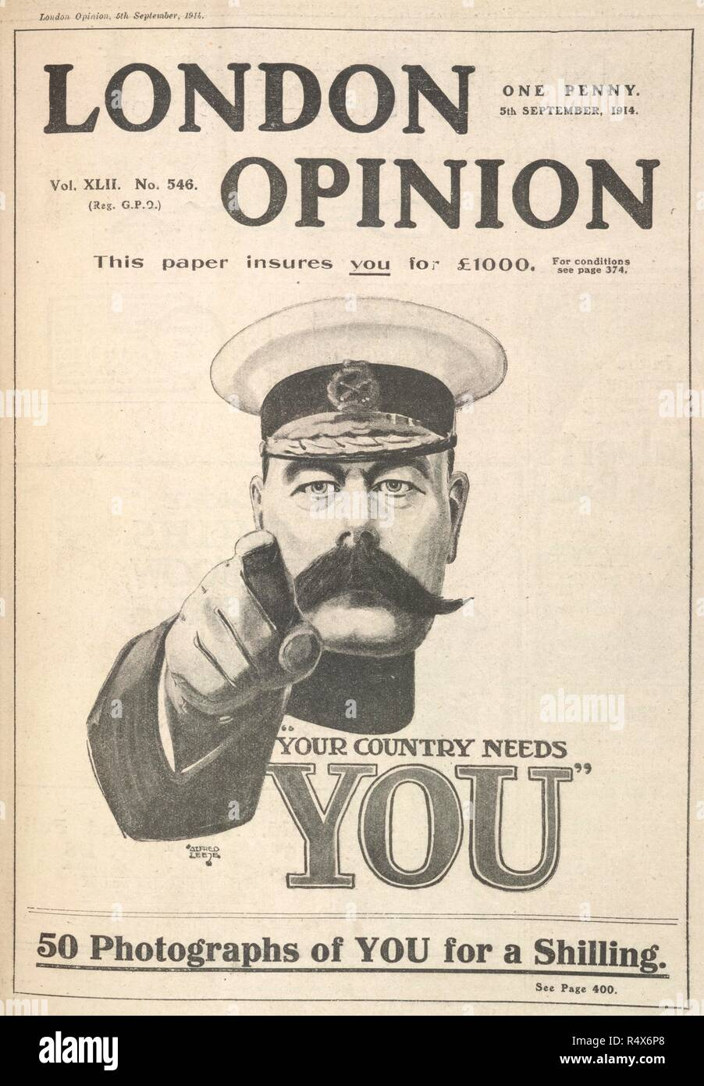
Historical Context
In 1937, the Institute for Propaganda Analysis (IPA) was founded to educate Americans about the prevalence of political propaganda. It is best known for identifying seven key propaganda techniques: Name-Calling, Glittering Generalities, Fear, Testimonial, Plain Folks, Card Stacking, and Bandwagon. In The Fine Art of Propaganda, the IPA emphasized: “In a democracy, people must learn to think critically and independently, while respecting others’ right to reach different conclusions. The art of democracy is the art of thinking and discussing freely, both alone and together.”

Slide 3
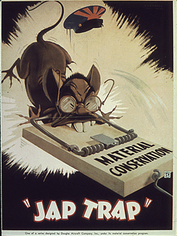
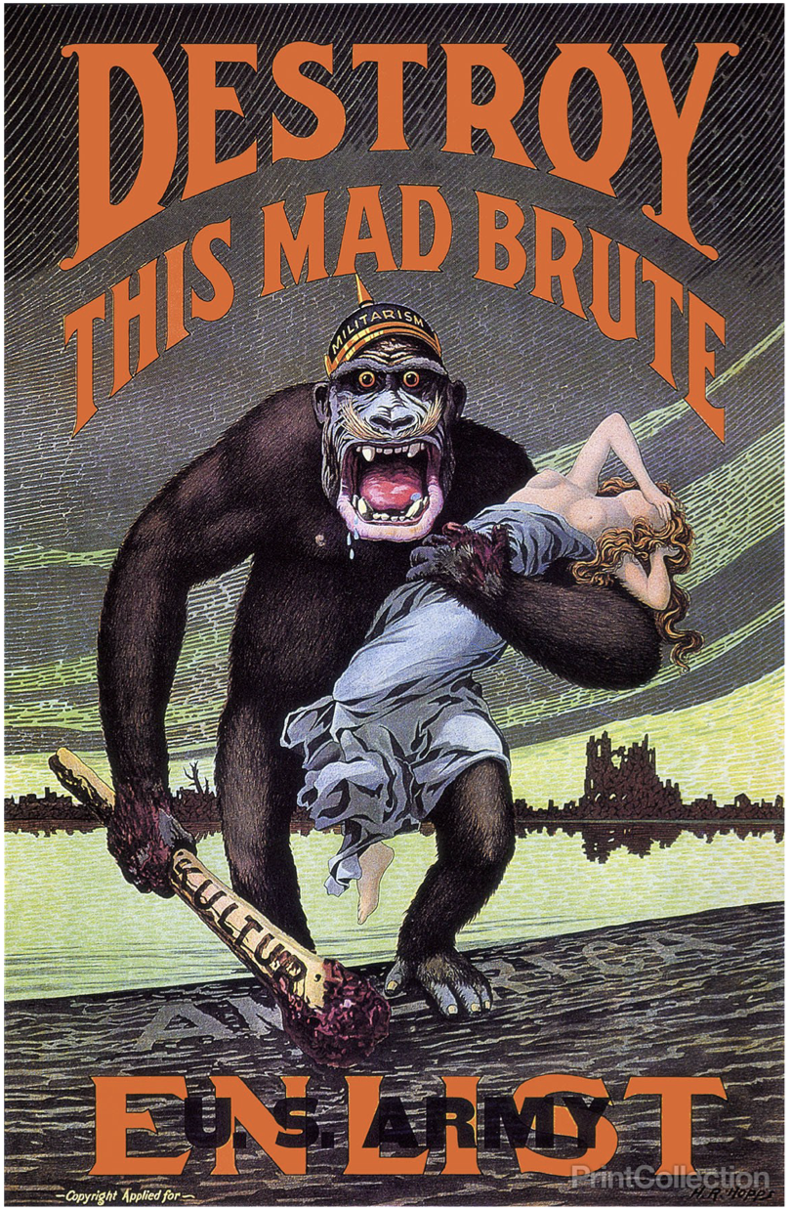
Name-calling: using a derogatory term with the aims of insulting and creating a negative image of the person, idea, or object.
In a notorious WWII poster, created in the months following the bombing of Pearl Harbor by the Japanese, the Japanese are derogatorily depicted as rats while the words “Jap Trap” are prominently displayed below.
In the second poster, the word brute combines with the depiction of an ape dehumanizes German soldiers using a slur and animal imagery.

Slide 4
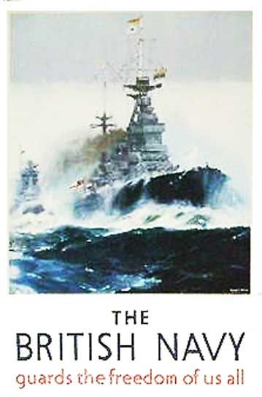
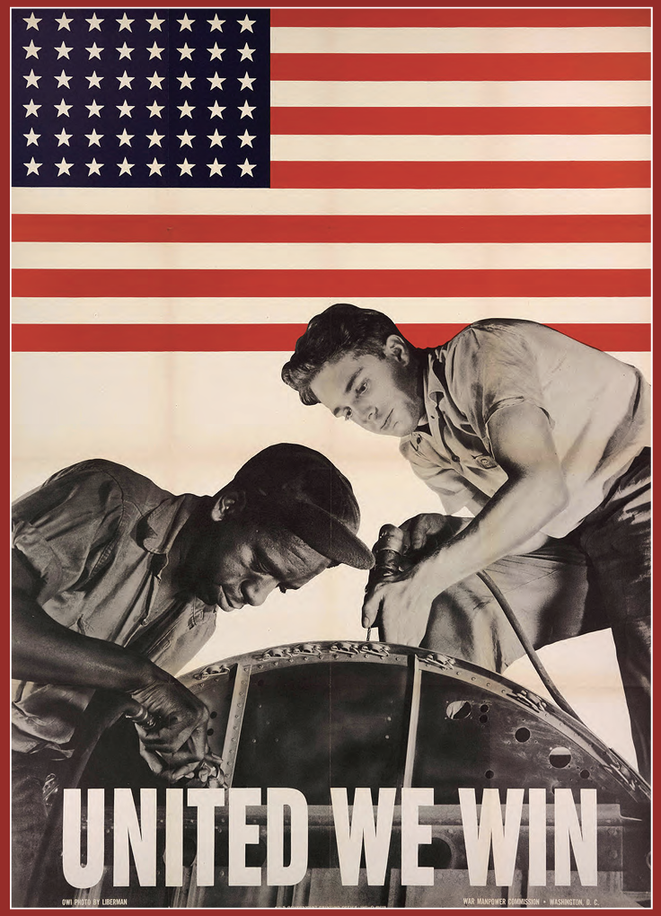
Glittering Generalities: vague and empty words are used to evoke positive emotions but don’t provide specific details
A British WWII poster gives a sense of security, promising to guard your freedom without going into detail about when, where, or how.
Similarly, an American WWII poster exhorts people to work together to ensure victory, in a vague way that appeals to emotions and patriotism but doesn’t give any more information.

Slide 5
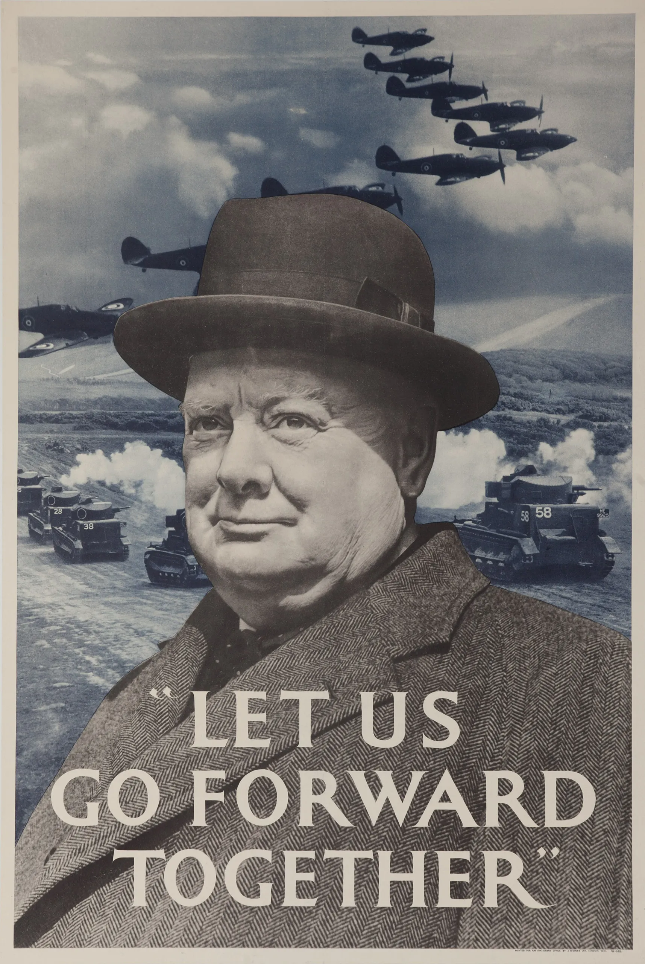
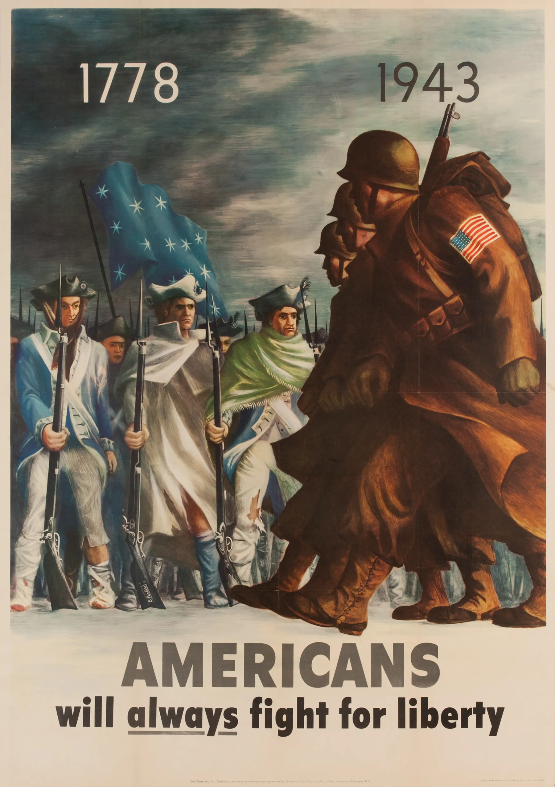
Testimonial: an authoritative or famous figure ‘transfers’ their quality to the current situation, evoking reassurance and trust
In the lefthand WWII poster, the trust, confidence, and authority of Winston Churchill is transferred into a message of hope and reassurance.
In the WWII poster on the righthand side, the virtue of the historical soldier is transferred to the present-day through juxtaposition and use of the word ‘always’.

Slide 6
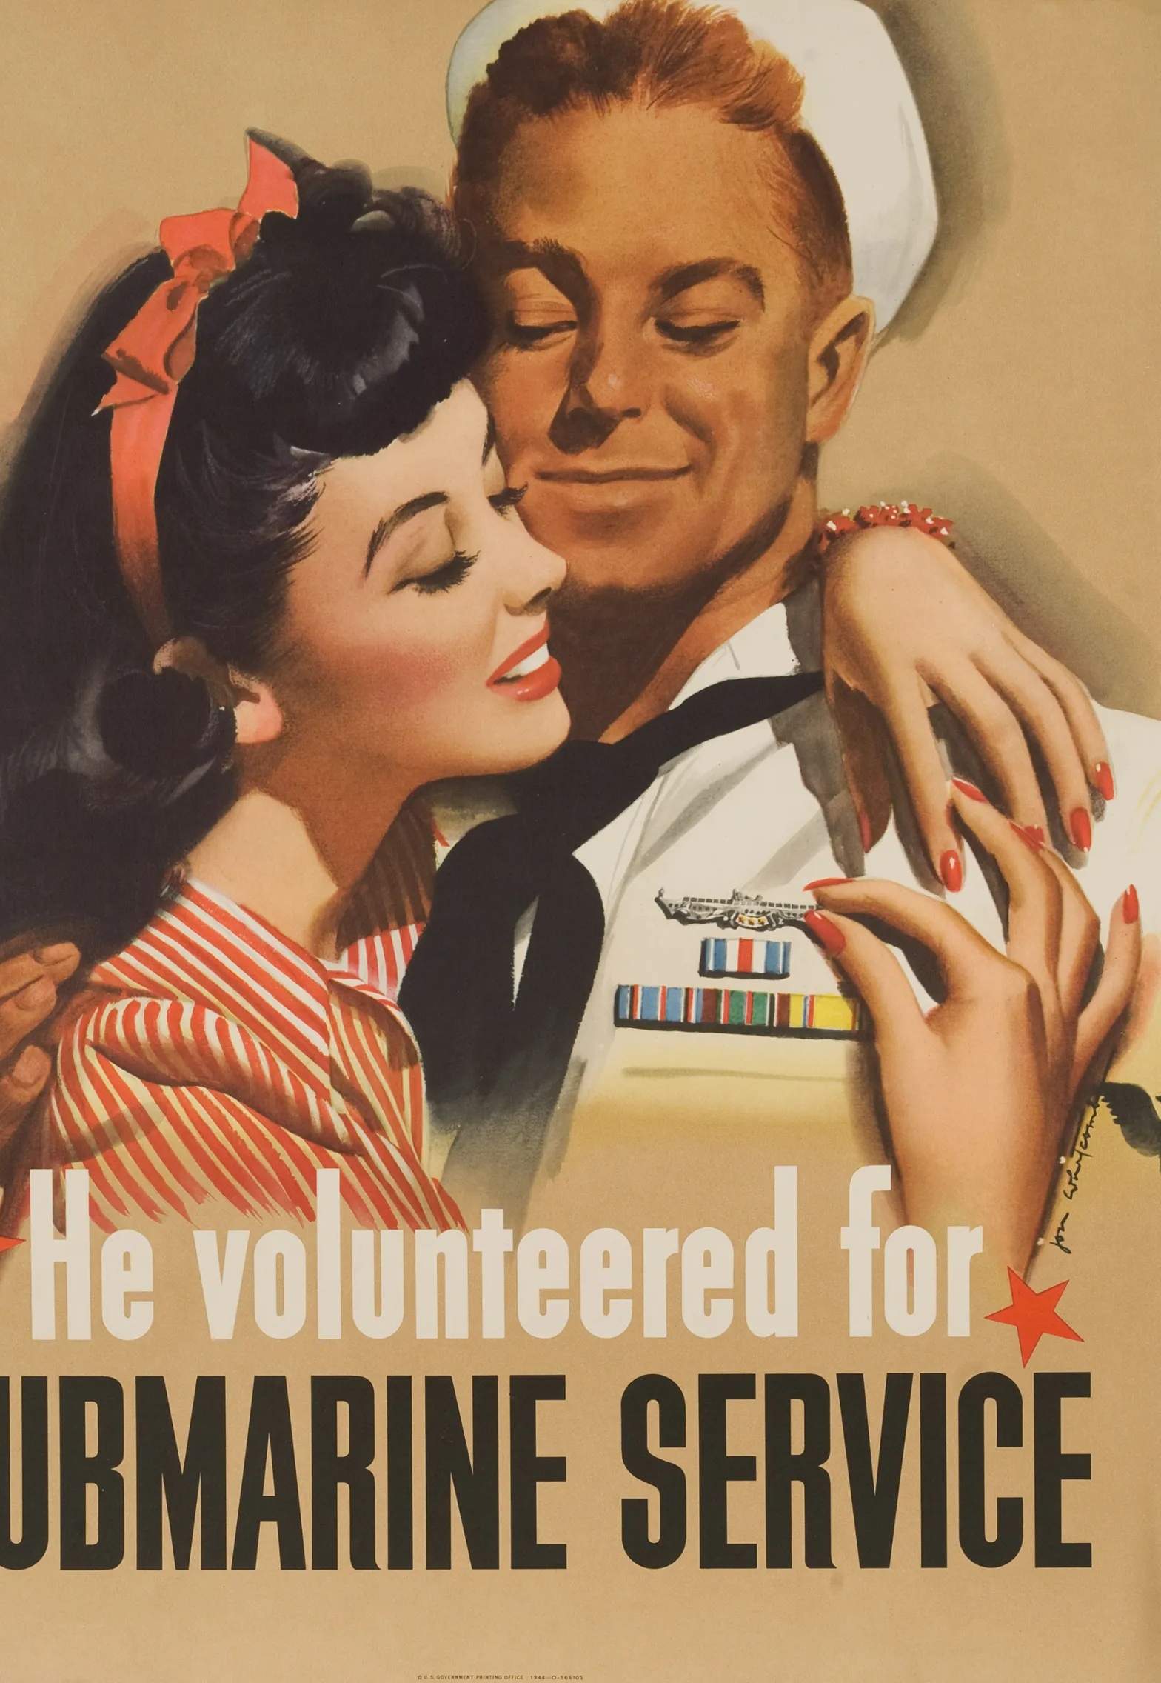
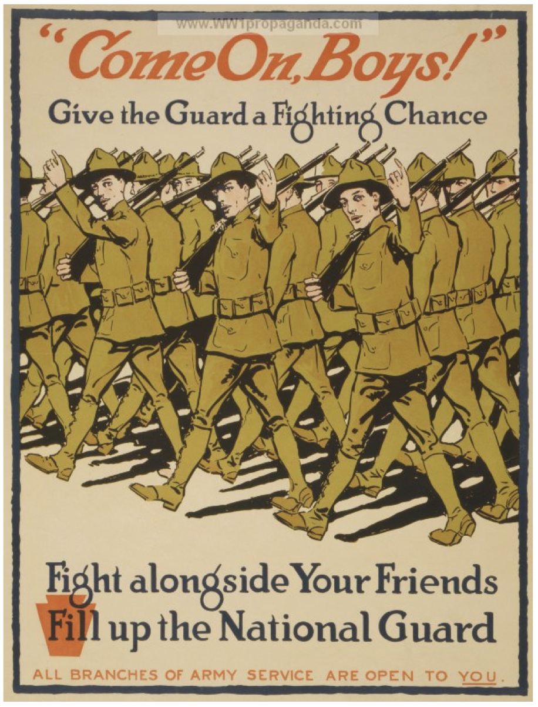
Bandwagon: attempts to persuade people by implying that others have already joined a cause and are happier for doing so.
He volunteered for service… ‘so you can too’ is the unspoken message of the leftside poster. The sailor is depicted as an ‘everyman’ who can achieve respect and adoration by joining up.
The bandwagon appeal is strong in this British WWI poster (right) pointing out that all ‘your friends’ have already signed up, so don’t let them down. Their smiles and jaunty waves strengthens the emotional appeal.

Slide 7
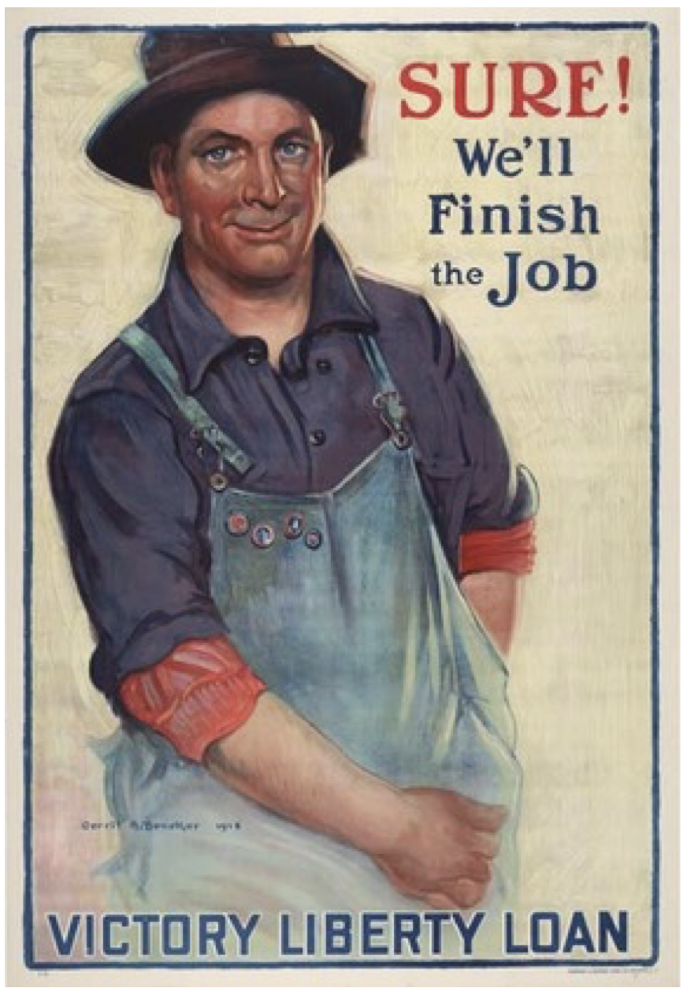
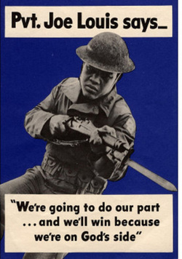
Plain Folks: an important person is brought down to the level of the general public as an ‘average joe’ type, creating the feeling of ‘we’re all in it together’
The word ‘we’ is key to the plain folks appeal in the WWI poster on the lefthand side, forging a connection between subject and viewer.
On the right, this poster depicts world heavyweight boxing champion Joe Louis after he signed up to fight in WWII. Famous as he was, he’s depicted wearing the clothes and equipment of an ordinary soldier… and he’s the lowest rank (private) like them too.

Slide 8
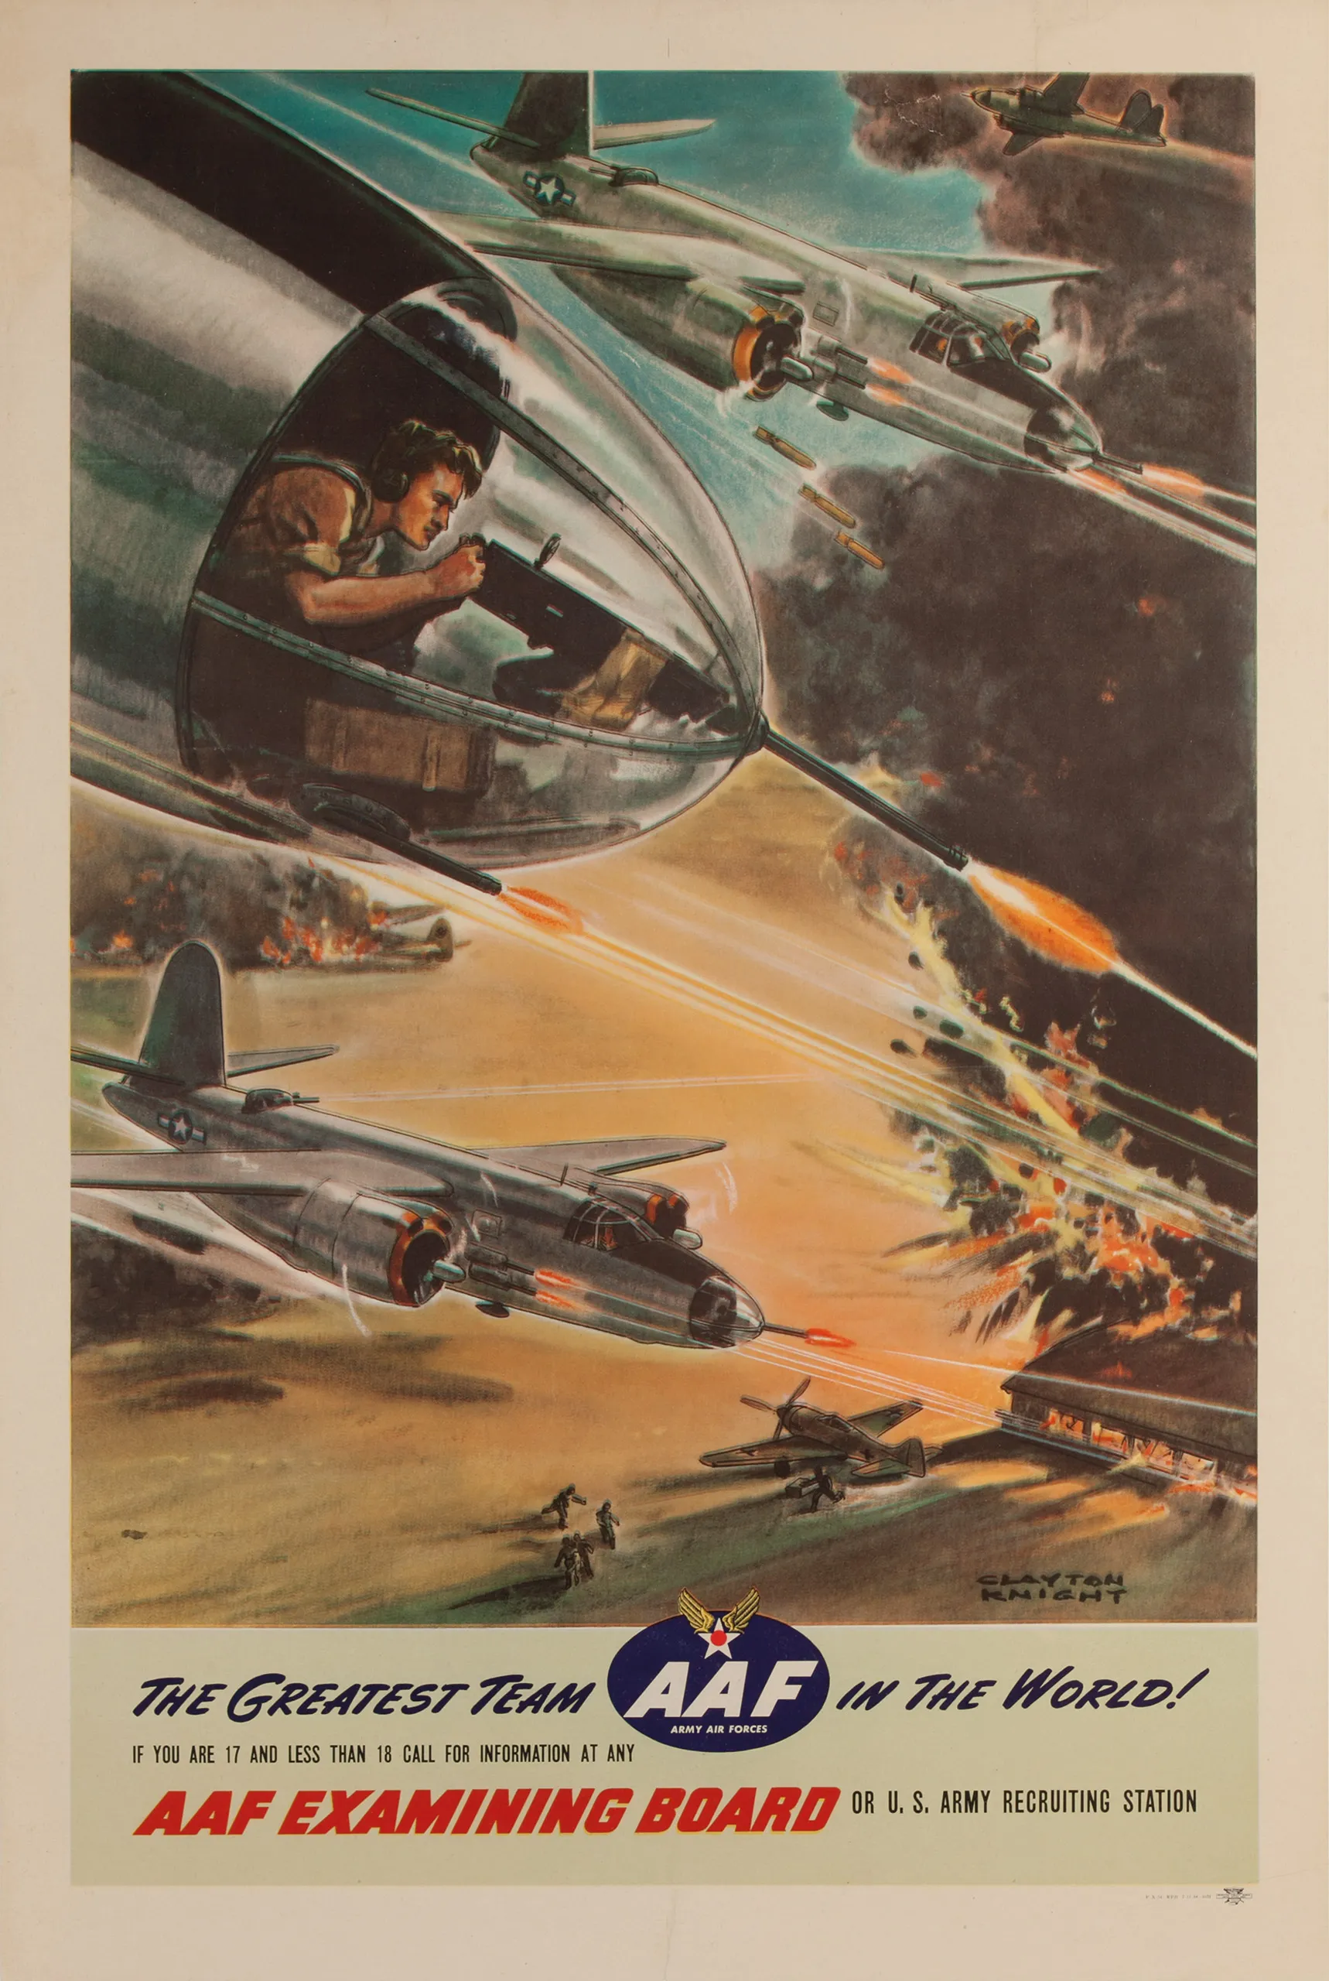
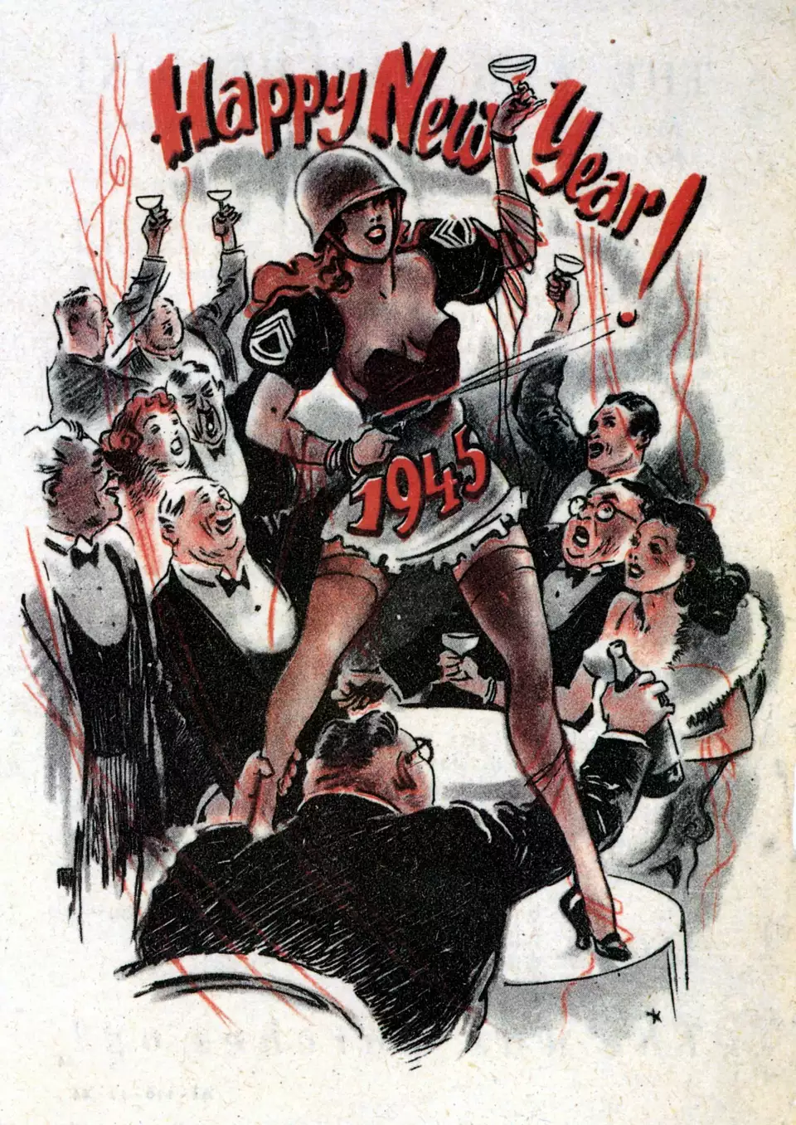
Card Stacking: selecting only the (usually positive) information that fits a certain narrative while omitting all contrary facts
In the US WWII poster on the left, all the glory and excitement of being a fighter pilot is depicted – but not the drawbacks (such as drastically short life expectancy).
Believe it or not, the poster on the right is from Germany and was created for New Year 1945 to imply the war was going much better than it actually was, attempting to raise the morale of people at home while demoralizing enemy forces.

Slide 9
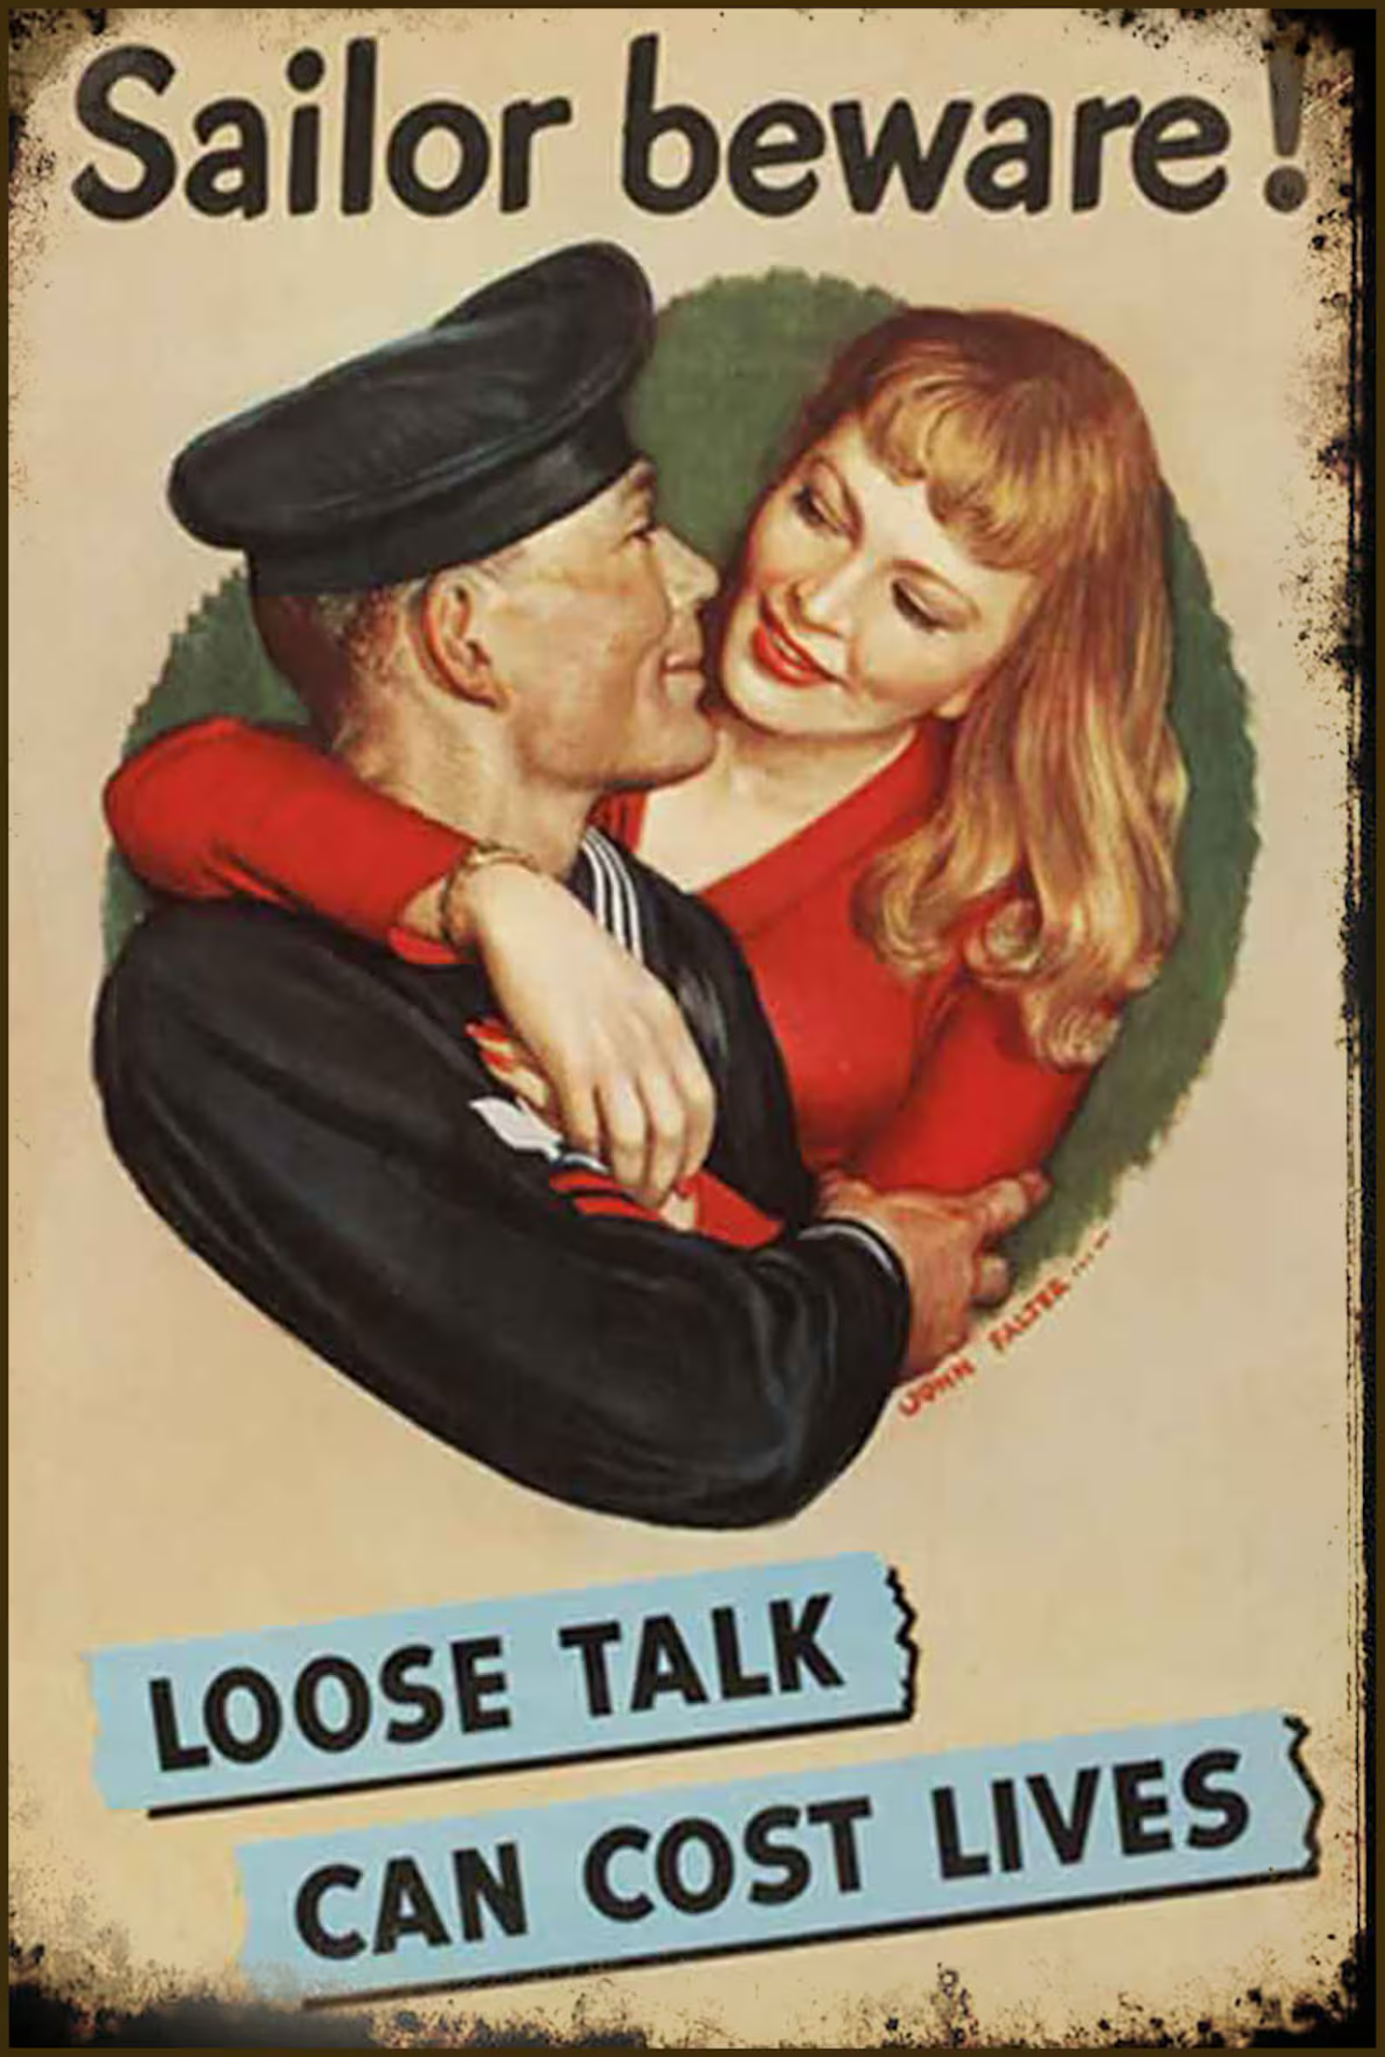
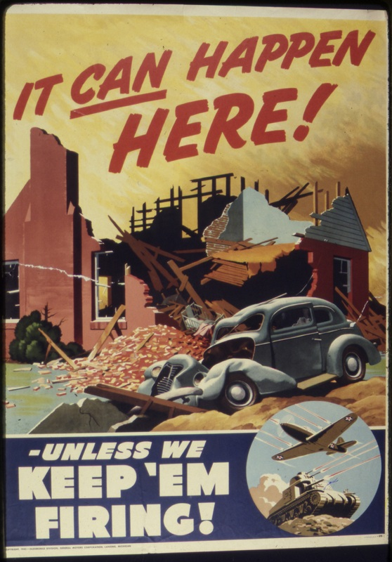
Fear: the presentation of a disastrous outcome that can only be prevented through a certain course of action
The left side poster is an iconic example of effective WWII propaganda, warning servicemen not to divulge details of their assignments to family and friends.
The apocalyptic imagery of the poster on the right served to keep the American public in favour of the war through 1944, after public support wavered because the war showed no signs of ending any time soon.

Slide 10

Over to You: choose a follow up activity
Design a propaganda poster for your school, aimed at recruiting new students, or promoting a school value. Which technique will you use? (For fun, randomly assign the different methods.)
Research the crossover between propaganda and advertising. Are there any brands or products that use these techniques in their campaigns?
Collate your own collection. Almost all the examples here were from Britain or America. Does your country have a history of propaganda? Compile a small gallery, labelling the methods you see being used from a fresh context.

