Slide 1

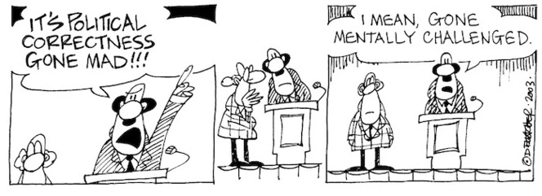
Politically Correct Language
OK or No Way?

Slide 2
Introduction
Language is always evolving, and there’s always going to be more than one way to say something. Sometimes politically correct changes feel smooth and natural, like saying ‘firefighter’ instead of ‘fireman.’ Other times, new terms sound awkward or over-engineered, sparking debate about whether political correctness has gone too far. The goal of inclusive language is to promote respect and equality, but not every term succeeds in sounding authentic.
In this activity, you’ll see pairs of words: the original term and its politically correct alternative. Your job is to decide whether the new term feels empowering and natural (‘OK’) or awkward and cringey (‘No Way’). There are no wrong answers, just your honest opinions!

Slide 3
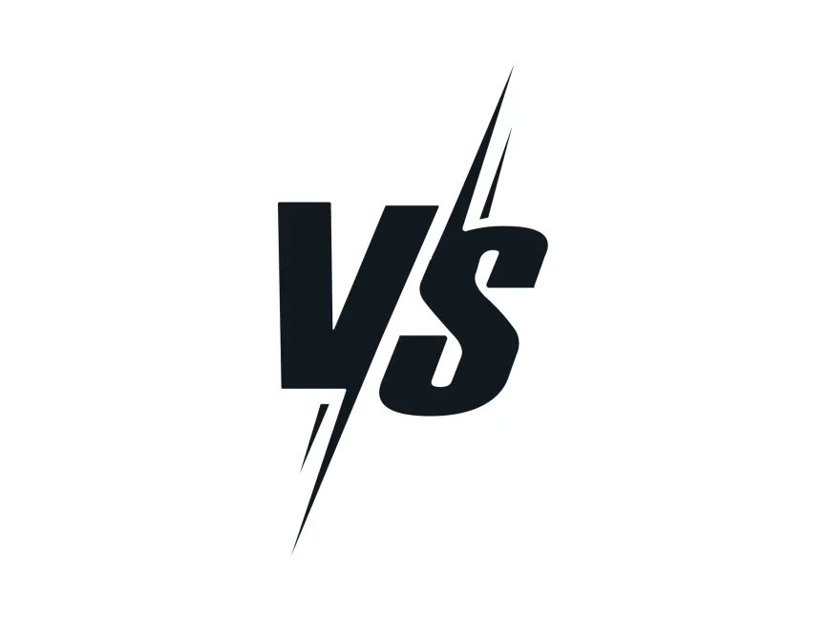
OK or No Way?
Differently-abled
Disabled

Slide 4
OK or No Way?
Vertically- challenged
Short

Slide 5
OK or No Way?
Plus-sized
Fat

Slide 6
OK or No Way?
LGBTQ people
Folkx

Slide 7
OK or No Way?
Sanitation Engineer
Cleaner

Slide 8
OK or No Way?
Personkind
Mankind

Slide 9
OK or No Way?
Economically marginalized individual
Poor person

Slide 10
OK or No Way?
Parenting partners
Mum and Dad

Slide 11
OK or No Way?
Senior Citizen
Old person

Slide 12
OK or No Way?
Asian
Oriental

Slide 13
OK or No Way?
Low- income household
Poor family

Slide 14
OK or No Way?
Illegal immigrant
Undocumented

Slide 15
OK or No Way?
Indigenous
Native

Slide 16
OK or No Way?
Person of colour
Coloured

Slide 17
OK or No Way?
Flight attendant
Air hostess

Slide 18
OK or No Way?
Person with alternative mobility needs
Wheelchair user

Slide 19
Why Do Some Changes Stick While Others Make Us Squirm?
After voting on which terms feel natural and which feel awkward, take a few minutes to think about any of these reflection questions. Share your ideas:
What makes a term feel natural and empowering?
Why do some politically correct terms sound forced or “cringe”?
Where’s the line between inclusion and over-engineering; when does language stop helping and start confusing?
Can the ‘feel’ of a word change over time; can something that used to be cringe become cool, or vice versa?
Is there a risk that focusing on words distracts from real issues?

