Slide 1
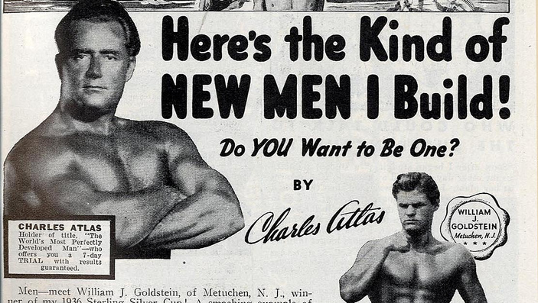
Money and Muscles
What Makes a Man (according to Advertising)?

Slide 2
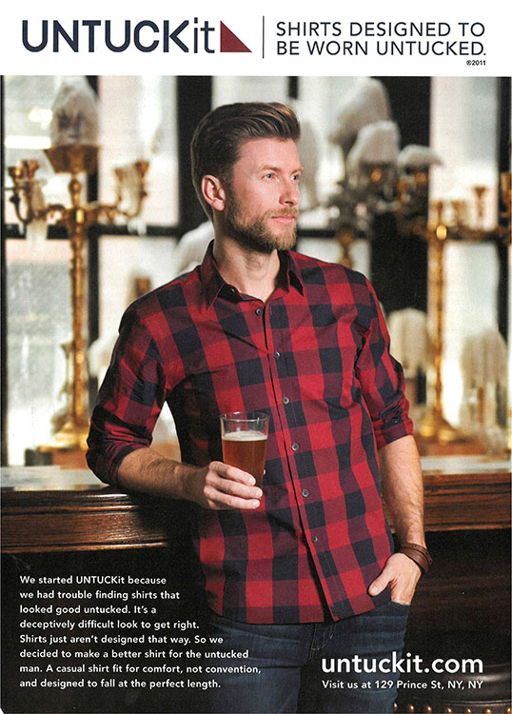
Men in
Advertising
You’ll see a selection of advertising images. Simply note down what the images tell you about being a man.

Slide 3
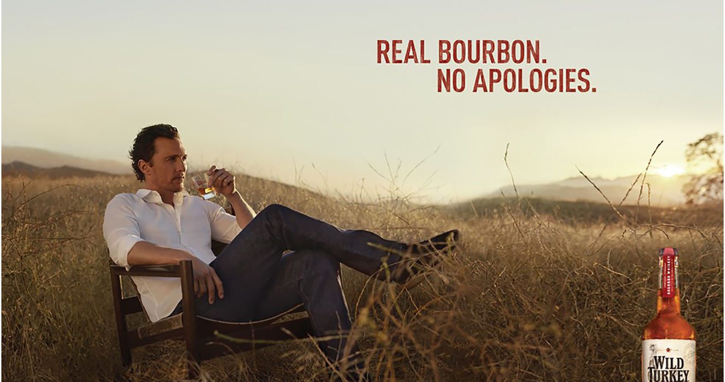
Notes:
Possible ideas: Unapologetic, loner, stylish, rugged, at home in the outdoors, confident/arrogant

Slide 4
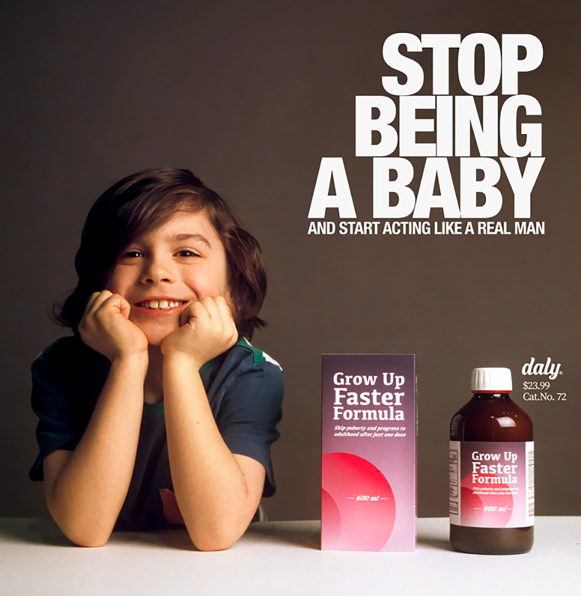
Notes:
Suggestions: stoic, don’t cry, tough, hide your true feelings

Slide 5
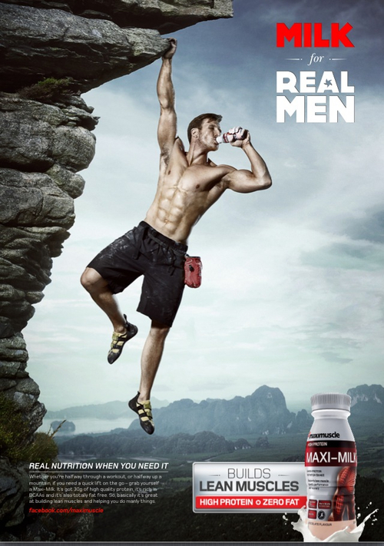
Notes:
Suggestions: strong, muscular, confident, brave, adventurous, comfortable with risk, at home in the outdoors

Slide 6
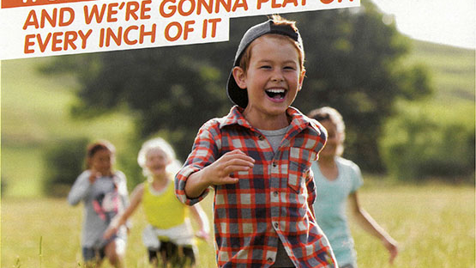
Notes:
Suggestions: boys as leaders, confident, outgoing, outdoorsy,

Slide 7
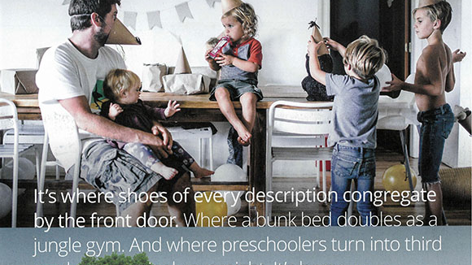
Notes:
Suggestions: leader of the family, driver of fun and activity, role model, capable, relaxed

Slide 8
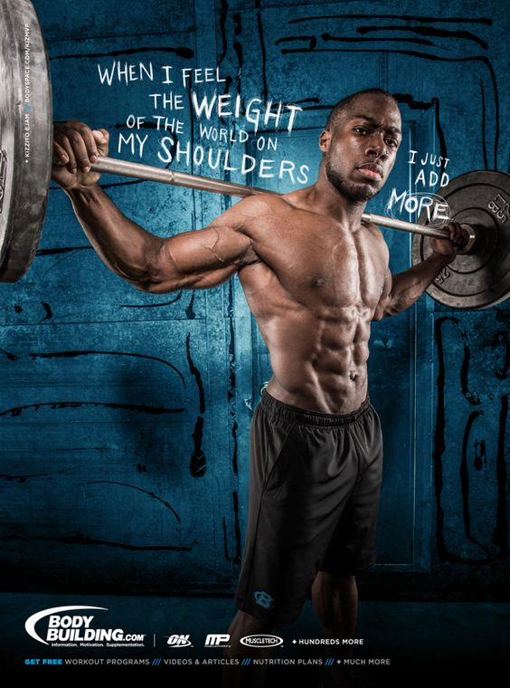

Slide 9
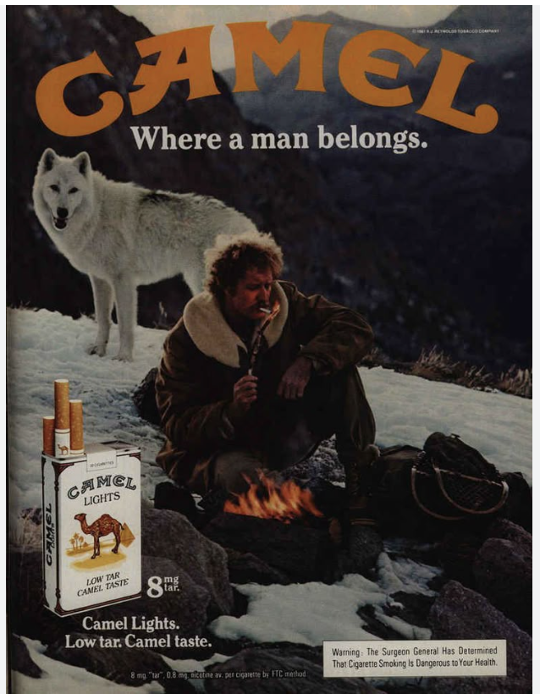
Notes:
Suggestions: rugged, individual, strong, adventurous, unafraid

Slide 10
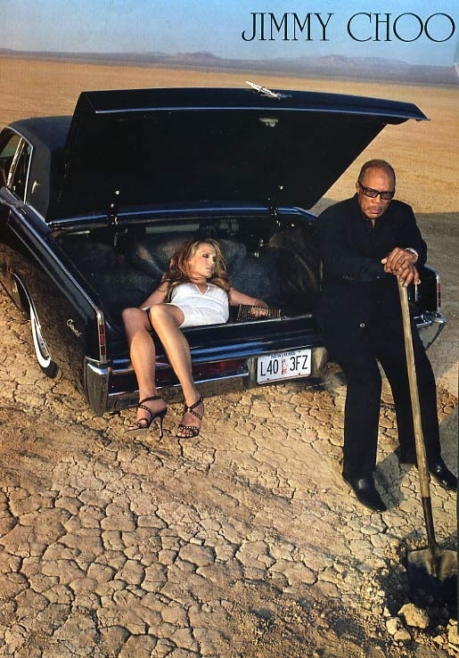
Notes:
Suggestions: comfortable with violence, relaxed, in control

Slide 11
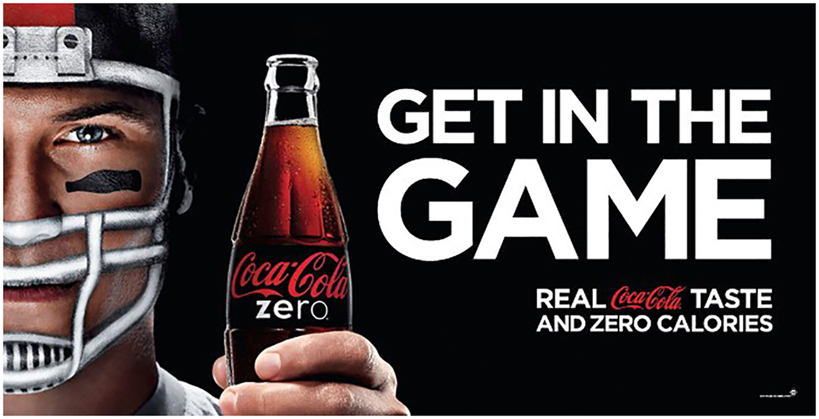
Notes:
Suggestions: sporty, tough, confident, ready for action

Slide 12
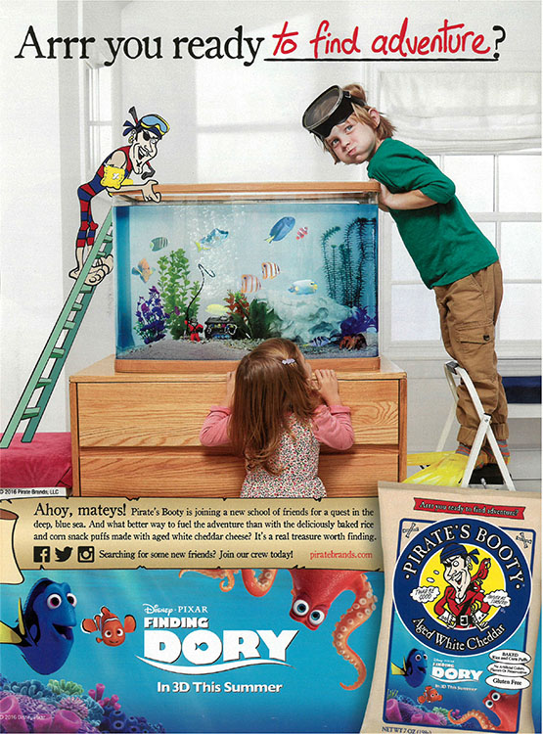
Notes:
Suggestions: active, adventurous, role model, leader, fun loving,

Slide 13
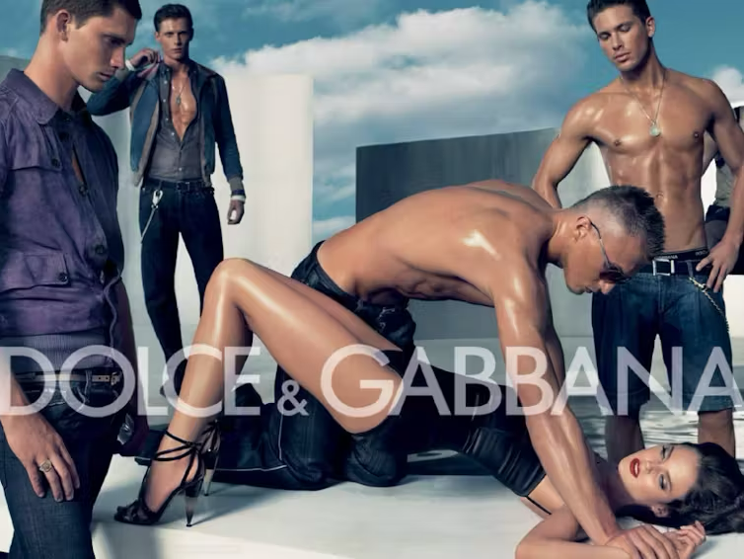
Notes:
Suggestions: in control, dominant, handsome, muscular, comfortable with violence

Slide 14
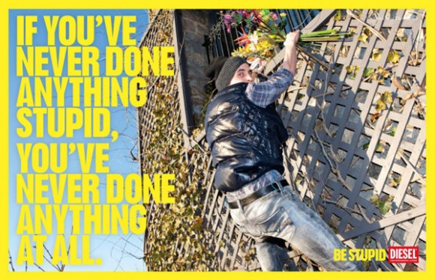
Notes:
Suggestions: risk taker, fun loving, adventurous, doesn’t follow rules

Slide 15

Notes:
Suggestions: professional, stoic, determined, responsible, financially successful, hard

Slide 16
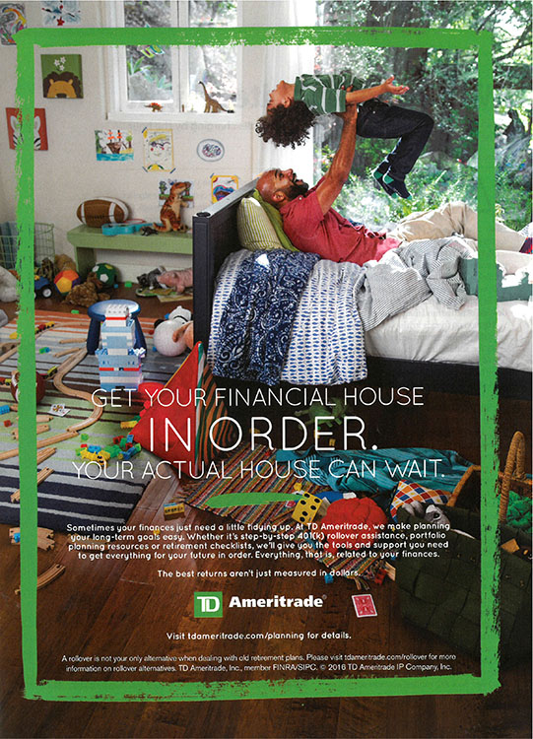
Notes:
Suggestions: driver of fun, financially responsible, leader of the family

Slide 17
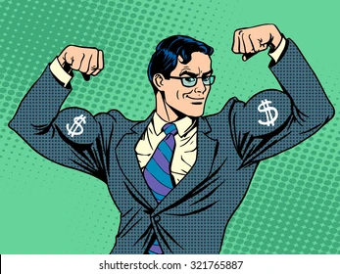
Reflection
What messages come through most strongly from these advertising images?
What images of men are likely to stay in your mind? Are there any recurring visuals?
Write a single paragraph in your notebook using the following prompt:
According to messages from the media and advertising, what does it mean to be a ‘man’?

