Slide 1
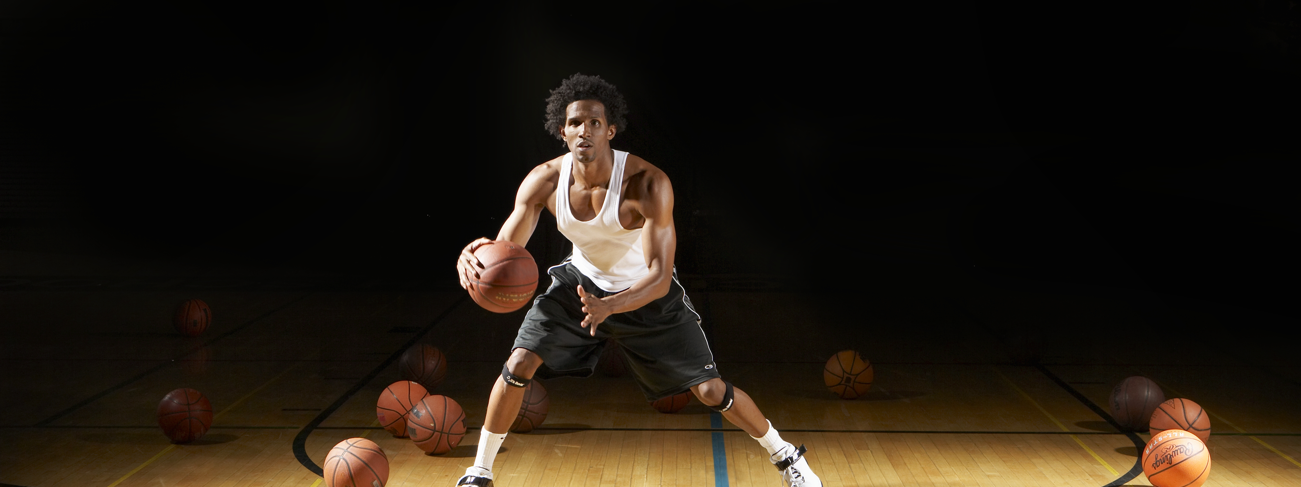
Historical and Modern Black Representation
Discover the roots of racial stereotyping in the media today:
Slavery Era
19th Century Minstrelsy
The Birth of Cinema
Hollywood’s Golden Age
Civil Rights Era
Hip Hop and Rap
Modern Advertising

Slide 2
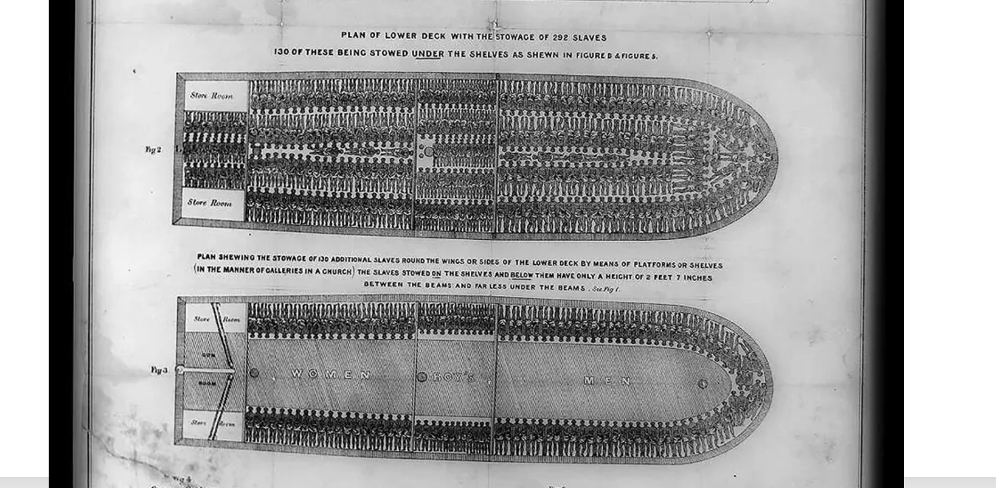
The 1700s – 1800s (slavery era) is where many stereotypes of black people originated. The purpose was to justify racial oppression and colonial exploitation of African people.
The slave trade inflicted unimaginable suffering on millions of people. Indigenous and African people were seen as less than human. Many Europeans saw enslaved people merely as ‘chattel’ (property to be bought and sold). They created a violent system of abuse, as evidenced by these plans for transportation (pictured). Without dehumanization, it would have been harder to inflict such conditions on any people. Racism and white supremacy justified the violence and abuse of slavery for hundreds of years.
This image and information is from ‘The Story of Black Slavery in Canadian History by Steve McCullogh and Matthew McRae (2018)
Media portrayals of Black people have never existed in a vacuum; they are deeply rooted in historical narratives that shaped racial attitudes for centuries. From the era of slavery and colonialism, stereotypes were constructed to justify oppression and maintain social hierarchies. These early depictions painted Black individuals as ‘primitive,’ ‘childlike,’ or ‘savage,' laying the foundation for caricatures that later entered popular culture.

Slide 3
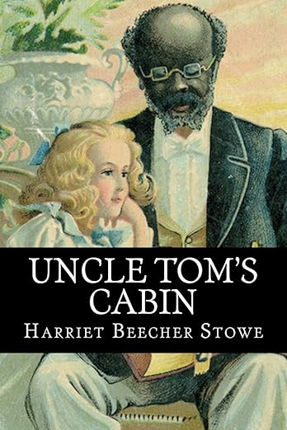
Racial discrimination was so pervasive during the slavery era that even counter-narratives featured stereotypes and caricatures, cementing the inferiority of African and Indigenous peoples in the minds of readers and viewers.
In 1852, Harriet Beecher Stowe, an abolitionist and opponent of slavery, wrote Uncle Tom’s Cabin. While intended as an anti-slavery novel, it nevertheless introduced stereotypes like the submissive black man and the ‘Mammy’ figure, a matronly, loyal black female servant. These characters reinforced the notion that, enslaved or free, black people are submissive and suitable only for servitude.
The cover of this edition of Uncle Tom’s Cabin features an early stereotype of the elderly wise black man.

Slide 4
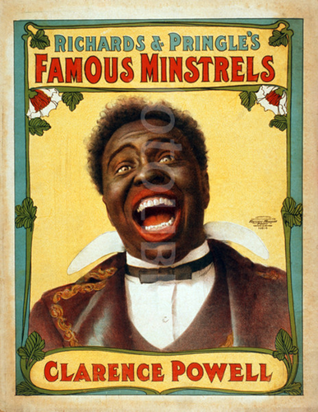
Blackface Minstrelsy
During the 19th century, minstrel shows became one of America’s most popular forms of entertainment, cementing harmful racial caricatures in mainstream culture. White performers in blackface exaggerated features and behaviours to portray Black people as lazy, ignorant, and comical.
Characters like Jim Crow and Sambo reinforced ideas of inferiority, while the Mammy figure depicted Black women as loyal, asexual caretakers. These stereotypes shaped public attitudes and justified segregation. Minstrelsy’s influence extended into early cinema and advertising, creating a foundation for racial tropes that persist in media today.

Slide 5
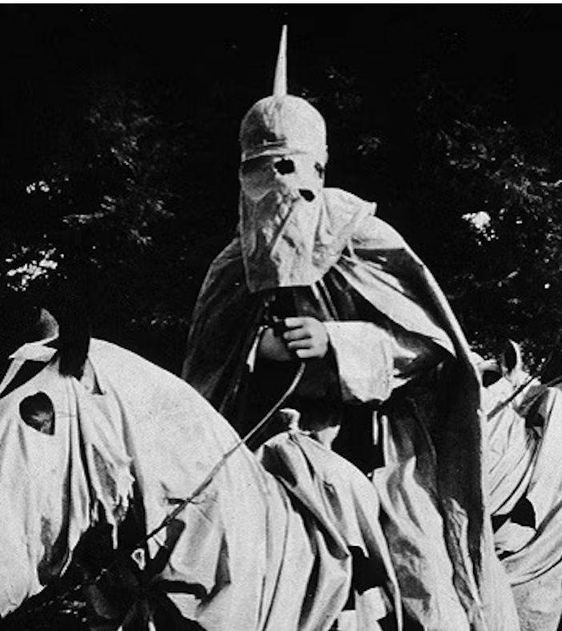
1915 The Birth of a Nation
Described recently by the Washington Post as ‘the racist movie everybody should watch’, D.W. Griffith’s The Birth of a Nation revolutionized filmmaking but cemented some of the most damaging racial stereotypes in American media. The film portrayed Black men as violent, hypersexual predators and glorified the Ku Klux Klan as heroic defenders of white society. Its popularity fueled racial terror and legitimized segregationist ideology, demonstrating how media can shape public opinion and reinforce systemic racism.

Slide 6

Hollywood’s Golden Age (1930s – 1950s)
During Hollywood’s Golden Age, film was America’s most powerful cultural medium. Yet Black actors were largely confined to subservient or comic roles, reinforcing stereotypes rooted in slavery and minstrelsy. Films like Gone With the Wind (1939) romanticized plantation life and popularized the ‘Mammy figure’ as loyal, nurturing, and asexual. Other roles depicted Black men as buffoons or entertainers, rarely as complex characters. These portrayals normalized racial hierarchies and shaped public perceptions for decades.
Watch the embedded video on the left for a short discussion over Hattie McDaniel, the first Black woman Oscar winner – but who’s famous portrayal of Mammy in Gone With the Wind cemented this stereotype in cinema and society.

Slide 7
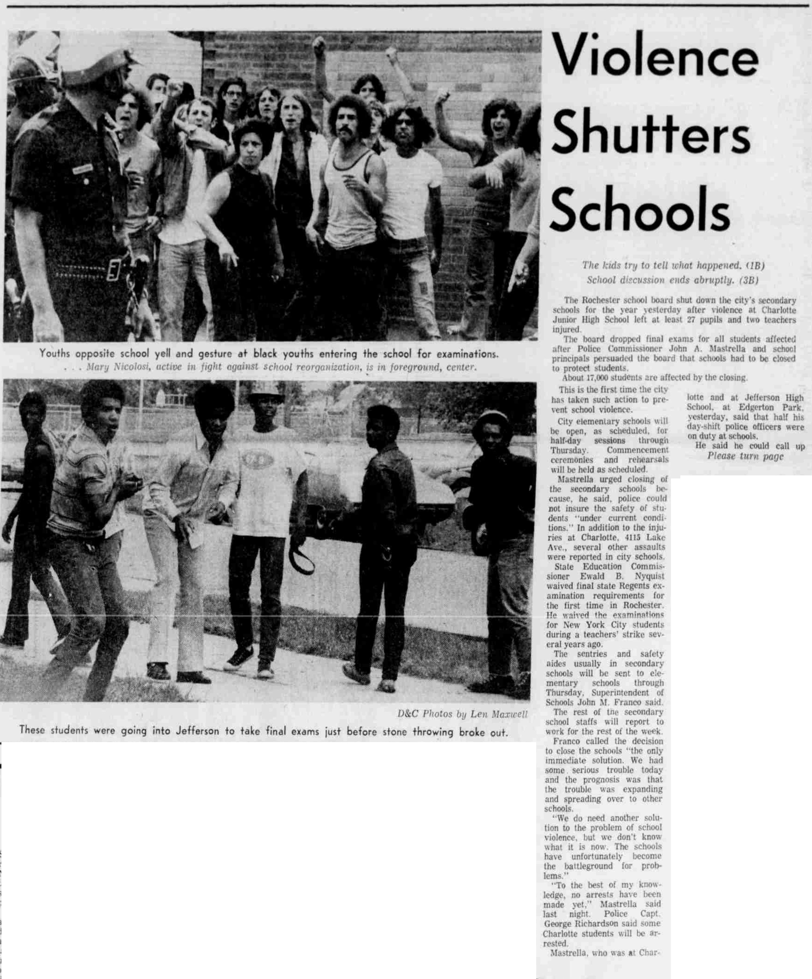
Civil Rights Era (1950s – 1960s)
During the Civil Rights Movement, media coverage played a pivotal role in shaping biased public opinion. While peaceful protests were common, headlines frequently emphasized ‘riots’ and unrest, portraying Black activists as dangerous or disruptive. Television sometimes showed images of violence without context, reinforcing stereotypes of aggression. These portrayals perpetuated racial hierarchies and made change difficult during a transformative time.
This historical newspaper clipping was sourced from Rochester Public Library (1972)

Slide 8
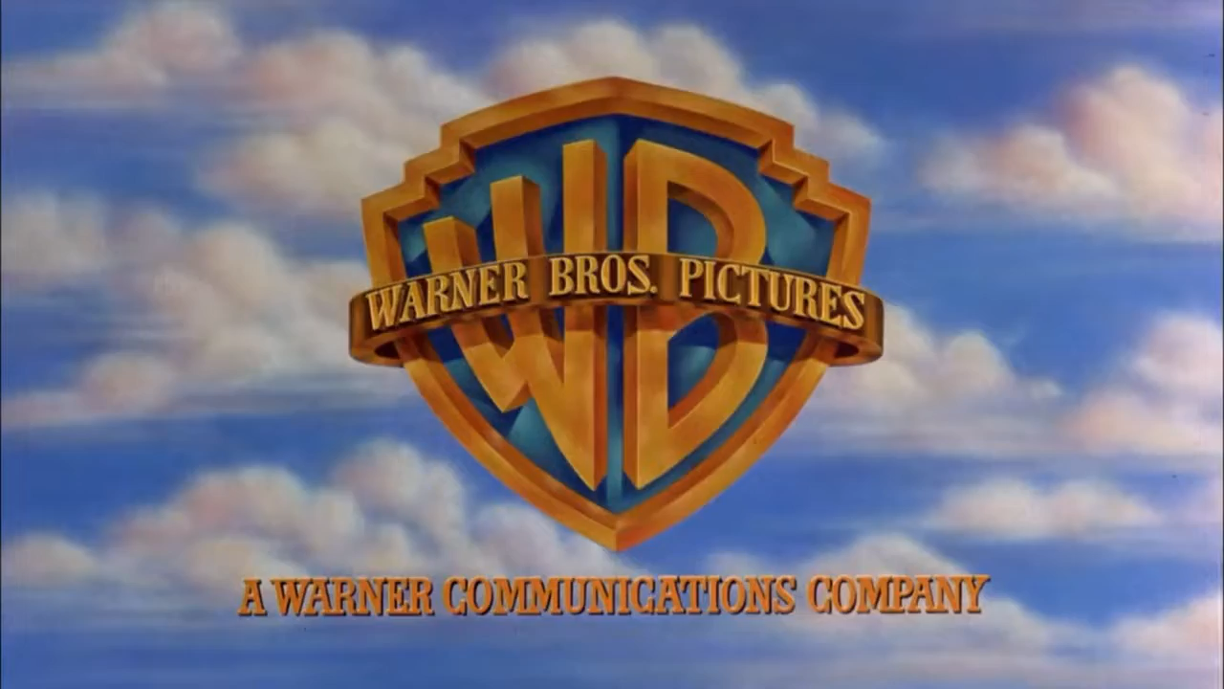
1980s – 1990s Hip Hop and Hollywood
As we get closer to the present day, media stereotypes evolved. Hip-hop culture gained global influence, yet music videos often reinforced images of hypermasculinity, aggression, and material excess, echoing historical stereotypes of black men as ‘brutes’.
Meanwhile, Hollywood introduced the ‘Magical Negro’ trope, where Black characters exist primarily to guide or redeem white protagonists, as seen in Driving Miss Daisy (1989) and later The Green Mile (1999). While these films were Oscar-winners, these portrayals limited Black identity to narrow roles even as exposure increased.
Watch the trailer for Driving Miss Daisy and see if you can sense the ‘magical negro’ trope hidden behind the undeniable sweetness of this film.

Slide 9
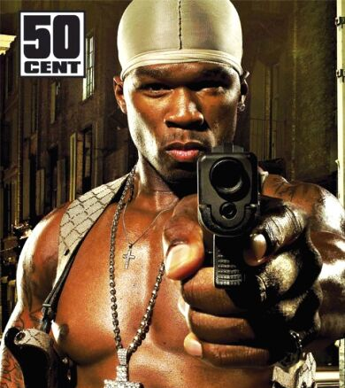
21st Century
Contemporary media still reflects racial bias. News coverage disproportionately associates Black individuals with crime, while advertising and pop culture sometimes perpetuate hypersexualized, violent, or exoticized imagery. Films like The Help (2011) and Green Book (2018) recycle tropes like the servant stereotype and the ‘magical negro’, showing how historical stereotypes linger.

Slide 10
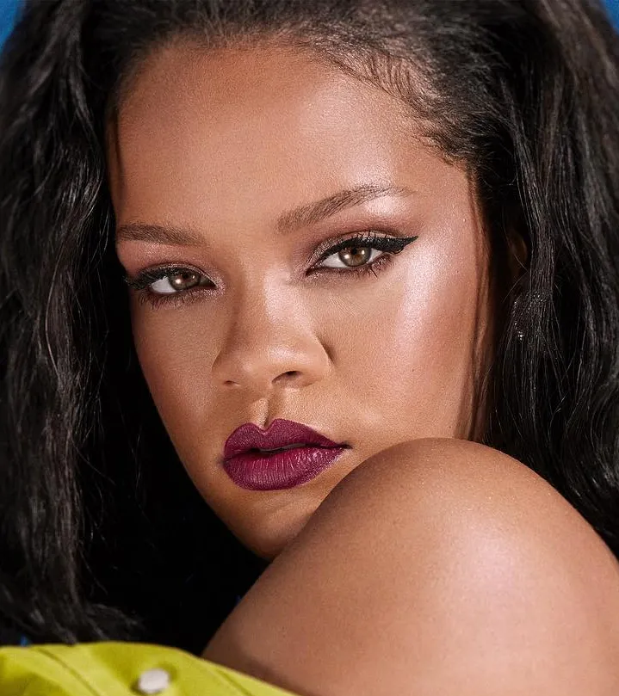
Modern Counter-Narratives
However, the 21st century also marks a rise in counter-narratives. Black creators use streaming services and social media to challenge stereotypes and tell authentic stories, reshaping representation. Creators are moving beyond one-dimensional stock characters to portray black individuals with depth and complexity. Authentic stories highlight everyday life, steering away from settings of poverty or trauma. Importantly, black voices are steering the production of these stories, ensuring representation is becoming less imposed and more self-defined.
Rihanna’s Fenty Beauty brand revolutionized beauty by offering inclusive marketing imagery. It challenged industry norms and celebrated diversity authentically, not as a trend.

