Slide 1

Advertising: The 15 Basic Appeals
For Use after reading Jib Fowles’ essay

Slide 2
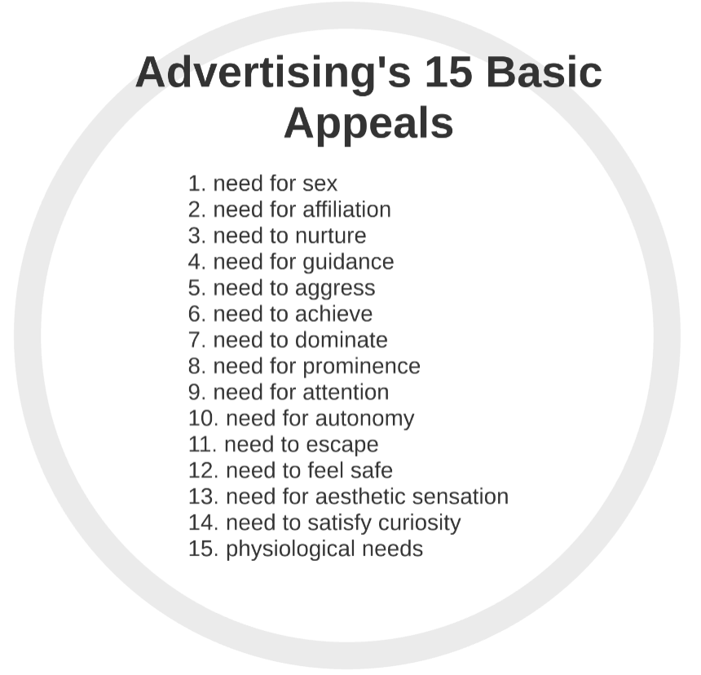
On the next slides, you’ll see a series of adverts which use one (or more) of the 15 basic appeals as outlined by Jib Fowles in his seminal 1982 essay.
Discuss the appeals you think are most prominent and how they are communicated effectively.

Slide 3
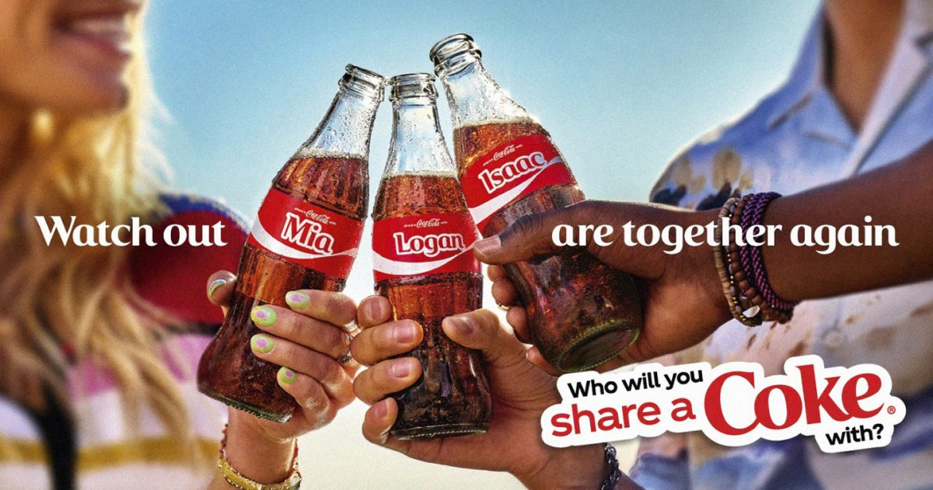
Notes:
Need for affiliation

Slide 4

Notes:
Need for safety

Slide 5

Notes:
Need to nurture

Slide 6
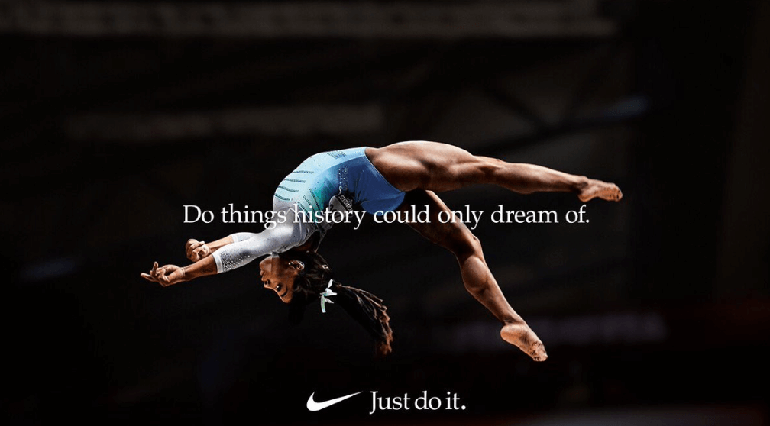
Notes:
Need to achieve

Slide 7
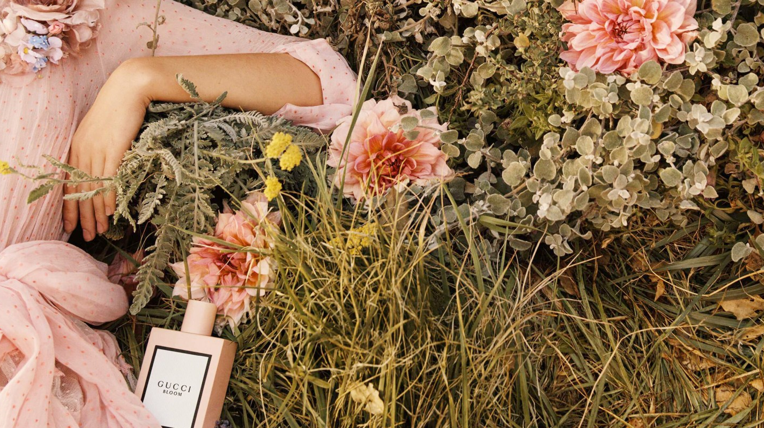
Notes:
Need for aesthetic sensations

Slide 8
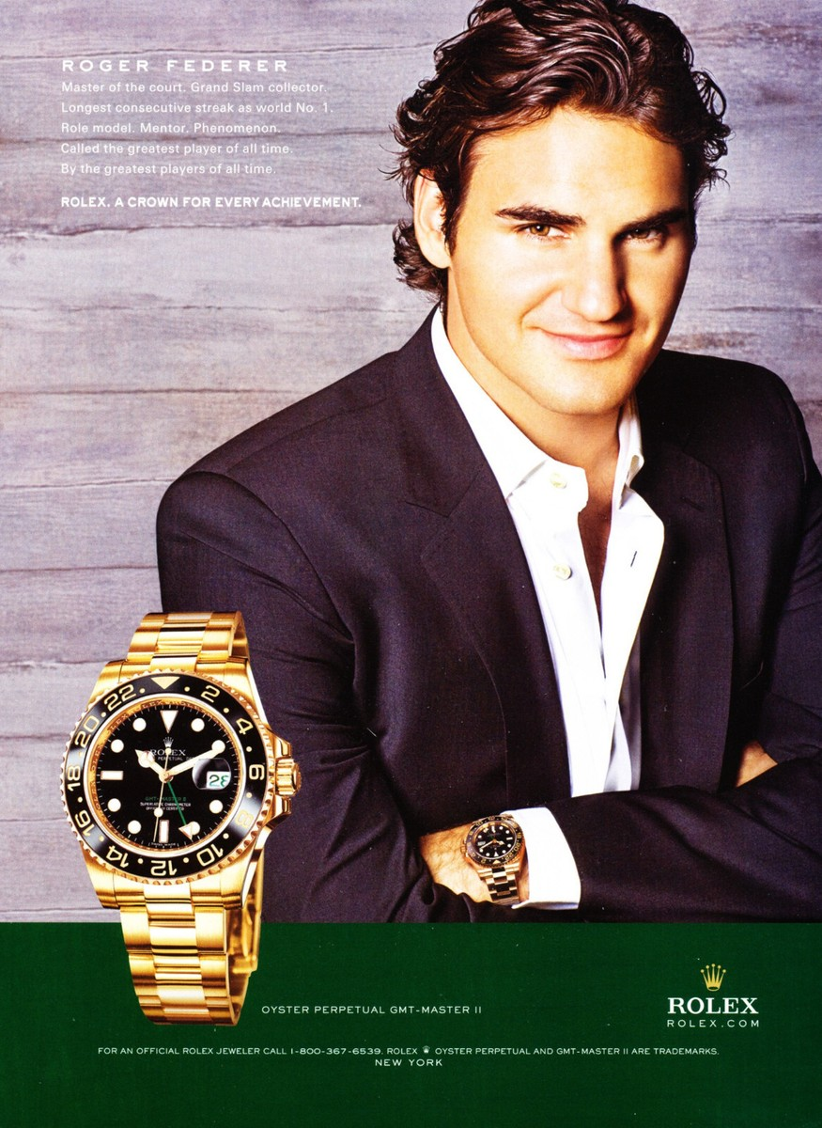
Notes:
Need for prominence

Slide 9

Notes:
Need for sex

Slide 10
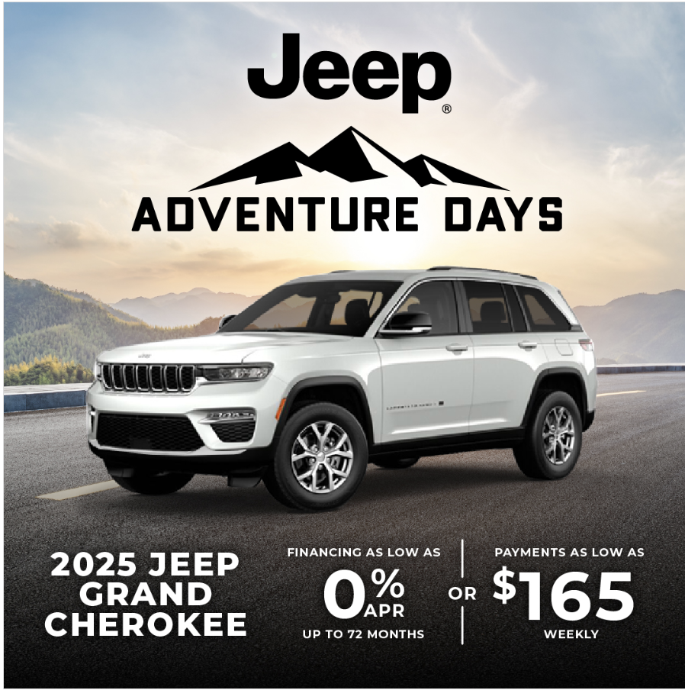
Notes:
Need for escape

Slide 11

Notes:
Need for guidance

Slide 12

Notes:
Physiological need + autonomy

Slide 13
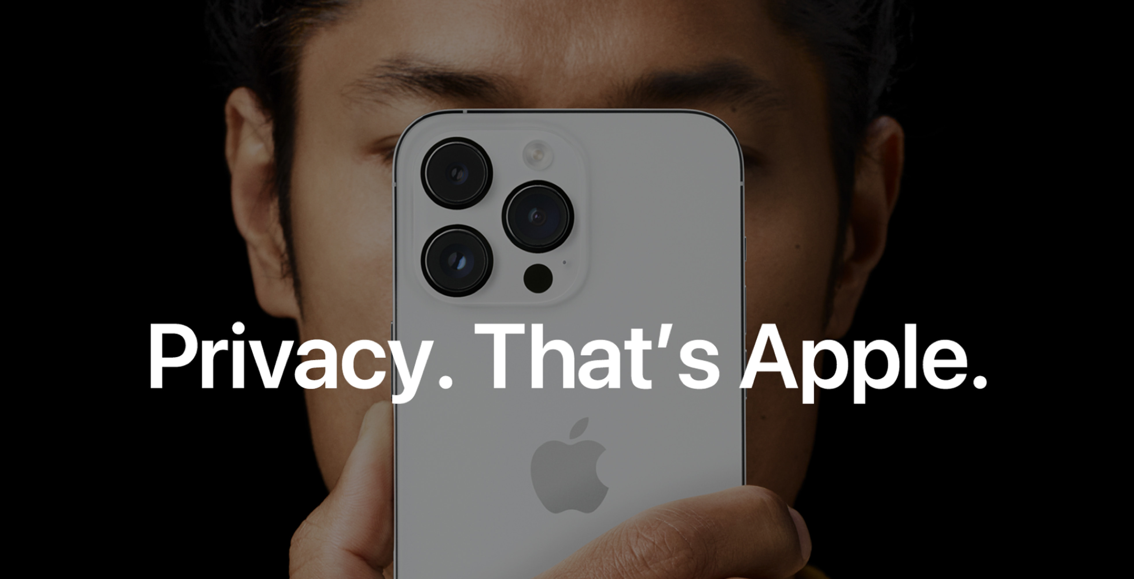
Notes:
Need for autonomy

Slide 14
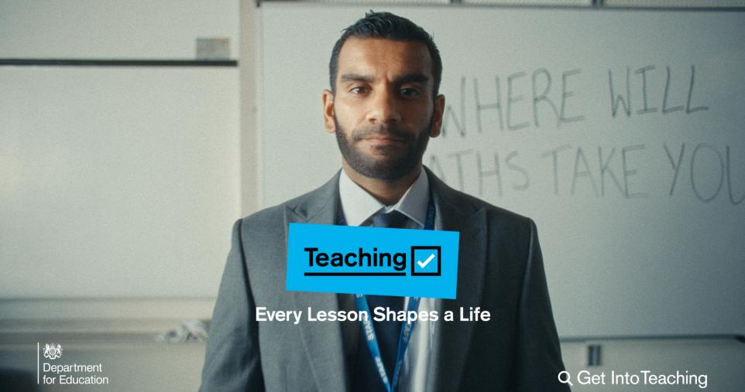
Notes:
Need to dominate

Slide 15

Notes:
Need for attention

Slide 16
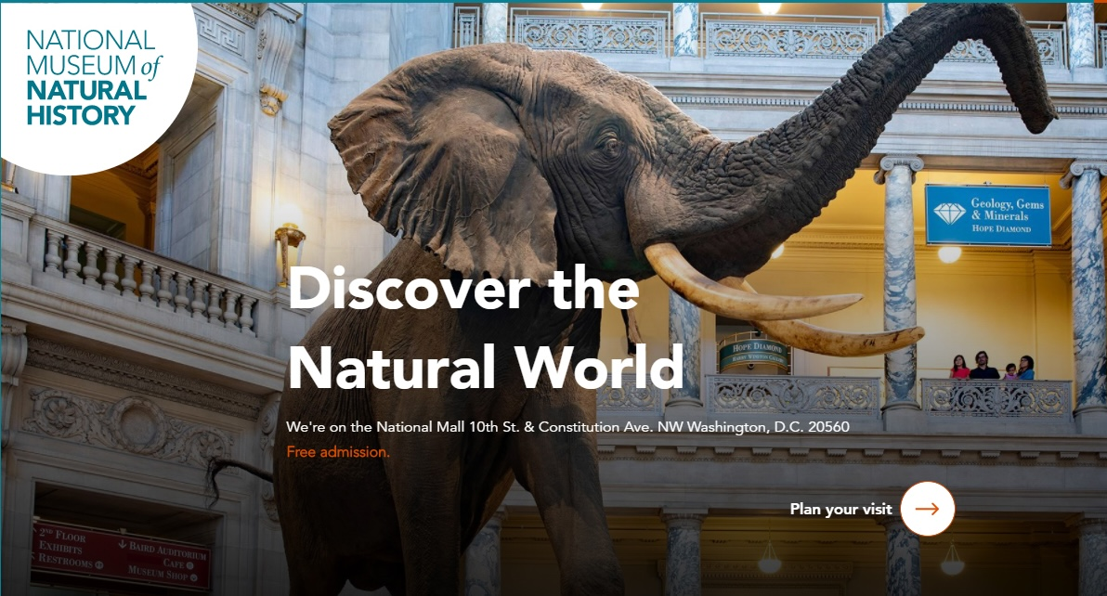
Notes:
Need for. curiosity

Slide 17

Notes:
Need to aggress

Slide 18

Follow- Up Task (choose 1)
Curate your own collection of adverts that demonstrate the different appeals. Create a PPT and test your classmates.
Choose an advert from this PPT and complete a paper 1-style analysis using the following prompt: How does the advert use visual techniques to create an emotional appeal for the reader?
Research the advertising history of a single brand. How has the appeal to the consumer changed over time?
Choose one of the adverts in this PPT to redesign, appealing to a different consumer need. (For example, redesign an ad appealing to the need for prominence, so it features the need to nurture instead). Sketch out your design and present it to your class.

