Slide 1
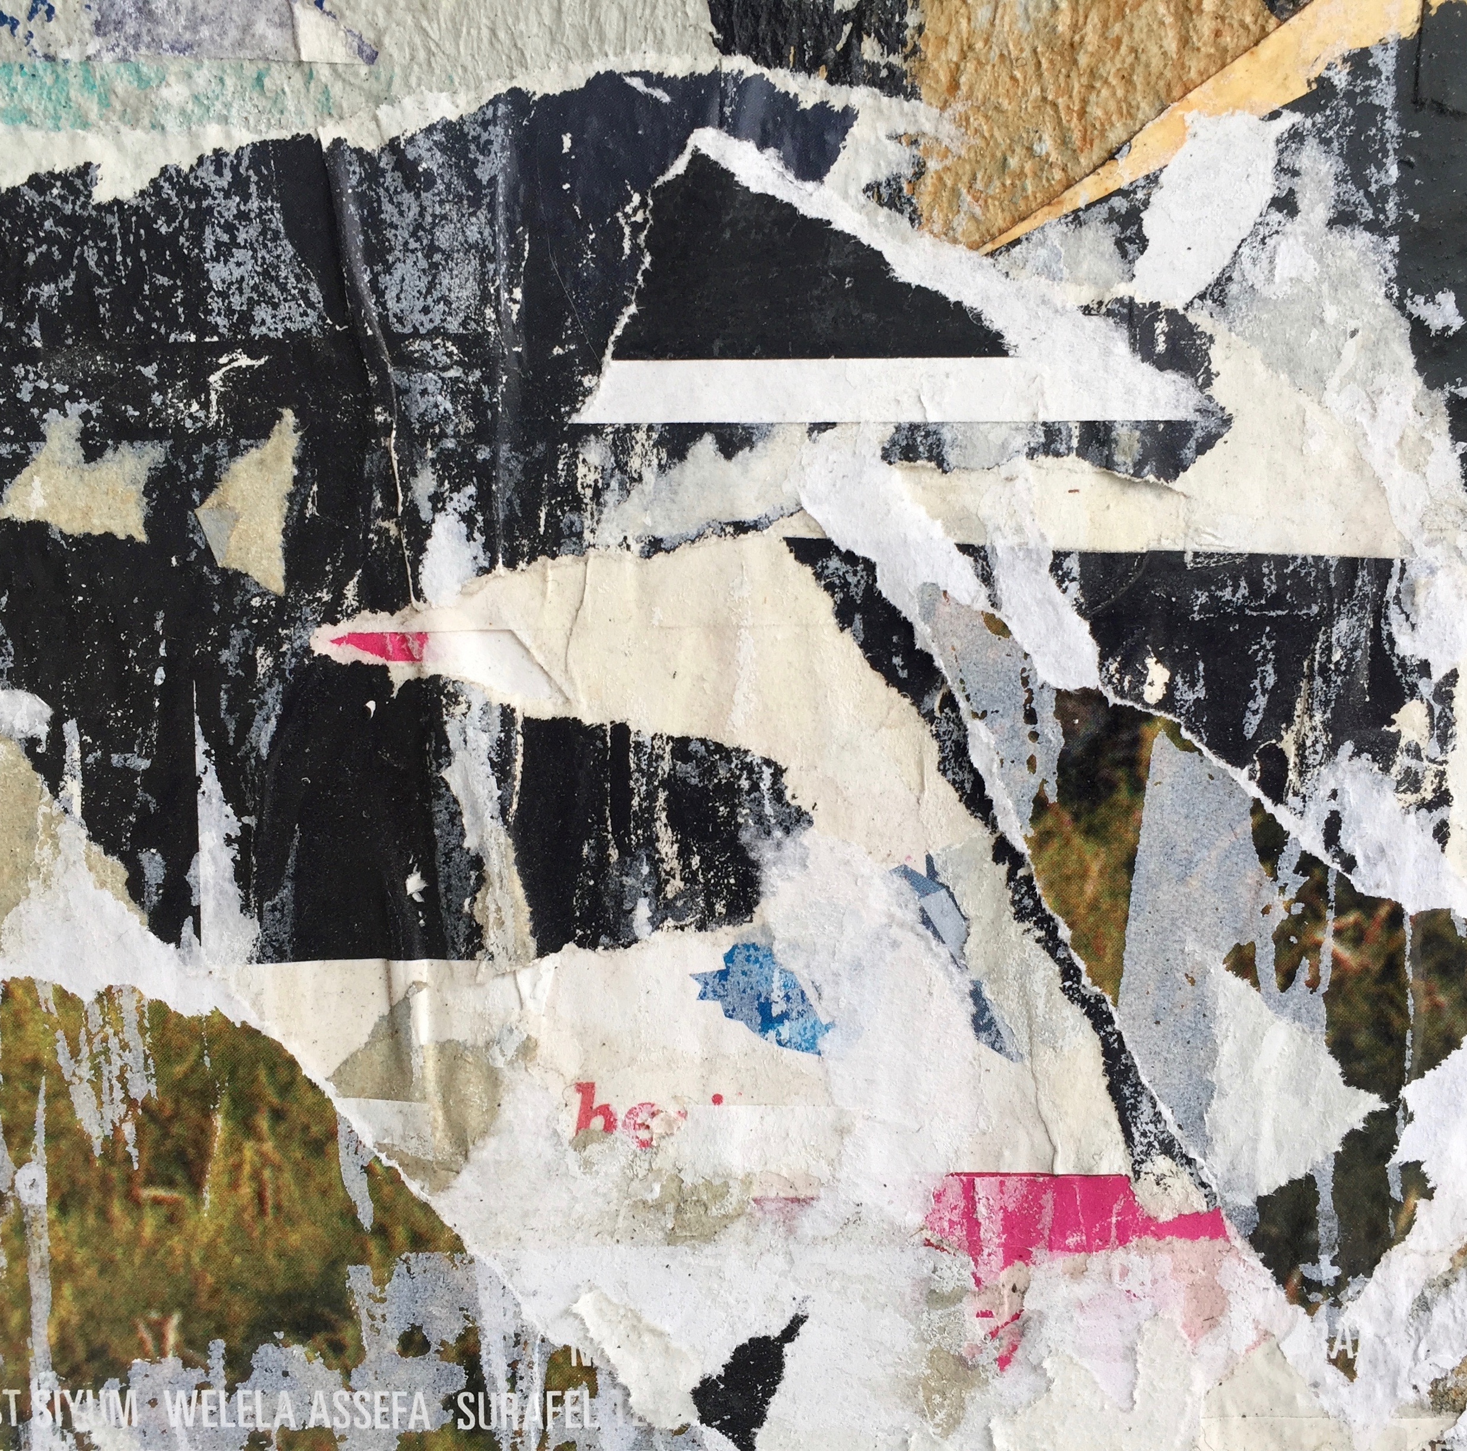
What’s the Claim?
Use with the Essay by Jeffrey Schrank: the language of Advertising Claims

Slide 2
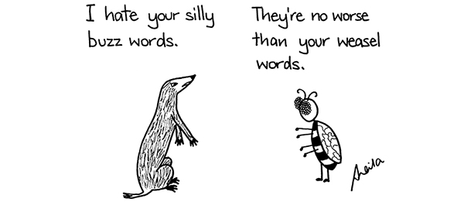
On the next slides, you’ll see a series of adverts in which are hidden one (or more) of the advertising claims identified by Jeffrey Schrank in his famous essay.
Can you find and explain the claims in each ad?

Slide 3
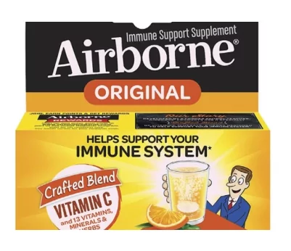
Notes:
Weasel words include ‘supplement’ and ‘helps support…’ and a statistical claim (13 vitamins) with a touch of ‘so what?’

Slide 4

Notes:
Unfinished claim – easier than what? (Also a weasel – ’easier’ doesn’t mean ‘easy’)

Slide 5

Notes:
Endorsement using a well-known figure to support claim (regardless of product efficacy)

Slide 6
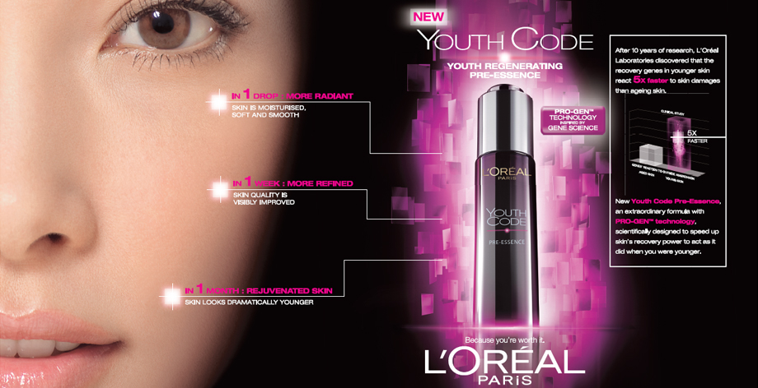
Notes:
Scientific claims abound in the science jargon (‘regenerating pre-essence’), unproven statistics (‘5x faster’) and science-y graphics.

Slide 7

Notes:
Compliment the consumer – ‘you deserve the best’

Slide 8
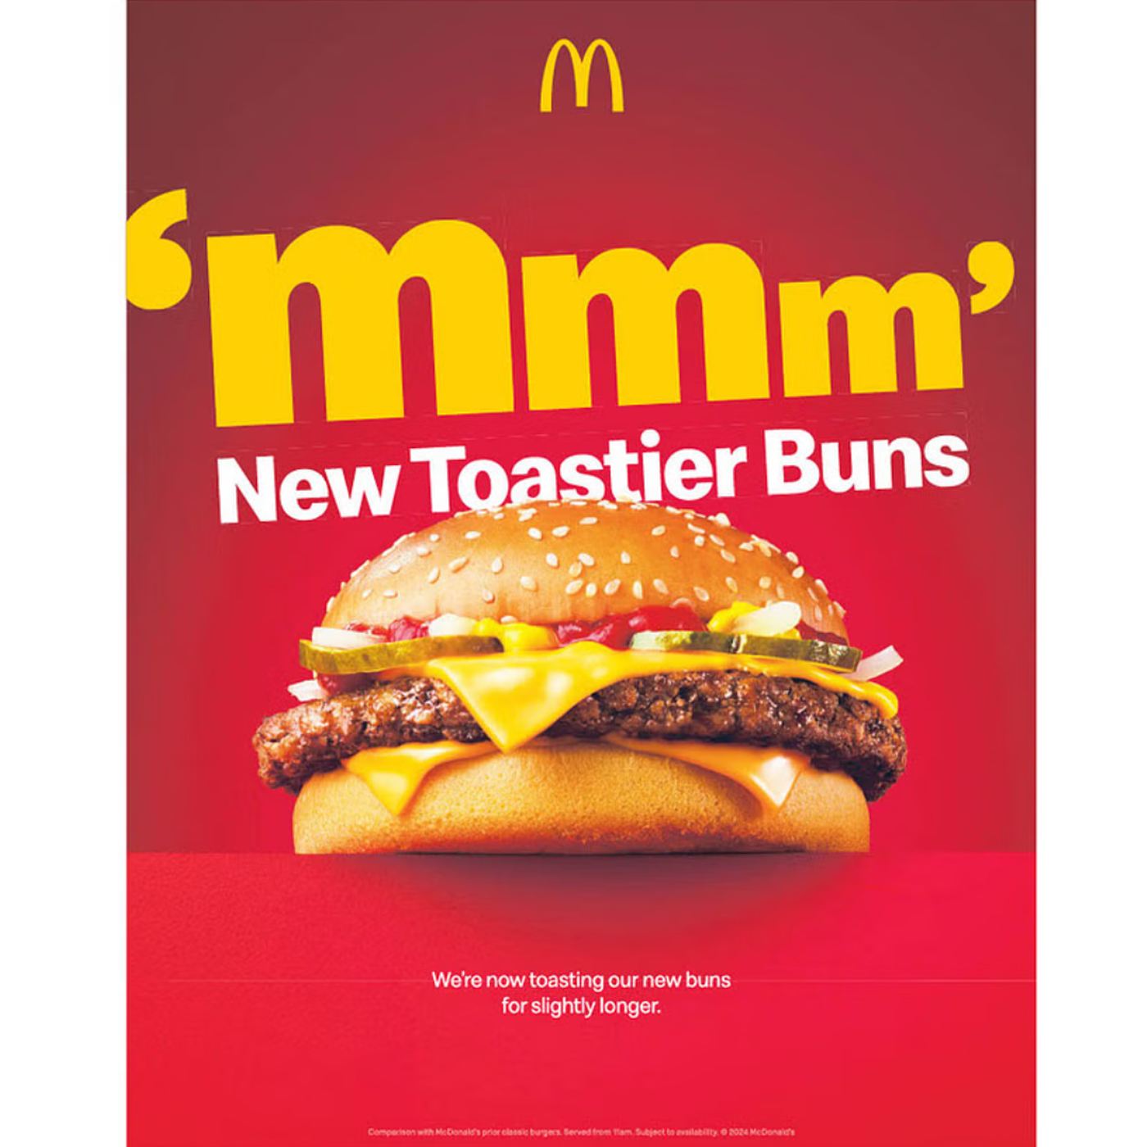
Notes:
A perfect so what? How a toastier bun improves the product is not stated and unclear.

Slide 9

Notes:
Water is wet – all disinfectant products kill most germs. Plus scientific claim (stats), weasel word (‘protects’ does not guarantee efficacy) and endorsement (IMA recommended)!

Slide 10
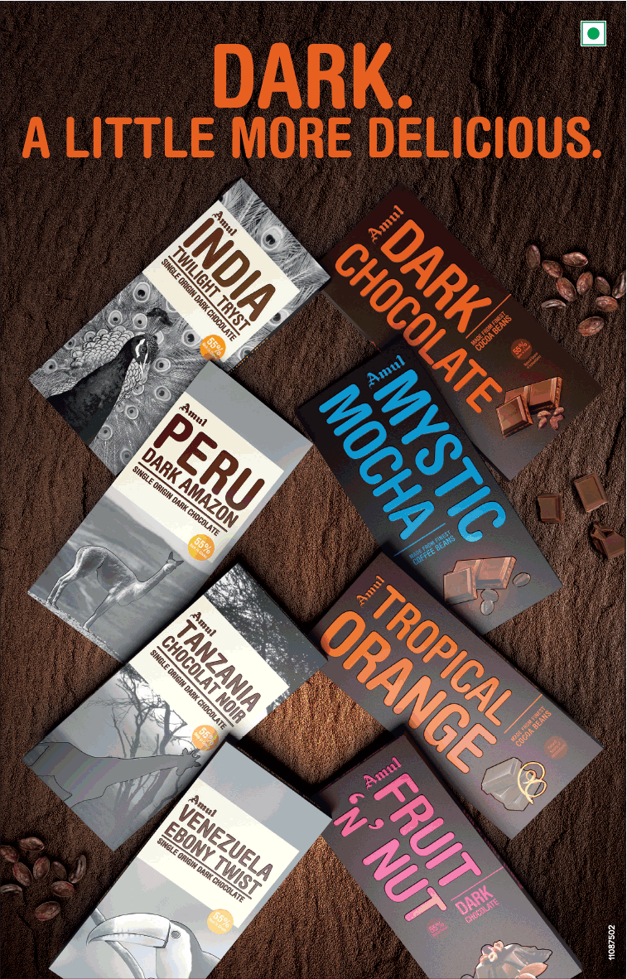
Notes:
Another unfinished claim – ‘more delicious’ than what?

Slide 11

Notes:
An outstanding vague claim – what is ‘antioxidant power’?

Slide 12
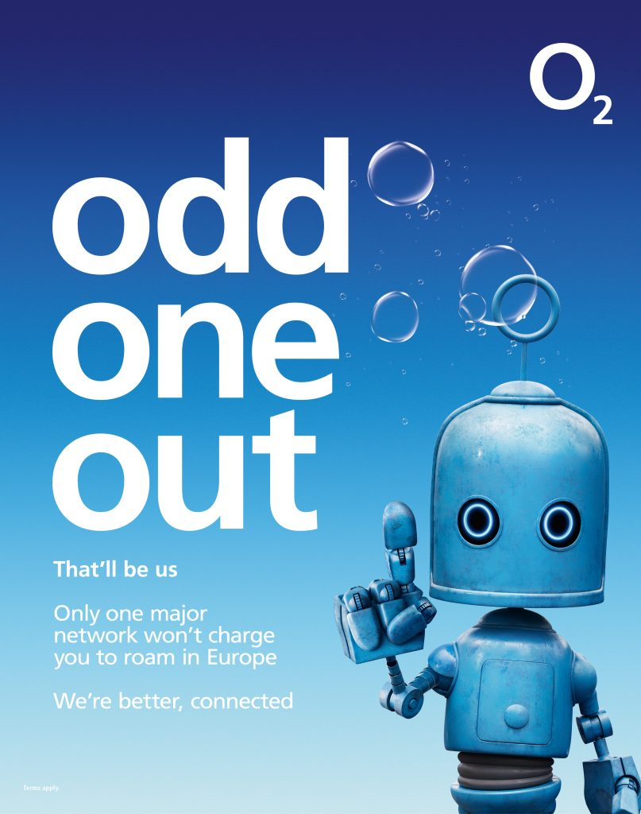
Notes:
The unique-and-different claim – ‘odd one out’, ‘only one’. Also an unfinished claim (‘we’re better’… than what?) A touch of water is wet in the word ‘connected’ (all mobile networks connect the customer).

Slide 13
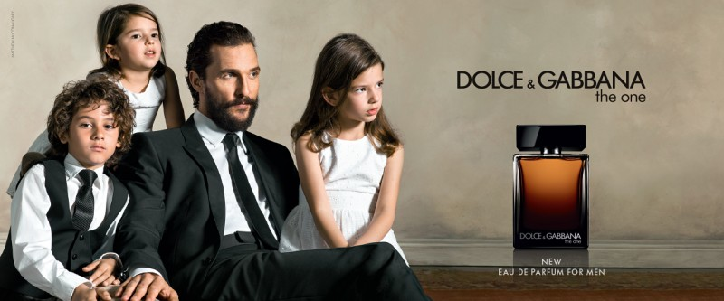
Notes:
The product name implies we’re different-and-unique. Some students may recognize the Matthew Mcconaughy endorsement too

Slide 14
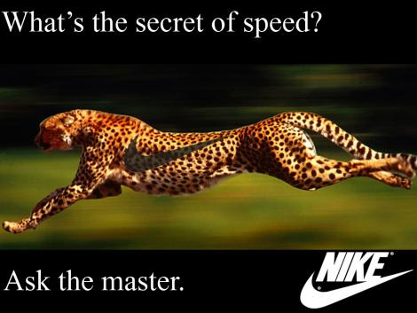
Notes:
Rhetorical question

Slide 15
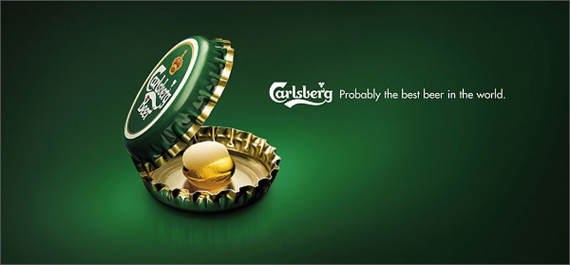
Notes:
‘Probably’ – a classic weasel word

Slide 16
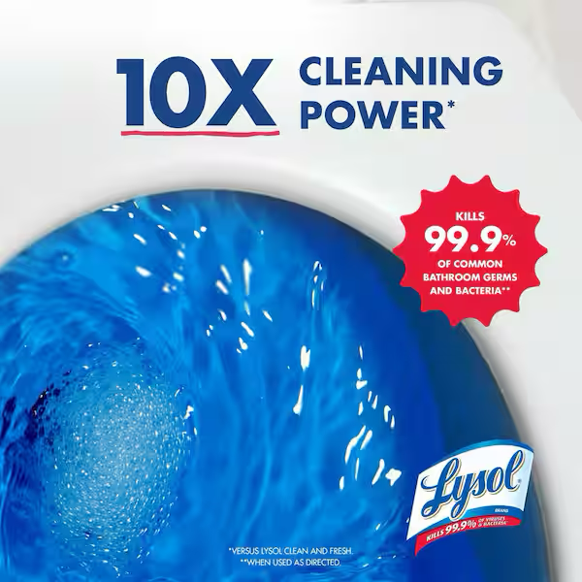
Notes:
Vague (How is ‘cleaning power’ measured?) Also a water is wet statistical claim – all similar products kill the same germs.

Slide 17
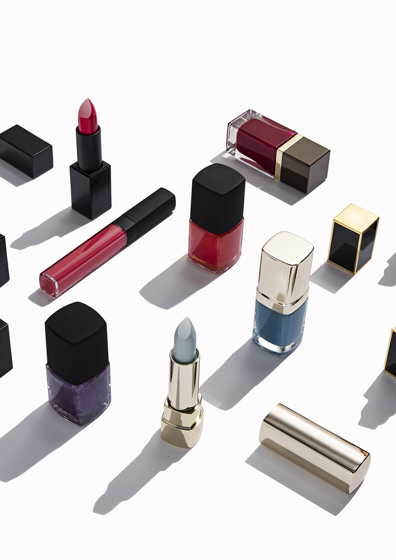
Follow- Up Task (choose 1)
Find more adverts illustrating Schrank’s Advertising Claims. Create a PPT and text your classmates.
Write a magazine spread advertising a new product of your choice. Employ a judicious selection of the language devices you have learned about in this section of the course (advertising appeals, advertising claims).

