Slide 1

The History of Advertising
From Ancient Egypt through the American Golden Age to today’s Digital Landscape

Slide 2

Today advertising pervades our lives. The media and new technologies make it impossible to escape. Anywhere in the world we are subjected to an “uncontrolled pressure” to buy and consume. There are people who regard advertising as the art of convincing the public to spend money on objects they do not need. British historian Hobsbawm called the society of the twentieth century the “affluent society” which means that the need to consume governs our lives consciously and unconsciously. Undoubtedly, the luxuries of our parents have become our needs.
But advertising is not something new. Traces of it can be found in the origins of civilization and trade. Since products to market appeared, the need arose to make them known and the most common way to do so was oral communication.
- https://tripandtravelblog.com

Slide 3
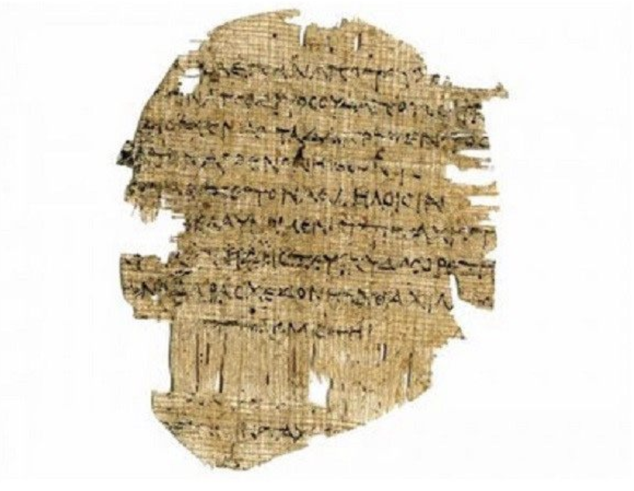
The earliest known written advertisement dates back to Ancient Egypt, around 3000 BCE. Archaeologists discovered a papyrus that advertised a slave named Shem for sale, created by his owner Hapu. It also mentioned Hapu’s shop, making it a kind of dual-purpose ad — both for the slave and the business. Here’s the full transcript translation:
The man-slave, Shem, having run away from his good master, Hapu the Weaver, all good citizens of Thebes are enjoyed to help return him. He is a Hittite, 5' 2" tall, of ruddy complexion and brown eyes. For news of his whereabouts half a gold coin is offered. And for his return to the shop of Hapu the Weaver, where the best cloth is woven to your desires, a whole gold coin is offered.
- the Story of Advertising, James Playsted Wood

Slide 4
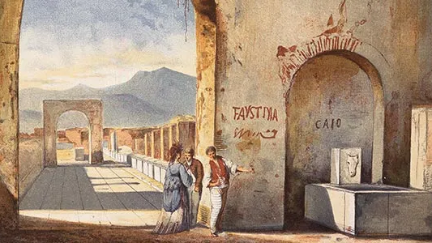
In the ancient Roman world, graffiti was a respected form of writing—often interactive – not the kind of defacement we now see on rocky cliffs and bathroom stalls.
The eruption of mount Vesuvius almost destroyed the ancient Roman city of Pompeii but saved evidence of multiple messages scrawled on the walls in the form of graffiti.
Before the disaster, Pompeii citizens lived in whitewashed buildings that lacked ground-level windows. This construction technique avoided burglary and gave a tremendously large space for advertising politics, gladiator games, real estate, and other topics.
- https://www.smithsonianmag.com/history/reading-the-writing-on-pompeiis-walls-1969367/

Slide 5
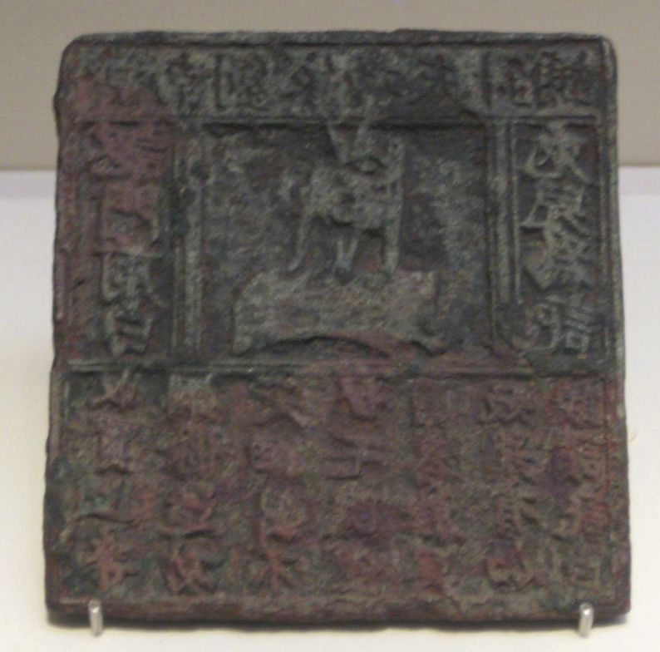
In the beginning of the Middle Ages, nothing affected the development of advertising for centuries. While shouters shouted, sellers came up with original signs and flags to attract the attention of potential buyers. However, the rapid growth of the world’s population and the human passion for exploration saw the first consumer cultures emerge and business owners started to make money.
The earliest-identified example of an outdoor advertising medium is a printed poster from the Northern Song period (960 – 1127) in China, consisting of a square sheet of paper with a logo in the form of a white rabbit in the centre. Written above this is: “Quality Needle Shop of Jinan Liu’s Family” and below: “We buy high quality steel rods and make quality fine needles, to be ready for use at home in no time.” On either side are the slogans: “Identify the white rabbit as our mark” and “Please remember ‘white rabbit’.”
- Liu Hong, Chinese Business: Landscapes and Strategies

Slide 6
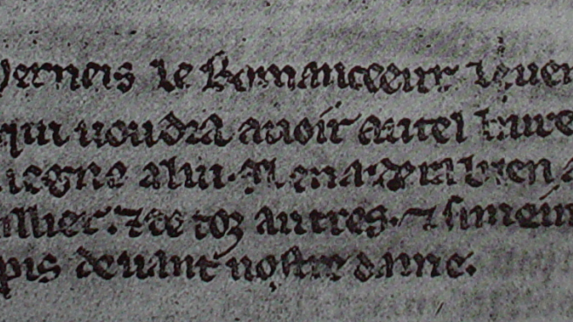
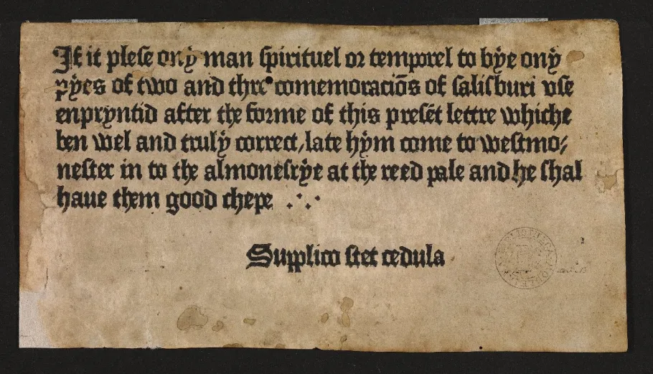
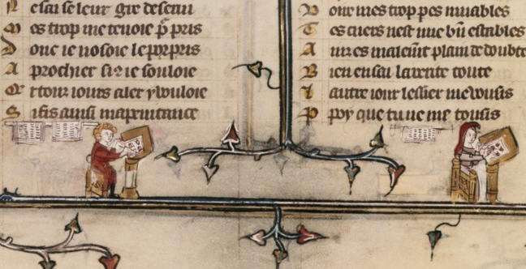
Four centuries after Jinan Liu’s family printed their needle posters, Gutenberg started the printing revolution in Europe by inventing the mechanical movable-type printing press in 1439.
Within the next forty years, Gutenberg’s presses were set up in multiple cities all around Europe including in Germany, England, France, Spain, and Portugal.
Along with books, people all around Europe got an opportunity to read newspapers, gazettes, magazines, and journals. Retailers and manufacturers began mass production of flyers and trade cards.
These advertisement sheets, flyers, and inserts are examples of scribes directly addressing potential customers. An illuminating case concerns a scribe who calls himself Herneis. On the last page of a book he had copied for a client he wrote the following note: ‘If someone else would like such a handsome book, come and look me up in Paris, across the Notre Dame cathedral’ (Fig. 1, top). The message ‘lured’ the beholder to the book street of medieval Paris, right opposite the cathedral. It’s a great example of medieval spam.
- https://medievalbooks.nl/2014/12/05/medieval-spam-the-oldest-advertisements-for-books/

Slide 7
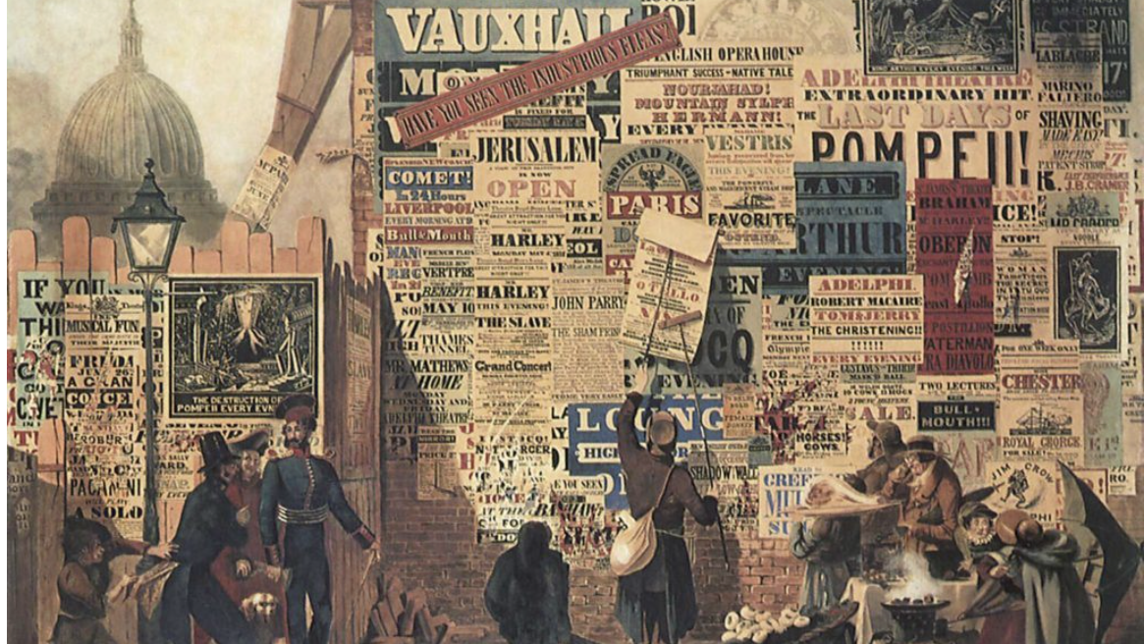
In 1841, the first advertising agency in the United States was founded by Robert Palmer, the son of a newspaper publisher and a coal businessman who considered himself an advertising agent. Palmer’s major contribution was the formation of the newspaper advertising market by setting aside a large amount of space for ads and reselling it at higher rates to professional advertisers whose competition got fiercer year by year.
- https://softcube.com/the-entire-history-of-advertising/

Slide 8
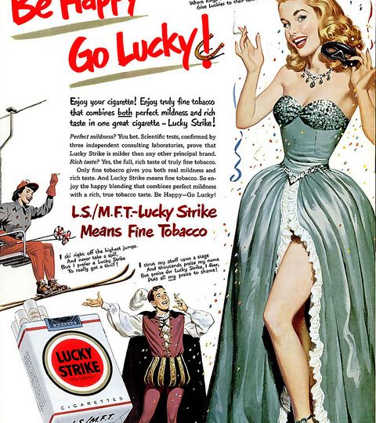
Up until 1929, it had been illegal for women to smoke in public. One man changed that: Edward Bernays, the ‘father of public relations.’ He organised a ‘Torches of Freedom’ march on Easter Day in New York. On cue , his secretary and all her friends lit cigarettes and smoked them – right in front of gathered photographers and reporters positioned in advance by Bernays to catch the moment. Lucky Strike – the tobacco company that had hired Bernays as public relations consultant – saw their potential market double overnight! From this moment, Bernays ran adverts with pictures of women holding cigarettes and women began to feel confident about smoking in public. A legendary ad campaign was born.
Edward Bernays was the first to link ads to people’s subconscious desires; modern advertising has embraced this philosophy wholesale.

Slide 9

In the beginning of the 20th century, advertising was everywhere and advertising agencies were fully responsible for its content.
The first paid radio ad was aired on WEAF (WFAN) in New York on August 28, 1922 - a 10-minute broadcast on the subject of a carefree life in the suburbs at the Hawthorne Court Apartments in Jackson Heights, Queens. It cost $50 to run the ad!
After World War II, television became the major source for promoting products and services to the masses. The first TV advertisement was aired on July 1, 1941, and lasted nearly ten seconds. Produced by the Biow Company, the video promoted a Bulova Watch. The message was “America runs on Bulova time.”
- https://softcube.com/the-entire-history-of-advertising/

Slide 10
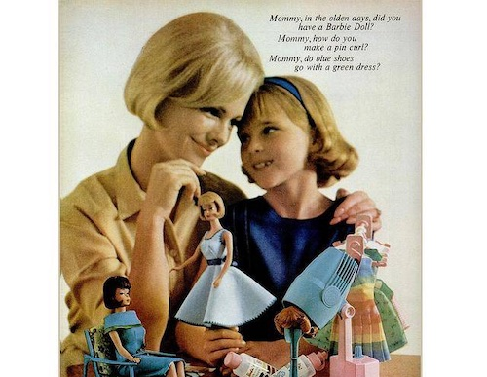
Heralded as the ‘Golden Age of Advertising’, the 1960s was when advertising really started to get exciting. Driven by massive political, economic and societal changes, including increasing interest in alternative lifestyles and human rights issues, creativity was very much the name of the game.
Ads became more image-based and they were also starting to emotionally connect with their audience.
Take this ad for Barbie, which shows how Barbie can help your little girl grow up, using a subtle emotional message to encourage people to buy their products.
- https://wearembc.com/why-the-1960s-was-the-start-of-the-golden-age-of-advertising/

Slide 11
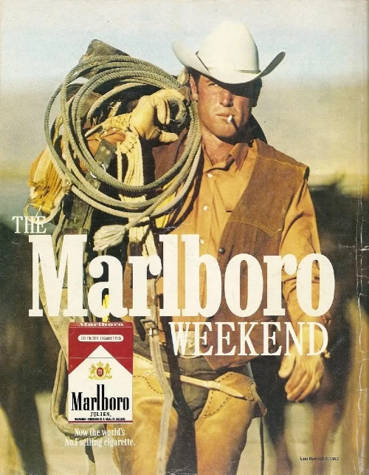
The Golden Age was the first time when brands considered using consistent messaging and ideas across all their different forms of marketing material and started to develop, what would become, established brand personalities. Brands realized the power of using a ‘spokesperson’ to personify a brand.
In 1963 McDonald’s first introduced Ronald McDonald to the unsuspecting public. As Ad Age put it in a 2007 retrospective: ‘He…exemplifies one of the most important qualities of an effective commercial character: he doesn’t sell for McDonald’s, he is McDonald’s.’
In another example, The Marlboro Man became a recognizable cultural figure between the 1960s and 1990s. The aim was to turn filtered cigarettes from a feminine phenomenon to a more masculine one with the help of rugged cowboys and a stream of moody-looking men.

Slide 12

The Golden Age was a time of creativity and innovation. Many of the genre conventions we associate with advertising come from this period. For example, this television advert for Mr. Clean features a famous jingle – one of the first ever used in advertising.
Written by Thomas Scott Cadden and sung by Don Cherry and Betty Bryan, the song was used in many different Mr Clean adverts and the 10-second jingle was in every commercial. Now the song is the longest running jingle used in television history!

Slide 13
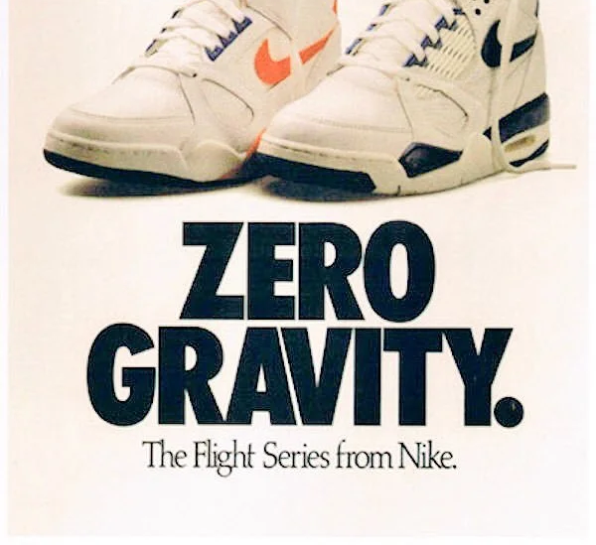
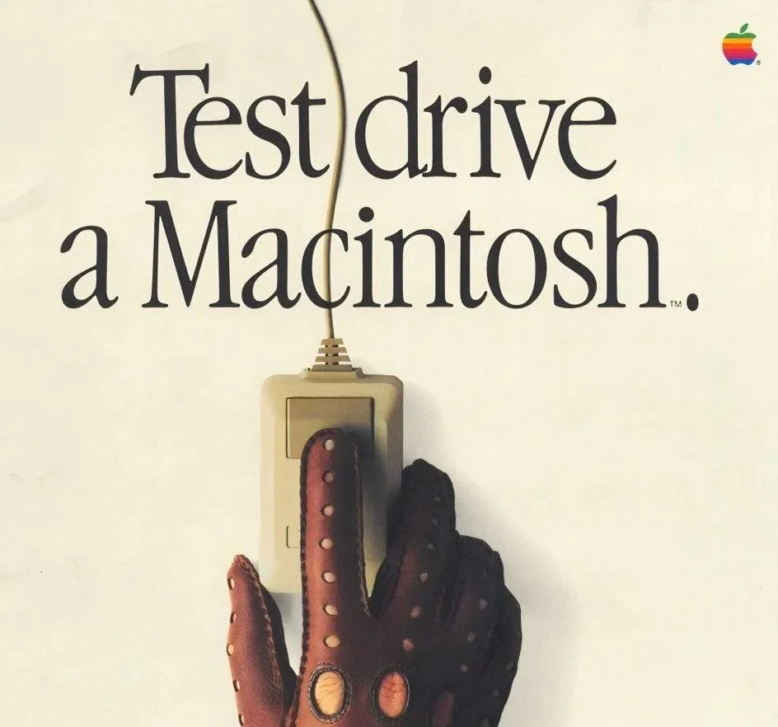
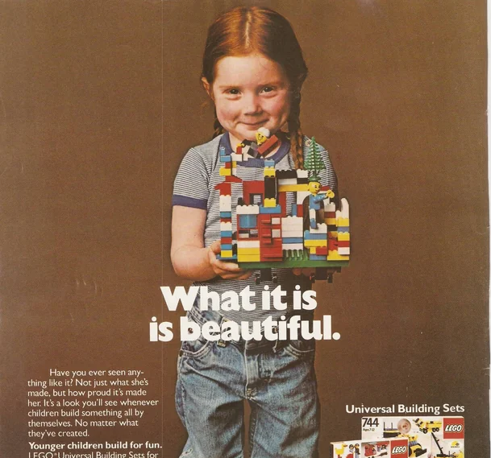
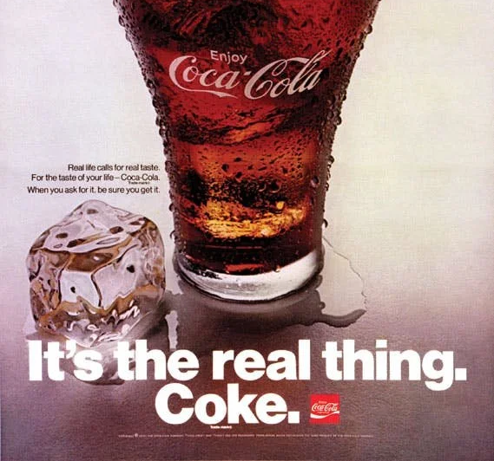
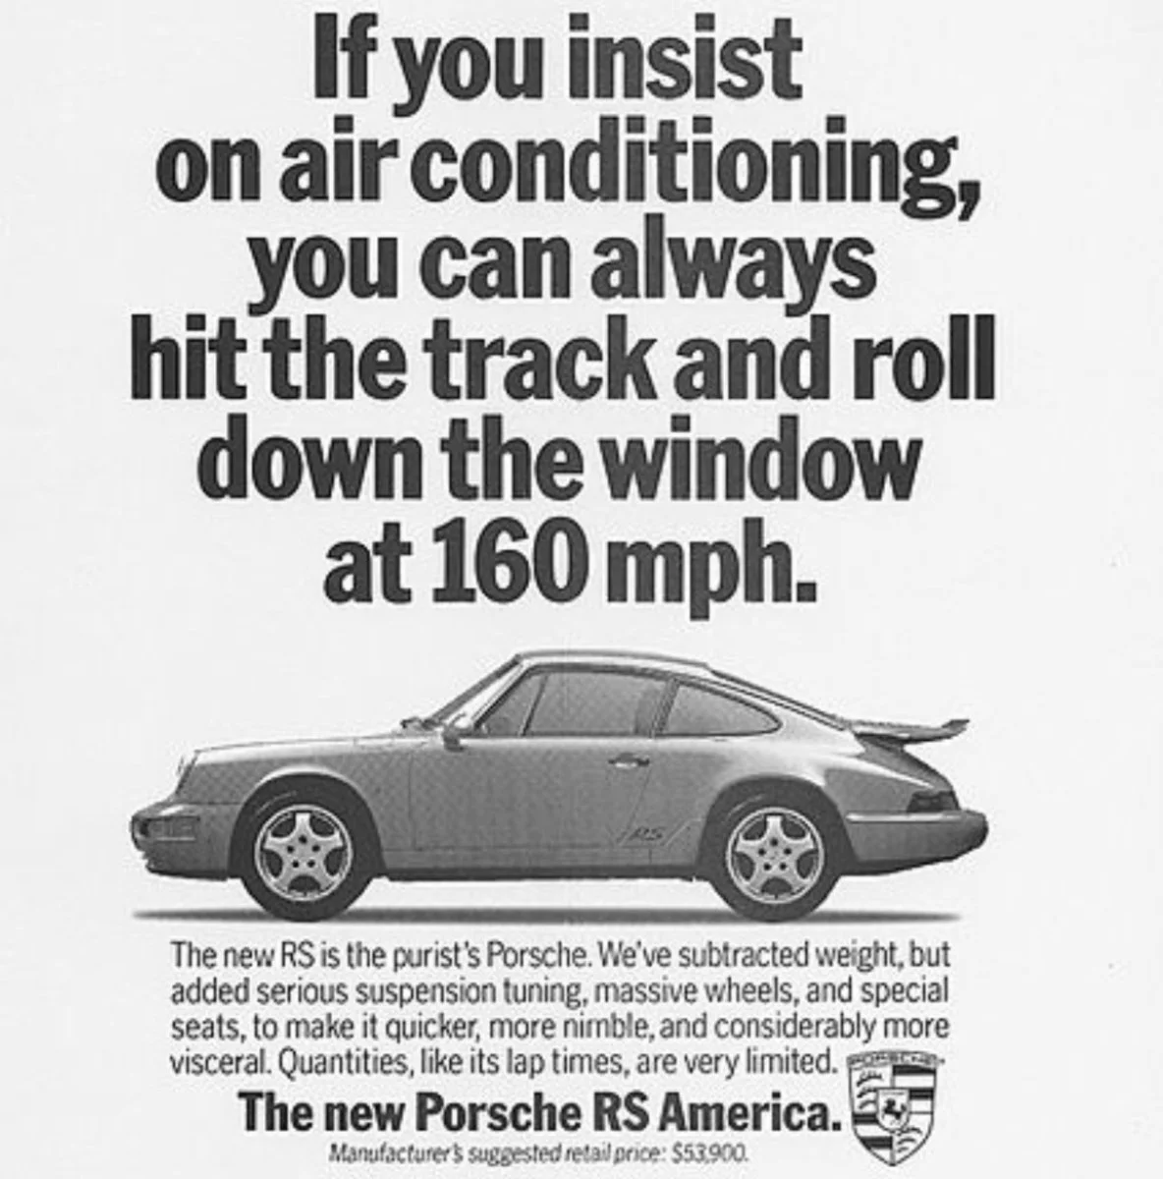
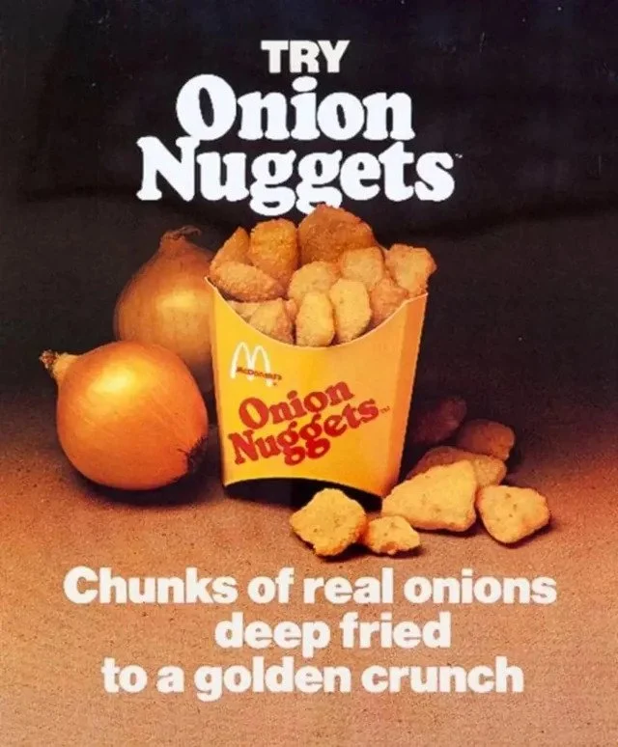
The admen (and most of them were men) of the Sixties, Seventies and Eighties created some of the most unforgettable images of modern times and codified the features of adverts such as striking photography, catchy slogan, and creative, bold designs.

Slide 14

When the internet took off in 1992, everyone suddenly began living life online. Advertisers jumped all over the opportunity to reach consumers there. They began shifting their attention to more digital ads, starting with display advertising.
Rather than selling, the evolution of ads lead to a focus on problem-solving. What is the consumer’s problem, and how can the product solve it? Now the product was no longer the center-piece of the ad… the consumer was.
- https://instapage.com/blog/advertising-evolution-how-personalization-has-improved-over-time-4/

Slide 15
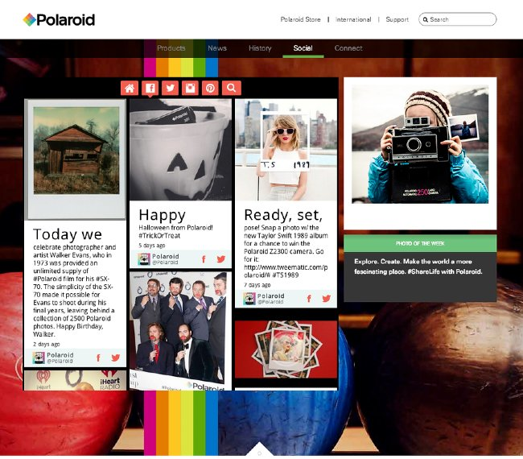
In the digital age, traditional linear models of communication are disrupted by interactive technologies. In advertising, consumers have become a part of advertising, rather than passive onlookers. Take Polaroid, a company that promotes user-generated content on their website rather than ads. They encourage consumers to get involved by asking them to carry out tasks, like “snap a photo with the new Taylor Swift album for a chance to win the Polaroid 22300 camera”.
Because companies are increasingly becoming aware that people trust other people above brands, they’re shifting their focus from one-time buyers to creating a loyal following and increase engagement rather then simply sell a product.

Slide 16
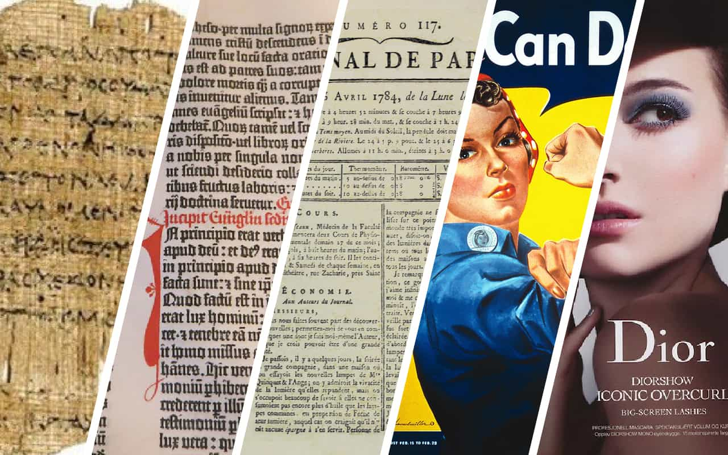
The history of advertising has taken it from the etchings of ancient Egypt, through the emergence of the printing press, through the golden age of infomercials and character-led sales pitches, to today, where ads are evolving ways to build trust and community.
Marlboro Man might have been the man of the moment in the 1960s, but what impact would he have now in a time where delivering solutions comes above the sell, sell, sell mentality?
- https://www.trueloyal.com/blog/history-evolution-advertising-marketing/

