Slide 1
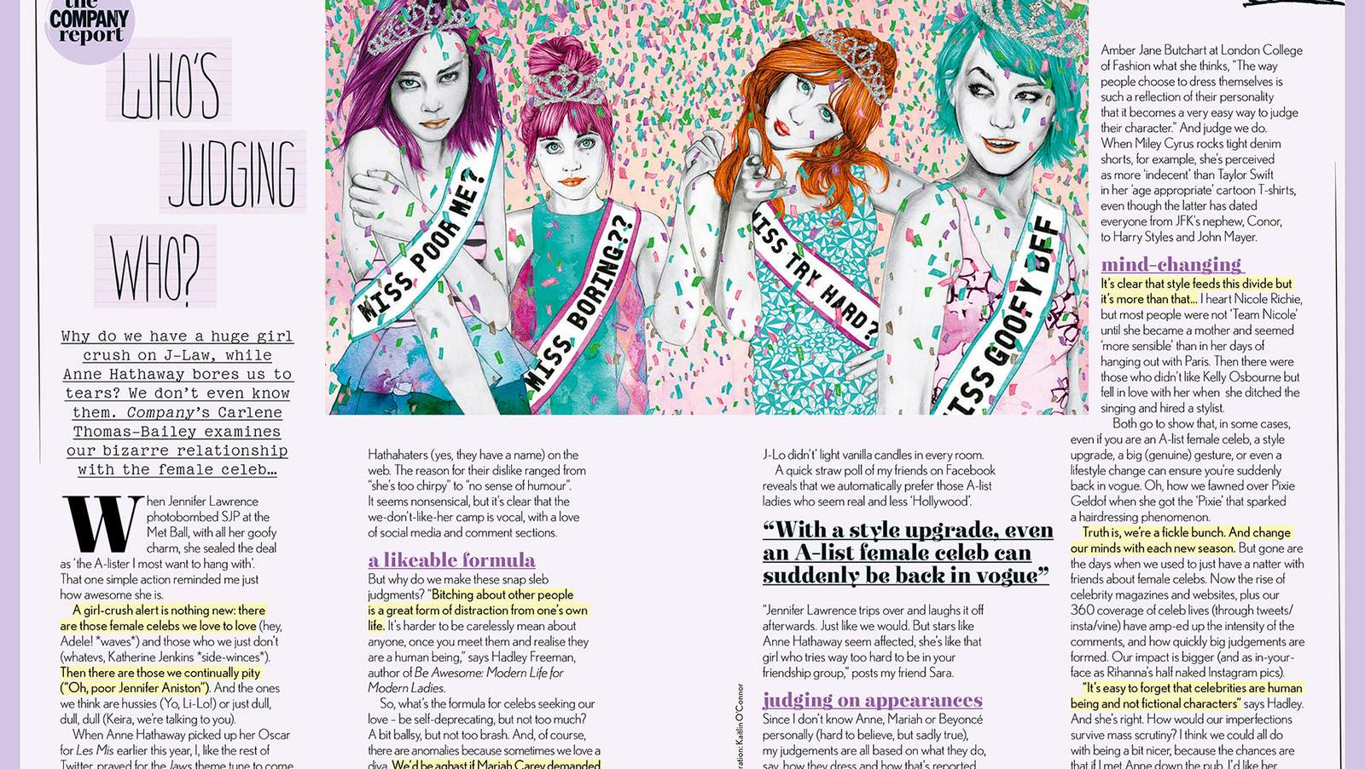
Text Type Focus: Feature Articles
IB English Language and Literature Paper 1: Textual Analysis

Slide 2
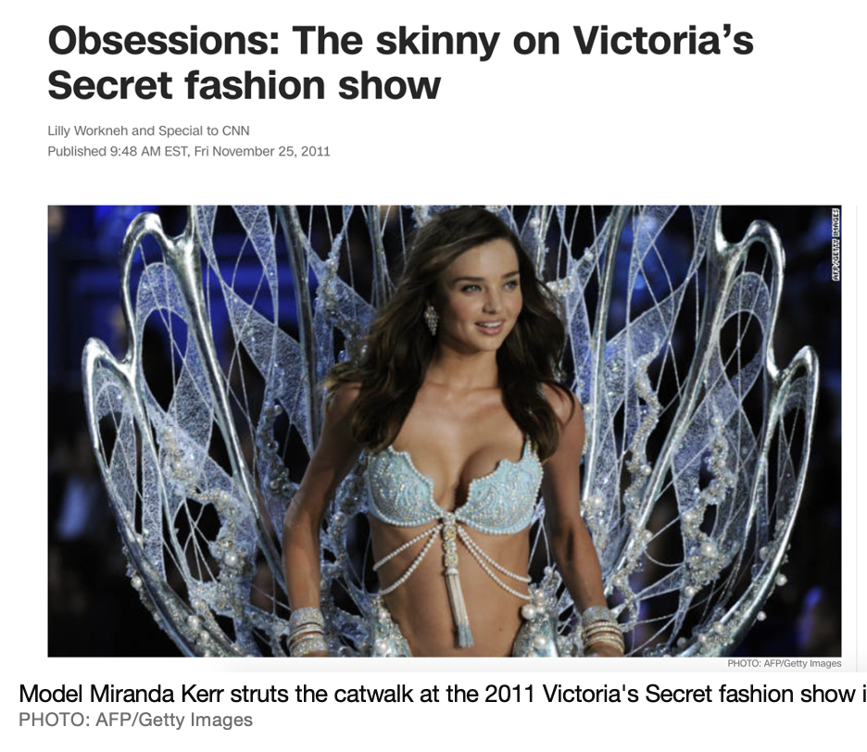
Purpose
Different feature articles have different purposes, but most aim to both inform and entertain readers.
Feature articles are written about a wide variety of topics and issues: fashion, celebrity, food, travel, science, literature. You name it and there’s probably a feature article written about it!
Some feature articles are about current events or topical trends. Articles may put a modern spin or take an original angle on certain topics. Sometimes a feature article is written after investigative journalism work has been completed.
Look at the headline of the article opposite. How does it convey a dual intention: both to entertain and inform?
Notes:
‘Skinny’ is a wordplay. On one hand ’skinny’ refers to the models themselves, who tend to be thin or underweight. On the other hand, ‘skinny’ is an American slang for ‘inside information’. The use of this word is both entertaining and promises the reader will learn something new as well.

Slide 3
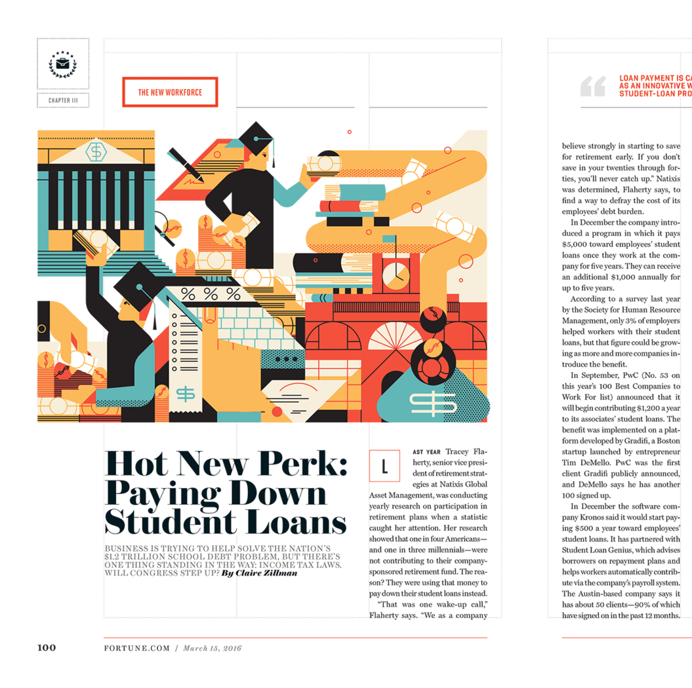
Audience
Feature articles are traditionally published in magazines where they are the publication’s ‘crown jewel’. Increasingly, feature articles and other magazine articles have migrated online where they continue to offer readers a deep dive into certain topics. Depending on this, some articles will have a wide readership while others will have a niche readership of people with specific interests.
A semi-formal text type, article writers often use the second person perspective and speak to the reader using direct address. This often has the effect of drawing interested readers into the article.
Look closely at the article opposite. Who do you think it is intended for? How would you describe the most likely readership for this article?
Notes:
The article is likely for a niche readership of university students who are required to get a loan to pay for their studies. It would also be of wider interest to graduates and young professionals who may be interested in changing the way they pay off historical student loans, and to anyone in the workplace, including employers or lawyers, for whom this is a relevant topic.

Slide 4
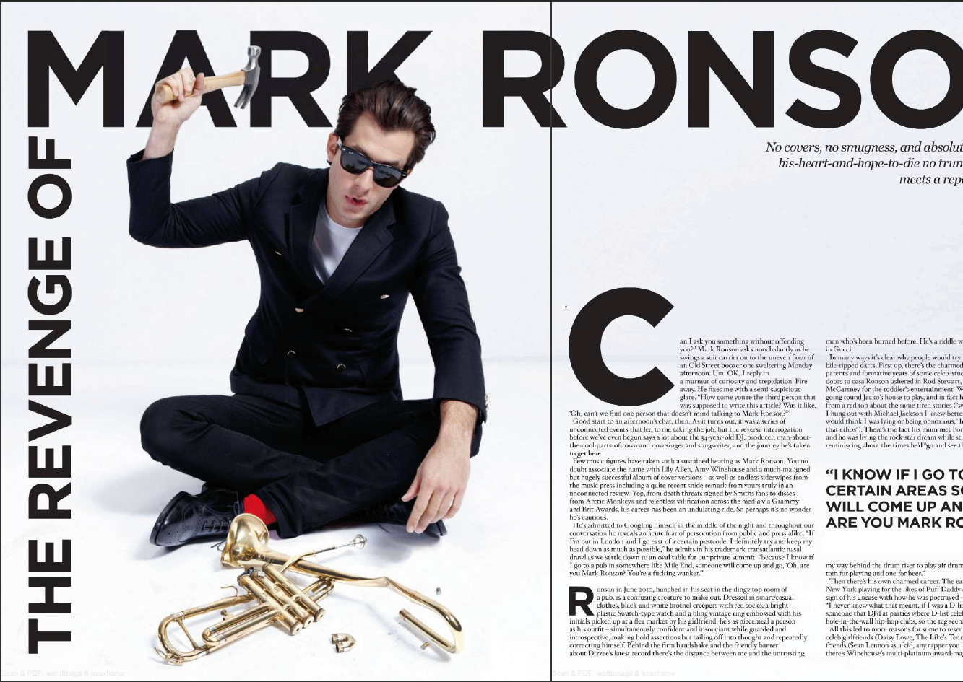
Images
Feature articles are guaranteed to have prominent images, sometimes taking up as much room on the page as the text (especially in an article spread across a double page).
The main image can grab a reader’s attention, communicate the theme of an article, tell a story, humanize a subject, and more.
Photographs are the most common type of image, although illustrations and infographics are not uncommon. Photos are often posed, involving the use of clothing, make-up, lighting, backdrop, body language and facial expression, and so on.
What is worth commenting on in the image opposite?
Notes:
Mark Ronson released an album with a famous trumpet riff that has defined his musical success throughout his career. The image of him smashing a trumpet is his way of pushing back against the narrow way he has been appreciated ever since. If you don’t know who Mark Ronson is, you can still comment on the ‘rebelliousness’ of the image or the connection with the word ‘revenge’ in the article’s title. This is clearly a man with an axe to grind! However, the image is posed, not genuine, so there is little anger or aggression conveyed. His facial expression is quite neutral (although his mouth is open) and his body language relaxed – as seen in the way his hand relaxes laconically on his knee. The raised hammer, sunglasses, and smashed trumpet are all specific elements of the image worth commenting on, as is the effect created by the bright red splash of his socks. You could also comment on the negative space used in the design of the image and the black/white contrast that makes the image so striking.

Slide 5
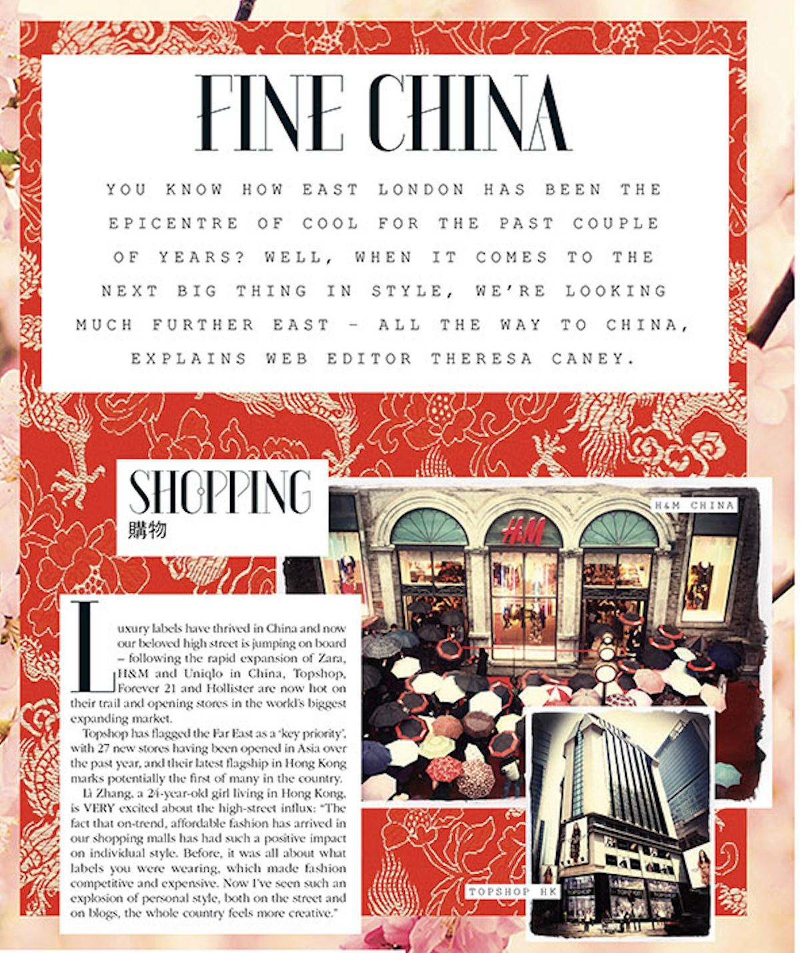
Heading/Headline
The large, bold type at the top (head) of the article is the headline.
Writers go to great lengths to find the perfect headline for their article, as this is often the way to hook the reader’s intrigue, attention, and interest.
You’ll find all kinds of techniques such as alliteration, single-words, puns and wordplay, hypophora, punctuation (e.g. a headline featuring a colon is called a slammer), and more.
Look out for typographical features such as colour, size, font, or graphic design.
Can you analyze and explain the headline on the article opposite?
Notes:
Fine China is a pun on the name of a country and on the word ‘ceramics’. China was named so because of its traditional export: ceramics. The long subheading gives the information you need to develop your understanding of ‘Fine China’ and discover what the article is mostly about. The word ‘fine’ takes on a praiseworthy connotation, as if China is now a great place to find good shopping experiences. The typography of the heading is worth noticing, especially the choice of font with a mixture of bold and delicate lines giving the words a classy, stylish, ‘ceramic’ quality.

Slide 6
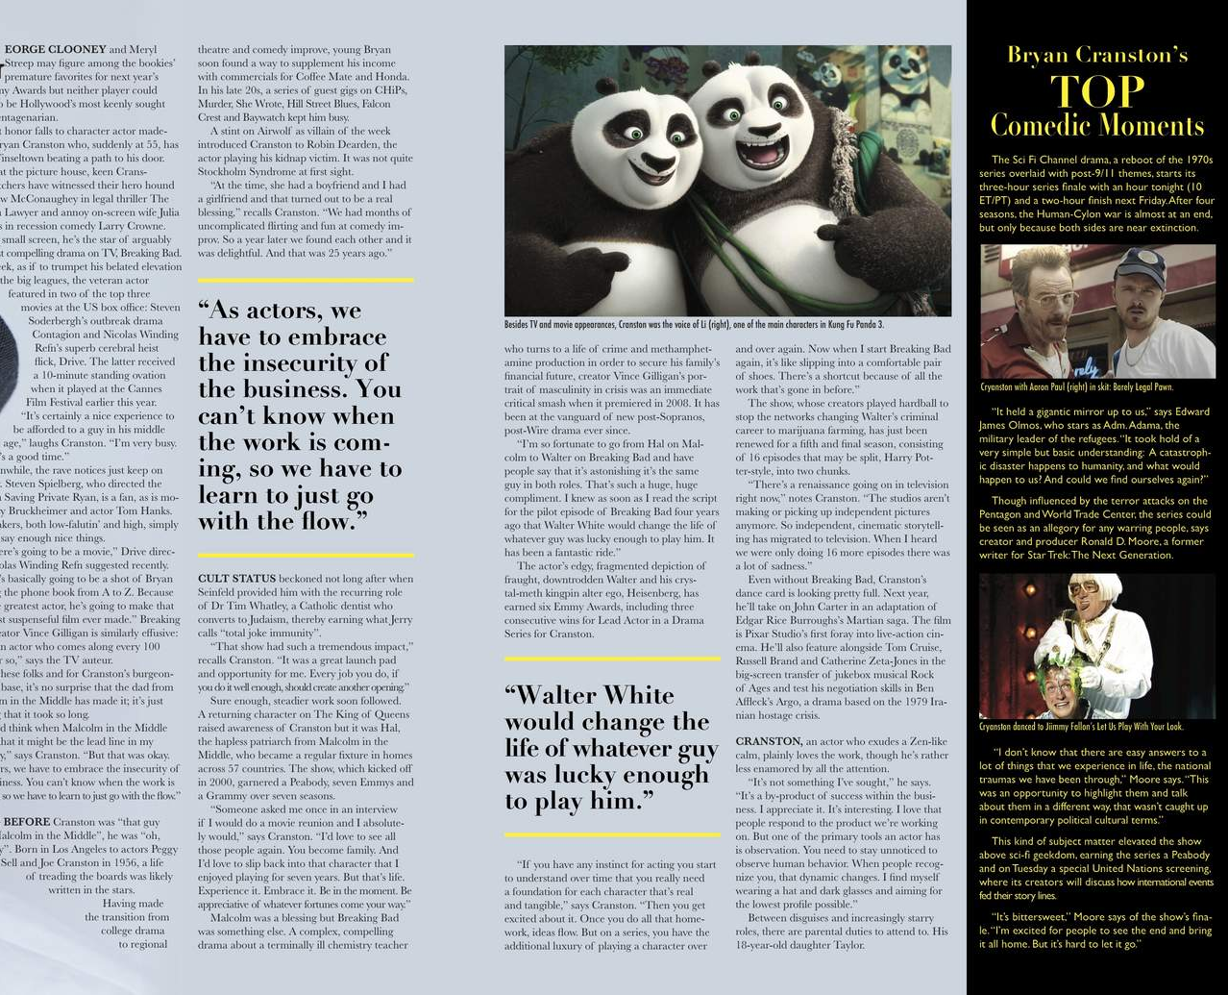
Pull Quotes
Pull quotes (or pull-quotes) are visually distinct excerpts from the article itself. They have an attention-grabbing purpose.
A good pull quote can often do the job of a headline in conveying the main point or most interesting idea of an article. Pull quotes can also be used alongside or in place of subheadings.
Typographical features come into play again, especially font and colour.
Look at the two pull quotes in the feature article opposite. What messages from the article are conveyed most strongly? Just from reading the pull quotes, what do you think is one of the themes of the article?
Notes:
The first pull quote attributes the success of an actor to his ability to ‘go with the flow’, indicating there’s more than just acting talent required to be successful. The business is ‘insecure’ so actors must be prepared to take all kinds of work, not just prestige projects. The second pull quote refers to the actor’s most famous role: Walter White from Breaking Bad. Even if you don’t recognize this reference, you can still see how he attributes his success as an actor to his character. Taken together, the quotes imply the actor is humble (he calls himself a ‘guy’), grateful for his career, and doesn’t let fame go to his head. He admits the role of ‘luck’ in his success. It is likely this is a good overview of the ‘message’ of the article – that career success comes down to more than individual talent and ability,

Slide 7
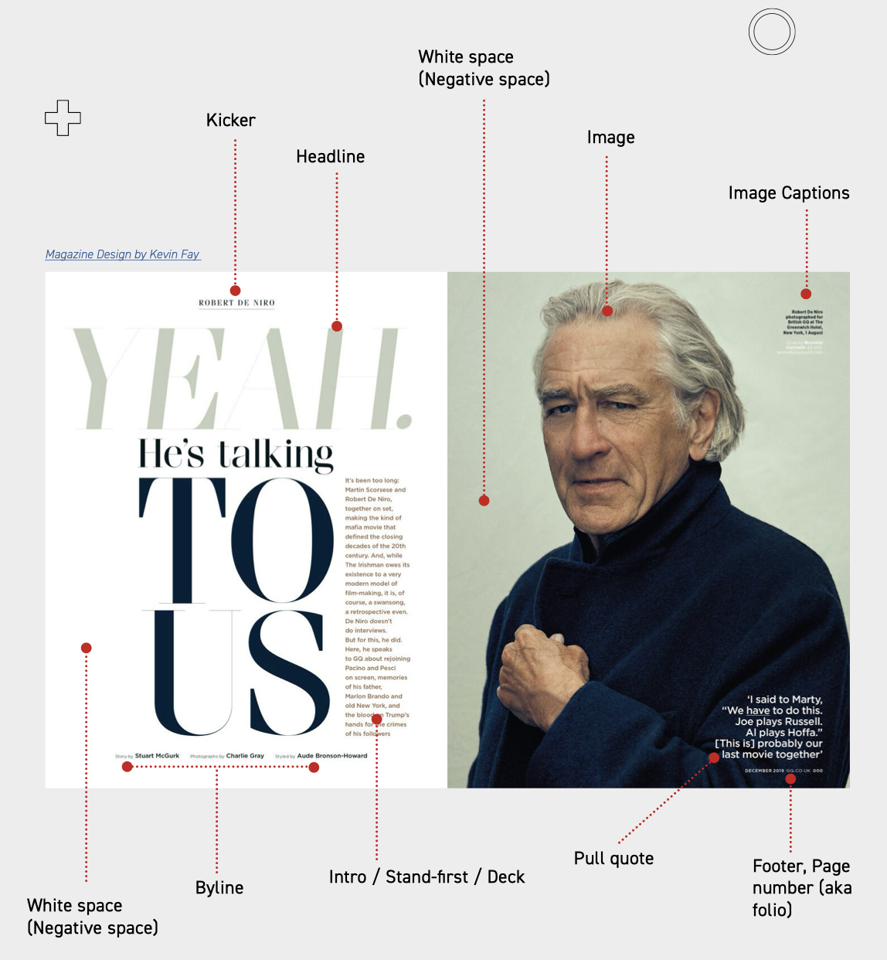
Design and Layout Features
As a versatile and engaging medium, magazine and feature articles are designed in a wide variety of ways. However, you can look out for certain presentational devices:
Sidebars run down the side of a page and straplines run across the top or bottom. They may contain extra information, or links to further information (in the magazine or elsewhere). Sidebars (or sidepanels) might contain further small images or icons.
Boxes or pullouts are areas of the article separated from the main article. They normally contain extra information, or they might feature a graph, table, or infographic.
Bylines give crucial information about the writer, recognizing the authorship of the article and building credibility.
If you are interested, you can visit sites like Yes I’m A Designer that go into more detail about the composition and design of spreads like the one on the right. (NB English Lang and Lit is not a design course, and you don’t need a professional level of technical know-how to analyze feature articles).

Slide 8
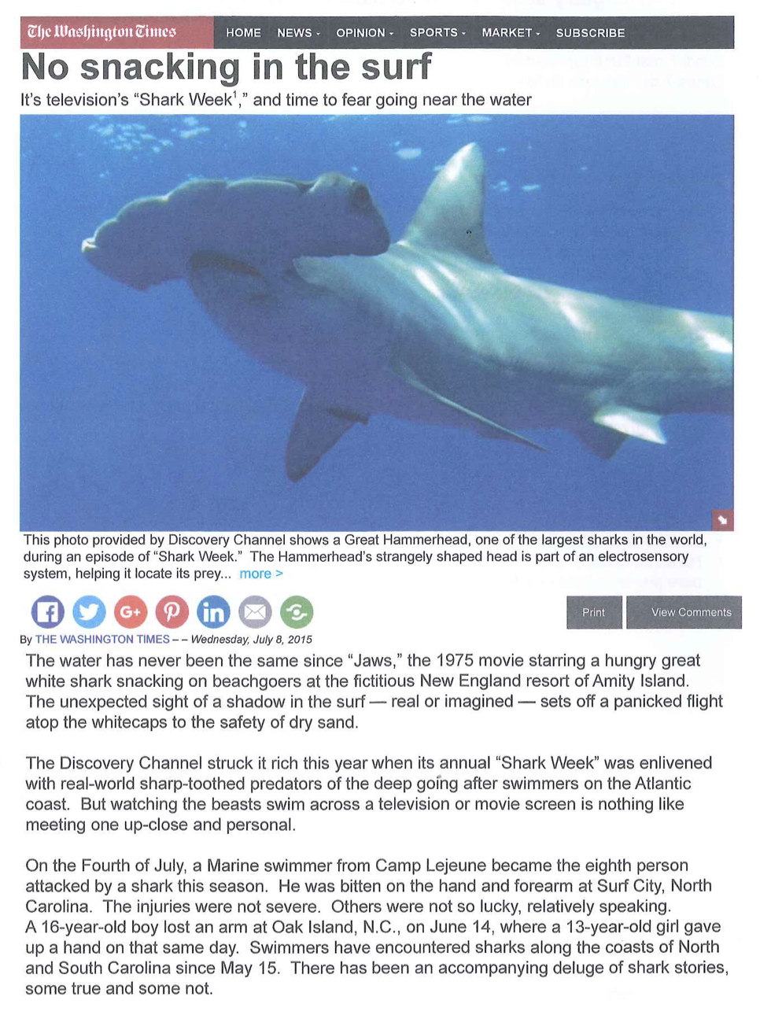
Introduction / Lead / Hook
The first paragraph of a feature article is one of the most important. It acts as a bridge between the headline, image, and copy and is the first detailed information that the reader encounters.
The first paragraph is also called the lead, which presents need-to-know information (such as the scope of the article, the topic under discussion, or the outlook of the writer). The lead paragraph may establish the tone of the article.
Here’s where you might find a hook that catches the reader’s interest and intrigues them with a novel premise or twist on a well-worn theme.
Look at the lead paragraph opposite and think about what makes it an effective opening to the article.
Notes:
The lead refers to a famous film that many people have either seen or heard of. ‘Jaws’ plants an image in the reader’s mind of a fierce, man-eating predator and may even summon up the famous ‘daa-da’ theme tune. The language of the lead is engaging and a little shocking, with phrases like “snacking on beachgoers” mixing humour with a grisly image. The introduction to the topic cleverly foreshadows the shark through its famous stealthy approach, describing the telltale ‘sight of a shadow in the surf’, as if the reader can just make out the shape of a shark lurking in the water. The image is enhanced by sibilance using the letter S, conveying the sinister sound of an approaching danger. Overall, the lead paragraph hooks the reader’s attention through the dramatic introduction to this most feared predator.

Slide 9
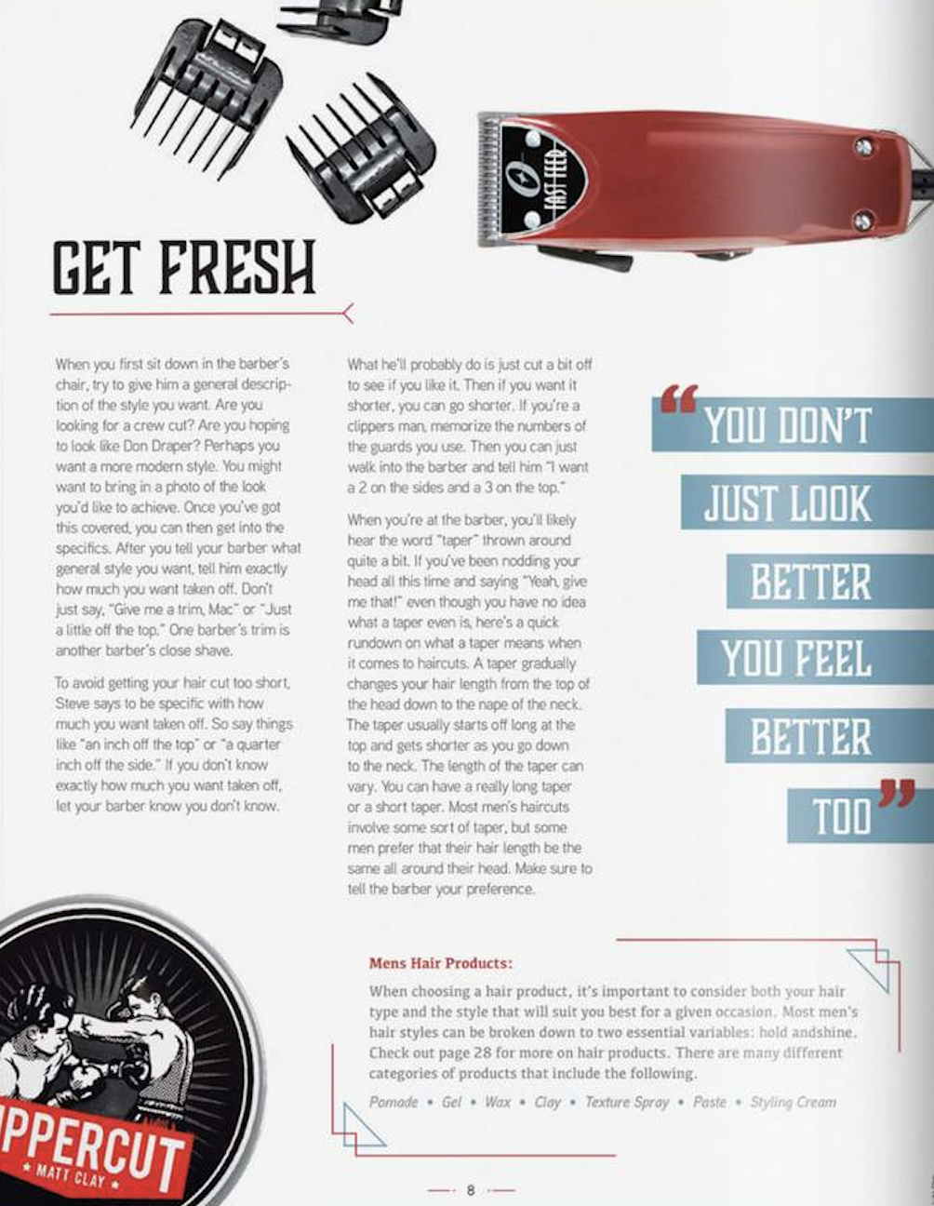
Technical Language
Articles about specific topics, hobbies, and interests are very likely to use language from that particular lexical field. This kind of language is called technical language.
Recognizing technical language is an excellent way of judging audience and purpose. If the language is overly technical, the article is certainly for a niche readership.
However, if the language is more everyday, or if the writer explains the meaning of certain words and phrases, the article is likely to be for a wider readership.
Overly technical language is called jargon, and overusing this type of language may have an off-putting effect, as if you are excluded from understanding the article.
Can you find examples of technical language in this excerpt from a feature article? Is technical language being used in an exclusive way? What can you infer is the article’s purpose and audience?
Notes:
“Clippers, taper, trim, ‘taken off’, crew cut” are some examples of subject-specific language from the text. While technical, the language is not overly exclusive. The way the article is written is more friendly and down-to-earth, foregrounding the idea of speaking to a hairdresser and asking for just the right style you want for your hair. While the theme of the article is ‘language matters’ (e.g. ‘one barber’s trim is another barber’s close shave’) overall it’s not that serious and would likely appeal to a wide audience of men who may feel entertained by a quick delve into an experience men stereotypically find uncomfortable: interactions at the hairdresser.

Slide 10
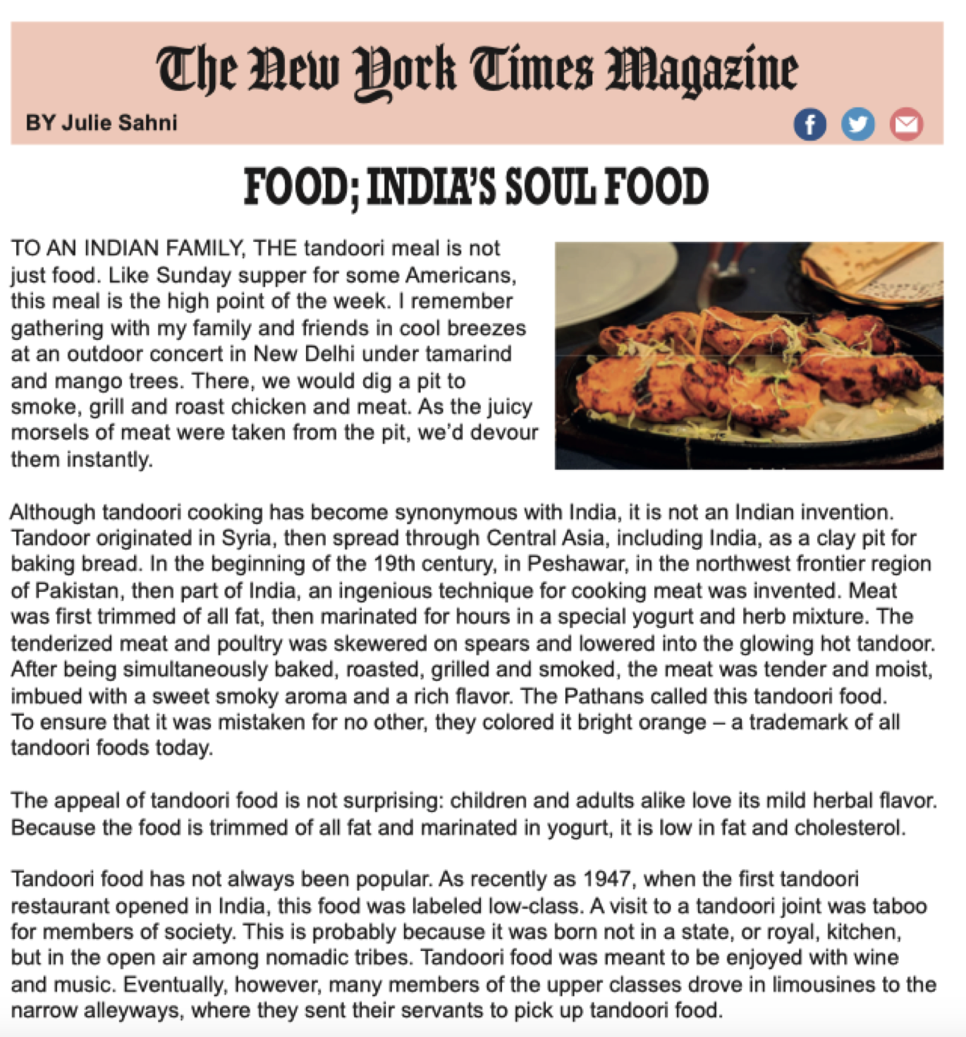
Figurative Language
Professional writers of feature articles use language in original and interesting ways. It is probable that you will find uses of figurative language throughout any feature article you are given.
The most commonly seen figurative language is metaphor, a type of comparison that describes one thing in terms of another.
A metaphor that extends through an entire text is called an extended metaphor. Sometimes, understanding this metaphor can be the key to unlocking the meaning of the whole text!
Quickly read the article opposite. How is the metaphor from the heading developed in the next two paragraphs?
Notes:
The metaphor of tandoori being ‘India’s soul food’ is introduced in the headline. This implies that food is more than just ‘something to eat’; rather, Indian people feel like they can be defined by the way they cook their food. The idea that ‘food is more than just food’ is developed in the first paragraph through words and images that create a sense of food bringing people together. A prime example is ‘I remember gathering with my family and friends in cool breezes’ as is the use of the word ‘we’ and other inclusive language (e.g. ‘children and adults alike’) throughout the article. In the second paragraph, the history of tandoori is briefly summarized, suggesting that food crosses national and ethnic boundaries. Language used when describing the cooking method is certainly ‘soulful’, for example: ‘ the meat was tender and moist, imbued with a sweet smoky aroma and a rich flavour’ is a very evocative sentence describing a wonderfully intense culinary experience.

Slide 11
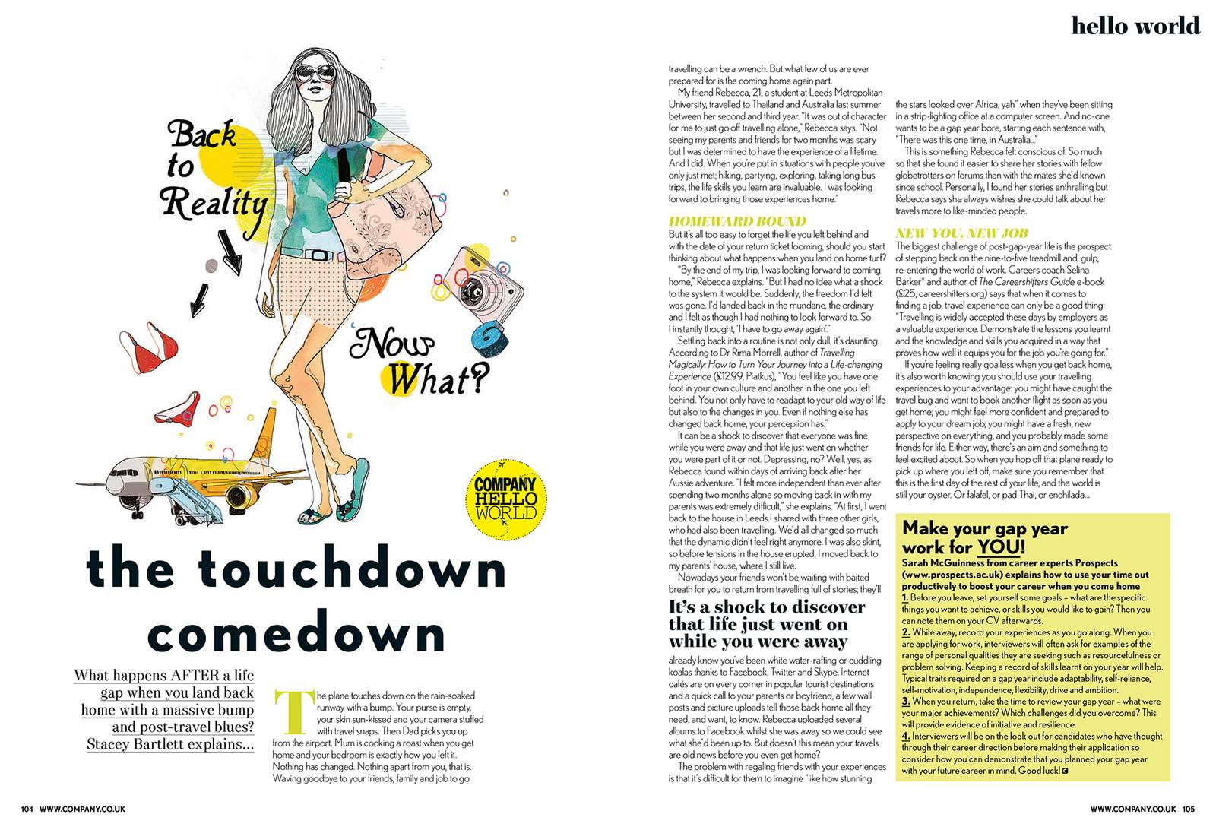
Your Turn…
Download the feature article on the left and print it clearly so you can read the words.
Practice by working with the guiding question: Analyze the ways this feature article both engages and informs the reader.

