Slide 1

Adverts Sell More Than Stuff
As Don Draper would say, an ad should make you feel something. With the advertising industry’s strong emphasis on values-based marketing, more brands are creating emotive adverts that sell more than just stuff.
You will see a series of adverts that convey ideas, values, attitudes, feelings, and beliefs. As you are shown each ad, write down the first words that come into your mind. The first slide provides an example.

Slide 2
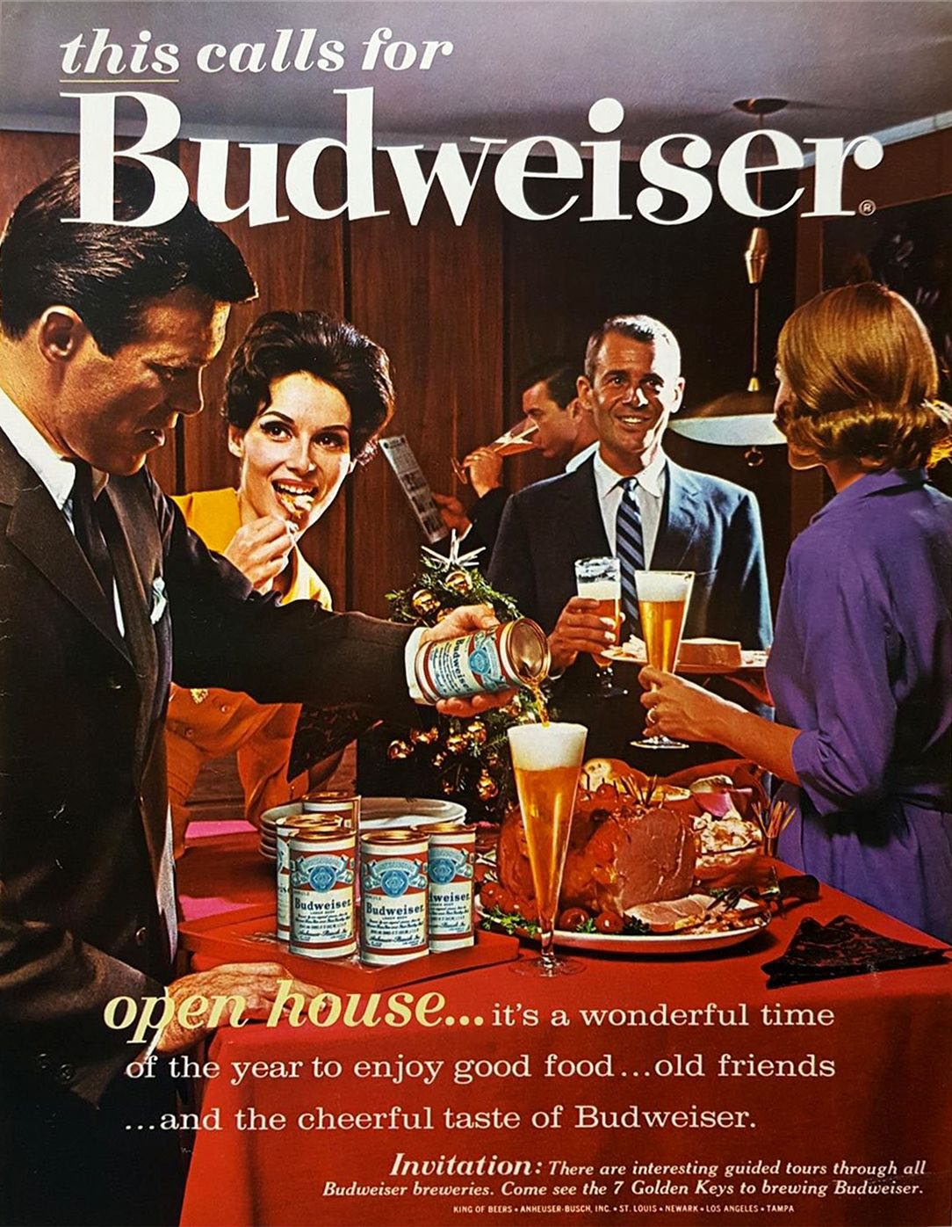
Budweiser Beer
Friendship
Community
Socializing
Get together
Attractiveness

Slide 3
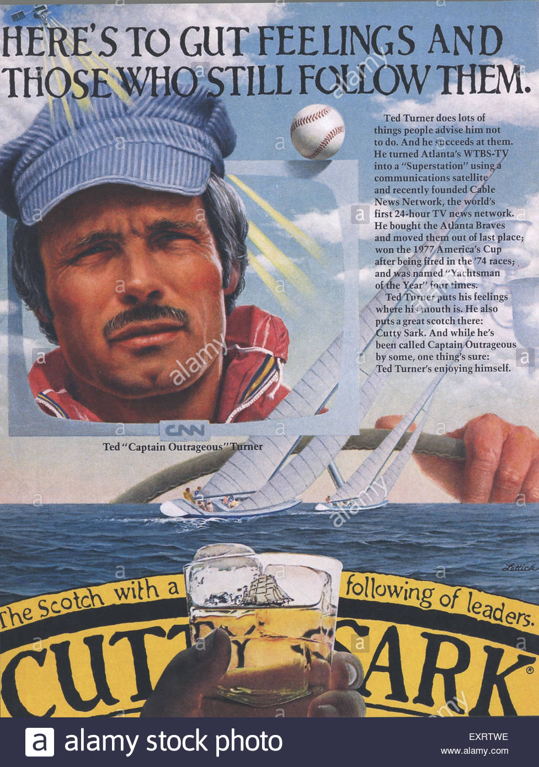
Cutty Sark Scotch Whisky

Slide 4
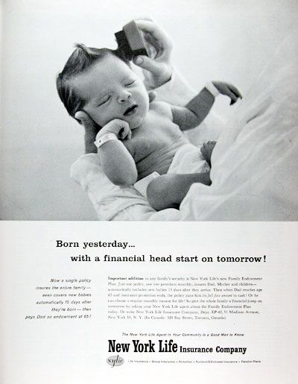
New York Life Insurance

Slide 5

Panera Bread

Slide 6
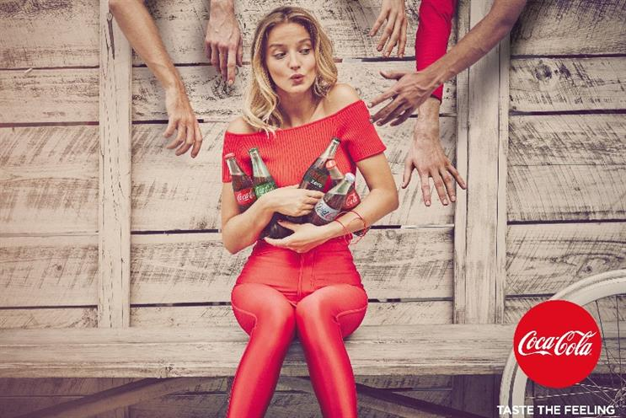
Coca Cola

Slide 7

Phone Case

Slide 8
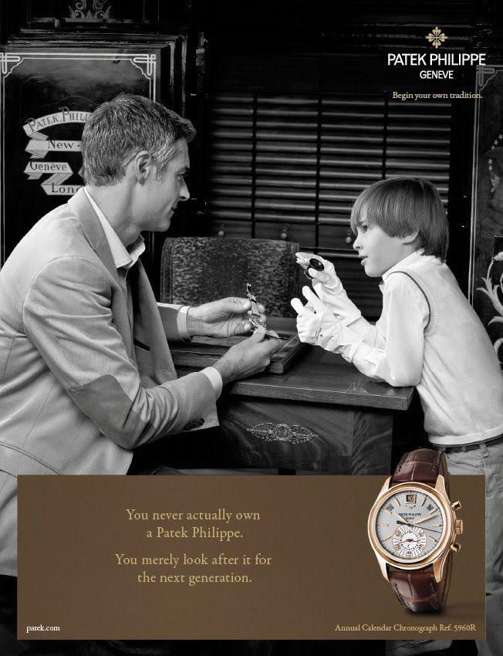
Patek Philippe Watches

Slide 9
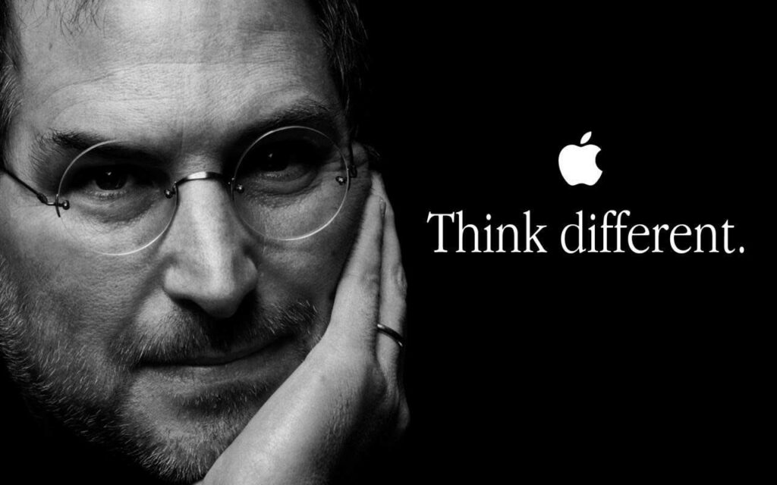
Apple

Slide 10

Lego

Slide 11

Jeep

Slide 12

FedEx

