Slide 1
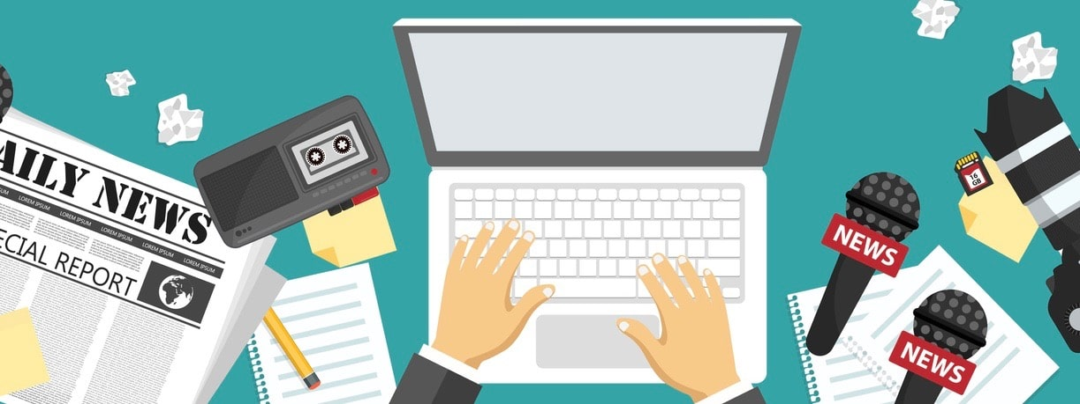
Text Type Focus: News Articles
IB English Language and Literature Paper 1: Textual Analysis

Slide 2
Headlines
Headlines summarize the story to follow. The biggest headline on the page is called the ‘main splash.’ Good headlines contain 4Ws: where, when, who and what.
The purpose of a headline is to attract attention and hook the reader, so bold typography is always used.
The writer’s attitude towards the story is conveyed through word choice, especially active verbs.
Compare these headlines about the same story: how does the word choice of the headlines convey the writers’ attitudes and help you make predictions about the angle of the story to follow?
Blow to Brexit as new deal sees trade slump.
Key trade agreement with Japan branded Brexit boost.
New deal disappoints as Brexit Britain lags behind trade rivals.

Slide 3
Different Headline Styles
There are several techniques available to the headline writer (who is often the newspaper sub-editor and not the writer of the article) including:
  Question – which the article will go on to answer.
  Hammer - designed to be vague. Often omits verbs.
  Catchy – using alliteration, rhyme or assonance to sound appealing.
  Shock factor – a bold, controversial or opinionated statement.
  Slammers – a two-part headline separated by a colon.
  Factual – often containing a surprising or important statistic.
Obama Wins: race barrier broken in historic election result
Rockstar Ate My Hamster!
Underwear Bandit’s Bad Day
Vegas Bloodbath on Night of Shooting
12 Million Wiped After Crypto Crash
Will New Contract Launch Lebron into Sporting Stratosphere?
Which of these techniques can you identify in the headlines opposite?

Slide 4
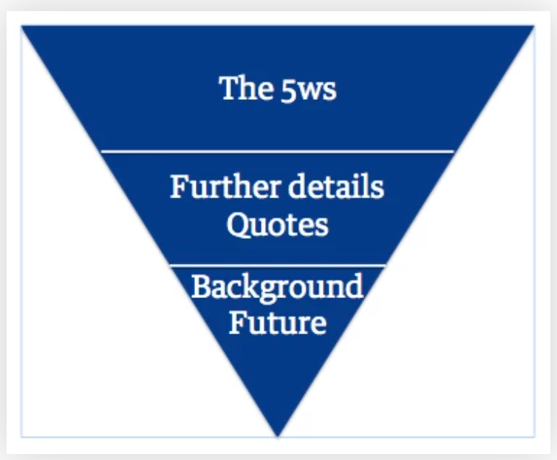
Structure
Research shows that 100% of readers absorb the headline – but only 20% of readers get to the end of the article. Therefore, journalists follow a writing structure called the inverted pyramid.
The most important information is in the first one or two paragraphs (called the lead) followed by extra detail and supporting information in the main body. Finally, backstory and predictions about what might happen next are given at the end of the article (called the tail).

Slide 5
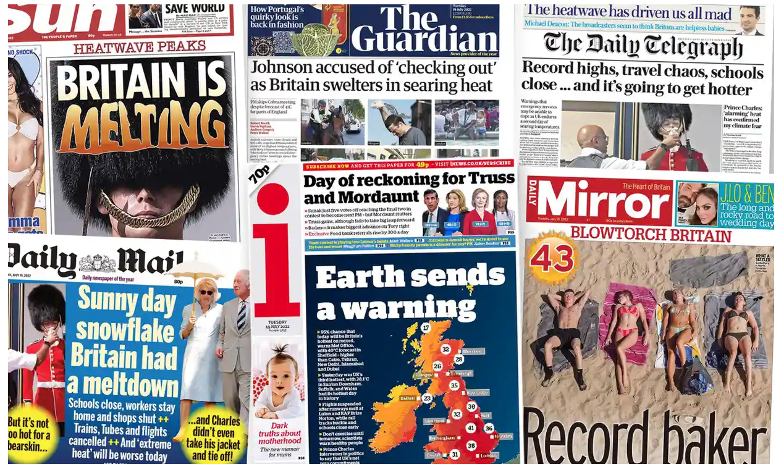
Audience and Newsworthiness
The news doesn’t just happen. People decide what events are reported by using criteria called news values. While there are many to learn, you can look out for the following more-common values:
  Impact – stories that have relevance for people’s lives or might affect the reader in some way.
  Proximity – news is affected by geography. The closer the event to the reader, the more likely it is to make the news.
  Scale – the larger the event, and the more people it effects, the more newsworthy it is.
  Prominence – does the story involve a celebrity or authority figure? As a general rule, the more ‘elite’ the person, the more likely he or she is to make the news.
  Extraordinariness - a story about a dog biting a man is not news; but if a man bites a dog, people want to know about it. The more unusual, strange or bizarre the story, the more newsworthy it becomes.
Which of these news values can you detect in the stories on the front pages opposite, all taken from British papers dated 19th July 2022?

Slide 6
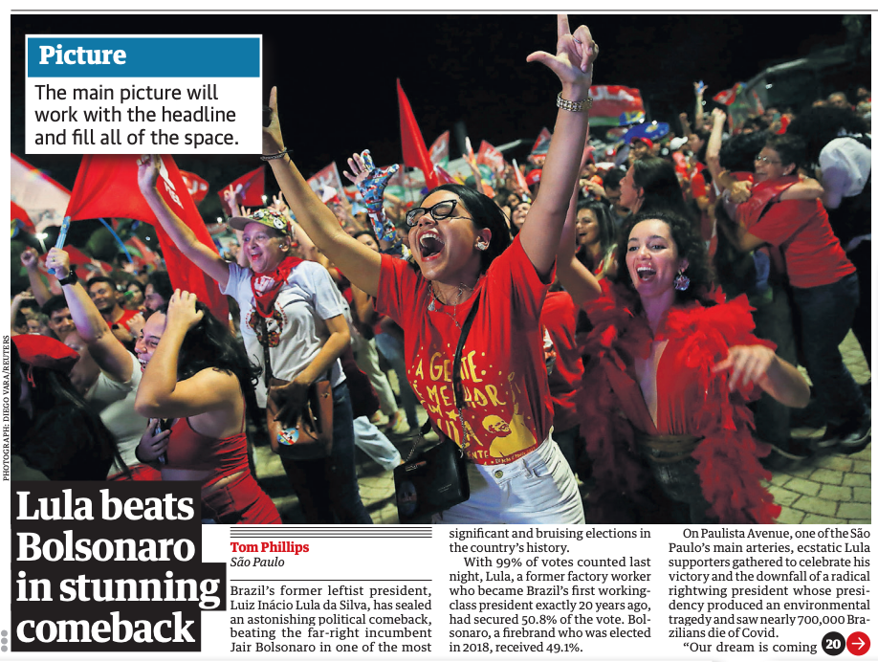
Photography
The main picture will work with the headline to provide visual information for the reader.
You can learn various ways how images and photographs can be analyzed here.
Tabloid newspapers may be dominated by photographs, while broadsheets may have more of a balance of image to text.
What are one or two significant aspects of the photograph accompanying the story in this news report?

Slide 7
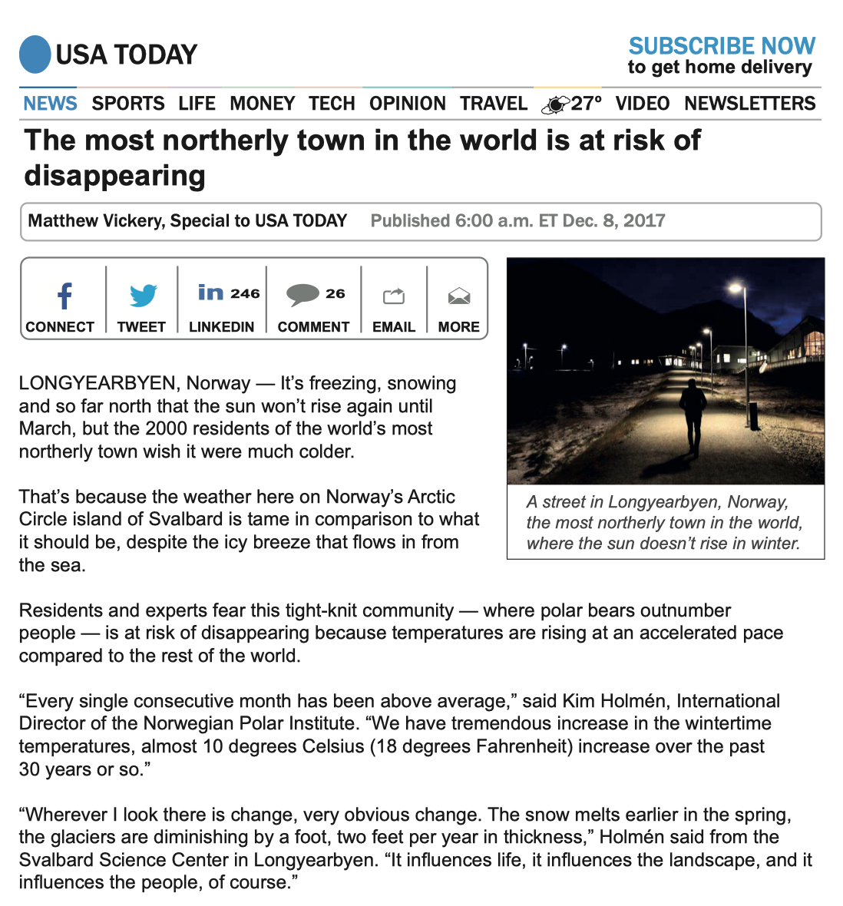
Sensationalism
Bad news is good for news circulation. As the old saying goes: ‘if it bleeds, it leads.’
The language, stylistic features, and word choice of a sensational news story is likely to emphasize, dramatize or exaggerate any sensational aspects of a given story.
The hallmark of sensationalism is emotive language.
Can you find aspects of sensationalism in the story opposite?

Slide 8
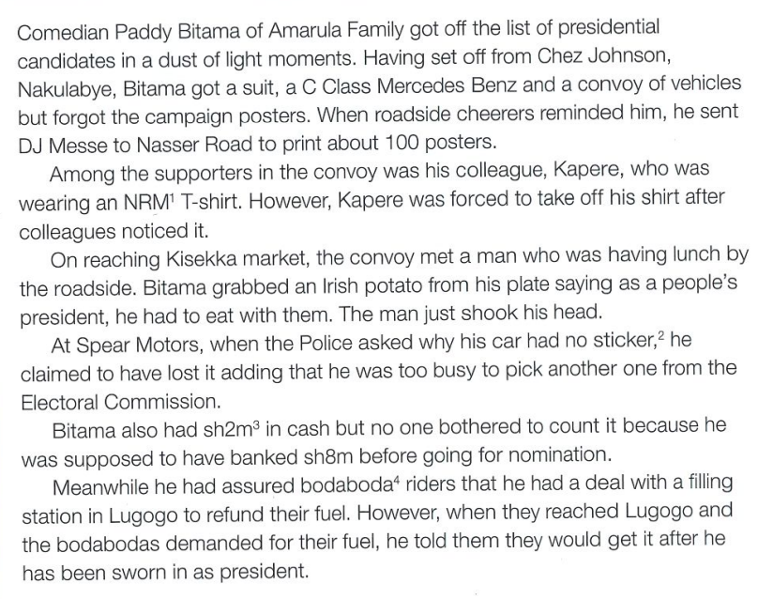
Vague Language
While newspaper journalists are meant to report the truth, that doesn’t stop some writers resorting to vague language to create effects linked to sensationalism.
Vague language is a problem as it encourages the readers to make false assumptions. For example: frequent, many, about, lots, few, more than are all vague qualifiers.
Vague language might be figurative. For example, the phrases stunning model, dirty tricks, mystery deepens, and people’s champion are all vague.
Can you find examples of vague language in this report from a Ugandan paper about the presidential election campaign?

Slide 9
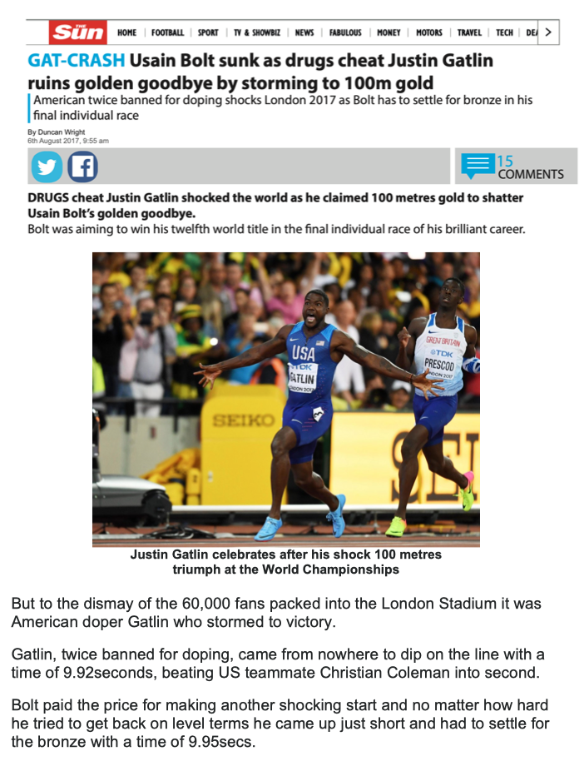
Bias
While journalists are meant to report the news in a factful and objective way, perhaps it is inevitable that some opinion creeps into news stories from time to time.
Bias can be defined as elements of the article – particularly word choice – that leads the opinion of the reader.
In what ways is the story opposite flagrantly biased towards one participant over the other?

Slide 10
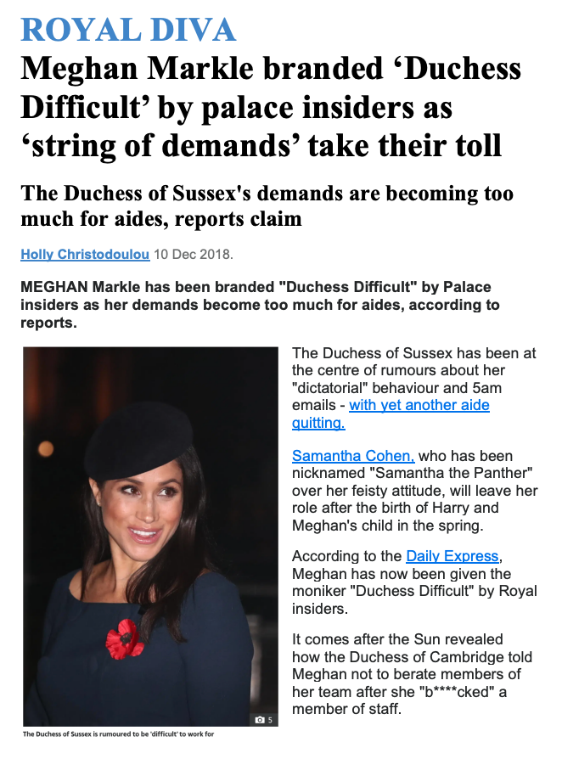
Embedded Interviews
If an event is unpredictable (such as an accident, crime, or a natural disaster) it is unlikely the journalist will have been present at the event.
Witness interviews are essential in establishing the credibility of the story.
A journalist may also interview experts or authority figures in order to provide more detail to the reader.
Whose words are included in the article is an important way of establishing bias. For example, perhaps only one side of the story is presented.
The words of an interviewee can be presented in reported speech (inside quotation marks) or as indirect free speech (e.g. Sources have reported that…)
What do you notice about the embedded interviews in this newspaper story about Meghan Markle?

Slide 11
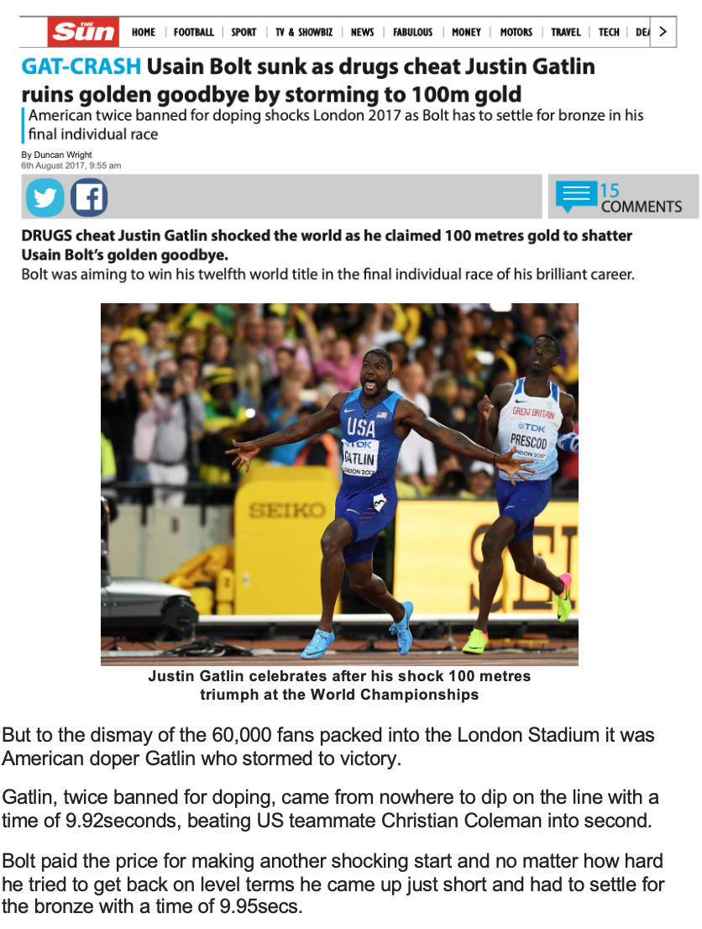
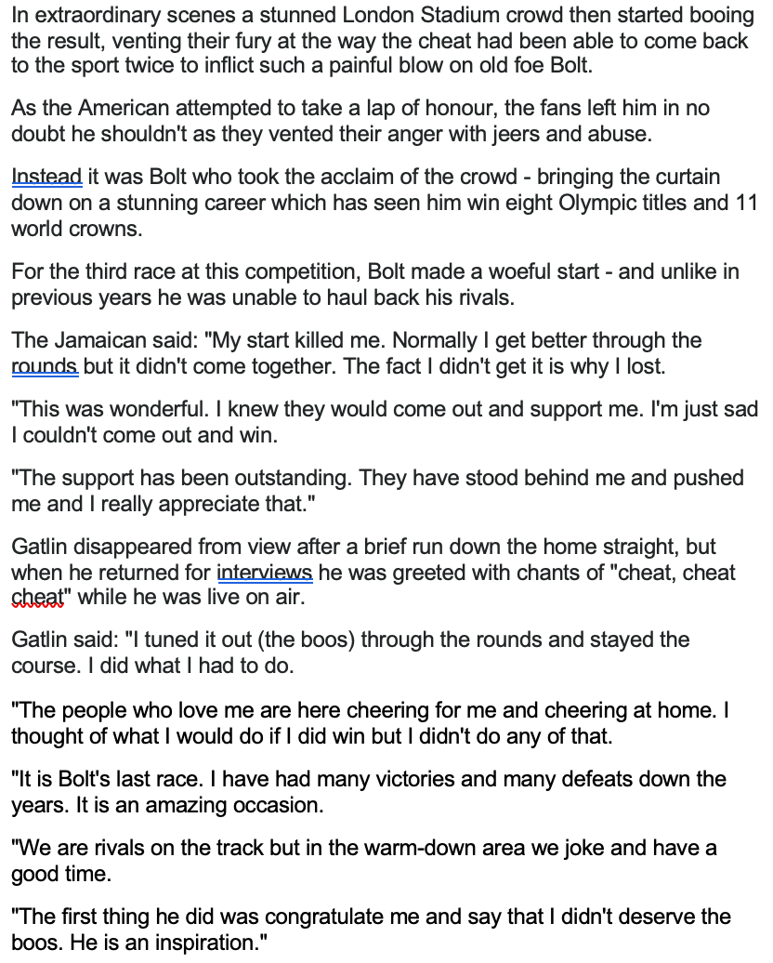
Your Turn... Analyse how both Usain Bolt and Justin Gatlin are presented in this newspaper report.

