Slide 1
The Spread of English

Slide 2

Aims and Objectives
Of all the languages in the world, why has English become the world’s lingua franca? Marshall McLuhan coined the phrase ‘global village’ in the 1960s to refer to the way people were reaching out to connect with one another – but he could not have known at the time that the unifying language of this village would be English. As an introduction to the IB course, we will find out how English became the language of the global village by looking at the convergence of three groups of factors: historical factors, economic factors, and popular culture.

Slide 3
Quick Quiz
How many people speak English as a native language?
200 million
400 million
600 million
1 billion
How many people speak English as an additional language?
300 million
400 million
600 million
1 billion
How many people are learning English today as a foreign language?
300 million
400 million
600 million
2 billion

Slide 4
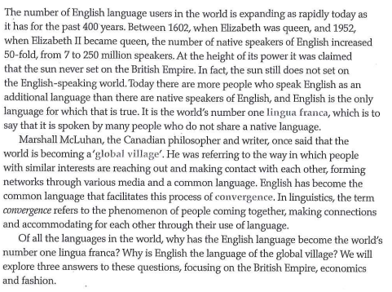
English as a Global Language

Slide 5
Do you know these key terms?
Anglophone world
Text
Culture
Lingua Franca
Global village
Convergence

Slide 6
Key Terms
Anglophone world: places in the world where English is spoken
Text: any written work or transcribed piece of speech. For the sake of our studies, we will think of texts as clues that lead to a better understanding of one of the many Anglophone cultures, and these clues can range from e-mails to poems and from advertisements and posters to books
Culture can have 2 meanings:
  It describes the values, goals, convictions and attitudes that people share in a society.
  It refers to the fine arts and a society’s appreciation of the arts.

Slide 7
Key Terms
Lingua franca: a language spoken by people who do not share a native language
Global village: describes how members of a social group can be spread around the world, but be interconnected through various media
Convergence: describes what happens when people come together and accommodate for each other through their use of language

Slide 8
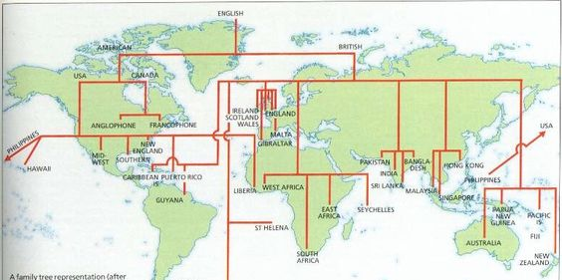
Historical Factors: The British Empire
If you look at a map of the English-speaking world, you can see that many ports are connected to the UK. It is not difficult to see why English became the language of the shipping industry! In each of these ports, English was used to conduct trade, navigate and communicate inside ports and on the open sea.

Slide 9

Historical Factors: The British Empire
Watch this video created by linguist Olly Richards, who studies the history of languages and speaks 8 languages – including English (duh!) – and explains the historical factors behind the spread of English around the world.

Slide 10
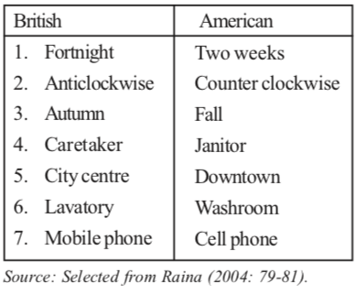
Economic Factors: The World Market
Looking at India can help explain the economic advantages of learning English. In a country with over a hundred dialects, the English Language is one that connects people from all corners of this vast country. Economically, India is very outward looking; many Indians learn English to compete in the World Market. This image is an example taken from call center training: by ‘improving’ their accents and use of English, many Indians can improve their employment opportunities.

Slide 11
Language Currency
These texts raise the issue of language currency. Mastering English can bring rewards – in this case, financial rewards.
Being motivated to do one thing (like learn a language) so that you can accomplish something else (such as preventing an accident, providing customer service, or passing a job interview) is called instrumental motivation. A candidate who can speak English might mean the difference between a contract being awarded to one company instead of another. This person is more likely to land the job.
On the other end of this spectrum is integrative motivation, which means learning something in order to fit into society. Think about why somebody might learn Finnish instead of English and you’ll understand integrative motivation.

Slide 12

Cultural Factors: Being Cool
Anglophone culture is spread around the world today through influential media such as BBC, MTV, and so on.
For many (young) people, the English language is associated with ‘cool’ and ‘fashionable’ ideas – celebrities, good looking clothing, new headphones, and Hollywood movies.

Slide 13

You can see how the English language has ‘infiltrated’ Dutch by reading this magazine cover. Even if you’re not a Dutch speaker, you can probably understand most of the meaning of this text

Slide 14
Language Borrowing
The last text draws our attention to a phenomenon known as language borrowing, where one culture imports words from another language. The Dutch are not the only culture to ‘borrow’ English words.
The Japanese say ‘karisamas’; the French say ‘le weekend’; the Chinese say ‘taksi’. These words are technically called loan words.
Language borrowing works both ways: English has borrowed loan words from hundreds of different languages: ‘jazz’ is from West Africa; ‘sofa’ is Arabic and ‘boomerang’ is Australian, to give but three examples.

Slide 15
Review these key terms. Do you know what each term means?
Language Currency
Instrumental Motivation
Integrative Motivation
Bilingualism
Language Borrowing
Loan words
Etymology
Lingua Franca

Slide 16

Class Activity
The study of English words is called etymology (not to be confused with ‘entomology,’ which is the study of insects). Browse through a dictionary, looking specifically for the origins of words. How many different historical origins can you find in 10 minutes?
Use the blank world map on the next slide. Use this map to show where English words come from.

Slide 17
