Slide 1
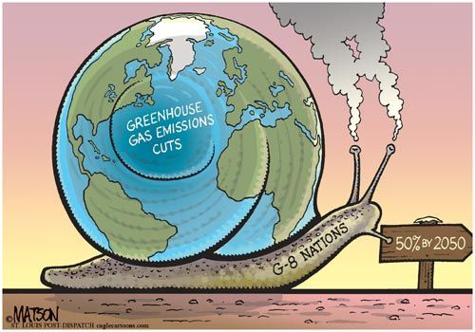
Text Type Focus: Satirical Cartoons
IB English Language and Literature Paper 1: Textual Analysis

Slide 2
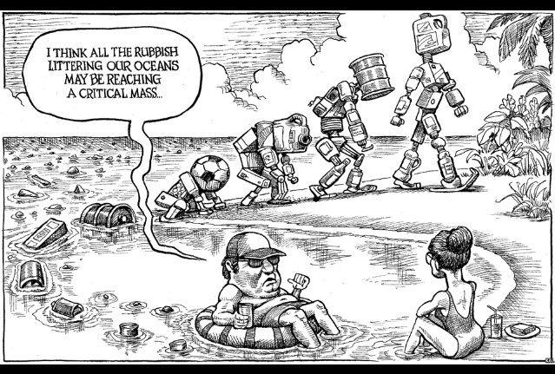
Purpose
Satirical cartoons are also called editorial cartoons or political cartoons.
The purpose of a satirical cartoon is to critique.
The cartoon is usually topical as the artist is commenting on current events.
The artist may want to draw attention to the actions of an individual. Favourite targets of satirical cartoons are politicians, celebrities and people in the public eye.
Can you identify the purpose of this cartoon, and express who or what is the target?

Slide 3
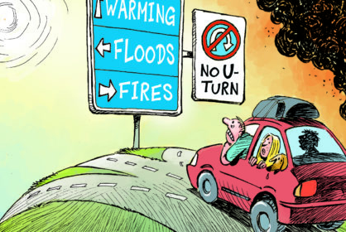
Structure
You are likely to see satirical cartoons presented as a single panel, as in this example by Patrick Chapatte.
Sometimes, though, satirical cartoons are designed to be read like a comic strip, such as the cartoon on the next slide.

Slide 4
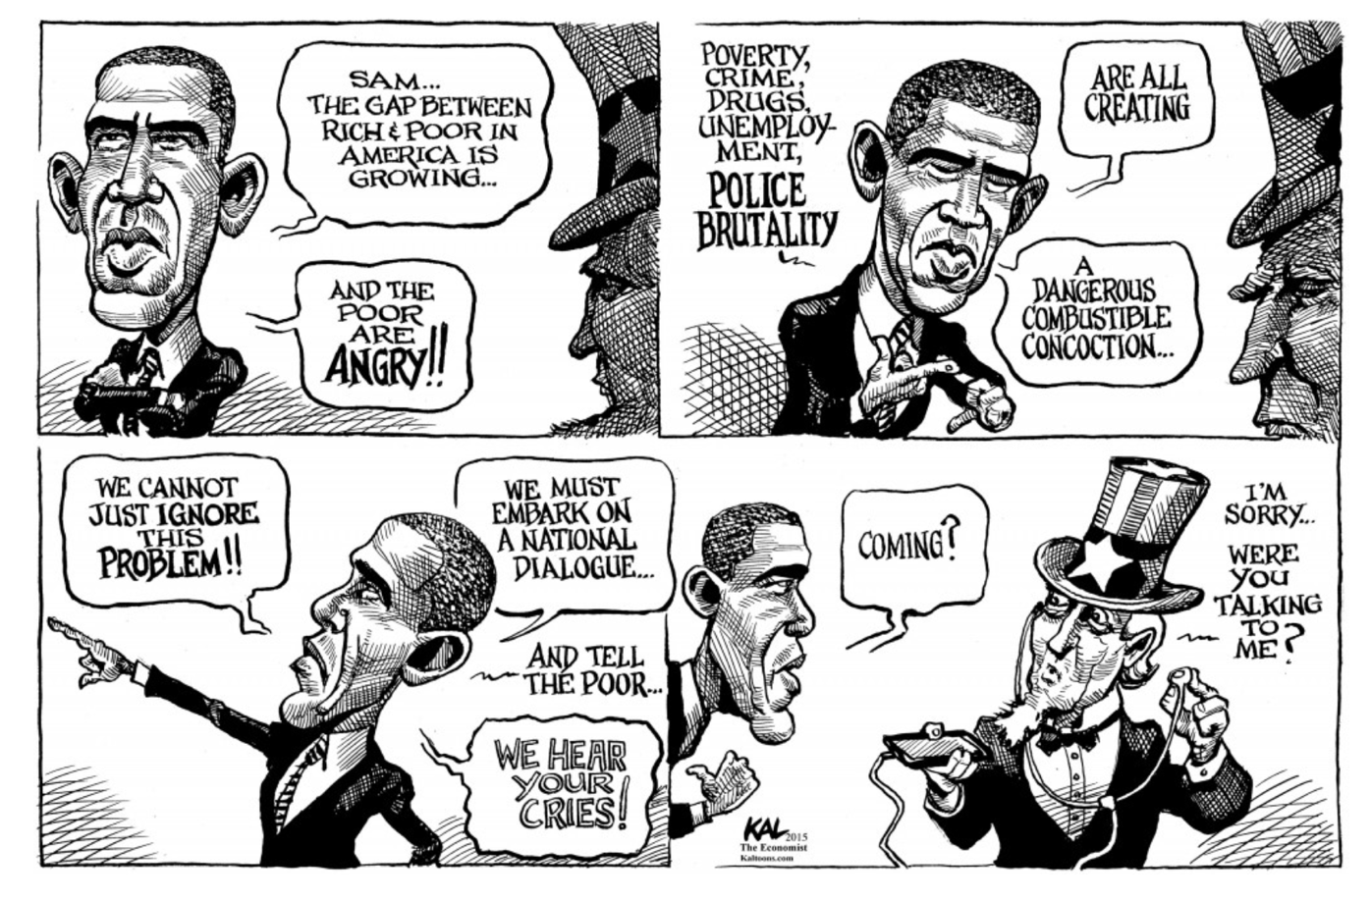
Caricature
People are simplified, distorted or exaggerated for effect in satirical cartoons. An overly simplified or distorted image is called a caricature.
Sometimes, a single feature of a person is enlarged or exaggerated in this way. This is a technique called synecdoche, whereby a part of something stands for the whole.
How is Barack Obama being caricatured by Kal Kallauger in this satirical cartoon?

Slide 5
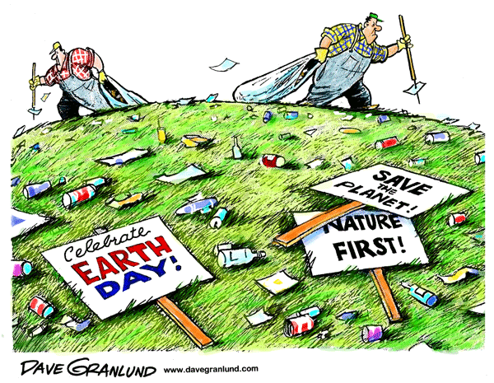
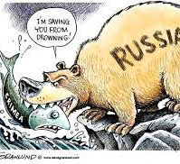
Irony
A satirical cartoonist often likes to draw attention to hypocrisy.
Therefore, the cartoonist employs frequent irony whereby a person’s actions contradicting their words.
Another kind of irony is situational irony, whereby one’s actions produce an opposite effect to those stated.
Can you identify and explain the irony in these cartoons by Dave Granlund?

Slide 6
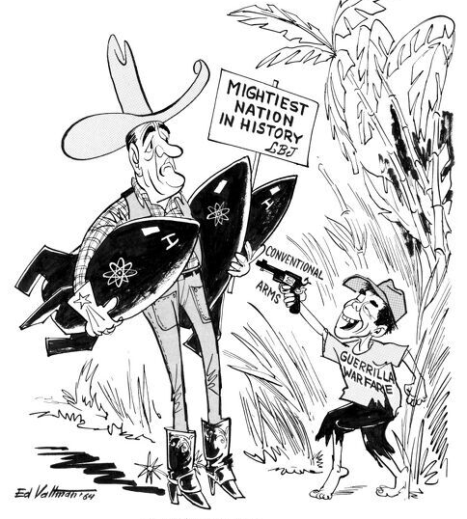
Symbolism
Items, colours and symbols convey meaning visually. Symbols stand for meanings other than themselves and may relate to ideas outside the text.
A sometime-seen convention of satirical cartoons is for artists to label the items or characters in the image.
Can you identify and explain the symbolism in this political cartoon from 1964?

Slide 7
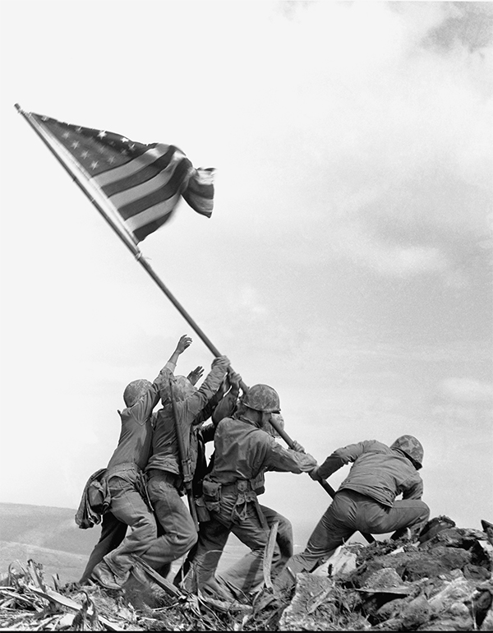
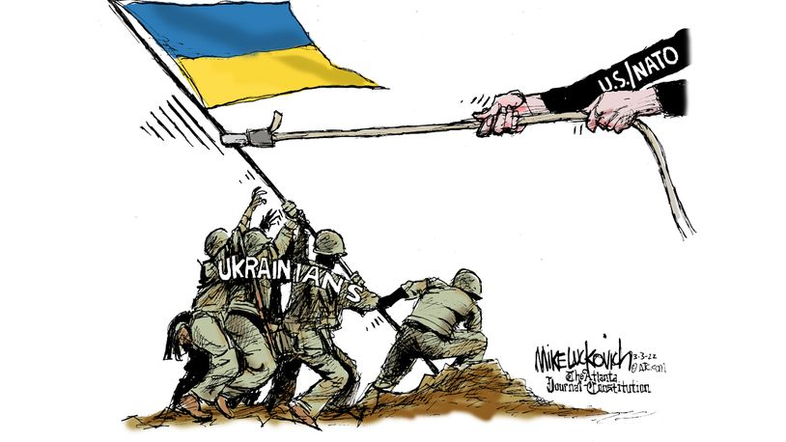
Allusion
Sometimes an artist will make a reference to something outside the text. This is called an allusion.
The success of an allusion depends upon the reader recognizing this reference.
In this cartoon, artist Mike Luckovich alludes to the famous photograph of American soldiers raising the stars and stripes on the island of Iwo Jima during World War Two.
Did you recognize this allusion? Can you explain the purpose?

Slide 8
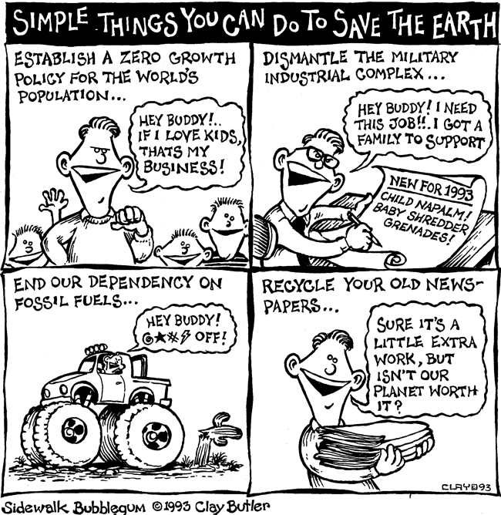
Tone
Tone reveals the attitude of the writer towards his or her subject matter.
Satirical cartoons can be pointed, sarcastic, angry, caustic, scathing, humorous, rueful and more.
How would you describe the tone of this cartoon, by Clay Butler?

Slide 9
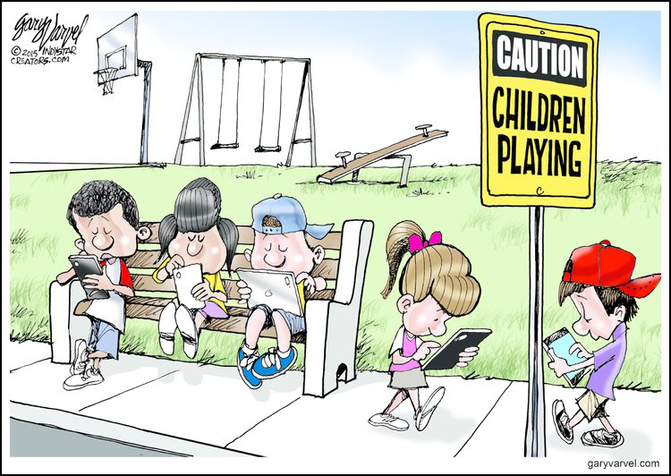
Bias
As an expression of the cartoonist’s opinion, the image will be bias.
Bias is an unfair prejudice towards or against a particular person or group of people.
Even if the artist is sharing a widely held opinion, it is still bias.
Can you identify the bias in this image, by Gary Varvel?

Slide 10
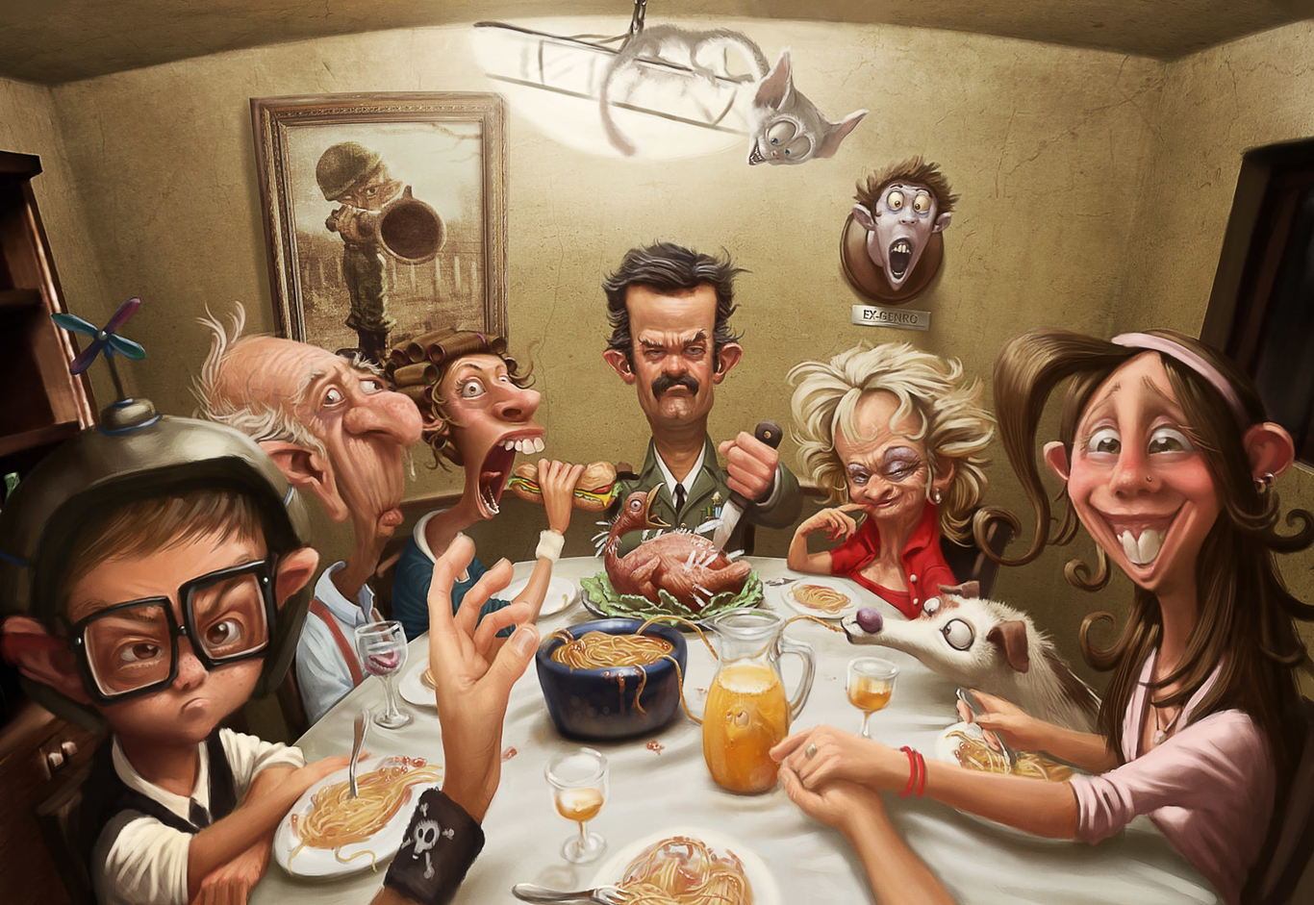
Your Turn…
Study this image, which is a computer-generated cartoon by Brazilian artist Tiago Hoisel.
Answer the guiding question: ‘Explore the methods by which this image creates a story in the reader’s mind.’

