Slide 1
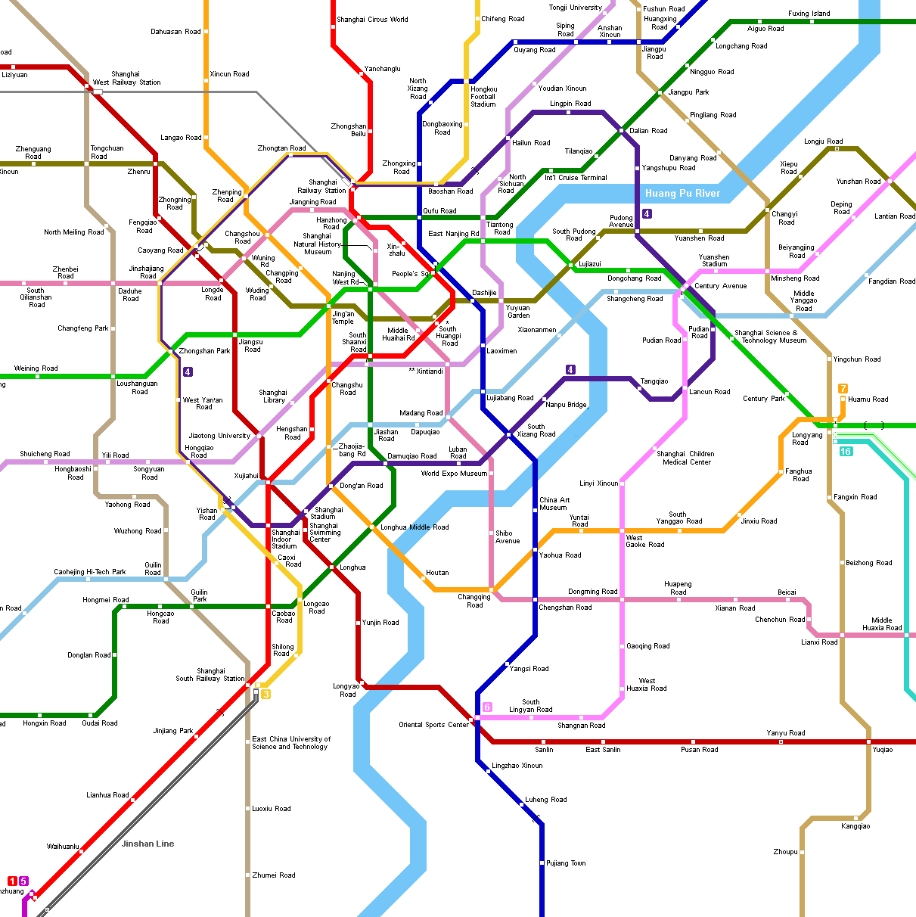
Text Type Focus: Infographics
IB English Language and Literature Paper 1: Textual Analysis

Slide 2
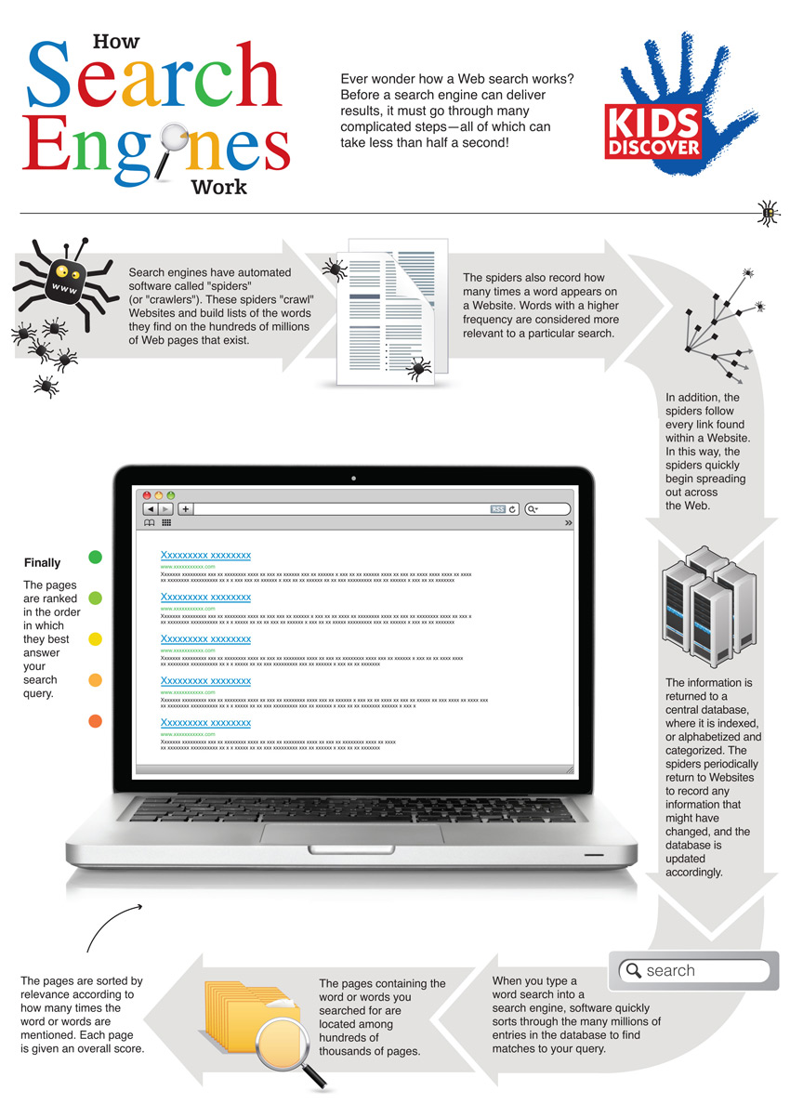
Purpose
Infographics (short for ‘information graphic’) are a visual representation of knowledge, statistics or data.
The main purpose of an infographic is to simplify complex information. They can be used in many fields such as medicine, journalism, education and more.
Infographics should also be eye-catching and engaging.
This gives simple, easy-to-understand information about how search engines work for a wide audience; it is designed in such a way that children can access the information in the text.

Slide 3
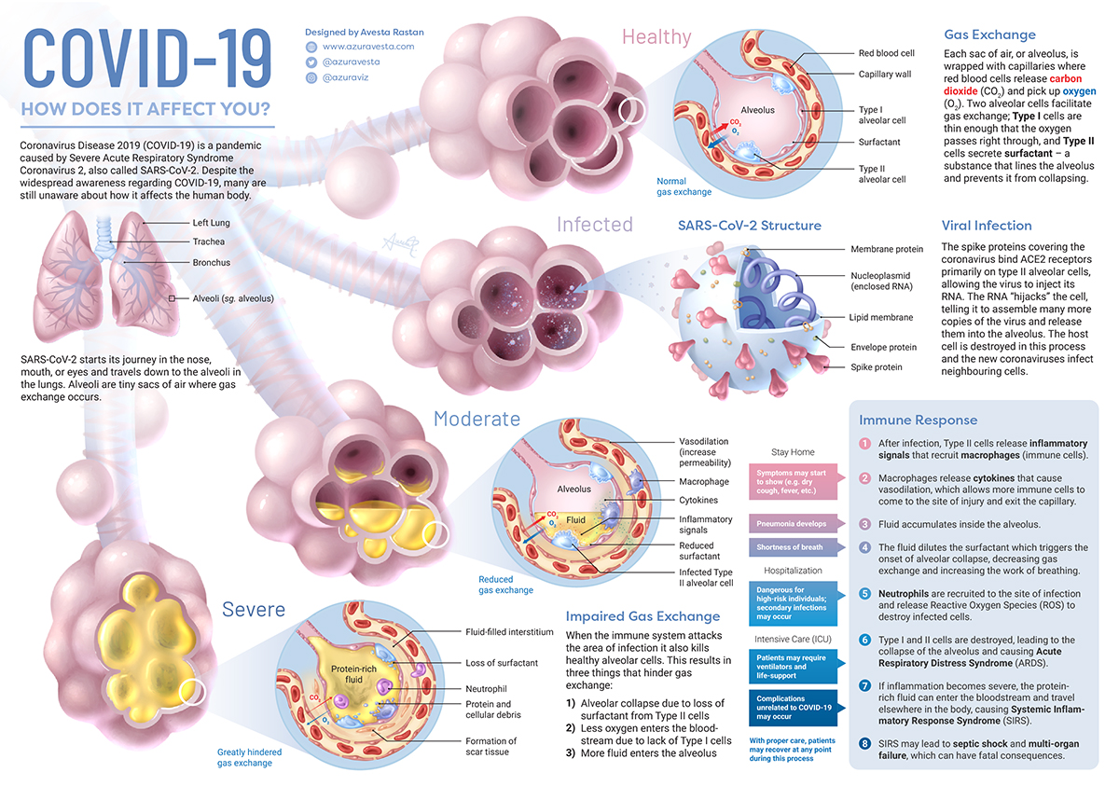
Audience
Many information texts are designed to reach as wide an audience as possible.
However, sometimes an infographic will be aimed at a certain group of people (a niche audience) or include more in-depth research.
This infographic, by Avesta Azur, is meant to be read carefully and contains technical language that might not appeal to a wide readership.

Slide 4
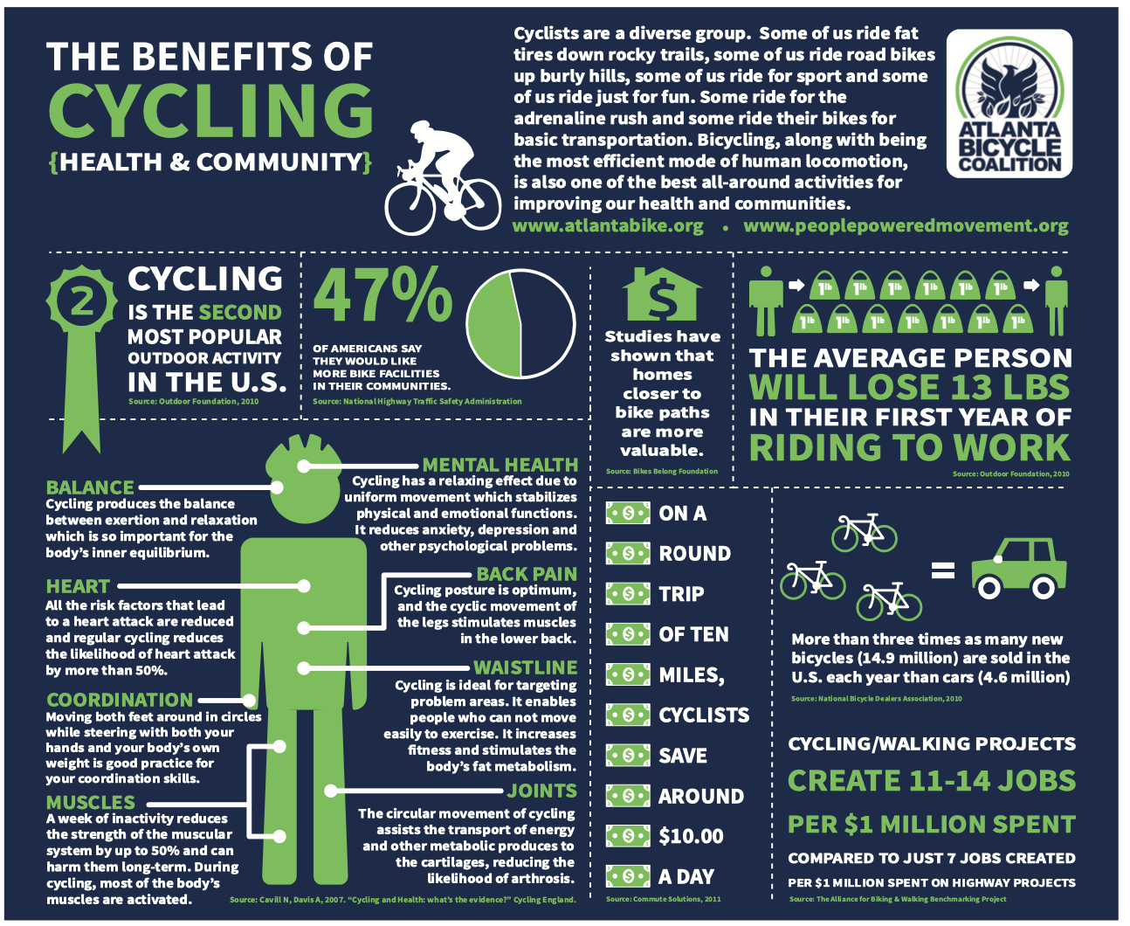
Data
One of the main components of many infographics is data.
Data may be presented as words, in numerical form, or in another visual way.
There may be some typographical features involved in the presentation of data, such as using colour, bold text or other kind of emphasis.
Data should be accurate and credible. Sources and citations help create trustworthiness for the reader.
How many ways of presenting data can you find in this text, an infographic by Jonathan Hart?

Slide 5
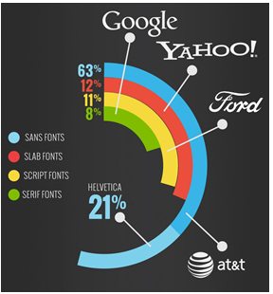
Graphs and Charts
More complex data might be presented using a graph or chart.
Charts should be enlivened by design features. This isn’t an excel spreadsheet or an accountant’s file. Infographics should present data in an engaging way.
What do you find effective about the way data has been presented in this image? (It presents research into the font styles used in the logos of the world’s top brands.)

Slide 6
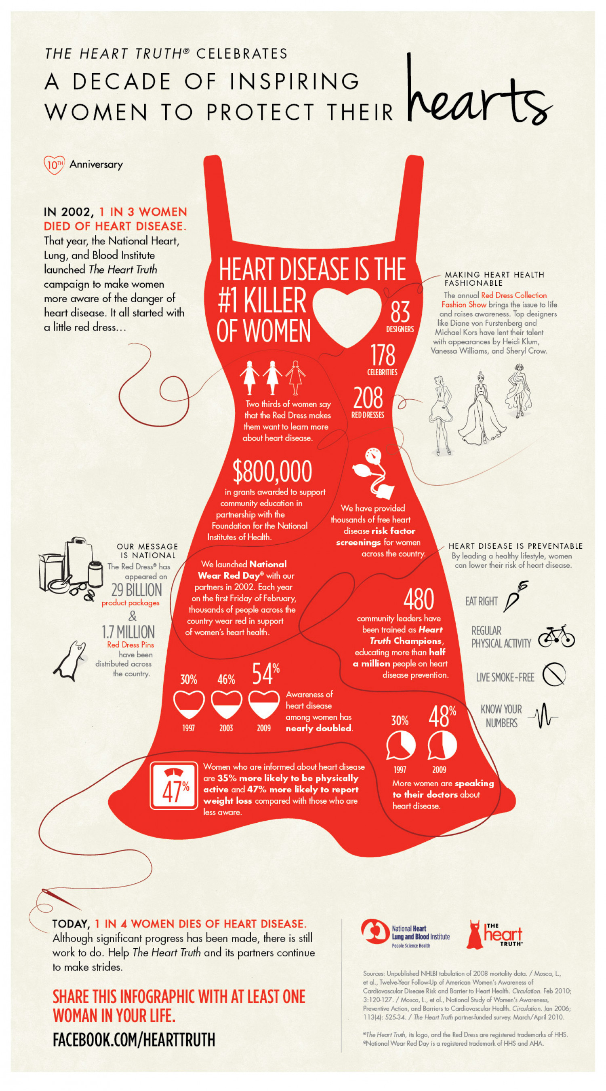
Illustrations and Icons
As a primarily visual text you will see all kinds of images when studying infographics.
Illustrations are images designed or drawn with the intention of presenting information in a simple, straightforward way.
Some images are simplified into icons. These are little symbols which represent some of the key concepts in the infographic.
What do the illustrations and icons in this text, an infographic by Ogilvy, symbolize?

Slide 7
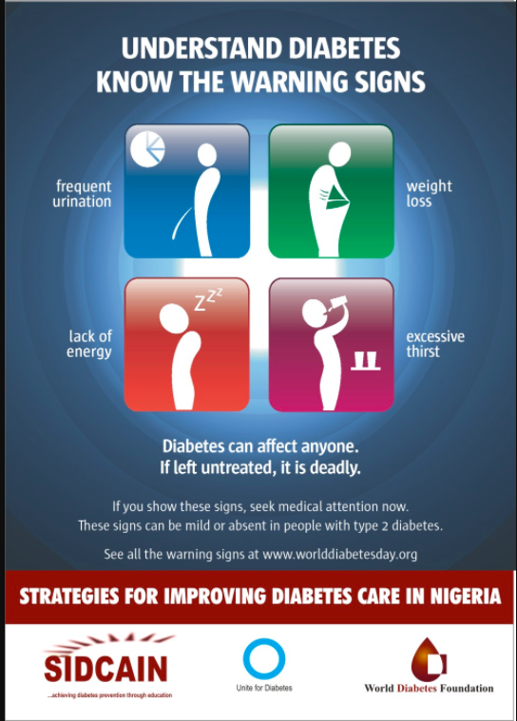
Copy
Most infographics are multimodal; that means they contain images and a certain amount of text.
Infographics may have headlines and subheadings that clarify different types of information.
Illustrations or icons might be labeled.
Short pieces of text are called snippets.
While most infographics try to keep it simple, there may necessarily be some technical language or topic-specific vocabulary in the copy.
How does text help to clarify images and give different types of information in this infographic from Nigeria?

Slide 8

Structure and Story
The best infographics don’t just present information; they are little visual narratives that tell a story.
You can often find sequential or chronological structures, or straightforward timelines, in infographics.
Look at this simple infographic. How is it structured in a way that tells (or implies) a story?

Slide 9

Colour
Infographics are designed to be eye-catching, so you can expect colour to be a feature of this text type.
Colour schemes are simple and designers normally choose a combination of two or three colours.
Look out for symbolic uses of colour and colours that suit the subject matter.
Can you describe the colour scheme of this infographic? Why are these colours particularly suitable for the subject matter?

Slide 10
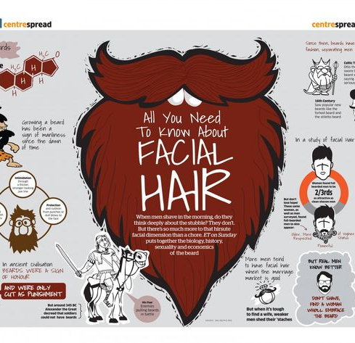
Design Elements
Infographics are designed as well as authored. You can expect a range of design features that may be unique to the infographic you are reading.
Design elements include background effects, layout and composition, lines that help guide the reader through the text, typography and fonts, and more.
Take a look at this infographic by Alankar. Can you identify and comment on one or two of the design features on show?

Slide 11
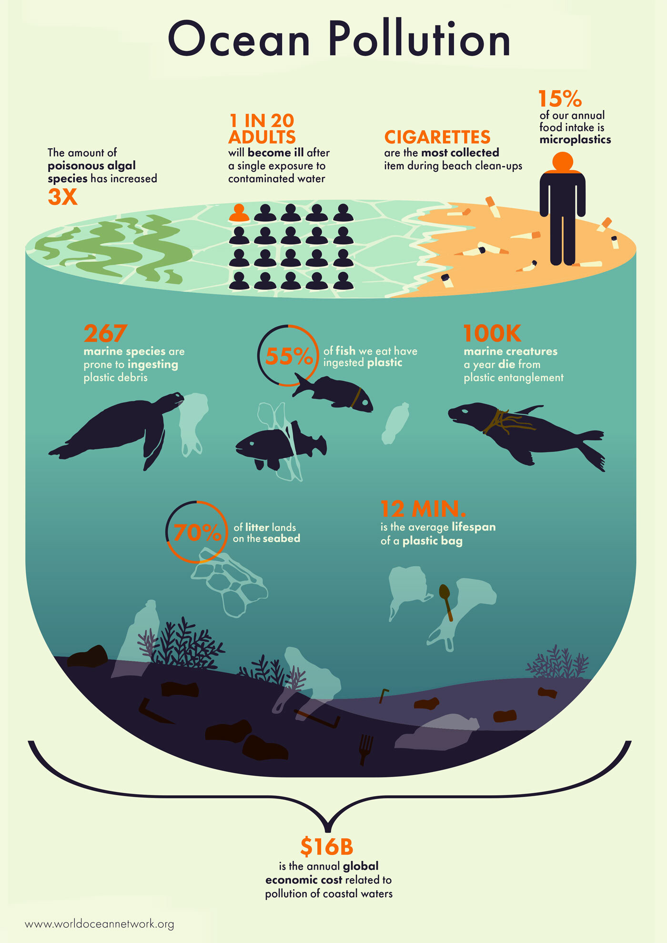
Your Turn…
Study this text, an infographic about Ocean Pollution by Stephanie Phung.
Answer the guiding question: Comment on the methods used in this infographic to both present information and create create other effects on the reader.

