Slide 1
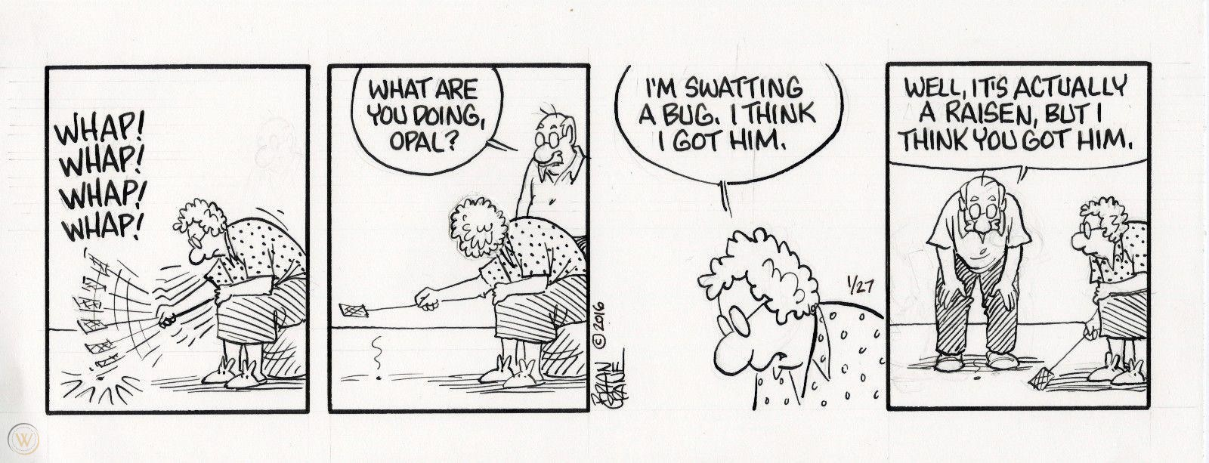
Text Type Focus: Comic Strips
IB English Language and Literature Paper 1: Textual Analysis

Slide 2
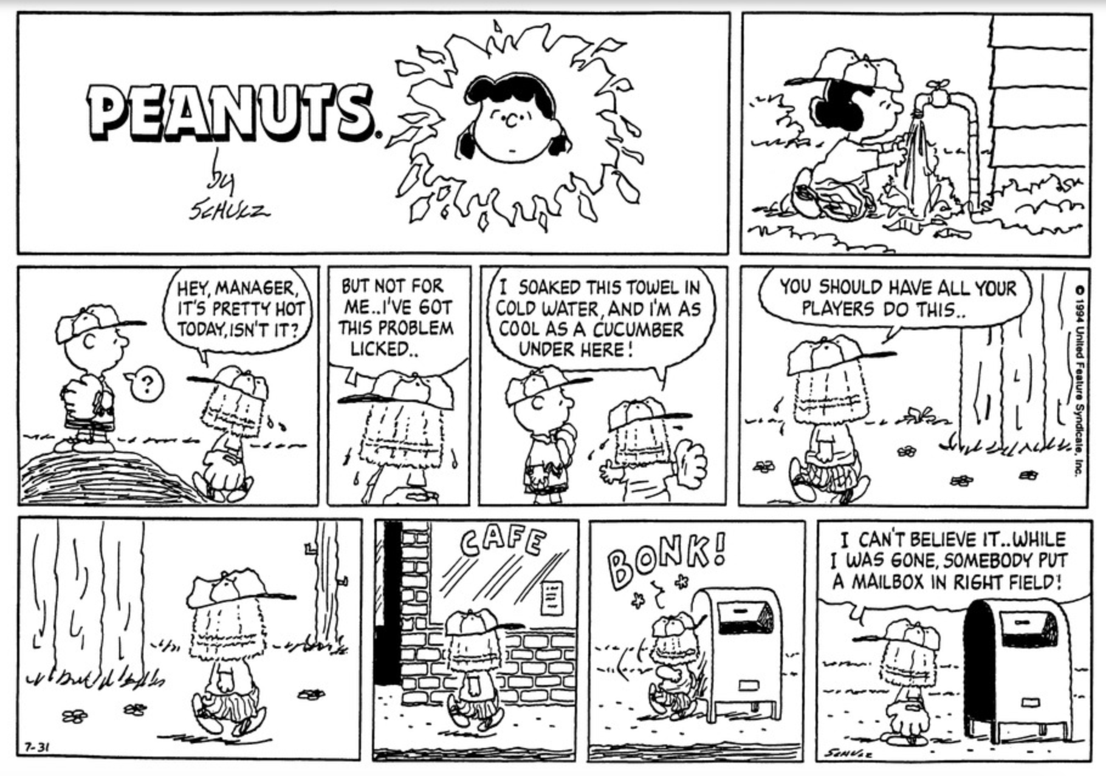
Structure
Comic strips are divided into multiple frames called panels. Each panel represents a single moment in time. Panels are read sequentially from left to right, top to bottom.
The white space between panels is called the gutter. When reading, your mind either consciously or subconsciously fills in the action between frames.
Some comics begin with a large panel that stretches from left to right. This is called a splash.
Analyze framing in the same way you would analyze camera angels in films: for example, long shot, close-up, high angle, low angle and so on.

Slide 3
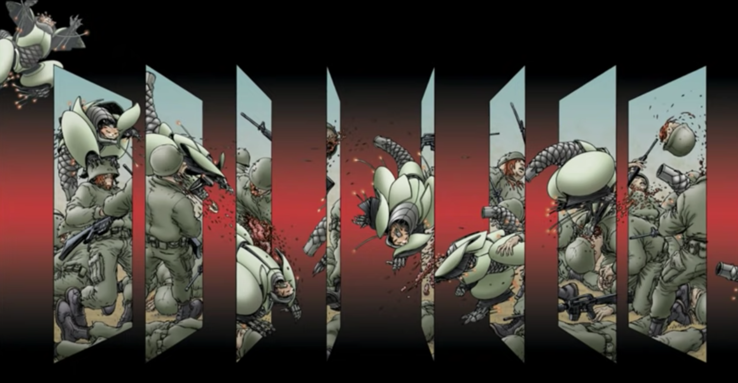
Space and Time
By manipulating panels and gutters, comic strip artists can rearrange space and time. This process is called spatial and temporal mechanics.
Can you explain how Frank Quitely, the writer of We 3, presents space and time in an interesting way in this image?
You might like to listen to Frank explain why comics are a unique narrative form in this interesting Tedtalk.

Slide 4
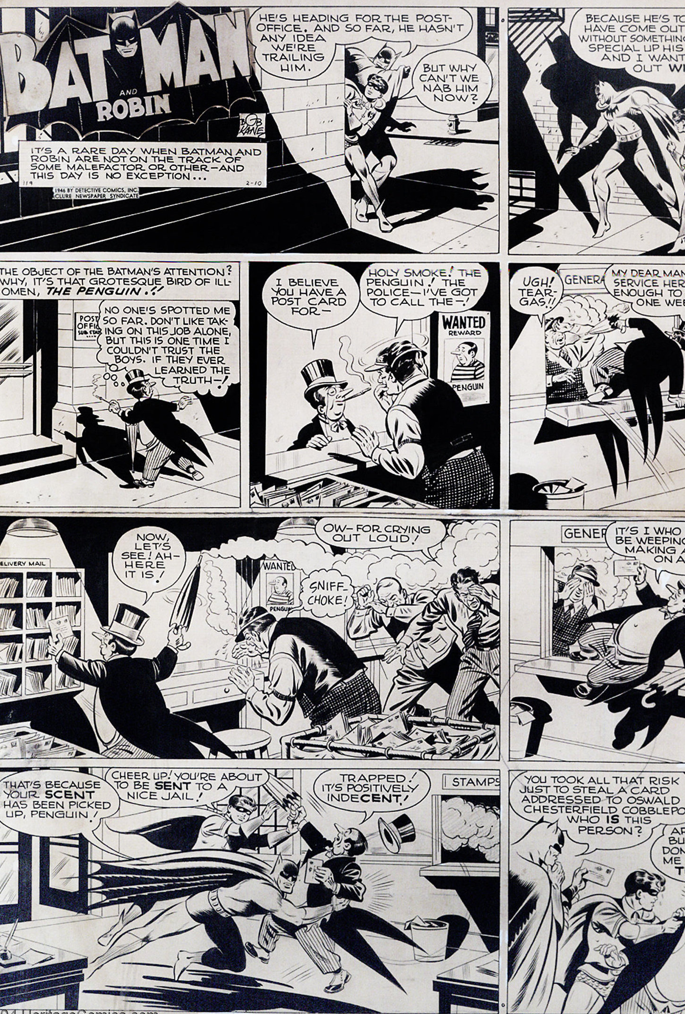
Exposition and Dialogue
Text that tells the story is presented in captions at the top or bottom of the picture.
Speech and thought is presented in bubbles emanating from characters. Can you tell the difference?
Thought bubbles cannot be seen or heard by other characters, only the reader.
Can you find examples of exposition, speech and thought in this cartoon strip?

Slide 5
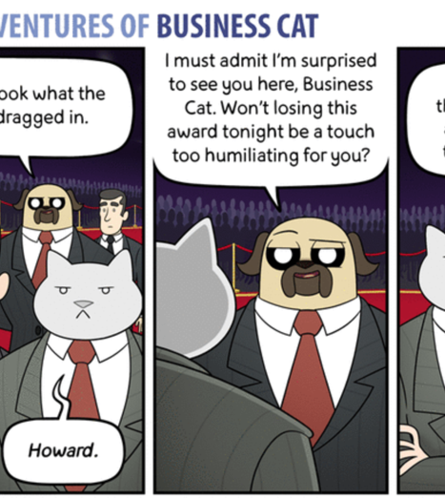
Symbolism
Items, colours and symbols convey meaning visually. Symbols stand for meanings other than themselves and may relate to ideas outside the text.
What do ‘ties’ symbolize in this strip, The Adventures of Business Cat by Tom Fonder?

Slide 6
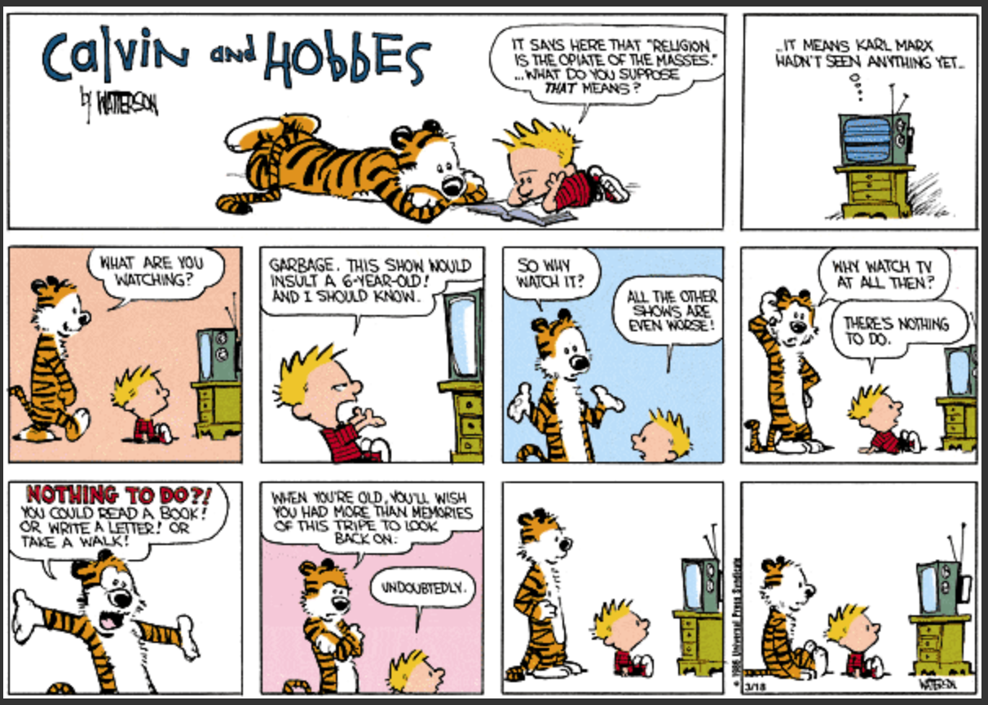
Negative Space
Also called empty space, blank space or dead space.
This technique can create different effects depending on how it is used. For example, it may suggest something is ‘missing’ or create tension.
Or it may help direct your attention on a certain point of focus.
What is the effect of negative space in the last frame of this comic, Calvin and Hobbes by Bill Watterson?

Slide 7
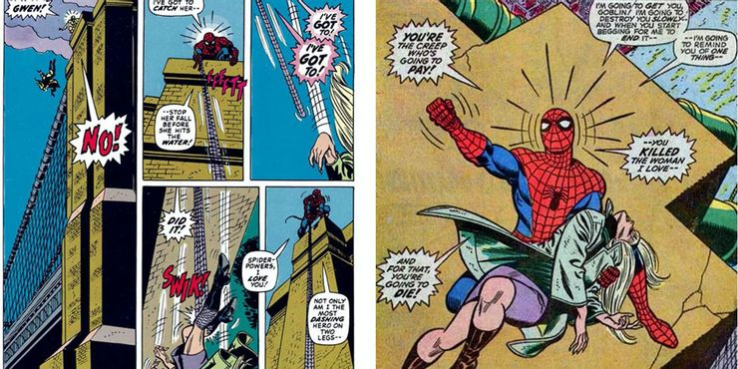
Emanata
A term that refers to dots, lines, exclamations, onomatopoeia, teardrops, light bulbs appearing overhead, or any other marks that depict thought, sound, action or emotion ‘emanating’ from a character or object in the scene.
Can you identify various emanata and comment on the effects created by this technique in this excerpt from a classic 1970 Spiderman strip?

Slide 8
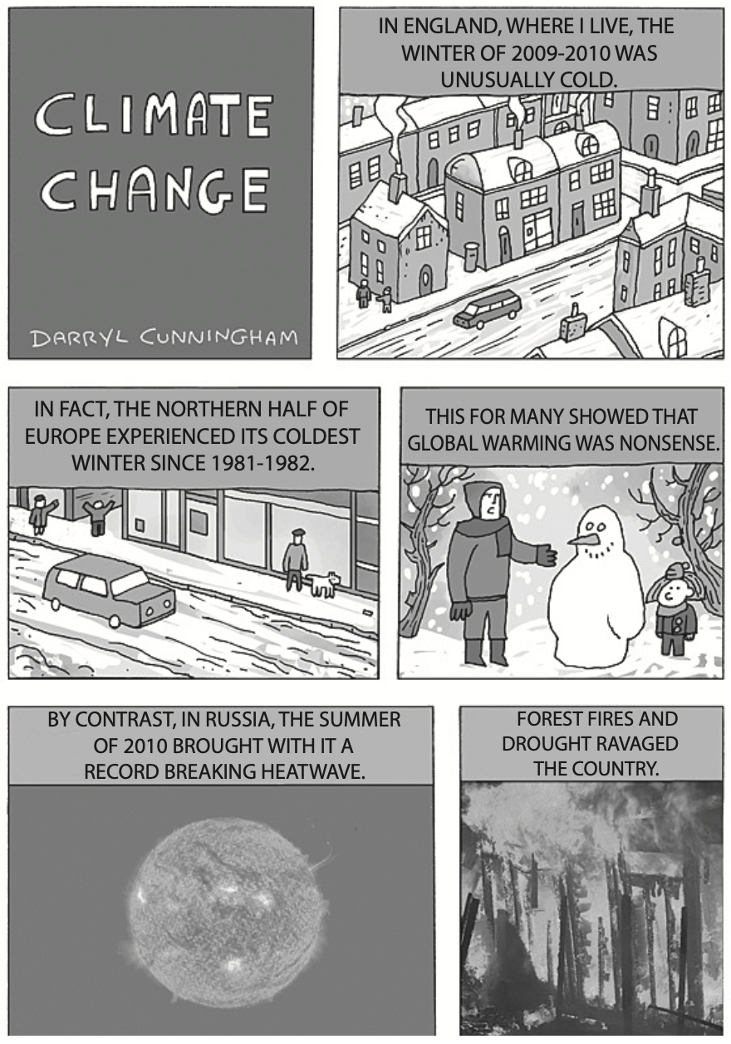
Style: ‘Cartoonification’
Imagine a spectrum of realism, with photorealistic, lifelike images on one side, and the most simple, sticklike representations on the other. Where do the images in your comic strip lie on this spectrum of ‘cartoonification’?
Darryl Cunningham presents simple, cartoony images juxtaposed with photorealistic images in his comic strip textbooks. What is the effect of this technique in this extract from his strip about climate change?

Slide 9
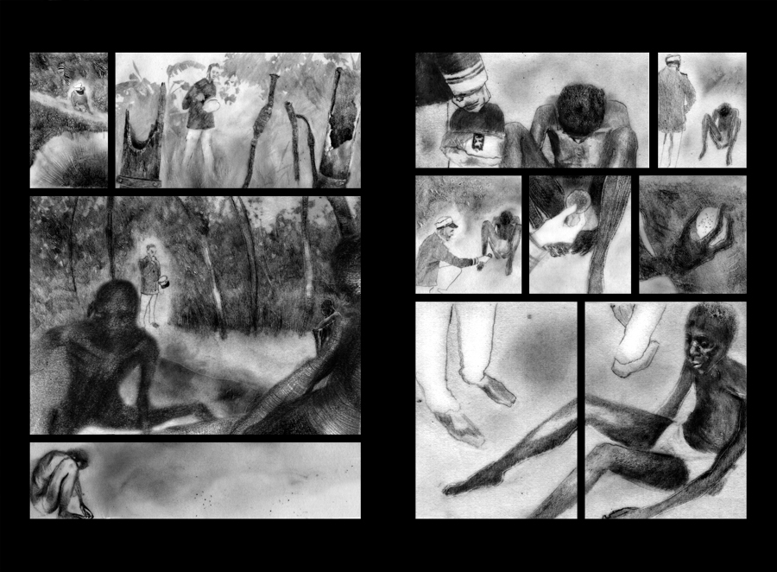
Style: graphic weight and saturation
Can you tell whether the artist has used pen, ink, pencil, brush or other techniques?
Graphic weight describes the shading and contrast of the images: lines might be heavy, light, thick, fragile and so on.
Saturation describes the colour and brightness of the images.
Words that describe mood, tone and atmosphere can be used to describe artistic style as well.
How might you describe these images from Heart of Darkness, illustrated by Peter Kuyper?

Slide 10
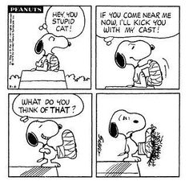
Punchline
A commonly-encountered comic strip format is the four-panel strip, which is associated with humour.
Whether four-panels or longer, a strip seeking to make readers laugh may set up a joke which culminates in the final frame. This frame is called the punchline.
Can you explain how the punchline works in this strip, an episode of Peanuts by Charles Schultz?

Slide 11
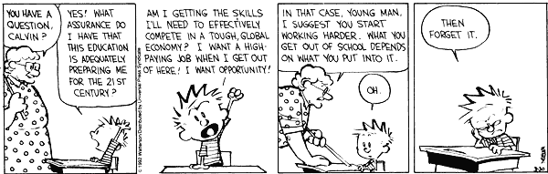
Your Turn…
Study this text, an episode of Calvin and Hobbes by Bill Watterson from 1992.
Answer the guiding question: How do both text and image create humour in this comic strip?

