Slide 1

Text Type Focus: Charity Appeals
IB English Language and Literature Paper 1: Textual Analysis

Slide 2
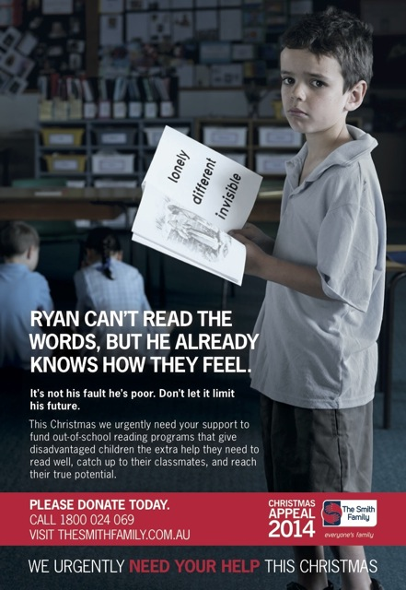
Purpose
A sub-category of advertising, charity appeals are persuasive in nature.
Appeals often ask for either donations or volunteering in some capacity. To succeed, they must persuade the reader that the cause is worthwhile.
Some adverts seek to simply raise awareness rather than call a reader to action.
How does this text make it’s persuasive intention clear?

Slide 3

Pathos
Charity appeals are essentially emotive. They work by making you feel angry, sorry, sad or guilty.
By first creating an emotional reaction, the ad-writers make it more likely that the reader will then want to take action.
What emotive strategies can you detect in this text, an advert by the Royal Society for the Prevention of Cruelty to Animals?

Slide 4

Shock Tactics
One strategy that has been historically effective is for charities to use hard-hitting images to evoke strong reactions in the reader.
This approach is called shock tactics.
This famous 2003 advert campaign by the children’s charity Barnardo’s features one of the most-complained adverts in Britain. However, the charity reported that donations increased after the advert’s publication.

Slide 5



Positive Representation
In recent times, charities have become wary that audiences do not react to shock tactics anymore. One reason is viewer apathy, as over time people have become desensitized to images of poverty and abuse.
An alternative to shock tactics is to present positive images of people instead.
According to research, people can sometimes be more willing to help others who help themselves. You can think of this as the ‘hand-up, not hand-out’ effect.
Consider the images from Christian Aid presented here. Look how, despite obvious difficulties posed by their environment, the women in these pictures are determined, hardworking and successful. These are examples of positive representations.

Slide 6
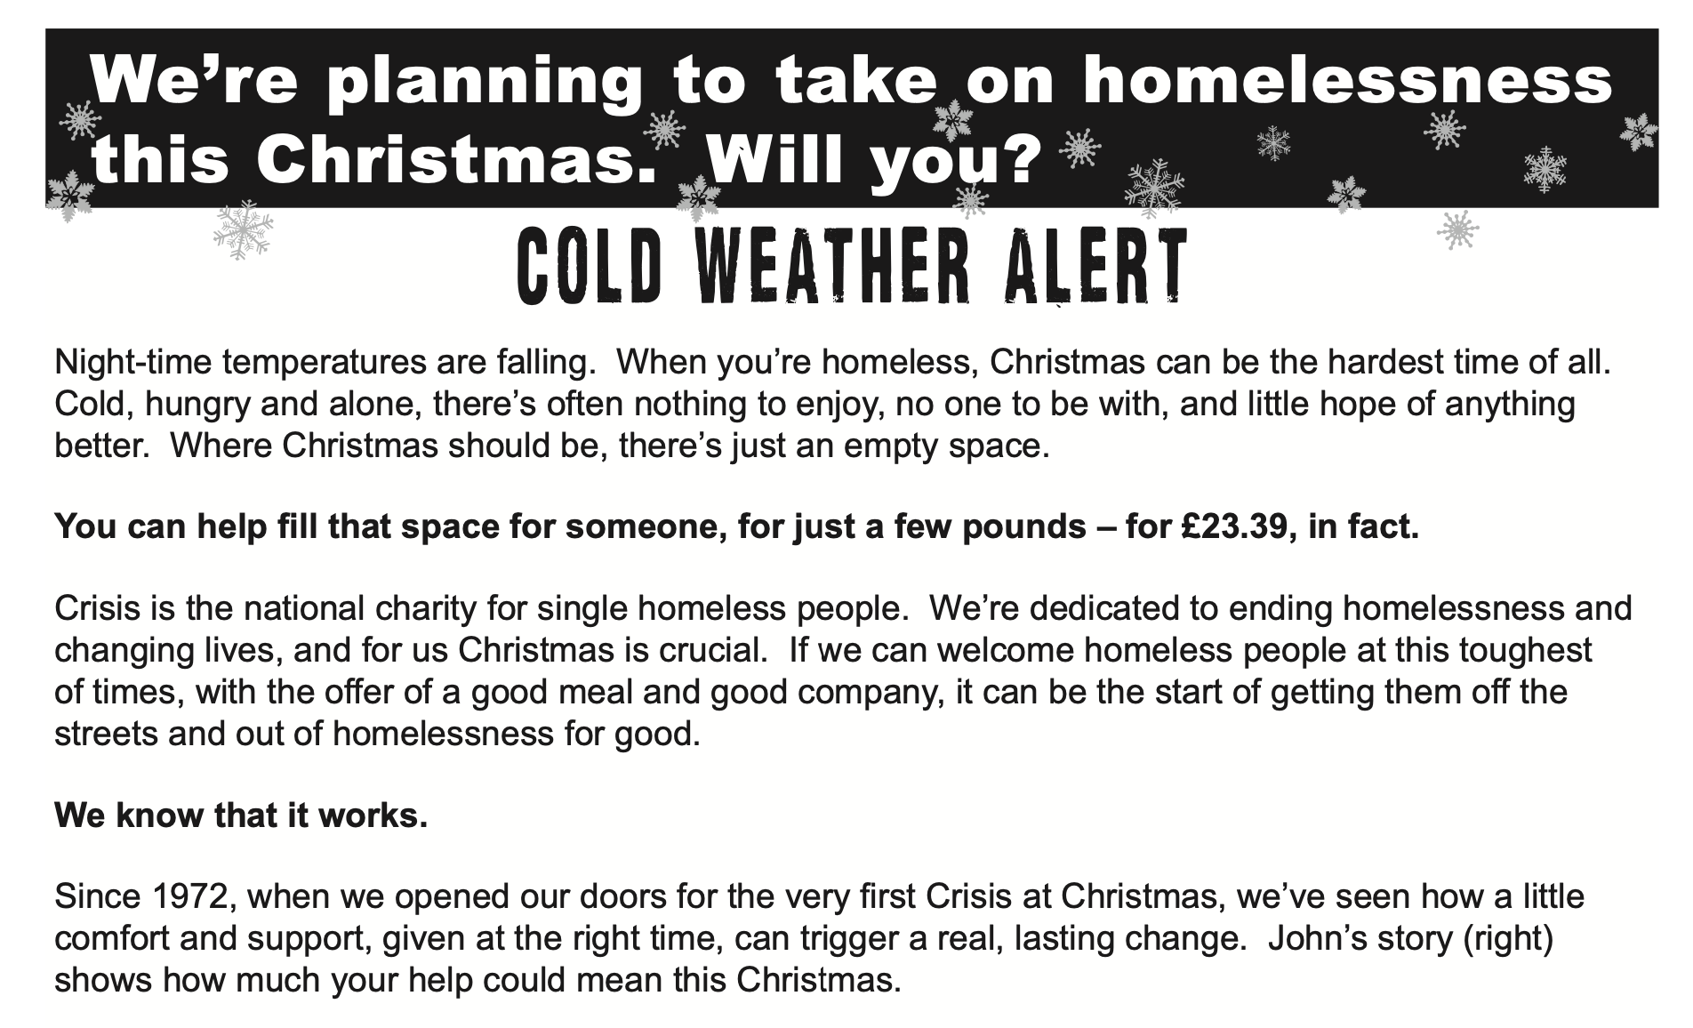
Credibility (Ethos)
The trustworthiness and credibility of a charity appeal is even more important than in other persuasive texts. If the charity is not trustworthy, readers are unlikely to donate!
Charities with history and backstory are inherently trustworthy, so some appeals might point this out.
Previous successes may be described, perhaps in the form of testimonials.
If… then… structures are very effective at suggesting the effectiveness of reader donations. A common pattern might be ‘If you donate just 10 dollars, then we can feed a hungry child for a week.’
Can you see where Crisis at Christmas attempts to build credibility in this extract from on e of their advertisement campigns?

Slide 7
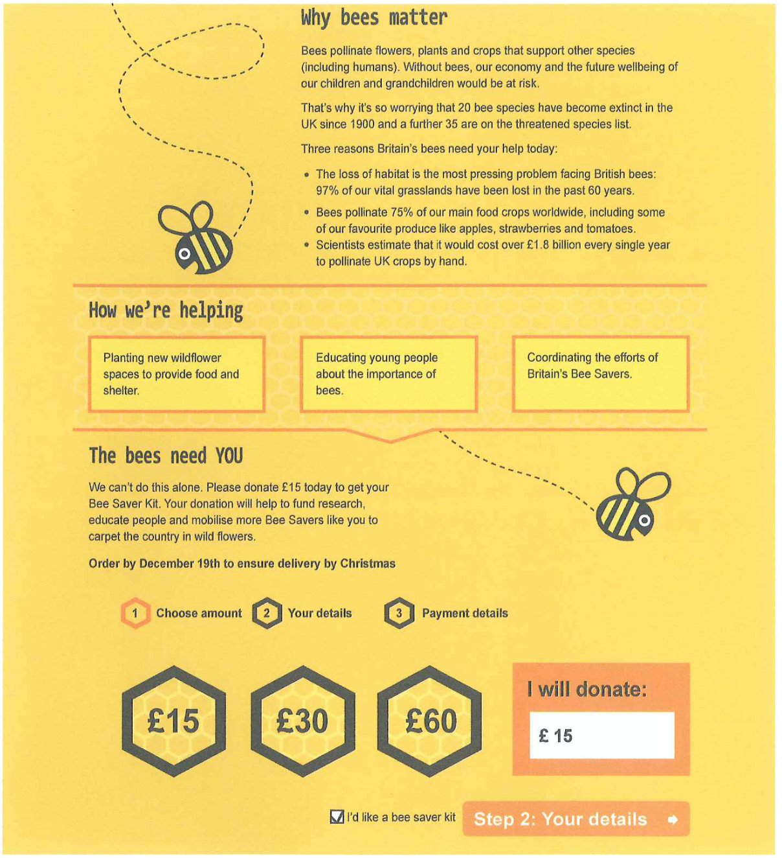
Logical appeals
While charity appeals do rely on emotion, that doesn’t mean logos is completely ignored.
You might encounter logical appeals in charity adverts, particularly if the advert is trying to convince you that your help will make a tangible difference.
If… then… structures are very effective at suggesting the effectiveness of reader donations. A common pattern might be ‘If you donate just 10 dollars, then we can feed a hungry child for a week.’
You may also find a range of facts and statistics in some charity ads, such as in this appeal to ‘Save the Bees’ by Friends of the Earth.

Slide 8
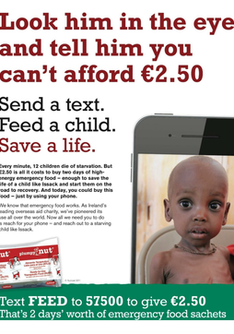
Direct Address
Charity adverts are not coy about addressing you, the reader, directly.
Some texts may ask rhetorical questions, to which the answer is normally self-evident.
Look out for people in the images making eye contact, a form of visual direct address.
Some adverts may even issue a challenge to the reader, employing guilt tactics to make you want to donate.
You can see some of these techniques put to work in this text, an advert by the children’s charity Concern.

Slide 9

Urgency
A charity appeal might urge you to act ‘now’ or ‘before it is too late’.
A seasonal appeal may have a deadline or a limited effective time.
Appeals to urgency are a feature of charity appeals. The technical name for this feature is kairos.
This advert by Save the Children features more than one urgent appeal. Can you find them?

Slide 10
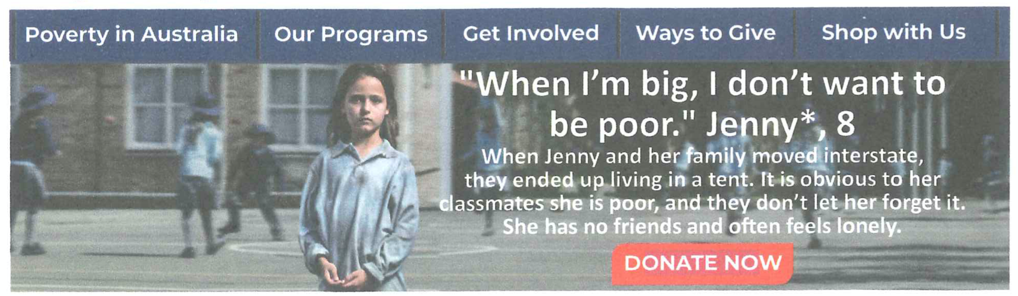
Metonymy
Another danger that charity adverts have to overcome is feelings of helplessness in the reader. Some social and global issues might seem insurmountable. Abstract problems such as poverty, homelessness, abuse and addiction may seem too large for individuals to believe they can make a difference. This might stop some people from wanting to donate.
Therefore, you will see many appeals using a type of figurative technique called metonymy, whereby an individual is used to symbolize a wider issue.The effect is clear: you may not be able to solve world hunger – but you can help feed a single child.
In this text, an advert by the Australian charity The Smith Family, the reader is introduced to Jenny, and asked to help see children like Jenny receive support and education.

Slide 11
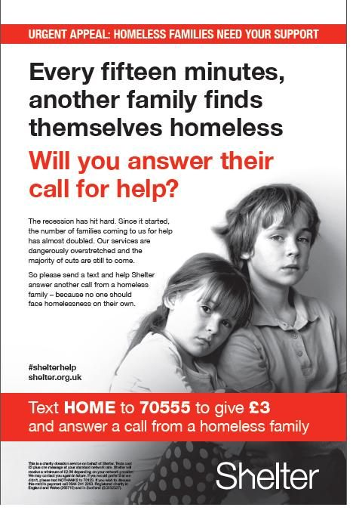
Your Turn…
Study this text, an advert by Shelter, a UK homeless charity.
Answer the guiding question: Analyze the methods used in this advert that makes the appeal more effective.

