Slide 1
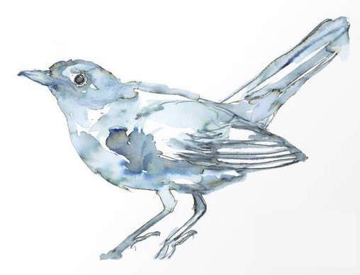
Ode to a Nightingale
By John Keats

Slide 2

Ode to a Nightingale
read by Benedict Cumberbatch
What is the ‘story’ of the poem?
Choose 5 ‘golden’ words or phrases. Explain your choices.
Condense the poem into no more than 10 lines without losing the overall meaning.
What poetic devices can you find? Can you suggest effects?

Slide 3
Topics and Themes
Ode to a Nightingale
Art
Beauty
Time
Impermanence
Nature
Escapism
Nature
Isolation
Here are a list of topic words for Ode to a Nightingale.
Once you have read and discussed the poem, write a theme statement using as many of these words as you see fit
Remember: a topic is a category of ideas. Many poems can be about ‘time’, for example. When you write your theme statement, you should try to explore what are Keats’ thoughts, feelings and ideas about ‘time’ in this poem.
For this reason, while a topic can be one word, a theme statement should be a developed paragraph using your own words.

Slide 4
Poetic Devices
Ode to a Nightingale
Rhythmic Disruption
Repetition
Assonance
Sensory Imagery
Apostrophe
Caesura
Allusion
Juxtaposition / Oxymoron
In addition to common poetic techniques such as imagery and metaphor, Keats employs some very specific poetic devices to create effects and emphasize his ideas in Ode to a Nightingale.
Can you both locate these devices in the poem and discuss the uses to which they are put?

