Slide 1
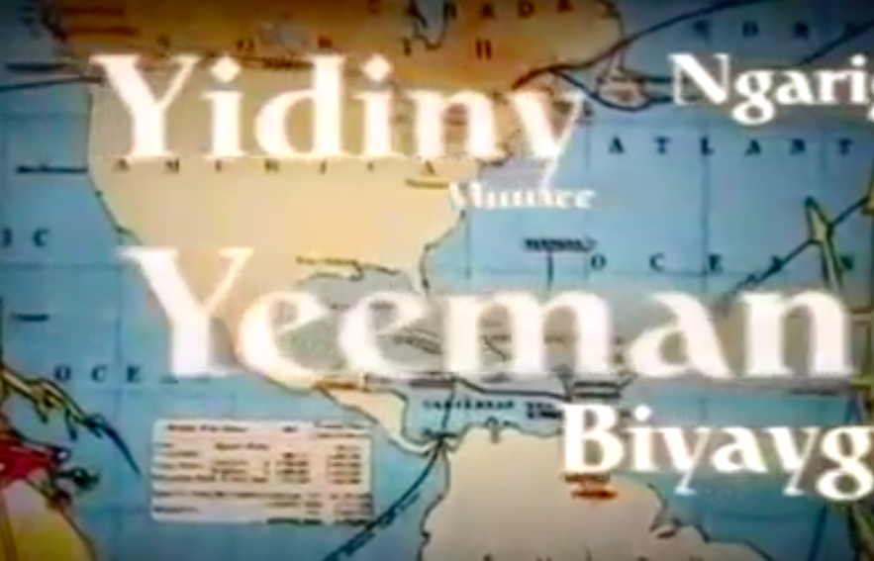
Spread of English
Quiz

Slide 2
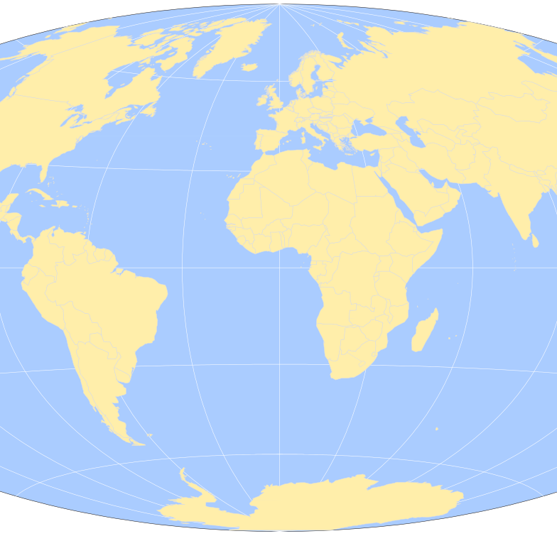
Geography Round
Round 1

Slide 3
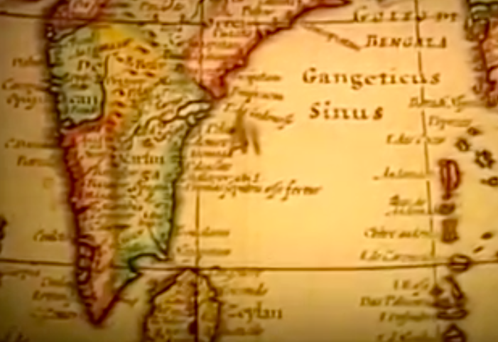
Question 1
Name three places to which English spread as a result of the British Empire imposing the language on native peoples?

Slide 4
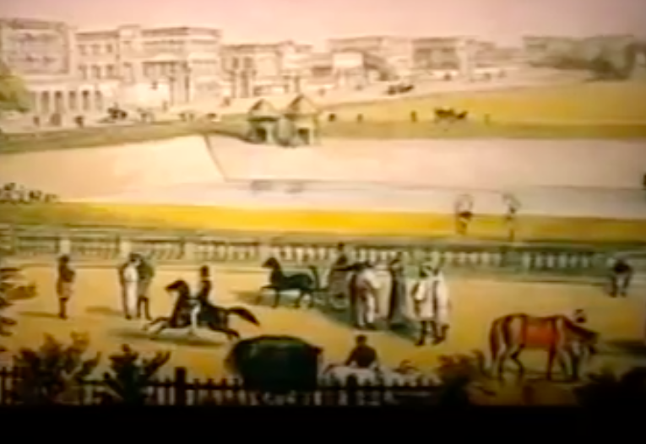
Question 2
Which of these countries was not a former British Colony?
Kenya
Nepal
Malaysia
Canada

Slide 5
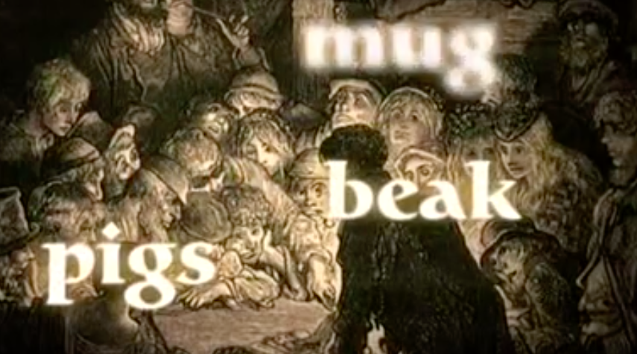
Question 3
Name two factors that shaped the development of English in Australia:

Slide 6
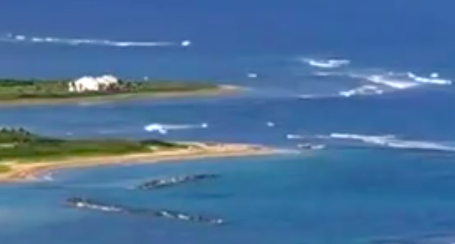
Question 4
The name ‘Caribbean’ comes from the name of which tribe, also the root of the word ‘cannibal’?

Slide 7
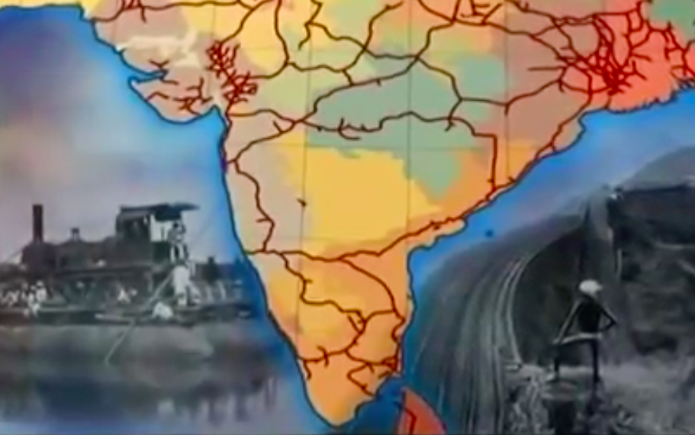
Question 5
What commodity drove British financial interests in India, a factor for the spread of English?

Slide 8
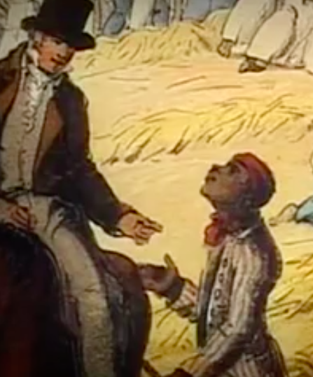
Question 6
What is a ‘Creole’ language?

Slide 9
Famous People
Round 2

Slide 10
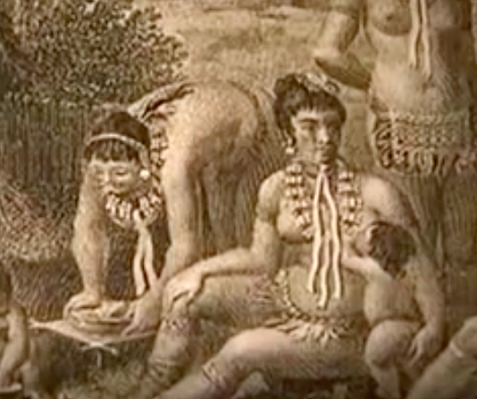
Question 1
Who made landfall in the Caribbean and mistakenly called the natives ‘Indians’ because he thought he had found a new passage to India?

Slide 11
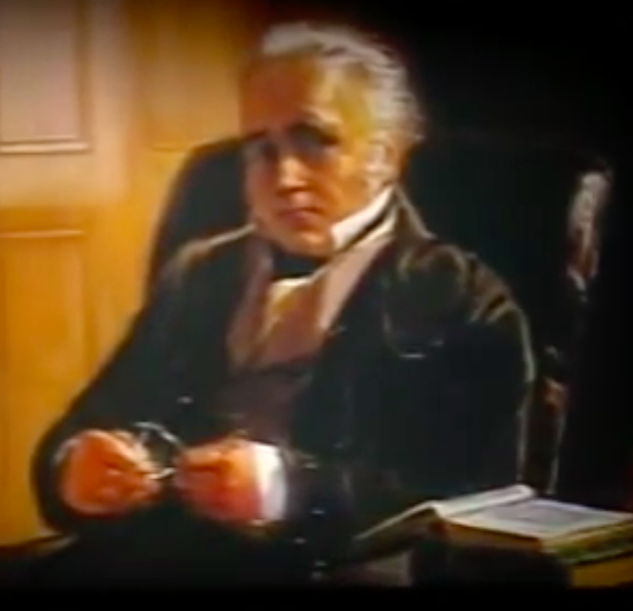
Question 2
Who devised the New English Language Policy, because Indian ‘dialects contain no literary or scientific information?’

Slide 12
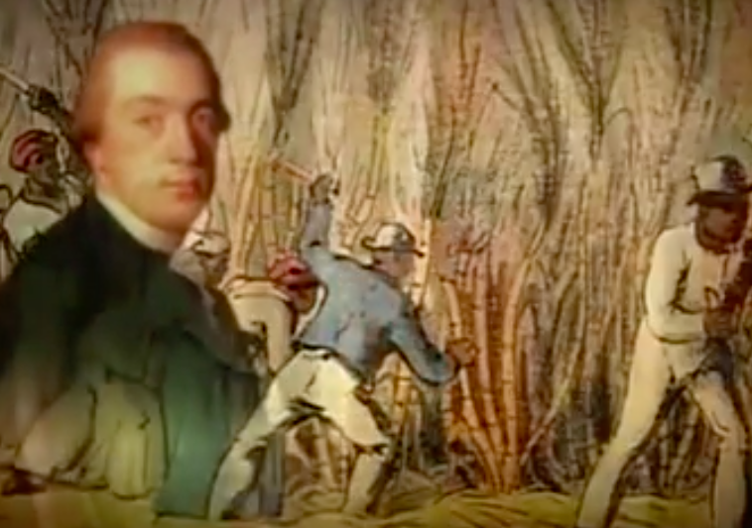
Question 3
What poem did Granger write using the variety of English spoke in the Caribbean?

Slide 13
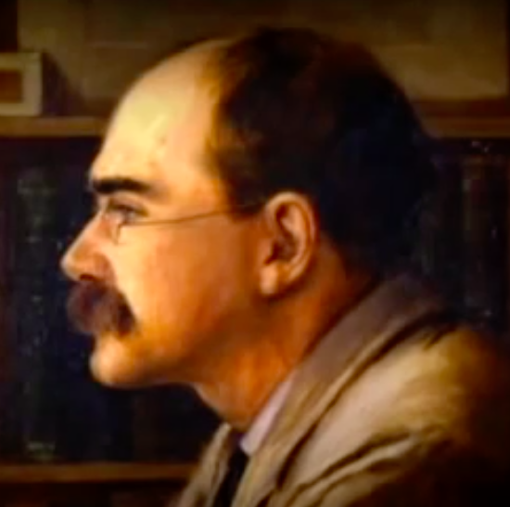
Question 4
What did Rudyard Kipling say about the sound of the variety of English spoken in India, (sometimes called Baboo English)?
“Beautiful words that make it sound credible”
“An incarnate insult to the English Language”

Slide 14
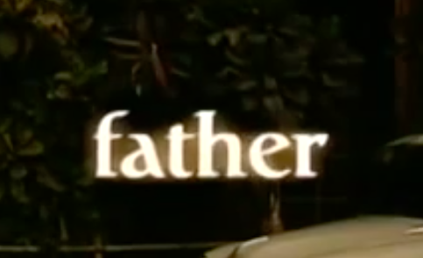
Question 5
What discovery did William Jones make about world languages, such as Greek, Latin and English, through his study of Sanskrit?

Slide 15
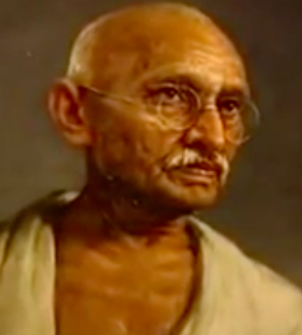
Question 6
Who said of English in India, “Is it not a sad state of affairs that we should have to speak of home rule in a foreign tongue?”

Slide 16

Statistics
Round 3

Slide 17
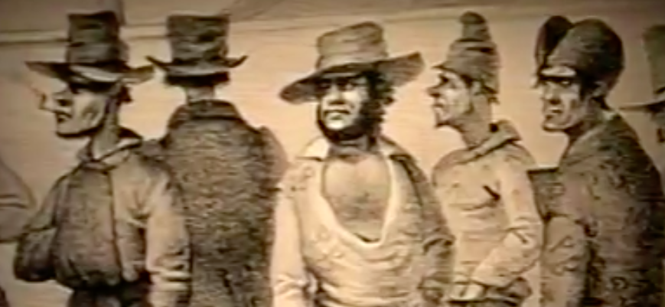
Question 1
How many convicts were exported to Australia over the first 80 years after the first fleet arrived?
100,000
150,000
200,000
250,000

Slide 18
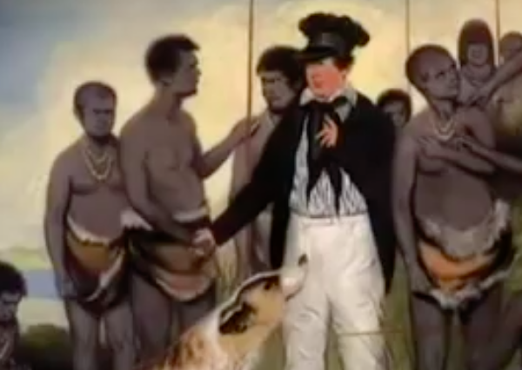
Question 2
How many Aboriginal Dialects existed when the British first arrived, half of which are extinct today?
25
100
250
1000

Slide 19
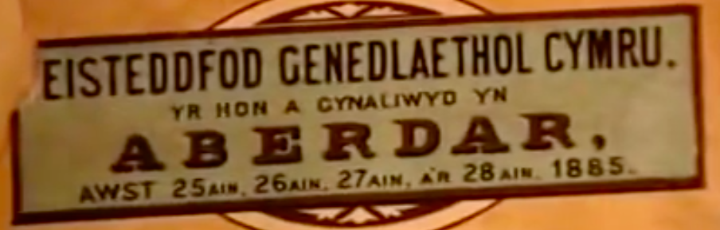
Question 3
What percentage of Welsh people today do not speak the welsh language?

Slide 20
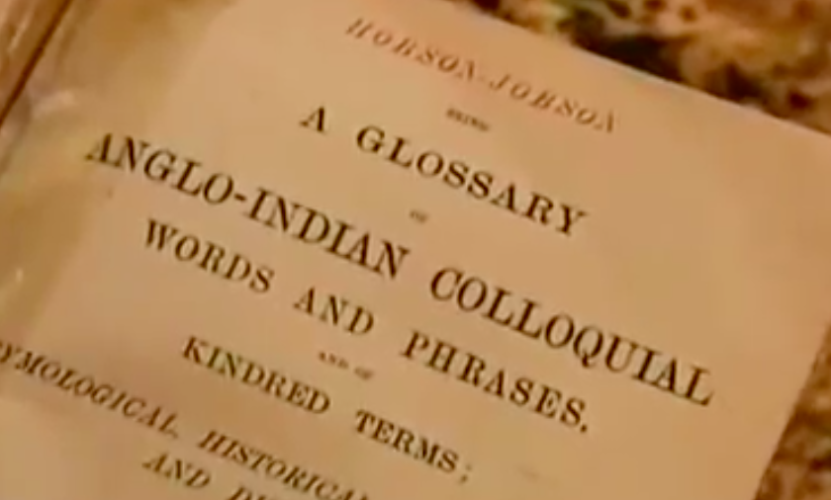
Question 4
How many pages long was the Glossary of Anglo-Indian Words and Phrases ?

Slide 21
Words, words, Words
Round 4

Slide 22
Question 1
From what source did the following words enter the English language:
Buccaneer, Freeloader, Doubloon, Cutlass, Privateer?

Slide 23
Question 2
Which of these words did not enter the English language through India?
Loot, swastika, bungalow, ghoul, thug, yoghurt, pundit, divan, shampoo, gymkhana, doolally, juggernaut, avatar, yoga

Slide 24

Question 3
Name three words for types of material that have entered the English language through India?

Slide 25
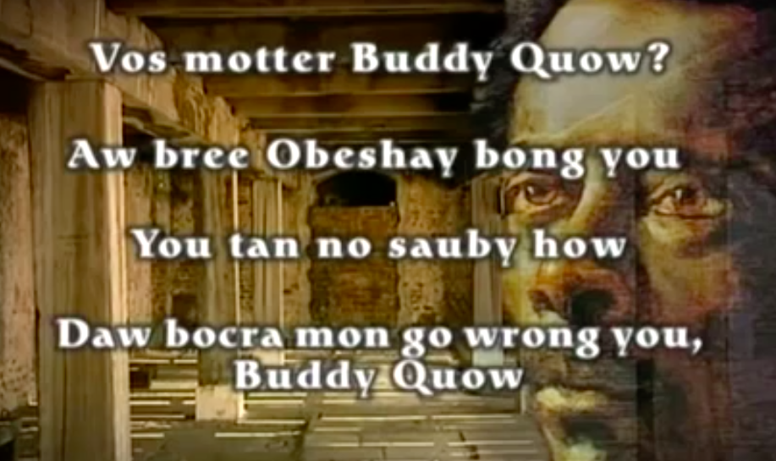
Question 4
What does the word bocra mean in Jamaica?

Slide 26
Question 5
Which seven of these words came to the English language through the Caribbean?
Canoe, hurricane, saloon, guava, hammock, vinegar, iguana, lasso, potato, barbeque, tornado.

Slide 27
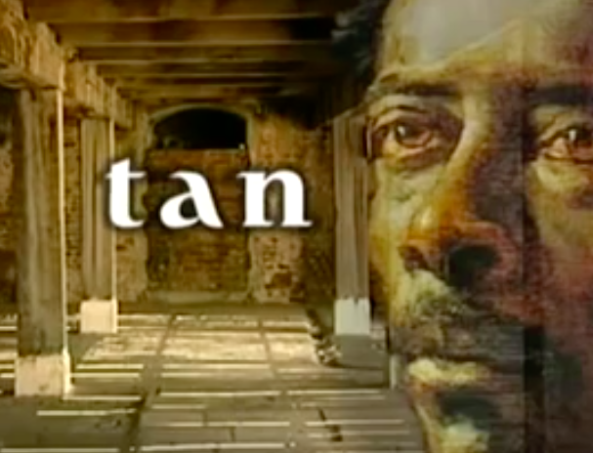
Question 6
Why, in Jamaican Patois, has the word ‘stand’ changed into the word ‘tan’?

Slide 28
Question 7
Complete this phrase from Australian English:
Better than a poke in the eye…

Slide 29
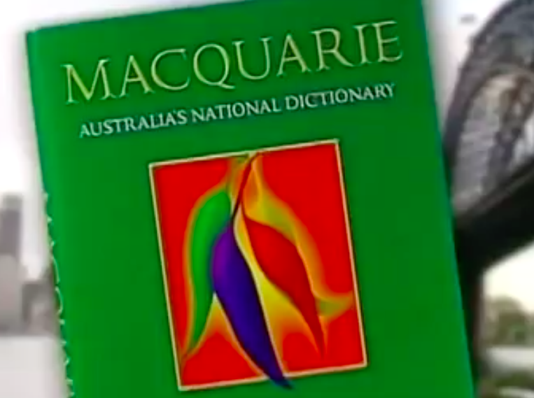
Question 8
Which of these words is not the name of an animal:
Kangaroo
Larrikin
Bandicoot
Wallaroo
Wombat

Slide 30
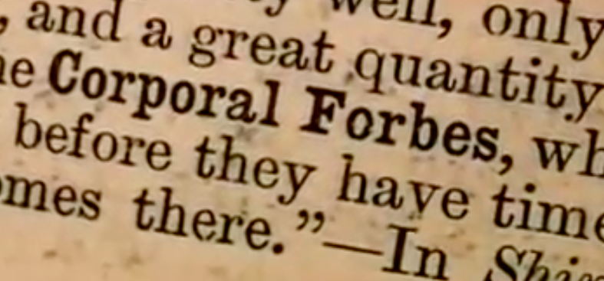
Question 9
What does the word Colonel Forbes mean in India?

