Slide 1
Spread of English
Quiz

Slide 2
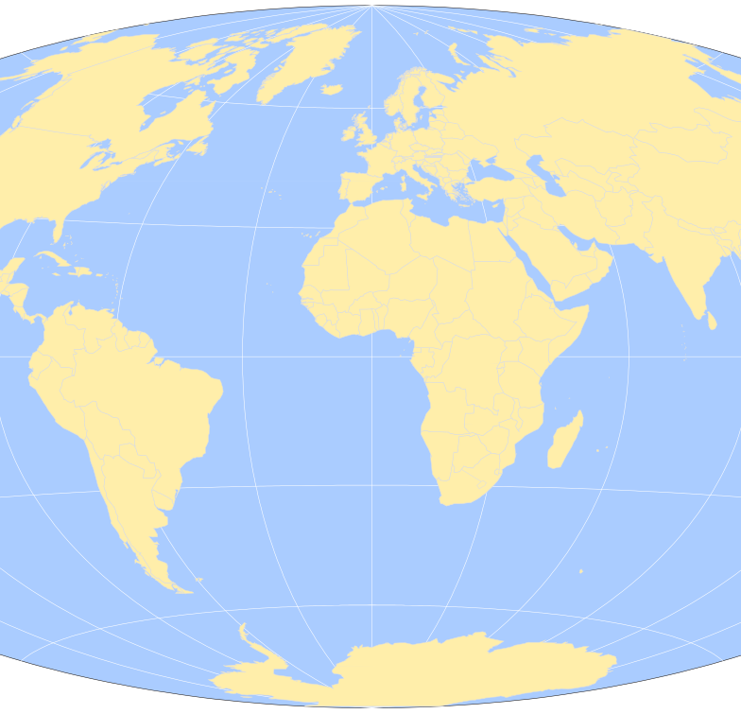
Geography Round
Round 1

Slide 3
Question 1
Name three places in which English spread as a result of the British Empire imposing the language on native peoples?
India
Australia
Caribbean
America
Kenya
Malaysia
Etc

Slide 4
Question 2
Which of these countries was not a former British Colony?
Kenya
Nepal
Malaysia

Slide 5
Question 3
Name two factors shaped the development spoken in Australia:
Regional and Criminal Variations of English Speakers.

Slide 6
Question 4
The name ‘Caribbean’ comes from the name of which tribe, also the root of the word ‘cannibal’?
Carib

Slide 7
Question 5
What commodity drove British financial interests in India, a factor for the spread of English?
Cloth

Slide 8
Question 6
What is a ‘Creole’ language?
A language that evolves from the collision of English and African languages.

Slide 9
Famous People
Round 2

Slide 10
Question 1
Who made landfall in the Caribbean and mistakenly called the natives ‘Indians’ because he thought he had found a new passage to India?
Christopher Colombus

Slide 11
Question 2
Who devised the New English Language Policy, because Indian ‘dialects contain no literary or scientific information?’
MacCauley

Slide 12
Question 3
What poem did Granger write using the variety of English spoke in the Caribbean?
In Praise of the Sugar Cane

Slide 13
Question 4
What did Rudyard Kipling say about the sound of the variety of English spoken in India?
“Beautiful words that make it sound credible”
“An incarnate insult to the English Language”

Slide 14
Question 5
What discovery did William Jones make about world languages, through his study of Sanskrit?
Sanskrit, English and other languages share a common ancestor.

Slide 15
Question 6
Who said of English in India, “Is it not a sad state of affairs that we should have to speak of home rule in a foreign tongue?”
Mahatma Gandhi

Slide 16

Statistics
Round 3

Slide 17
Question 1
How many convicts were exported to Australia over the first 80 years after the first fleet arrived?
100,000
150,000
200,000
250,000

Slide 18
Question 2
How many Aboriginal Dialects existed when the British first arrived, half of which are extinct today?
25
100
250
1000

Slide 19
Question 3
What percentage of Welsh people today do not speak the welsh language?
80%

Slide 20
Question 4
How many pages long was the Glossary of Anglo-Indian Words and Phrases ?
900

Slide 21
Question 5

Slide 22
Words, words, Words
Round 4

Slide 23
Question 1
From what source did the following words enter the English language:
Buccaneer, Freeloader, Doubloon, Cutlass, Privateer?
British Piracy

Slide 24
Question 2
Which of these words did not enter the English language through India?
Loot, swastika, bungalow, ghoul, thug, yoghurt, pundit, divan, shampoo, gymkhana, doolally, juggernaut, avatar, yoga

Slide 25
Question 3
Name three words for varieties of cloth that have entered the English language through India?
Muslin, chintz, cashmere.

Slide 26
Question 4
What does the word Bokra mean in Jamaica?
White man

Slide 27
Question 5
Which seven of these words came to the English language through the Caribbean?
Canoe, hurricane, saloon, guava, hammock, vinegar, iguana, lasso, potato, barbeque, tornado.

Slide 28
Question 6
Why, in Jamaican Patois, has the word ‘stand’ changed into the word ‘tan’?
Because many African dialects do not allow 2 consonants to run together.

Slide 29
Question 7
Complete this phrase from Australian English:
Better than a poke in the eye…
…with a burnt stick

Slide 30
Question 8
Which of these words is not the name of an animal:
Kangaroo
Larrikin
Bandicoot
Wallaroo
Wombat

Slide 31
Question 9
What does the word Colonel Forbes mean in India?
Cholera

